Slide 1
US neuromodulation is a frequency mixing effect
25/06/2023

Slide 2
Calibration Diagram
I,V Monitor
Voltage
output
DAQ
I
V
Goldcup reference electrode
0.9% Saline
Computer
NOTE: do not add a gnd to this, otherwise my impedance measure will be wrong.
Single electrode stim and measurement system with vertically aligned cup electrode reference.

Slide 3
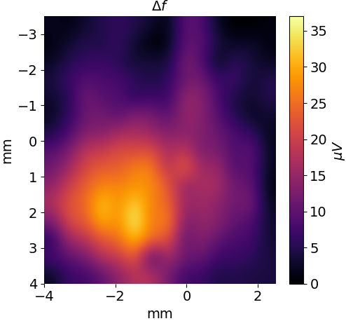
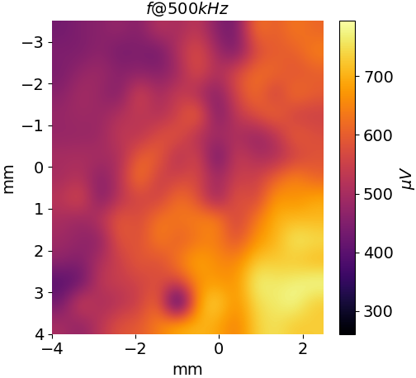
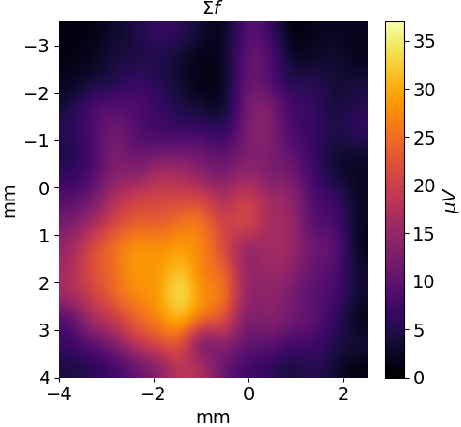
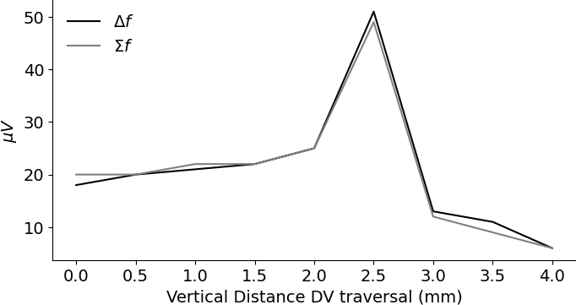
SALINE: 8kHz 1V amplitude, single electrode spatial calibration at 1MPa
AP
ML
Focal point
You can see the difference frequency and the electrical carrier frequency are totally uncorrelated. The 500kHz amplitude seems more guided by the distance from the US source. Gold cup reference electrode mounted vertically below the stim/measure electrode with 7mm spacing.
Note: This is about 0.1mA, PtIr point electrodes are used.
DV
e97t6

Slide 4
SALINE: no electric field, single electrode spatial calibration at 1MPa
Look at DC, 1MHz and 500khz.

Slide 5
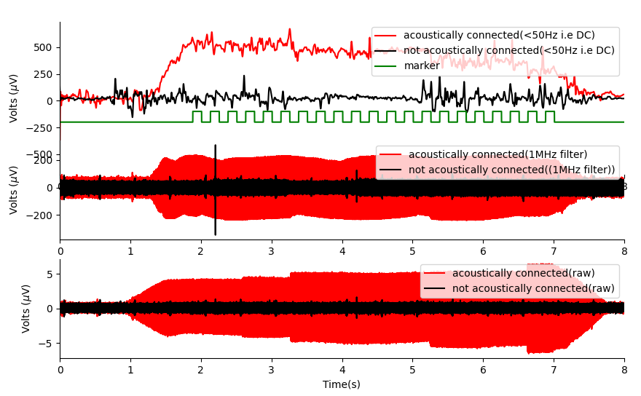
E97-t11 results analysis (mouse/isoflurane)
Positive Result: There is a consistent DC offset and sum when ultrasound is applied to the mouse brain.
The DC offset and 1MHz suggests that the 500khz commode mode noise is mixing with itself to form 0Hz and 1MHz signals.
The bottom plot shows the measurement channel, where you can see a large 500khz signal when there is an acoustic connection with the brain. I believe this acoustic signal is due to commode mode noise, with some small component being due to piezoelectric effect in ionic liquids.

Slide 6
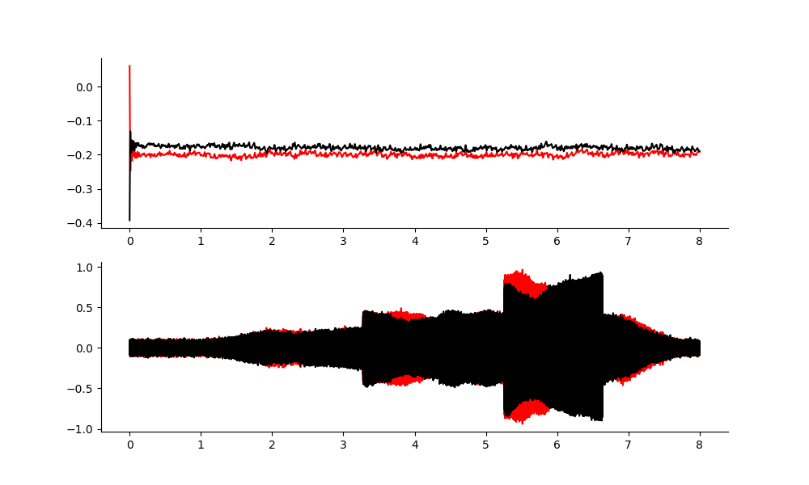
Back up on the rf amplifier output.
DC offset at the RF Amplifier output is non-existent
1MHz band filtering, shows reflections in cable, but is very different to what we see in the mouse.
RESULT: A separate source of is occurring in the tissue, potentially acoustoelectric mixing of 500khz.

Slide 7
Why not look at hydrophone data?
When I used the hydrophone, I did not have an electric field in exactly the same geometry. Instead I measured pressure with a hydrophone, then I offset by known distance to the electric probe and applied the AE effect.
The problem with looking at hydrophone data, is the hydrophone picks up both electrical and acoustic signals. It doesn’t discern between the two.
The hydrophone may be non-linear… as it is an amplifier. If it picks up the carrier frequency as it should, it could add its own non-linearities.

Slide 8
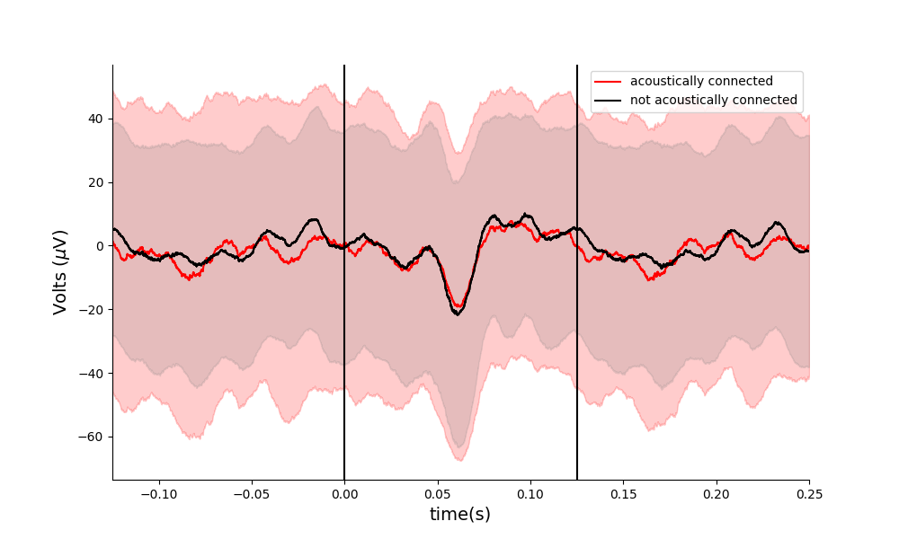
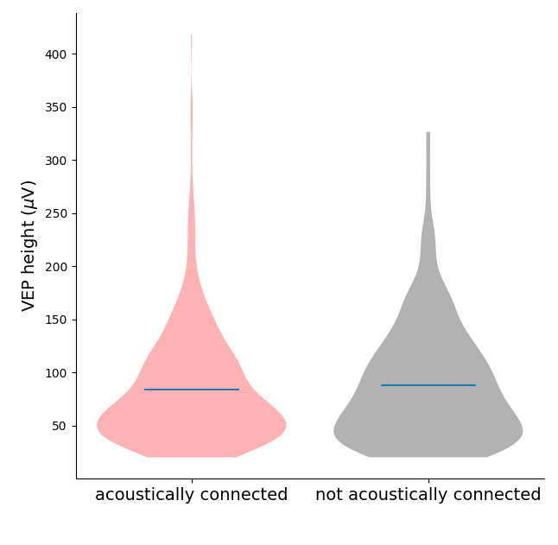
E97-t11 results analysis – vep software threshold 20 microvolts
Number of repeats (Acoustically connected: 480, not acoustically connected: 406). T-test p-value = 0.27 (not significantly different).

Slide 9
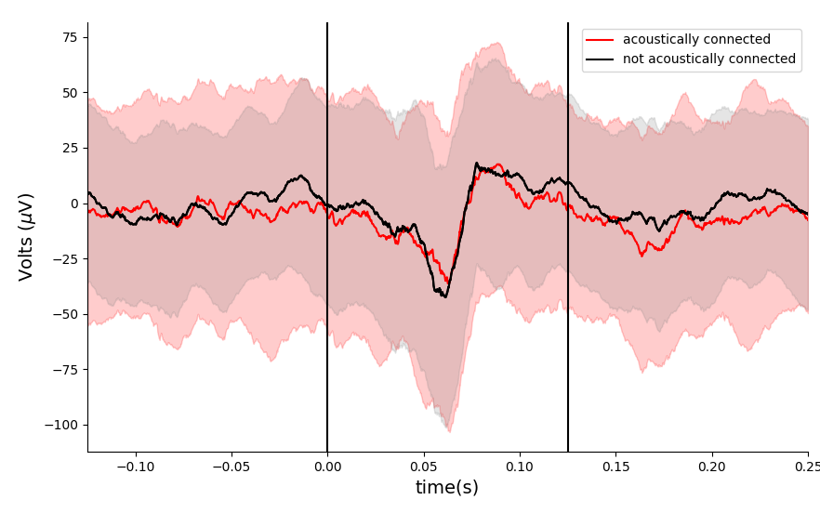
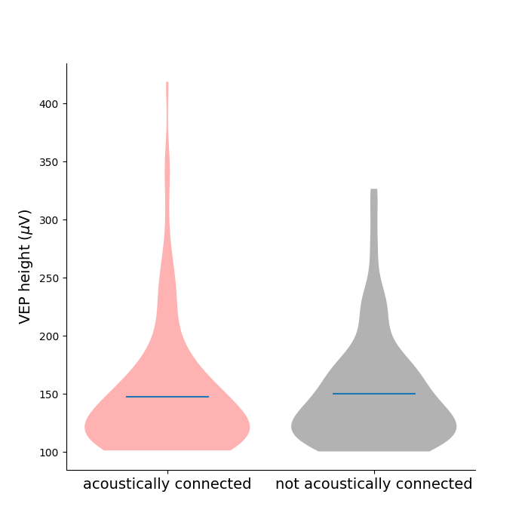
E97-t11 results analysis – taking all VEPs > 100 microvolts
There is no clear difference here when acoustically connected and not when comparing height. These plots do not contain the large DC offset that I see.

Slide 10
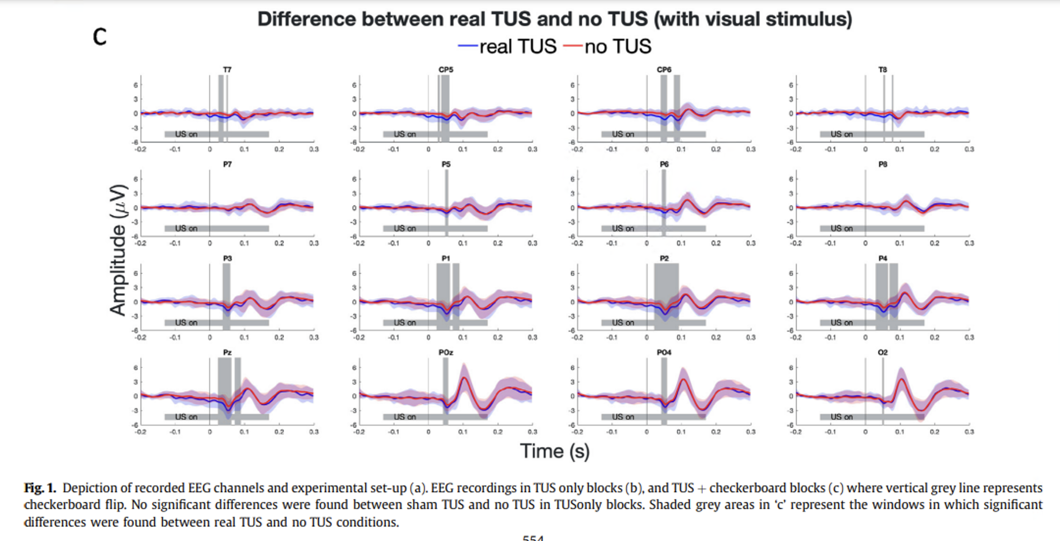
What has been shown
Ramped V1 transcranial ultrasonic stimulation modulates but does not evoke visual evoked potentials, ulika Nandi,Ainslie Johnstone, Eleanor Martin,Til Ole Bergmann,Bradley Treeby,Charlotte J. Stagg (2023)
This paper uses a ramped US signal before each VEP, and they show that it is offset by an amount, i.e. a DC offset. This is what I also see, except I am using a continuous wave.

Slide 11
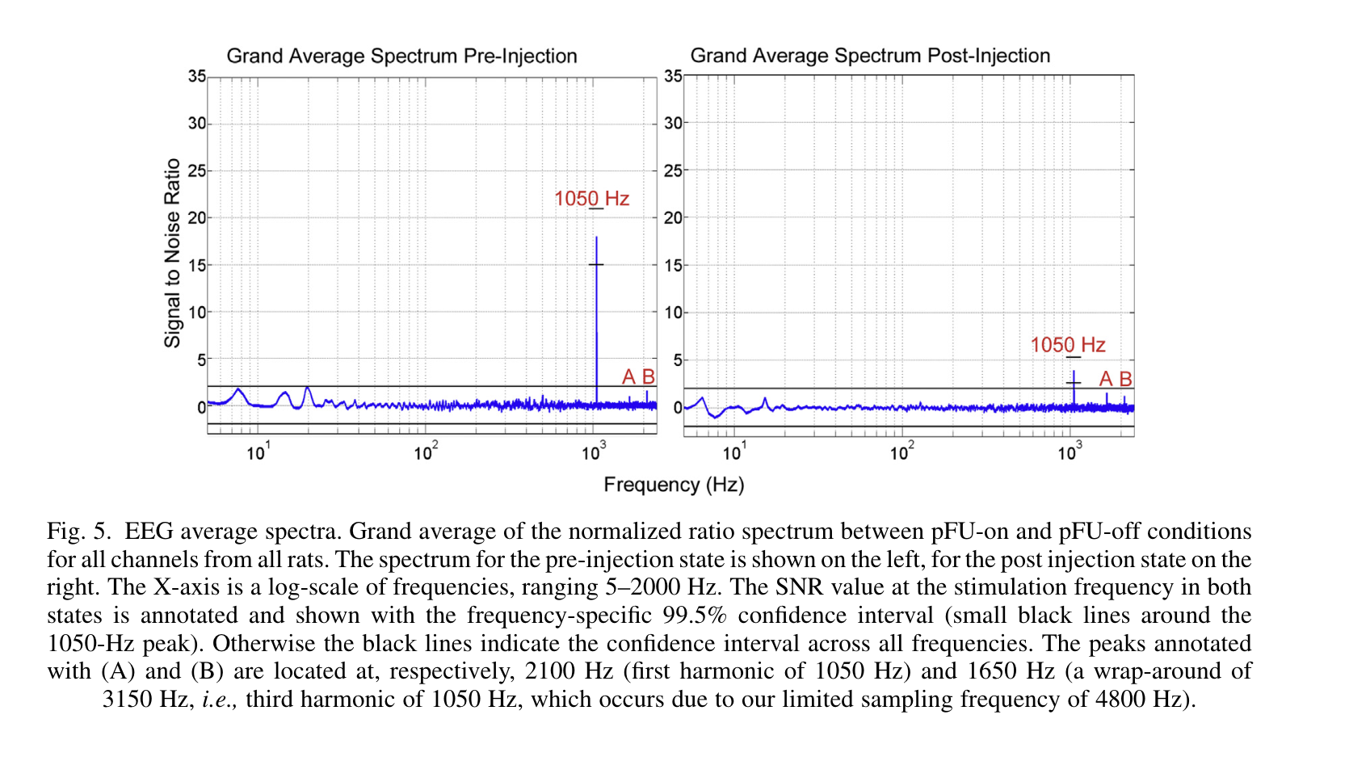
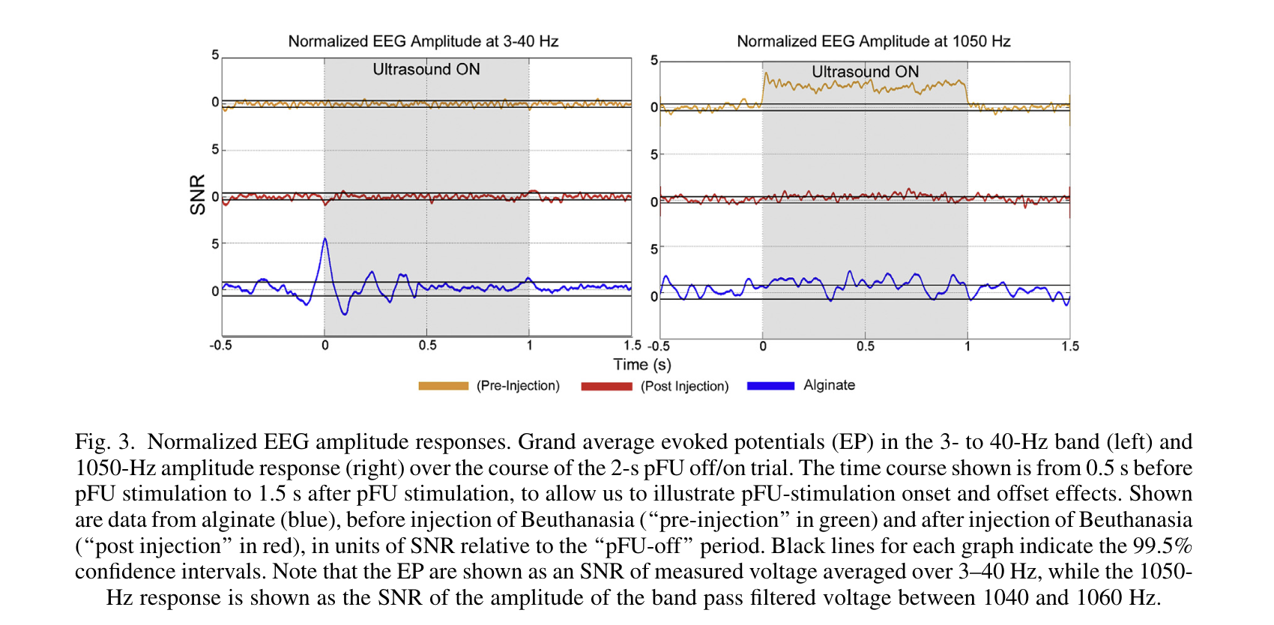
Interesting paper has seen this too, but using a PRF of 1050Hz. They have a bandwidth limited measurement system, so they cannot see the US transducer frequency…
Alive mouse
Recently dead mouse
Time series results with and without ultrasound
This is also seen in that paper where they did alive vs dead mouse. Interesting finding here that this signal is larger in alive brains. Ultrasound neuromodulation only works in live brains. Alive brains notably have electrical signals in them, and dead brains don’t so much. Can this be the AE effect?
[1] Darvas, F., Mehić, E., Caler, C. J., Ojemann, J. G., Mourad, P. D. (2016). Toward Deep Brain Monitoring with Superficial EEG Sensors Plus Neuromodulatory Focused Ultrasound. Ultrasound in Medicine & Biology. i.e.
Their result: you can only do US neuromodulation in living brains.

Slide 12
The Shapiro paper, though thorough in many ways – does not consider frequency mixing or the AE effect as a mechanism, and their findings do NOT rule it out.
[1] Yoo, S., Mittelstein, D. R., Hurt, R. C., Lacroix, J., Shapiro, M. G. (2022). Focused ultrasound excites cortical neurons via mechanosensitive calcium accumulation and ion channel amplification. Nature Communications 2022 13:1 https://doi.org/10.1038/s41467-022-28040-1
1. This paper shows what US neuromodulation is NOT through exhaustive experiments, i.e.
‘Cavitation, temperature changes, large-scale deformation, and synaptic transmission are not required for this excitation to occur. ‘ . NOTE: they also rule out the acoustic radiation force(it’s too weak) through experiments. They also show it is independent of synaptic connections through post-synaptic blockers. i.e. it works with and without these blockers. ‘Intracellular calcium release from the endoplasmic reticulum does not play a major additional role .‘
2. Positive finding: The endogenous voltage-gated Ca2+ channels that they show through calcium imaging are stimulated by ultrasound. Calcium enters the cell directly as a result of ultrasound application, in addition to its entry following depolarization. ‘In calcium-free media this voltage response to ultrasound was completely eliminated, while the cells retained their ability to respond to other stimuli ‘. ‘It is not possible to rule out contributions from more direct activation of voltage gated ion channels’ – this too is a telling remark that leaves ROOM for the AE effect.
Summary results:
First key finding: These results demonstrate that extracellular Ca2+ is the essential ionic initiator of ultrasonic neuromodulation.
Second key finding: Response to ultrasound is amplified by calcium-gated and low-threshold voltage-gated ion channels
Counterpoint to their first key finding which adds sufficient ambiguity for the AE effect to be considered: There are plenty of articles showing Ca2+ is also modulated by direct DC electric fields(tDCs). E.g. below.
[2] Ca2+ channel dynamics explain the nonlinear neuroplasticity induction by cathodal transcranial direct current stimulation over the primary motor cortex. (2020, Mohsen Mosayebi-Samani 1, Lorena Melo 2, Desmond Agboada 2, Michael A Nitsche 3, Min-Fang Kuo 4)
Explanation of amplification(their second key finding) actually supports the AE effect being amplified in vivo. (something we have seen, but Jean still needs better controlled data for – surface area of electrodes!)
Thus, US neuromodulation and DC electric fields modulate extracellular Ca2+. If US neuromodulation were to induce a DC electric field, we would be able to entirely explain US neuromodulation without the need for specific mechanosensitive ion channels or any special neural mechanism.

Slide 13
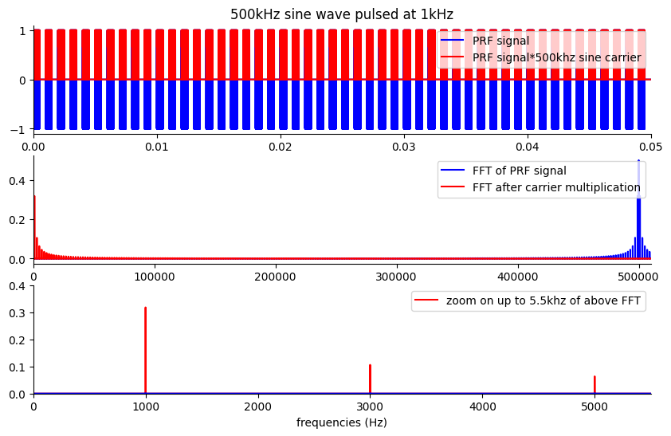
Step by step theory of ultrasound neuromodulation. When we say mechanosensitive ion channels – this is the acoustoelectric effect.
500khz
Ultrasound neuromodulation has been noted at the PRF. To obtain a signal at the PRF you multiply the US frequency by the US PRF. i.e. the signal multiplies with itself. This would happen on reflection in the mouse brain.
I saw the center frequency(500khz) appear often in the tank phantom as well as a DC offset when applying a continuous 500khz wave.

Slide 14
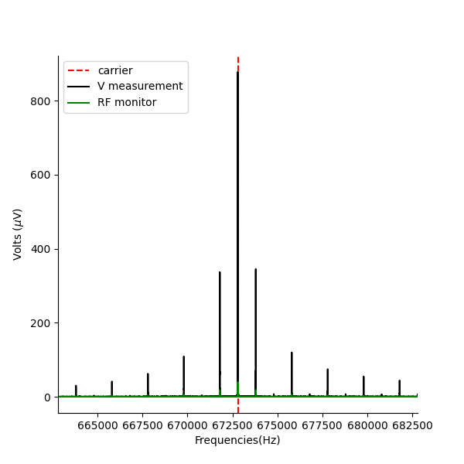
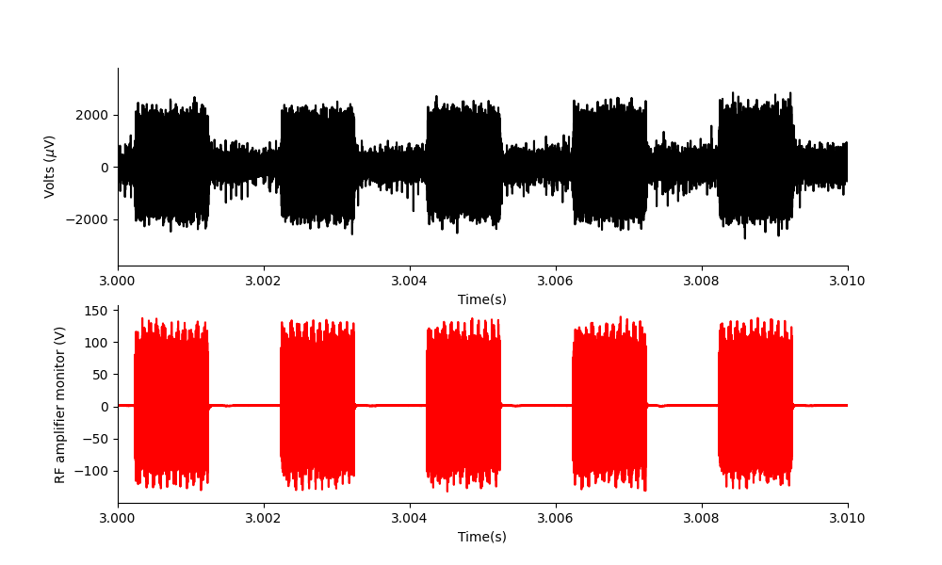
Carrier close up of 1khz PRF.

Slide 15
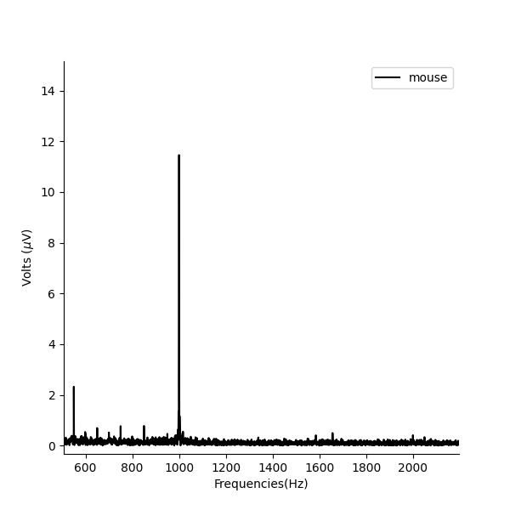
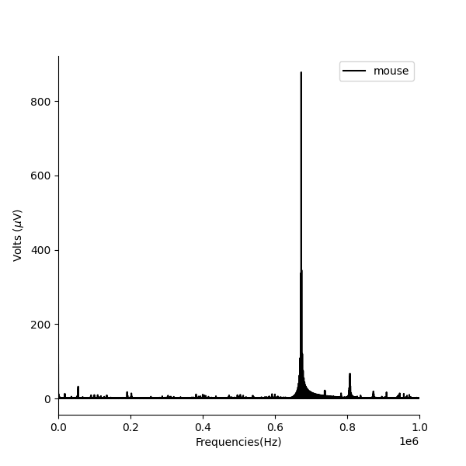
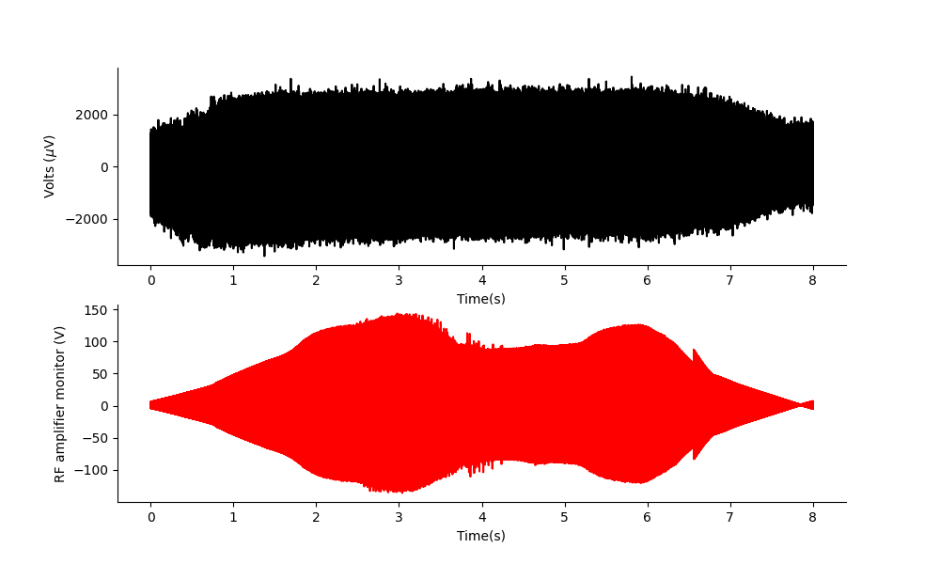
Imitating the PRF 1khz paper result in a mouse over the visual cortex and measuring the electric signal.
Zoom view
900 microvolts at US transducer frequency
12 microvolts at 1khz PRF.
This effect is approximately 75 times stronger at the transducer frequency.
When you use a continuous wave the effect is 1200 microvolts, so over 100 times bigger.
This size may be an advantage in demodulation signal recovery.
ASD
Time series

Slide 16
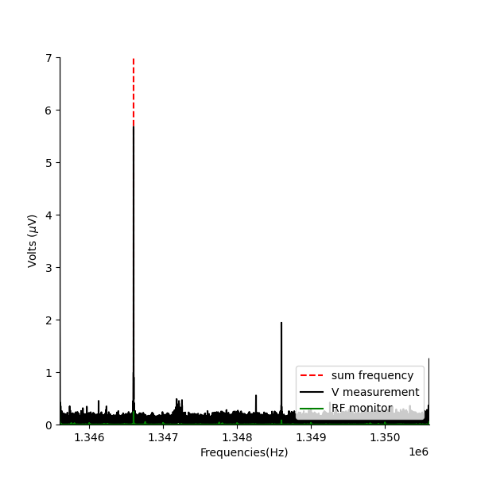
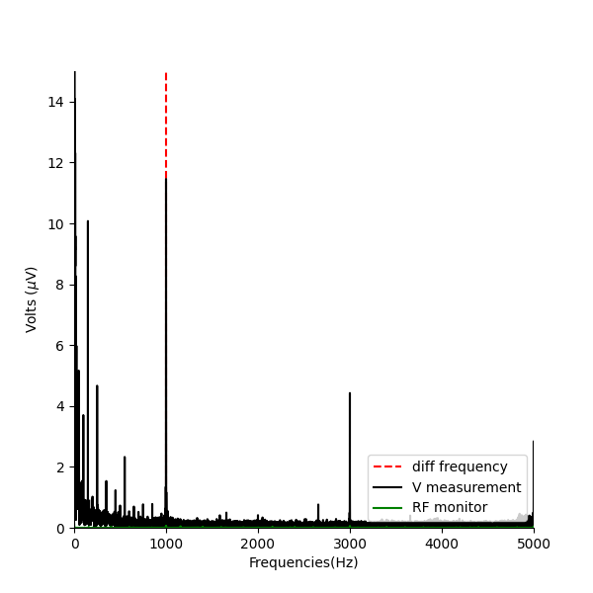


PRF 1kHz – does appear at the sum and difference frequency of this pulse. The ultrasound IS mixing with itself.
If the ultrasound(672800Hz) was mixing with itself to create sum and difference frequencies using PRF of 1kHz, you’d expect to see the difference frequency at 1kHz, and at 2*672800 + 1kHz.
NOTE: THIS only occurs on the electrical measurement probe. It is not present on the RF monitor output.
$$Σf$$
$$Δf$$
Reflections?

Slide 17
What kind of exciting publishable statement can be made?
On the lower bound, there is strong evidence that US neuromodulation is a frequency mixing effect and noting that we haven’t considered the AE effect in any studies is important in itself.The DC offset also explains a lot of what people have seen and can be used to predict future experiments more accurately.
On the upper bound, a strong statement that US neuromodulation mechanism is the acoustoelectric effect.
Care must be taken to control for artefacts arising from the interaction of sound waves with recording electrodes. (I have done artefact tests for this in the published AE paper supplementary section but not provided a written logic description – which will be important to do in the supplementary section of this next paper).

