Slide 1
Acoustoelectric characterization in mouse versus saline.
25/05/2023

Slide 2
Calibration Diagram
I,V Monitor
Applied voltage output
DAQ
I
V
Goldcup reference electrode
0.9% Saline
Computer
Single electrode stim and measurement system with vertically aligned cup electrode reference.
For demodulation: connect the preamp to the voltage monitor.
For stimulation. Take the SR560 preamp output with gain.

Slide 3
Demodulation Diagram
SR560 Preamp
DAQ
LED in Faraday Cage
Goldcup reference electrode
0.9% Saline
Computer
Single electrode stim and measurement system with vertically aligned cup electrode reference.
For demodulation: connect the preamp to the voltage monitor.
For stimulation. Take the SR560 preamp output with gain.

Slide 4
Stimulation diagram
SR560 Preamp
LPFILTER
I,V Monitor
Applied voltage output
V
DAQ
I
Goldcup reference electrode
0.9% Saline
Computer
Single electrode stim and measurement system with vertically aligned cup electrode reference.
For demodulation: connect the preamp to the voltage monitor.
For stimulation. Take the SR560 preamp output with gain.

Slide 5
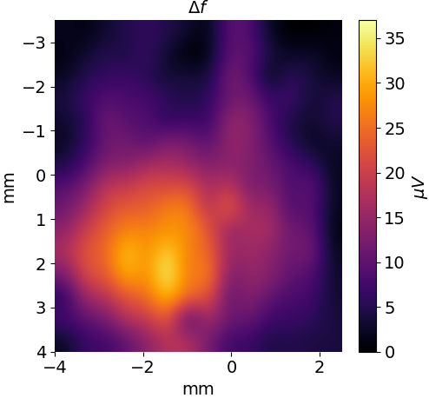
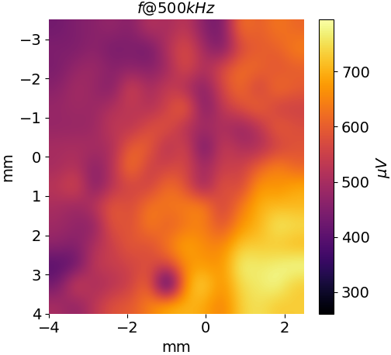
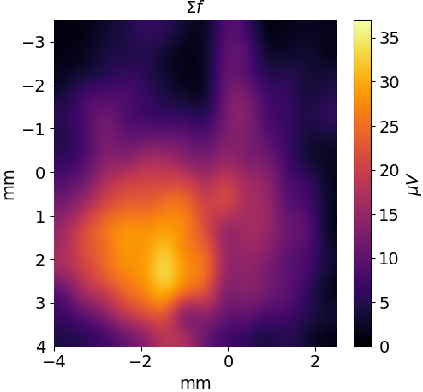
SALINE: 8kHz 1V amplitude, single electrode spatial calibration with 1MPa
AP
ML
You can see the difference frequency and the electrical carrier frequency are totally uncorrelated. The 500kHz amplitude seems more guided by the distance from the US source. Gold cup reference electrode mounted vertically below the stim/measure electrode with 7mm spacing.

Slide 7
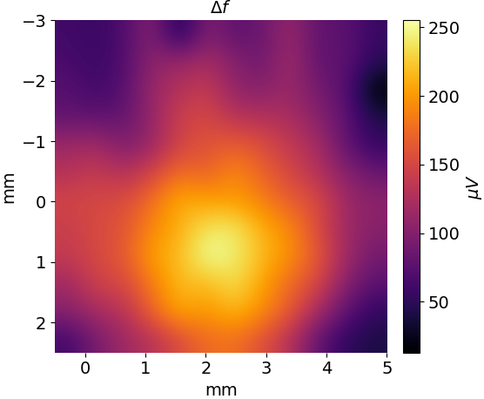
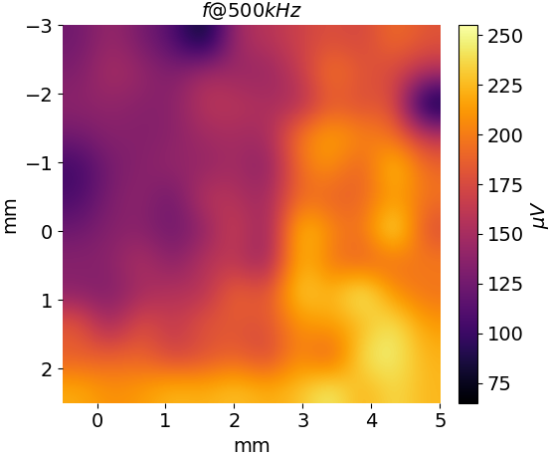
Saline Position Calibration with single electrode: exp 97t3
The difference frequency here is 500kHz – 8kHz = 492kHz, and I am calibrating the US position by using the acoustoelectric effect as a hydrophone. You can see the difference frequency and the electrical carrier frequency are totally uncorrelated. The 500kHz amplitude seems more guided by the distance from the US source. Note: I didn’t have time to calibrate for DV.

Slide 8
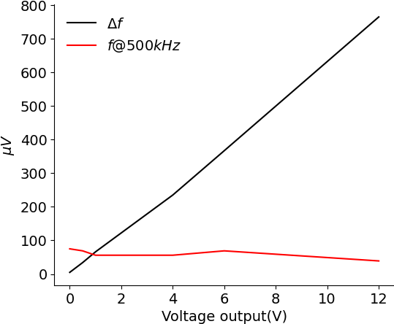
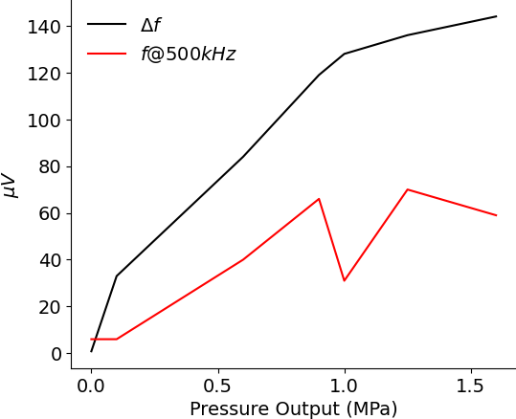
AE amplitude wrt to applied voltage and pressure (in saline phantom)
Pressure = 1MPa
Voltage = 2V
The difference frequency here is 500kHz – 8kHz = 492kHz. It seems like the effect plateaus with pressure(which is also reflected in the calibration data), and continues linearly upwards when voltage is increased. Previously, when there was no cone I could linearly increase the pressure to 2MPa. This suggests that some aspect of reflections within the cone is leading to this asymptote.

Slide 9
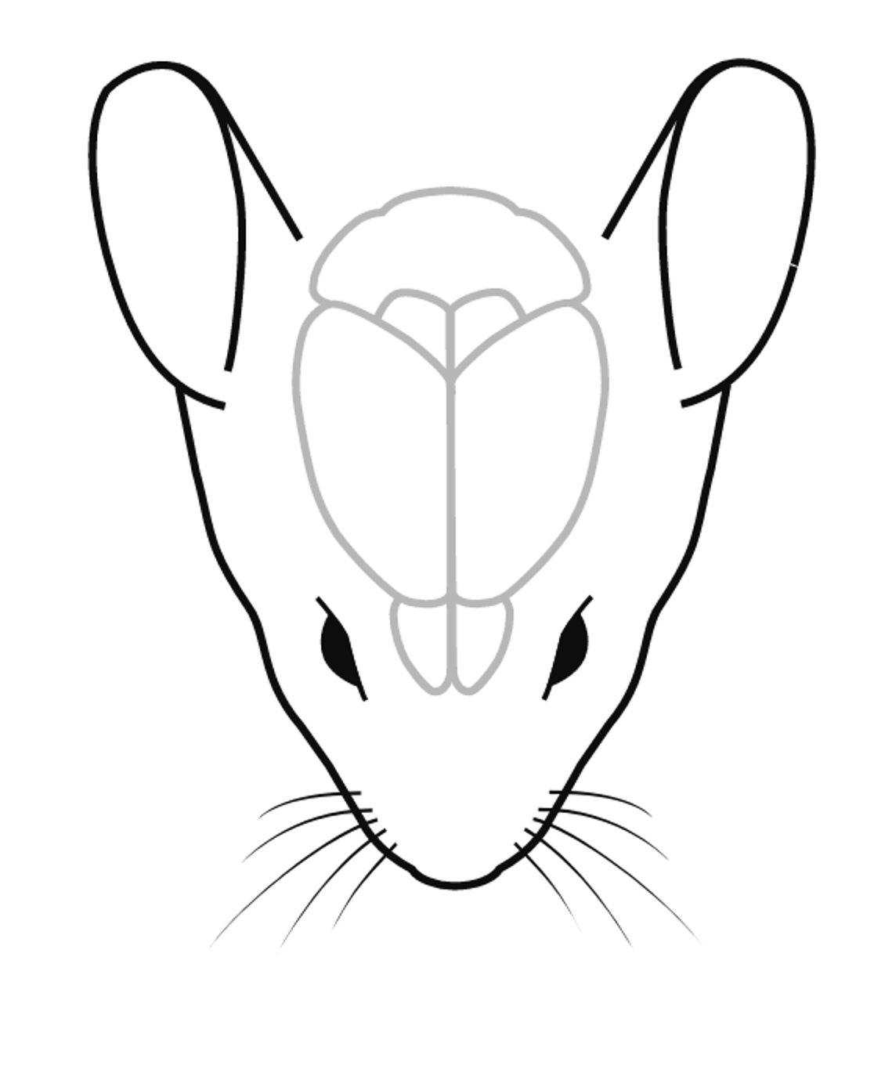
Mouse spatial distribution.
VEP: AP -3.5mm, ML -1.5 left of bregma.
Motor Cortex Forepaw: AP 0.0mm, ML 2.0
Distance between two points =
D = sqrt ((x2-x1)^2+ (y2-y1)^2)
D = Sqrt(3.5^2 + 3.5^2) = sqrt(12.25+12.25) = 4.94 mm
Distance between two screws is approx. 5mm.
At 12V, we have an average of 1.6mV at the difference frequency. The electric field in V/m would be:
E = 0.0016/0.005 = 0.32 V/m assuming a constant electric field in the 5mm region. This is not true though, as the voltage point source dissipates 1/r^2. Thus the electric field at the point the screw is, will be stronger. So really, it depends on the impedance of the medium.

Slide 10
Questions to answer. Figure 1 AE characterization.
Is the AE amplitude bigger in a mouse than in saline? How can I prove this is just not a position calibration issue, or connection impedance issue? How to conclusively show this? ANSWER: Do a complete X,Y,Z calibration in both saline and mouse. With the same connections and cabling. Keep all files.
Does the AE amplitude decrease over time in saline, compared to a mouse? One hour tracking at 2 minute intervals?
Are the AE amplitude vs voltage and AE vs pressure gradients similar in saline and a mouse?

Slide 11
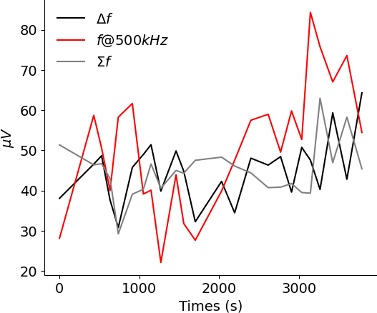
Time w.r.t saline.
Over 1 hour there is no discernible trend, whereas in a mouse the ae values are higher in amplitude and also go down over time.
TODO: show this relationship more clearly on the same plot.

Slide 12
Amplitude calibration should be done such that electric field is aligned with acoustic field.
When I tried doing a calibration with a 5mm horizontal alignment, I got much lower values than when I had the vertical electrode alignment. It was hard to do any calibration.
This suggests I need to do a vertically aligned electrode spatial calibration in the mouse.
TODO: try using the gold cup electrode to do a spatial calibration. Immediately I got a higher value. Why?

Slide 13
Can I obtain a 4 Hz difference frequency in saline and see it in the data?
No, I am getting some serious aliasing issues. These may be alleviated by adding back a low pass filter. TEST THIS. Not so much. Here, I think measuring and stimming from same electrode is an issue. The filter isn’t helping and I am not sure how to get this well again.
In the phantom uren tank, I used the low pass filter, and it just worked when I did an 8 second measurement.
If I decrease the sample rate, I am seeing a clear mixing frequency. Something about this I do not understand correctly.
In Uren, I measured with a different electrode/amplifier etc. I can still do this here If I use the middle electrode, and a distance reference.

Slide 14
Can I modulate up a 4Hz signal, and see it in the data?
Yes. This works.
It’s a ratio of 1:40 when exactly calibrated… so doing this is entirely dependent on having low noise, and excellent position calibration.

Slide 15
TO DO list. What frequency to do this at? 8kHz
With a more distant reference – ideally with same spacing as mouse, calibrate the center and do a 15 by 15 calibration saline image at dF and carrier. Repeat this spatial map in a mouse.
At the center point, with distant reference – do a difference/sum vs pressure, and difference/sum vs voltage. Repeat in a mouse after position calibration.
Measure the amplitude of the AE amplitude at the center point for a fixed setting over time for 1 hour. Repeat in a mouse. Ideally I get a comparative plot showing AE amplitude stays the same in saline, and changes in a mouse.
Test out adding a low pass filter to my voltage input for stimulation set up.

Slide 16
TODO list: 31/05/2023
Draw new equipment diagram. – Done.
Determine swappable set up inclusive of the filter so that I can obtain low dfs using the preamp.
Repeat measurement to test whether to do horizontal or vertical alignment with cup electrode. Cup electrode can be more than 5mm away now… maybe whatever the thickness of the head is?
Find a good frequency and voltage in the chosen set up to do a 15x15 image where I record all data for posterity, so I can display df, usf, sf.
In this new arrangement, create a v vs ae df and sf, and a p vs ae df and sf plot.

