Slide 1
Could US neuromodulation be due to frequency mixing?
30/6/2023
OR: A study on whether US neuromodulation could be confounded by high frequency electromagnetic noise.

Slide 2
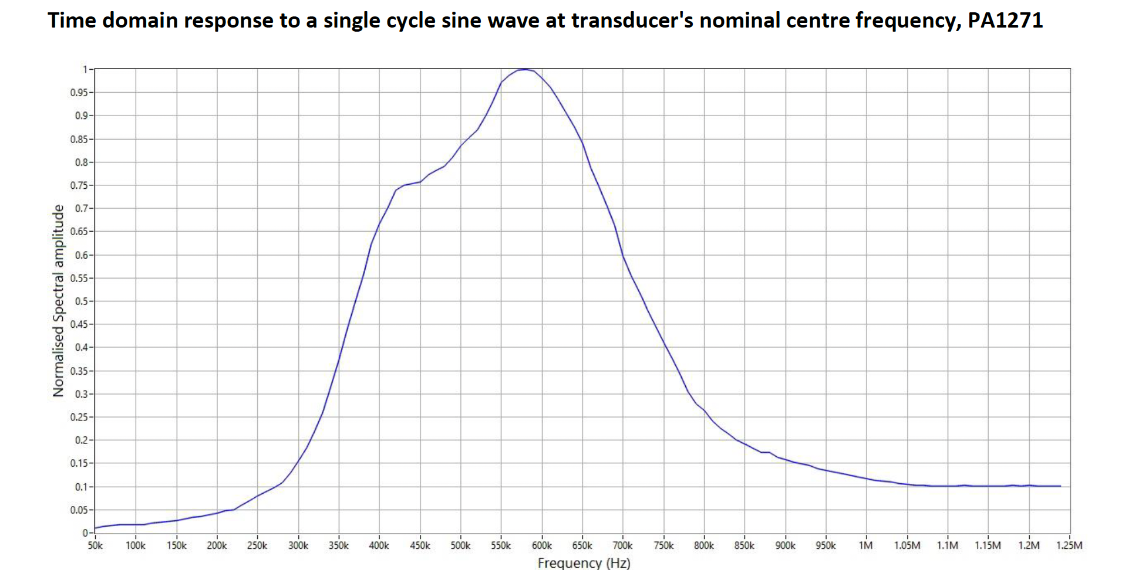
Transmission curve of 500kHz transducer.

Slide 3
Proof points of frequency mixing occurring due to the medium
Amplitude covariance scale test.
In the mouse and in saline the sf and df scale with the applied pressure.
RF amplifier confound tests.
In saline I see that the RF amplifier also has mixing frequencies in it.
With and without acoustic connection. Could it be due to EM noise from the US?
I see the mixing frequencies in either continuous or PRF ultrasound, it scales with how close it is to the medium(either brain or saline).
Size of the mixing PRF components should be larger at 1khz than at 2kHz and 3khz if it is frequency mixing.
This is true(1kHz is bigger than 3kHz), but also visible in the RF data so it is unclear the medium is the cause of the mixing, or whether the cause is coupling from the high voltage source.
Spatial test is valid, as we presuppose that the mixing effect is proportional to the pressure focus. Hence moving off pressure focus should yield a lower value if it is the acoustoelectric effect.

Slide 4
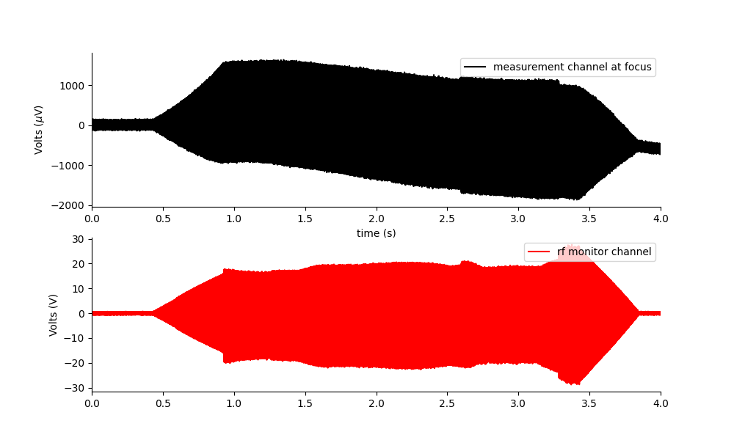
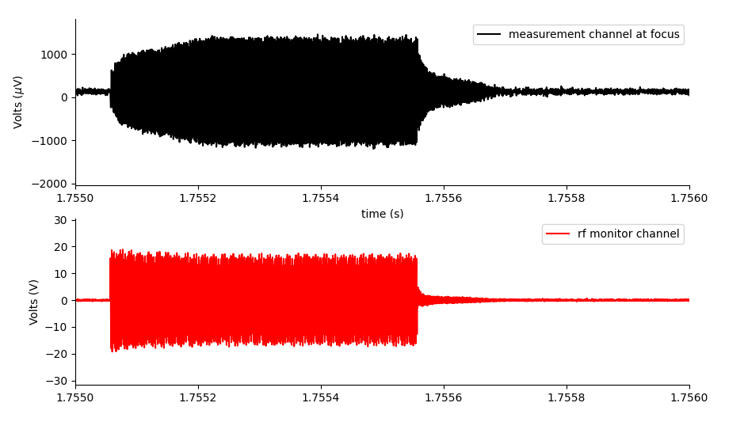
Repeating with RF amplifier channel and preamp
Spatial profile: The EM mixing amplitude appears to scale with the size of the carrier, not the pressure focus(unlike the AE effect).
Close up of a single pulse on RF amplifier and measurement channel reveals they look quite different.
In saline, there is definitely frequency mixing occurring.
Close up of a single pulse
Is this part is from reflected pulse?
Raw data with clear DC offset
You can tell that the voltage measured is related to the acoustic field(not just the electric field in the RF amplifier), as it ramps up like a bell(as does the transducer), then has a reflection area at the end.

Slide 5
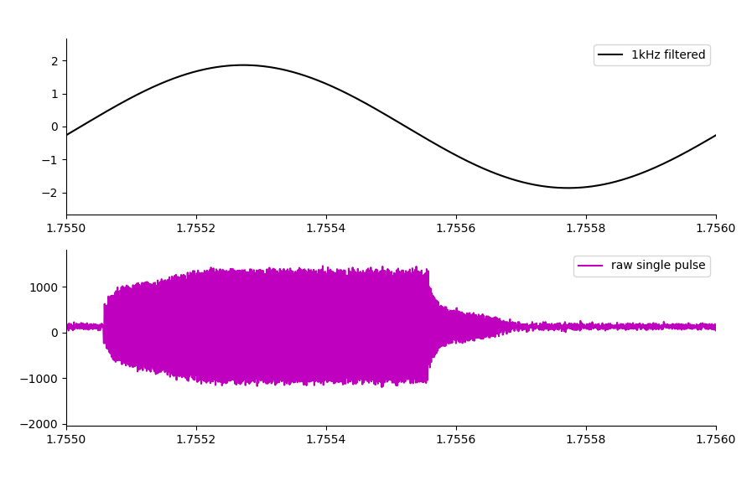
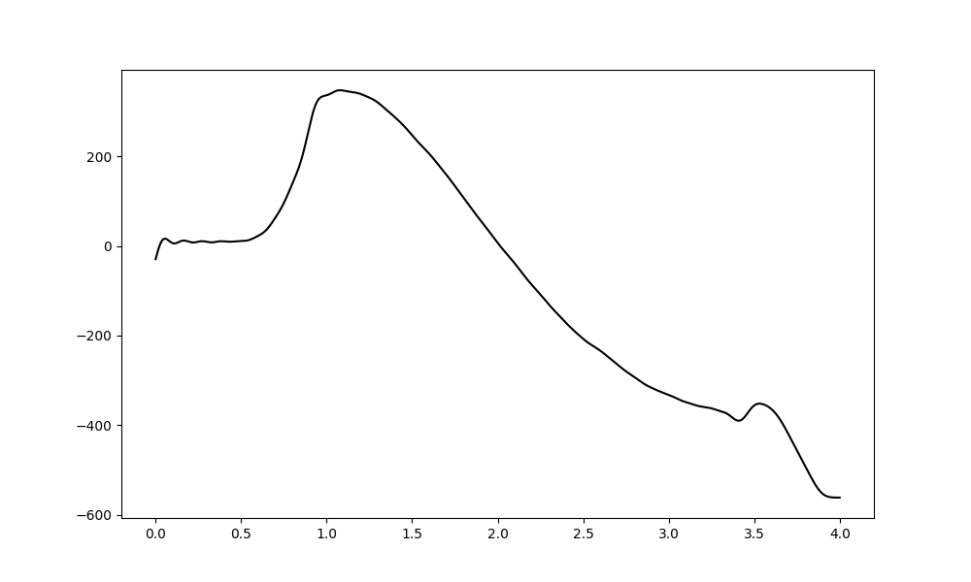
Looking at phase of individual components of mixed frequencies
This frequency mixing around DC means that we get one half of the phases(just one side of the spectrum) adding together.
On the left we can see how the phase of a single pulse translates into the 1khz. The largest effect however is at DC – with a pronounced on and off offset(10Hz cut) as the US starts and stops shown below.

Slide 6
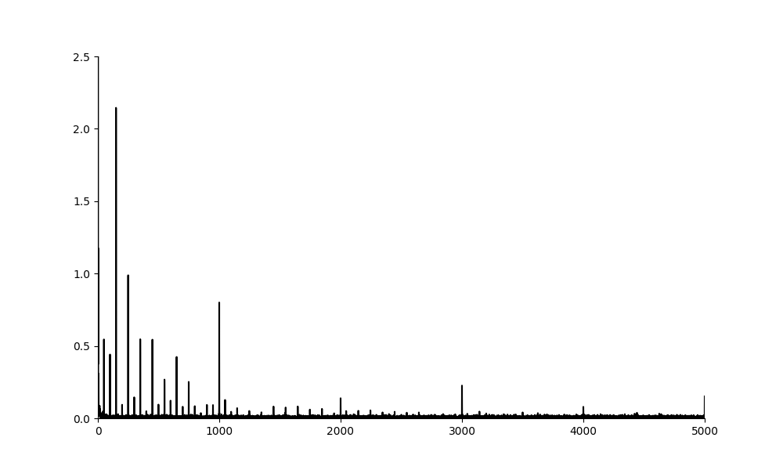
Proof of frequency mixing
Here in the FFT of the preamp measured data we can see that the 1kHz is larger than the 3kHz, this shows that frequency mixing is occurring around the carrier(500kHz).
This effect is stronger, when we do not use the PRF but use a continuous signal instead.
Where is the frequency mixing occurring?

Slide 7
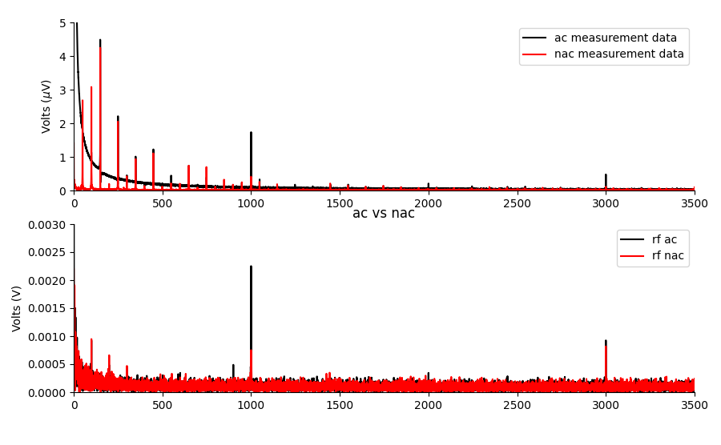
Acoustically connected vs not (saline)
Here we show the measurent electrode which is run through the preamp at gain 1000, applying PRF acoustic signal at 1kHz, and also the RF amplifier monitor.
In the RF amplifier monitor, the 1kHz is smaller than the 3kHz which suggests frequency mixing is NOT happening in the NAC case. In the AC case, there is frequency mixing.
In the voltage monitor, there is some ambiguity due to mains harmonics. It would be better to change the PRF to a non-integer multiple of 50Hz… i.e. 1020Hz would be a better PRF to disambiguate from mains noise.
Goal: State that frequency mixing ONLY occurs when there is an acoustic connection.

Slide 8
Applying Ultrasound Only
I notice there is frequency mixing, generating new frequencies which are not in the RF amplifier output.
The amplitude of this effect appears proportional to the distance from the US EM source, but not the focal area of the transducer.
The amplitude of these mixed frequencies is far larger in the mouse.
In all plots, I apply v_out = 0.1V, 1MPa at a calibrated focal position.

Slide 9
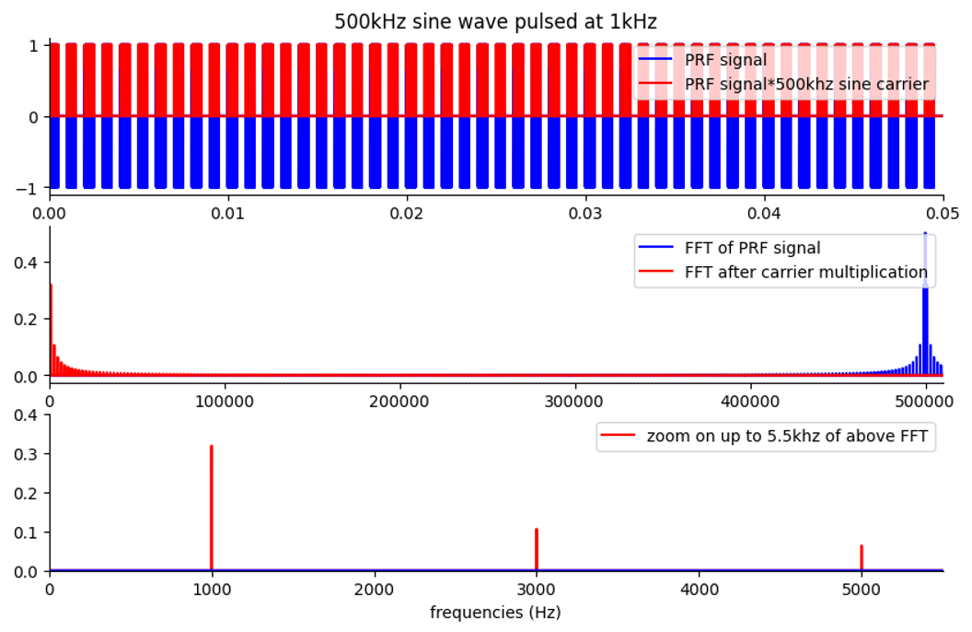
PRF 1020 at 500khz simulation to show spectrum.
Add code showing the shape of a PRF1020 at 500kHz in simulation.

Slide 10
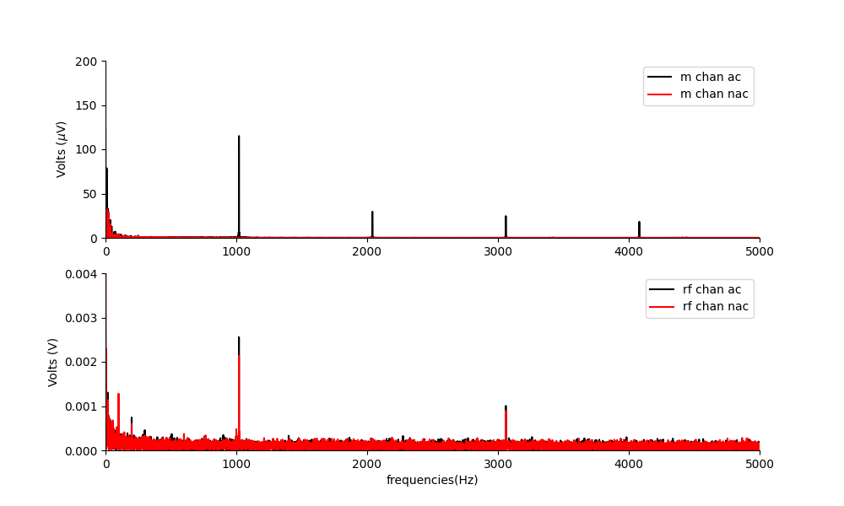
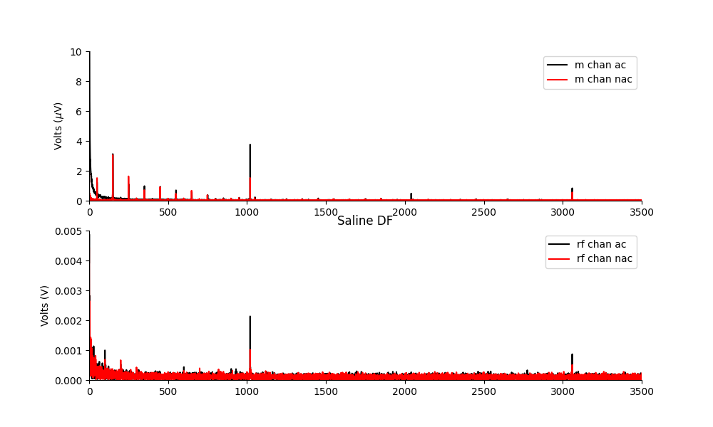
In a mouse, PRF1020Hz. DF
In a mouse
In saline
There are clear and large frequency mixing at 1020Hz, and at frequency between the main harmonics too. The amplitude is huge.
Notably there are also DC amplitudes here. It seems that the main challenge to doing this in a novel way is this DC area.
There is a smaller amount of mixing when the system is acoustically connected.

Slide 11
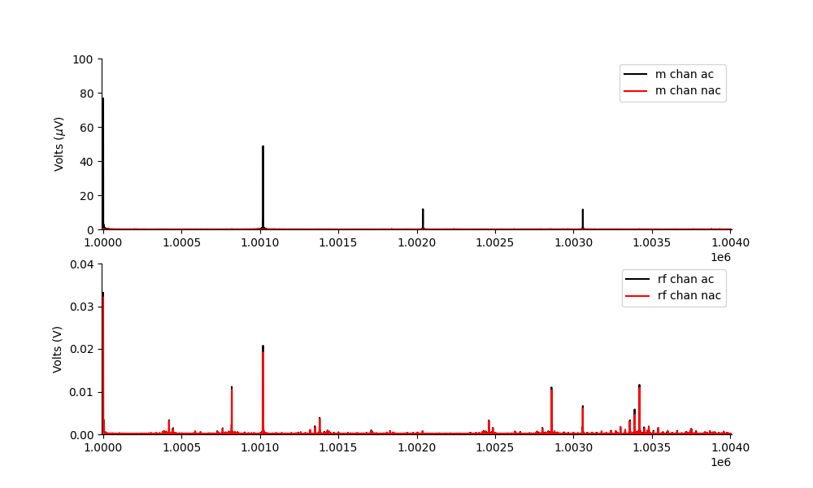
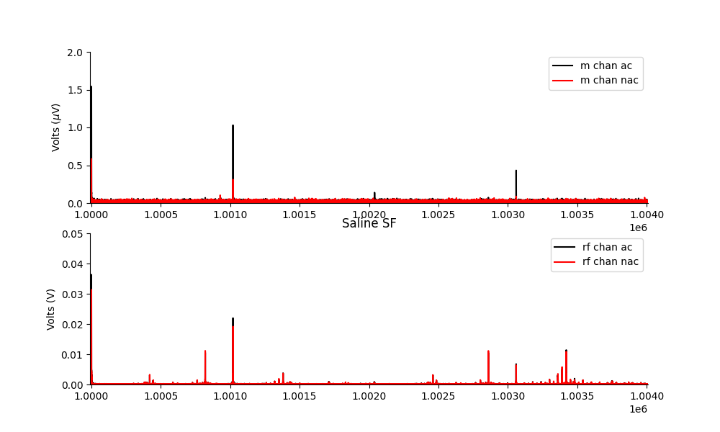
Sum Frequencies
In a mouse
In saline
There are frequencies that appear, due to mixing, that didn’t even exist before…
The amplitude in a mouse of these frequencies is much larger than in saline?
There is mixing and an amplitude increase, but it is much smaller amplitude.

Slide 12
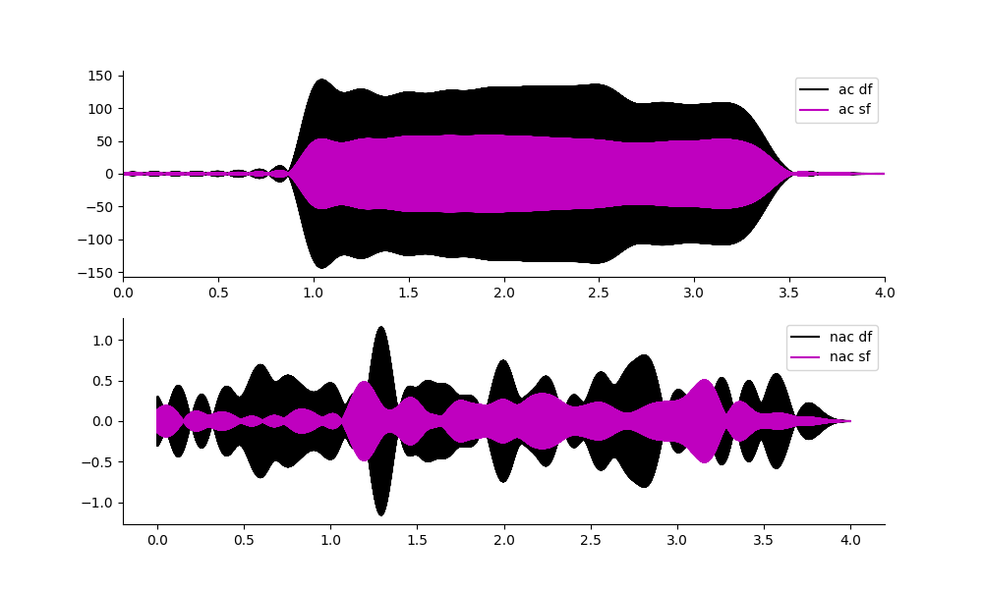
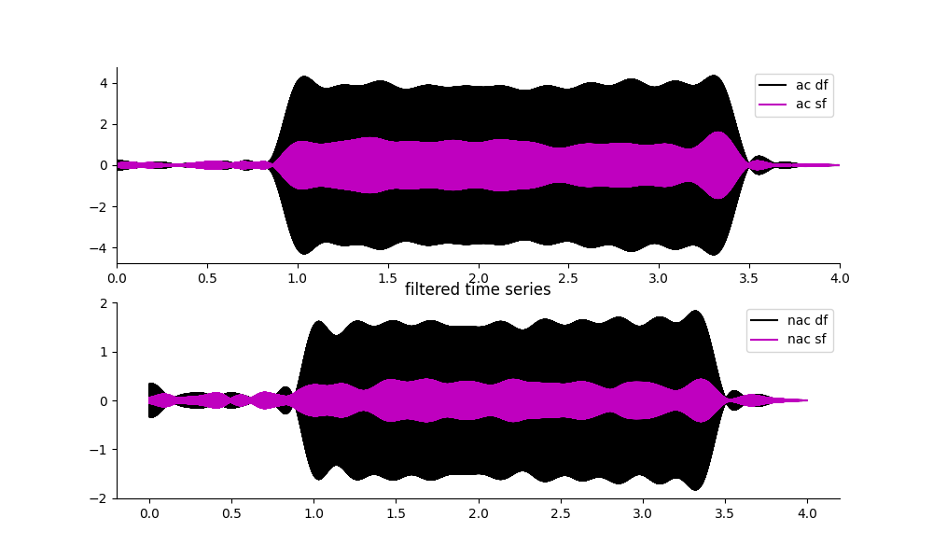
Time Series PRF 1020Hz
In a mouse
In saline
Time series. Acoustically connected sum and difference frequencies are huge.
Tiny when not acoustically connected.
Could the reflections have something to do with reflection and refraction through different impedances?

Slide 13
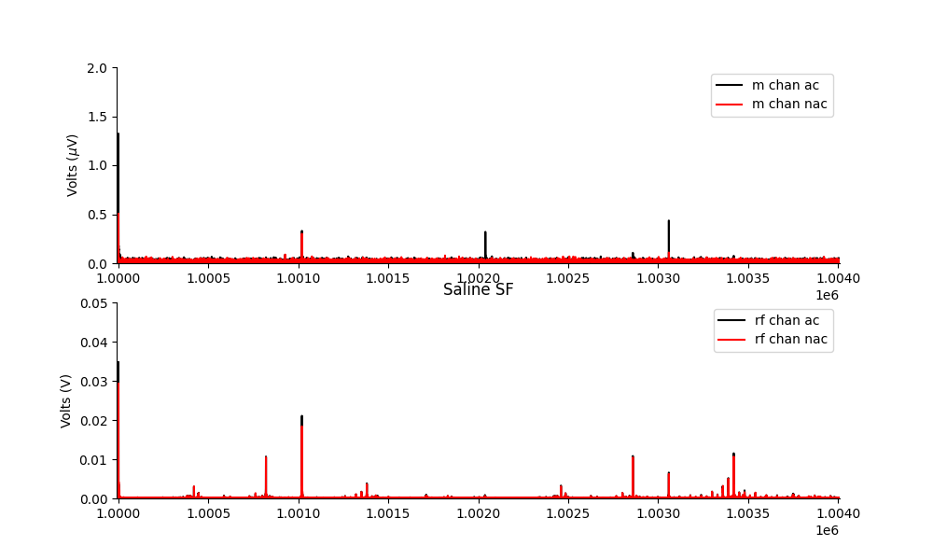
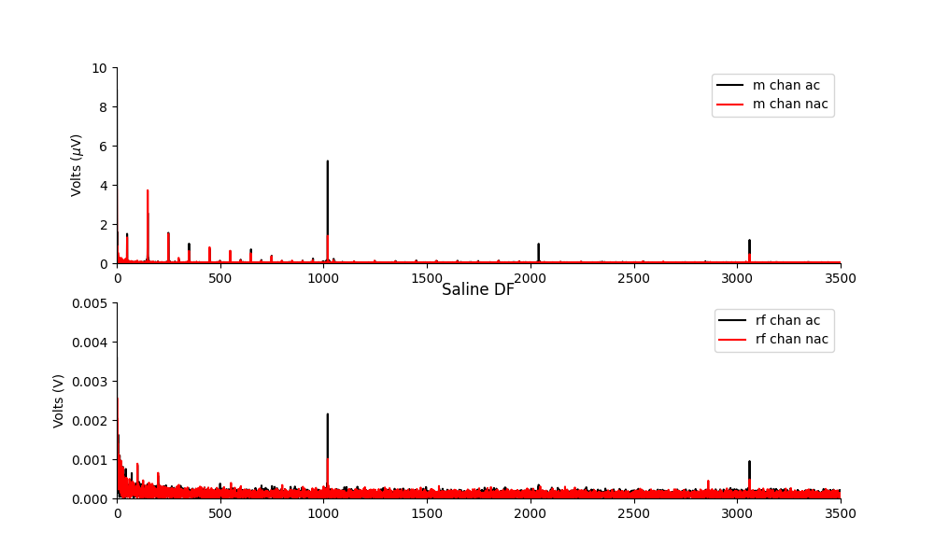
PRF1020 gold foil overlay test.
Could the acoustic connection also be a proxy for EM field traversal? To test this I try to block the EM by using a thin piece of foil between the transducer and the area with the measurement electrode.
Result: I still see frequency mixing. The amplitude gets a little larger than when there is no foil placed there.
TODO: add picture.
Why? In non-linear acoustics this would add an extra reflection point?
SF
DF

Slide 16
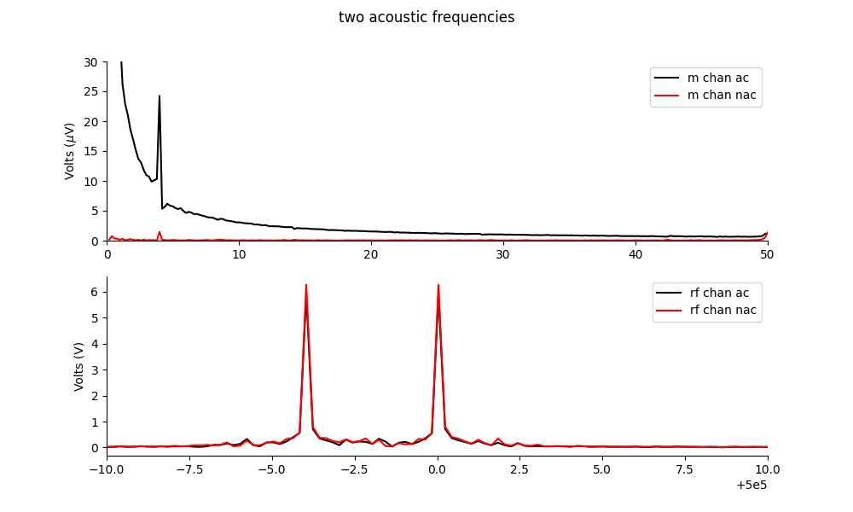
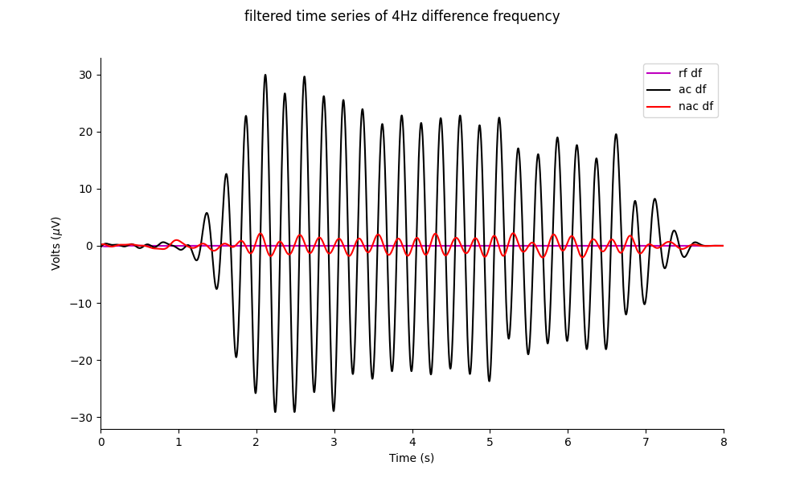
Phantom two-tone frequency mixing acoustics test.
I apply a 500kHz signal, and a 500kHz-4Hz signal in saline.
I can see the 4Hz.
500kHz
-4Hz
500kHz
Though there is a large DC offset, this method has potential as a MEP test.

Slide 17
DO A MEP TEST JUST WITH ACOUSTIC FIELD.

Slide 19
Today: 05/07/2023
Can I get a VEP with Ket/Xyl from the new mouse with Pat style electrodes, using the new cable, and the chemical heat mat? No VEP, but I did a neural recording test using the delta waves induced by ketamine. It looks promising. This should enable me to at least
Do a big saline test:
Do the PRF2020 test in saline at the calibrated focus, for an amplitude comparison.
What happens when I shield the area by placing that gold foil over the top of the gel? Do I still see frequency mixing? (i.e. is the current source EM noise from the transducer? or does it happen on its own).
Apply two US frequencies that are close together, can I see the diff frequency in saline?

Slide 20
Summary
What do I know?
Frequency mixing occurs to generate sum and different frequencies when an acoustic wave is present. (No EM source required, unless the EM source is the transducer itself?)
How can I use this? MEP with two close together US frequencies.
MEP experiment:
EMG with my new LED in place.
T1: US alone continuous wave. Showing DC offset response. (this proves US is not due to sound confound)
T2: US with two frequencies close together, can I measure dF?

Slide 21
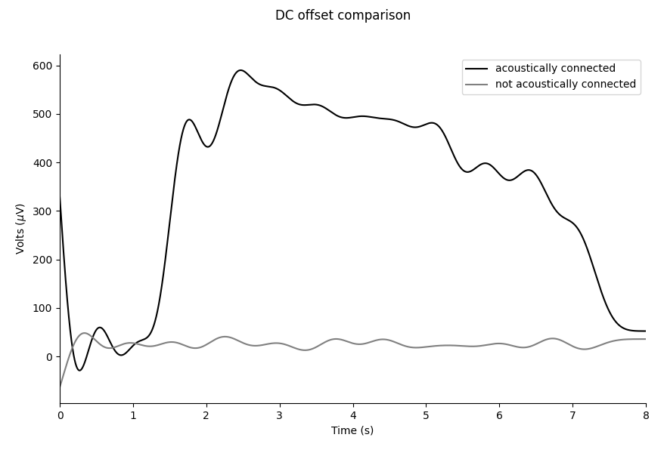
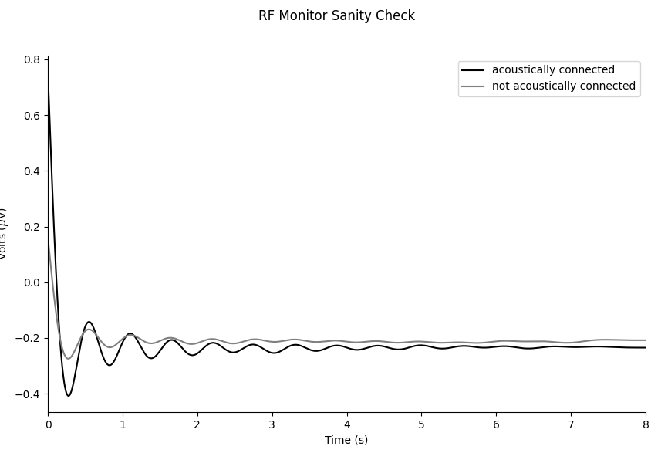
Continuous wave DC Offset comparison in vivo.

Slide 22
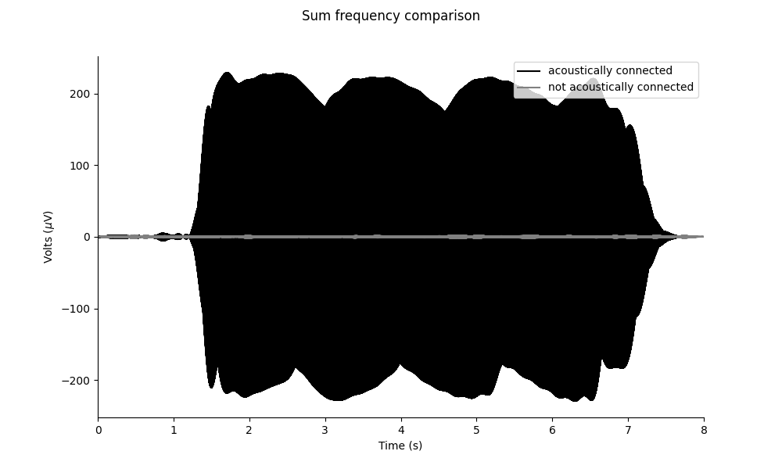
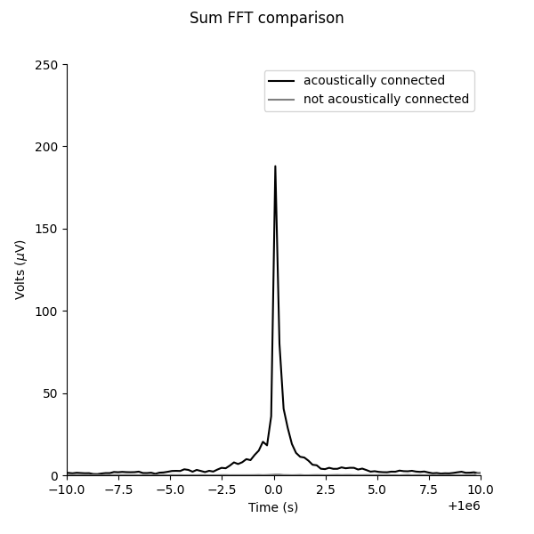
Sum Frequency: 500khz + 500khz = 1MHz

Slide 23
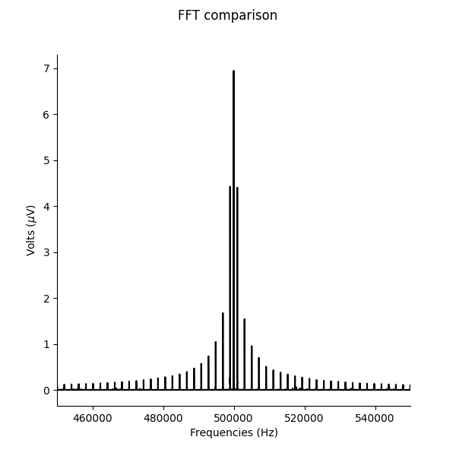
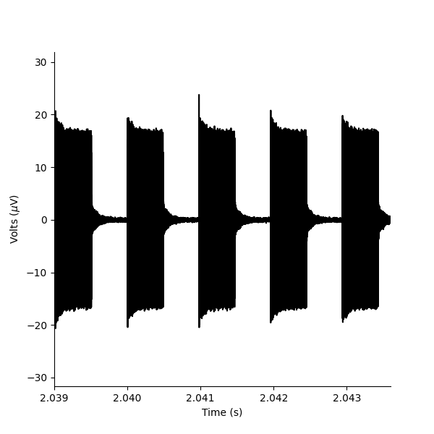
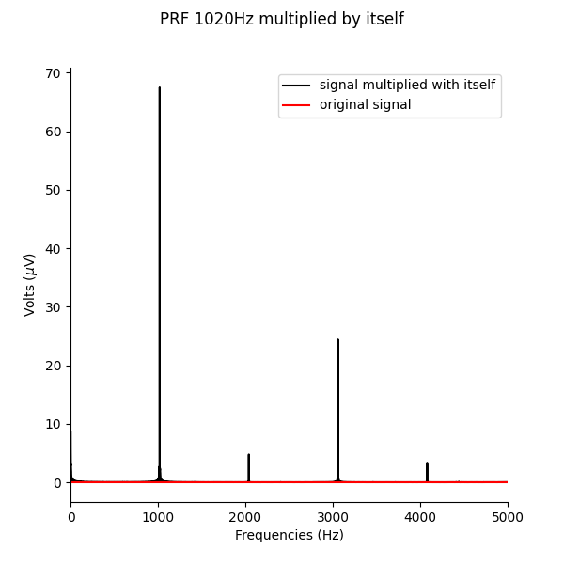
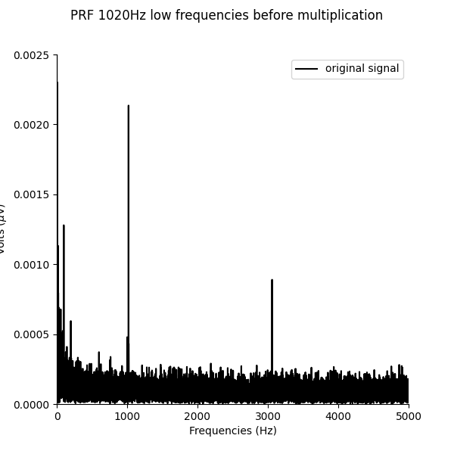
PRF SIGNAL simulation at 1020Hz
Time series pulses generated at 1020Hz of a 500kHz continuous wave.
What happens when we multiply this signal by itself?
New intermodulation frequencies appear due to mixing e.g. one appears at 2040Hz

Slide 24
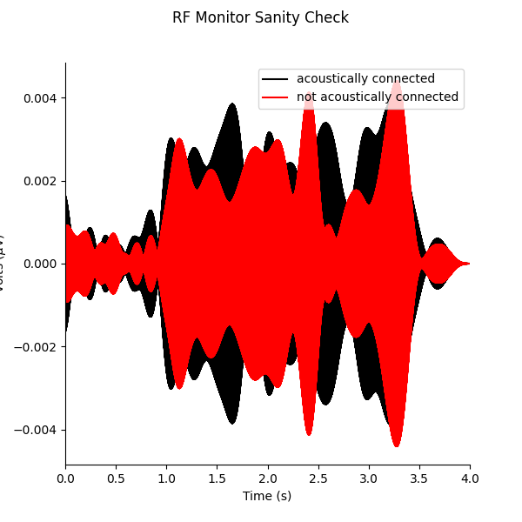
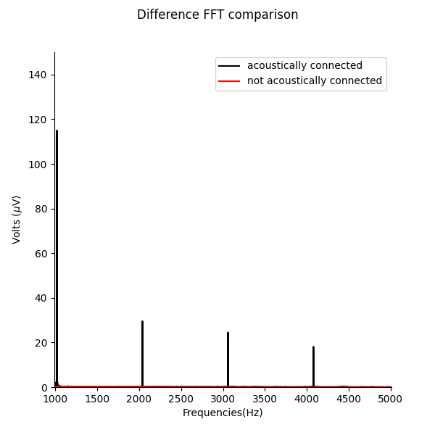
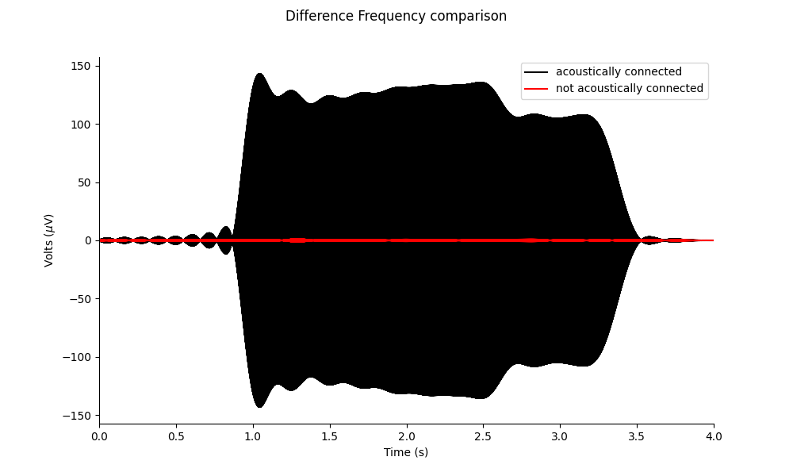
PRF 1020kHz comparison in vivo

Slide 25
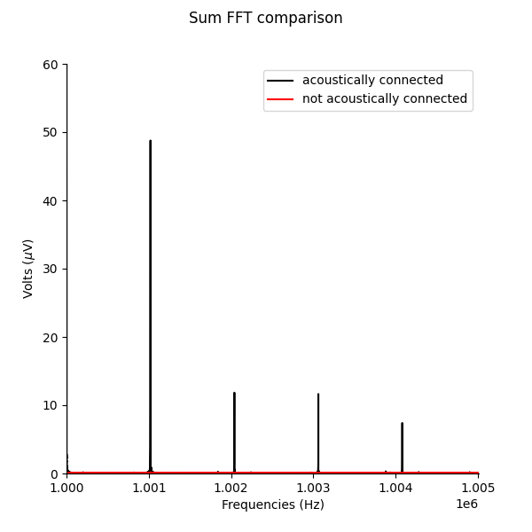
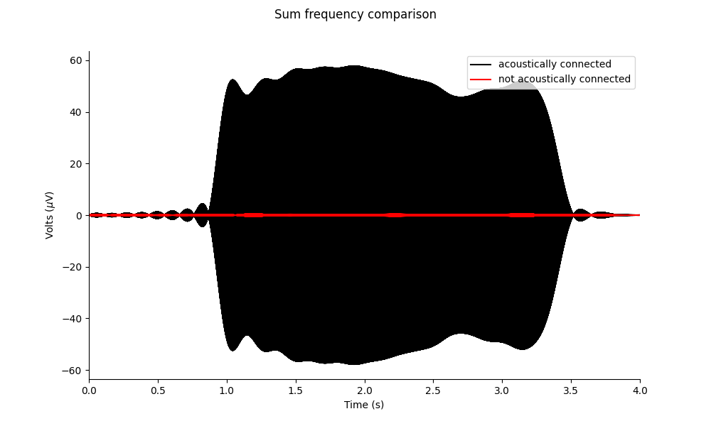
Sum PRF 1020kHz comparison in vivo

Slide 26
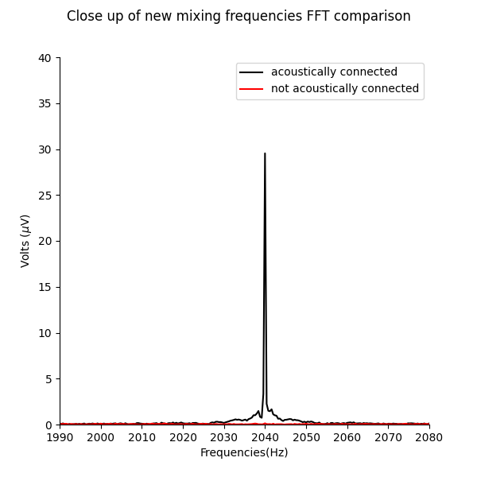
Proof of frequency mixing
Intermodulation frequency at 2kHz.

Slide 27
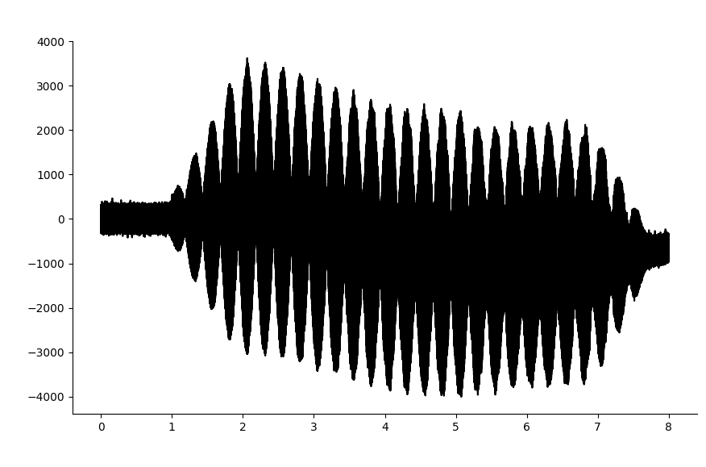
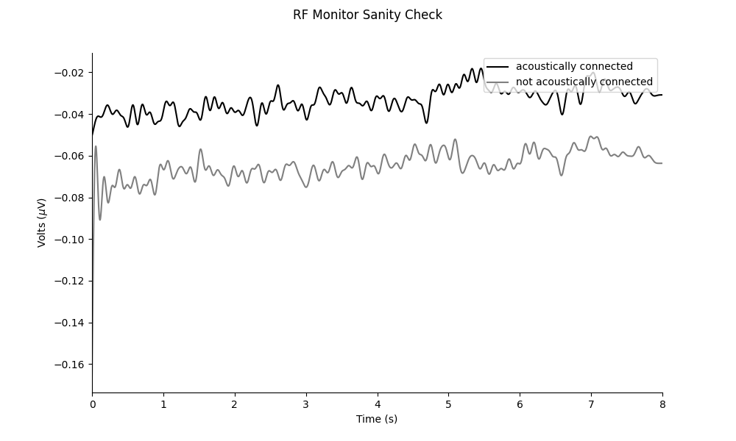
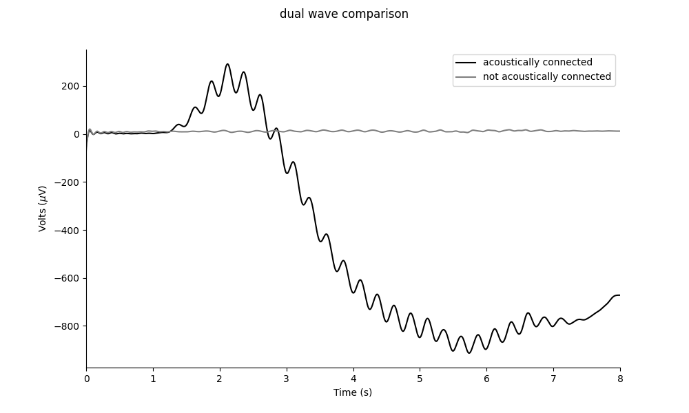
Dual waveform comparisons in phantom
Difference Frequenxy = 500000Hz - 499996Hz = 4Hz
The dual waveform phantom tests shows frequency mixing occurs in phantom.

