Slide 1
Could US neuromodulation be due to frequency mixing?
30/6/2023
OR: A study on whether US neuromodulation could be confounded by high frequency electromagnetic noise.

Slide 2
Proof points of frequency mixing occurring due to the medium
Amplitude covariance scale test.
In the mouse and in saline the sf and df scale with the applied pressure.
RF amplifier confound tests.
In saline I see that the RF amplifier also has mixing frequencies in it.
With and without acoustic connection. Could it be due to EM noise from the US?
I see the mixing frequencies in either continuous or PRF ultrasound, it scales with how close it is to the medium(either brain or saline).
Size of the mixing PRF components should be larger at 1khz than at 2kHz and 3khz if it is frequency mixing.
This is true(1kHz is bigger than 3kHz), but also visible in the RF data so it is unclear the medium is the cause of the mixing, or whether the cause is coupling from the high voltage source.
Spatial test is valid, as we presuppose that the mixing effect is proportional to the pressure focus. Hence moving off pressure focus should yield a lower value if it is the acoustoelectric effect.

Slide 3
Look at old files and re-analyse. E97 t11
Notably, I was using the preamp in these files which is different from the experiment I have just completed. It is possible that my connection to the DAQ/stim electrodes in the experiment I have just completed is the problem.
Re-analysing, and this indeed is the problem. My gain on the preamp was at 500 and I can see the differences really clearly.
What does this mean if I am comparing signals here though, it might be that I am just not measuring them the same way?
This makes the RF amplifier confound question harder to answer. The RF amplifier monitor is single-ended, and to be directly comparable it should be differential to match the preamp.
If I redo this test, what are the questions I can answer?
TODO: Plug the rf amplifier into the differential input, so that I can directly compare more accurately to the preamp data for the RF confound test.
In saline, set up the preamp to do the measurement, and remove the filter from the bono stim set up. It is not needed.
Spatial test
Do the RF amplitude confound test. In addition, provide evidence of the resonant frequency of this transducer.
With and without acoustic connection. (this seems like a strong one, as all measurement methods are the same). There is a massive different here, which bodes well.
Size of the f mixing components, i.e. the 1kHz PRF is larger than 3kHz, is proof that frequency mixing is occurring.
Amplitude covariance question.
REDO this analysis exactly but using the preamp instead and with RF amplifier plugged into the diff input.

Slide 4
Look at an old PRF file?
From compare_amplitude_prf_result.py, I can see the output from the RF amplifier and the preamp based df at 1khz.
Notably, I had the RF amplifier on chan 3 which is single-ended. There is 1kHz in both, but the pattern looks extremely different suggesting there is electrical mixing and an additional source of mixing in saline.
NB: It is possible that using a single-ended input to measure the RF channel means I do not see the whole set of reflections, hence I should move the RF channel to a differential input.
To consider: The reflections back into the RF amplifier are known to tell us something about the environment they were in. i.e. the reflected signal is both the time and frequency domain distortion induced by the medium the acoustic wave travels through.
The dF has clear beat frequency. The sf looks totally different in reflection compared to saline.
There is clearly frequency mixing occurring somewhere in the system. The frequency mixing is largest when there is an acoustic connection. Ideally this frequency mixing amplitude would follow the spatial profile of the pressure. When I tried to do this previously, I didn’t see any correlation. Maybe this was due to not using the preamp so I didn’t have good amplitude resolution? I should try this again in saline and using the preamp, but it seems like this might not be the answer.
The RF monitor channel shows all the same frequencies as the electrical channel. However, only when there is an acoustic connection do we see the mixing frequencies.
1khz is not the resonant frequency of the US, so the acoustic amplitude would be very small. So chances are high that the small mixing frequencies are due to an interaction in the medium. For instance if there is a dF mixing frequency in the medium, it may induce tiny vibrations due to the acoustoelectric effect as well – which would then be picked up as a reflection by the piezoelement.
Since the US connected vs not appear so different in the RF monitor channel, it suggests the electrolyte is important.

Slide 5
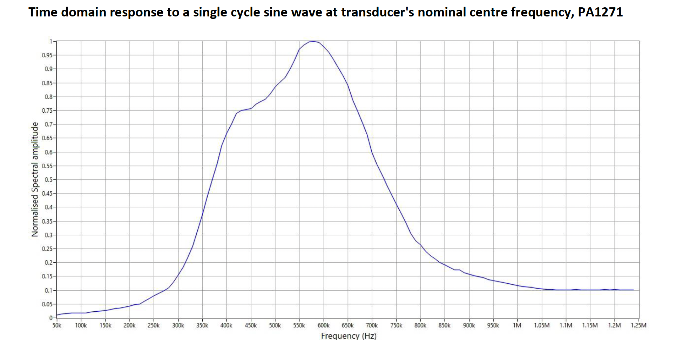
Transmission curve of 500kHz transducer.

Slide 6
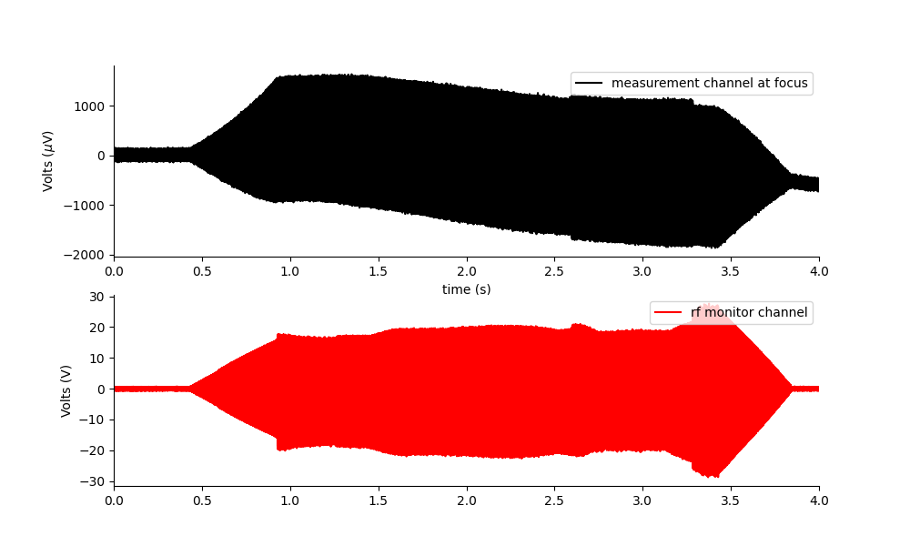
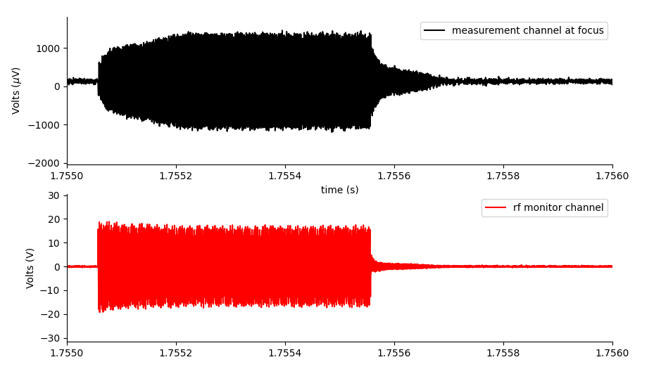
Repeating with RF amplifier channel and preamp
Spatial profile: The EM mixing amplitude appears to scale with the size of the carrier, not the pressure focus(unlike the AE effect).
Close up of a single pulse on RF amplifier and measurement channel reveals they look quite different.
In saline, there is definitely frequency mixing occurring.
Is this part is from reflected pulse?
Close up of a single pulse
Raw data with clear DC offset

Slide 7
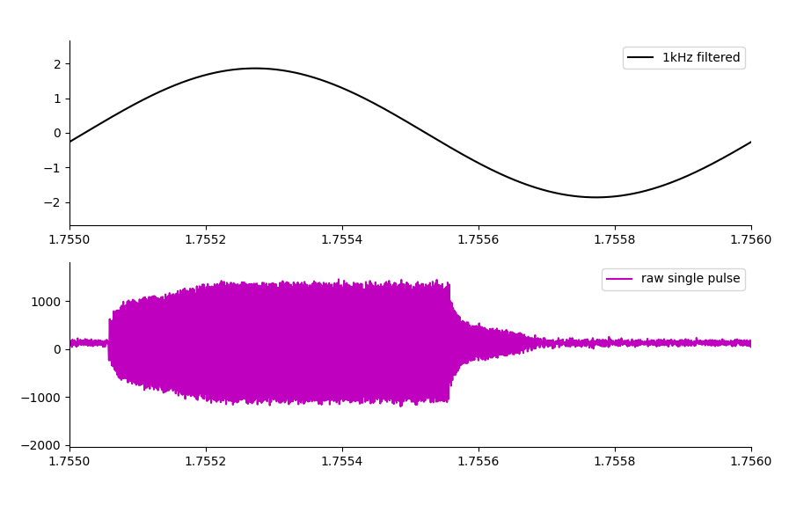
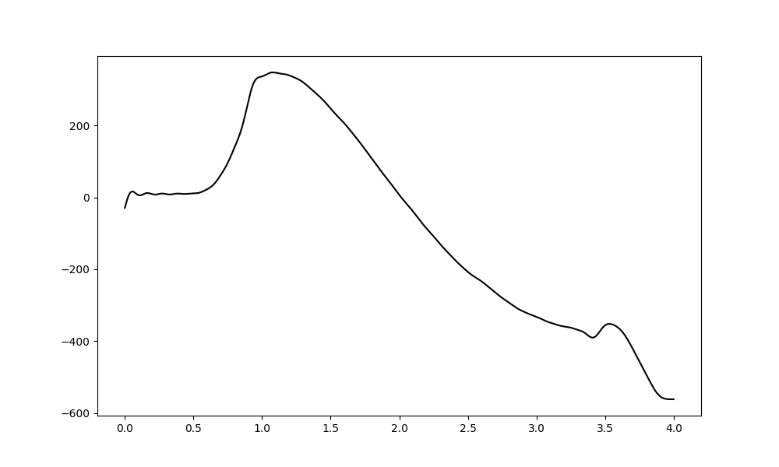
Looking at phase of individual components of mixed frequencies
This frequency mixing around DC means that we get one half of the phases(just one side of the spectrum) adding together.
On the left we can see how the phase of a single pulse translates into the 1khz. The largest effect however is at DC – with a pronounced on and off offset(10Hz cut) as the US starts and stops shown below.

Slide 8
We would expect the largest DC offset to occur with a continuous wave, as all the spectral mixing power would be at DC. Is this true?
If we sent through a superposition of US waves at 500kHz, and 502kHz would we see the difference frequency?

Slide 9
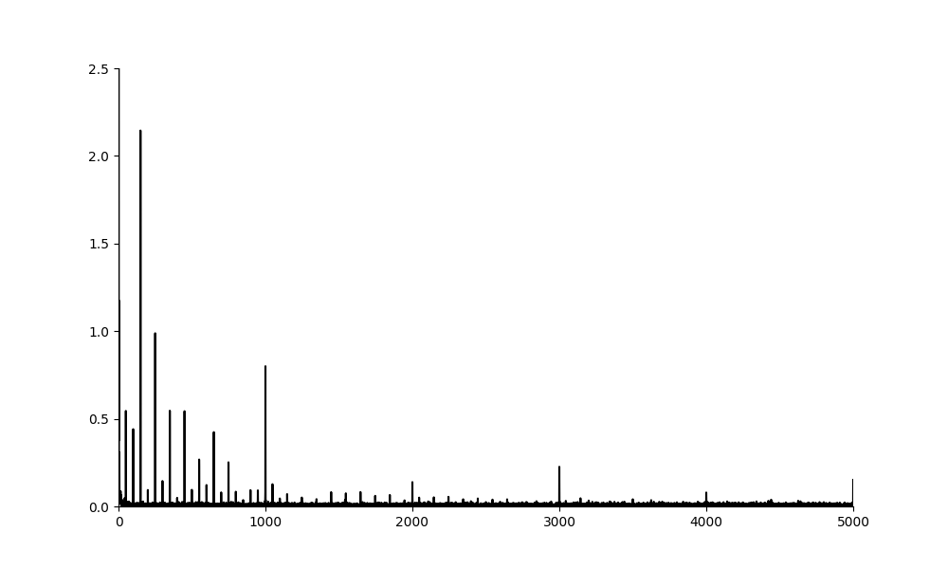
Proof of frequency mixing
Here in the FFT of the preamp measured data we can see that the 1kHz is larger than the 3kHz, this shows that frequency mixing is occurring around the carrier(500kHz).
This effect is stronger, when we do not use the PRF but use a continuous signal instead.
Where is the frequency mixing occurring?

Slide 10
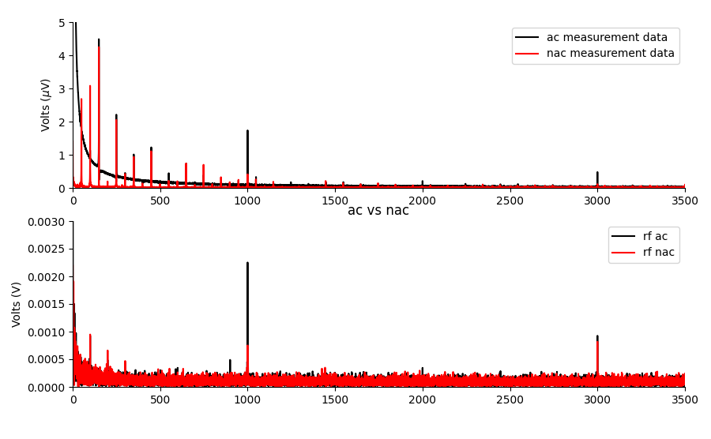
Acoustically connected vs not
Here we show the measurent electrode which is run through the preamp at gain 1000, applying PRF acoustic signal at 1kHz, and also the RF amplifier monitor.
In the RF amplifier monitor, the 1kHz is smaller than the 3kHz which suggests frequency mixing is NOT happening in the NAC case. In the AC case, there is frequency mixing.
In the voltage monitor, there is some ambiguity due to mains harmonics. It would be better to change the PRF to a non-integer multiple of 50Hz… i.e. 1020Hz would be a better PRF to disambiguate from mains noise.
Goal: State that frequency mixing ONLY occurs when there is an acoustic connection.

Slide 11
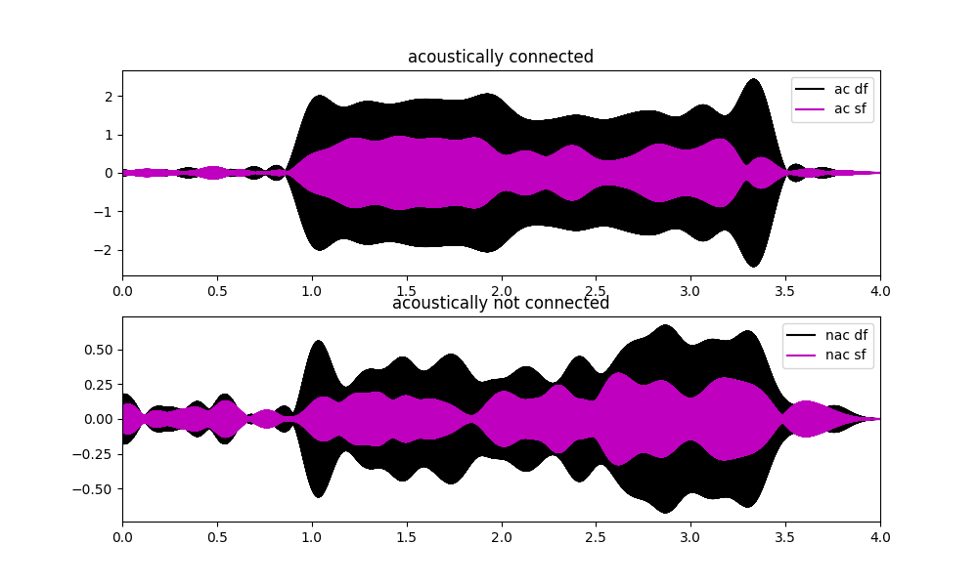
Time series.
The sum and diff frequencies are there either way, as they are output in the raw PRF signal. I can confirm that they change scale with the applied pressure amplitude.
When AC, they are much larger. Suggesting that frequency mixing takes place only in this case.
A better way to express this might be by a ratio of the 3rd to the 1st harmonic.

Slide 12
TODO: (04/07/2023)
Change PRF to 1020Hz, and redo acoustically connected vs not data.
Do a neural demodulation experiment?
Why can’t I see a spatial map of this frequency mixing change? What if this was the ratio between the first and third harmonic? As a proxy for the amount of f mixing taking place?
Maybe the mains harmonics are dominating? Maybe the base PRF amplitude is what I see… make a new map, even in saline where I use the ratio of the 3rd to the 1st harmonic.
Why does the carrier amplitude change size anyway? It changes based on the distance from the EM source. Currently I am doing EM source current source density imaging of the carrier.
It should still change amplitude based on the applied pressure?

Slide 13
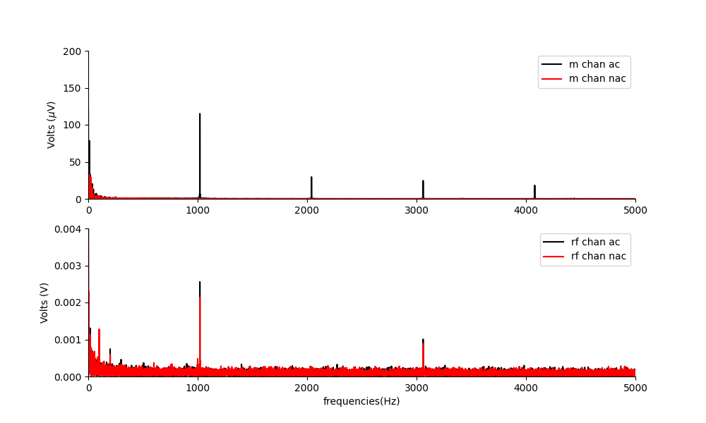
In a mouse, PRF1020Hz. DF
There are clear and large frequency mixing at 1020Hz, and at frequency between the main harmonics too. The amplitude is huge.
Notably there are also DC amplitudes here. It seems that the main challenge to doing this in a novel way is this DC area.

Slide 14
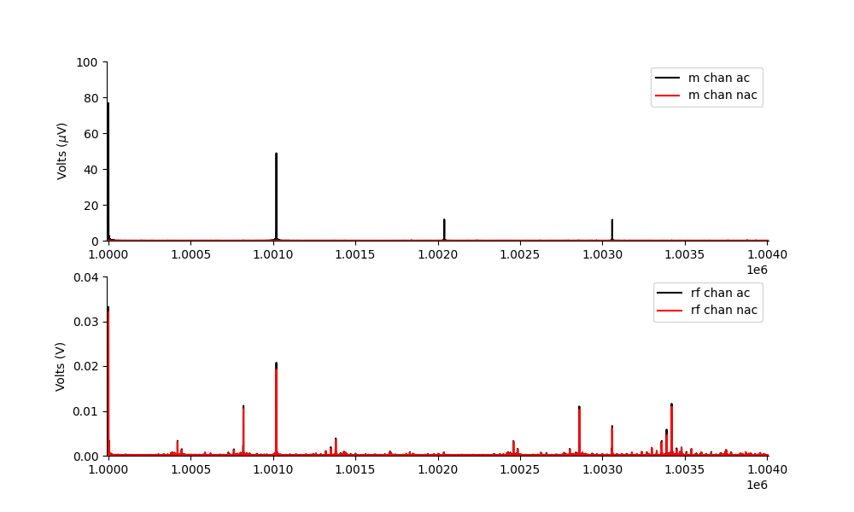
In mouse PRF 1020Hz, SF
Sum frequencies.
There are frequencies that appear, due to mixing, that didn’t even exist before…

Slide 15
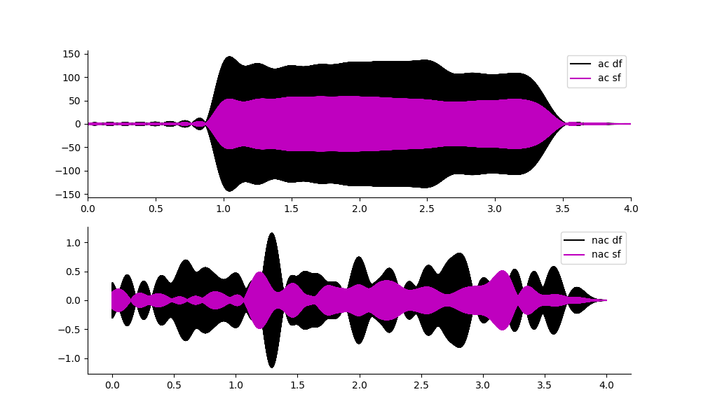
Time Series
Time series. Acoustically connected sum and difference frequencies are huge.
Tiny when not acoustically connected.

Slide 16
PRF1020 compare with saline amplitudes.

Slide 17
PRF1020 spatial map.

Slide 18
Today: 05/07/2023
Can I get a VEP with Ket/Xyl from the new mouse with Pat style electrodes, using the new cable, and the chemical heat mat? No VEP, but I did a neural recording test using the delta waves induced by ketamine. It looks promising. This should enable me to at least
Do a big saline test:
Do the PRF2020 test in saline at the calibrated focus, for an amplitude comparison.
What happens when I shield the area by placing that gold foil over the top of the gel? Do I still see frequency mixing? (i.e. is the current source EM noise from the transducer? or does it happen on its own).
Apply two US frequencies that are close together, can I see the diff frequency in saline?

Slide 19
Summary
What do I know?
Frequency mixing occurs to generate sum and different frequencies when an acoustic wave is present. (No EM source required, unless the EM source is the transducer itself?)
How can I use this? MEP with two close together US frequencies.
MEP experiment:
EMG with my new LED in place.
T1: US alone continuous wave. Showing DC offset response. (this proves US is not due to sound confound)
T2: US with two frequencies close together, can I measure dF?

