Slide 1
HI!
I AM JEANETTE.
HOME / ABOUT ME / MY WORKS
Aspiring UI/UX Designer.

Slide 2


HOME / ABOUT ME / MY WORKS
EDUCATION
2018 - 2022
National University of Singapore
Hi! I am Jeanette.
I aim to create thoughtful experiences through people-centric design.
Major: Global Studies
Specialization: Global Health, Environment & Technology
EXPERIENCE
Mar 2021 - Present
Generation Connect Pte Ltd.
Part-time UI/UX Intern

Slide 3

SHOPEE UI/UX Case Study
HOME / ABOUT ME / MY WORKS
A redesign of the mobile interface for Shopee, one of Southeast Asia’s leading e-commerce platforms.

Slide 4
SHOPEE UI/UX Case Study
SHOPEE PRODUCT & DESIGN CHALLENGE 2021
HOME / ABOUT ME / MY WORKS
Introduction
Process Overview
Research
Define
Ideate
Prototype
Validate
PERIOD
4 December 2020 - 16 January 2021
THEME
Engaging the 2021 local consumer
BRIEF
Propose a solution that focuses on:
(i) improving an existing feature OR
(ii) creating a new feature that would enable Shopee to remain the leading e-commerce platform in your chosen market.

Slide 5
SHOPEE UI/UX Case Study
My Role
Design Process
HOME / ABOUT ME / MY WORKS
UI/UX Design
User research, Ideation, UI design, Usability testing
Introduction
Process Overview
Research
Define
Ideate
Prototype
Validate
Define
Prototype
Research
Ideate
Validate
User Research
User Surveys
Market Research
User Persona
Pain Points
Journey Map
Solutions
Mock-ups
Interactive Prototype
Usability Testing

Slide 6
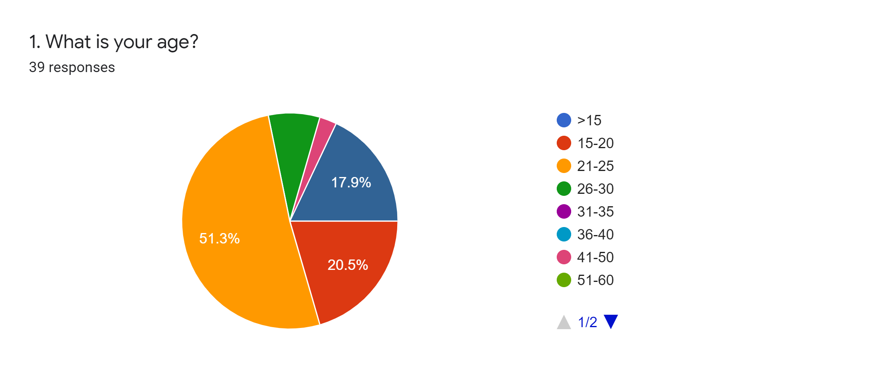
SHOPEE UI/UX Case Study
Research
HOME / ABOUT ME / MY WORKS
Administered a survey to 39 respondents
General shopping habits; shopee-specific questions; demographics
Sample focuses on Shopee’s target user group, mostly consisting of young adults in the 21-30 years old range.
Introduction
Process Overview
Research
Define
Ideate
Prototype
Validate
Notes:
Shopee’s target userbase is mostly young adults in the 21-30 years old range.

Slide 7
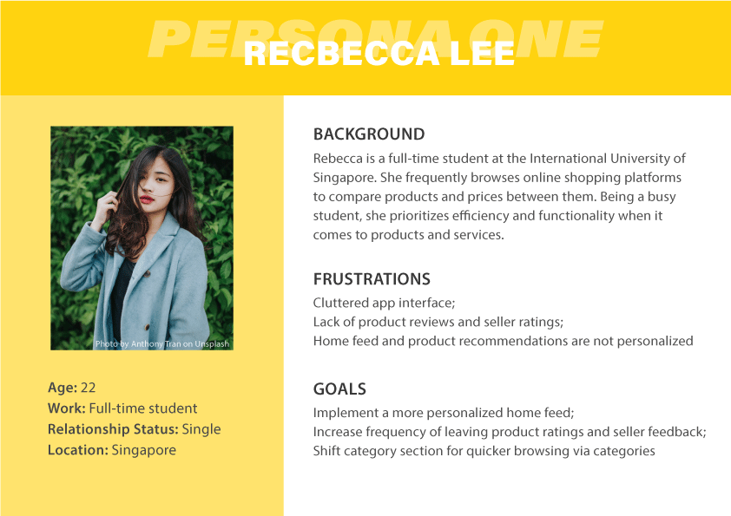
SHOPEE UI/UX Case Study
User Persona
HOME / ABOUT ME / MY WORKS
Introduction
Process Overview
Research
Define
Ideate
Prototype
Validate
Notes:
Shopee’s target userbase is mostly young adults in the 21-30 years old range.

Slide 8
SHOPEE UI/UX Case Study
Problem Definition
HOME / ABOUT ME / MY WORKS
Introduction
Process Overview
Research
Define
Ideate
Prototype
Validate
Overly cluttered homepage
Too many different features and sections with no clear distinctions between them
Lack of product ratings and seller feedback
Time-strapped young adults are looking for an easy way to just buy and go.
Notes:
Shopee’s target userbase is mostly young adults in the 21-30 years old range.

Slide 9
SHOPEE UI/UX Case Study
Proposed Improvements
HOME / ABOUT ME / MY WORKS
Introduction
Process Overview
Research
Define
Ideate
Prototype
Validate
A more personalized homepage containing only the most important features and listings
More user-friendly layout and neater categorization of features overall
Rework reminder for users to leave product ratings and seller reviews
New feature
Pop-up listings: An easy way for users to quickly view key information about a product and favourite/add to cart
Notes:
Shopee’s target userbase is mostly young adults in the 21-30 years old range.

Slide 10
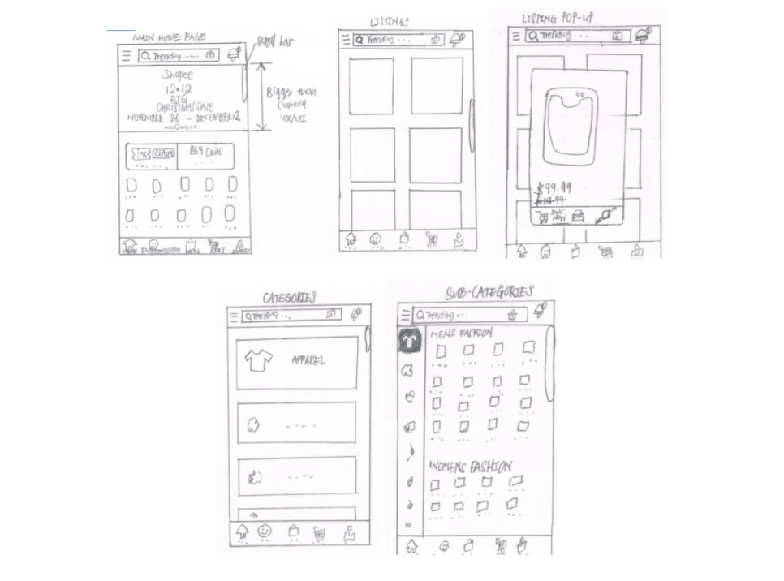
SHOPEE UI/UX Case Study
Lo-fi Mockups
HOME / ABOUT ME / MY WORKS
Introduction
Process Overview
Research
Define
Ideate
Prototype
Validate
Notes:
Shopee’s target userbase is mostly young adults in the 21-30 years old range.

Slide 11
SHOPEE UI/UX Case Study
Interactive Prototype
HOME / ABOUT ME / MY WORKS
Introduction
Process Overview
Research
Define
Ideate
Prototype
Validate
Notes:
Interactive prototype using Figma

Slide 12
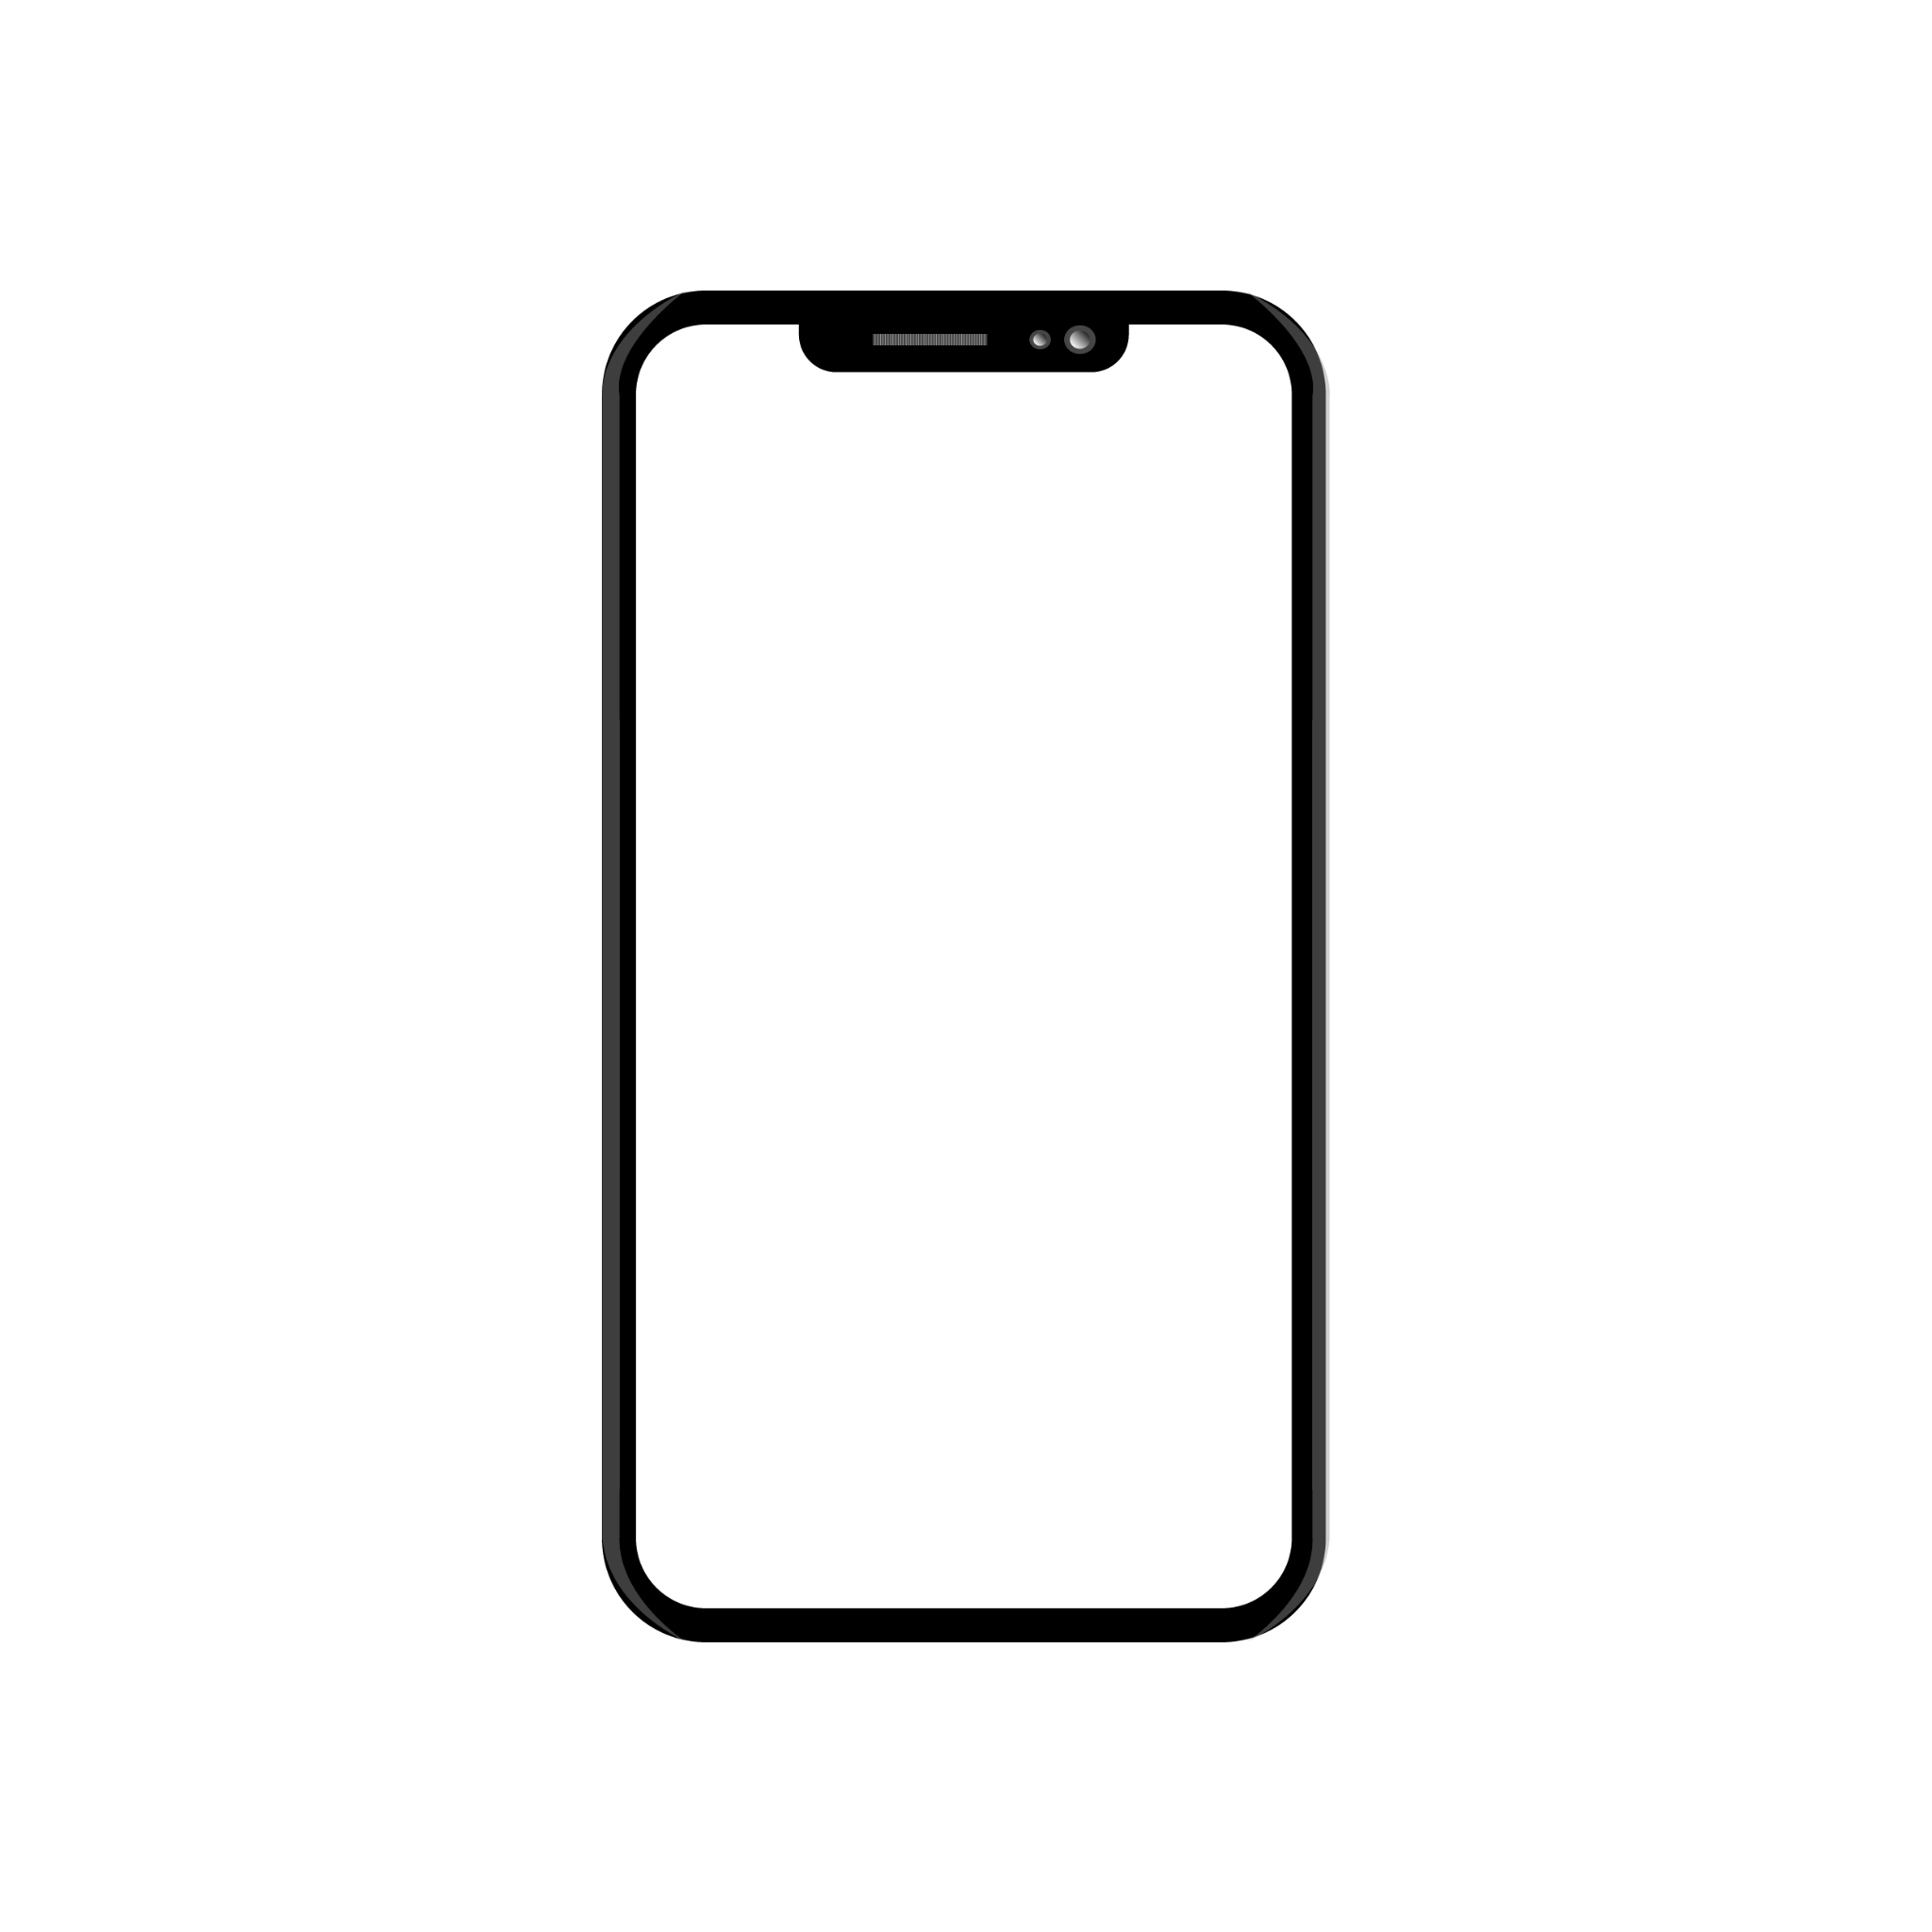
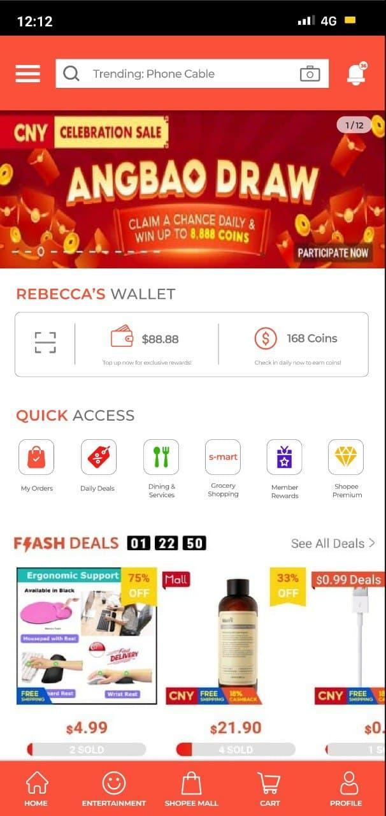
SHOPEE UI/UX Case Study
UI Changes
HOME / ABOUT ME / MY WORKS
*CATEGORIES at the top left for easy access and minimal scrolling
*CATEGORIZED NOTIFICATIONS into Chats, Order Updates and Others.
Introduction
Process Overview
Research
Define
Ideate
Prototype
Validate
*SEARCH BAR which shows trending items and previously viewed items when clicked
*ENTERTAINMENT TAB for Shopee Games, Shopee Live, Shopee Stories and Shopee Feed to free up space on main page
*CART shifted to the bottom to increase ease of usability as it is one of the most used features

Slide 13
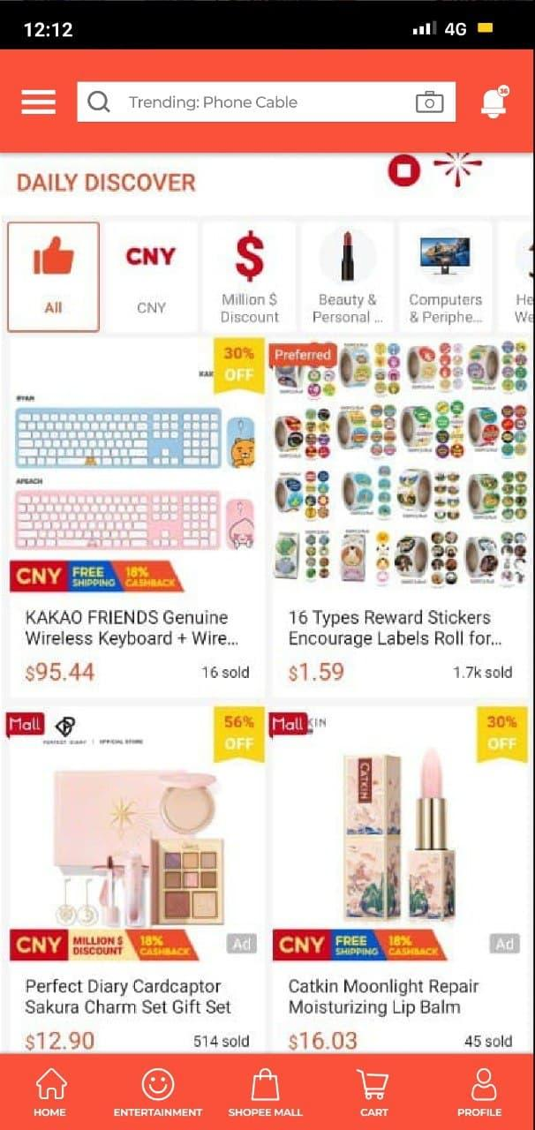
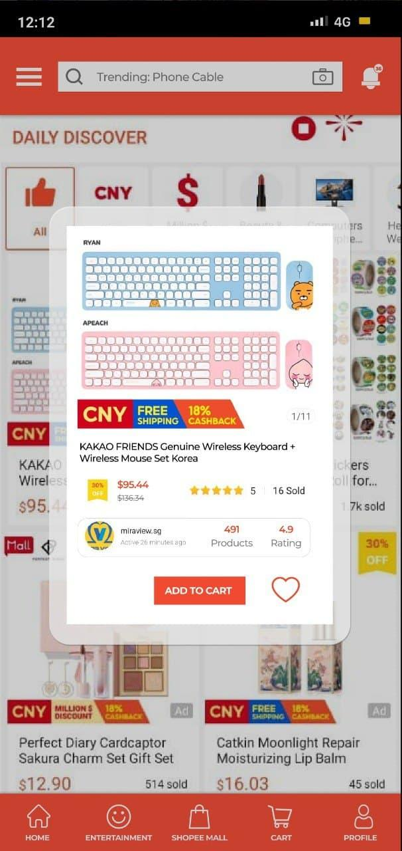
SHOPEE UI/UX Case Study
New Feature
HOME / ABOUT ME / MY WORKS
Introduction
Process Overview
Research
Define
Ideate
Prototype
Validate
*LISTINGS POP-UP which allows easier and faster carting
Contains key information that buyers consider when buying a product:
Product Name, Image, Price (and discounts), Rating, Number Sold, Shop Ratings

Slide 14
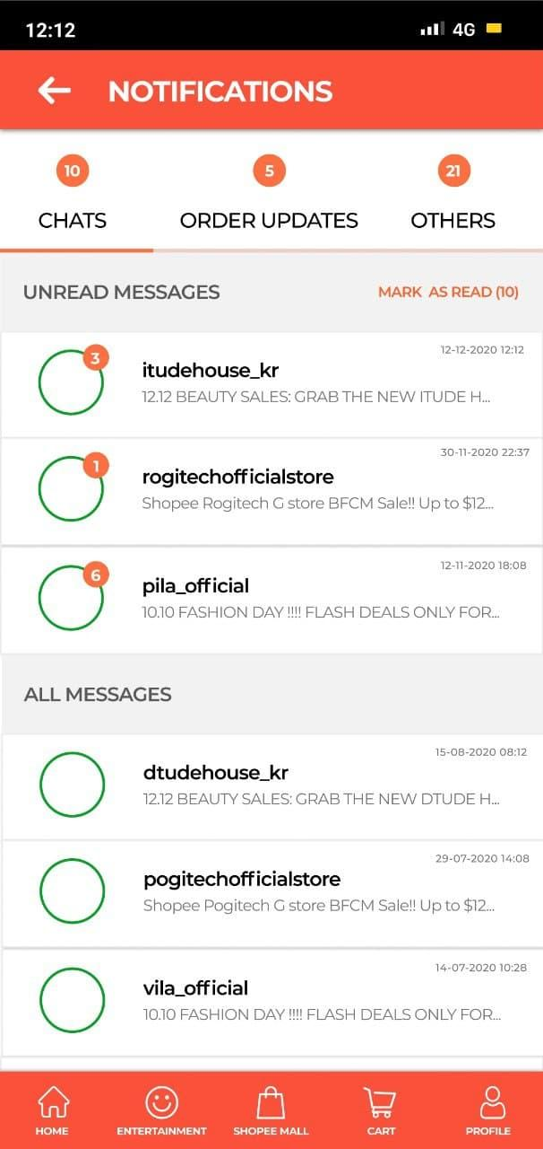
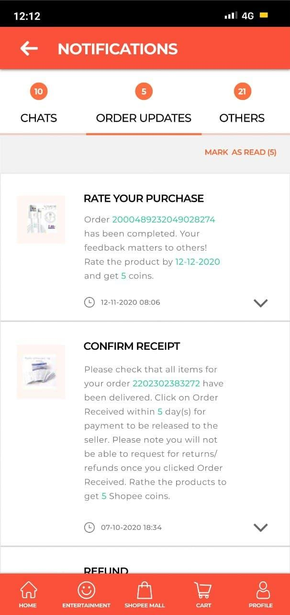
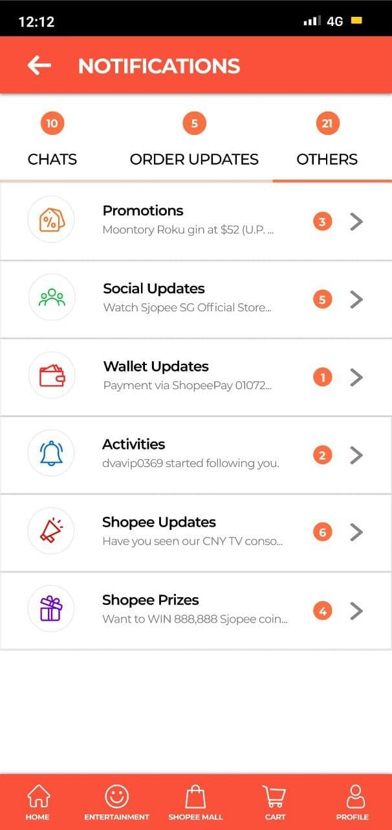
SHOPEE UI/UX Case Study
Notifications
HOME / ABOUT ME / MY WORKS
Introduction
Process Overview
Research
Define
Ideate
Prototype
Validate

Slide 15
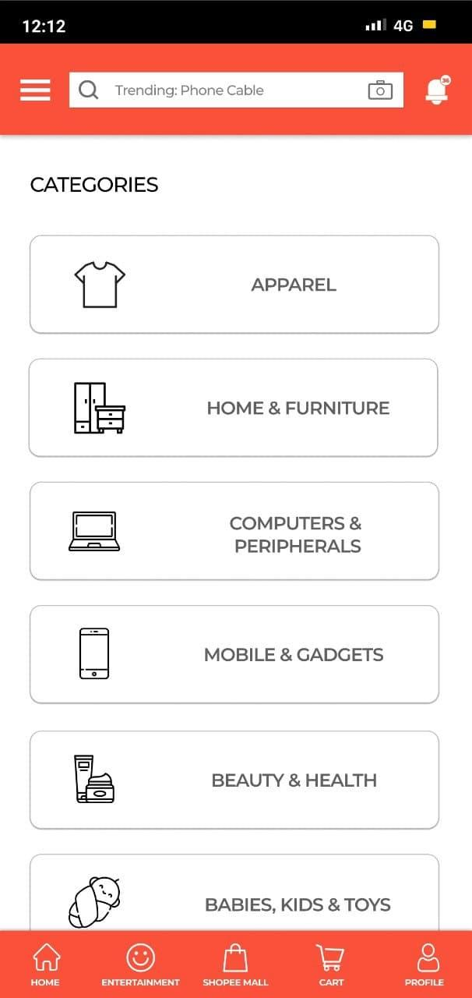
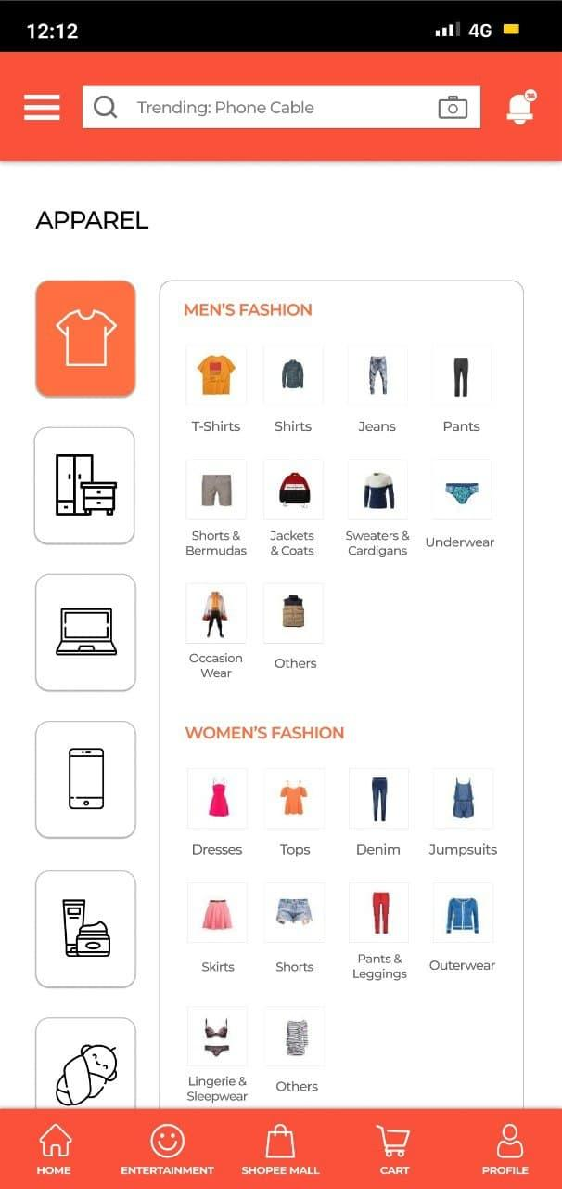
SHOPEE UI/UX Case Study
Categories
HOME / ABOUT ME / MY WORKS
Introduction
Process Overview
Research
Define
Ideate
Prototype
Validate

Slide 16
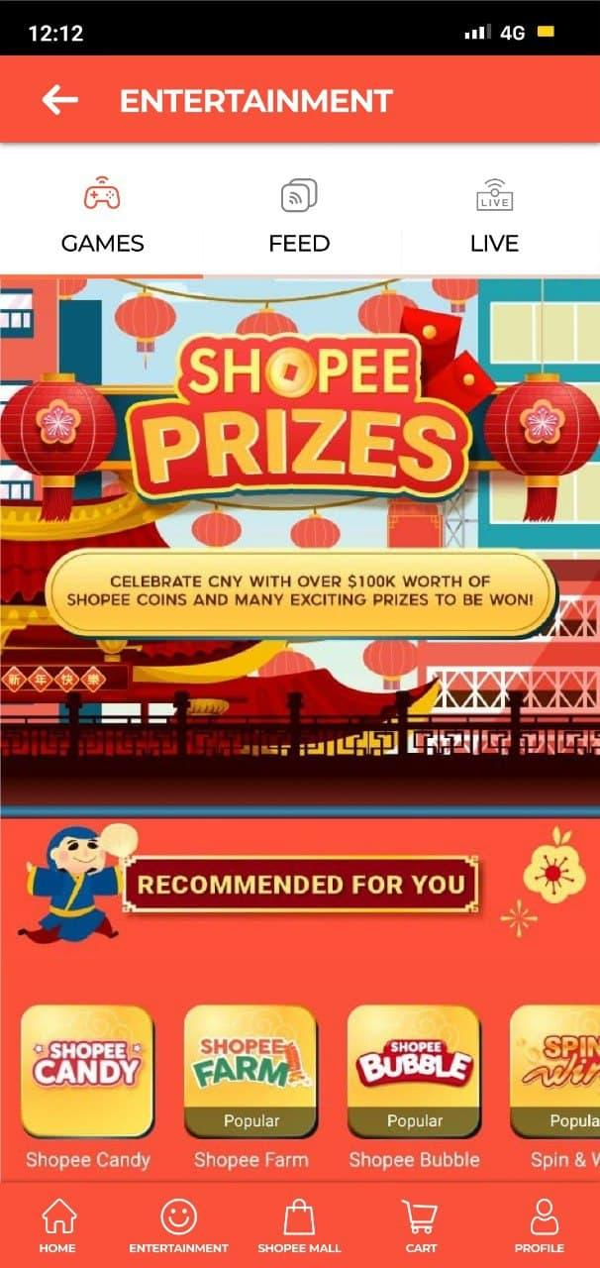
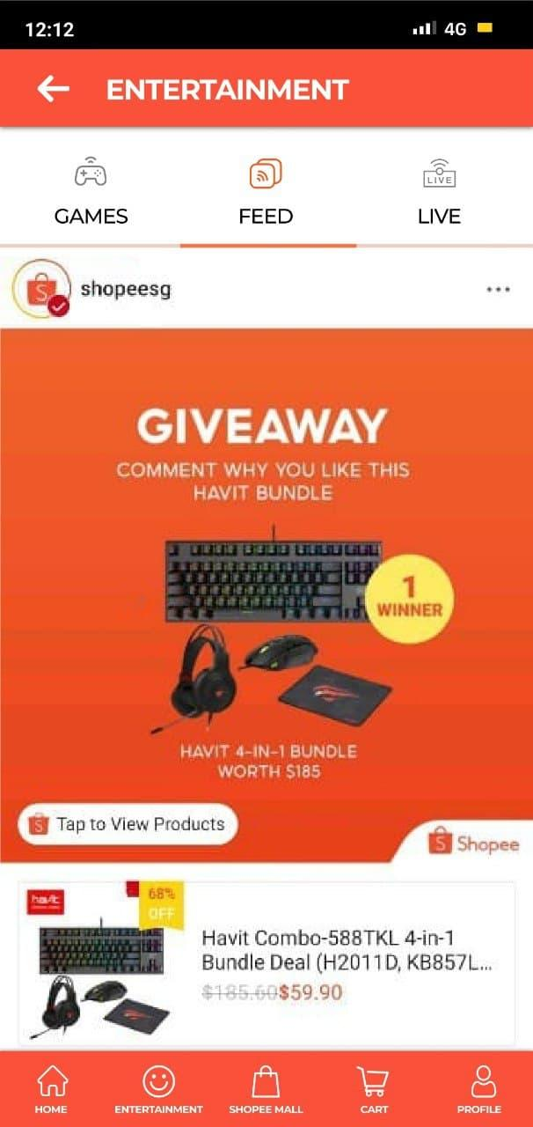
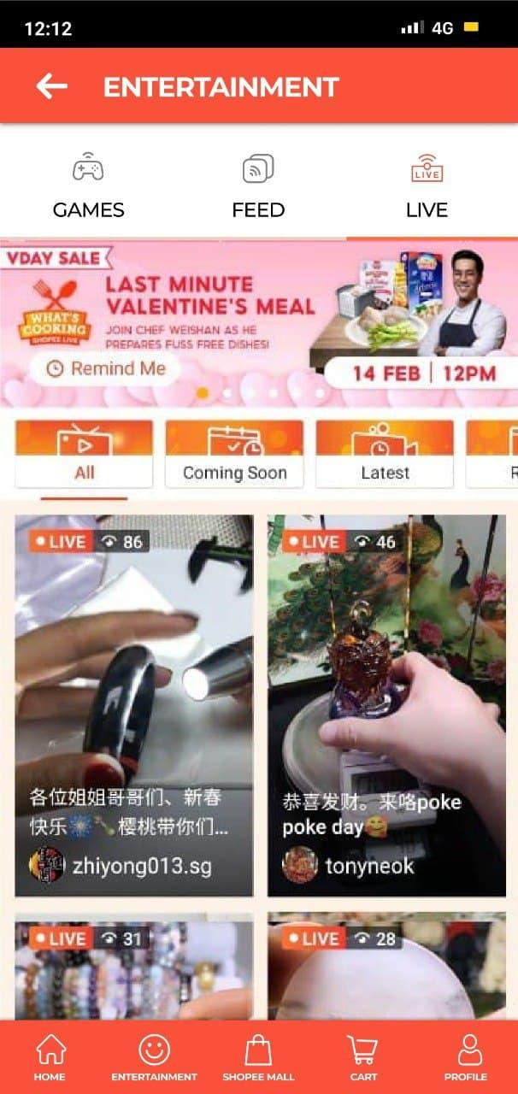
SHOPEE UI/UX Case Study
Entertainment
HOME / ABOUT ME / MY WORKS
Introduction
Process Overview
Research
Define
Ideate
Prototype
Validate

Slide 17
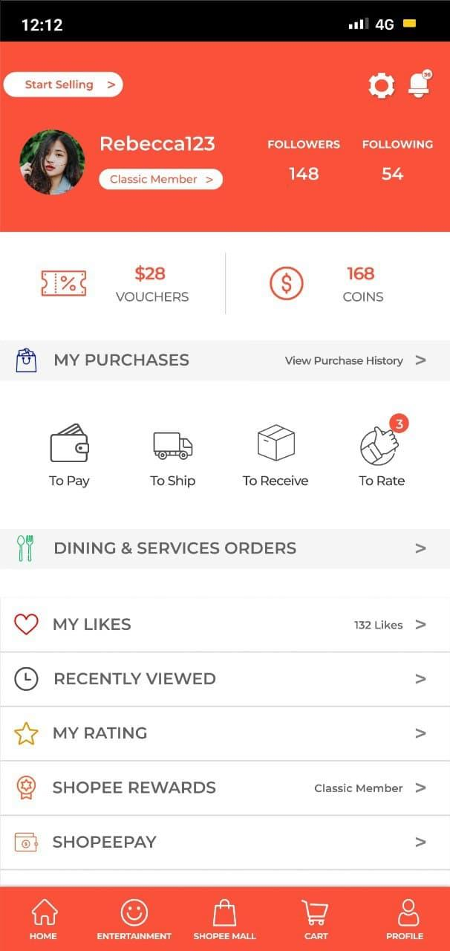
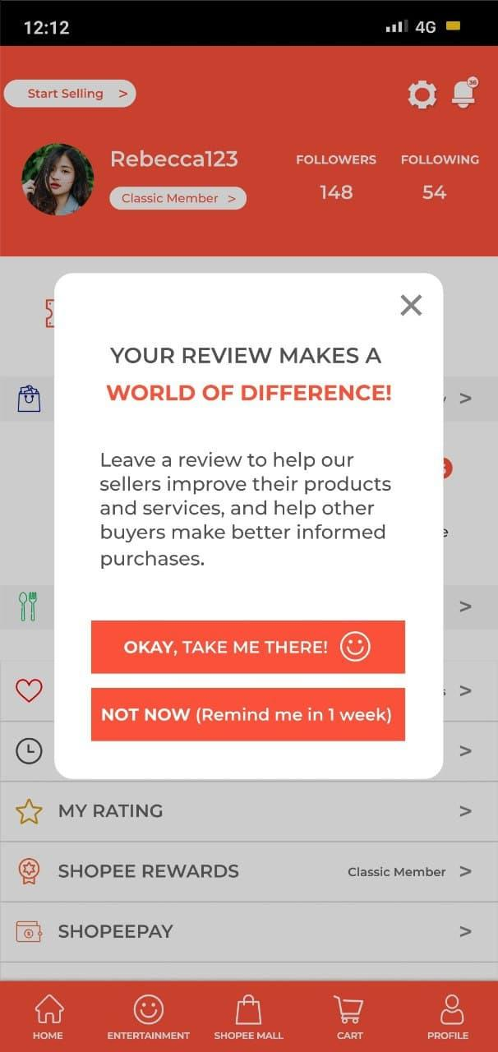
SHOPEE UI/UX Case Study
Leave a Rating
HOME / ABOUT ME / MY WORKS
Introduction
Process Overview
Research
Define
Ideate
Prototype
Validate
*Remind in one week: Option to review later by setting a reminder instead of an outright “Yes/No”

Slide 18
SHOPEE UI/UX Case Study
Validate
HOME / ABOUT ME / MY WORKS
Followed up with 9 users among the initial survey respondents.
Introduction
Process Overview
Research
Define
Ideate
Prototype
Validate
Do you think that the new design is better or worse than the Shopee original app?
What improvements do you think the new design has over the original app?
What flaws do you think the new design has over the original app?
Which design is easier and less frustrating to use?
Which design do you prefer to use in the long term (if you were to do online shopping on Shopee)?
What can you suggest to improve the new design?
Any other comments?

Slide 19
SHOPEE UI/UX Case Study
Validate
HOME / ABOUT ME / MY WORKS
Usability Testing Insights
“Refreshing change for the categories that shopee should implement from the start. You have to scroll down there pages worth to find out hahaha.”
“Working professional wanna buy and go. Do working adults play shopee games?”
“First thing notice on top... I like the cart to be shifted down. Bottom should be the most frequently used stuff. I don't like to press at the top. I need to change pen to press the top. Having the cart at the bottom is useful.”
“Where is the chat with seller? I wouldn't know to go to notifications.”
Introduction
Process Overview
Research
Define
Ideate
Prototype
Validate

Slide 20
Thank you.
Any questions?

