Slide 1
Git项目管理工具
由中央集权通向自由民主的代码创作之路☺
胡京徽 2018年9月14日

Slide 2
Part I: History and Motivation

Slide 3
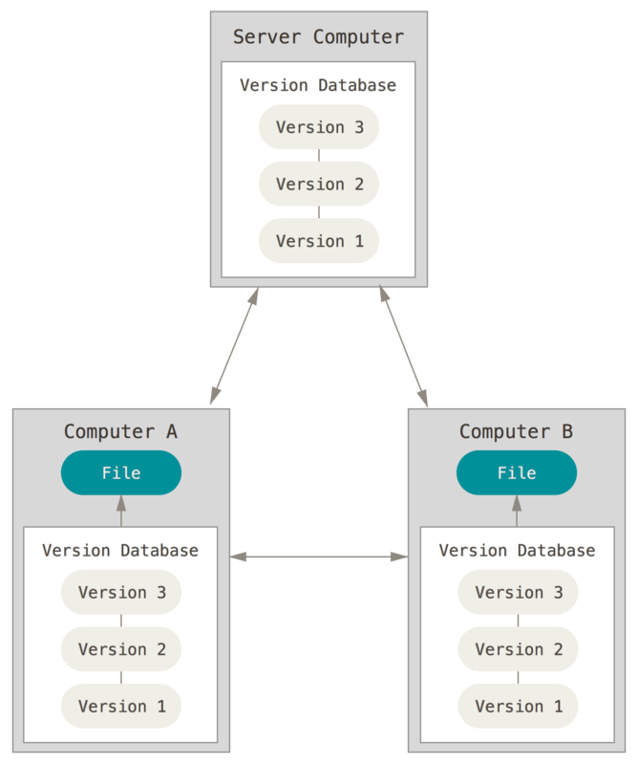

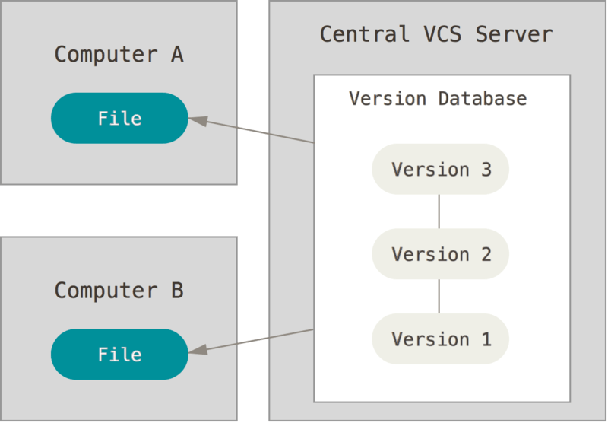
About Version Control System (VCS)
Local VCS
Central VCS
Distributed VCS

Slide 4

Why Git
Linus Torvalds
BitKeeper
Speed
Simple Design
Strong support for non-linear development (thousands of parallel branches)
Fully distributed
SVN, CVS
Support large projects
Support most OS ( Linux, macOS, Windows)

Slide 5
Part II: Learn by Practice

Slide 6
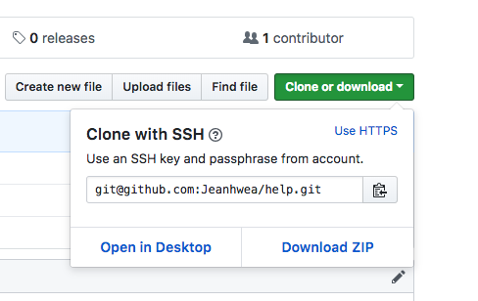
Git Basics
创建新仓库
git init
git init –bare
检出仓库
git clone /path/to/repository
git clone username@host:/path/to/repository
ssh http https
ssh-keygen -t rsa -b 4096 -C "your_email@example.com"
ssh style url

Slide 7

Git Basics
3 ”tree”s
工作目录: 持有实际文件
暂存区: 它像个缓存区域，临时保存你的改动
HEAD: 它指向你最后一次提交的结果

Slide 8
Git Basics
添加 (add)
git add <filename>
git add *
提交 (commit)
git commit -m “committed messages here”
git commit --amend
推送 (push)
git push origin master
git remote -v
git remote add origin <server>

Slide 9
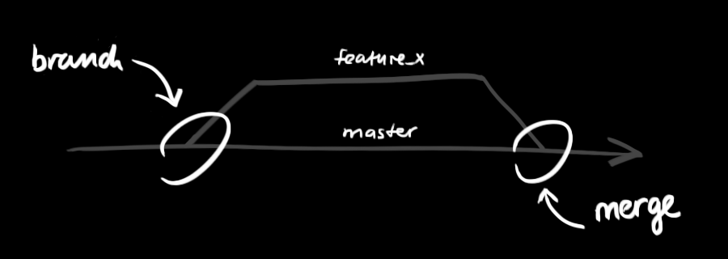
Git Basics
分支 (branch)
git checkout -b feature_x
git checkout master
git branch -d feature_x
git push origin <branch>

Slide 10
Git Basics
合并 (merge)
git pull
fetch & merge
git merge <branch>
git add <filename>
git diff <source_branch> <target_branch>

Slide 11
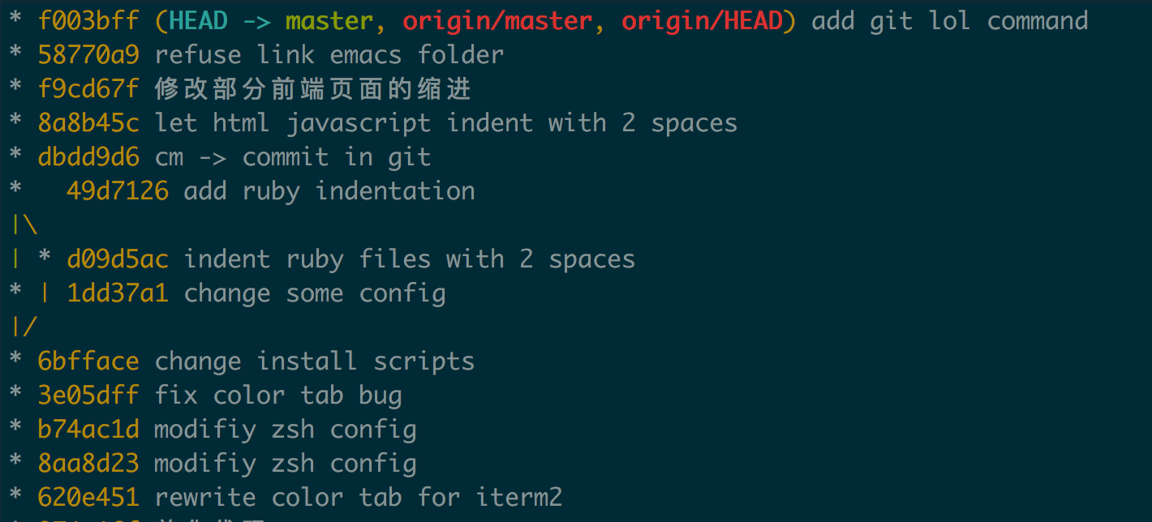
Git Basics
标签 (tag)
git tag 1.0.0 1b234ef32
git log
git log --author=”Jinghui Hu”
git log –pretty=oneline
git log --graph --oneline --decorate --all

Slide 12
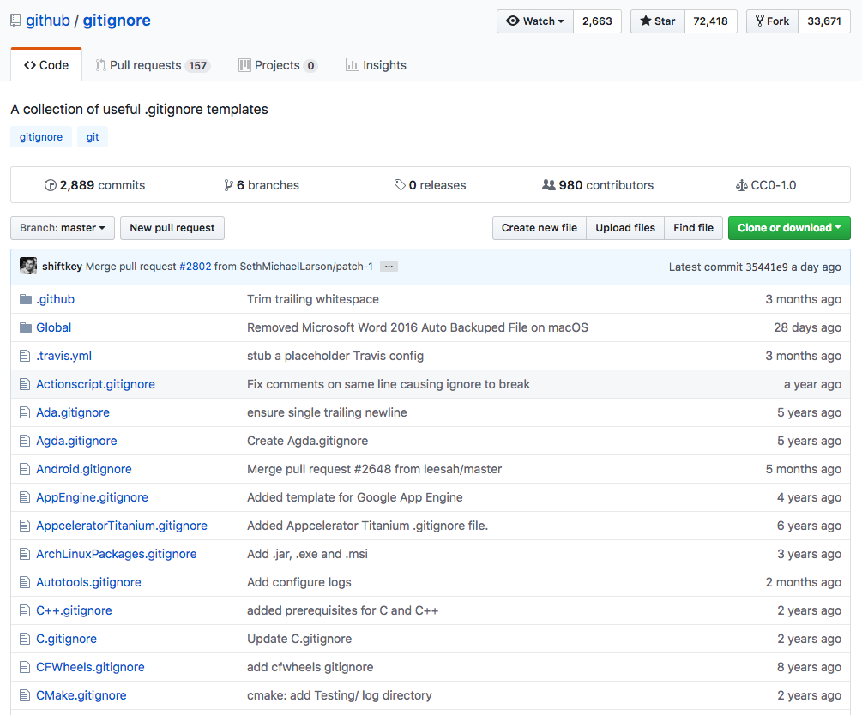
Git Basics - Dangerous Zone
替换本地改动 (reset)
git checkout -- <filename>
git fetch origin
git reset --hard origin/master
git reset --hard HEAD
.gitignore
忽略文件
https://github.com/github/gitignore
别名(alias)
git config --global alias.s status
git config --global -e

Slide 13
Part III: Enjoy Team work

Slide 14
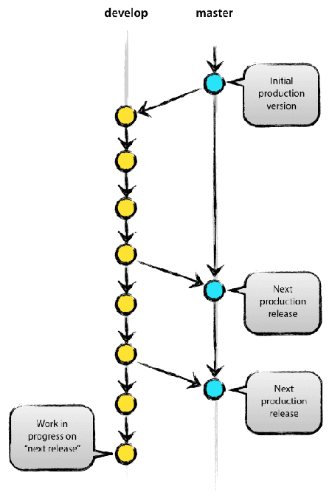
Git Work Flow
Simple Work Flow for small team
master
develop

Slide 15
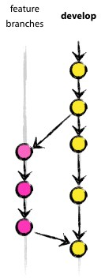
Git Work Flow
feature branch
name/branchname
name/feature
hujinghui/add_logging

Slide 16

Git Work Flow
more complicated version
feature branch
release branch
hotfixes
develop
master

Slide 17
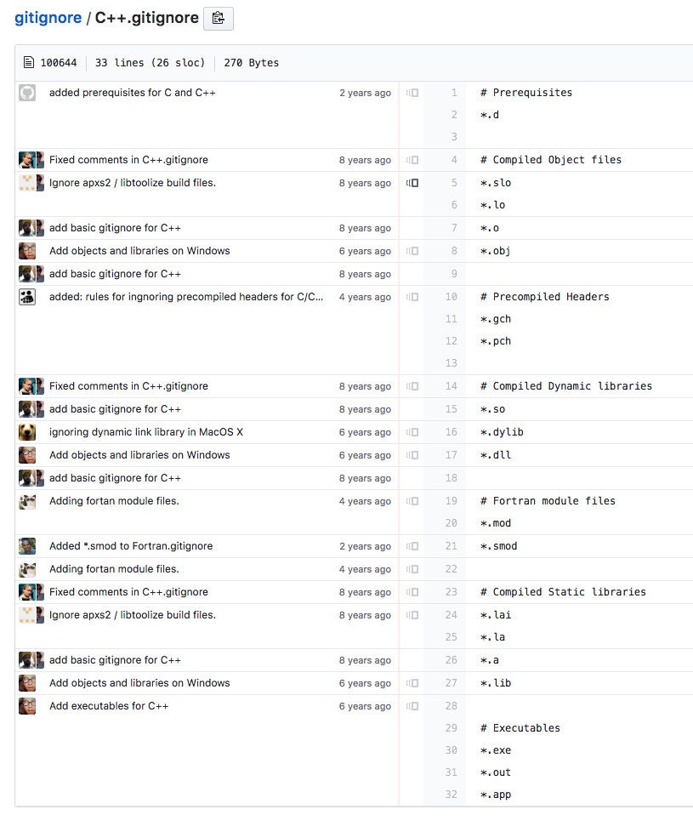
Tips
1. git blame
2. git status
3. git help <cmd> / man git-<cmd>
4. git log
5. pull request

Slide 18
Further Reading
1.在线资源
Git 简明指南（https://rogerdudler.github.io/git-guide/index.zh.html）
Atlassian Git Tutorial （https://www.atlassian.com/git）
Github Help Page （ https://help.github.com/）
Pro Git （https://git-scm.com/doc）
2.个人建议
多用多看手册
3.更多主题
git 对象模型 (blob, tree, commit)
git Hooks (自动化测试)
merging vs. rebasing

