Slide 1
Mna Test Pdf
Generated editable deck skeleton

Slide 2
Document Thesis
This presentation distills the core concepts of the Edinburgh Business School Mergers and Acquisitions course, guiding learners through the course structure, modelling principles, process development, drivers of M&A activity, and practical resources for application.

Slide 3
Available Data
PDF: mna_test_pdf.pdf
Raw text: C:\Users\jeanl\pdf_to_ppt\clean_ppt_pipeline_demo\output\final_runs\local_text_fal_images_rag_check__mna_test_pdf\artifacts\text\mna_test_pdf_extracted_text\mna_test_pdf_text.txt
Rendered page images: 50
Candidate cropped visuals: 4
Generated plots: 0
Manual refinement: validate slide logic, figure relevance, and wording.

Slide 4
1. Course Overview
Course
Mergers and Acquisitions – an integrated text covering strategy, finance, and implementation.
Authors
Prof. Alexander Roberts
Dr. William Wallace
Dr. Peter Moles
Philosophy
Multidisciplinary approach: from strategic rationale to execution.
Visual direction: text only

Slide 5
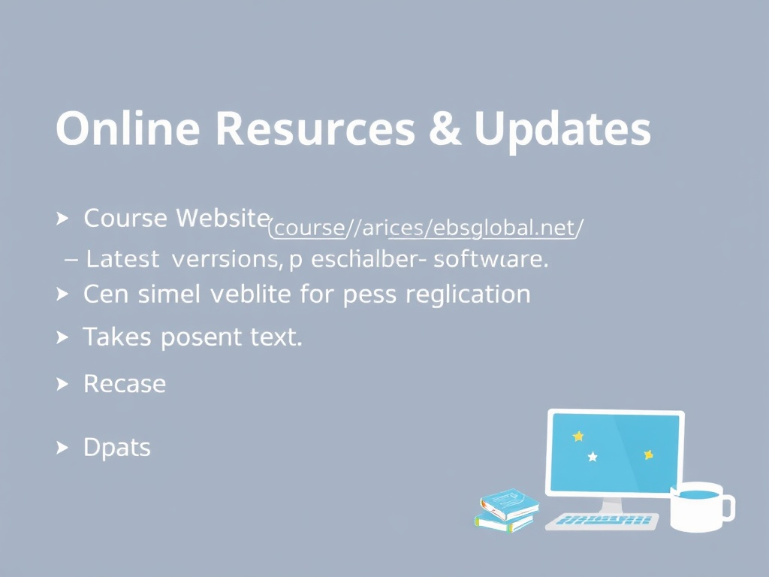
2. Online Resources & Updates
Course Website
http://coursewebsites.ebsglobal.net/ – latest version, past exams, Profiler software.
Updates
Version number on front page; changes reflected on website.
Contact
comments@ebs.hw.ac.uk for suggestions.
Coverage additions
course context: The financial issues are addressed by a financial special- ist and adopt a slightly different format and structure to the rest of the course
Visual direction: generated illustration

Slide 6
3. What is a Model in M&A?
Definition
Model: a description, comparison or analogy used to describe that which cannot be seen.
Process: a series of actions or operations in order to achieve a defined objective.
Process Model
A process model of M&A is a description or analogy of the actions and operations involved in achieving a mergers‑and‑acquisitions system.
It serves as a map or guide for developing the outcome of the model.
The model is generic, making it relevant across a range of applications.
Visual direction: text only

Slide 7
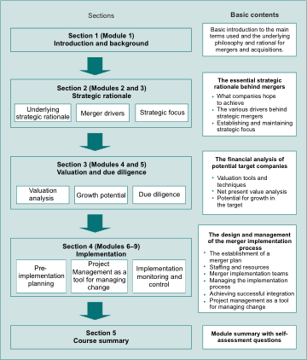
4. Why Process Models Matter in M&A
Purpose
Mergers and acquisitions impose a considerable degree of change on an organisation.
Properly designed procedures and processes are imperative.
Implementation Focus
Modules 7 to 10 consider the implementation process, using project management as a tool for managing change.
These modules cover the preparation of an implementation plan and its execution through completion.
Benefits
Process models provide a general representation of what must be done to achieve a specified outcome.
They are generic yet can be tailored for specific applications, guiding teams through complex M&A activities.
Coverage additions
model definition: Philosophy This text seeks to establish a process model for mergers and acquisitions
process model purpose: • Implementation and integration Modules 7 to 10 consider the implementation process particularly in the context of using project management as a tool for managing change (see the strategic focus wheel discussion in the preface)
Visual direction: extracted figure

Slide 8
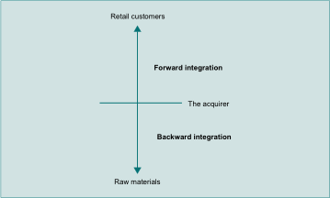
5. Generic M&A Process Model: The Blueprint
What a Generic Model Looks Like
Stages & Phases: A series of actions or operations to achieve a defined objective.
Analogy: The model is a description of the action and operations involved in achieving a mergers and acquisitions system.
Map/Guide: A user should be able to look at the process model and use it as a kind of map or guide to assist in developing the outcome.
General Representation: Useful because it shows what has to be done to achieve a specified outcome and is relevant across many applications.
Visual direction: extracted figure

Slide 9
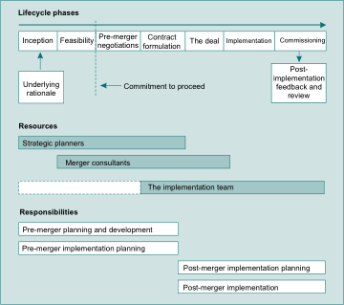
6. Tuning the Model with Company Data
From Blueprint to Actionable Plan
Data‑Driven Adjustment: For specific application, the process model has to be tuned with detailed company data and information.
Implementation Modules: Modules 7‑10 focus on preparing an implementation plan and managing it through completion.
Project Management: Use project management as a tool for managing change, ensuring the tuned model translates into real actions.
Outcome: A customized, actionable plan that reflects the company’s unique context while retaining the proven generic structure.
Coverage additions
generic stages: The idea of a process model is to represent the stages and phases involved in a task

Slide 10
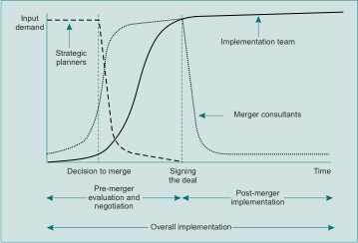
7. Drivers of M&A Activity
M&A decisions are shaped by a mix of strategic, market, and operational forces.
National consolidation: compatible firms in the same region.
Diversification risk: balancing a portfolio, yet often does not reduce risk.
Industry pressures: sector‑specific consolidation (e.g., oil, banking).
Capacity reduction: excess production versus demand.
Stock‑market dynamics: booms make share‑based deals easier; falls lower target values.
Globalisation: IT reduces geographic barriers, encouraging cross‑border deals.
Visual direction: extracted figure

Slide 11
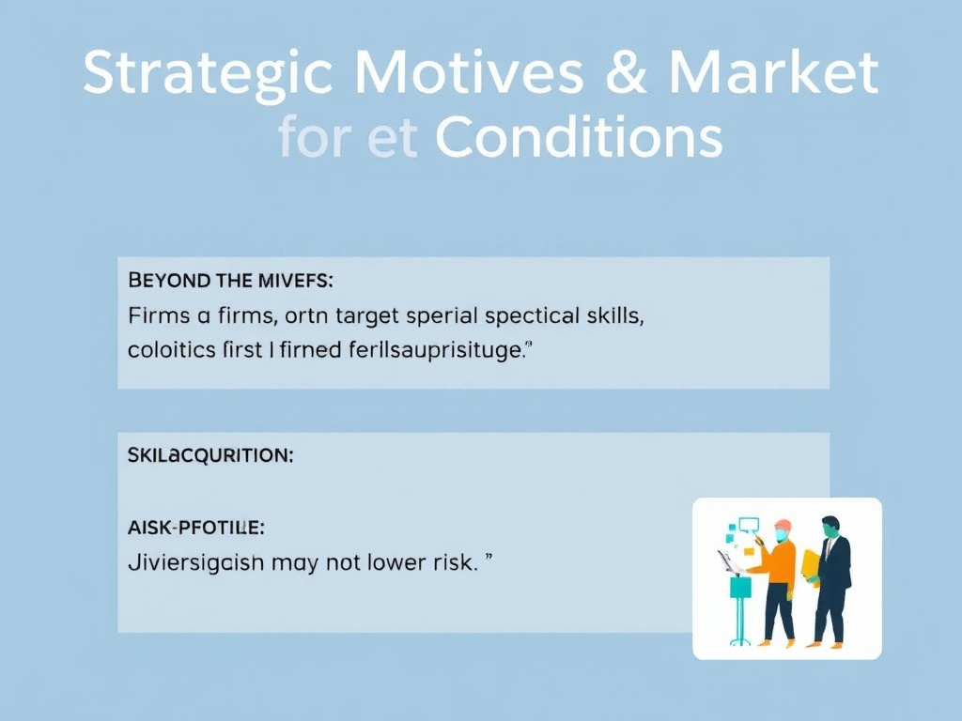
8. Strategic Motives & Market Conditions
Beyond the drivers, firms often target specific skills and resources.
Skill acquisition: small firms with high‑value expertise are attractive.
Risk profile: diversification may not lower risk.
Industry pressures: mergers common in high‑growth sectors.
Capacity issues: merging to align supply with demand.

Slide 12
9. Practical Resources & Application
Key points
In addition to this printed course text, you should also have access to the course website in this subject, which will provide you with more learning content, the Profiler software and past examination questions and answers
The content of this course text is updated from time to time, and all changes are reflected in the version of the text that appears on the accompanying website at http://coursewebsites.ebsglobal.net/
Most updates are minor, and examination questions will avoid any new or significantly altered material for two years following publication of the relevant material on the website
Focus block: website resources, profiler software
Visual direction: text only

Slide 13
10. Practical Resources & Application Details
Why it matters
Highlight the website, Profiler software, exam materials, and update procedures.
Transition: Finally, we connect theory to practice with the course’s supporting tools.
You can check the version of the course text via the version release number to be found on the front page of the text, and compare this to the version number of and Industry DVD digital versatile disc EAC estimate at completion EAIS enterprise application integration system EBIT earnings before interest and tax paid EBITDA earnings before interest, tax, depreciation and allowances EBS Edinburgh Business School ECC European Competition Commission ECTC estimated cost to complete EPS earnings per share ESOP employee stock ownership plan ETTC estimated time to completion EU European Union EV expected value EVA earned value analysis FARM functional area recovery management FCF free cash flow HR human resources IES intelligent electronic systems IMS information management system IR inherent risk IRG implementation review group IRR internal rate of return IT information technology KEI key environmental indicator KPI key performance indicator LPE London Petroleum Exchange LSE London Stock Exchange M&A mergers and acquisitions MACRS modified accelerated cost recovery system ME monetary error MIPM merger implementation project manager MIS merger integr QUERY: learning content updates version release number --- Page 1 --- MQ-A2-engb 1/2016 (1020) Mergers and Acquisitions Professor Alexander Roberts Dr William Wallace Dr Peter Moles --- Page 2 --- This course text is part of the learning content for this Edinburgh Business School course
You can check the version of the course text via the version release number to be found on the front page of the text, and compare this to the version number of ept of Implementation 7/10 7.5 Identifying Synergies 7/14 7.6 The Implementation Process 7/21 7.7 Implementation Risk Management 7/39 7.8 The Concept of Disintegration and Reintegration 7/52 7.9 Managerial Levers 7/54 7.10 Transformation Tools 7/57 Review Questions 7/73 Module 8 Project Management as a Tool for Managing the Implementation Process 8/1 8.1 Introduction 8/1 8.2 Some Common Questions about Project Management 8/3 8.3 Some Common Misconceptions about Project Management 8/6 8.4 The Overall Implementation Process 8/8 8.5 Project Management 8/17 8.6 Project Management as a Tool for Managing the Overall Acquisition or Merger Process 8/50 Learning Summary 8/69 Review Questions 8/84 Module 9 Developing the Implementation Plan 9/1 9.1 Introduction 9/1 9.2 Some Common Questions about Implementation Planning 9/3 9.3 Some Common Misconceptions about Implementation Planning 9/6 9.4 The Concept of the Implementation Strategic Project Plan 9/9 9.5 Project Aims and Objectives and Prelimin
Coverage focus: exam questions, content updates
Visual direction: text only

