Slide 1

Design of an AI-Assisted Customer Support System for Micro and Small E-Commerce Businesses in Baguio City and Benguet
Jeanalyn Marie B. Lagera
Mapúa University | MITO 611 – Advanced Web Systems and Technologies
Design Project
Notes:
[0:30] Stand, smile, wait for the room to settle.
Good morning po. My name is Jeanalyn Marie Lagera, and today I will present my design project for MITO 611, titled "Design of an AI-Assisted Customer Support System for Micro and Small E-Commerce Businesses in Baguio City and Benguet."
In short, I am designing a tool that helps small online sellers answer their customers' routine questions, using only information the seller has approved, and passing the difficult conversations to a real person.

Slide 2



One owner, many chats, the same questions
Shop page inbox
Time
The owner who packs, restocks and books couriers also types the same answers all day.
Hi po, avail pa?
unread
hm po?
unread
Consistency
COD po ba?
unread
Prices, stock and rules change. Replies typed from memory go out of date.
Ilang days delivery sa La Trinidad?
unread
After hours
Pwede po ba i-return?
unread
Customers message at night. Late replies can mean lost sales.
avail pa po medium?
unread
Notes:
[1:00] Point to the inbox on the left.
Let me start with a picture many of us know. This is a typical inbox of a small online shop. "Hi po, avail pa?" "hm po?" "COD po ba?" "Ilang days delivery sa La Trinidad?"
In most small shops, the person answering these messages is the owner, who is also packing orders, restocking, and booking couriers. So the first problem is time. The second is consistency: prices and stock change, and a reply typed from memory can easily be wrong. The third is after-hours messages. Customers message at night, and a late reply can mean a lost sale.

Slide 3
Online selling is now ordinary in the Philippines
99.63%
9.8%
of business establishments are MSMEs
of GDP from the digital economy; 32.2% of it is e-commerce
DTI, 2023 MSME Statistics
PSA, 2025 estimates
94.4%
87.9%
of online goods sellers sell through social media
of online sellers accept cash on delivery
PSA, 2024 NICTHS
PSA, 2024 NICTHS
Notes:
[1:15] Pause briefly on each number.
This is not a small issue. According to DTI, 99.63 percent of business establishments in the country are MSMEs. The PSA estimates that the digital economy is 9.8 percent of our GDP, and about a third of that is e-commerce.
The last two numbers matter most for my design. 94.4 percent of online sellers sell through social media, and 87.9 percent accept cash on delivery. This tells us that for a typical small seller, customer questions come through Messenger and Facebook, not through a big platform with its own help desk.

Slide 4

Local programs are pushing sellers online
Feb 2026
Apr 2026
Jul 2026
Sep 2026
DICT-CAR and DTI-CAR align digital-skills and e-commerce programs for Cordillera MSMEs
DTI-CAR sets a five-point agenda and development plan for regional MSMEs
50 Baguio City MSMEs join the Tatak Pinoy workshop with Shopee Philippines
25 Baguio-Benguet MSMEs finish DICT SPARK social media marketing training, including AI use
The gap
These programs teach sellers to open and promote online stores. Little attention goes to what happens next, when the messages start coming in.
Notes:
[1:15] Move left to right along the timeline.
Here in the Cordillera, the government is actively helping MSMEs go online. In February, DICT-CAR and DTI-CAR aligned their digital programs. In April, DTI-CAR released its MSME agenda. In July, 50 Baguio MSMEs joined the Tatak Pinoy workshop with Shopee. And in September, 25 sellers from Baguio and Benguet finished DICT's SPARK training on social media marketing.
These programs teach sellers how to open and promote their stores. But very little attention goes to what happens next, when the messages start coming in. That is the gap where my study begins. I want to be clear that these reports describe the setting; my seller survey will confirm the actual problem.

Slide 5

Problem statement and objective
The problem has five parts
1
Repeated questions take up the owner's time
2
Replies typed by hand are not always consistent
General objective
Design and develop a prototype AI-assisted customer support system for micro and small e-commerce businesses in Baguio City and Benguet that:
3
Prices, stock and policies change; answers must change too
4
Customers write in English, Filipino or Taglish
answers routine questions quickly and correctly
never states a fact the owner has not approved
hands difficult cases to a person
5
Complaints, refunds and unclear cases need a person
Notes:
[1:00] Left side first, then the objective box.
So the problem has five parts: repeated questions take the owner's time, typed replies are not always consistent, business information keeps changing, customers write in English, Filipino, or Taglish, and some cases, like complaints and refunds, really need a person.
My general objective is to design and develop a prototype customer support system that answers routine questions quickly and correctly, never states a fact the owner has not approved, and hands difficult cases to a person.

Slide 6





Research questions
RQ1 Seller needs
What do local online sellers need from a support assistant, based on the questions they receive?
RQ2 Grounded answers
How should products, FAQs and policies be stored so every answer traces to approved data?
RQ3 Language
How can English, Filipino and Taglish be handled in one workflow?
RQ4 Escalation
How can the system spot uncertain or sensitive messages and pass them to staff?
RQ5 Evaluation
How can accuracy, relevance, response time, usability and satisfaction be measured?
Notes:
[0:45] Read the short labels, not every word.
Five research questions guide the study. First, what do local sellers actually need? Second, how should the business information be stored so every answer can be traced to approved data? Third, how do we handle English, Filipino, and Taglish? Fourth, how does the system recognize when to pass a chat to staff? And fifth, how do we measure whether the prototype works?

Slide 7



What the literature tells us
Accuracy matters more than speed
Bot + light human help works
Speed, accuracy, convenience and access all shape service quality. Concrete answers raise satisfaction.
In 3 studies with 643 people, a chatbot with light human intervention matched human-only service.
Zhang et al. 2024; Zhu et al. 2023
Huang et al. 2024
Local chatbots still struggle
Taglish is harder for AI
Filipino users of Shopee and Lazada bots reported problems with problem resolution and understanding.
Language models perform unevenly on Tagalog and code-switched Taglish text.
DLSU SHS Research Congress 2024
Montalan et al. 2025; Layacan et al. 2024
Notes:
[1:15] Spend the most time on the top-right card.
From the literature, four lessons shaped my design.
First, customers value correct, concrete answers more than speed alone. A fast wrong answer is worse than a slower correct one.
Second, and this is the most important one for me: Huang and colleagues ran three studies with 643 participants and found that a chatbot with light human help matched human-only service on most outcomes. So we don't need to choose between full automation and doing everything by hand.
Third, a Philippine study of the Shopee and Lazada chatbots found that Filipino users struggled with how the bots understood them.
And fourth, AI models still perform unevenly in Tagalog and Taglish, so language must be tested on its own.

Slide 8
Similar studies and the research gap
Study / system | Where | Used in the PH? | What it shows
Chatbots in online shops (IJEAST 2025) | Nueva Ecija | Yes | Shoppers rated live shop chatbots well (ISO/IEC 25010)
Shopee and Lazada chatbots (DLSU 2024) | Philippines | Yes, large platforms | Users struggled with local dialogue
Taglish RAG benchmark (JAIT 2025) | Philippines | No, lab test | English > Taglish > Tagalog accuracy
iTANONG (DOST-ASTI) | Philippines | Yes, government | Taglish answers from approved data
ChatGenie | Philippines | Yes, MSMEs | Chat commerce; ordering, not grounded support
Chatbots in MSMEs (Cordero et al.) | Ecuador | No | High SUS and satisfaction for repetitive inquiries
Gap: no published design yet combines owner-controlled answers, Taglish testing and human hand-off for micro sellers, and none in Baguio or Benguet.
Notes:
[1:00] Point to the 'Used in the PH?' column, then the red box.
Has something like this been done in the Philippines? Partly. Online shops in Nueva Ecija already use chatbots. Shopee and Lazada have them. DOST-ASTI's iTANONG answers in Taglish from approved government data. And ChatGenie helps MSMEs sell through chat apps. In Ecuador, a similar MSME chatbot study reported high usability.
But none of these combines three things: answers controlled by the owner, testing in Taglish, and a built-in hand-off to a person, for micro sellers. And none is in Baguio or Benguet. That is the gap this study addresses.

Slide 9


Design-science approach with Agile sprints
Identify
Build
Evaluate
Seller interviews and Survey A confirm the real problem
Prototype developed in six two-week sprints
120-item test set and a user pilot with Survey B
Sprint plan (12 weeks)
Sprint 0
Sprint 1
Sprint 2
Sprint 3
Sprint 4
Sprint 5
Weeks 1–2
Weeks 3–4
Weeks 5–6
Weeks 7–8
Weeks 9–10
Weeks 11–12
Interviews, requirements, test-set draft
Database, login, owner dashboard
Masking, language and intent, retrieval
Grounded replies, confidence check, escalation
Chat interface, reports, security
Testing, pilot, fixes, documentation
Notes:
[0:50] Top row, then the sprint boxes.
Methodologically, this is a design project following the design-science pattern: identify the problem, build the artifact, then evaluate it.
Development follows Agile, adapted from Scrum, in six two-week sprints. Sprint zero is for seller interviews and requirements. I chose Agile because what sellers tell me may change the design along the way, for example the fields in the knowledge base or the escalation rules.

Slide 10
Four options compared
Criterion | A. Manual and saved replies | B. Keyword bot | C. General AI chatbot | D. Proposed: RAG + escalation
Saves owner time | Little | Some | Much | Much
Answers match shop data | Depends on owner | If rules are current | Not guaranteed | Yes, must cite a record
Handles Taglish | Yes (human) | Poorly | Well | Well, tested per language
Upkeep effort | High | High (many rules) | Low | Low (edit records)
Human hand-off | Always human | Manual | Not built in | Built in, rule-based
Cost | Owner's time | Low | Usage-based | Usage-based, capped by tier
Why D: it keeps the language ability of a modern AI model but limits every answer to the owner's records, and adds a clear hand-off to staff.
Notes:
[1:15] Walk across the columns, end on the red column.
Before choosing a design, I compared four options.
Option A is what many sellers do now: type replies or use saved replies. It's free, but it doesn't save time.
Option B is a keyword bot. It's cheap, but it breaks easily with Taglish spellings like "hm po" or "mgkano."
Option C is a general AI chatbot. It understands Taglish well, but it answers from general knowledge, so it might quote a price or a return period that the shop never set.
Option D is my proposal. It keeps the language ability of AI, but every answer must come from the owner's own records, and there is a clear hand-off to staff. That is why I chose D.

Slide 11
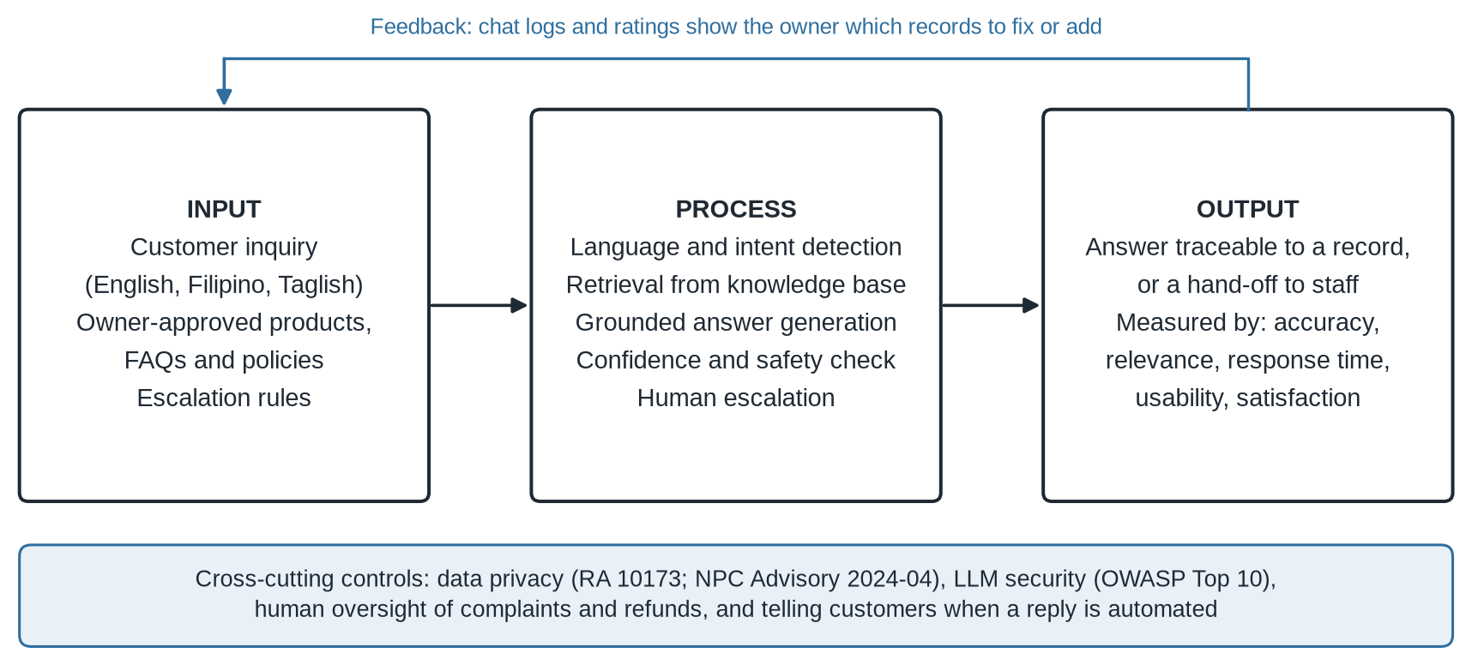
Conceptual framework
Input–Process–Output model with cross-cutting privacy, security and human-oversight controls
Notes:
[0:45] Trace input, process, output with your hand.
This is the conceptual framework. The inputs are the customer's message, the owner's approved records, and the escalation rules. The process detects the language and intent, retrieves the right record, writes a short answer, and checks its confidence. The output is either an answer that can be traced to a record, or a hand-off to staff.
At the bottom are the controls that apply everywhere: privacy, security, human oversight, and transparency. And at the top is the feedback loop. When a question has no matching record, the owner simply adds one.

Slide 12
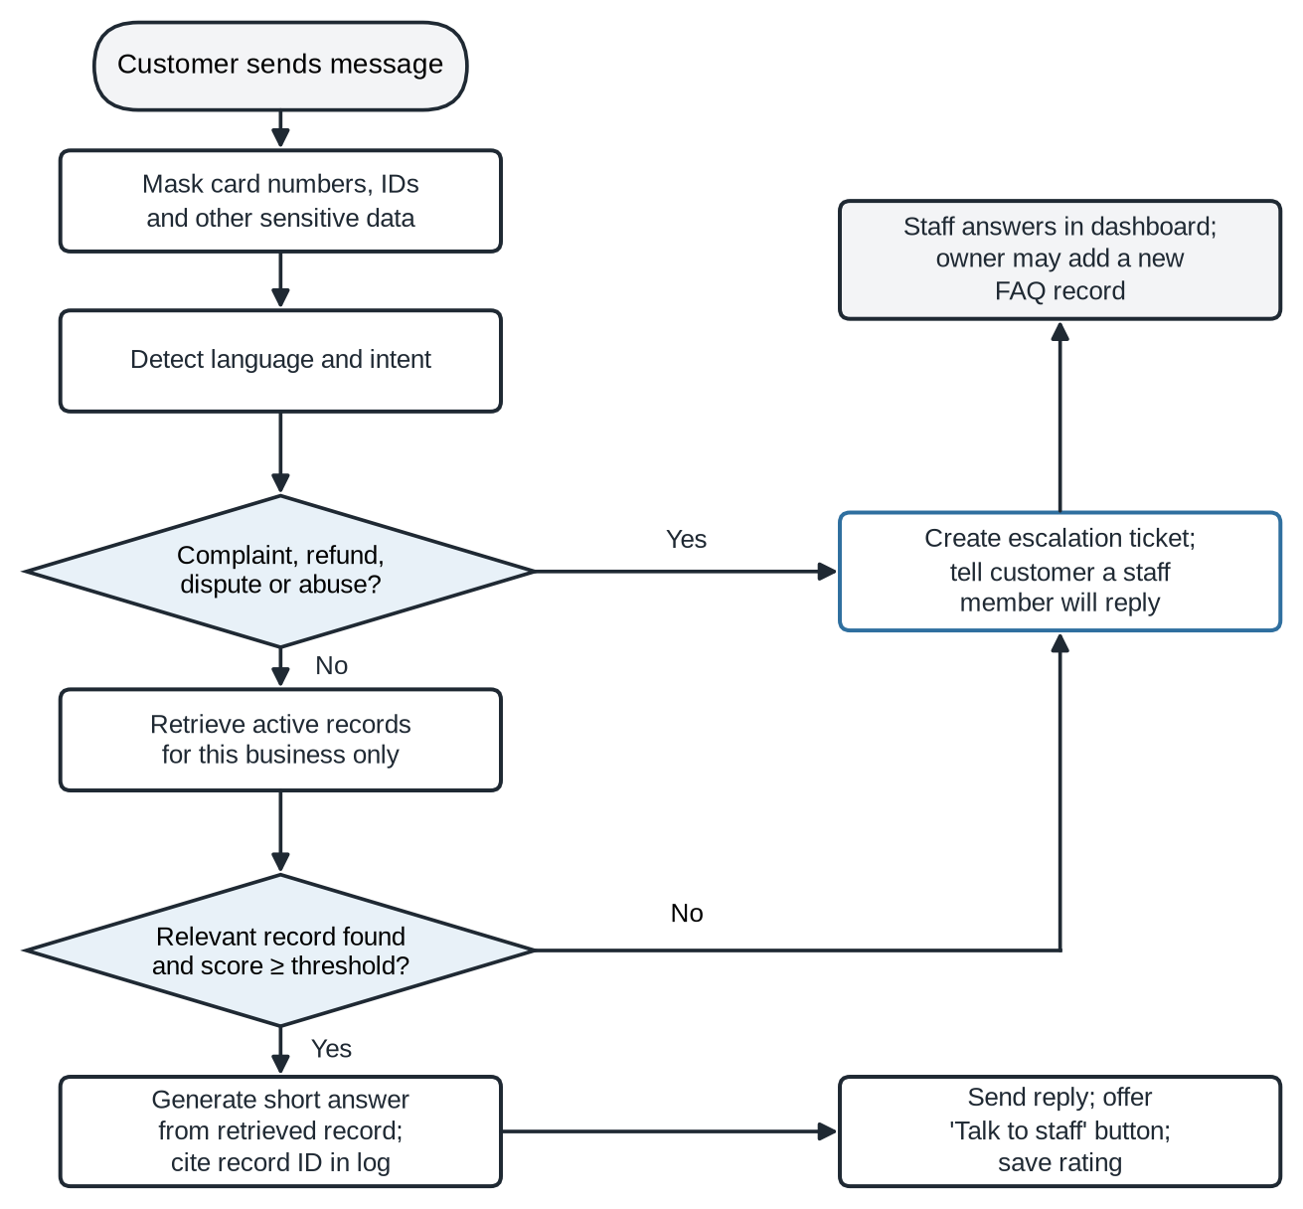



How each message is handled
Routine Taglish question
"Available pa po ba ang Arabica 250g?" → intent: stock → finds Product P-014 → "Yes po, in stock, ₱380."
Complaint
"Wrong item po ang dumating, I want a refund." → complaint → staff queue → "A staff member will reply po."
No matching record
Score below threshold → no guessing → escalated; owner can save the staff answer as a new FAQ.
Notes:
[1:30] Use the three example cards to walk the flowchart.
Here is how each message actually moves through the system.
First, sensitive data like card numbers is masked. Then the system detects the language and the intent.
Take the first example: "Available pa po ba ang Arabica 250g?" The system sees a stock question, finds the product record, and answers: "Yes po, in stock, 380 pesos."
Second example: "Wrong item po ang dumating, I want a refund." That is a complaint, so it goes straight to the staff queue. The bot doesn't try to handle it.
Third: if no record is a good enough match, the system does not guess. It escalates. And when staff answer, the owner can save that answer as a new FAQ for next time.

Slide 13
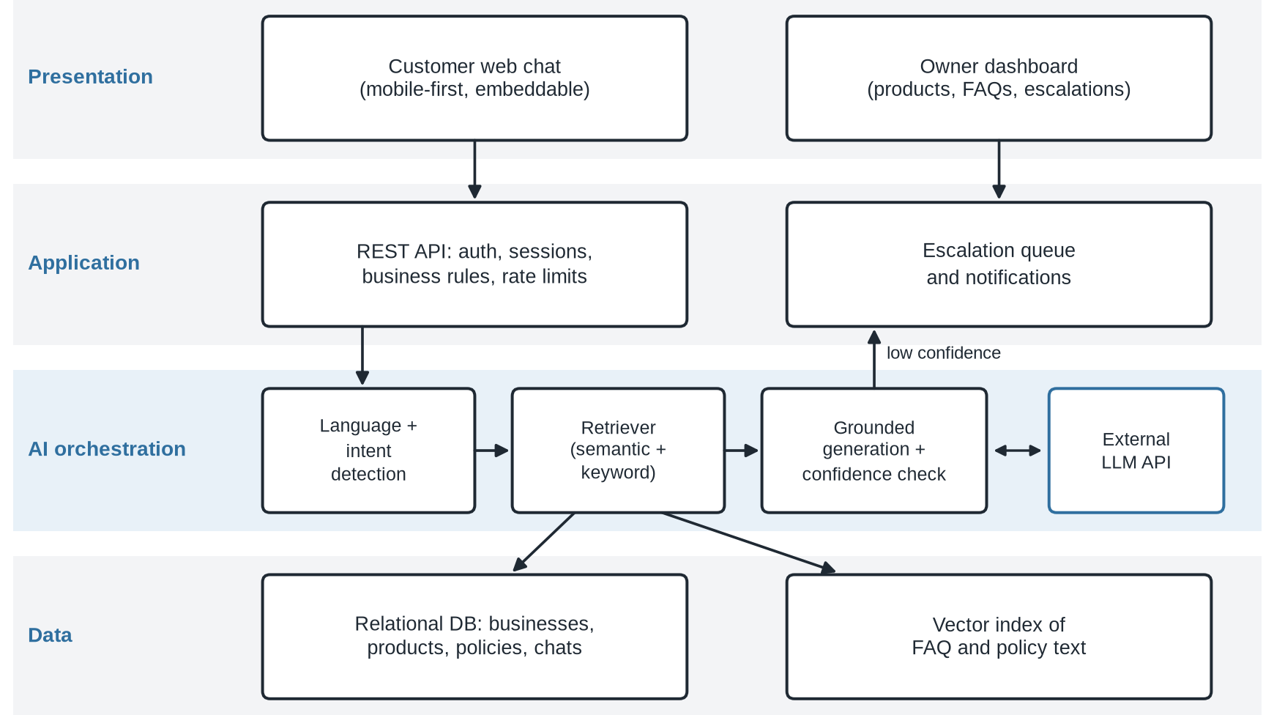



System architecture
The AI owns no data
It receives text and returns text. It cannot change records or take actions.
Code decides what it sees
Retrieval is filtered by business ID inside the database query.
Provider can be switched
The AI model is called through a neutral interface; PostgreSQL + pgvector stores both data and search index.
Notes:
[0:50] Point to the right-side points one by one.
The architecture has four layers: presentation, application, AI orchestration, and data.
The key design choice is this: the AI owns no data and cannot take any action. It receives text and returns text. The application code decides which records the AI can see, filtered by business, and whether a reply is sent. And the AI provider can be switched later without rebuilding the system.

Slide 14
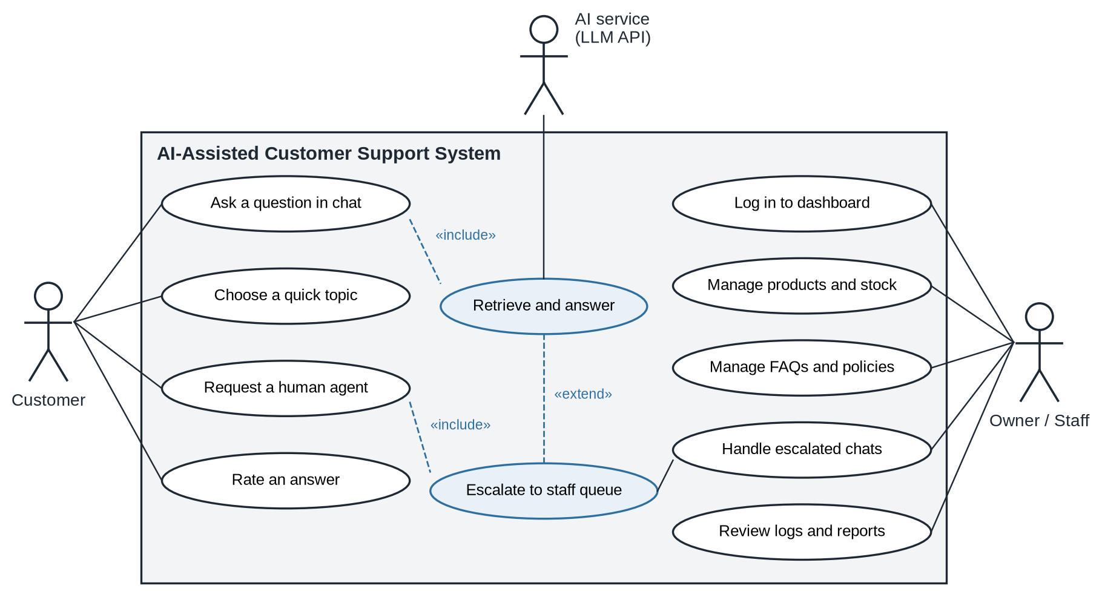
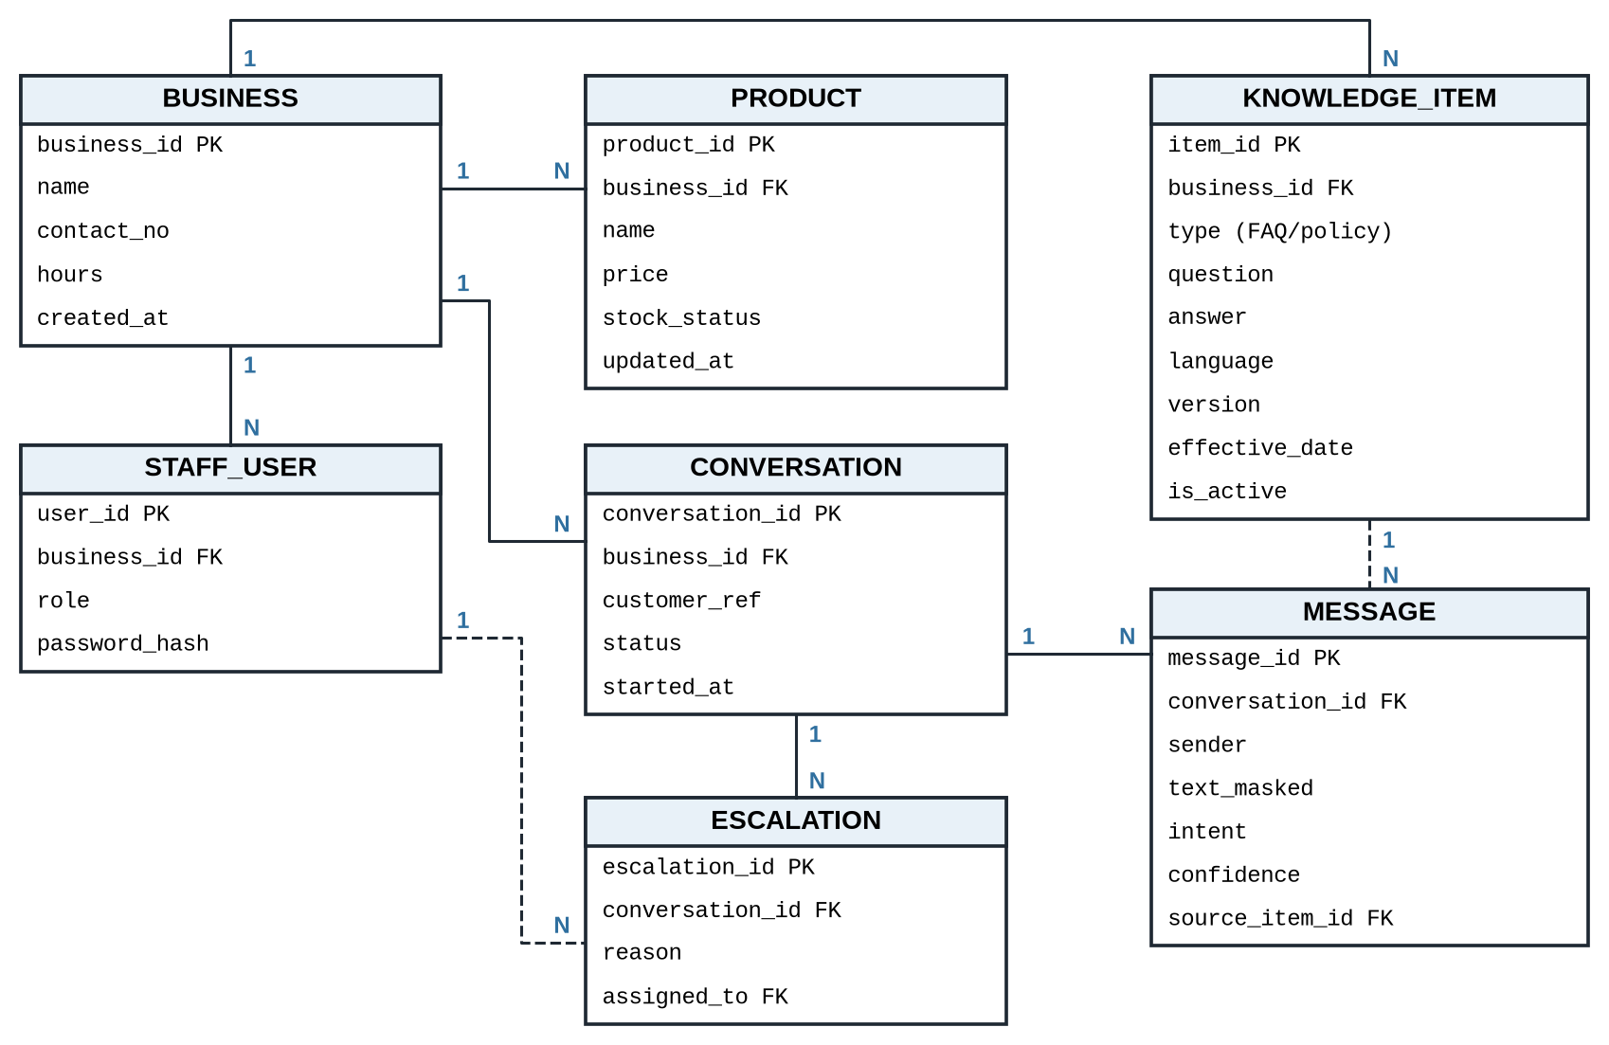
Use cases and data model
Use case diagram: customer, owner/staff and AI service
ERD: every message stores the knowledge item it used
Notes:
[0:40] Left diagram, then right diagram.
On the left is the use case diagram. Customers ask questions, choose quick topics, request a person, and rate answers. Owners and staff manage products, FAQs, and policies, and handle escalated chats. The AI service only takes part in retrieving and answering.
On the right is the data model. The important detail is that every message stores which knowledge record it used, so every automated answer can be checked later.

Slide 15
Business rules the AI cannot override
BR1
BR2
BR3
BR4
Only active, in-effect records are used
A seller's data never reaches another seller's customers
Refunds, complaints and unlisted discounts always go to a person
Conflicting records: newer wins, owner alerted
BR5
BR6
BR7
BR8
Quoted price and stock must match the record exactly
Stock not updated in 14 days triggers a reminder
Card and ID numbers are masked before storage and AI calls
Only owners change policies; staff edit products
Notes:
[0:50] Point to BR3 last.
These are the business rules, BR one to eight. They are written in the application code, so the AI cannot override them. For example, only active records are used, one seller's data never reaches another seller's customers, prices quoted must match the record exactly, and card numbers are masked.
The most important is BR3: refunds, complaints, and discounts not in the policy always go to a real person.

Slide 16
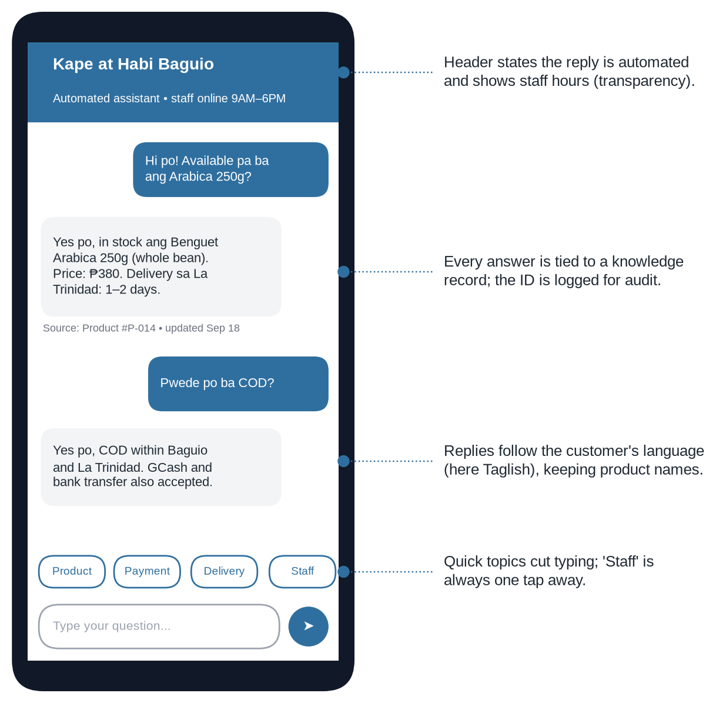
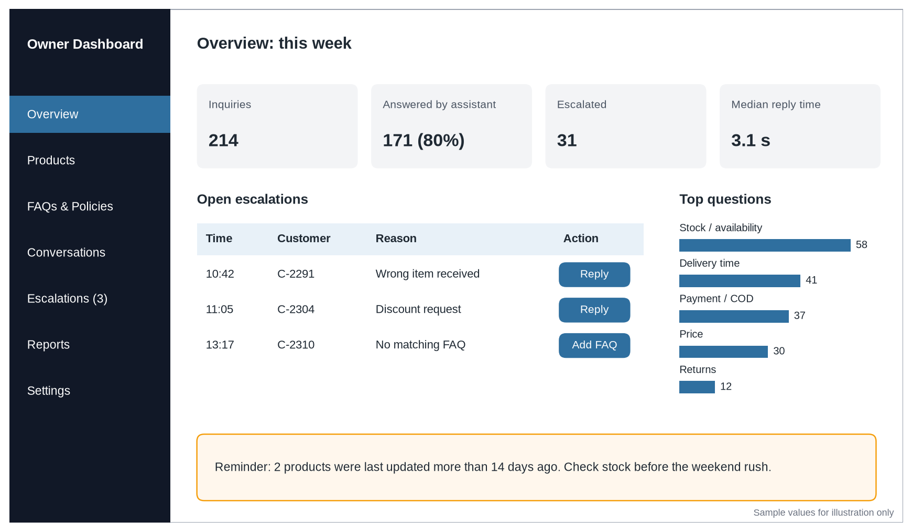
Interface mockups
Customer chat (fictional store): automated label, record source, Taglish reply, 'Staff' button
Owner dashboard: weekly counts, escalation queue, top questions, stale-stock reminder (sample values)
Notes:
[0:50] Left mockup, then right mockup.
On the left is the customer chat, designed for mobile because most buyers message from their phones. It says clearly that replies are automated, it shows which record each answer came from, it replies in the customer's language, here in Taglish, and there is always a Staff button.
On the right is the owner dashboard. It shows weekly counts, the chats waiting for staff, the most common questions, and a reminder when stock hasn't been updated. The numbers here are sample values only.

Slide 17





Technical requirements and security
Client
Responsive web app on phone or desktop
Security and privacy
Application
REST API (Node.js or Python), role-based access
HTTPS, hashed passwords, optional 2FA for owners
Customer text treated as data, never as instructions
Replies checked against the record before sending
Sensitive numbers masked; chats kept 90 days
Chats never used to train models
Follows RA 10173 and NPC Advisory 2024-04
AI / NLP
Hosted LLM API + embedding model for retrieval
Data
PostgreSQL with pgvector; daily encrypted backups
Hosting
Cloud VM, about 2 vCPU and 4 GB RAM for the pilot
Notes:
[0:45] Left list briefly, then the security box.
Technically, the system is small and affordable: a web app, a REST API, a hosted AI model, and PostgreSQL with vector search on one small cloud server.
For security and privacy: customer messages are treated as data, never as instructions; replies are checked against the record before sending; sensitive numbers are masked; chats are kept for 90 days and are never used to train models. The design follows the Data Privacy Act and NPC Advisory 2024-04.

Slide 18



Business and sustainability model
Model
Free
Starter
Growth
B2B software-as-a-service; the seller pays, not the buyer
₱0
₱499
₱1,299
per month
per month
per month
Channels
Up to 100 AI-answered chats a month
1 staff account
Try with no risk
1,000 chats a month
2 staff accounts
Fits most micro sellers
3,000 chats a month
5 staff accounts, reports
Messenger integration (future)
DTI Negosyo Centers, DICT training cohorts, local seller groups
Cost control
Exact FAQ matches skip the AI; usage caps per tier
Planning figures; to be tested in the seller survey. Optional ₱1,500 one-time setup help.
Notes:
[0:50] Point to the Starter tier.
The business model is B2B software-as-a-service. The seller pays, not the buyer. There is a free tier so sellers can try it, a Starter tier at 499 pesos a month for most micro sellers, and a Growth tier at 1,299 pesos for busier shops. These are planning figures, and my survey asks sellers what they would actually pay.
To keep it sustainable, simple FAQ matches skip the AI completely, and each tier has a usage limit. The first market would be sellers who finished DTI and DICT digital-selling programs.

Slide 19
How the prototype will be judged
≥ 90%
≤ 5 s
≥ 70
Response accuracy
Response time
Usability (SUS)
Correct, supported answers on the test set
Median time from message to reply
System Usability Scale score
≥ 4.0
100%
≤ 10 pts
Satisfaction
Escalation safety
Language parity
Relevance and satisfaction ratings, out of 5
Critical cases never answered by the bot
Accuracy gap across English, Filipino, Taglish
Test set: 120 inquiries (40 English, 40 Filipino, 40 Taglish), expected answers fixed before testing. No results are claimed until the prototype is tested.
Notes:
[0:50] Point to 90% and 100%.
These are my evaluation targets. At least 90 percent accuracy, replies within five seconds, a usability score of at least 70, satisfaction of at least 4 out of 5, and 100 percent of critical cases sent to a person. I also set a language target: the accuracy gap between English, Filipino, and Taglish should be no more than 10 points.
I will test with 120 questions, 40 per language, and the correct answers are written down before testing. I want to be clear: these are targets. No results are claimed until the prototype is tested.

Slide 20


Data collection plan
Survey A: Seller needs
Survey B: Prototype evaluation
Before building. Screening question, 28 items: profile, current practices, views on AI, willingness to pay, open questions.
After testing. Accuracy, response time, SUS usability, trust and escalation, dashboard, satisfaction.
Target: 30+ sellers; 8–12 interviews
Target: 15–20 pilot users
Recruitment channels (purposive and referral sampling)
DTI Baguio-Benguet / Negosyo Centers
DICT-CAR SPARK cohort
Baguio City business office
Local Facebook seller groups
Bazaars and trade fairs
Next step: adviser approval of the instruments and request letter, then send letters and open the survey. Data handled under RA 10173.
Notes:
[0:50] Survey A, Survey B, then the channels.
For data collection, I prepared two instruments. Survey A is for sellers, before building. It starts with a screening question so only businesses that sell online are included. Survey B is the evaluation after testing, including the System Usability Scale.
To reach sellers, I prepared a request letter to DTI, DICT-CAR, and the Baguio City office, asking them to forward the survey. I am not asking for any participant lists, in line with the Data Privacy Act. I'll also reach sellers through local Facebook groups, bazaars, and referrals. The next step is your approval of these instruments, po.

Slide 21
Conclusion and recommendations
Recommendations
Conclusion
1
Build and test the prototype; report results only after testing
Small sellers in Baguio and Benguet are moving online, and answering customers is becoming a daily burden.
The design answers only from the owner's records, works in Taglish, and hands off to staff.
Of four options, it was the only one that gave owners control over the facts while still cutting their workload.
2
Confirm requirements through seller interviews before Sprint 2
3
Keep escalation rules strict at launch; relax only with evidence
4
Add Facebook Messenger integration next
5
Partner with DTI-CAR and DICT-CAR as a follow-up to their training
Notes:
[1:00] Slow down here.
To conclude. Small sellers in Baguio and Benguet are being encouraged to sell online, and answering customers is becoming a daily burden for one- or two-person shops. My design answers only from the owner's records, works in Taglish, and hands off to staff when it should. Of the four options, it was the only one that gave owners control over the facts while still reducing their workload. The AI is a helper, not a decision-maker.
My recommendations are: build and test the prototype, and report results only after testing; confirm the requirements with sellers before the second sprint; keep the escalation rules strict at the start; add Messenger integration next; and work with DTI and DICT as a follow-up to their training.

Slide 22
Selected references
Department of Trade and Industry. 2024. 2023 Philippine MSME Statistics in Brief.
Philippine Statistics Authority. 2025. 2024 NICTHS: E-Commerce; 2026. Digital Economy Satellite Account.
D. Huang, D. G. Markovitch, R. A. Stough. 2024. Can chatbot customer service match human service agents on customer satisfaction? J. Retail. Consum. Serv. 76.
Y. Zhang, C. Liang, X. Li. 2024. Understanding virtual agents' service quality in the context of customer service. Electron. Commer. Res. Appl. 65.
J. R. Montalan et al. 2025. Batayan: A Filipino NLP benchmark for evaluating large language models. ACL 2025.
DLSU Senior High School Research Congress. 2024. Optimizing customer support: AI chatbots of Shopee and Lazada in the Philippines.
National Privacy Commission. 2024. NPC Advisory No. 2024-04 on AI systems processing personal data.
OWASP Foundation. 2025. OWASP Top 10 for LLM Applications; E. Tabassi. 2023. NIST AI RMF 1.0.
Philippine Information Agency. 2026. Reports on DICT, DTI and Tatak Pinoy MSME programs in Baguio and the Cordillera.
Notes:
[0:10] Do not read this slide.
These are my main references. The complete list of thirty sources, in ACM format, is in the paper.

Slide 23
Maraming salamat po!
“The owner's records, not the AI's general knowledge, decide what customers are told.”
Questions and suggestions are welcome. | jeanalynlagera123@gmail.com
Notes:
[0:20] Say the quote slowly, then open the floor.
I'll end with the one idea behind the whole design: the owner's records, not the AI's general knowledge, decide what customers are told.
Maraming salamat po. I'm happy to answer your questions and hear your suggestions.

