Slide 1

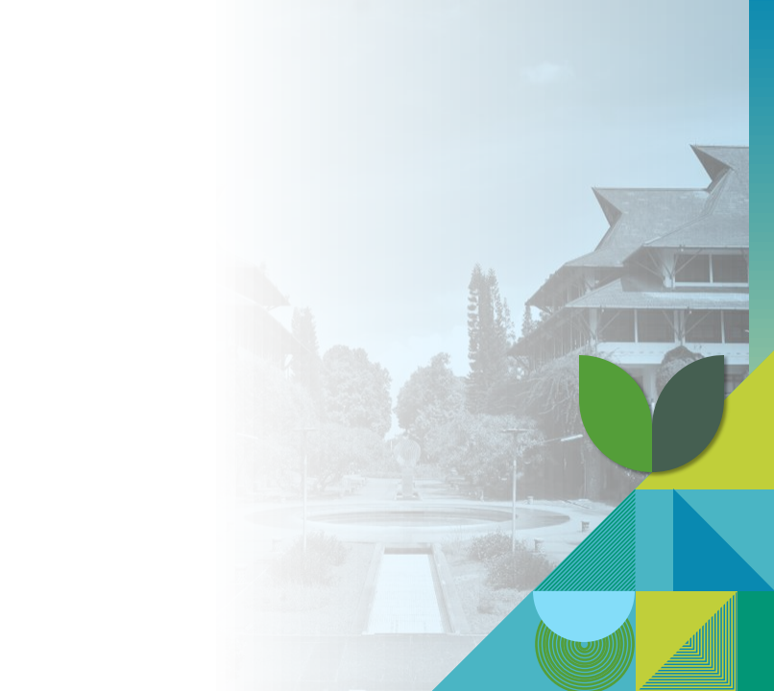
Tragedy of The Commons and The Impact of Human Activities on the Environment
WI1103 Introduction of Sustainability Principles Week-2)
Semester I 2026/2027

Slide 2

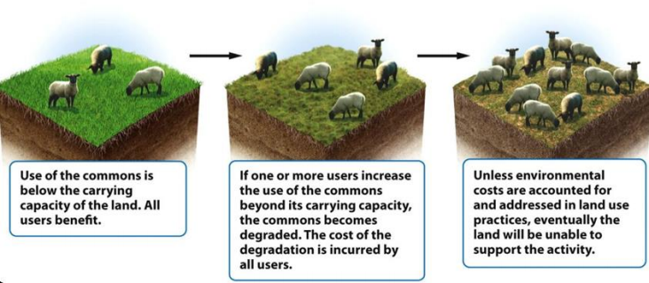


Pengantar Konsep Tragedy of The Commons
“Picture a pasture that is open to all. Each
herdsman will try to keep as many cattle as
possible on the
commons…the inherent logic of the commons
remorselessly generates tragedy.” ---Garrett
Hardin, The Tragedy of
the Commons 1968
“the commons” is a resource that is "open to all" (open access)
2
WI1103 Pengantar Prinsip Keberlanjutan
Notes:
Diusung oleh Garrett Hardin tahun 1986 melalui artikel yang diterbitkan di Science
Degradasi pada sumber daya terbarukan yang digunakan bersama atau berakses terbuka terjadi karena tiap pengguna berpikir, “Sedikit yang saya pakai atau saya cemari tidak akan berdampak, lagipula ini sumber daya terbarukan.” Saat tingkat pemakaian masih kecil, logika ini tampak bekerja. Namun lama-kelamaan, dampak kumulatif dari banyak orang yang mengeksploitasi sumber daya terbarukan yang tersedia luas atau dipakai bersama dapat menurunkannya, bahkan menghabiskan atau merusaknya. Akhirnya tak ada yang diuntungkan dan semua dirugikan. Itulah tragedinya.

Slide 3

Commons vs open-access resource
• The commons proposed by Hardin is debated, because according to the literature, commons refers to shared ownership
The difference between commons and open-access resources emphasizes that tragedy can occur in open-access resources that are not well managed.
 | The commons | Open-access resource
Ownership | Joint ownership | There are no ownership rights or possession.
Definition of Community | A group that is defined and restricted more narrowly with certain boundaries between members and non-members. | The community at large
Level of exclusion | Exclusion for non-members | None
3
WI1103 Pengantar Prinsip Keberlanjutan

Slide 4
Open-access resources
Some renewable resources, known as open-access resources, are not owned by anyone and can be used by almost anyone.
Examples include the atmosphere and the open sea along with its fish.
Another example that is not entirely open but is often used collectively includes grasslands, forests, rivers, and underground water bodies (aquifers).

Slide 5
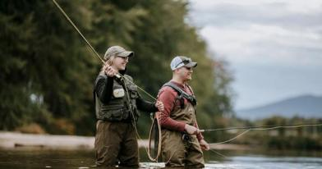
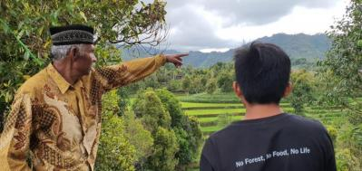
Does the tragedy lie on the commons?
Contoh 1: Lobster fisheries in Maine, UK, have policy mechanisms among local communities to protect water resources as well as lobsters and to avoid overfishing of lobsters.
Contoh 2: Customary forest Barambang Katute
The customary forest area is managed by the Barambang Katute indigenous community, which has mechanisms in place to protect this forest area. There are sacred areas where mining activities are not allowed.
5
WI1103 Pengantar Prinsip Keberlanjutan
Notes:
Tragedinya bukan pada commons-nya, melainkan pada akses terbuka yang tak dikelola
Hardin terutama menggambarkan situasi open access (tanpa hak/aturan/pemantauan), bukan common property yang dikelola komunitas.
Banyak commons justru lestari ketika ada batas jelas, aturan panen/kuota, pemantauan, sanksi bertahap, dan forum sengketa.
Yang memicu “tragedi” biasanya: ketiadaan institusi, biaya pemantauan tinggi, eksternalitas (biaya dibagi ke publik), serta ketimpangan skala (mis. atmosfer sebagai global commons).
Contoh kontras: perikanan pesisir dengan aturan adat sering lebih berkelanjutan dibanding laut lepas (open access) yang mudah overfishing.
Jadi, masalahnya ada pada rezim pengelolaan—bukan pada berbagi sumber daya itu sendiri.
Salah satu cara mengatasi masalah sulit ini adalah memakai sumber daya terbarukan bersama/akses terbuka pada tingkat yang lebih rendah. Ini dilakukan dengan saling menyepakati pengurangan penggunaan, mengatur akses terhadap sumber daya, atau keduanya. Cara lain adalah mengubah sumber daya terbarukan bersama menjadi kepemilikan privat, dengan alasan bahwa jika seseorang memiliki sesuatu, ia cenderung lebih melindungi investasinya. Namun sejarah menunjukkan hal ini tidak selalu terjadi. Selain itu, pendekatan ini tidak dapat diterapkan pada sumber daya akses terbuka seperti atmosfer dan laut lepas, yang tidak bisa dibagi-bagi dan dijual sebagai properti pribadi.

Slide 6
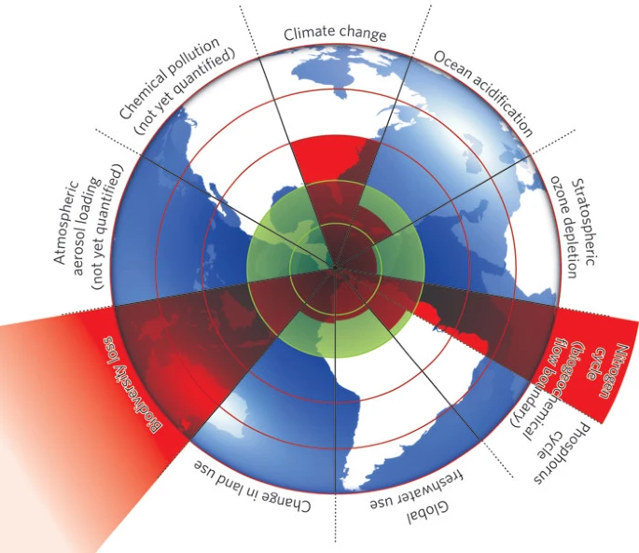
Planetary Boundaries
The planetary boundaries framework draws upon Earth system science. It identifies nine processes that are critical for maintaining the stability and resilience of Earth system as a whole.
The planetary boundaries framework delineates the biophysical and biochemical systems and processes known to regulate the state of the planet within ranges that are historically known and scientifically likely to maintain Earth system stability and life-support systems conducive to the human welfare and societal development.
The planetary boundaries framework formulates limits to the impact of the anthroposphere on Earth system by identifying a scientifically based safe operating space for humanity that can safeguard both Earth’s interglacial state and its resilience.
https://www.nature.com/articles/461472a
6
WI1103 Pengantar Prinsip Keberlanjutan
Notes:
The planetary boundaries framework draws upon Earth system science. It identifies nine processes that are critical for maintaining the stability and resilience of Earth system as a whole.
The planetary boundaries framework delineates the biophysical and biochemical systems and processes known to regulate the state of the planet within ranges that are historically known and scientifically likely to maintain Earth system stability and life-support systems conducive to the human welfare and societal development.
The planetary boundaries framework formulates limits to the impact of the anthroposphere on Earth system by identifying a scientifically based safe operating space for humanity that can safeguard both Earth’s interglacial state and its resilience.

Slide 7
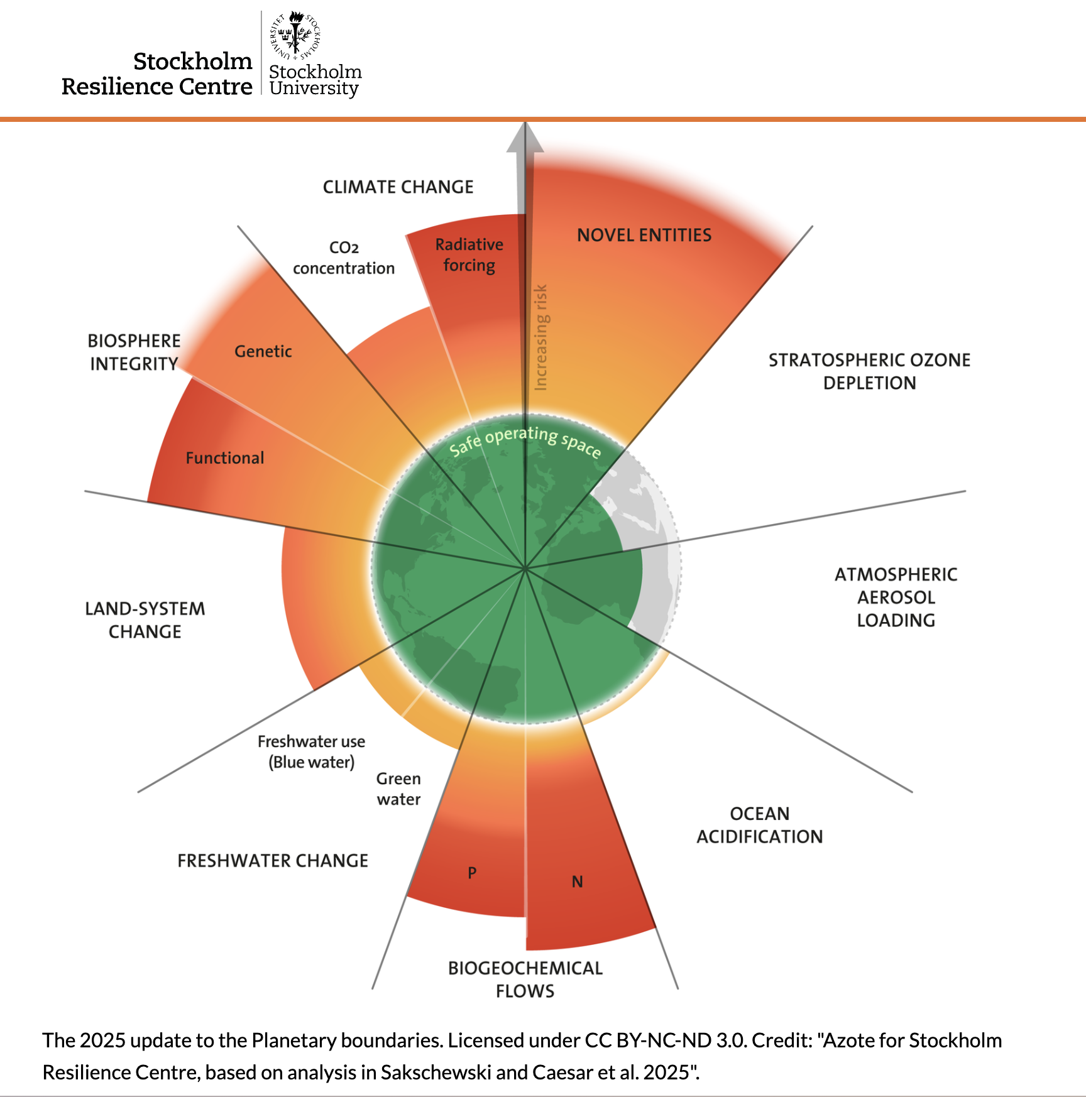
Planetary Boundaries
7 out of 9 planetary boundaries have been transgressed
indicating that the Earth is now outside the safe operating space for humanity.
https://www.stockholmresilience.org/news--events/general-news/2025-09-24-seven-of-nine-planetary-boundaries-now-breached.html
7
WI1103 Pengantar Prinsip Keberlanjutan
Notes:
Doughnut economics, developed by Kate Raworth, is built directly on top of the planetary boundaries framework, the outer ring of the doughnut is the planetary boundaries model epurposed as an "ecological ceiling" beyond which humanity risks destabilizing Earth systems like climate, biosphere integrity, and biogeochemical flows. Raworth's contribution was to pair this ceiling with an inner ring — a "social foundation" derived loosely from SDG-type deprivation thresholds (food, water, health, education, etc.) — so that the doughnut shape itself represents the safe and just space between ecological overshoot and social shortfall. Planetary boundaries alone is a biophysical model with no inherent theory of human wellbeing or distribution, while doughnut economics uses it as one half of a normative claim about what an economy should be for — meeting human needs without breaching the boundaries that keep the planet in a stable state.

Slide 8
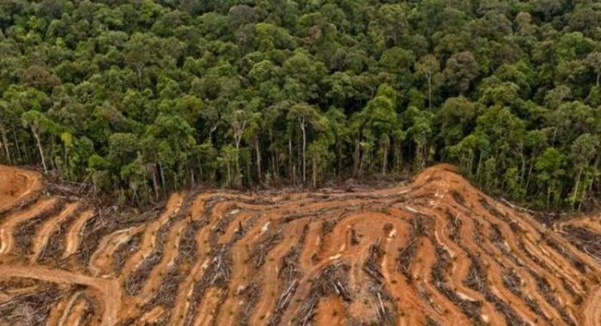
Changes in Land Use
Large-scale land conversion for agriculture, urbanization, and deforestation has disrupted natural ecosystems, reduced biodiversity, and affected carbon and water cycles.
Global Water Cycle
Changes in water use, such as large-scale irrigation and river diversion, have altered the hydrological cycle, causing droughts, floods, and a decline in water quality.
8
WI1103 Pengantar Prinsip Keberlanjutan
Notes:
https://agroindonesia.co.id/memahami-deforestasi-secara-utuh/

Slide 9
Climate Change
Greenhouse gas emissions, particularly from the burning of fossil fuels, have increased CO2 concentrations in the atmosphere, causing global warming and climate change.
Loss of biodiversity
Human activities, such as habitat destruction, pollution, and resource exploitation, have caused species extinction at a very high rate, disrupting ecosystem functions.
9
WI1103 Pengantar Prinsip Keberlanjutan

Slide 10
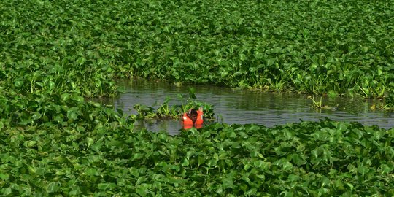
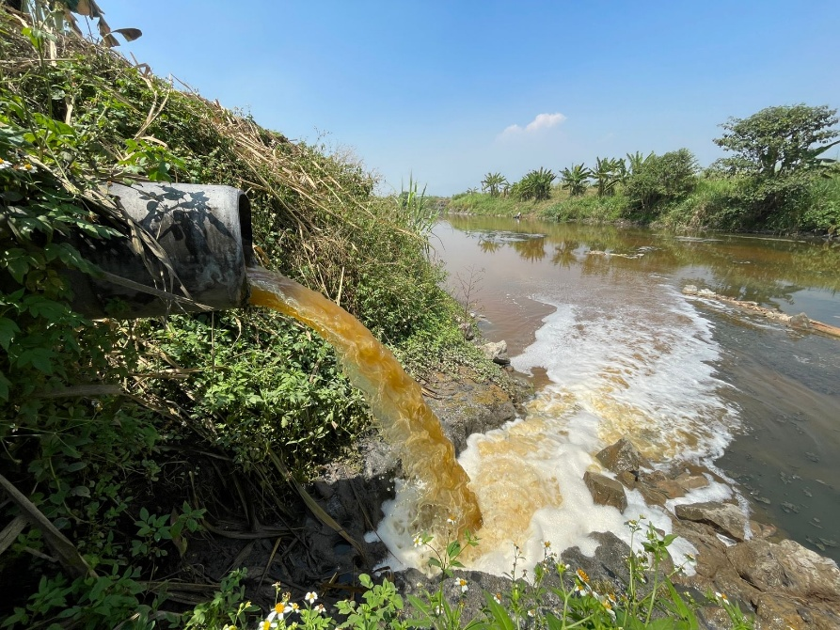
Biogeochemical flow:
The excessive use of synthetic fertilizers in agriculture has resulted in the excessive flow of nitrogen and phosphorus into the ecosystem, causing eutrophication and disruptions in the natural cycle.
Eutrofikasi
Chemical pollution:
The use of hazardous chemicals, including pesticides, heavy metals, and industrial chemicals, has polluted the environment, affecting the health of humans and animals.
Chemical Polution
1010
WI1103 Pengantar Prinsip Keberlanjutan
Notes:
https://www.merdeka.com/jateng/penyebab-eutrofikasi-pada-lingkungan-air-ketahui-berbagai-dampak-lingkungannya-kln.html
https://mojokerto.disway.id/read/4343/ecoton-temukan-pencemaran-sungai-di-das-brantas-diduga-akibat-dari-pembuangan-limbah-industri-kertas

Slide 11
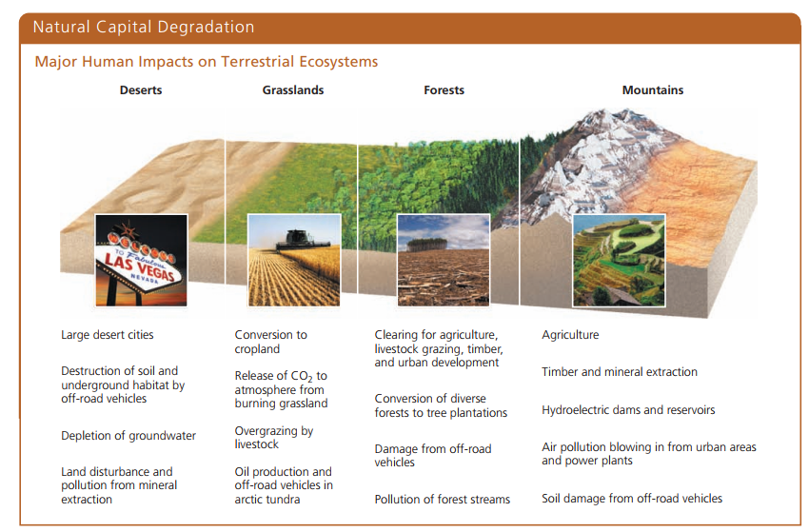
Miller and Spoolman, 2019
1011
WI1103 Pengantar Prinsip Keberlanjutan

Slide 12
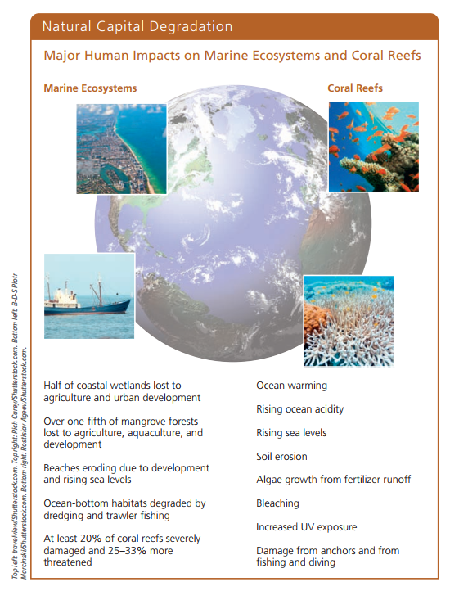
Miller and Spoolman, 2019
1010
WI1103 Pengantar Prinsip Keberlanjutan

Slide 13
Discussion
Imagine a future where two other planetary boundaries have been breached. In your opinion, what would the state of the world be like then? How might daily life change?
Discuss how local actions, such as reducing plastic use or saving water, contribute to maintaining planetary boundaries. Are these actions enough, or do we need more global efforts?
With knowledge of planetary boundaries, what ethical responsibilities do individuals, corporations, community, and governments have to prevent violations of those limits?
11
WI1103 Pengantar Prinsip Keberlanjutan
Notes:
Prompt: How do the concepts of planetary boundaries and the tragedy of the commons intersect? Can you think of an example where overuse of a common resource has led to crossing a planetary boundary?
Ethical Responsibility:
Prompt: Given the knowledge of planetary boundaries, what ethical responsibilities do individuals, corporations, and governments have in preventing boundary transgressions?
Future Scenarios:
Prompt: Imagine a future where three more planetary boundaries are crossed. What do you think the world would look like? How might daily life change?
Global vs. Local Actions:
Prompt: Discuss how local actions, like reducing plastic use or conserving water, contribute to maintaining planetary boundaries. Are these actions enough, or do we need more global efforts?
Balancing Development and Sustainability:
Prompt: How can developing countries balance the need for economic development with the necessity of staying within planetary boundaries? What trade-offs might be involved?

Slide 14
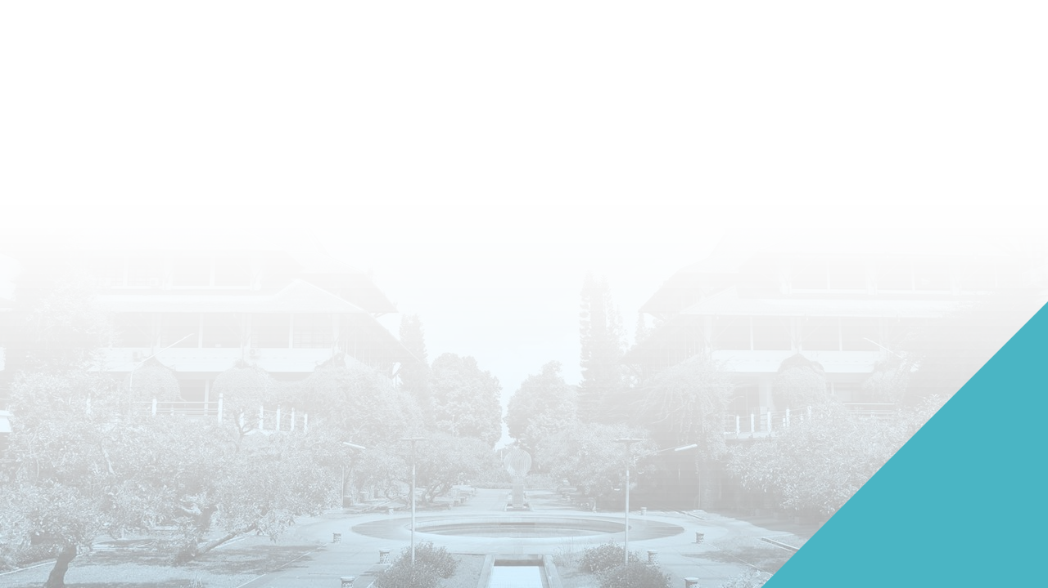



Terima kasih
12
WI1103 Pengantar Prinsip Keberlanjutan

