Slide 1
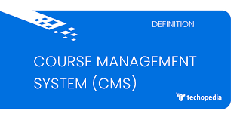
Course Management System

Slide 2
5 Weeks Training
This is 5 weeks of training include below learning and development part.
Java & MySQL
Spring Boot Rest API
Spring Boot JPA implementation
Spring Boot Micro-services
Angular 11 and Wireframe

Slide 3

Agenda
1
Our Execution Plan
2
Our Team
3
Team Structure
4
Project Goals
5
Software Development Cycle
6
Tech Stack
7
Development
8
Challenges & Learning's
9
Questions

Slide 4
Execution Plan
Plan | Actions
1) December 13- December 23 | -- To develop Course Management System using Java and MySQL
2) January 3 – January 7 | -- Convert CRS Application into Maven CRS application using REST API
3) January 10 – January 14 | -- Convert CRS Application (REST API) into CRS Application using JPA implementation.
4) January 17 – January 21 | --Learning of Wireframe, HTML , JavaScript and implementation of micro services.
5) January 24 – January 31 | -- Development in Angular 11 and integration with backend services.

Slide 5


Slide 6
Our Team
1) Shahul Hameed – Group Leader
2) Sayli Gurav
3) Manoranjan Mahakud
4) Parag Raut
5) Shital Bhosale
6) Kagitha Jeaswanth
7) Sharaddha Patil

Slide 7

Project Goals

Slide 8

To create a Course Registration System using JAVA/REST tools and Angular 11 technologies, where a professor can add grades for student and student can view/drop/add courses and enroll in some of the courses.

Slide 9
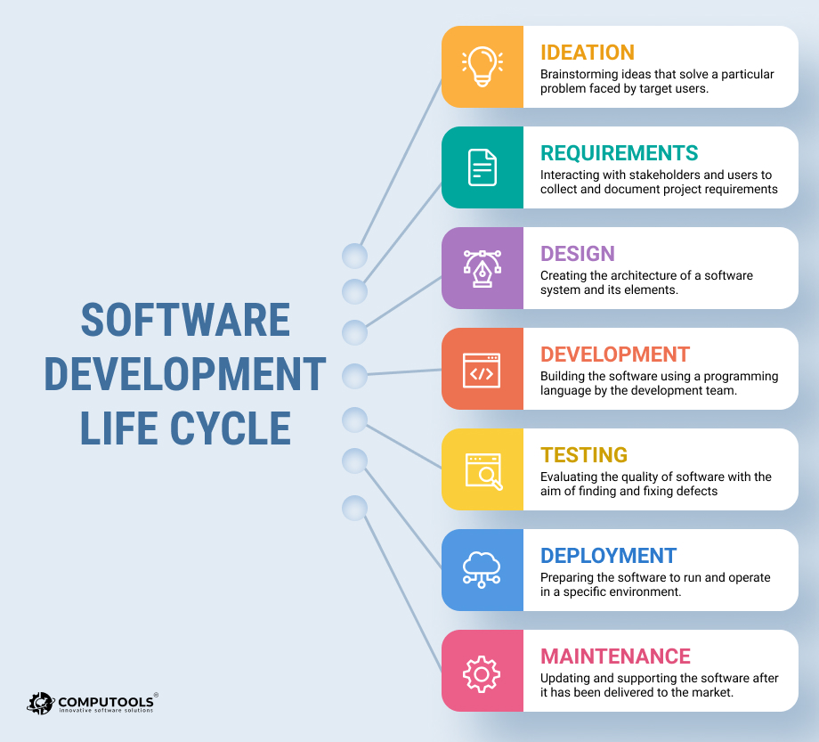
Requirement Gathering
UML Artifacts Design
Code Implementation
System Testing

Slide 10
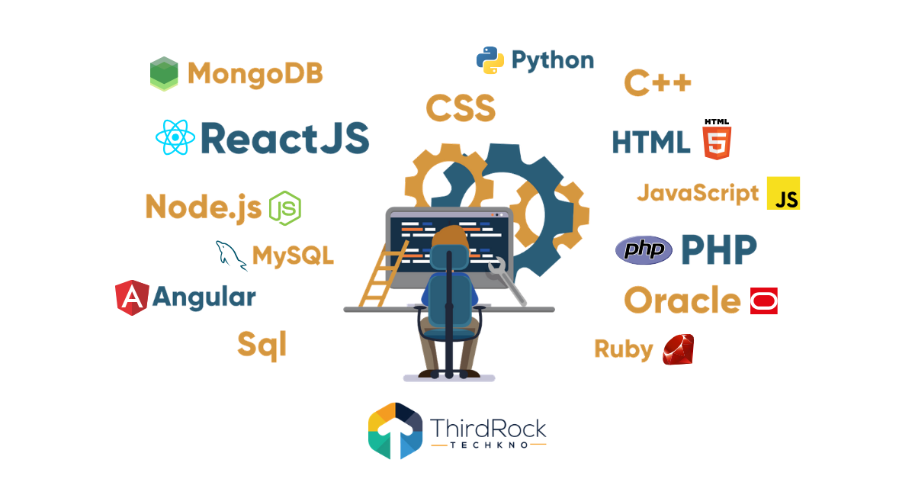
Tech Stack

Slide 11









Backend
Testing
Data
SCM
Core Language
Tools
SQL Database
Code Collaboration
Framework
Application Server

Slide 12

Development

Slide 13
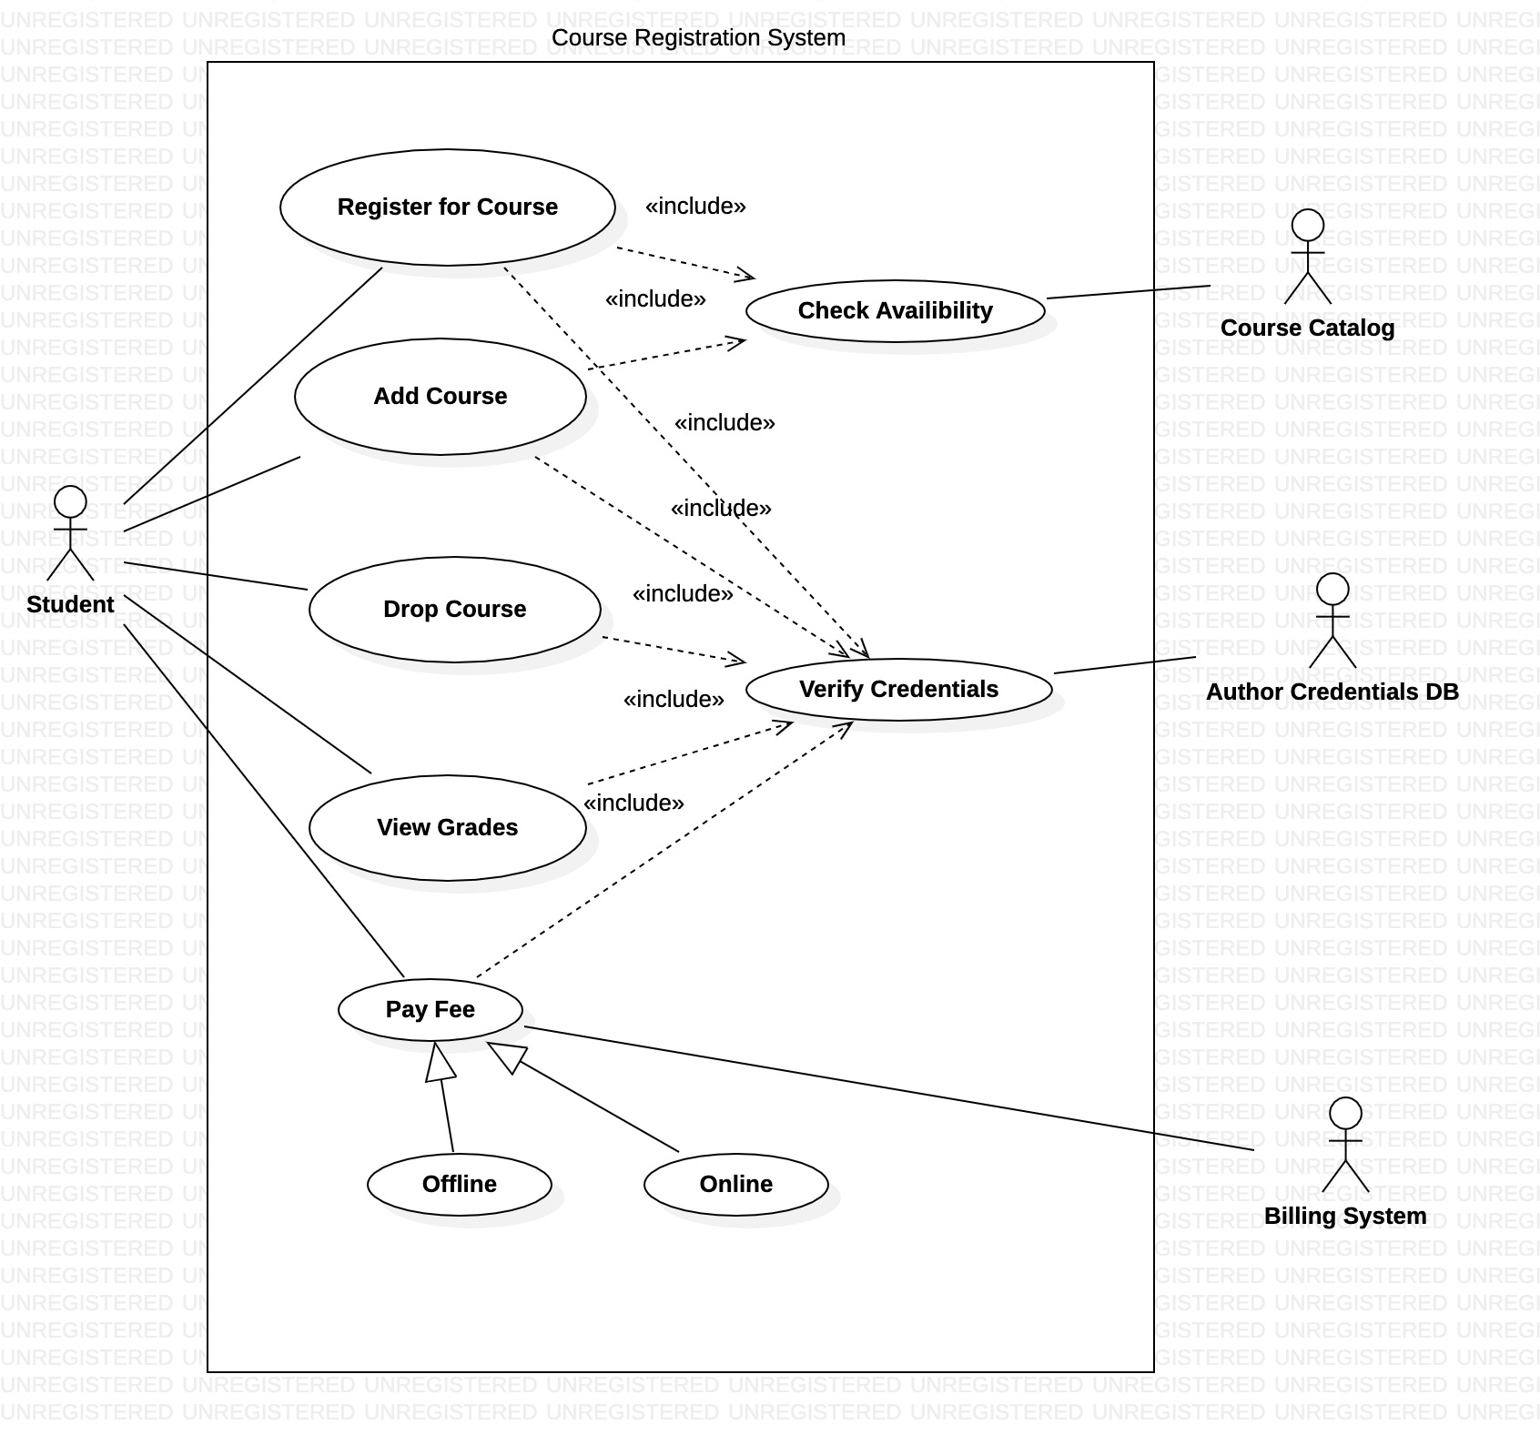

Slide 14
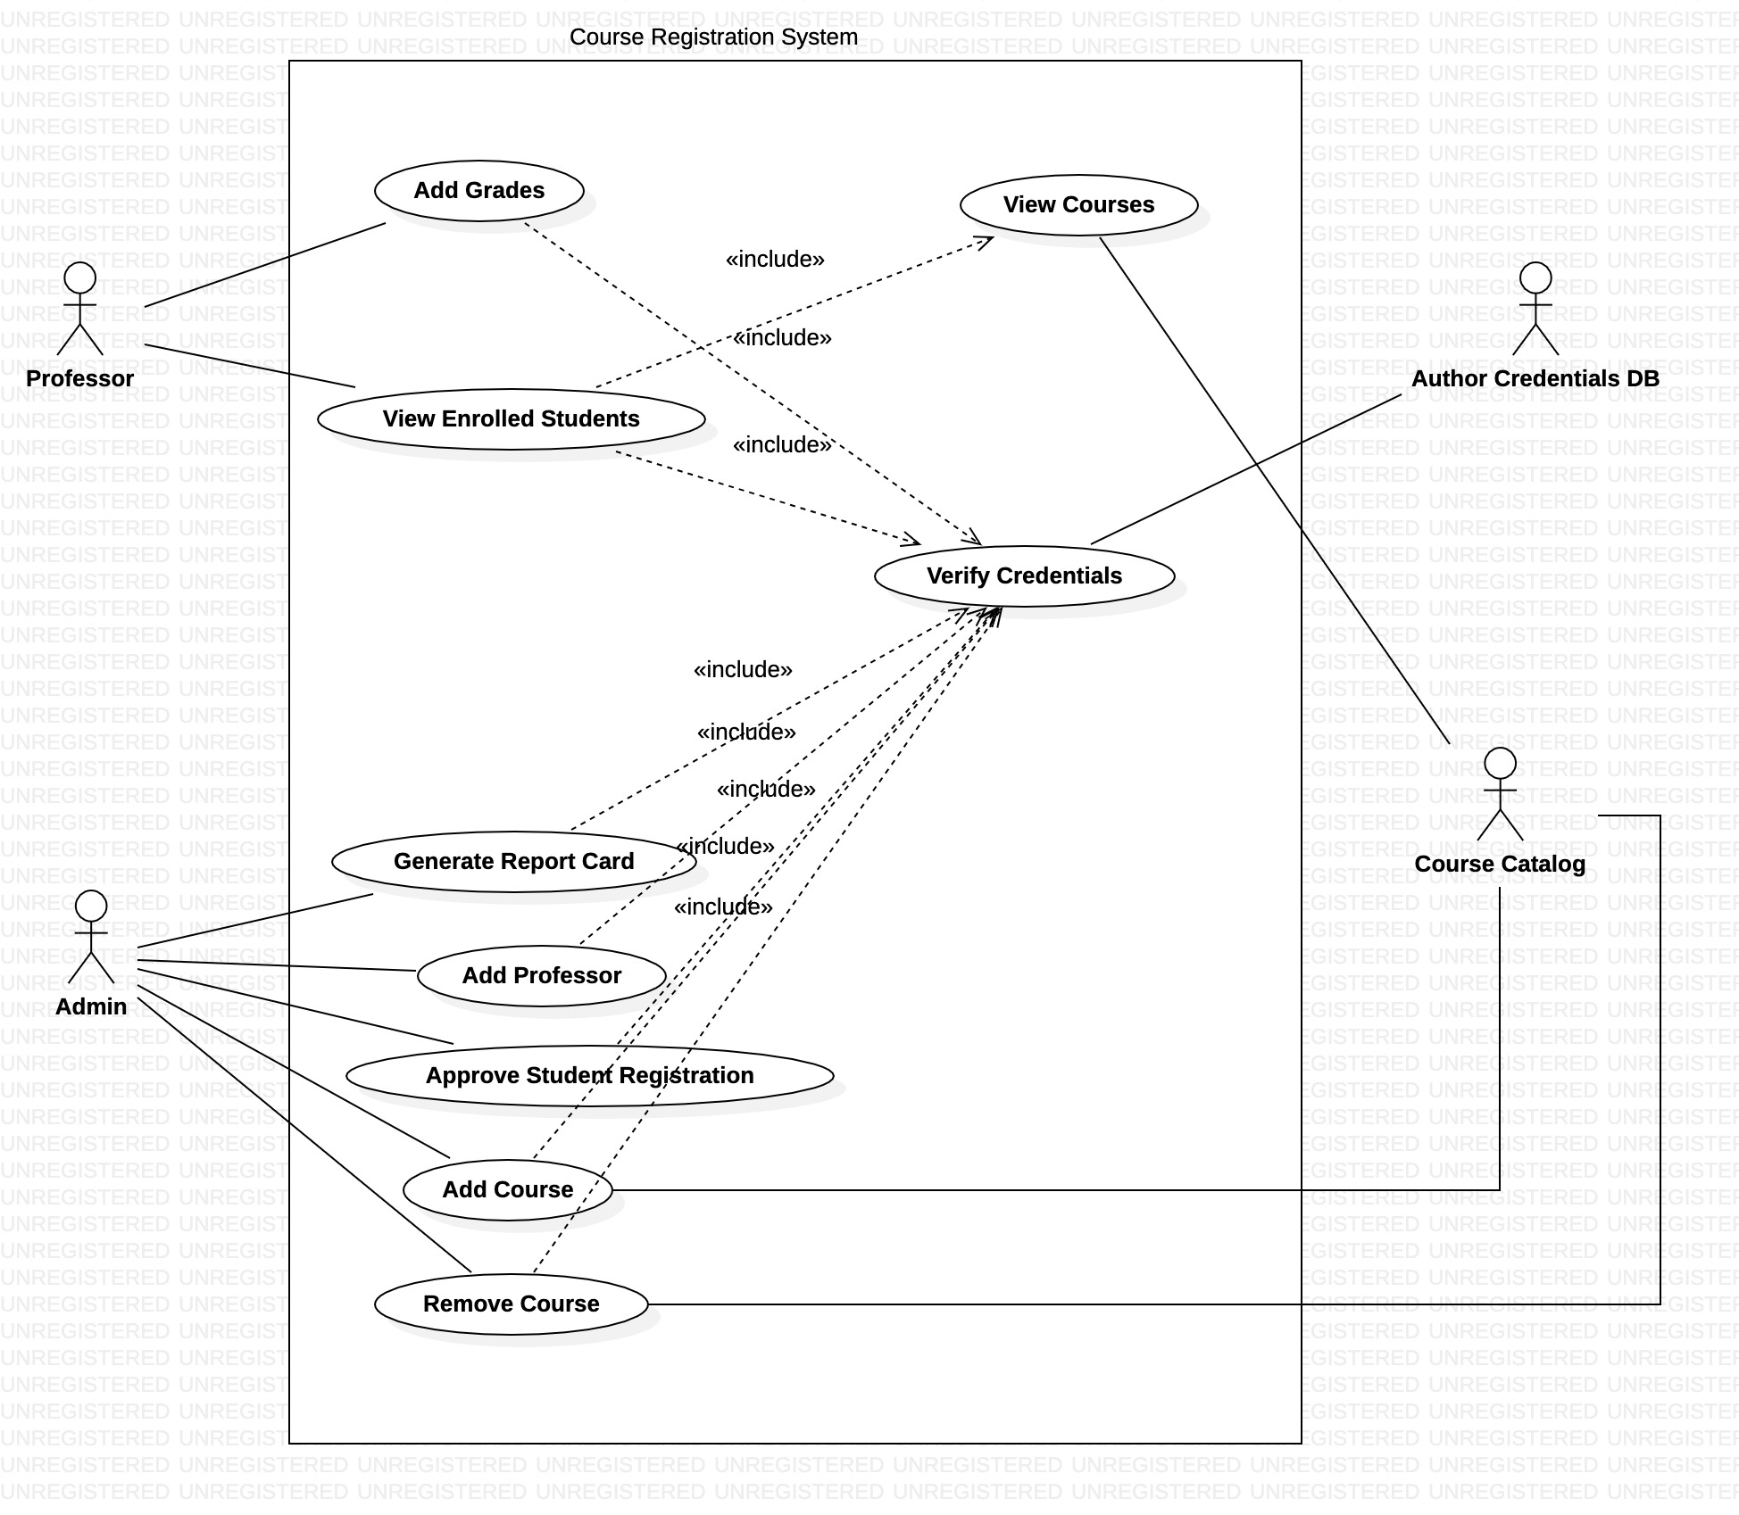
UML Artifact Design of Admin and Professor

Slide 15
Requirement understanding
Research and analysis
Estimation
Sprint Planning
Spring Grooming
Delivery
Sprint Implementation
Development
Code Review
Commit
Integrate
Deploy
Test

Slide 16

Challenges and Learning's

Slide 17
Challenges | Learning
Understanding the requirements and work distribution according to technical skills. Resolving errors and implementation of Logger. | -- Team Leading skill & working in team -- Logger
3) Installation and making changes in the IDE. 4) Developing the UI part of application using Wireframe | -- Eclipse, STS,Visual Studio and MySQL -- Wireframe & JavaScript
5) Resolving errors in of User Interface section 6) Integration of frontend part with backend part. | -- Angular 11 -- End to End connection of application

Slide 18


Slide 19


