Slide 1
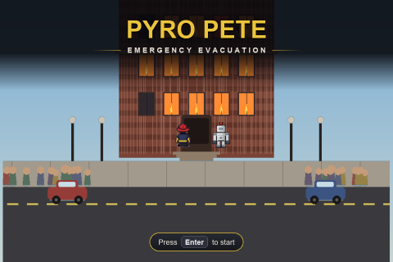
Pyro Pete: Emergency Evacuation
CT3201 Mini Project · An evacuation-routing AI agent · Learn with AI
▸ Team: Lee Tze Hian (U2423241F), Ong Chuan Hau (U2420725E), See Jun Wen (U2420456K)
▸ Problem area: Search / Intelligent agent / Decision-making under uncertainty
▸ Can AI help us design AI — And can we recognise when AI is wrong?
Pyro Pete: Emergency Evacuation · CT3201 Introduction to Artificial Intelligence Mini Project
1

Slide 2
1 - Problem Definition
Phase 1, Stage 1 - Defined human-first, before using AI
1
▸ Problem: Occupants who don't know a burning building's layout must be found and led to an exit before fire, smoke and collapse cut the route off
▸ User: A rescuer inside the building (human or AI) — the system is a decision-support tool that proposes a route, not an autonomous replacement
▸ Environment: Multi-room floor plan as a grid graph; hazards evolve over time; only a small radius is visible
▸ Desired outcome: All reachable occupants out, then the rescuer out — fast, with minimal hazard exposure
▸ Main decision: Push deeper for another occupant, or take the ones I have and get out now?
▸ Think first: The team brainstormed and picked this problem before opening any AI tool
Pyro Pete: Emergency Evacuation · CT3201 Introduction to Artificial Intelligence Mini Project
2

Slide 3
2 - Initial Human Solution
Phase 1, Stage 2 - The AI formulation
2
Element | Our project
Agent | One autonomous rescue unit (robot or drone skin, player's choice; human plays the same role)
State | Current cell · occupant statuses · map seen so far · health
Actions | Move to one of the 4 adjacent floor cells
Goal | Lead every reachable occupant to the exit, then exit
Cost | 1 / step + hazard surcharge (fire +8, smoke +2xdensity, panel +7.5, pending collapse +25)
Constraints | Walls & debris impassable; door impassable until key; health drains in hazards, 0 = run over
Information | Partial - only cells/occupants within a vision radius; re-plan when reality differs
▸ Initial plan: BFS to the nearest occupant, escort out, repeat; treat fire as a wall — worked out once AI-assisted implementation started
Pyro Pete: Emergency Evacuation · CT3201 Introduction to Artificial Intelligence Mini Project
3

Slide 4
3 - AI-Assisted Exploration
Phase 2, Stage 3 - Used AI to challenge, not to design
3
We asked AI to... | What it surfaced | What we took from it
Challenge BFS-with-fire-as-a-wall | BFS minimises tiles, not danger - it walks through fire to save a step | Treat hazards as weighted costs; use cost-aware search
Suggest alternative search strategies | Dijkstra / A* / Greedy and their trade-offs | Implement all four to compare on our own map
Point out assumptions | We assumed a full map of occupant locations | Add partial observability + frontier exploration
What could make it fail? | Locked door on the only corridor; a collapse could trap someone | Key sub-goal; connectivity-checked collapse
Pyro Pete: Emergency Evacuation · CT3201 Introduction to Artificial Intelligence Mini Project
4

Slide 5
4 - AI Critique and Student Decisions
Phase 3 & 4 - Accept / Modify / Reject, each verified
4
AI suggestion | Decision | Why / how verified
Use Greedy Best-First (fewer expansions) | ✗ Reject | Not cost-optimal on a weighted map; comparison harness shows BFS routes through 9 fire tiles
Use A* over the hazard cost | ✓ Accept | Ties Dijkstra for optimality, far fewer expansions; search theory + harness
Keep BFS for unweighted jobs | ✓ Accept | Fire-ring counting & connectivity have no weights; unit tests
Generate NPC walk as AI video | ✗ Reject | Video model only did side-view, unstable; checked vs engine needs (see ai_critique.md)
Perfect (single-path) maze | ~ Modify | Every search returns the same route -> braided the maze so routing has choices
Give the agent a full occupant map | ✗ Reject | Contradicts 'you don't know the building'; unbalances the human-vs-AI race
Pyro Pete: Emergency Evacuation · CT3201 Introduction to Artificial Intelligence Mini Project
5

Slide 6
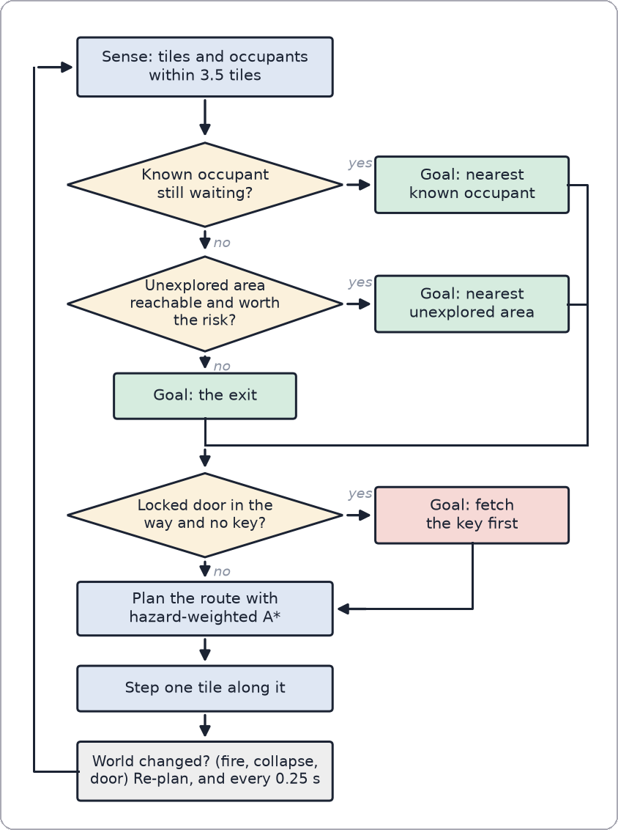
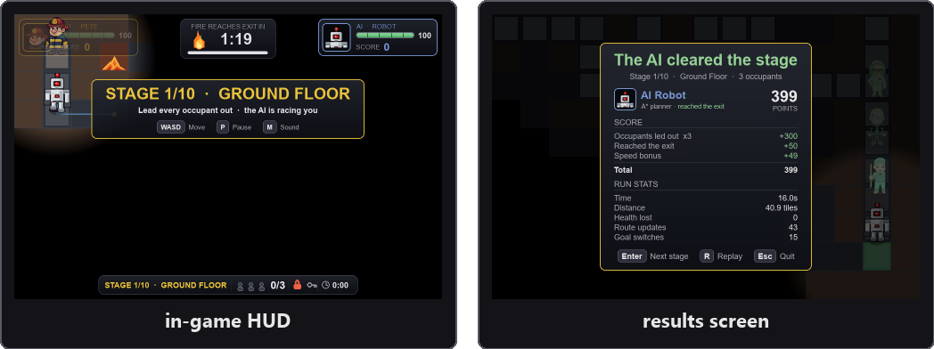
5
5 - Final AI Solution
Playable game + Autonomous rescue agent (robot or drone skin)
▸ Decision loop: Sense (vision radius) -> choose goal -> hazard-weighted A* plan -> step -> re-plan every 0.25 s
▸ Goal selection: Nearest KNOWN occupant by weighted distance; else nearest unexplored area; else the exit; key first if a door blocks the goal
▸ Techniques (from the brief's list): Search (BFS/Dijkstra/A*/Greedy) • Intelligent agent • Decision-making under uncertainty • Machine learning (optional second brain, imitates A*)
▸ Systems: Spreading fire + functional smoke • sparking panels • timed ceiling collapse • locked door + key • fog of war with memory
▸ Score: +100 per occupant led out • +50 for exiting • speed bonus • damage penalty
Pyro Pete: Emergency Evacuation · CT3201 Introduction to Artificial Intelligence Mini Project
6

Slide 7
6 - Evaluation and Testing
Phase 6, Stage 7 - Testing an AI recommendation with evidence
6
▸ AI recommendation tested: "Use Greedy Best-First - fewer node expansions, so it's faster."
Strategy | Path cost | Steps | Hazard tiles crossed
✗ BFS (unweighted) | 101.8 | 30 | 9
Dijkstra | 43.8 | 42 | 2
✓ A* | 43.8 | 42 | 2
✗ Greedy best-first | 43.8 | 42 | 2 (only when the straight line is safe)
▸ Appropriate? NO - 'fewer expansions' optimises the wrong thing. BFS/Greedy minimise tiles, not danger.
▸ Evidence: BFS route = 2.3x the cost through 9 burning tiles. A* = Dijkstra cost, fewer expansions -> optimal AND fast. Tested systematically (10 stages x 3 layouts x 5 fire times): Greedy costlier than A* in 98 of 150 situations, never cheaper.
▸ Decision: A* for routing; Greedy & BFS rejected; BFS kept only for unweighted jobs. Plus 12 unit tests.
Pyro Pete: Emergency Evacuation · CT3201 Introduction to Artificial Intelligence Mini Project
7

Slide 8
7 - Responsible AI
Phase 7, Stage 8 - Should this system be deployed?
7
Dimension | Assessment
Fairness | In-game the AI agent takes hazard damage & has the same vision as the human - fair by construction
Bias | Goal selection is greedy nearest-first: no triage, no notion of who is most at risk
Transparency | The agent DRAWS its planned route + walked trail - you can see what it decided and why it changed
Privacy | A real occupant-locator needs live location data on people - sensitive, must be minimised
Security | The agent trusts its hazard map; a spoofed feed could steer it (and followers) into a hazard
Accountability | If it leads someone into a collapse - operator? developer? sensor vendor? needs an audit log
Human oversight | It's decision-support, not an autonomous replacement for firefighters - the right posture
▸ Should it deploy? Not as an autonomous router (no triage, trusts its hazard map blindly) — yes as a transparent aid a trained rescuer can override, if the sensor feed's integrity is assured and triage replaces greedy nearest-first
Pyro Pete: Emergency Evacuation · CT3201 Introduction to Artificial Intelligence Mini Project
8

Slide 9

Critical Evaluation — What AI Got Wrong
Compulsory slide — What worked, what didn't, how it was verified
!
▸ What worked: Side-view (left/right) walk clips, concept art, the whole implementation
▸ What didn't: No working “toward camera” or “away from camera” walk, across multiple re-prompts — that axis never worked
▸ What AI got wrong: It treated “looks like a walk” as done; it never delivered a complete, 4-direction, production-ready set
▸ How verified: Checked against the engine's own requirements — 4 directions, fixed sprite size, feet-anchored — it met exactly one of four
▸ Corrected: Assembled the 4-direction set from mixed sources (front/back from the character sheet, one side frame mirrored) + a procedural walk bob
▸ This is the mandatory identified → verified → corrected example.
Pyro Pete: Emergency Evacuation · CT3201 Introduction to Artificial Intelligence Mini Project
9

Slide 10
8 - Human-AI Reflection
Phase 8, Stage 9 - MANDATORY
8
▸ AI helped: Explained tiles-vs-cost, listed search options, caught bad assumptions; later, built the whole UI rebuild fast (results, menus, pause, HUD, intro)
▸ AI got wrong: The video model couldn't animate toward/away from camera; recommended Greedy without weighing safe vs fast
▸ Accepted: Weighted costs, A*, partial observability, key sub-goal, connectivity-checked collapse, braided maze; later, the UI rebuild — reviewed screen by screen
▸ Rejected: Greedy & BFS for routing, full occupant map, AI-video for toward/away; later, AI opening PRs or merging into master unprompted
▸ Verified via: Search theory, a purpose-built harness, unit tests, assets vs engine requirements; later, real screenshots, the real test suite, the real game run end-to-end
▸ Human judgement was necessary for: Scope, tuning, seeing the AI failure was narrow, the Responsible-AI stance, judging the UI by eye
▸ If we'd blindly followed AI: Agent walks through fire (looks like bad balance, not a wrong algorithm); AI colliding with a teammate's work on master
▸ Learned: A technically-true claim (“fewer expansions”) can still be wrong for the problem; a git commit proves whose account, not who typed the code — verify evidence, not summaries
Pyro Pete: Emergency Evacuation · CT3201 Introduction to Artificial Intelligence Mini Project
10

Slide 11
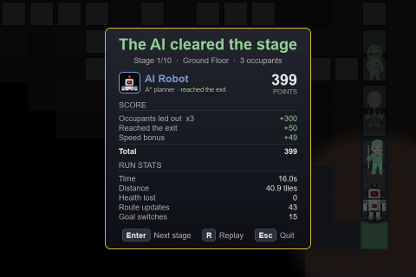
9 - Conclusion
9
▸ Designed the agent human-first, then used AI to challenge and broaden it
▸ AI moved us from unweighted BFS to a hazard-weighted A* agent that plans under partial information and re-plans as the building changes
▸ Tested an AI recommendation (Greedy) against a purpose-built comparison — found it inappropriate, rejected it with evidence
▸ The AI's clearest failure — directional NPC animation — was identified, verified, and corrected
▸ An optional learned-AI brain (imitating A*) was added and evaluated: it roughly matches A* on familiar stages and trails it on new ones — A* stays the default
▸ AI widened the option space and sped the work; the objective, the verification and every final decision were ours
Pyro Pete: Emergency Evacuation · CT3201 Introduction to Artificial Intelligence Mini Project
11

