Slide 1
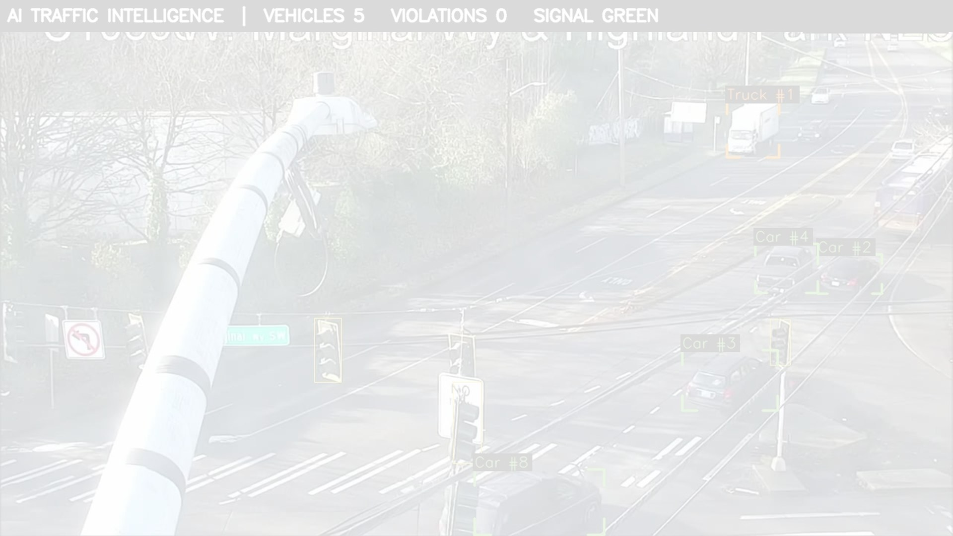
SECOND ROUND
From a system that works to a business that ships
AI Smart Traffic Intelligence Platform - how it gets onto Sri Lanka's roads
Team Three Hacks
Startup Innovation Competition 2026

Slide 2
WHAT THIS DECK ANSWERS
You asked us seven questions
Your question
Answered on
Who is the customer, and how do you sell it?
3
How do you connect with the Sri Lanka Police?
4 - 5
How do you import data from existing CCTV?
6 - 7
At scale, where does the zone data come from?
9 - 10
Revenue model - your cost, your earnings from a province
11 - 13
SWOT analysis
14
We have not re-pitched the detection. You already said it works.
How do you implement it, and what will go wrong?
15
PART 1 · BUSINESS
PART 2 · TECHNOLOGY
PART 3 · MONEY AND ROLLOUT
Who will buy it, and how we reach them. Slides 3-5
Camera, AI, data, maps, detection flow. Slides 6-10
Pricing, revenue, launch and risk. Slides 11-15

Slide 3
PART 1 · BUSINESS
Who benefits is not who signs
Segment
Who signs
Why they buy
Cycle
Municipal councils
Municipal Commissioner
Own CCTV, get no value from it
1-3 months
Sri Lanka Police - Traffic
Ministry of Public Security
Manpower gap; needs evidence
12-24 months
RDA / Expressways
Expressway Division
Speed enforcement already budgeted
6-12 months
Private fleets
Fleet owner
Insurance, liability, driver behaviour
2-6 weeks
Campuses, ports, BOI zones
Facilities head
Private roads - no legal complexity
2-6 weeks
Insurers and donor programmes
Head of Motor / programme manager
Risk pricing; road-safety targets with money
3-12 months
The police are our biggest customer and our slowest customer. Three students cannot live two years on no revenue - so the private track (fleets, campuses, ports: no procurement, signs in a week) funds the government track.

Slide 4
PART 1 · BUSINESS
We do not ask for a contract. We climb a ladder.
MONTH 0-3
Give away evidence, not enforcement
Free 30-day road-safety audit at one junction for one council. We issue ZERO fines. Nobody has to be brave to say yes.
MONTH 3-6
Get a named champion
Take that report to the National Council for Road Safety and Police Traffic HQ. Ask for a letter of support - free for them to give.
MONTH 6-12
Supervised enforcement pilot
One division. Every challan approved by an officer. We publish officer-time saved and the fall in the violation rate.
MONTH 12-24
Procurement - through a partner
Sub-contract under an integrator who already holds government vendor registration. A two-year problem becomes a two-month partnership.
Every rung is something the other side can say yes to without spending money or taking a risk.

Slide 5
PART 1 · BUSINESS
THE DESIGN DECISION THAT MAKES ENFORCEMENT POSSIBLE
The AI proposes. A police officer decides.
Built and running today - not a plan.
Every violation is PENDING until a named officer approves it. Until then the system refuses to print, export or email it - the block is in the server, not the screen.
Legal
Trust
Accuracy
Auditable
Evidence Act No. 14 of 1995 - a named human is accountable
No citizen is ever fined by a machine
Officer rejections measure our false-positive rate
Approve, reject and cancel are append-only. Even a session wipe is recorded
We are not asking a court, or a country, to trust an algorithm.

Slide 6
PART 2 · TECHNOLOGY
From a camera on a pole to a challan
1 CAMERA
2 EDGE BOX
3 DETECT
Existing council CCTV, our own camera, or a drone. We pull the video over the ONVIF / RTSP standard.
One small computer in the cabinet that is already there. It handles about four cameras.
The AI finds vehicles, riders, helmets, phones and plates, and gives every vehicle an ID it keeps as it moves.
4 MEASURE
5 JUDGE
6 EVIDENCE
The map calibration turns pixels into metres, so we get real speed and real position - not a guess.
Ten rules run at once. Each needs several frames of agreement before it will accuse anybody.
A photo stamped with plate, time, place and rule goes to an officer's queue. Approved, it becomes a challan.
Only step 6 ever leaves the site. Everything before it happens on the pole.

Slide 7
PART 2 · TECHNOLOGY
Cameras that are already on the poles
Almost every installed camera and recorder speaks ONVIF over RTSP. We pull a stream - no firmware change, no rewiring, nothing new on the pole.
Council CCTV
Our own camera
Drone
Installed and paid for. We just read it.
Where none exists, or the angle is wrong.
Already working today - we fly one.
Approach
Network load for 1,000 cameras
Verdict
Send every video stream to a central server
1,000 x 2 Mbps = 2 Gbps sustained, ~21 TB per day
Impossible
Detect at the edge, send EVENTS only
A challan is ~250 KB - about 5 Mbps average across the fleet
Runs on what exists
A 400x reduction in bandwidth - deployable on Sri Lankan municipal networks.
Honest caveat: most municipal CCTV was installed to watch for theft, not to read plates. Expect ~40% of any estate to be usable without repositioning - we survey and say so before anyone signs.

Slide 8
PART 2 · TECHNOLOGY
What the AI does with one frame
Detect
One pass of the model finds vehicles, people, helmets, phones and number plates.
Track
The same motorcycle keeps ID #47 across frames, so a rule can watch it over time instead of judging a snapshot.
Associate
Is this person actually ON that motorcycle? Overlap, centre and foot position are all checked - so a pedestrian is never fined.
Persist
Three to four frames must agree before any accusation. One bad frame is never enough.
Measure
Is it genuinely moving? Net displacement with camera shake removed, so a parked bike can never be fined.
Refuse
No calibration, no geometric rules at all. We deleted our own speed estimate rather than ship one that read 155 km/h for a parked car.
Four of those six steps exist to STOP it firing, not to make it fire. In a product whose output is evidence, that is the whole job.

Slide 9
PART 2 · TECHNOLOGY
Where the zone data comes from
Today a human clicks four corners of the road per clip. Fine for five cameras, impossible for five thousand. We had been mixing up two kinds of data:
Kind of data
Example
Per camera?
Cost
Camera geometry - where the ground plane sits in THIS image
4-point homography, metres per pixel
Yes. Unavoidable.
Minutes, once
World knowledge - what the law says about this piece of road
Speed limit, no-parking, one-way, stop line
No. It belongs to the map.
Once, nationally
Fix the geometry by dragging 4 points on the image and 4 on a satellite map. That one act gives speed, stop lines, direction and no-parking zones.
4 min
67 hrs
2 people
Auto
per camera, once
for 1,000 cameras
2 weeks, a province
re-flags if moved
That is a line item on a budget. It is not a blocker.

Slide 10
PART 2 · TECHNOLOGY
The world data already exists
WE IMPORT IT ONCE, NATIONALLY
SIX OF TEN RULES NEED NO MAP AT ALL
RDA road register - road class and centrelines
Survey Dept / GIS - built-up boundaries = the legal 50 km/h limit
Council gazetted schemes - no-parking, one-way, bus halts
OpenStreetMap - maxspeed, oneway, crossings, schools
Motor Traffic Act defaults - where nothing is known, the law is the data
Learned proposals - reviewed and approved by a human, never auto-enforced
Live on day one: No Helmet · Triple Riding · Wheelie / stunt riding · Mobile Phone Use · No Rest Break
Waiting on a model: No Seatbelt
After geo-registration: Over Speeding · Wrong Way · Red Light Jump
After zone import: Illegal Parking
They do not wait by guessing. They wait by switching off.
So we deploy on day one and enrich over weeks. The customer sees value in week one, not month six.

Slide 11
PART 3 · MONEY AND ROLLOUT
How you subscribe or licence it
Tier
Who it is for
Price
Audit
First contact. 30-day report, no fines issued
Free
Enforce
Per camera. All rules, dashboard, officer review queue
LKR 3,500 / camera / month
Enforce + ANPR
Adds plate recognition, owner lookup, PDF challan
LKR 5,500 / camera / month
No-upfront option
Same service, setup and hardware rolled in over 3 years
LKR 5,000 / camera / month
Fleet
Bus, logistics, plantation, courier. Driver scorecards
LKR 1,000 / vehicle / month
Provincial Licence
Ministry / Police HQ. Unlimited cameras, ON-PREMISE, SLA
LKR 12,000,000 / province / year
Site Activation
One-time: survey, geo-registration, zone import, training
LKR 45,000 / camera
Anchor on the alternative
Operating cost, not capital
Publish volume tiers early
Not on our cost. Three constables cover one point 24/7 for ~LKR 300,000/month.
A council approves a monthly line; a purchase needs a tender. Hence no-upfront.
100+ LKR 3,000 · 500+ LKR 2,600 · 2,000+ LKR 2,200. Never negotiate from zero.
Free to enter, cheap to start, cheaper at scale, and never a capital purchase.

Slide 12
PART 3 · MONEY AND ROLLOUT
Is this the right price for Sri Lanka?
Buyer
What they pay us
Compared with
Verdict
Council, 40 cameras
LKR 1.68M / year
Less than 2 constables cost for a year
Fits an existing budget line
Police HQ, one province
LKR 12M / year
A rounding error against the Police budget
No new budget vote needed
Fleet, 25 vehicles
LKR 1,000 / vehicle / month
About 10% of a commercial motor premium
Free at a 10% premium discount
Versus imported software
~USD 140 / camera / year
Imported ANPR licences run USD 200-1,000
We are 3-7x cheaper
Roughly 50x cheaper per point-hour than three constables. Margin ~74%.
The real pricing risk is not the price. It is getting paid.
Government here pays in 90 to 180 days, and that is what kills small vendors. So: 25% of activation invoiced up front, the provincial licence billed quarterly in advance, and private-sector revenue held as working capital.

Slide 13
PART 3 · MONEY AND ROLLOUT
Western Province, three years
Year 1 - prove it
Year 2 - own it
Year 3 - expand
Cameras live
80
600
2,200 (4 provinces)
Subscriptions + licences
2.9M
44.4M
166.8M
Activation, hardware, fleet
7.9M
37.4M
135.0M
TOTAL REVENUE
10.8M (~$36k)
81.8M (~$273k)
301.8M (~$1.0M)
Total cost
21.6M
64.0M
-
NET
-10.8M (this is the ask)
+17.8M BREAKEVEN
-
All figures LKR, assuming LKR 300 = USD 1. Our own modelled assumptions with the working shown - not published facts.
Saturated, Sri Lanka is only ~USD 1.6M of recurring revenue. We will say that before you do. It is the right market to PROVE this in - the same product, unchanged, fits Bangladesh, Nepal, Vietnam and East Africa, where the traffic mix is identical and the death rate is worse.

Slide 14
PART 3 · MONEY AND ROLLOUT
SWOT - an honest one
STRENGTHS
WEAKNESSES
It exists - 10 rules on live video, 85 tests, our own evidence
Built for Sri Lankan traffic: bikes, three-wheelers, mixed lanes
It refuses to guess - no calibration, no speed reading
CPU-capable and edge-first: cheap to run
Local team, local cost base, same-afternoon support
No revenue, no reference customer, no registered company
No measured accuracy figure yet - a court will ask
Seatbelt rule disabled: the model we got is unusable
Three part-time students; no procurement or legal experience
We depend on camera quality we do not control
OPPORTUNITIES
THREATS
~3,000 deaths a year; enforcement is still manual and spot-based
Existing municipal CCTV is a sunk asset we can activate
PDPA 2022 compliance is a moat foreign vendors handle badly
Donor funding needs no police budget line
Fleet and insurance markets need no government sale at all
Hikvision / Dahua / Huawei bundling ANPR free with hardware
Tenders written around an incumbent, or never issued
Government paying 90-180 days late
One high-profile false positive destroying trust
We are students - graduation is a continuity risk

Slide 15
PART 3 · MONEY AND ROLLOUT
Launch, risks, and what we need
HOW WE LAUNCH IT
WHAT WILL GO WRONG
WHAT WE NEED
0-3 mo Incorporate. Publish real accuracy. PDPA assessment. (Officer review queue: done.)
2-5 mo Free 30-day audit, 1 council.
4-7 mo Letter from NCRS / Police HQ.
6-12 mo Supervised pilot, 20-40 cameras.
3-12 mo In parallel: 8 fleets, 2 campuses.
12-24 mo Western Province, 600 cameras. Breakeven.
24-36 mo 3 provinces + first export.
Procurement takes 2 years -> private revenue funds us; go via an integrator
Is AI evidence admissible? -> officer approves every fine; audit trail; calibration certificate
Privacy backlash -> no face recognition, ever. Plates only, 90-day purge
Cameras are the wrong quality -> survey and say so before anyone signs
Government pays late -> bill in advance, hold private revenue as buffer
A wrong fine -> human gate (built), one-click dispute, publish our error rate
'Make this challan disappear' -> append-only trail; even a session wipe is recorded
LKR 15M (~USD 50,000) for 18 months of runway. 60% salaries.
And four things that are not money:
1. A letter of support from NCRS or Police Traffic HQ
2. One council to host a free 30-day audit
3. An introduction to a registered government IT integrator
4. Access to a labelled Sri Lankan traffic dataset
We already built the hard part. We are asking for the boring part: one council, one letter, one pilot. Thank you - we are happy to take your questions.

