Slide 1
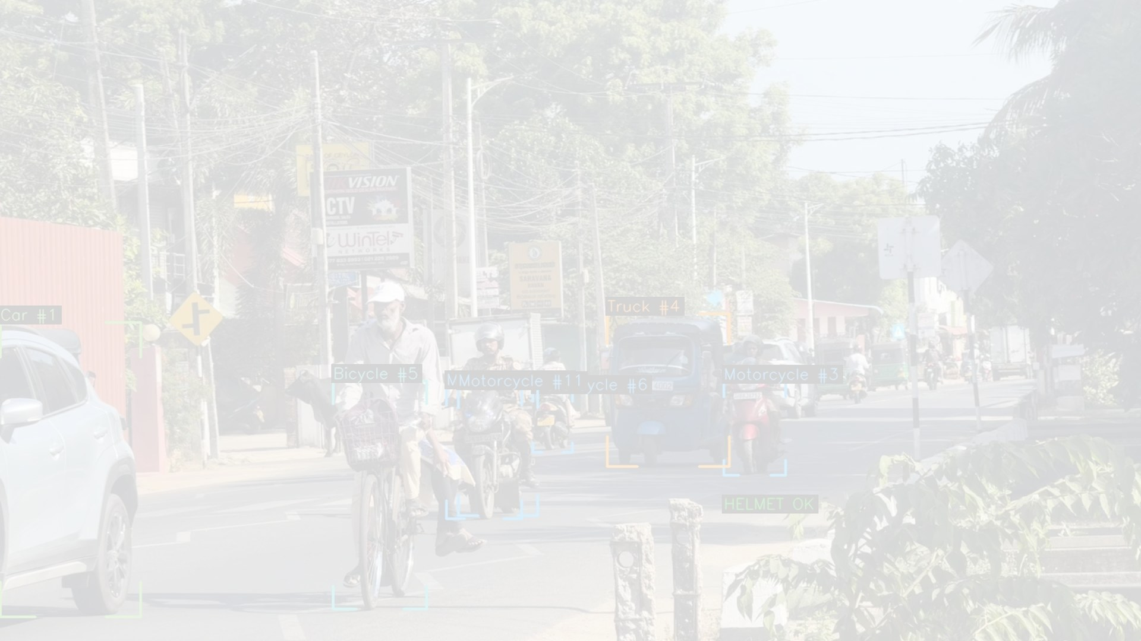
AI Smart Traffic Intelligence Platform
Turning any camera feed into fair, evidence-based enforcement
Team Three Hacks | Startup Innovation Competition 2026
9
85
83-163
violation types live today
automated tests passing
km/h speed verified

Slide 2
PROBLEM STATEMENT
Every day, people die on roads a camera was watching
Sri Lanka records roughly 3,000 road deaths a year, most of them from violations that are simple to see.
Officers cannot stand at every junction, 24 hours a day. Enforcement is limited by how many people we can hire.
A fine written without a photo and a verified plate is argued about, and often never paid.
Nothing is recorded in a searchable way, so repeat offenders stay invisible.
The gap is not cameras. The gap is coverage and proof.

Slide 3
WHY NOW
The opportunity
What already exists
What is missing
Colombo alone has over 100 road cameras already installed.
Police already issue spot fines - the legal framework is in place.
Phones and drones make any road coverable today, with no civil works.
Those cameras are watched by a person, or by nobody at all.
There is no automatic path from camera to challan to payment.
Enforcement grows with headcount, not with technology.
We do not need new cameras. We need intelligence behind the ones already there.

Slide 4
THE PRODUCT
Our solution
One AI pipeline on an ordinary camera that judges traffic violations of any kind we teach it.
Reads number plates on every vehicle, not only on offenders.
Measures real road speed using surveyed road geometry.
Issues an e-challan with stamped photographic evidence, sent to the police automatically.
Camera -> YOLOv8s -> ByteTrack -> Homography -> Violation engine -> ANPR -> e-Challan
Runs on a single laptop CPU. No new hardware to install.

Slide 5
THE PIPELINE
How it works, in six steps
1
2
3
See
Follow
Measure
YOLOv8s finds vehicles, riders, helmets and plates in each frame
ByteTrack gives every vehicle an identity it keeps across frames
Four surveyed road corners turn pixels into real metres
4
5
6
Judge
Identify
Act
The rule engine runs, each rule behind motion and persistence gates
OCR reads the plate; three agreeing reads confirm it
An e-challan with photo evidence is generated and emailed
Every step runs live. Nothing is pre-recorded and nothing is faked.

Slide 6
CAPABILITY AND EXTENSIBILITY
A rule engine, not a fixed feature list
Nine rules are live today. Each is a small module over the same detection and tracking core, so the tenth is days of work, not a new product.
No Helmet
Triple Riding
Over Speeding
Red Light Jump
Wrong Way
No Seatbelt
Mobile Phone Use
Illegal Parking
No Rest Break
Already asked for and straightforward to add: lane discipline, unauthorised bus-lane use, overloaded three-wheelers, number-plate obscuring, pedestrian-crossing blocking.
Plus ANPR on every tracked vehicle, building a searchable enforcement log underneath all of it.

Slide 7
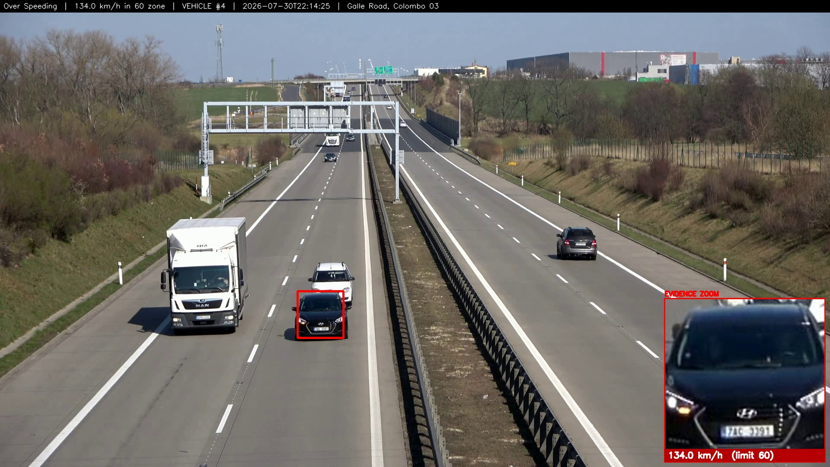
VERIFIED SYSTEM OUTPUT
Proof: over-speeding
134.0 km/h in a 60 zone - vehicle boxed, plate zoomed, proof stamped onto the image. 7 events measured at 83-163 km/h across two calibrated cameras.

Slide 8
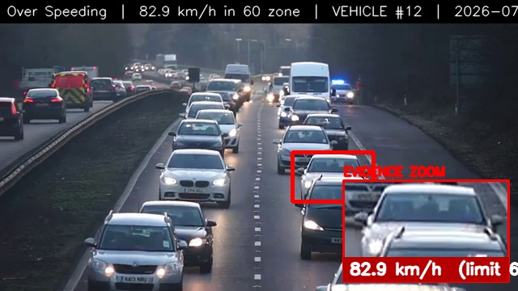
HOW THE NUMBER IS EARNED
Proof: speed is measured, not guessed
We survey four road corners and map pixels to metres, then fit distance against time across many frames and reject outliers. Replay accuracy: 0.99-1.01x true speed. An uncalibrated camera shows no speed at all.

Slide 9
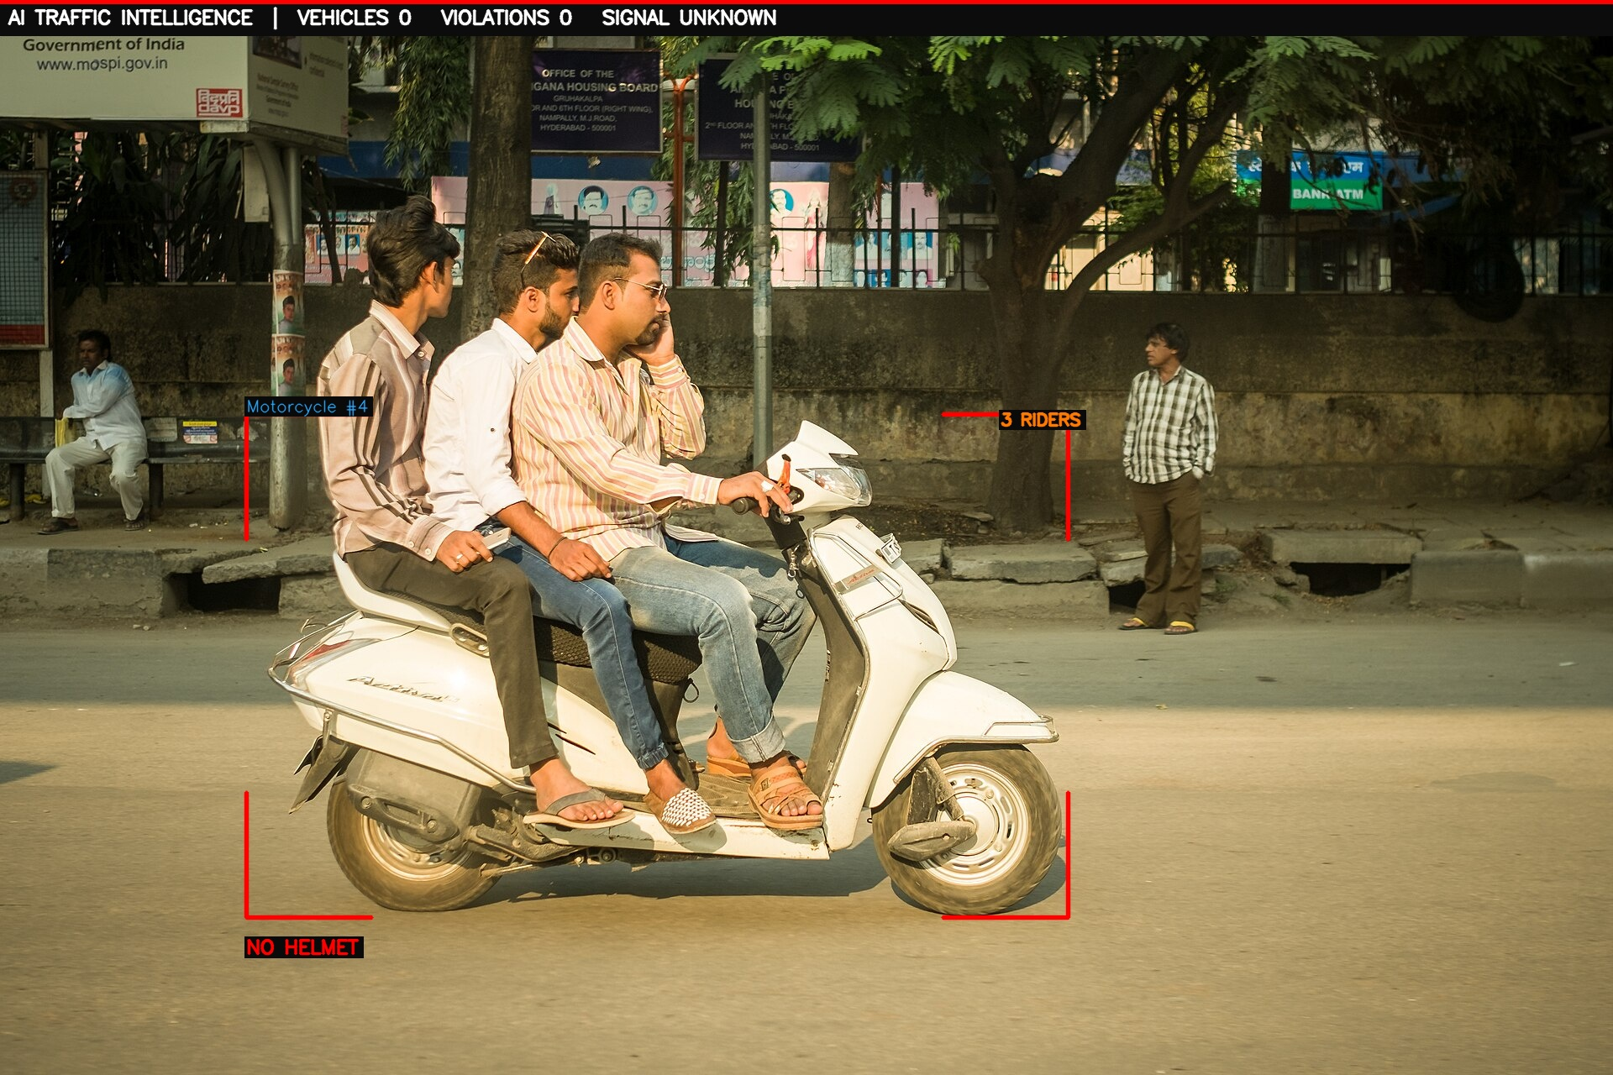
VERIFIED SYSTEM OUTPUT
Proof: helmet and triple riding
Both violations detected from a single photograph, producing two separate challans. Riders are matched to their motorcycle geometrically, so a bystander on the pavement is never counted.

Slide 10
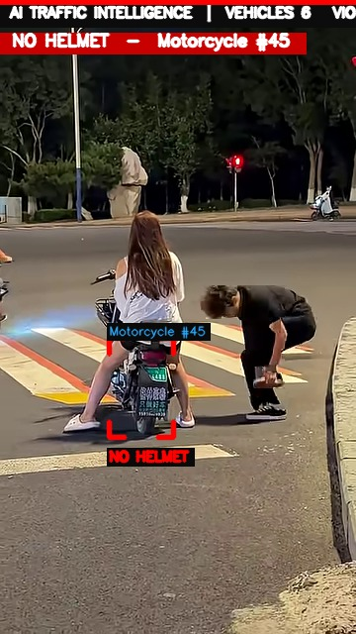
PRECISION, NOT JUST DETECTION
Proof: the bystander is not counted
The rider is fined for no helmet. The person crouching beside the bike is not counted as a rider, and the scooter behind is not accused. Anyone can draw a box. Judging correctly is the hard part.

Slide 11
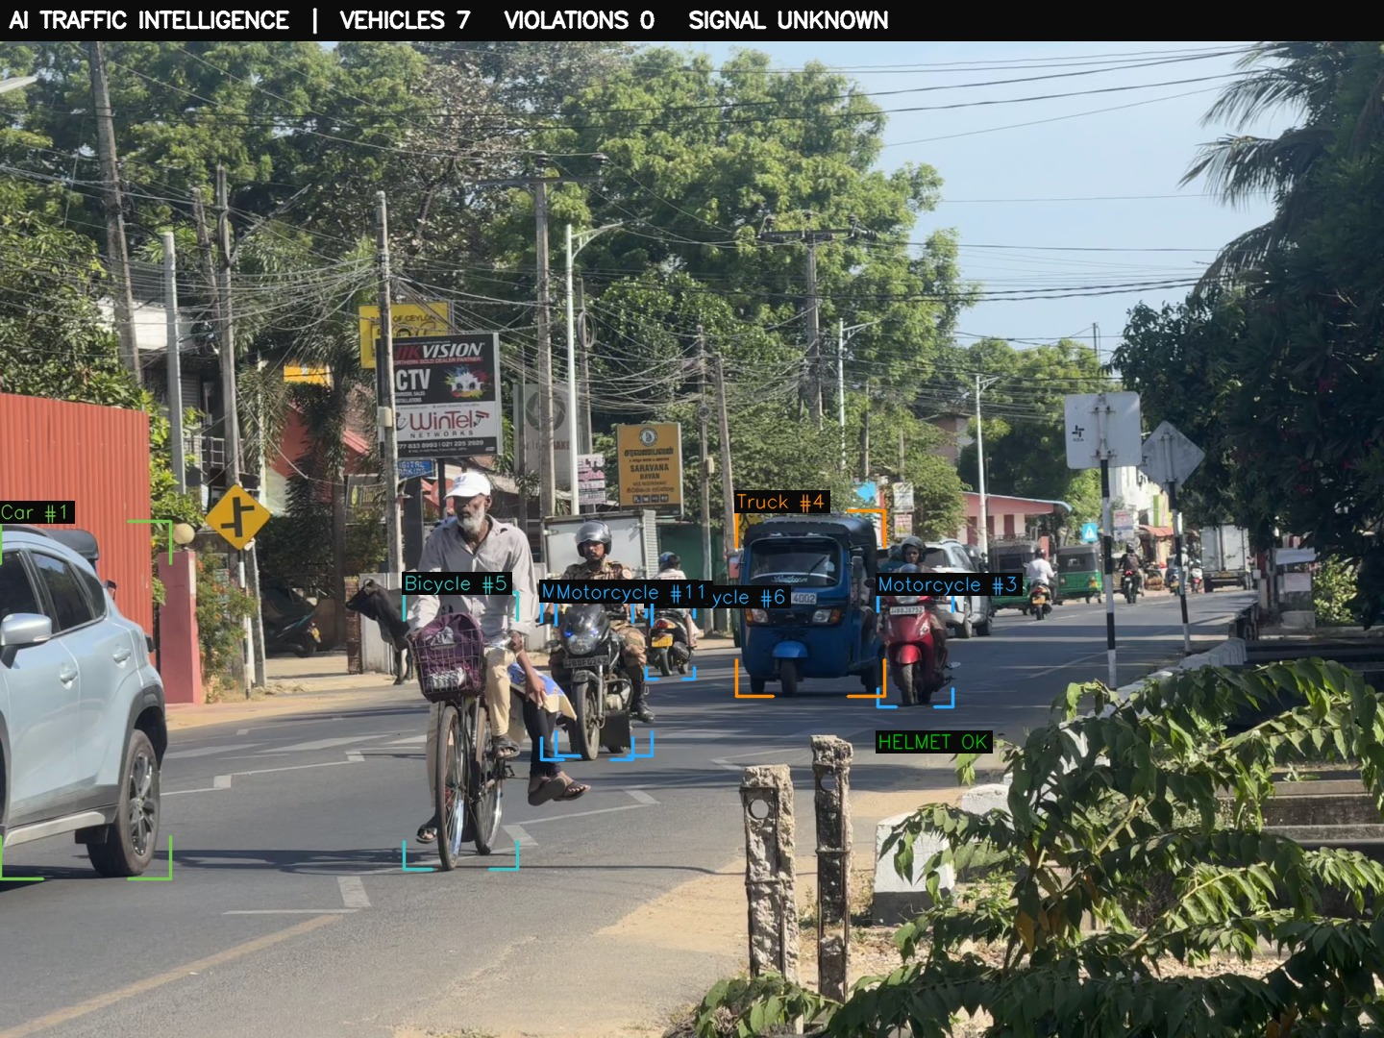
ANPR ON A REAL SRI LANKAN ROAD
Proof: number-plate recognition
150 vehicles tracked; plates AAG 4002 and BBJ 8752 read and confirmed. A plate is written to a challan only when three separate reads agree - otherwise it says UNREADABLE.

Slide 12
AN HONEST ENGINEERING ANSWER
Every rule needs the right camera view
Helmet, triple riding
Any view where the rider is visible
Demonstrated on real footage
Over speeding
Four surveyed road corners, so pixels become metres
Demonstrated - 83-163 km/h, two cameras
Red light jump
The stop line, and which signal head governs the lane
Fires once calibrated; never guessed
Illegal parking
A fixed camera, so stillness can be proven
Needs a mounted camera, not hand-held video
No seatbelt, phone use
A front view of the driver, close enough to resolve
Fleet cameras have it; road CCTV does not
Every rule is built and tested. We demonstrate only what our footage genuinely contains.

Slide 13
THE REAL DIFFERENTIATOR
Why it can be trusted
Parked vehicles are never fined - 41 vehicles, 0 violations on a parked-motorcycle clip.
Unreadable plates say UNREADABLE - a number is never invented.
No calibration means no speed shown, rather than a misleading guess.
A violation must persist across frames - one-frame anomalies rejected.
A model that cannot prove itself is switched off, not trusted.
8
85
0
false-positive defects found and fixed
automated tests passing
violations on parked bikes

Slide 14
ENGINEERING RIGOUR
Found by testing on real roads
Our own seatbelt model was broken
It called a belted driver, and an empty road, 'no seatbelt'. We disabled the rule rather than ship it
A stopped car fined for a red light
A signal from a different junction approach was applied to it
Helmeted riders accused of no helmet
The helmet crop was catching neighbouring riders
A sleeping driver flagged as 'on phone'
A marginal 0.36 detection on a dark steering column
Speeds shown on uncalibrated cameras
Meaningless numbers where no perspective calibration exists
We found these in our own system and fixed them. Each one is now an automated test.

Slide 15
INNOVATION AND UNIQUENESS
What makes it different
Typical systems
Ours
Single purpose - a speed camera, or a plate reader.
Report a number with no proof attached.
Demo well, then fail on real roads with false positives.
Need dedicated hardware installed at each site.
One engine, many rules, on any camera.
Evidence-first: every fine carries a stamped photo and plate crop.
Engineered to refuse - it reports only what it can prove.
Runs on cameras that already exist, on a laptop CPU.

Slide 16
TARGET USERS AND MARKET
Who it is for
Primary users
Why they buy
Sri Lanka Police traffic division - automated enforcement on existing junction cameras.
Road Development Authority and municipal councils - highway corridors, school and hospital zones.
Commercial fleet operators - seatbelt and fatigue compliance for buses and lorries.
Enforcement reach without hiring proportionally more officers.
Evidence that survives dispute, so fines are actually collected.
Data on where violations concentrate, to target scarce resources.
Fleet operators cut insurance exposure and liability.
Entry point: a single pilot junction. Expansion: corridor, then city.

Slide 17
HOW IT SUSTAINS ITSELF
Business model
Pilot deployment fee
One-off setup and calibration per camera site
Annual software licence
Per-camera subscription covering updates and model improvements
Support and analytics tier
Dashboards, reporting and repeat-offender analytics for authorities
Fleet compliance package
Per-vehicle monitoring sold to commercial operators
Cost advantage: no new cameras and no per-site hardware, so a pilot is software and calibration only.

Slide 18
ECONOMIC, SOCIAL, ENVIRONMENTAL
Sustainability
Economically self-sustaining
Socially and environmentally sound
Runs on infrastructure already paid for.
One laptop starts a pilot; no civil works, no gantries.
Recovered fines fund expansion without new capital.
Fairness: identical rules for every driver, no discretion.
Fewer deaths through deterrence, not punishment.
Lower emissions - smoother traffic, fewer crash-related jams.
Privacy-respecting: plates confirmed three times or marked unreadable; no identity inference.

Slide 19
WHERE THIS GOES
Scalability and future plans
Now
Working system, 85 tests, verified on real Sri Lankan road footage
Next 3 months
Live pilot at one signalised junction with police partnership; night and rain models
6-12 months
Corridor deployment on GPU edge boxes; a trained three-wheeler class for local traffic
Beyond
City-wide multi-camera dashboard; export to comparable South Asian markets
The accuracy ceiling is compute, not architecture
Today we run YOLOv8s on a laptop CPU - chosen because it fits, not because it is the best available. The detector is one swappable file: on GPU hardware the same pipeline takes YOLO11x, RT-DETR or DINO with no change to a single rule.

Slide 20
TECHNICAL ROADMAP
What more compute buys us
We benchmarked five detectors on our own footage. Every rule sits on one detector interface, so upgrading is a file swap, not a rewrite.
Laptop CPU (today)
YOLOv8s
2.5 analysed frames/sec. We measured yolo11m finding 32% more riders per frame - but running 3.6x slower, so it sees fewer frames and delivers LESS. On CPU, yolov8s wins.
GPU edge box (pilot)
YOLO11m / YOLO11x
Frame dropping disappears, so raw recall wins instead of speed. The same measurement now ranks yolo11m first.
Server GPU (city scale)
RT-DETR, DINO
Transformer detectors handle dense, overlapping traffic far better - exactly our junctions at rush hour.
Open-vocabulary (research)
Grounding DINO, VLMs
Describe a new violation in words instead of collecting and labelling a dataset for it.
The hard part - the rules that refuse to guess - is the part that does not need replacing.

Slide 21
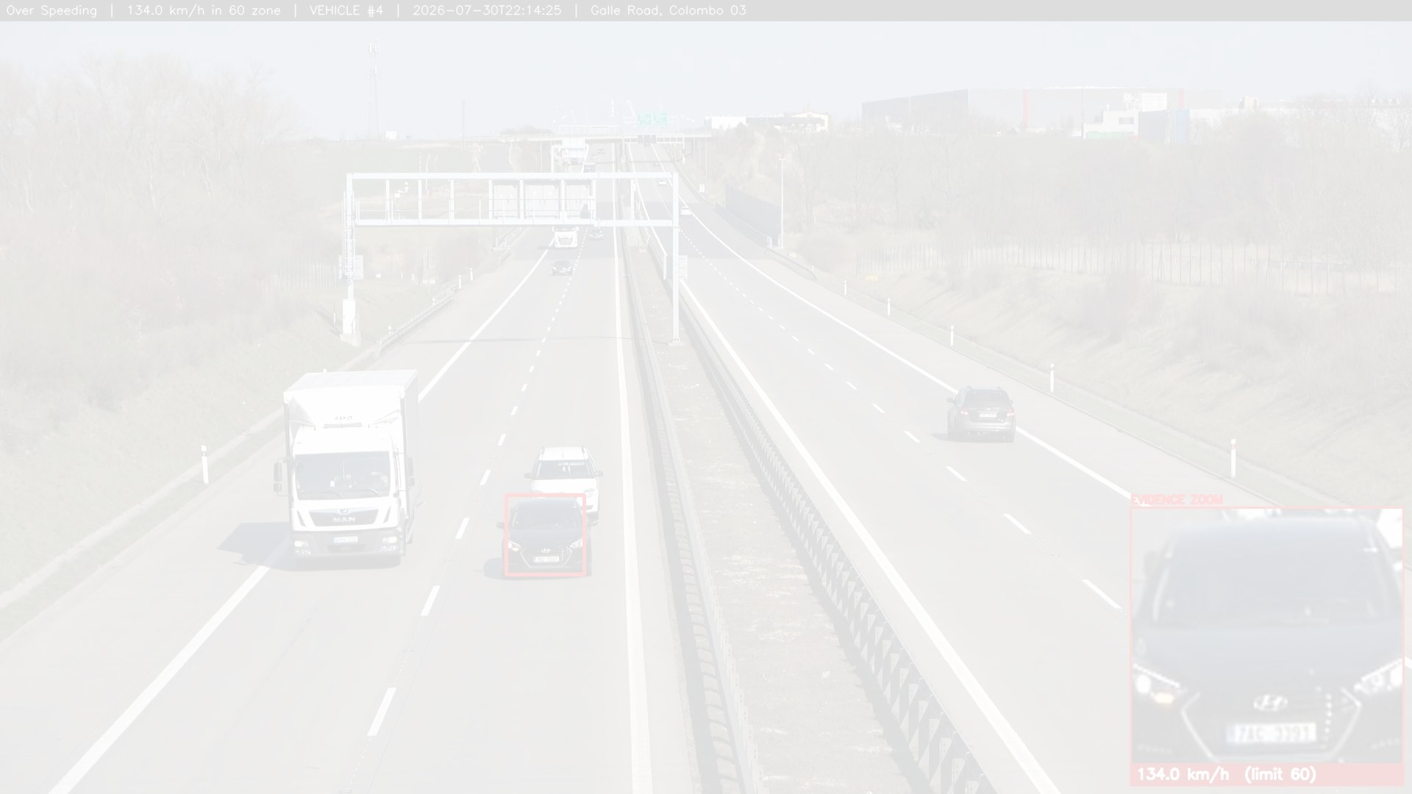
Safer roads, proven by evidence.
Real speed. Verified plates. Automatic challans, with the photograph attached.
On cameras this country already owns.
Thank you. We are happy to take your questions.
Team Three Hacks | github.com/Jeba-Jebarsan/AI-SMART-TRAFFIC-INTELLIGENCE

