Slide 1
AI Smart Traffic Intelligence Platform
Turning any camera feed into fair, evidence-based enforcement
Team Three Hacks | Startup Innovation Competition 2026
9
79
83-163
violation types
automated tests
km/h speed verified

Slide 2
PROBLEM STATEMENT
The problem
Sri Lanka records roughly 3,000 road deaths a year, most from preventable violations.
Officers cannot watch every junction, 24 hours a day - enforcement is a human bottleneck.
Violations recorded without photographic proof or a verified plate are disputed and go unpaid.
No searchable record means repeat offenders go unnoticed.
Coverage and proof are the enforcement gap.

Slide 3
WHY NOW
The opportunity
What already exists
What is missing
Colombo alone has over 100 road cameras already installed.
Police already issue spot fines - the legal framework is in place.
Smartphones and drones make any road coverable today.
Those cameras are watched by people, or not at all.
No automatic link from camera to challan to payment.
Enforcement scales with headcount, not with technology.
We do not need new cameras. We need intelligence behind the ones already there.

Slide 4
THE PRODUCT
Our solution
One AI pipeline on an ordinary camera detects nine violation types.
Reads number plates on every vehicle, not only offenders.
Measures real road speed through geometric calibration.
Issues an e-challan with stamped photographic evidence, delivered to the police automatically.
Camera -> YOLOv8s -> ByteTrack -> Homography -> Violation engine -> ANPR -> e-Challan

Slide 5
CAPABILITY
Nine violations, one pipeline
No Helmet
Triple Riding
Over Speeding
Red Light Jump
Wrong Way
No Seatbelt
Mobile Phone Use
Illegal Parking
Driver Fatigue
Plus ANPR on every tracked vehicle, building a searchable enforcement log.

Slide 6
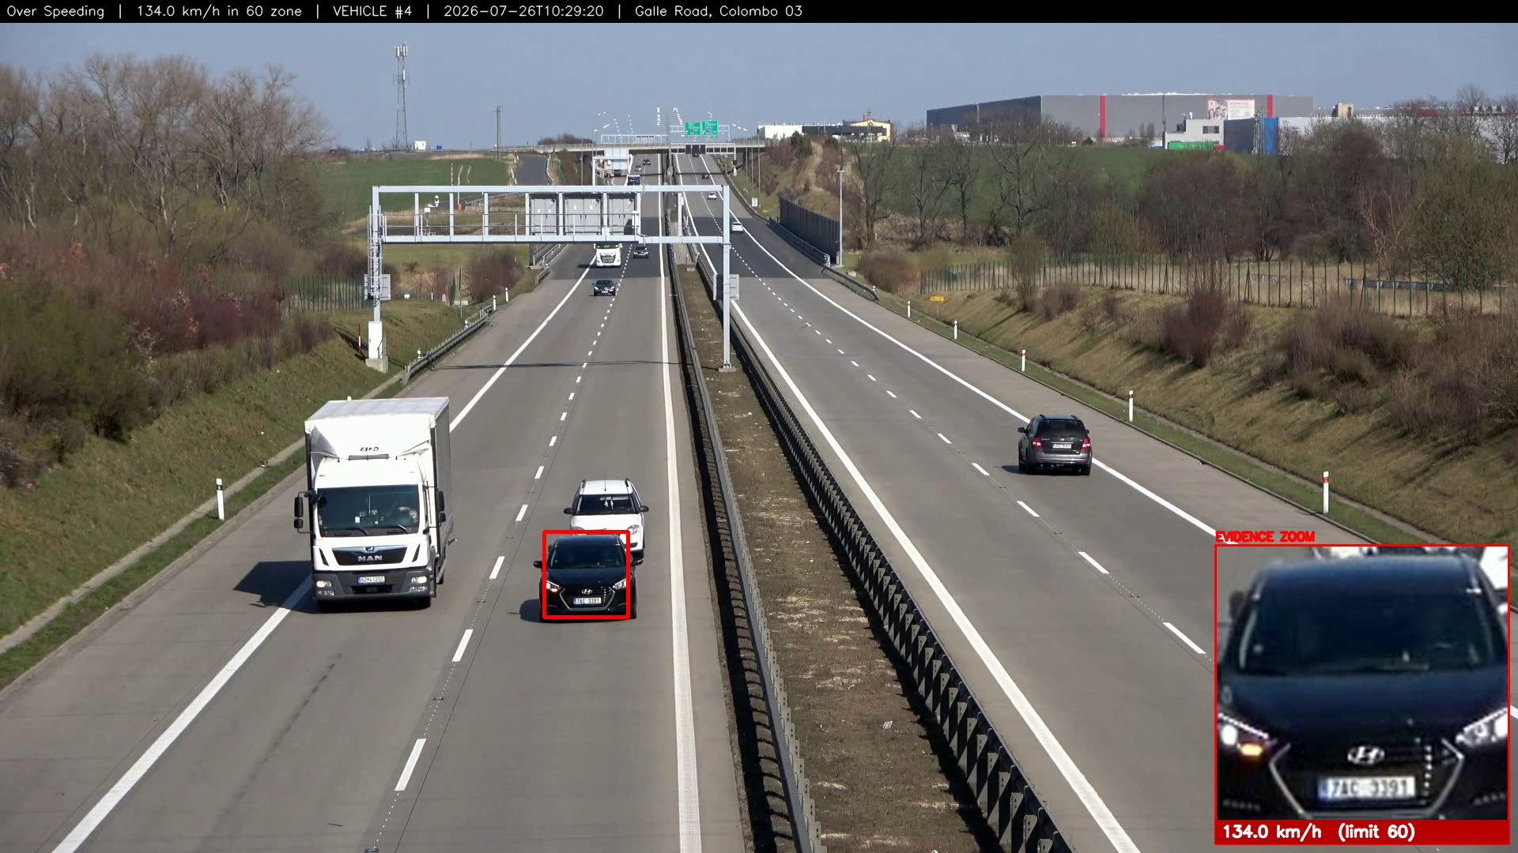
VERIFIED SYSTEM OUTPUT
Proof: over-speeding
134.0 km/h in a 60 zone - vehicle boxed, plate zoomed, proof stamped onto the image. 7 events measured at 83-163 km/h across two cameras.

Slide 7
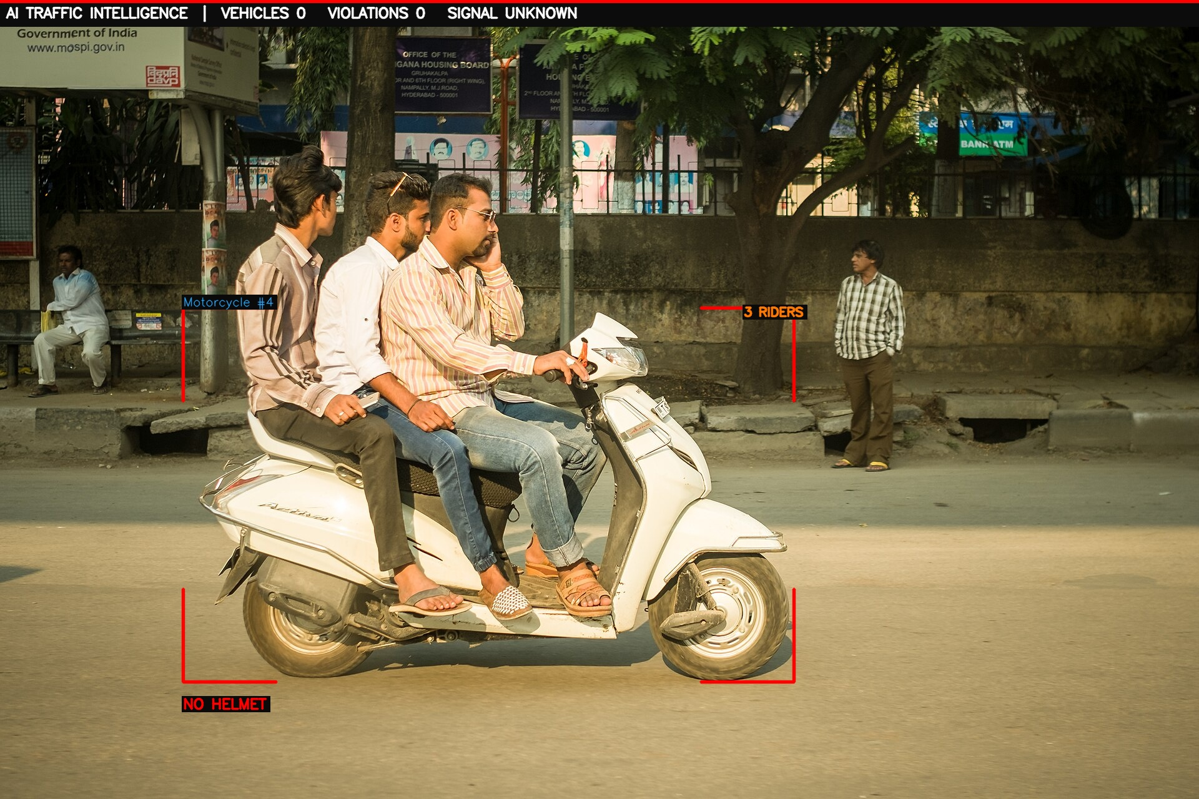
VERIFIED SYSTEM OUTPUT
Proof: helmet and triple riding
Both violations detected from a single uploaded photograph, producing two separate challans.

Slide 8
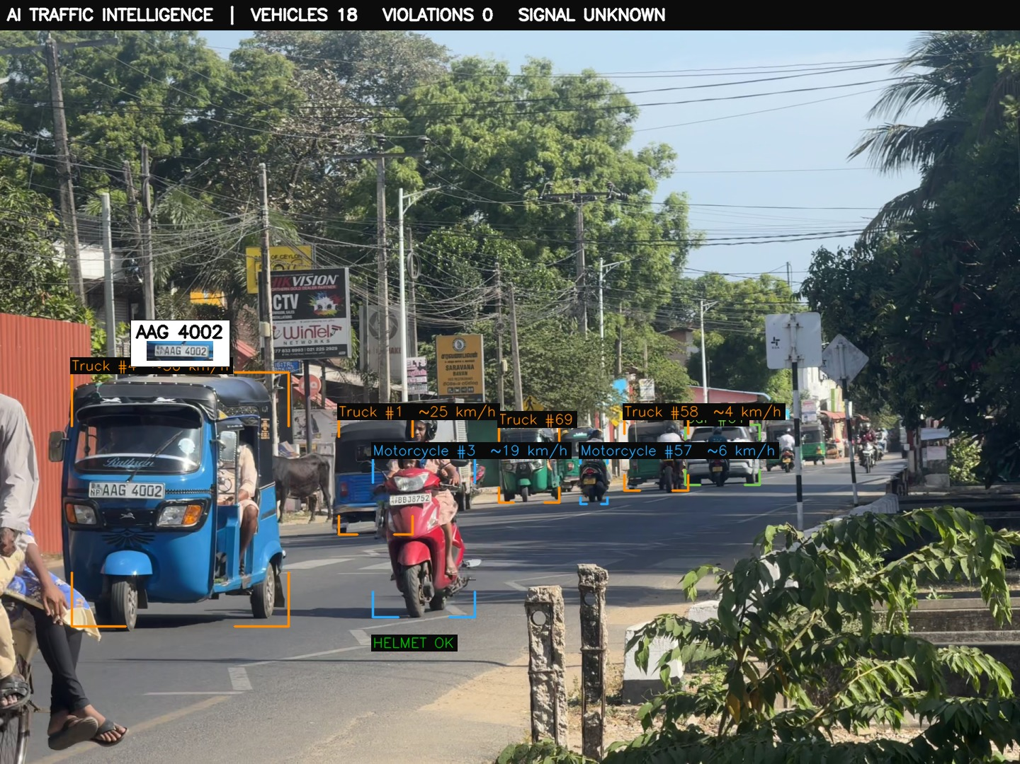
VERIFIED SYSTEM OUTPUT
Proof: number-plate recognition
Live Sri Lankan road: 18 vehicles tracked, plate AAG 4002 read and confirmed. A plate counts only when three separate reads agree.

Slide 9
INNOVATION AND UNIQUENESS
What makes it different
Typical systems
Ours
Single purpose - a speed camera, or a plate reader.
Report a number with no proof attached.
Demo well, then fail on real roads with false positives.
Need dedicated hardware at each site.
Nine rules in one pipeline, on any camera.
Evidence-first: every fine carries a stamped photo and plate crop.
Engineered to refuse - it reports only what it can prove.
Runs on cameras that already exist, on a laptop CPU.

Slide 10
THE REAL DIFFERENTIATOR
Why it can be trusted
Parked vehicles are never fined - 41 vehicles, 0 violations on a parked-motorcycle clip.
Unreadable plates say UNREADABLE - a number is never invented.
No calibration means no speed shown, rather than a misleading guess.
A violation must persist across frames - one-frame anomalies rejected.
No mock data exists anywhere in the product.
6
79
0
false-positive defects found and fixed
automated tests passing
violations on parked bikes

Slide 11
ENGINEERING RIGOUR
Found by testing on real roads
Moving vehicles fined for parking
Motion gate misjudged 89% of moving vehicles as stationary
Helmeted riders accused of no helmet
Helmet crop was catching neighbouring riders
Bare heads marked compliant
Compliance threshold was lower than the accusation threshold
Stopped car fined for a red light
A signal from a different approach was applied to it
Wrong plate numbers on challans
Two agreeing OCR reads could both be wrong
We fixed cases where our own system accused the wrong person. Each is now a test.

Slide 12
TARGET USERS AND MARKET
Who it is for
Primary users
Why they buy
Sri Lanka Police traffic division - automated enforcement on existing junction cameras.
Road Development Authority / municipal councils - highway corridors, school and hospital zones.
Commercial fleet operators - seatbelt and driver-fatigue compliance for buses and lorries.
Enforcement reach without hiring proportionally more officers.
Evidence that survives dispute, so fines are actually collected.
Data on where violations concentrate, to target scarce resources.
Fleet operators reduce insurance exposure and liability.
Entry point: a single pilot junction. Expansion: corridor, then city.

Slide 13
HOW IT SUSTAINS ITSELF
Business model
Pilot deployment fee
One-off setup and calibration per camera site
Annual software licence
Per-camera subscription covering updates and model improvements
Support and analytics tier
Dashboards, reporting and repeat-offender analytics for authorities
Fleet compliance package
Per-vehicle monitoring sold to commercial operators
Cost advantage: no new cameras and no per-site hardware, so a pilot is software and calibration only.

Slide 14
ECONOMIC, SOCIAL, ENVIRONMENTAL
Sustainability
Economically self-sustaining
Socially and environmentally sound
Runs on infrastructure already paid for.
One laptop starts a pilot; no civil works, no gantries.
Recovered fines fund expansion without new capital.
Fairness: identical rules for every driver, no discretion.
Fewer deaths through deterrence, not punishment.
Lower emissions - smoother traffic and fewer crash-related jams.
Privacy-respecting: plates confirmed three times or marked unreadable; no identity inference.

Slide 15
PRACTICAL AND MODULAR
Deployment
Works with existing CCTV, a phone stream, or a drone via OBS.
A pilot site runs on a single laptop; cities use GPU edge boxes.
Helmet, seatbelt, plate and three-wheeler models are drop-in files - no code change.
Python, FastAPI, YOLOv8, ByteTrack, OpenCV, EasyOCR, SQLite.
Dashboard is a single self-contained HTML file, no external dependencies.

Slide 16
WHERE THIS GOES
Scalability and future plans
Now
Working system, 79 tests, verified on real Sri Lankan road footage
Next 3 months
Live pilot at one signalised junction with police partnership
6-12 months
Corridor deployment; night and adverse-weather models; trained three-wheeler class for local traffic
Beyond
City-wide multi-camera dashboard; vision-language models for ambiguous cases; export to comparable South Asian markets
Each camera added is software only - marginal cost falls as coverage grows.

Slide 17
Safer roads, proven by evidence.
Nine violation types. Real speed. Verified plates. Automatic challans.
On cameras this country already owns.
Team Three Hacks | github.com/Jeba-Jebarsan/AI-SMART-TRAFFIC-INTELLIGENCE

