Slide 1
Team ID : H26DSI07 Project Title : SENTINEL – AI ( An Autonomous application security platform focusing SAST) Team Leader : JEBIN RUFUS R Team Members : 1. JOSHUA DANIELL A 2. HARSHINI A College : RAJALAKSHMI INSTITUTE OF TECHNOLOGY

Slide 2
PROBLEM STATEMENT
As software systems become larger and AI accelerates software development, security vulnerabilities are becoming harder to identify. Current static analysis tools often struggle to understand application context, leading To incomplete or less effective security analysis

Slide 3
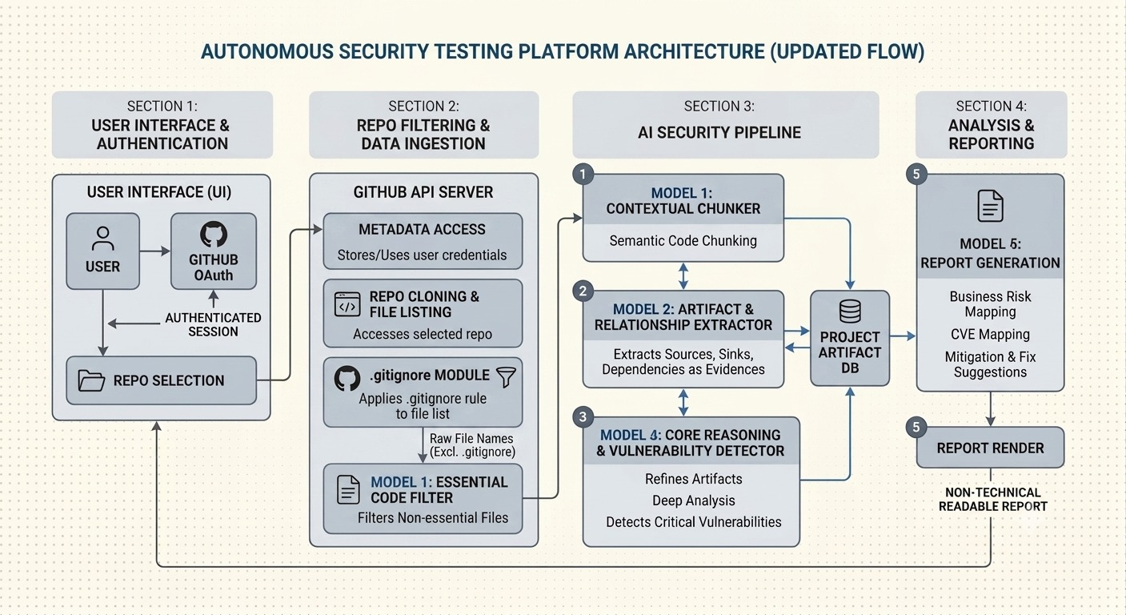
SYSTEM DESIGN

Slide 4
EXISTING SOLUTIONS AND GAPS :
1.SonarQube : Algorithm Used : Rule-Based Static Analysis Research Paper : P/Taint: Unified Points-to and Taint Analysis (2017) Authors : Neville Grech, Yannis Smaragdakis
Limitation : Heavily relies on rigid pattern matching , resulting in massive volumes of false positives.
2.Snyk :
Algorithm Used : Software Composition Analysis (SCA)
Research Paper : The Dynamics of Software Composition Analysis (2019)
Authors : Darius Foo, Jason Yeo, Hao Xiao, Asankhaya Sharma
3. GitHub Copilot :
Algorithm Used : OpenAI Codex
Research Paper : Evaluating Large Language Models Trained on Code(2021)
Authors : Mark Chen et al
Limitation : Less security-centric , and there exists no general purpose models that can find vulnerable source and sinks.
Limitation : Scans packages in isolation and lacks correlating the findings , and also cannot completely solve for every existing static code vulnerabilities.

Slide 5


IMPLEMENTATION PROGRESS :

Slide 6
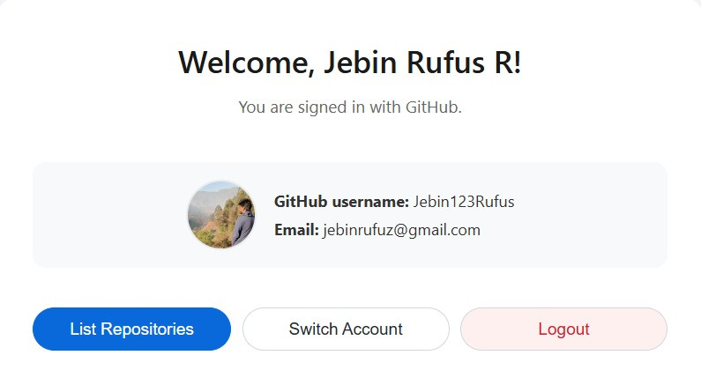

Slide 7
