Slide 1
Visitor-Exhibitor Matchmaking System
Data Analysis & Recommendation Engine
Presented by: Jebinu Nijas
Date: 21 April 2025

Slide 2
Objective
Understand visitor and exhibitor preferences
Build a matchmaking system to connect relevant parties
Derive business insights from behavioral data

Slide 3
Dataset Overview
Visitors: Registration info & answers
Answers: Text of selected responses
Questions: Survey structure
Exhibitors: Business categories
Exhibitor Categories: Category descriptions

Slide 4

Data Cleaning & Processing
Parsed nested JSON structure from visitor responses
Merged visitor, question, and answer datasets
Cleaned and merged exhibitor category data
Removed duplicates and handled missing values

Slide 5
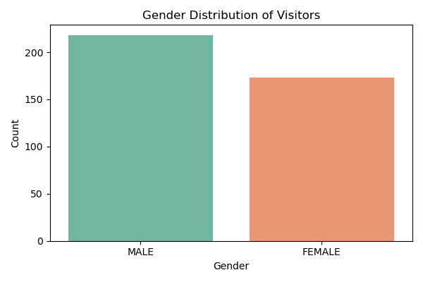
Visitor Profile Analysis
Gender distribution analysis
The majority of visitors are male, which could be helpful when planning future experiences to better engage a wider audience.

Slide 6
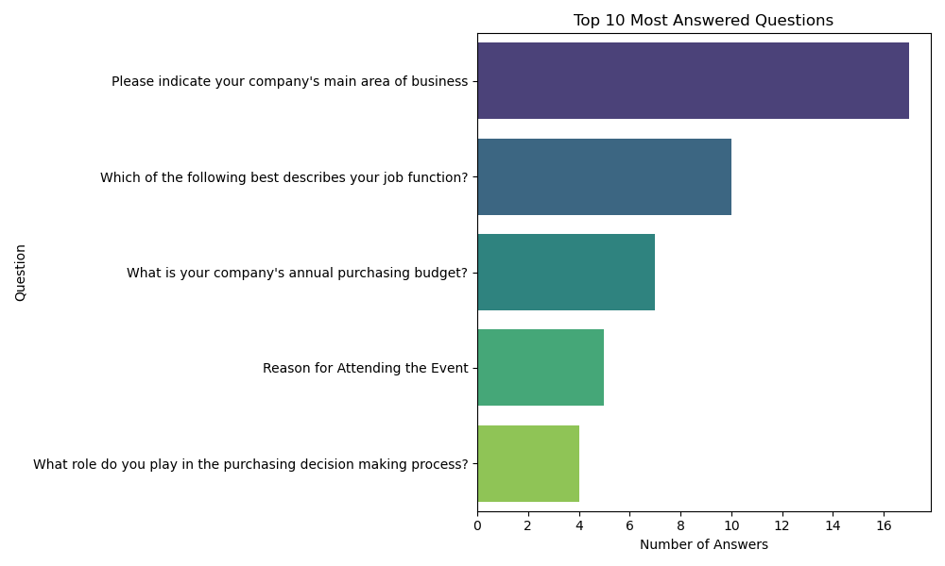
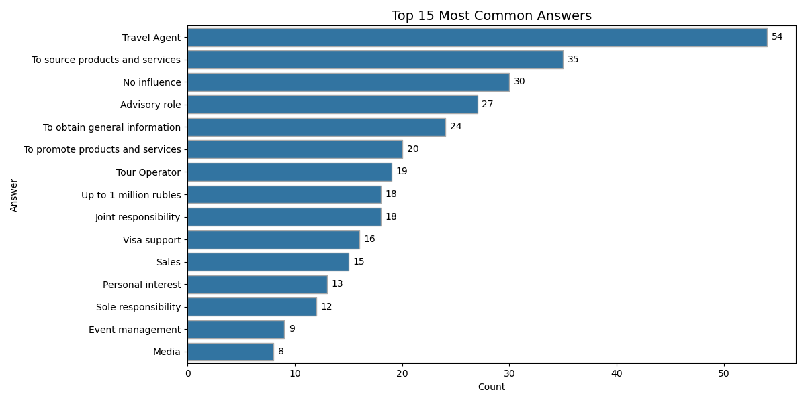
Visitor Profile Analysis
Visitor Engagement & Interests
Top questions highlight visitor engagement, while common answers reveal their key interests

Slide 7
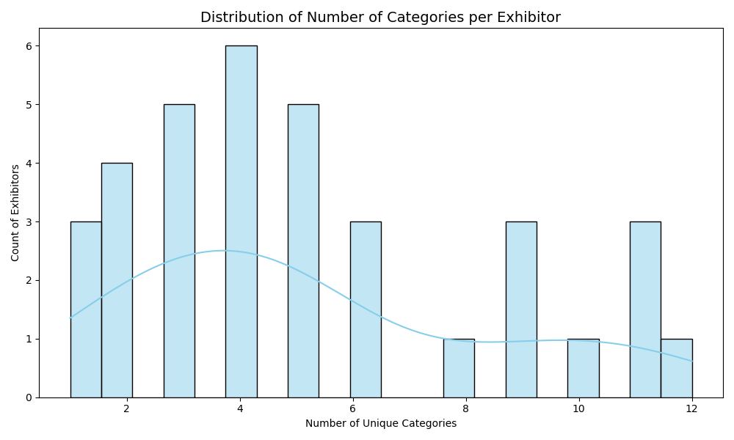
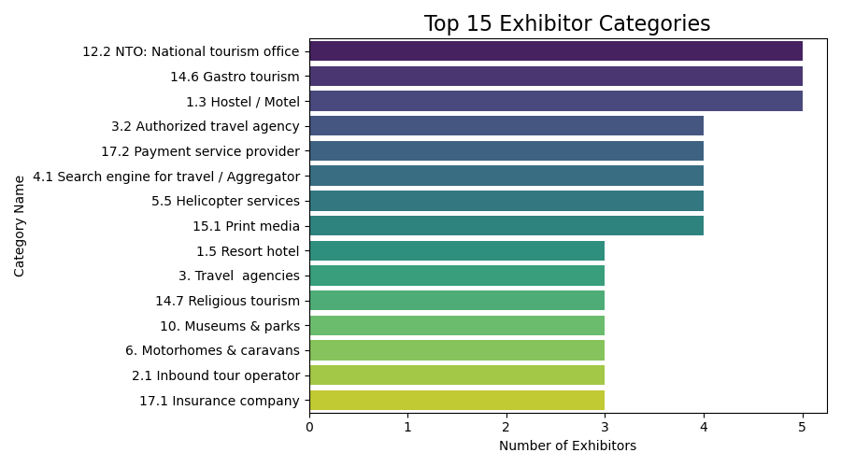
Exhibitor Profile Analysis
Category popularity and frequency count
Detected over-generic exhibitors

Slide 8
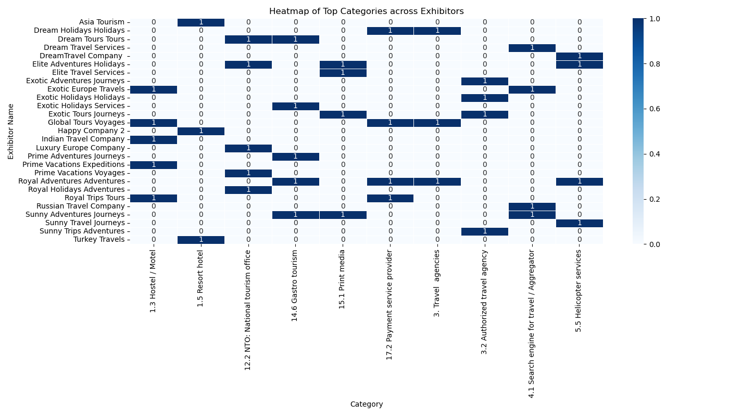
Exhibitor Profile Analysis
Shows how different categories are spread across exhibitors to spot common and unique areas.

Slide 9
Visitor-Exhibitor Matching Model
TF-IDF + Cosine Similarity for matching
Three recommendation functions: by visitor answers, visitor email, and exhibitor ID.
Matching based on highest similarity scores

Slide 10
Sample Recommendations
This sample shows exhibitor recommendations generated using visitor email, matched by interest via TF-IDF and cosine similarity.
Exhibitor ID | Name | Category Name | Similarity Score
97818 | Sunny Trips Adventures | 3.2 Authorized travel agency 12.1 TIC: Travel ... | 0.230892
27827 | Exotic Tours Holidays | 14.8 Other type of specialized tourism, 12.1 TIC: Travel ... | 0.1873

Slide 11
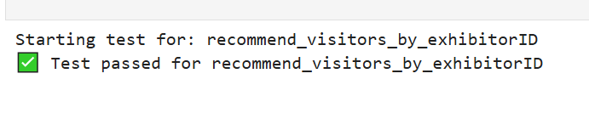

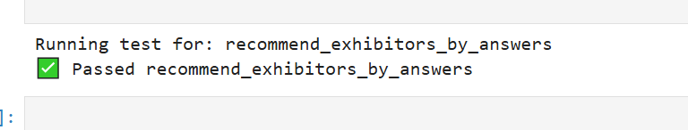
Unit Testing
Validated matching logic using visitor data.
Handled edge cases like missing info and generic categories
Reusable and scalable test cases for future use

Slide 12
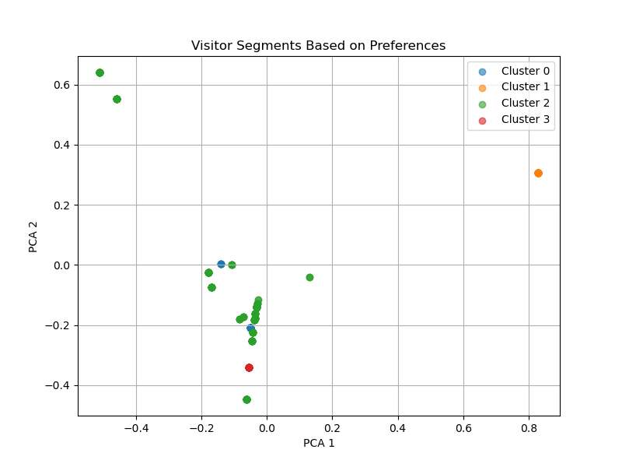
Advanced Insights
Predictive Analysis: Discovered emerging themes from visitor preferences using topic modeling (NMF).
Cluster Analysis: 4 distinct visitor segments based on preferences.
Supports personalized recommendations and informed category planning.

Slide 13
Conclusion
Successfully built a recommendation engine
Actionable insights for event organizers
Scalable and adaptable for future events

Slide 14
Thank You
Contact: Jebinu Nijas
Email: jebinunijas@gmail.com

