Slide 1
The Solution
Software Architecture meetup

Slide 2
Definitions
Distributed Systems
Time and State

Slide 3
Distributed Systems

Slide 4
Time and State

Slide 5
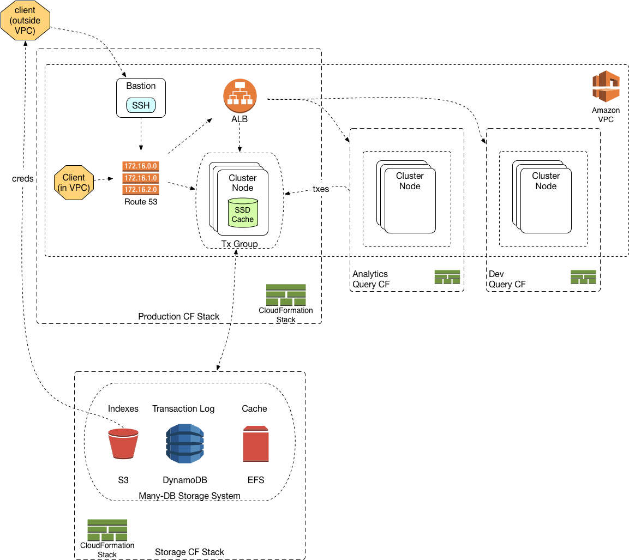
The Solution

Slide 6
Questions

