Slide 1
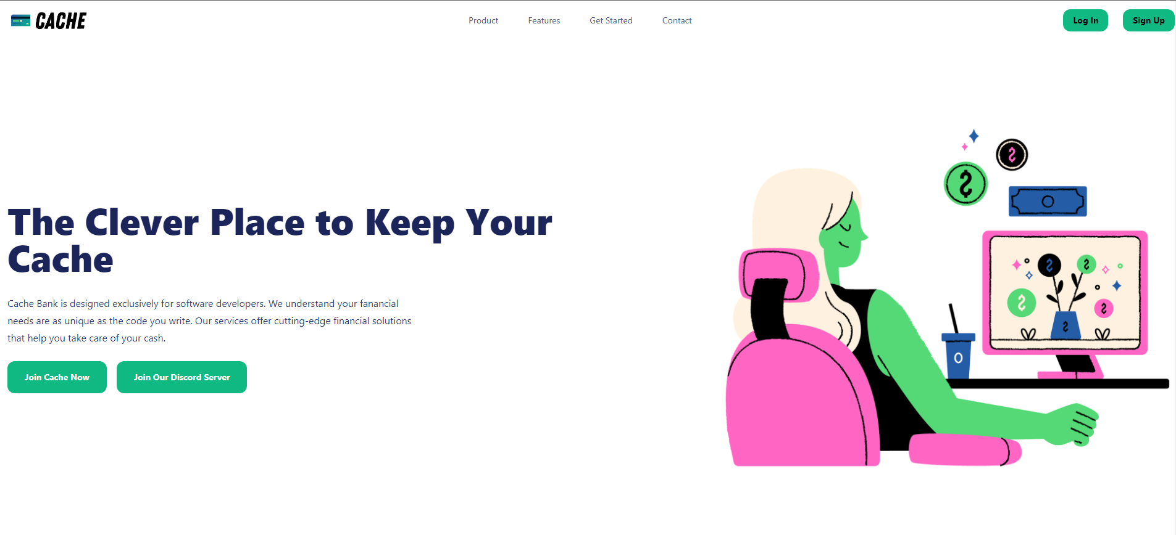
Jed Ernstzen
Cache Project
Codespace student Responsive portfolio piece website (HTML5,TAILWIND CSS3 & JavaScript)

Slide 2
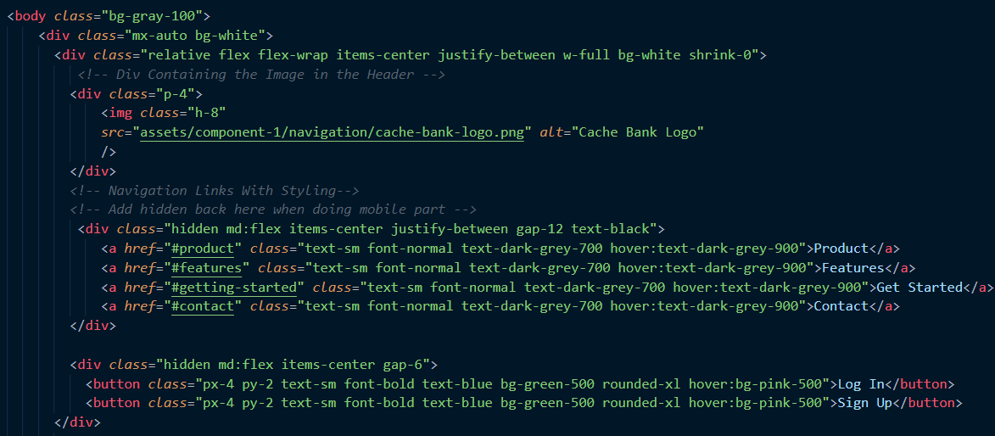
Explaining The Header

Slide 3

Explaining The Hero

Slide 4
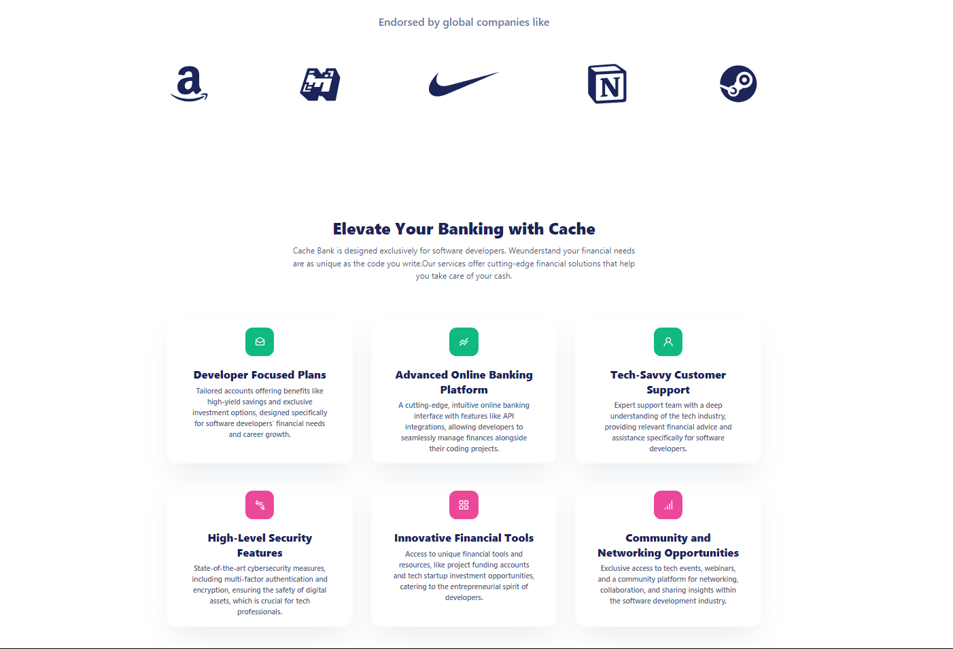
Explaining Endorsements and Component 3

Slide 5
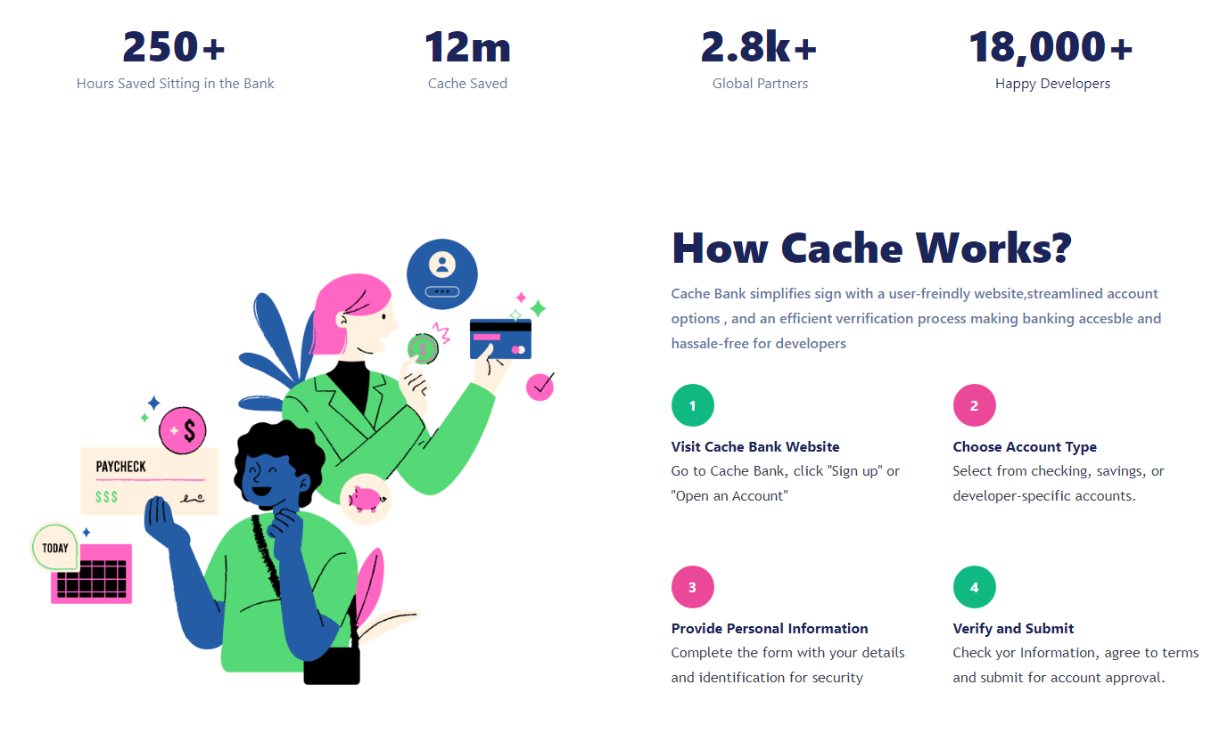
Explaining Component 4

Slide 6

Explaining Component 5

Slide 7


