Slide 1
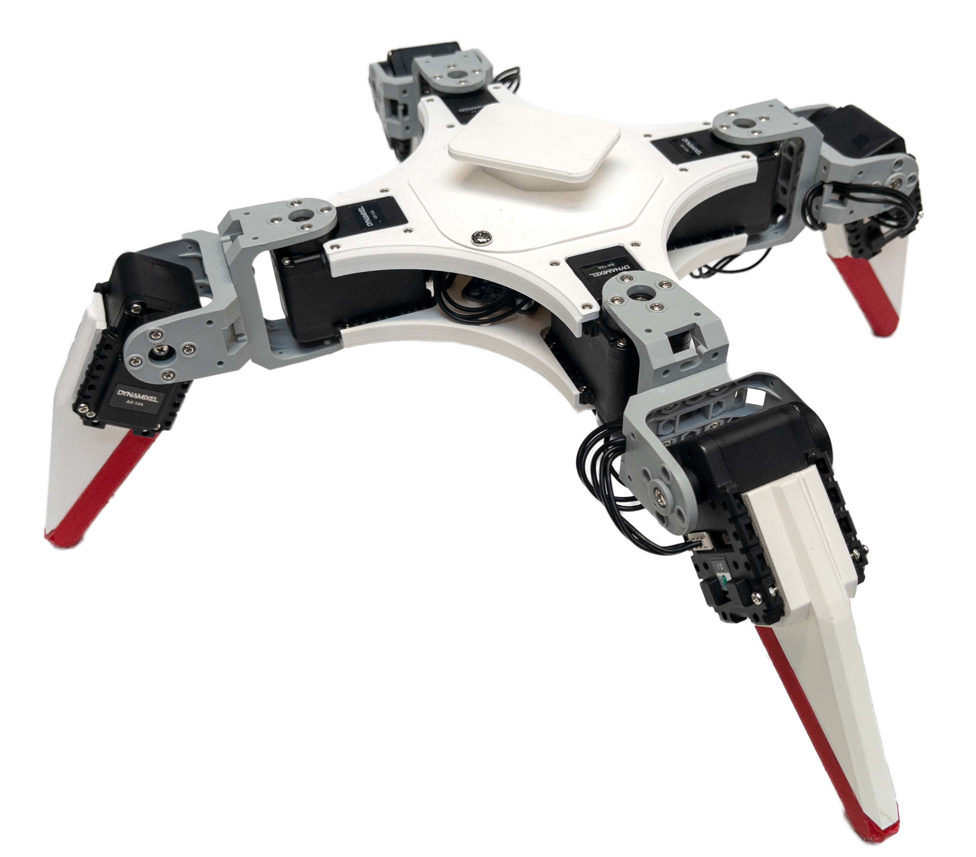
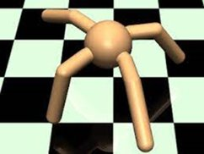
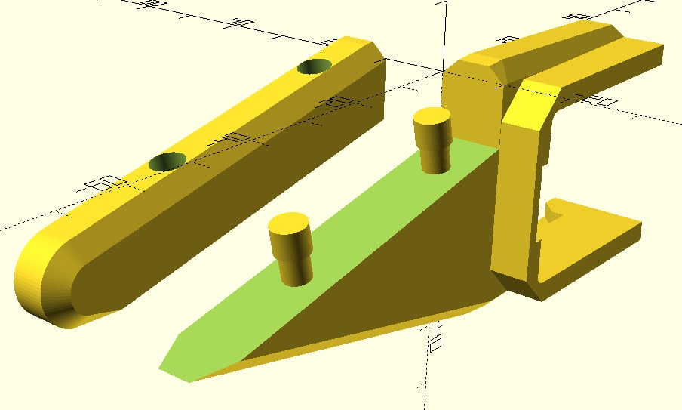

AEE Project Work course 2022 Master’s Programme in Automation and Electrical Engineering
J. Muff (project manager), A. Sippola, E. Hannus , J. Vepsä , J. Mikala, R. Kaushik (instructor)
Building a Quadruped Robot for Reinforcement Learning Research
Objective
The main objective was to build a quadruped robot which can be used for reinforcement learning (RL) research. Improvements to the original design were also made to improve usability and robustness.
Results
The robot was successfully built according to the original design. Then a new design with improved robustness and usability was developed. This design included soft parts from TPU 95A for absorbing shocks and vibrations, a hatch for easier access to the control and power board and a stand for attaching, e.g., reflectors used in machine vision for reinforcement learning.
Testing proved that the built robot works in the RL setup it was designed for. Additionally, pre-programmed movement and actions were designed so that the robot can perform simple motion without needing to set up the more extensive RL setup.
Fig. 1: The finished quadruped robot
Fig. 2 :The Ant in the MuJoCo simulator
Fig. 3: CAD of soft leg design
eea.aalto.fi
Intelligent Robotics research group

