Slide 1

System Design using Verilog
Contents of the lecture
Truth Table of 4 Bit Gray to Binary Code converter
Structure Model of 4 Bit Gray to Binary Code converter
Behavior Model of 4 Bit Gray to Binary Code converter
Dataflow Model of 4 Bit Gray to Binary Code converter
Test Bench

Slide 2
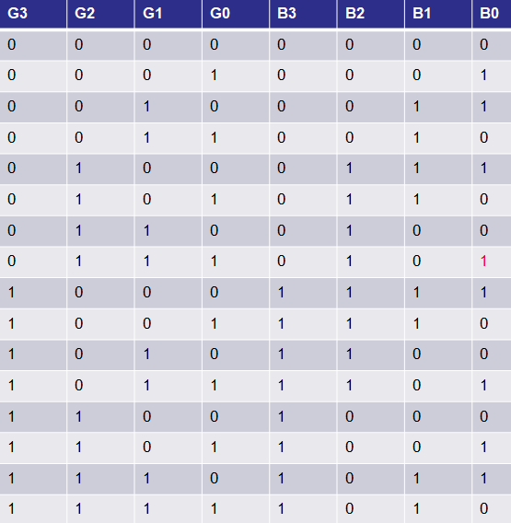
Truth Table of 4 Bit Gray to Binary Code converter

Slide 3
Truth Table of 4 Bit Gray to Binary Code converter

Slide 4
Circuit Diagram
b[3]=g[3];
b[2]=g[3] xor g[2];
b[1]=g[3] xor g[2] xor g[1];
b[0]=g[3] xor g[2] xor g[1] xor g[0];

Slide 5
Behaviour Model
module gray_to_binary(g,b);
input [3:0]g;
output [3:0]b;
reg [3:0]b;
always@(g)
begin
b[3]=g[3];
b[2]=g[3]^g[2];
b[1]=g[3]^g[2]^g[1];
b[0]=g[3]^g[2]^g[1]^g[0];
end
endmodule
b[3]=g[3];
b[2]=g[3] xor g[2];
b[1]=g[3] xor g[2] xor g[1];
b[0]=g[3] xor g[2] xor g[1] xor g[0];
Dataflow Model
module gray_to_binary(g,b);
input [3:0]g;
output [3:0]b;
assign b[3]=g[3];
assign b[2]=g[3]^g[2];
assign b[1]=g[3]^g[2]^g[1];
assign b[0]=g[3]^g[2]^g[1]^g[0];
endmodule

Slide 6
Structure Model
module gray_to_binary(g,b);
input [3:0]g;
output [3:0]b;
buf b1 (b[3],g[3]);
xor x1 (b[2],g[3],g[2]);
xor x2 (b[1],g[3],g[2],g[1]);
xor x3 (b[0],g[3],g[2],g[1],g[0]);
endmodule

Slide 7
Testbench
Behaviour Model
module gray_to_binary(g,b);
input [3:0]g;
output [3:0]b;
reg [3:0]b;
always@(g)
begin
b[3]=g[3];
b[2]=g[3]^g[2];
b[1]=g[3]^g[2]^g[1];
b[0]=g[3]^g[2]^g[1]^g[0];
end
endmodule
Test Bench
module testbench;
reg [3:0]g; wire [3:0]b;
gray_to_binary uut (.g(g),.b(b));
initial
begin
$monitor($time,"g=%b,b=%b", g,b);
#5 g=4'b0000;
#5 g=4'b0001;
#5 g=4'b0010;
#5 g=4'b0011;
#5 g=4'b0100;
#5 g=4'b1011;
#5 $finish;
end
endmodule

Slide 8
Simulation

