Slide 1


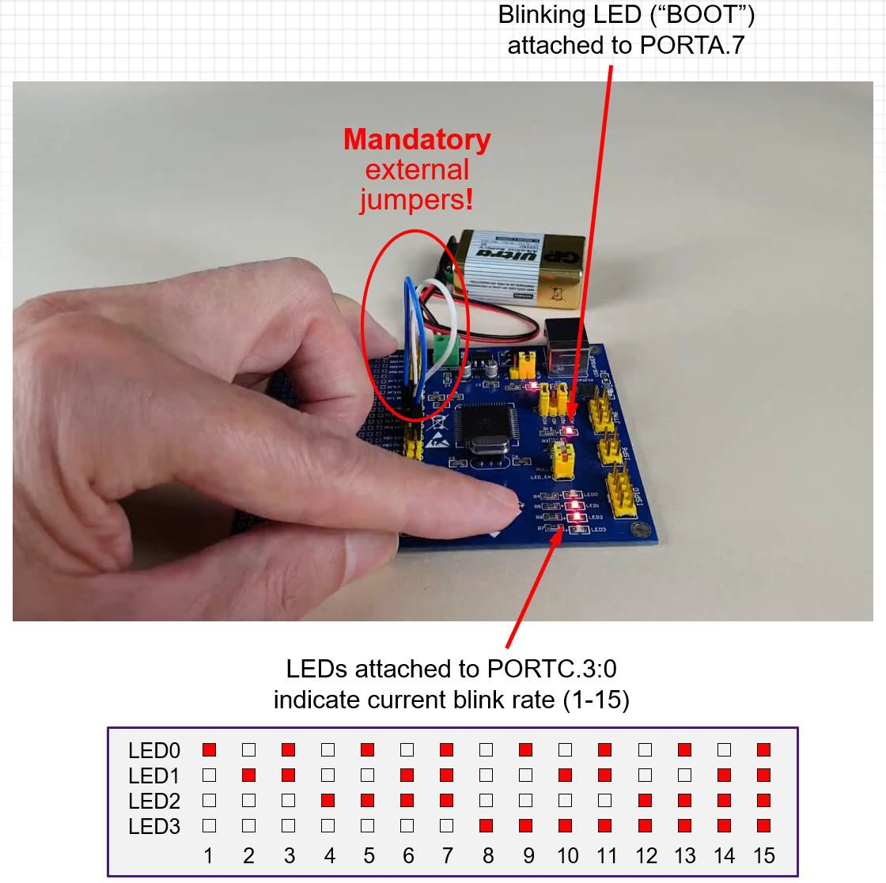
Lab05 Notes
EECE 3624 Microprocessors
RAYMOND B. JONES
COLLEGE OF ENGINEERING
Use ReadyAVR’s joystick to control the blink rate of the “BOOT” LED
Modify Lab02 to:
  Blink the “BOOT” LED (PORTA.7) at a rate of 1-15Hz, as governed by a value stored in R20.
  Use ISRs to change the value of R20 in response to up/down movement of the joystick.
  Show current blink rate as a 4-bit binary number using LEDs connected to PORTC.3:0. Only update these LEDs when the blink rate is changed (i.e. in the ISR).

Slide 2
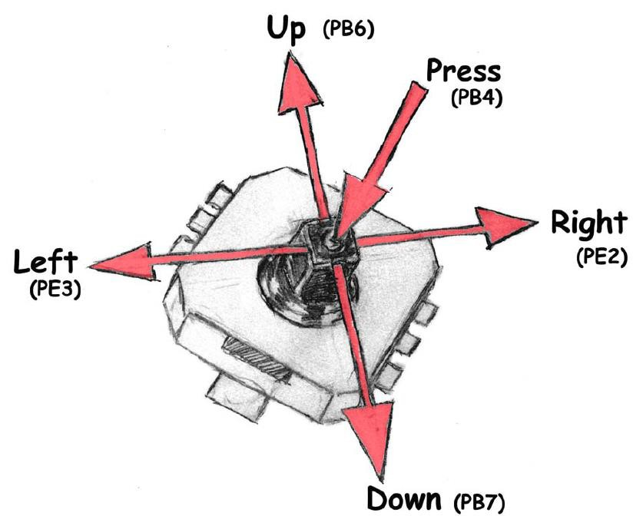
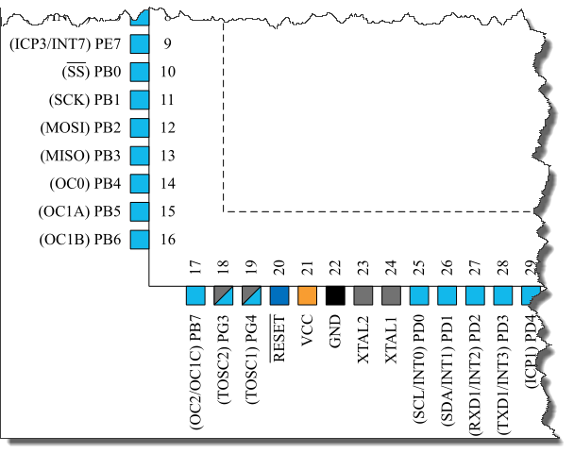

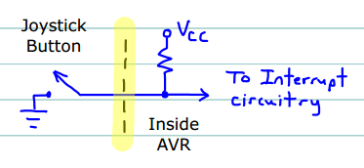
Lab05 Notes
EECE 3624 Microprocessors
RAYMOND B. JONES
COLLEGE OF ENGINEERING
(PB3)
ATmega128A
(PB0)
(PB2)
You must enable the internal pull-up resistors
(PB1)
NB: Joystick switches are physically connected to PORTB pins, but those pins can’t generate interrupts. However, PORTD pins can, and they can be connected externally to PORTB pins allowing joystick movements to invoke ISRs (see next page for details).
P_{n}

Slide 3





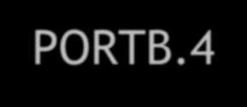
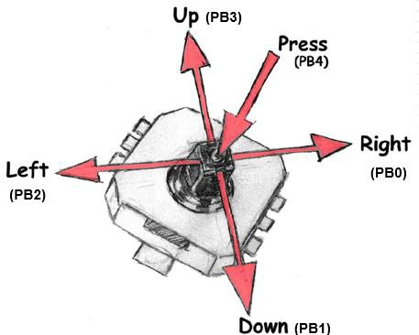
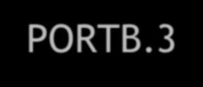
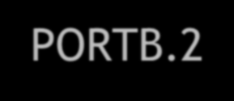
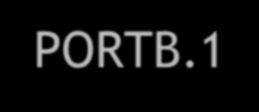
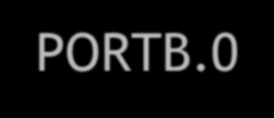


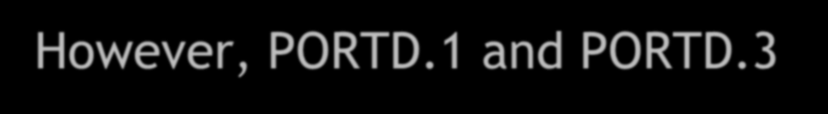


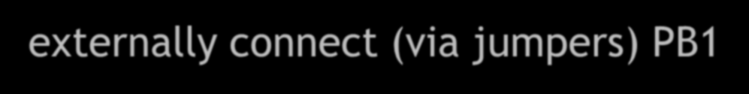

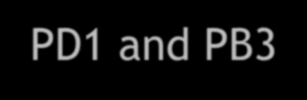
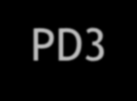
Lab05 Notes
EECE 3624 Microprocessors
RAYMOND B. JONES
COLLEGE OF ENGINEERING
As shown on the previous page, the ReadyAVR joystick is connect to five ATmega128A pins:
PORTB.4 PORTB.3 PORTB.2 PORTB.1 PORTB.0
Key points:
  PORTB.1 and PORTB.3 cannot generate interrupts
  However, PORTD.1 and PORTD.3 can generate interrupts, so
externally connect (via jumpers) PB1⬄PD1 and PB3⬄PD3
  Then program PD1 (down) and PD3 (up) to trigger ISRs
  MAKE SURE BOTH SETS OF PINS ARE CONFIGURED AS INPUTS!

Slide 4





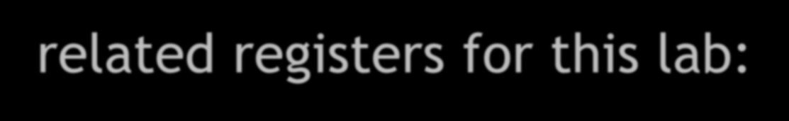

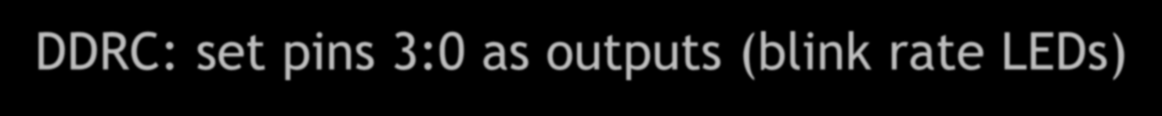


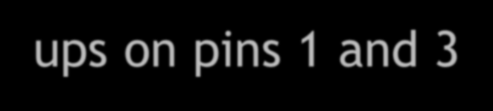
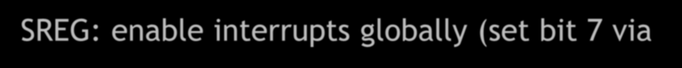









Lab05 Notes
EECE 3624 Microprocessors
RAYMOND B. JONES
COLLEGE OF ENGINEERING
You will need to configure several port- and interrupt-related registers for this lab:
  Set INT1, INT3 ISR vectors (to handle up/down)
  DDRA: set pin 7 as an output (the “BOOT” LED)
  DDRB: set pins 1 and 3 as inputs (up/down joystick)
  DDRC: set pins 3:0 as outputs (blink rate LEDs)
  DDRD: set pins 1 and 3 as inputs (to trigger ISRs)
  PORTB: set internal pull-ups on pins 1 and 3
  EICRA: set INT1 and INT3 to activate on RISING edge
  EIMSK: allow INT1 and INT3 to generate interrupts
  SREG: enable interrupts globally (set bit 7 via sei)
Read the ATmega128A data sheet slowly, carefully, and for full understanding!

Slide 5

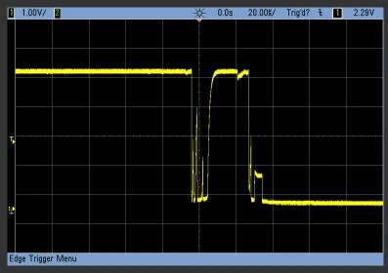
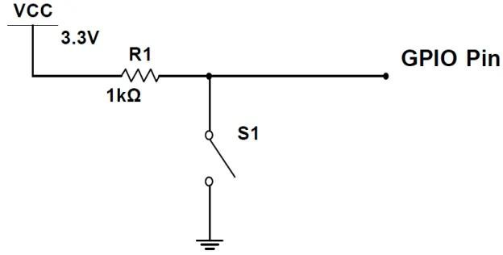
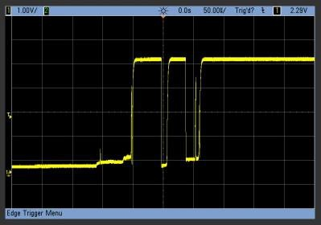
Switch Bounce
EECE 3624 Microprocessors
RAYMOND B. JONES
COLLEGE OF ENGINEERING
Simple active low
switch circuit
Switch
Pressed
(N.O. pushbutton)
Switch Released

Slide 6


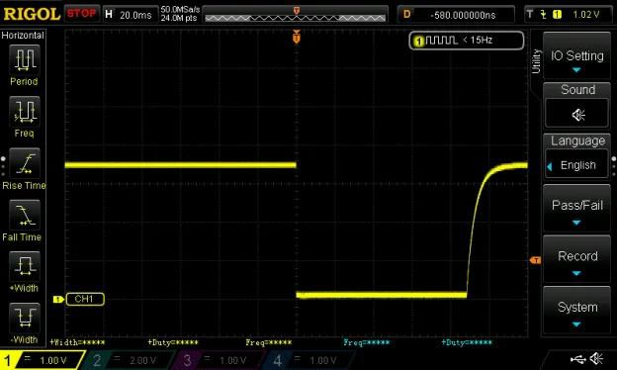
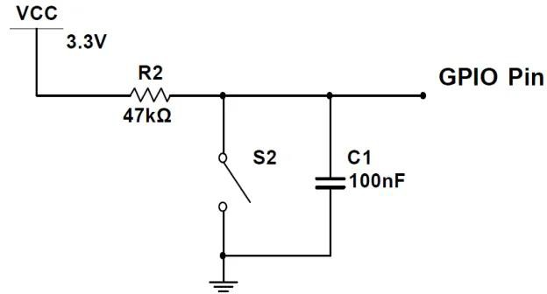

RC Switch Debouncing
EECE 3624 Microprocessors
RAYMOND B. JONES
COLLEGE OF ENGINEERING
Simple active low switch circuit with RC debouncing
*
Switch
Pressed
Switch
Released
(N.O. pushbutton)
5𝜏 = 5(𝑅 × 𝐶)
= 5(47𝑘Ω × 100𝑛𝐹)
= 5(4.7𝑚𝑆)
= 23.5𝑚𝑆 25mS
*You can use the ATmega128A’s internal pull-up resistor as R2, but you’ll need to check the datasheet to discover it’s value.

