Slide 1

Tasty Bytes
Highlighting the Optimal Recipe for the Website
Notes:
Hi! I’m Jędrzej Wydra, and in this presentation I’ll walk you through the results of my analysis of a business challenge provided by Tasty Bytes. I’ll take you step by step through the data science process — from identifying the problem, through preparing and running the analysis, to sharing practical recommendations for the business.

Slide 2
Business Problem
The company Tasty Bytes displays selected recipes on their homepage. They noticed that some recipes generate more website traffic than others;
Currently, the recipe is chosen by administrators based on their intuition;
There is a question of whether it is possible to predict which recipe will generate high traffic on the webpage;
The company provided us with data to build a model and formulate recommendations.
Notes:
So, what’s the background? Tasty Bytes features selected recipes on their homepage — and they’ve noticed that some of them attract significantly more website traffic than others. Right now, the selection is based mostly on administrators’ intuition. That raised an important question: can we predict which recipes are likely to generate high traffic? To explore this, the company provided us with data, and our goal was to build a model and come up with data-driven recommendations.

Slide 3
Data
The dataset contains eight columns: 'recipe’, 'calories’, 'carbohydrate’, 'sugar’, 'protein’, 'category’, 'servings’, and 'high_traffic’;
The 'recipe' column provides a unique identifier for each recipe;
No problems observed.
The 'calories' column indicates the total energy content of the recipe, measured in kilocalories (kcal);
The 'carbohydrate', 'sugar', and 'protein' columns provide the macronutrient content in grams;
The 'category' column specifies the type or group of the recipe (e.g., dessert, beverage);
The 'servings' column shows how many portions the recipe yields;
The 'high_traffic' column indicates if the recipe generated high website traffic.
Notes:
The dataset contained eight columns: 'recipe', 'calories', 'carbohydrate', 'sugar', 'protein', 'category', 'servings', and 'high_traffic'.
The 'recipe' column was simply a unique identifier for each recipe — no issues there. The 'calories' column showed the total energy content in kilocalories, and the 'carbohydrate', 'sugar', and 'protein' columns described macronutrient content in grams.
I noticed some missing values in these four nutritional columns — only 52 rows out of about a thousand. Since this was a small fraction, I decided to drop those rows to keep things simple.
The 'category' column indicated the recipe type, like ‘dessert’ or ‘beverage’. There was a minor inconsistency: one of the values was ‘chicken breast’, which didn’t appear in the documentation. But since ‘chicken’ was a valid category, I assumed ‘chicken breast’ was a subcategory and recoded it to just ‘chicken’.
The 'servings' column usually showed a number, but occasionally it included extra text like ‘4 as a snack’. I cleaned it up by keeping just the numeric part — so ‘4 as a snack’ became simply ‘4’.
The last column was 'high_traffic', which indicated whether a recipe drove a lot of website traffic. If it did, the value was ‘high’; otherwise, the cell was blank. I converted this into a binary format: 1 for high traffic, and 0 otherwise. This kind of data suggests a binary classification problem — in other words, we want to predict whether a recipe will generate high traffic or not.

Slide 4
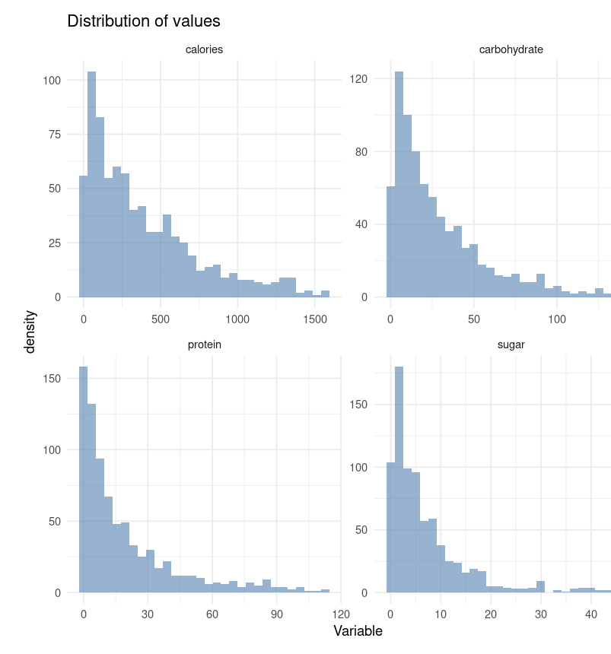
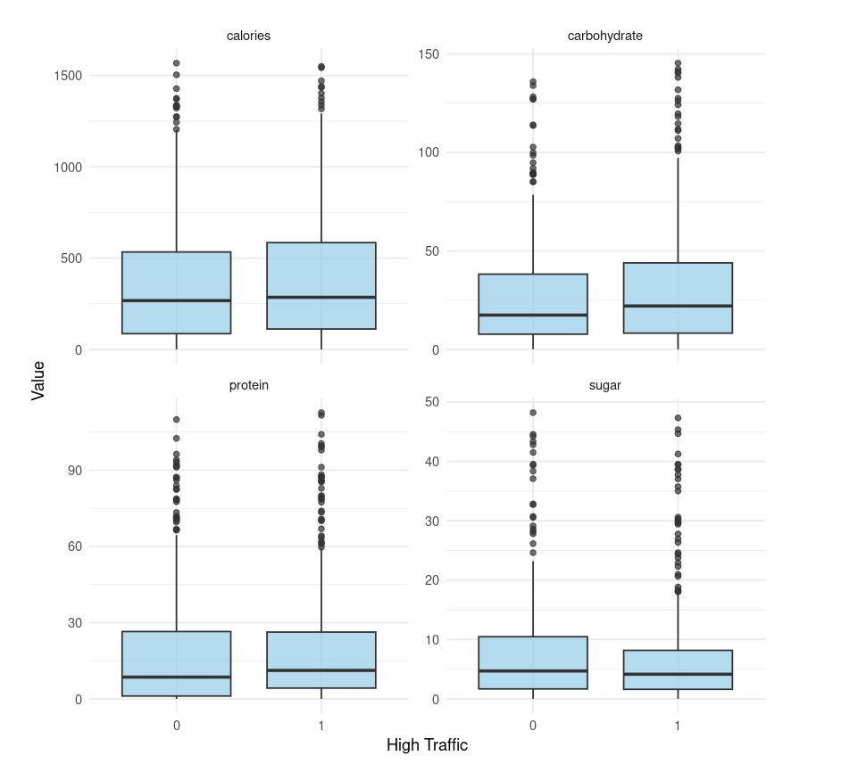
Exploratory analysis
Notes:
The distributions of the variables — calories, carbohydrates, protein, and sugar — were all right-skewed, with quite a few outliers. To reduce their influence, I removed the top 3% of the highest values for each variable.
Then, I checked whether these variables differed between recipes that generated high traffic and those that didn’t. It turned out that these features had little to no effect. Carbohydrates had no noticeable impact at all, while calories, sugar, and protein showed only a minor influence on traffic.

Slide 5
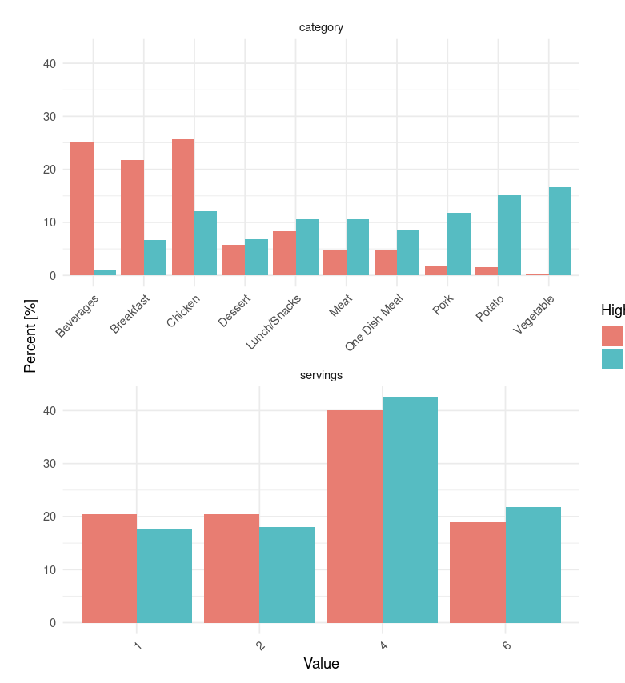
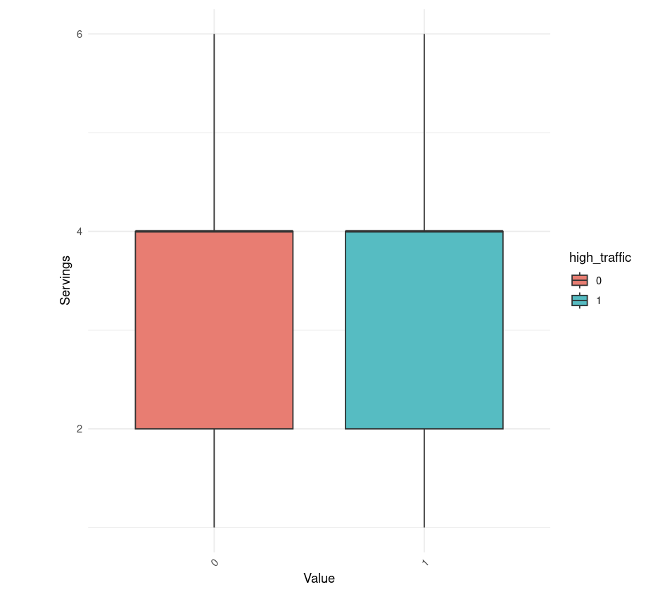
Important variable
Notes:
Next, I looked at the 'servings' variable. I found it to be unimportant — its distribution was nearly identical across both high-traffic and low-traffic recipes.
On the other hand, the 'category' variable seemed to have a clear impact. For example, recipes in the 'vegetables' category almost always generated high traffic, while those in the 'beverages' category almost never did.
Based on this, I decided to test two models: logistic regression and a decision tree. I expected logistic regression to perform better, but I wanted to compare both. In each case, the dependent variable was 'high_traffic', and the independent variables were: 'category', 'sugar', 'protein', and 'calories'.

Slide 6
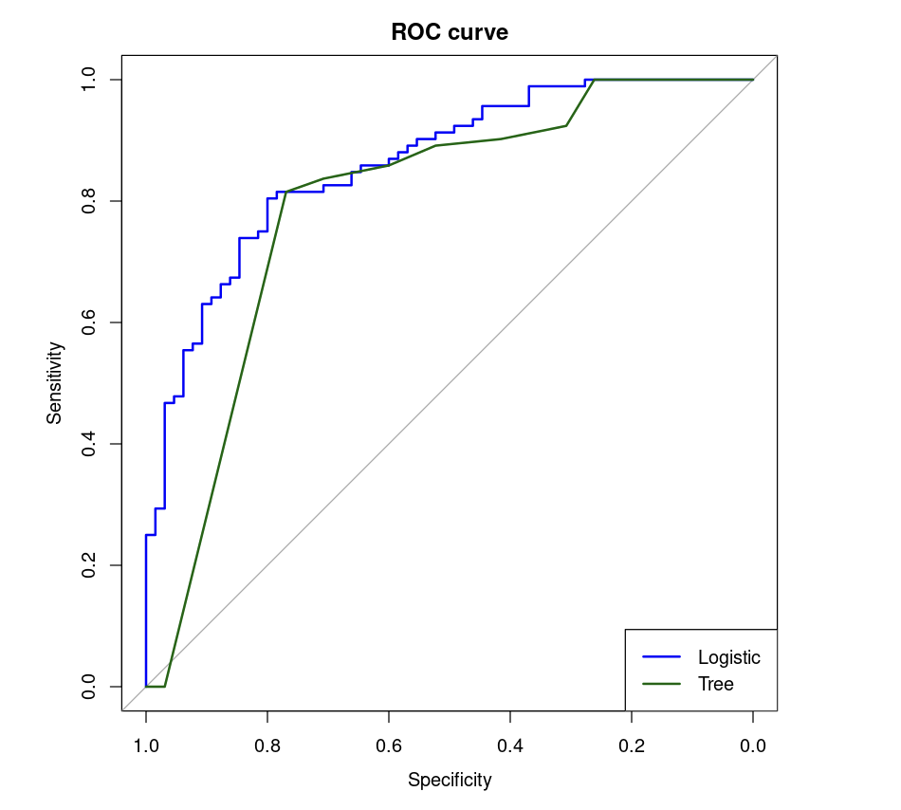
Binary classification model
Logistic:
Accuracy = 0.8025
AUC = 0.8615385
Tree:
Accuracy = 0.7516
AUC = 0.791806
Notes:
The client expected the model to achieve at least 80% accuracy in predicting high-traffic recipes. The logistic regression model met this requirement and, as I had suspected, performed clearly better than the decision tree.
To get a more complete picture of model performance, I also evaluated both models using the ROC curve and AUC score. AUC tells us how well the model distinguishes between high-traffic and low-traffic recipes — the higher the AUC, the better the model’s ability to recognize true positives. A value of 1 means perfect prediction, and anything above 0.8 is generally considered strong.
All metrics were calculated on a separate test set, while the models were trained on the training set.
In short — the model not only met, but confidently fulfilled the client’s expectations.

Slide 7
Business Metrics 1
The analysis indicated that recipes from the 'Beverages' category have little chance of generating high traffic. Recipes from categories such as 'Meat', 'Pork', and 'Potato' have a much higher likelihood. However, the best-performing category appears to be 'Vegetable’.
Calories, sugar, and protein do not significantly affect the likelihood of high traffic. However, the data suggest that, in cases of uncertainty, recipes with fewer calories, less protein, and slightly more sugar may be a better choice—possibly because such meals are perceived as slightly more appealing or tasty.
Notes:
The analysis showed that recipes from the 'Beverages' category have a low chance of generating high traffic. On the other hand, recipes in categories like 'Meat', 'Pork', and 'Potato' tend to perform much better. The best-performing category overall was clearly 'Vegetable'.
Nutritional values like calories, sugar, and protein turned out to have only a minor effect. That said, the data suggests that — in cases where we’re unsure — recipes with slightly fewer calories, lower protein, and a bit more sugar might be a safer bet. Possibly because such meals are perceived as more appealing or tasty. However, this should be treated as a side conclusion, and I would suggest not relying on it too heavily — it’s more of a clue than a solid rule.

Slide 8
Business metric 2
To evaluate whether the model works effectively in a business context, I recommend collecting detailed traffic data for at least one week — ideally, for a full month. Once this data is collected, I suggest primarily selecting recipes from the 'Vegetables' or 'Potato' categories for the homepage. If such recipes are not available, 'Meat' and 'Pork' categories are also likely to significantly boost traffic.
If there are multiple recipe options within these categories, it may be beneficial to prioritize those with slightly fewer calories and protein, and slightly more sugar — although this effect is less pronounced and should be treated as a secondary consideration.
Finally, recipes from the 'Beverages' category should generally be avoided, as they are associated with low traffic and may reduce engagement when displayed on the homepage.
Notes:
To assess how well the model works in a real business setting, I recommend collecting detailed traffic data over at least one week — ideally for a full month. Based on this data, I suggest prioritizing recipes from the 'Vegetables' or 'Potato' categories for the homepage. If those aren’t available, 'Meat' and 'Pork' are also good options and are likely to drive higher traffic.
When choosing between multiple recipes within those categories, it might be slightly more effective to pick ones that are lower in calories and protein, and a bit higher in sugar — although this effect is minor and should be treated as a secondary guideline.
Finally, recipes from the 'Beverages' category should generally be avoided, as they’re consistently linked with low traffic and may reduce user engagement when featured on the homepage.

Slide 9
Business recomendations
The analysis showed that recipe category has the greatest impact on traffic. Recipes in the ‘Vegetables’, ‘Potato’, ‘Meat’, and ‘Pork’ categories are most likely to attract high traffic, while ‘Beverages’ are consistently associated with low engagement. Nutritional features like calories, sugar, and protein have only minor effects.
I recommend prioritizing recipes from high-performing categories on the homepage. To assess business impact, traffic should be monitored over time — ideally both before and after applying these recommendations. If implemented, the model is expected to help increase website traffic and support subscription growth.
Notes:
In summary, the analysis showed that recipe category has the strongest impact on website traffic. Recipes in the ‘Vegetables’, ‘Potato’, ‘Meat’, and ‘Pork’ categories are most likely to attract high engagement, while ‘Beverages’ are consistently linked to lower traffic. Nutritional factors like calories, sugar, and protein have only a minor influence.
I recommend featuring recipes from the top-performing categories on the homepage. To evaluate the business impact, traffic should be monitored over time — ideally both before and after applying these changes.
One of the key advantages of this solution is its simplicity. There’s no need for ongoing calculations or model scoring — the results can be applied directly by following a few clear, high-level recommendations.
If implemented, the model is expected to help increase website traffic and improve overall user engagement.

Slide 10
Thank you for your attention
Jędrzej Wydra
Notes:
That concludes my presentation. Thank you for your attention — it’s been a real pleasure and an honor to work on this project.

