Slide 1

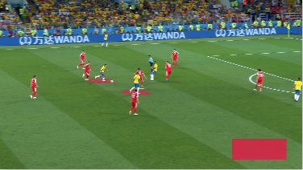
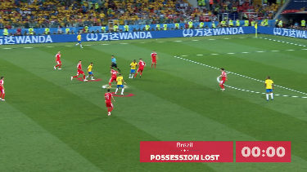
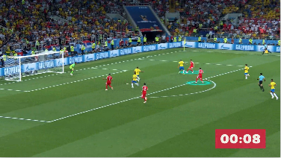
xSFR – Expected Shot From Recovery
Jedrzej Sarna
BRAZIL IN POSSESSION
LOST POSSESSION
00:00
SHOT
00:08
shot within 10 seconds from recovery

Slide 2




Recommended Players
Name: Frank Anguissa
Position: Defensive Midfielder
Age: 23
Club: Olympique Marseille
Price: 18M €
xSFR per 90: 0.40
Average SFR in Premier League 17/18 season was 0.05
1.
Name: Geoffrey Kondogbia
Position: Defensive Midfielder
Age: 25
Club: Valencia CF
Price: 30M €
xSFR per 90: 0.32
2.

