Slide 1
Mini-Project 2
Computelech: the future lives here
In partial fulfilment of KodeGo Bootcamp 2022
By Mark Nixon, Justine, and Jed

Slide 2



GROUP 3 members
Mark Nixon
JUstine
jed
marxenion
justine077
jedxxx

Slide 3
AGENDAs
Introduction​
Road Map
Site Map
Technologies Used
​Summary
Outroduction
​

Slide 4
Introduction
Purpose
To provide modern concepts and quality education through e-learning.
Audience
Any user who are interested in learning topics that will benefit them to their studies.

Slide 5





road map
Research & goal setting
planning
Content and DESIGN
Coding
Testing and deployment
Gather information
Conduct research
Contents
Pre-planning with sitemap & roadmap
Constructing design
Client approval
Page layouts
Review layouts
Client approval
Build structure
Review and test for errors
Approval of constructed layout
Final review and approval of the client
Testing
Launching
Ongoing Support

Slide 6
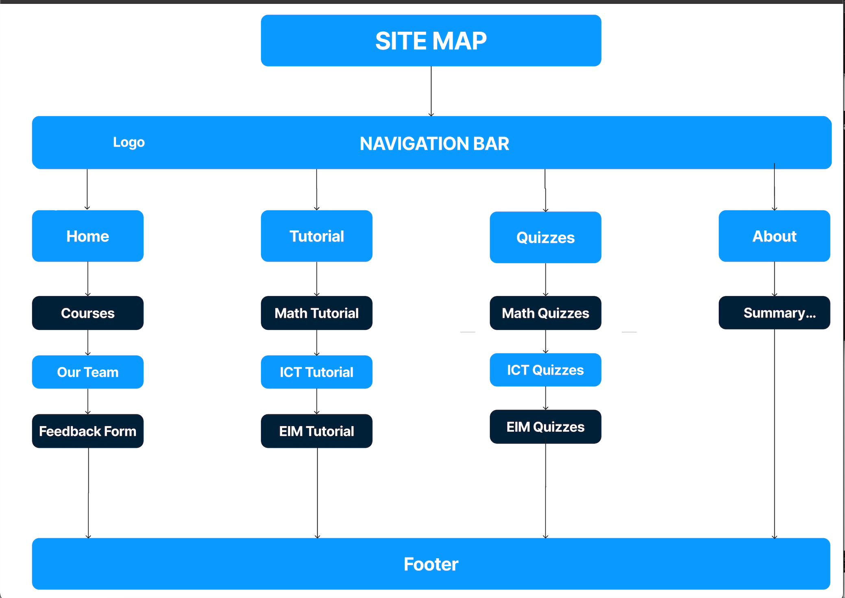
Site map

Slide 7









Technologies used

Slide 8
SUMMARY
The ComputElech website is an e-learning website that helps you to learn and to test your knowledge about the fundamentals of selected courses such as Mathematics, ICT, and EIM.
Meta information
Font: Abril Fatface & Poppins
Color theme: White, Blue, and Cyan
Feature & functionality: Responsiveness, Dark mode theme, Tutorial Navigation, Interactive quizzes and Feedback form with API.

Slide 9
Programming isn't about what you know; it's about what you can figure out.
“
”
Chris Pine

