Slide 1
FreePLM

Slide 2
table of contents
Requirements
Requested Information
Workflows
Route map

Slide 3
Requested information – General
User Size
  (Small? )Company size <#OfUsers
Development Environment(s)
  Server / Raspberry Pi
  Virtual Machines
  Local
How to access files
  Direct from server
  Local Copy

Slide 4
Requested information – Stored general properties
What database are the databases convertible?
See for set of example properties Part Attributes.pdf original see Windchill Attributes

Slide 5
Requested information – Stored part properties
Name / Number (is this the unique identifier?)
Description
Material
Weight
Key words

Slide 6
Requested information – Stored Assembly properties
Name / Number (is this the unique identifier?)
Description
BOM (Read out file?)
Weight?
keywords
...

Slide 7
Requested information – Stored Drawing? properties
Name / Number (is this the unique identifier?)
Description
Drawing standards
keywords
...

Slide 8
Requested information – User properties
Name / Number (is this the unique identifier?)
Access to projects / top level Systems
Role(s)

Slide 9
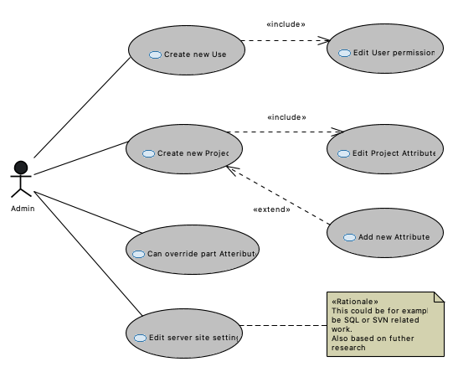
Workflows - Administrator
Create new users
  Edit user permissions
Create new projects
  Edit project Attributes
Can override Part attributes(related to its state)
Edit Server side settings

Slide 10
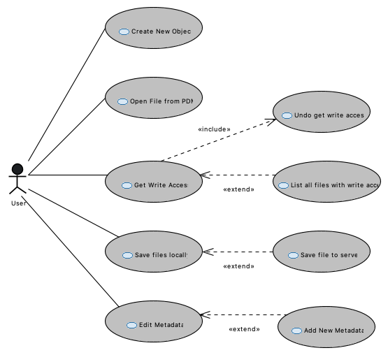
Workflows - Users
Open File from pdm
Get write Access (Check-out)
  List all files with write access
Save file locally
Save file to server (Check-in)
Edit Metadata
  Add (new) Metadata
Create new part.

Slide 11
Requirements
Create Requirements for example in a spreadsheet and add link

Slide 12
Roadmap – Short term
Define information about
  Define user group
  Define need info(in what term)
  Define work environment
  Define workflows(how to’s)
  Define programming Language == Python
Developing Requirements
Get features out of requirements

Slide 13
Roadmap – Short term
Create feature tree
  Define What features are in what state
Create State 0 program (see features)

Slide 14
Roadmap – Mid term

Slide 15
Roadmap – Long term

