Slide 1
AWS and Docker

Slide 2
AWS
Go to aws.amazon.com and create an account or
Ask your trainer for an account
Logon to AWS as a root user

Slide 3
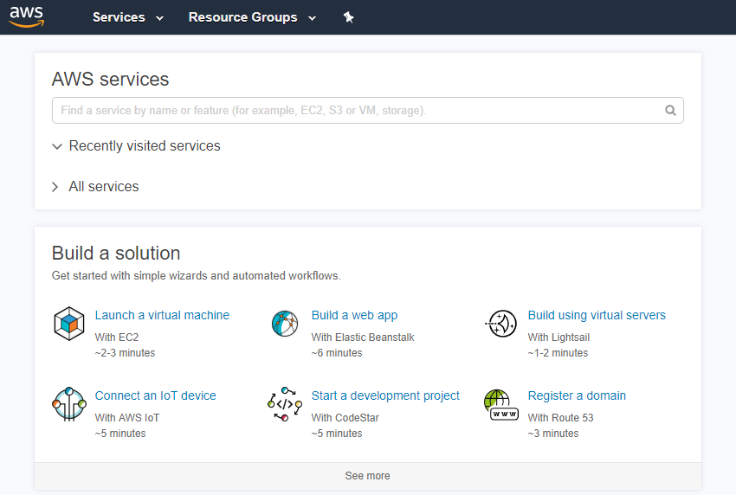
Home Page

Slide 4
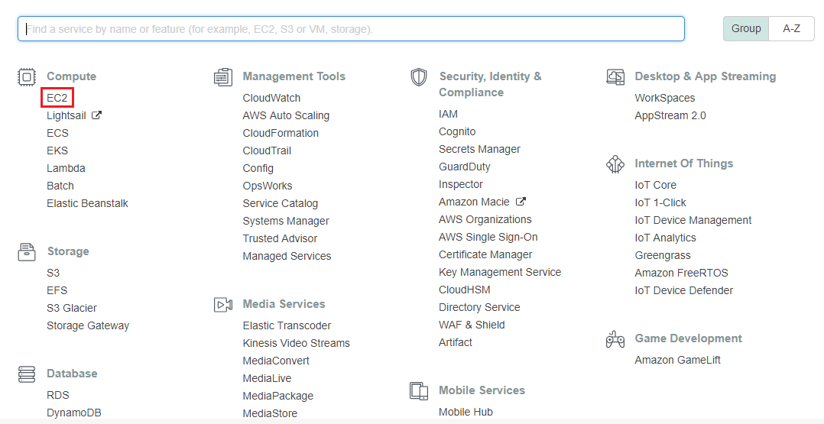
Invoking EC2

Slide 5
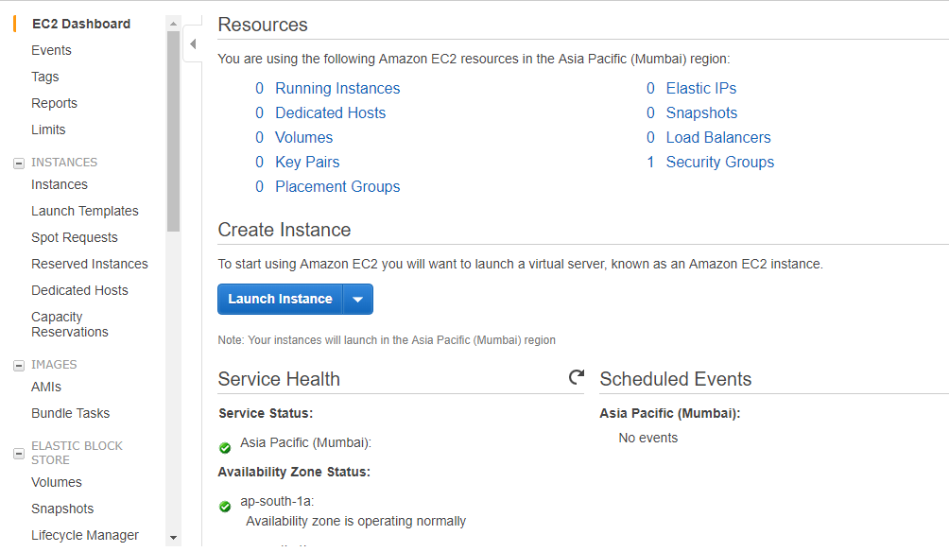
EC2 Dashboard & Launching Instance

Slide 6
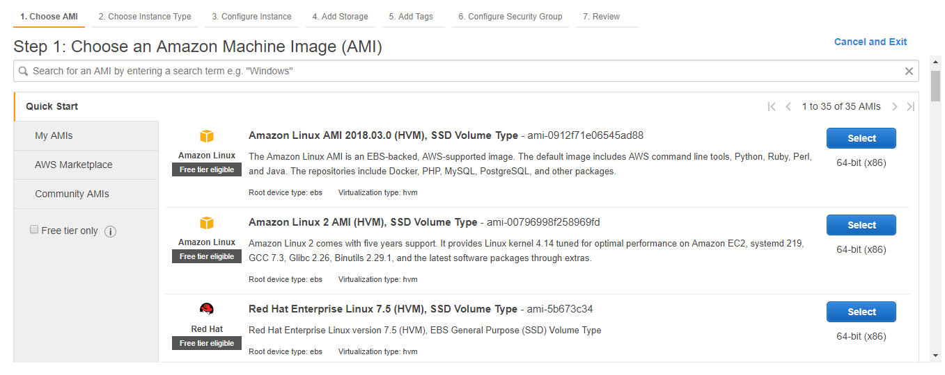
Choosing an AMI

Slide 7
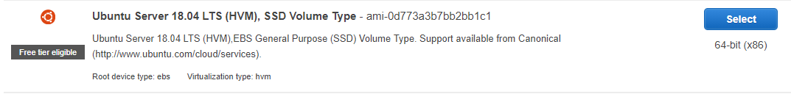
Choosing Ubuntu Image Do not use any other image

Slide 8
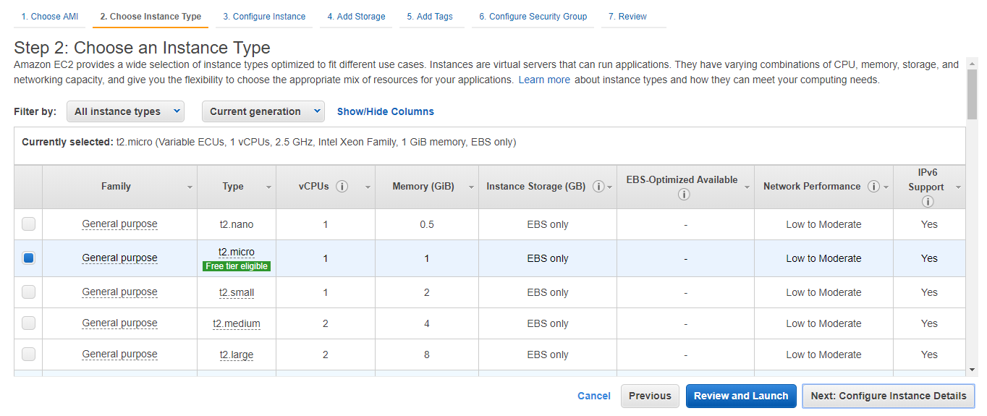
Choosing Instance Type

Slide 9
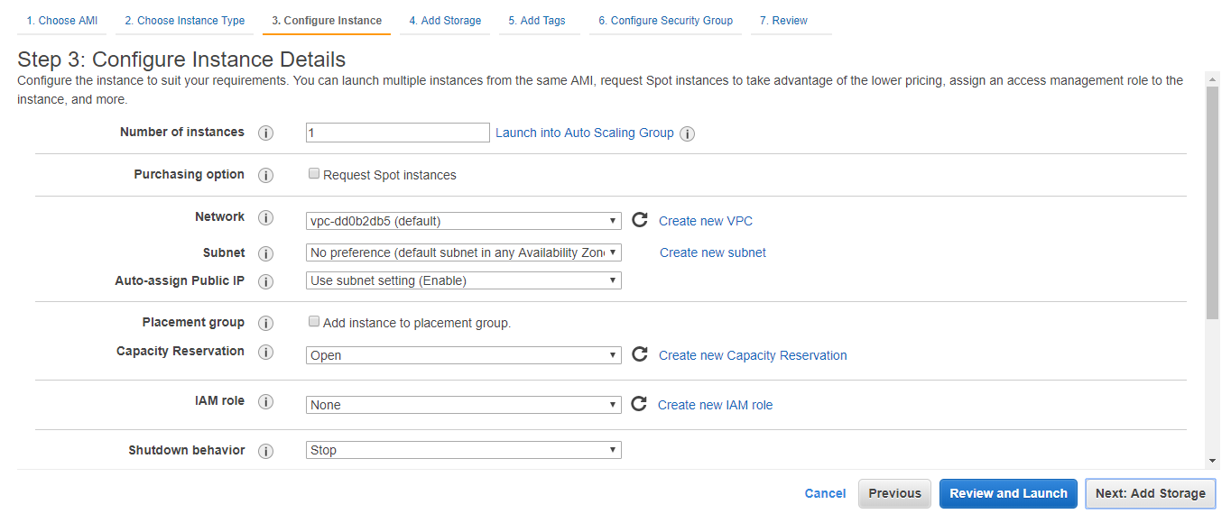
Configuring Instance Details

Slide 10
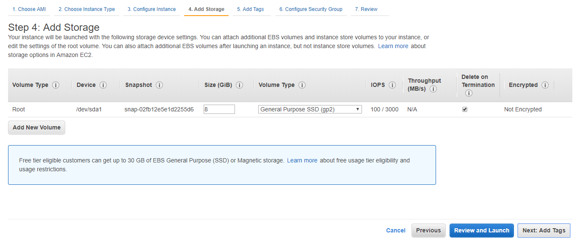
Adding Storage

Slide 11
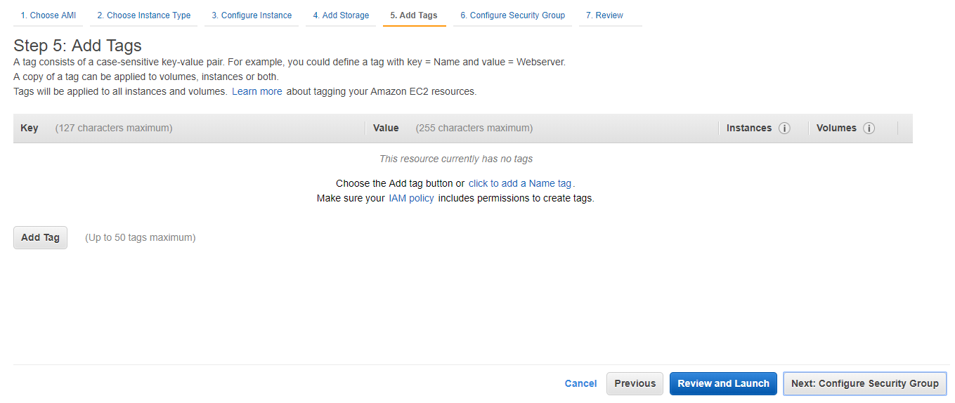
Adding Tags

Slide 12
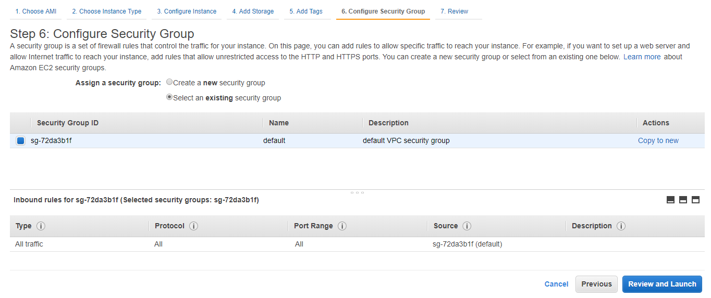
Configuring Security Group

Slide 13
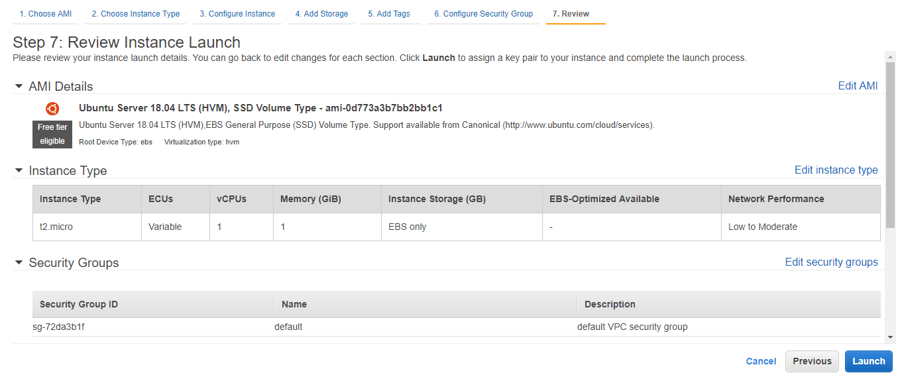
Reviewing

Slide 14
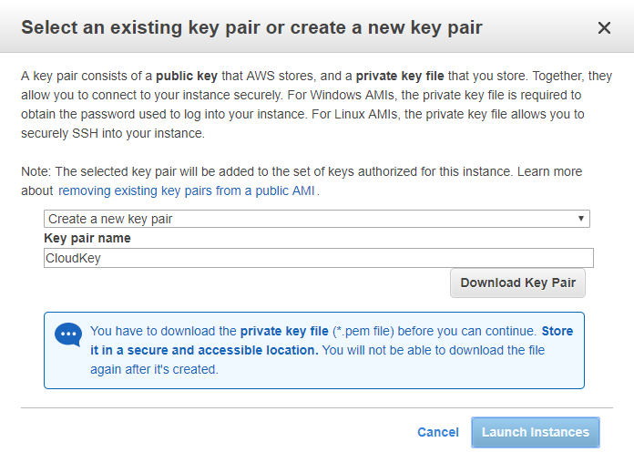
Key-Pair Creation

Slide 15
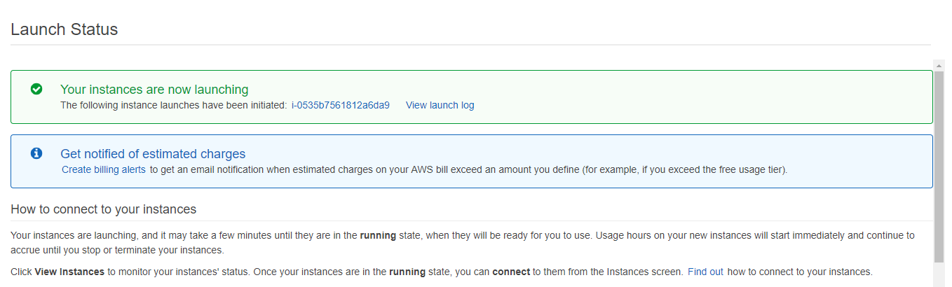
After Launch Status

Slide 16
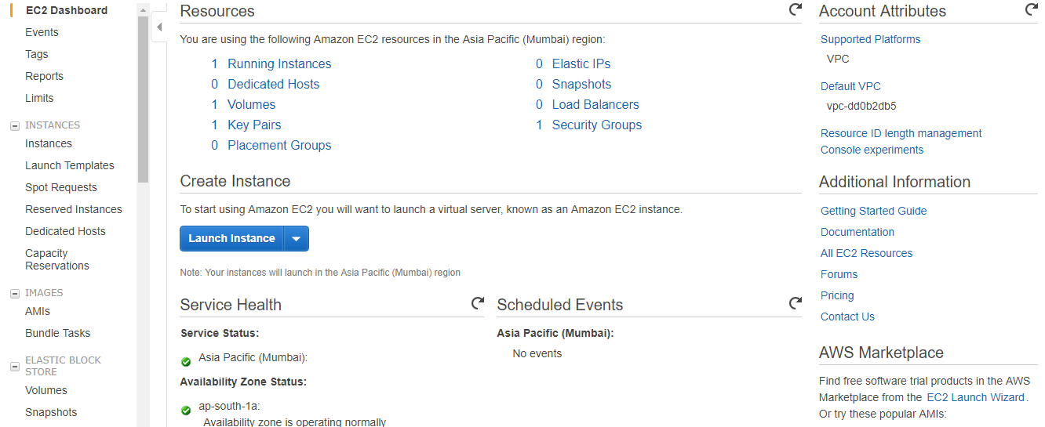
Dashboard

Slide 17
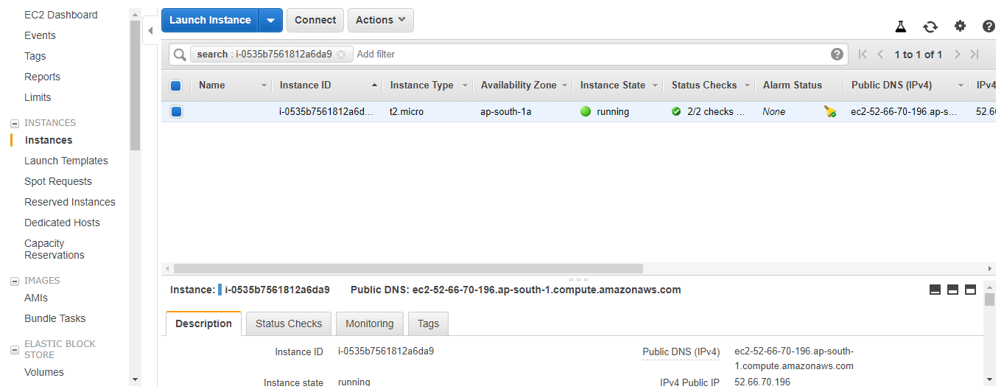
Running Instances

Slide 18
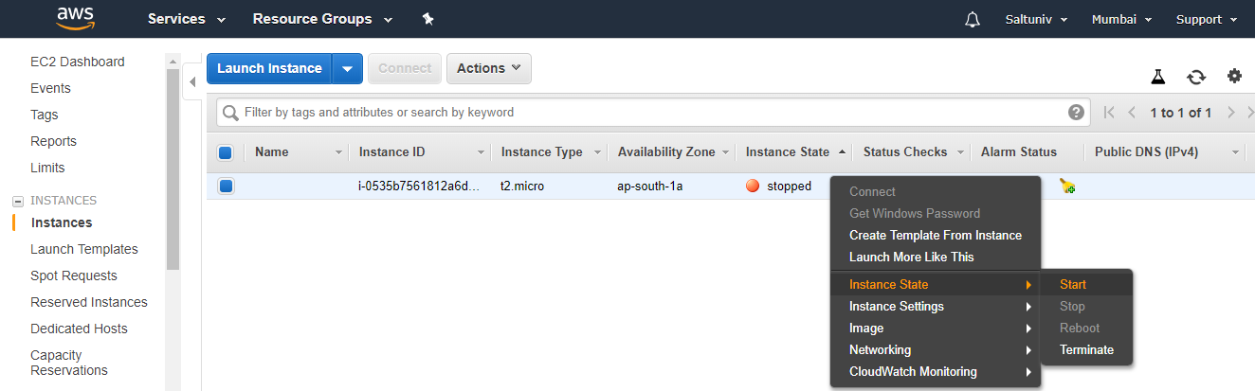
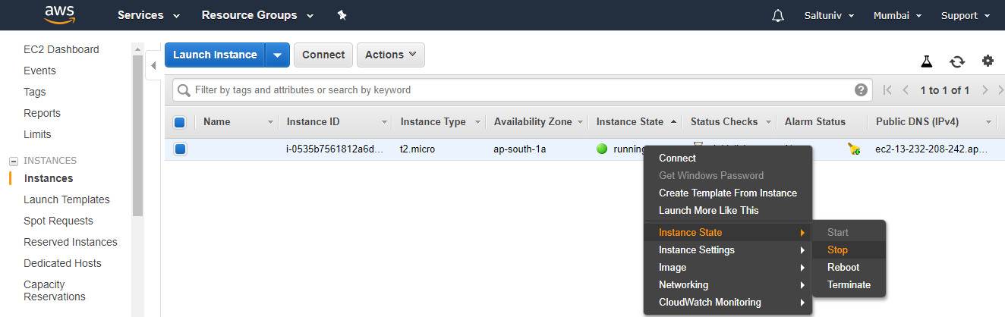
Starting/Stopping Instance

Slide 19
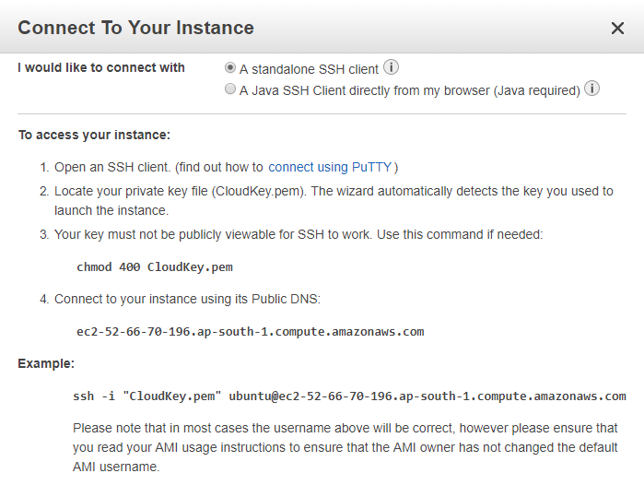
Connecting To Instance

Slide 20
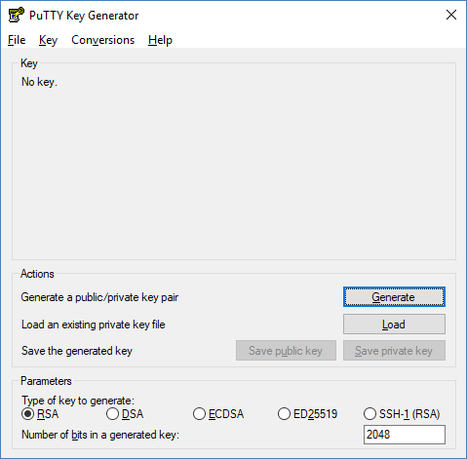
Using PuttyGen to Import Key

Slide 21
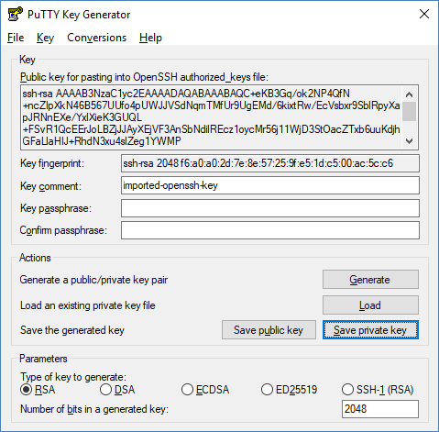
Saving Private Key

Slide 22
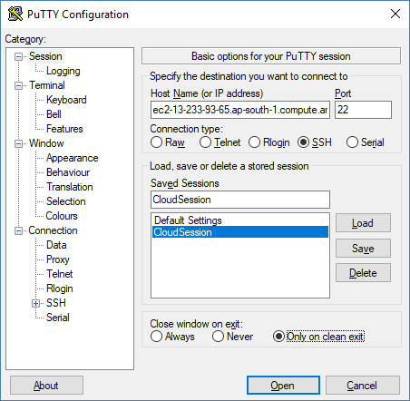
Using Putty to Connect

Slide 23
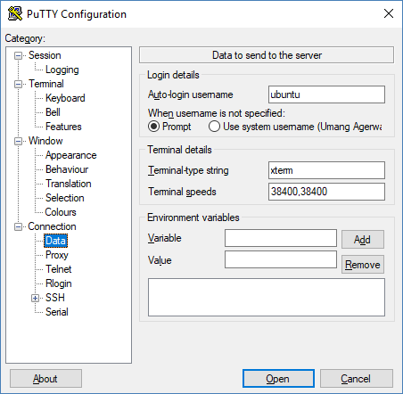
Data (User = ubuntu/ec2-user)

Slide 24
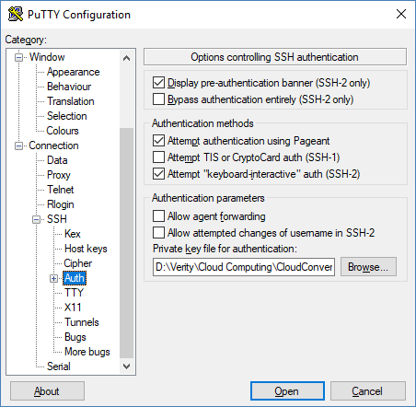
Selecting the Private Key

Slide 25
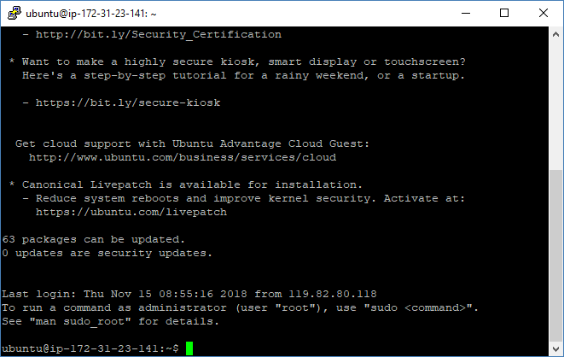
Connected to Putty

Slide 26
Docker with aws

Slide 27
Procedure
Setup & Run the instances on AWS
Launch AWS terminal using putty/Connect it using VNC

Slide 28
Install Docker on AWS server
If you create an Ubuntu instance Run following commands
sudo apt-get update
sudo apt-get install docker.io
docker --version
If you create an AWS instance, run the following commands
sudo yum update -y
sudo amazon-linux-extras install docker
sudo service docker start
sudo usermod -a -G docker ec2-user

Slide 29
Jenkins on AWS

Slide 30
Run the container on AWS server Manually
Run following commands:
sudo docker images
sudo docker container ls -a
sudo docker pull jenkinsci/blueocean
sudo docker run -it -p 8080:8080 <image id> /bin/bash
OR
docker run --rm -u root -p 8080:8080 -v jenkins-data:/var/jenkins_home -v /var/run/docker.sock:/var/run/docker.sock -v $HOME:/home jenkinsci/blueocean

Slide 31
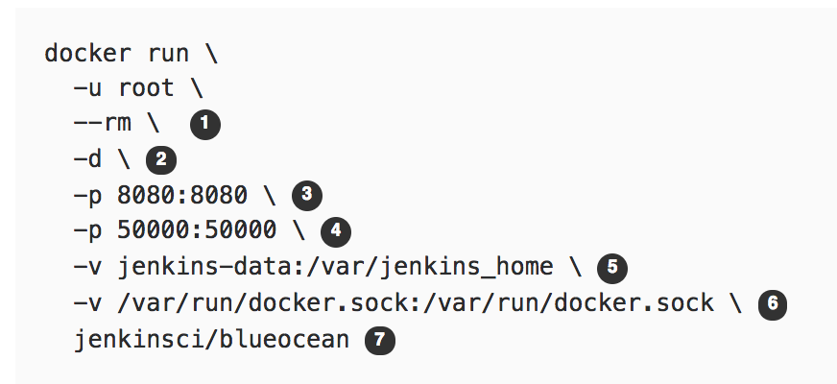

Understanding the Command
(O) Automatically removes the Docker container when it is shut down
(O) Runs the jenkinsci/blueocean container in the background (i.e. "detached" mode) and outputs the container ID
Maps port 8080 on the host machine to port 8080 of the jenkinsci/blueocean container
Let’s not worry about it right now
( O but highly recommended) Maps the /var/jenkins_home directory in the container to the Docker volume with the name jenkins-data (automatically created if non-existen). Makes Jenkins state to persist each time you restart Jenkins
Allows blueocean container to communicate with the Docker daemon when we use “agent” command in pipeline code
Maps the $HOME directory on the host machine to the /home directory in the container. Windows has slightly different syntax

Slide 32
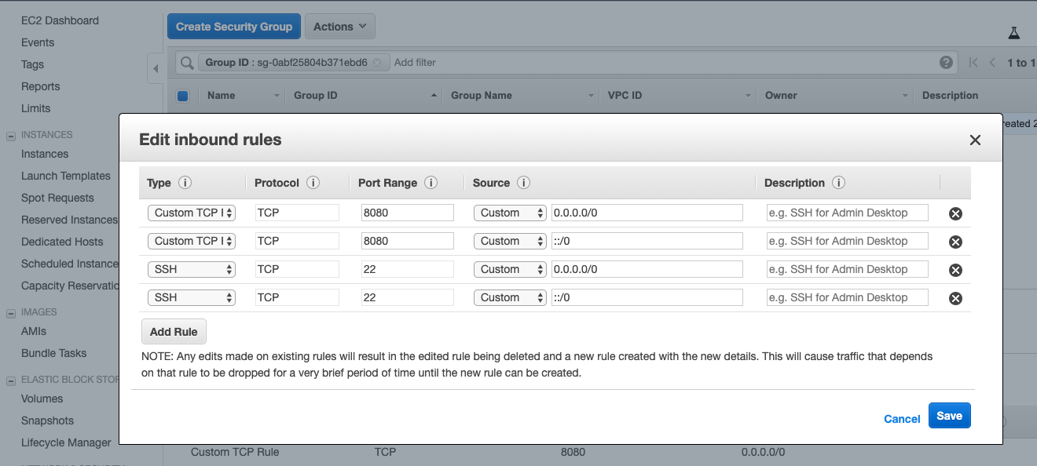
Create an In-bound rule on AWS

Slide 33
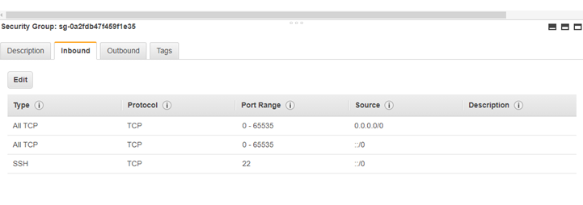

Slide 34
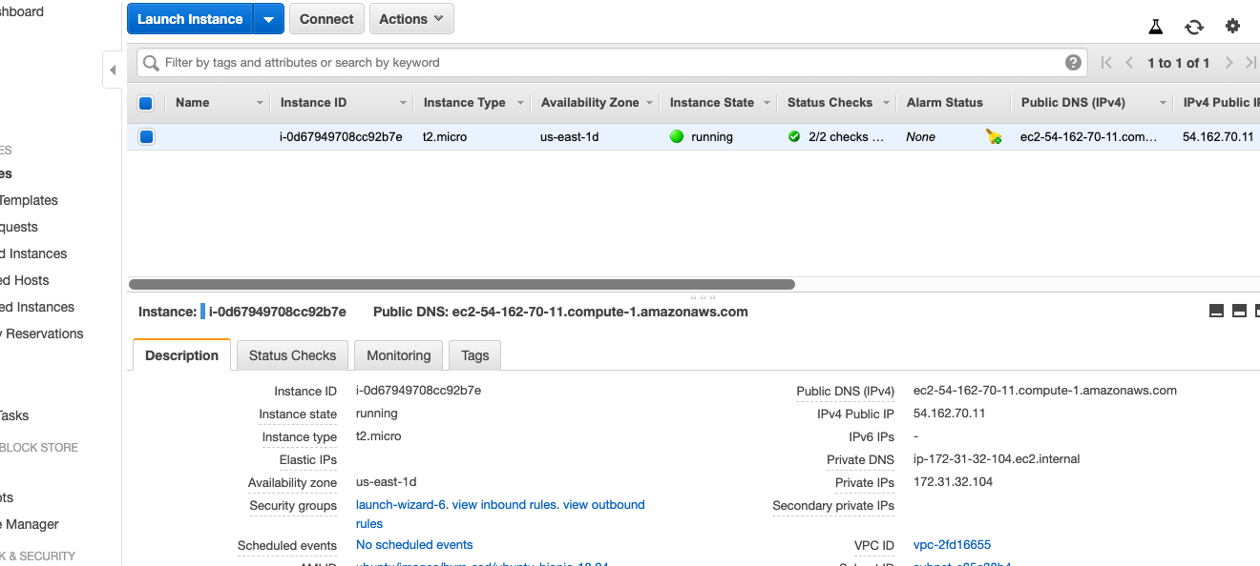
Capture the IP Address of the AWS Instance

Slide 35
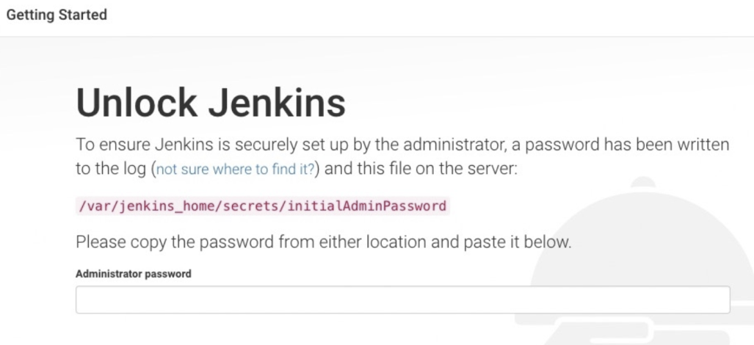
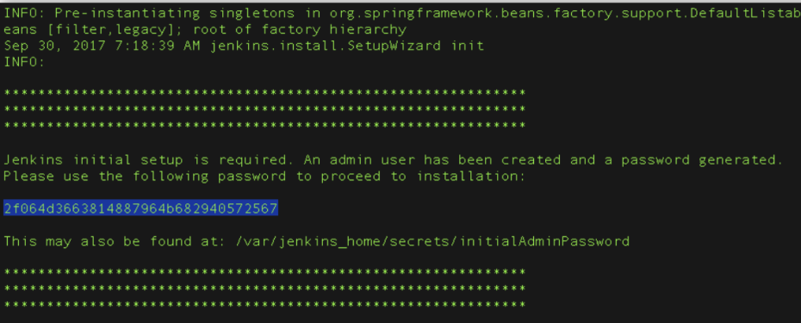
Unlocking Jenkis
After the 2 sets of asterisks appear in the terminal/command prompt window, browse to http://<<IP Address>>:8080 and wait until the Unlock Jenkins page appears
This is the same IP which we captured in the previous slide
From the terminal/command prompt window again, copy the automatically-generated alphanumeric password (between the 2 sets of asterisks)
On Customize Jenkins page click Install suggested plugins
IF YOU ARE RUNNING ALL THIS SECOND TIME then password will not be available on the screen. See next slide for recovering the password

Slide 36
Getting Jenkins Password
docker container ls
docker exec -it <container id from prv cmd> /bin/bash
cat /var/jenkins_home/secrets/initialAdminPassword
Note – Use sudo

Slide 37
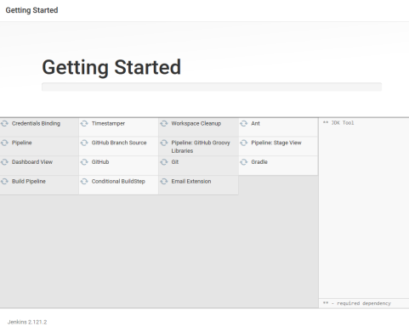
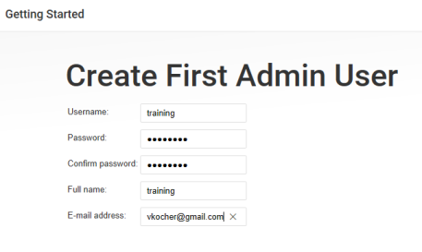
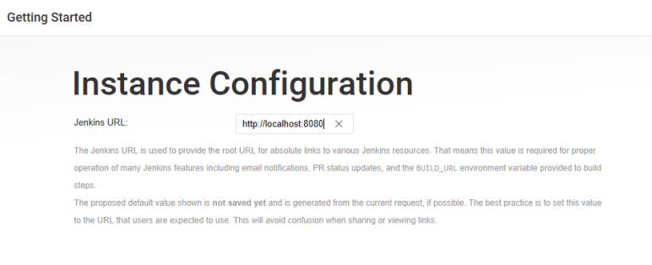
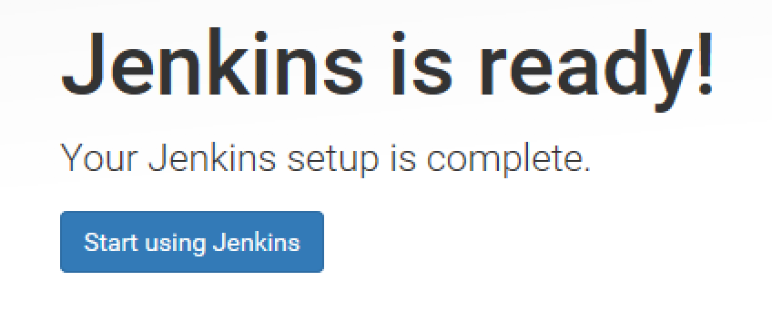
Getting Started
When the Create First Admin User page appears, specify your details in the respective fields and click Save and Finish.
When the Jenkins is ready page appears, click Start using Jenkins.
Please note
This page may indicate Jenkins is almost ready! instead and if so, click Restart.
If the page doesn’t automatically refresh after a minute, use your web browser to refresh the page manually.
If required, log in to Jenkins with the credentials of the user you just created and you’re ready to start using Jenkins!
you can stop the Jenkins/Blue Ocean Docker container by typing Ctrl-C

Slide 38
Getting Sample Code
Open the browser and go to https://github.com/login
Login to your account
Launch URL https://github.com/umangsaltuniv/simple-java-maven-selenium-app
Click Fork at right top section
“Simple Java Maven app” repository will be added on your GitHub account
Note: Simple Java Maven project has sample app & some unit and selenium tests that will run automatically once we create a pipeline project

Slide 39
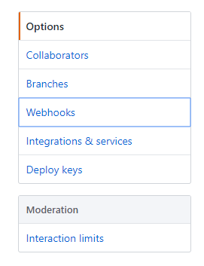
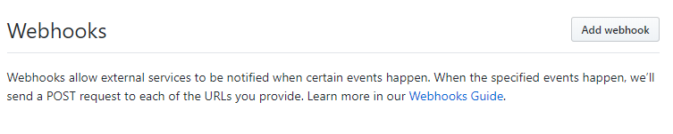
Setup Webhook on GitHub
Go to GitHub Web
Go to “simple-java-maven-app” repository
Navigate to the "Settings" tab
Select the "Webhooks" option on the left menu
Click "Add webhook"

Slide 40
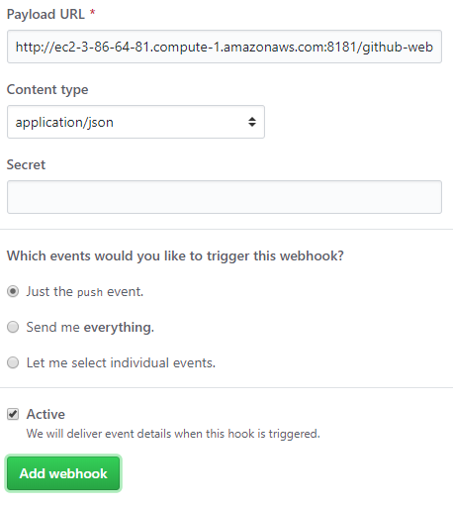
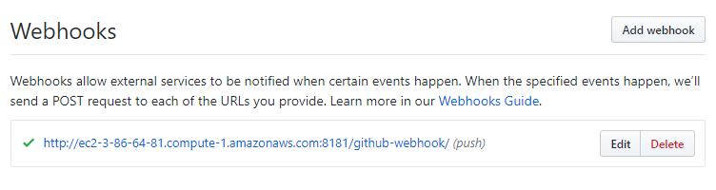
GitHub Settings
For "Payload URL":
Use the address for the aws server instance (e.g. http://ec2-3-86-64-81.compute-1.amazonaws.com:8080/)
Add /github-webhook/ to the end of it
example: http://ec2-3-86-64-81.compute-1.amazonaws.com:8080/github-webhook/
Select "application/json" as the encoding type
Leave "Secret" blank (unless a secret has been created and configured in the Jenkins "Configure System -> GitHub plugin" section)
Select “Just the push event"
Make sure "Active" is checked
Click "Add Webhook"

Slide 41
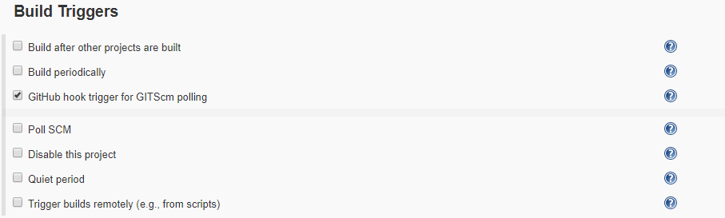
Create Pipeline Project
Go to Jenkins Dashboard
Click “New Item” at top left section
Enter any meaningful item name(e.g. simple-java-maven-app) > Select Pipeline > Click OK
Select ”GitHub hook trigger for GITScm polling” checkbox under Build Triggers section
Go to Pipeline section
Choose the ”Pipeline script from SCM” option from the ”Definition” field
Choose the ”Git” option from the ”SCM” field
Enter your Repository URL(e.g. https://github.com/<Your username>/simple-java-maven-app )
Enter “Jenkinsfile.txt” under “Script Path” section
Click Apply
Click Save

Slide 42
Run Pipeline Project
Make some change in code on GitHub
Pipeline project will be triggered automatically on Jenkins, once you make any changes on GitHub

Slide 43
Multiple Docker Containers

Slide 44
Automation:
In the example above, you deployed just a single Docker container to a single EC2 Instance. What happens if you have many different Docker containers (e.g., one container for a front-end web app, another for a back-end, another for a database, and so on) and you have to deploy multiple copies of each of those containers across many EC2 Instances. You wouldn’t want to repeat all of these manual steps over and over again, so you need a way to automate deployment
Integration:
Running a Docker container is only one piece of the puzzle. You also need to integrate it with all the other parts of your infrastructure, such as routing traffic to your containers (load balancing) and ensuring the your containers continue running (monitoring, alerting, crash recovery).
One way to solve both of these problems is to use the EC2 Container Service(ECS).

Slide 45
Deploying Docker containers on ECS
The idea behind ECS is that you create an ECS Cluster—which is a group of EC2 Instances managed by ECS—define what Docker containers you want to run, and ECS will take care of deploying those containers across the Cluster, rolling out new versions, and integrating with other AWS infrastructure. ECS can make it easier to manage multiple Docker containers running on multiple EC2 Instances—if you can figure out all the steps required to use it. These steps are:
Create an ECS Cluster
Create an ELB
Create IAM Roles
Create an Auto Scaling Group
Run Docker containers in your ECS Cluster
Update Docker containers in your ECS Cluster

Slide 46
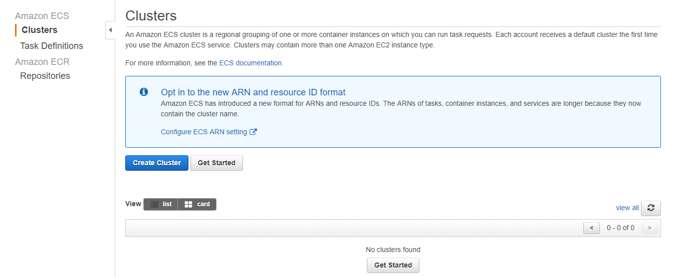
Creating a ECS Cluster
Notes:
Open up your AWS Console and click on the EC2 Container Service link > Click Clusters > This takes you to the Clusters page in the normal ECS UI. To create a Cluster, click the blue “Create Cluster” button

Slide 47
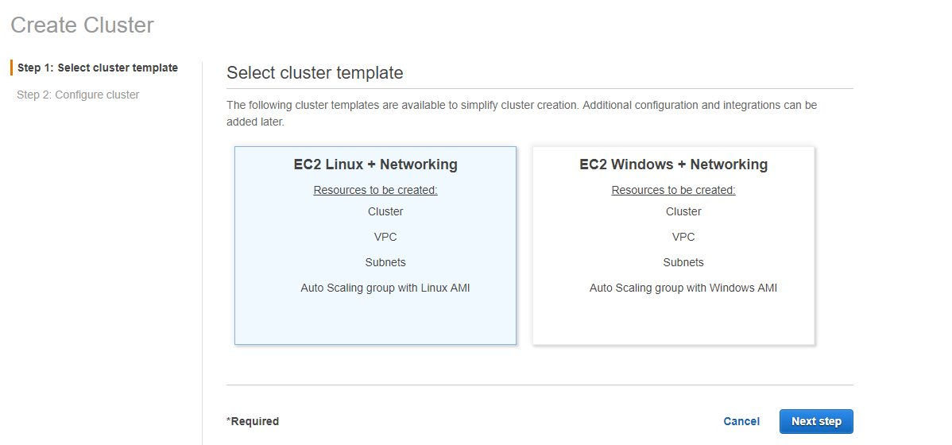
Notes:
Keep default selected option(EC2 Linux + Networking) > Next steps

Slide 48
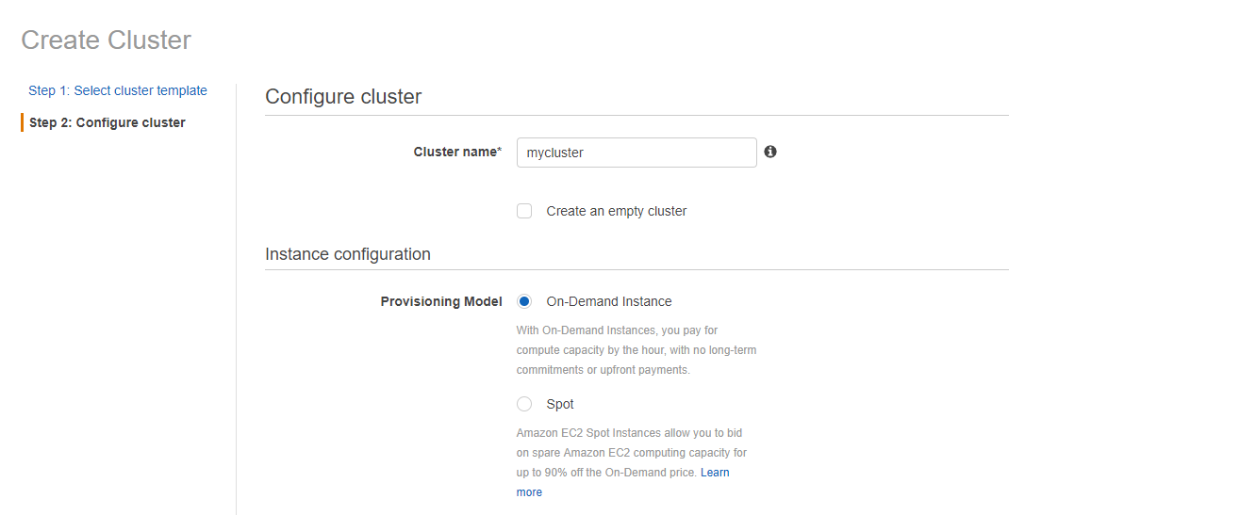
Notes:
Give the cluster a name, such as mycluster > Fill the form > Create > view Cluster
Form details:
Cluster name – mycluster/docker image name
On Demand Instance(pay by hour)
EC2 Instance Type – t2.small
No. of instances – 1 or 2
EBS Storage – 22
Key pair – select your keypair or generate by EC2 console(Create key pair/import key pair)
Networking - select/create vpc, subnets, security groups, security group inbound rule
Key details will be available under Key Pairs at EC2 dashboard
Key Name – CloudKey
Key Value - aa:1d:fe:b7:0d:1e:5e:f4:97:e6:29:c0:99:c4:f8:ad:f6:d0:46:06
Container instance IAM role - default
You need to create a bunch of new EC2 Instances and register them in the Cluster. Deploying, monitoring, and updating many EC2 Instances manually is tedious and error prone. A better solution is to use an Auto Scaling Group and an Elastic Load Balancer.

Slide 49
Elastic Load Balancer
You can use an Elastic Load Balancer (ELB) when you are running multiple EC2 Instances and you want to distribute load between them. The ELB monitors the health of your EC2 Instances, so if one goes down (due to a crash or an Auto Scaling Group reducing the number of instances) it can take it out of rotation or if a new one comes up (due to a new deployment or an Auto Scaling Group increasing the number of instances) it can add it to the rotation. Your users always send their requests to the ELB, so they are shielded from any changes within your data center.
Create the ELB first and then move on to the Auto Scaling Group.

Slide 50
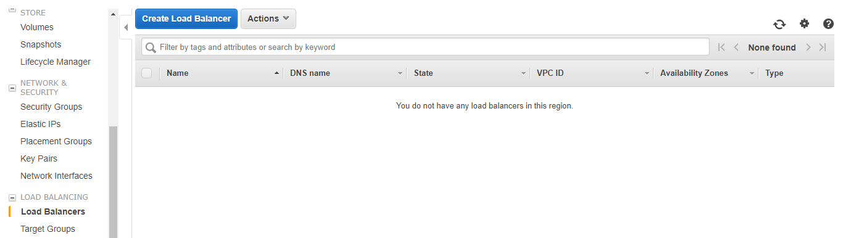
Create Load Balancer
Notes:
Click Load Balancers > Click Create Load Balancer

Slide 51
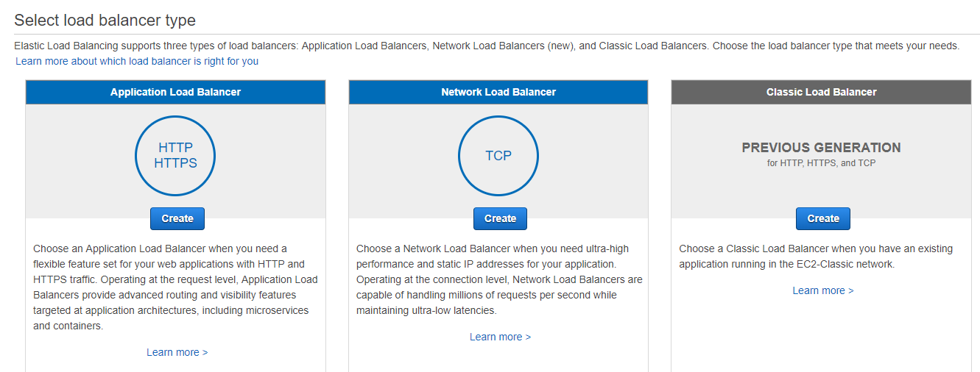
Select a Load Balancer Type
Notes:
For Application Load Balancer, choose Create

Slide 52
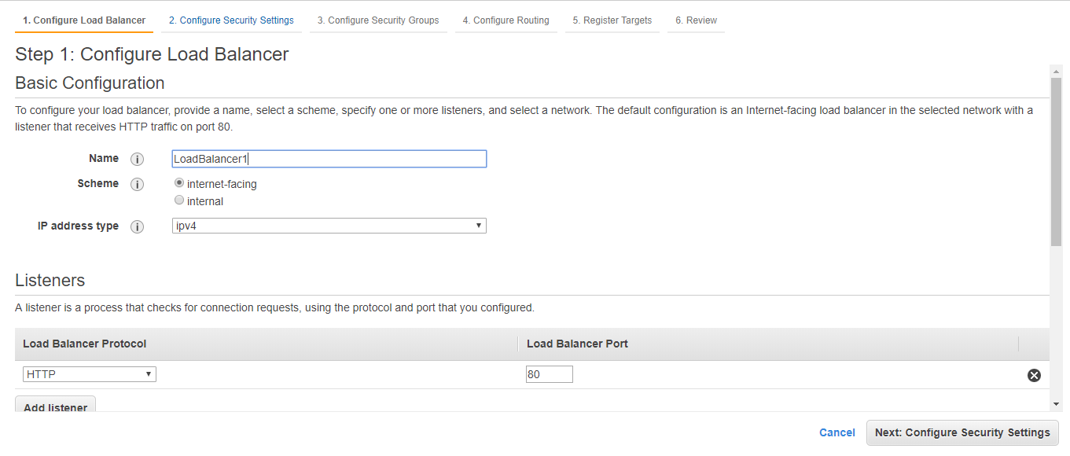
Configure Your Load Balancer and Listener
Notes:
Enter Name
Keep other default values as it is

Slide 53
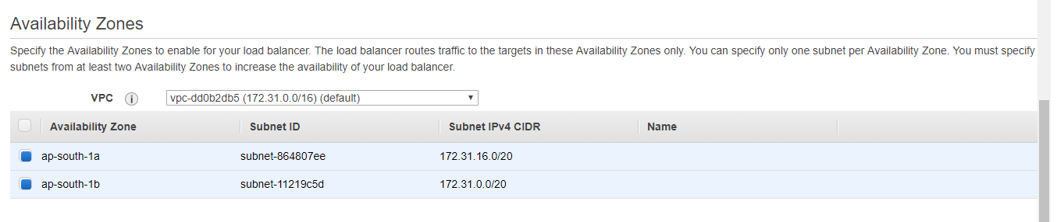
Notes:
Select 2 subnets(instances)
Click Next: Configure Security Settings

Slide 54
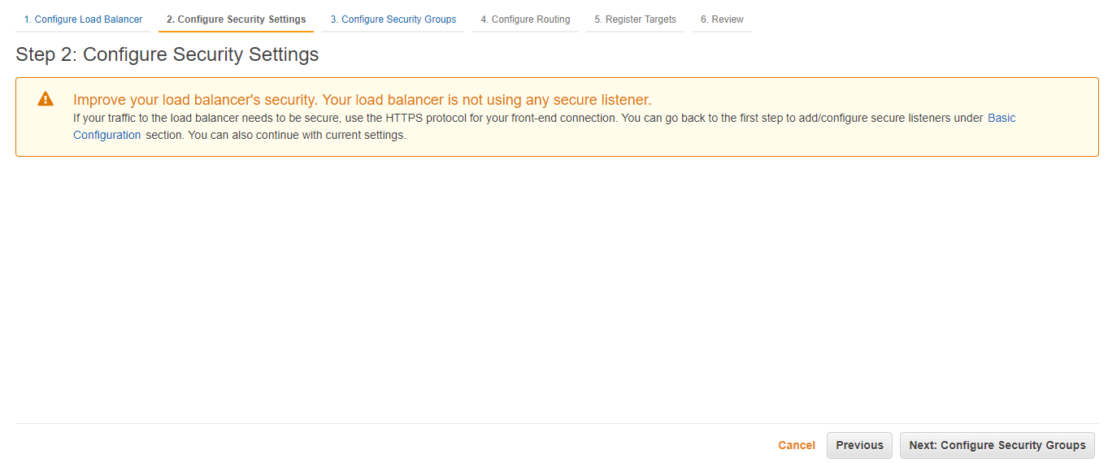
Notes:
Click Next: Configure Security Groups

Slide 55
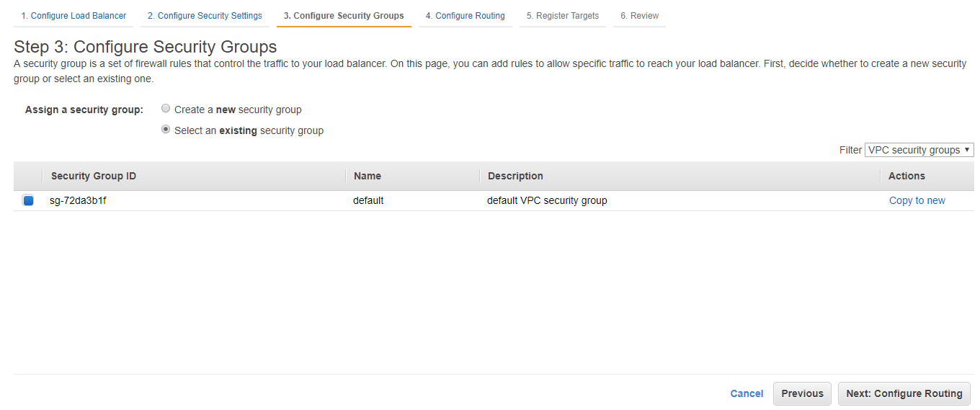
Configure a Security Group for Your Load Balancer
Notes:
Click Next: Configure Routing

Slide 56
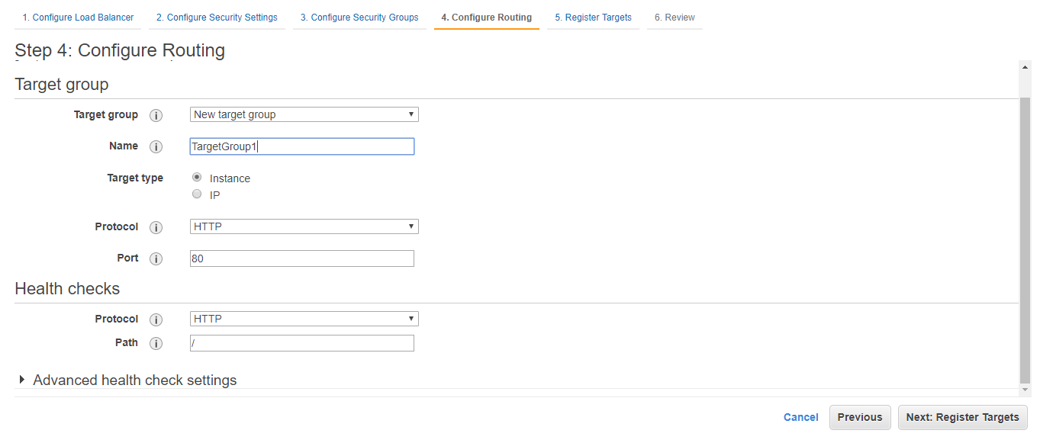
Target Group
Notes:
Enter Target Name
Click Next: Register Targets

Slide 57
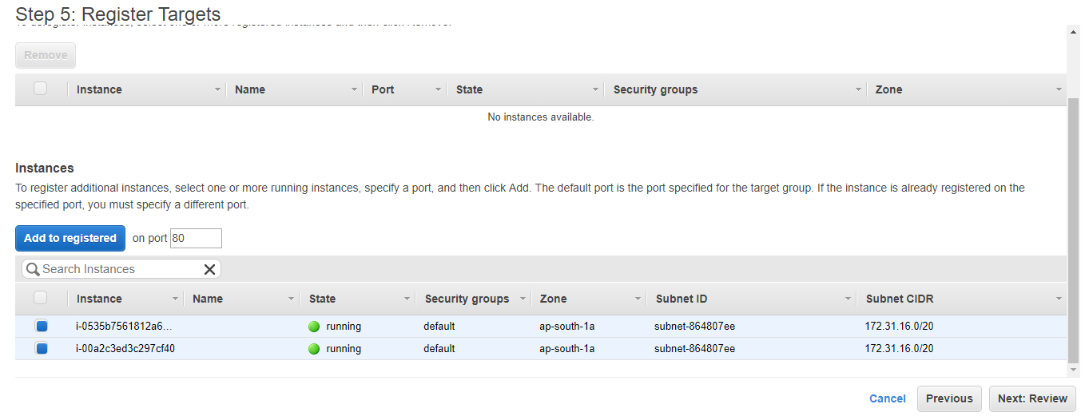
Notes:
Click Add to registered

Slide 58

Register Targets with Your Target Group
Notes:
Select both instances
Click Next: Review

Slide 59

Create and Test Your Load Balancer
Notes:
Click Create

Slide 60

Notes:
Click Close

Slide 61


Slide 62

Notes:
On the navigation pane, under LOAD BALANCING, choose Load Balancers.
Select the newly created load balancer.
On the Description tab, copy the DNS name of the load balancer (for example, my-load-balancer-1234567890.us-west-2.elb.amazonaws.com). Paste the DNS name into the address field of an Internet-connected web browser. If everything is working, the browser displays the default page of your server.

Slide 63

IAM Roles

Slide 64

Notes:
Click Roles

Slide 65


Slide 66


Slide 67


Slide 68


Slide 69


Slide 70


Slide 71

Create another IAM Role

Slide 72


Slide 73

Notes:
Why we created 2 roles - To allow the ECS Cluster to talk to your ELB so it can notify the ELB when it is deploying or undeploying Docker containers

Slide 74
AWS Services

Slide 75
Compute
Storage
Database
Migration
Networking & Content Delivery
Developer Tools
Management Tools
Media Services
Machine Learning
Analytics
Security, Identity & Compliance
Mobile Services
AR & VR
Application Integration
AWS Cost Management
Customer Engagement
Business Productivity
Desktop & App Streaming
Internet Of Things
Game Development

Slide 76

Compute
EC2
Lightsail
ECS
EKS
Lambda
Batch
Elastic Beanstalk

Slide 77

Storage
S3
EFS
S3 Glacier
Storage Gateway

Slide 78

Database
RDS
DynamoDB
ElastiCache
Neptune
Amazon Redshift

Slide 79

Migration
AWS Migration Hub
Application Discovery Service
Database Migration Service
Server Migration Service
Snowball

Slide 80

Networking & Content Delivery
VPC
CloudFront
Route 53
API Gateway
Direct Connect

Slide 81

Developer Tools
CodeStar
CodeCommit
CodeBuild
CodeDeploy
CodePipeline
Cloud9
X-Ray

Slide 82

Management Tools
CloudWatch
AWS Auto Scaling
CloudFormation
CloudTrail
Config
OpsWorks
Service Catalog
Systems Manager
Trusted Advisor
Managed Services

Slide 83

Media Services
Elastic Transcoder
Kinesis Video Streams
MediaConvert
MediaLive
MediaPackage
MediaStore
MediaTailor

Slide 84

Machine Learning
Amazon SageMaker
Amazon Comprehend
AWS DeepLens
Amazon Lex
Machine Learning
Amazon Polly
Rekognition
Amazon Transcribe
Amazon Translate

Slide 85

Analytics
Athena
EMR
CloudSearch
Elasticsearch Service
Kinesis
QuickSight
Data Pipeline
AWS Glue

Slide 86

IAM
Cognito
Secrets Manager
GuardDuty
Inspector
Amazon Macie
AWS Organizations
AWS Single Sign-On
Certificate Manager
Key Management Service
CloudHSM
Directory Service
WAF & Shield
Artifact

Slide 87

Mobile Services
Mobile Hub
AWS AppSync
Device Farm

Slide 88

AR & VR
Amazon Sumerian

Slide 89

Application Integration
Step Functions
Amazon MQ
Simple Notification Service
Simple Queue Service
SWF

Slide 90

AWS Cost Management
AWS Cost Explorer
AWS Budgets

Slide 91

Customer Engagement
Amazon Connect
Pinpoint
Simple Email Service

Slide 92

Business Productivity
Alexa for Business
Amazon Chime
WorkDocs
WorkMail

Slide 93

Desktop & App Streaming
WorkSpaces
AppStream 2.0

Slide 94

Internet Of Things
IoT Core
IoT 1-Click
IoT Device Management
IoT Analytics
Greengrass
Amazon FreeRTOS
IoT Device Defender

Slide 95

Game Development
Amazon GameLift

