Slide 1

CourseGenie+: Centralized Academic Workflow Automation
Team Members: Jeeda Kotob, Ryma Ait Tayeb, Ibraheem Mustafa
Deliverable 2
Mentors: Dr. Ali Assi & Mr.Qusai Hassan
November 2025

Slide 2
Motivation
Faculty and administrators spend significant time on repetitive academic tasks such as:
  Preparing Course Assessment Reports (CAR)
  Extracting and analyzing student grade statistics
  Preparing course peer-review reports.
Because these tasks are done manually, they reduce valuable time for teaching and research. CourseGenie+ streamlines these processes through automation and centralized dashboards, improving efficiency across the academic workflow.

Slide 3
User Stories - Professor Features
As a Professor, the system features should allow me to:
Log in to the correct dashboard | Manage course calendar (drag & drop assessments)
Generate and edit syllabus | View professors teaching same course
Submit syllabus | Assign exam rooms to students
View gradebook | Send automatic exam notifications
Grade color-highlighting | Download exam room assignment report
View class performance statistics | Edit profile info (office hours, email, room)
Auto-generate CAR report | Map CLO–PLO

Slide 4
User Stories - Administrator Features
As an Administrator, the system features should allow me to:
Admin dashboard access | Assign reviewer to reviewee and vice versa
Track syllabus submissions | Track peer review progress
Preview + download syllabus files | Initiate peer review workflow
Track CAR submissions | Automatic reminder emails (syllabus + CAR)
Preview + download CAR files | Create + configure course sections

Slide 5
User Stories - Reviewer & Reviewee Features
As a Reviewer, the system features should allow me to:
View assigned review tasks
Complete evaluation forms
Submit structured feedback
As a Reviewee, the system features should allow me to:
View received feedback
Submit reflection response

Slide 6
Use Case: UC01 - User Login & Dashboard Selection
Goal:
Direct user to correct dashboard based on role(s)
Actors:
Professor
Admin
System (Authentication)
Main Flow:
User enters credentials → System verifies
System checks user role(s)
If one role → go directly to dashboard
If multiple roles → show role selection popup
User chooses role → go to selected dashboard
Alternate / Exceptions:
Invalid credentials will show an error message

Slide 7
Use Case: UC02 - CAR Preview & Submission
Goal:
Allow professor to view, download, and submit auto-generated CAR)
Actors:
Professor
System (Database)
Main Flow:
Professor opens course section
Opens CAR Report tab
System generates CAR preview
Professor reviews preview
Alternate / Exceptions:
If required data missing → system disables Submit and shows error message

Slide 8
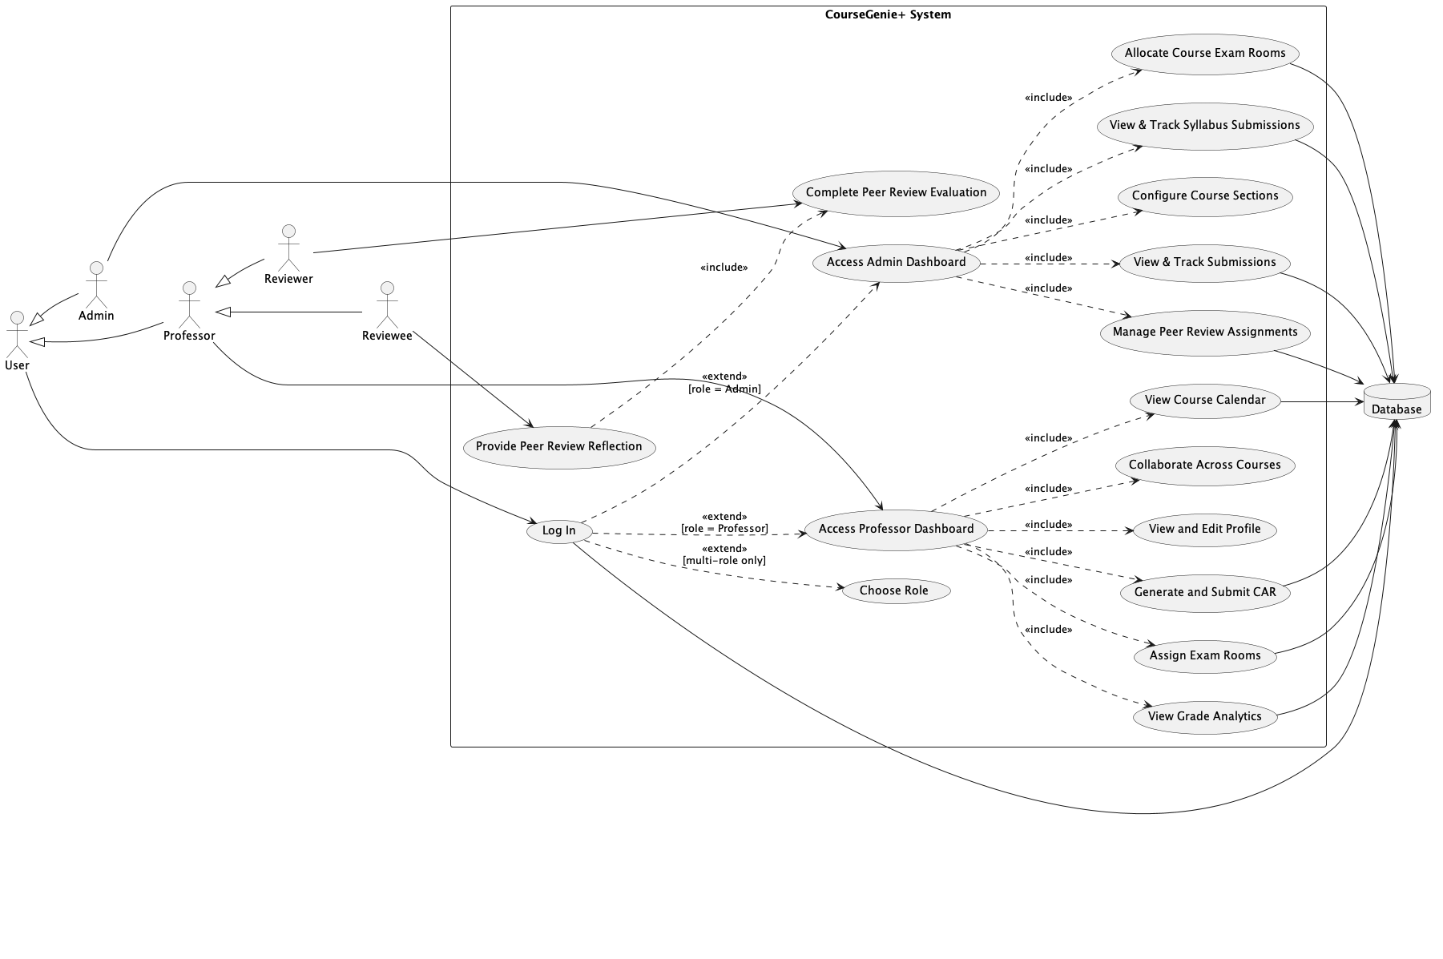
Use Case Diagram

Slide 9
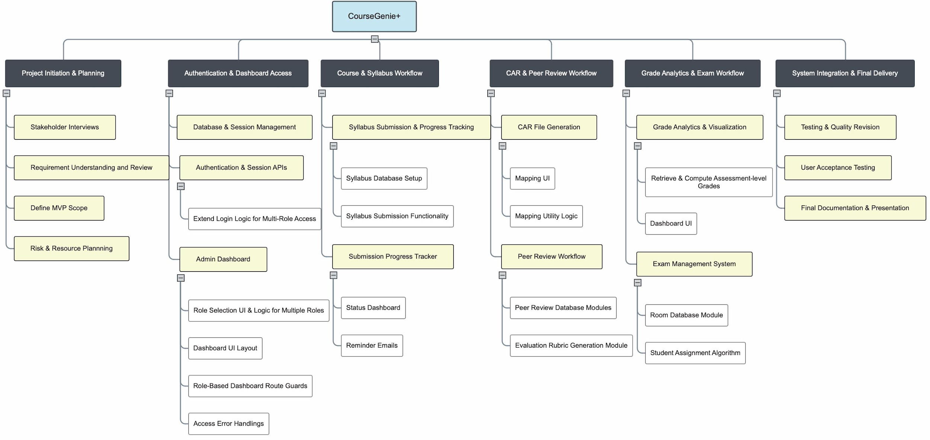
Work Breakdown Structure (WBS)

Slide 10
Project Risk Register
Risk | Impact | Mitigation
Learning curve in Spring Boot / Angular | High | Learning sprints, pair programming, small prototype modules
Time constraints due to other courses | Critical | Strict weekly sprint schedule; prioritize MVP features first
No access to MyCourses data/API | High | Run CourseGenie+ as standalone platform and allow manual import/export
Adoption resistance from professors | High | Simple UI, short training videos, early feedback loops
UI complexity causing confusion | Medium | Consistent layouts, tooltips, user testing with mentors
Data entry or selection errors | Medium | Validation fields, warnings, clear form guidance
Learning curve in Spring Boot / Angular | High | Learning sprints, pair programming, small prototype modules
Time constraints due to other courses | Critical | Strict weekly sprint schedule; prioritize MVP features first

Slide 11
Resource Planning
Human Resources
Jeeda Kotob – Full-Stack (backend–frontend integration, DB)
Ryma Ait Tayeb – Backend (APIs, Spring Boot)
Ibraheem Mustafa – Frontend (Angular dashboards)
Mentors: Dr. Ali Assi & Mr. Qusai Hasan
Stakeholder: Ms. Dezzil Castelino
Weekly mentor reviews & sprint meetings
Technical Resources
Spring Boot – backend framework
Angular – frontend dashboards
MySQL – data storage
GitHub – version control
VS Code / IntelliJ / PlantUML – dev & documentation tools
Logistical Resources
Personal / RIT laptops
Campus labs & meeting rooms
Google Drive & GitHub for collaboration
Mentor feedback sessions

Slide 12
Budget Overview
All tools = open-source or academic licenses
Infrastructure & hosting = RIT provided
Total Cost = 0 AED (University-supported)

Slide 13
Initial Bill of Materials (BoM)
Category | Component | Source | Purpose | Cost
Hardware | Developer Laptops | Personal / RIT Dubai | Development & testing | Provided
Software | Spring Boot | Open Source | Backend framework | Free
Software | Angular | Open Source | Frontend UI | Free
Database | MySQL Server | Oracle Community | Data storage | Free
Version Control | GitHub (Education) | GitHub Education | Collaboration & tracking | Free
Design Tools | PlantUML | Open Source | Diagrams & docs | Free

Slide 14
Test Plan
Objective:
Verify that system features function correctly for both Professors and Admins.
Testing Focus Areas:
Login & Authentication
Syllabus Generation & Submission
CAR Report Generation
CLO–PLO Mapping
Peer Review Workflow
Exam Room Assignment & Notifications
Gradebook & Statistics Display
Testing Method:
Manual functional testing per implemented feature
Pass/Fail tracking in structured test sheets

Slide 15
ThankYou!

