Slide 1


CourseGenie+: Centralized Academic Workflow Automation
Team Members: Jeeda Kotob, Ryma Ait Tayeb, Ibraheem Mustafa
Mentors: Dr. Ali Assi & Mr.Qusai Hassan
Fall 2025

Slide 2
Table of Contents
1
PROJECT OVERVIEW & MOTIVATION
4
BUDGET, RISKS, & TESTING
2
REQUIREMENTS & METHODOLOGY
5
ETHICS & IMPACT ON SOCIETY
3
SYSTEM DESIGN & ARCHITECTURE
6
CHALLENGES & CONCLUSIONS

Slide 3
Motivation
Faculty and administrators are responsible for a wide range of academic management and reporting activities in addition to teaching and research. Many of these processes involve repeated manual effort and offer limited system-level support.
CourseGenie+ extends the CourseGenie system developed in a previous phase and providing structured support and automation for academic management tasks within existing learning management systems, improving efficiency without altering established academic practices.

Slide 4

Project Requirements
Role-Based Access Control + Multi-Role
Peer Review Workflow Management
Exam Room Assignment Management
Course & Section Management
CAR File Generation & Submission
Section Grade Analytics
Viewing & Tracking Syllabus & CAR Submissions
Course Calendar Generation
Cross-Course Collaboration

Slide 5







Agile Iterative Workflow
PHASE 1
PHASE 2
PHASE 3
PHASE 4
PHASE 5
Planning
Design
Develop
Test
Review & Feedback

Slide 6

Roles & Responsibilities
Product Owner
Scrum Master
Development
Stakeholders
Dr. Ali Assi
Mr.Qusai Hassan
Jeeda Kotob
Jeeda Kotob (Full Stack)
Ryma Ait Tayeb (Backend)
Ibraheem Mustafa (Frontend)
Professors
Administrators (Dezzil Castelino – IE Office)

Slide 7
Technologies & Tools
Backend Development | Spring Boot
Frontend Development | Angular
Database | MySQL
Version Control & Collaboration | GitHub & Trello
Development Environment | IntelliJ Ultimate
Design & Documentation Tools | PlantUML & MindView

Slide 8



Requirements Representation
(Non)-Functional Requirements
User Stories
Textual Use Cases

Slide 9





Progress & Next Semester Plan
Completed
Current
Planned
Project Initiation & Requirement Determination
Course Calendar
Admin Dashboard
CAR Submission Flow
Gradebook & Statistics
Frontend Bug Fixes
Role Based Access Control
Peer Review Flow
System Validation & Refinement
Database Schema Updates
Exam Rooms Management
Syllabus Submission Flow

Slide 10
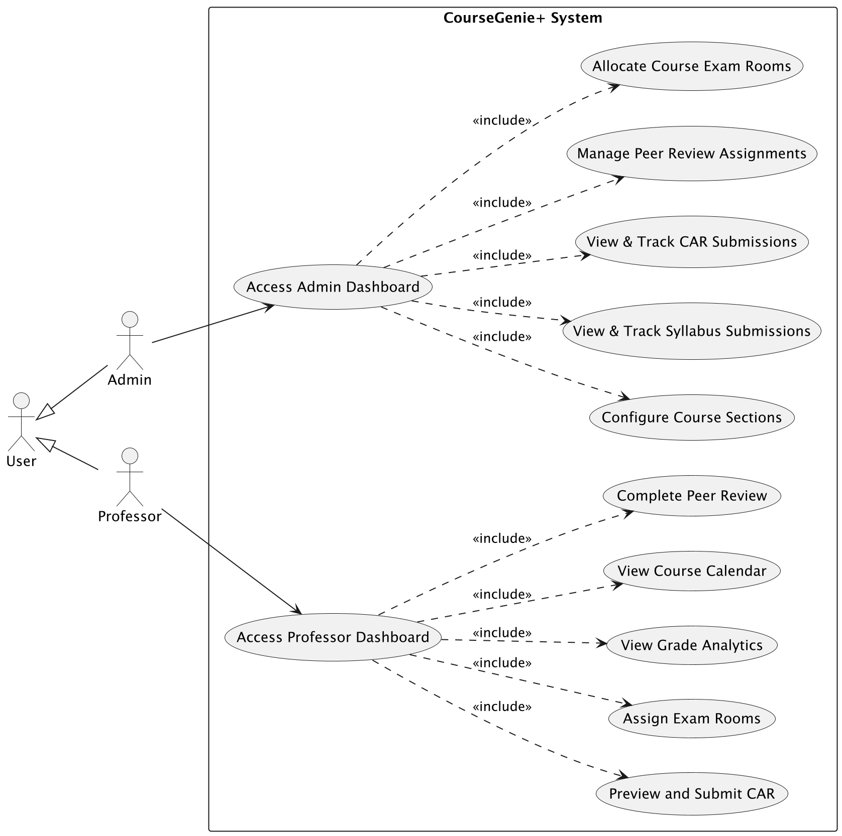
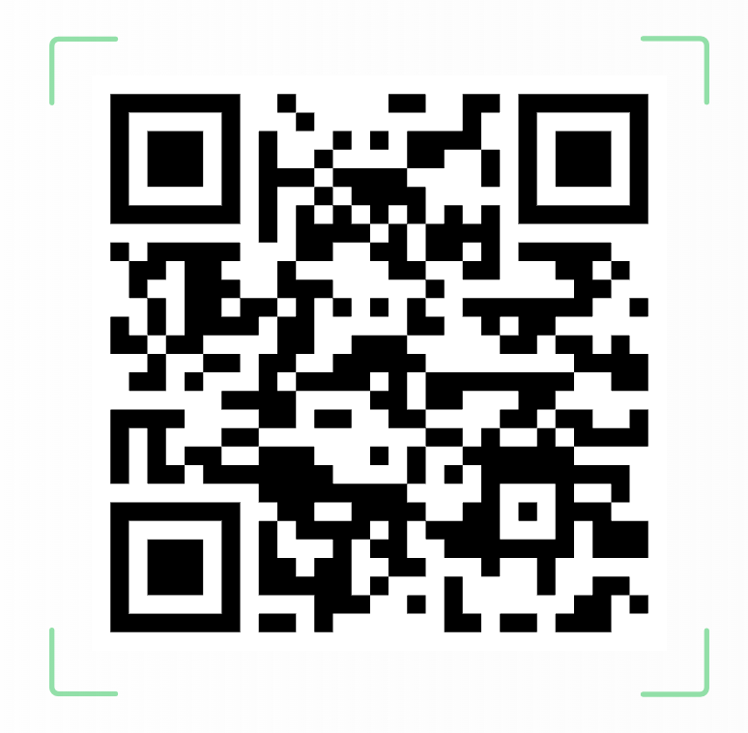
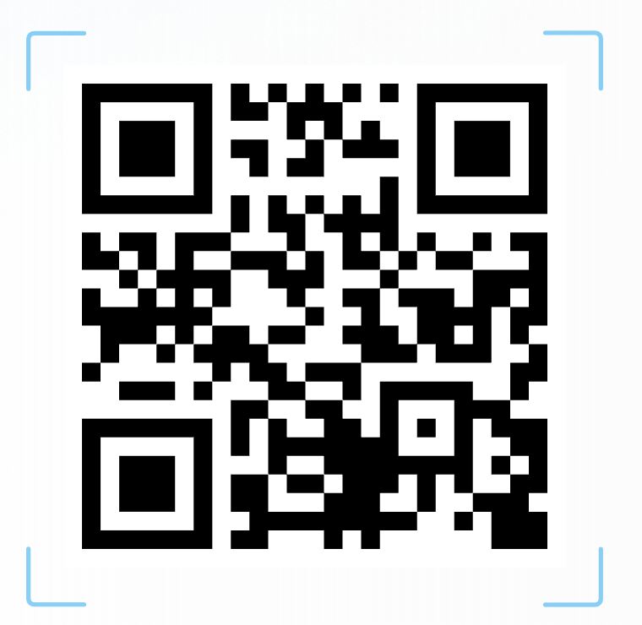
System Use Case Diagram
Sequence Diagrams
Activity Diagrams

Slide 11
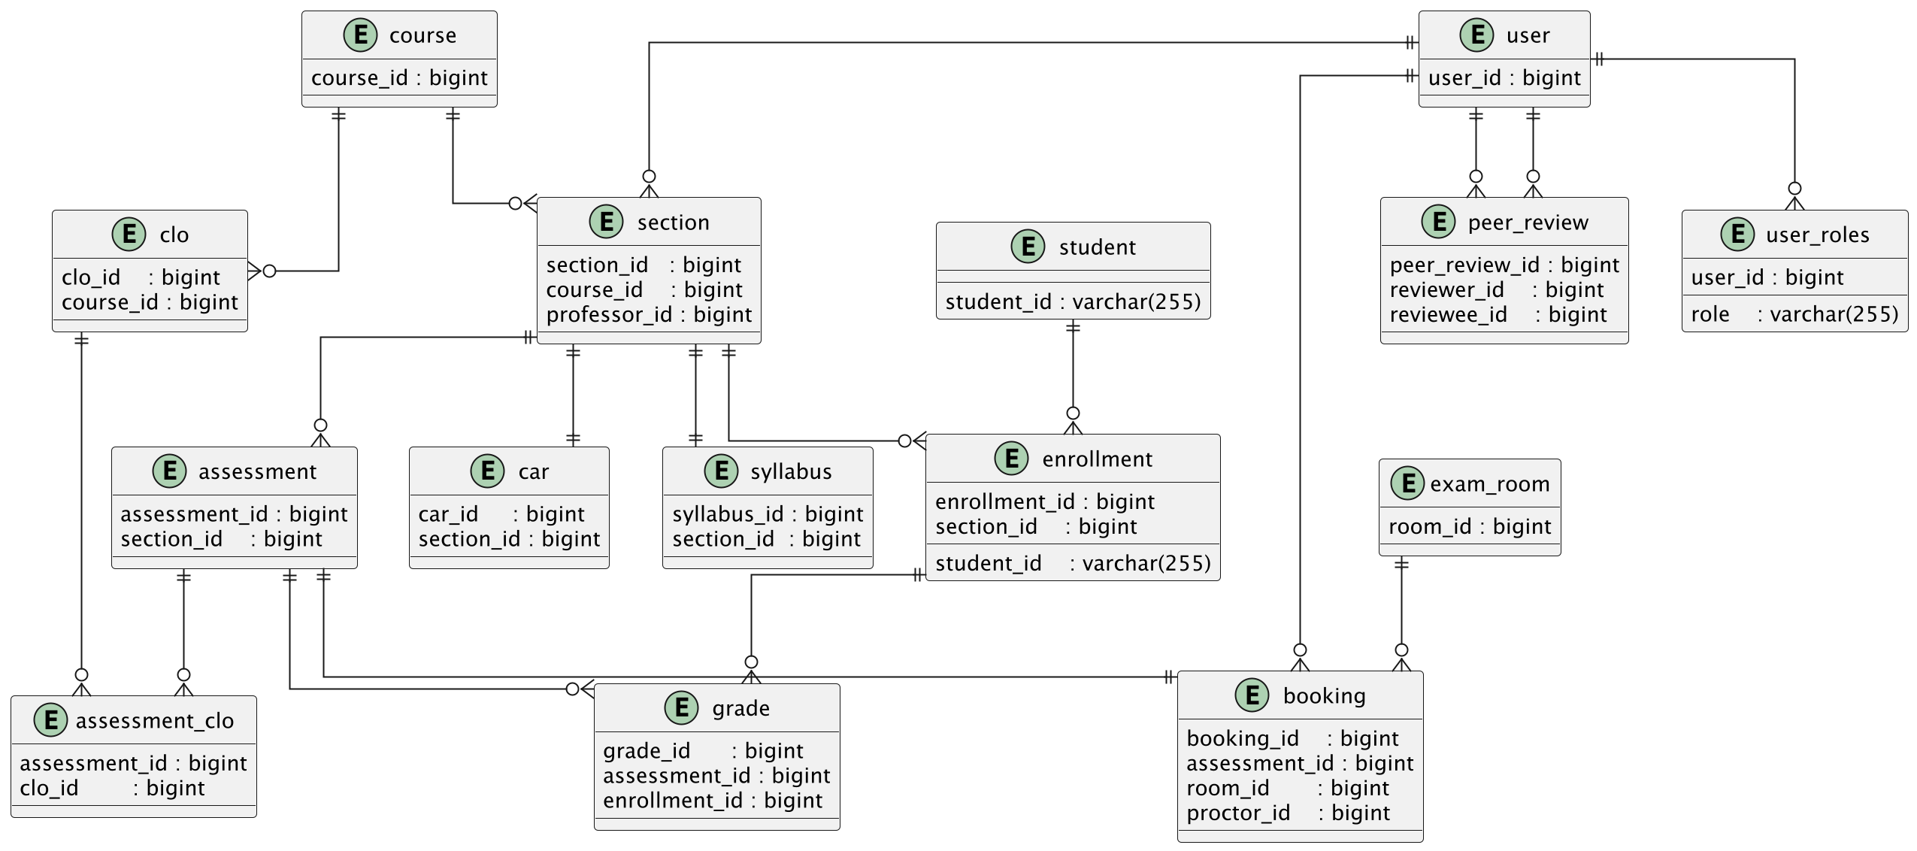
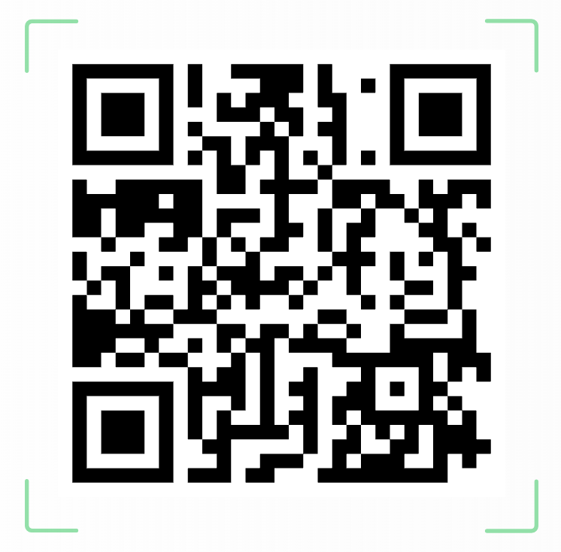
Database Diagram
Number of Tables: 25
Full DB Diagram

Slide 12
Bill of Materials
Category | Component | Source | Purpose of Need | Estimated Total Cost
Software | Angular & Springboot Frameworks | Open Source | Frontend & Backend Development | Open-source (AED 0)
Database | MySQL Server | Oracle Community | Data storage and management | Open-source under GPL (AED 0)
Version Control | GitHub | GitHub Education | Repository management and collaborative development | Open-source (AED 0)
Design Tools | PlantUML, MindView, Canvas, SlideBazaar | Open Source | Project planning and system design diagrams | ~ AED 100
Learning Resources | Online learning sources for UML design, frontend and backend technoplogies. | LinkedIn Learning | Skill development, framework understanding, and best practices | ~ AED 900
Unexpected Costs | Contingency expenses | Personal | Covers unforeseen software tools, subscriptions, or minor project expenses | ~ AED 200
 |  |  |  | Total Cost: ~ AED 1200

Slide 13
Project Risks
Risk | Impact | Mitigation
Learning curve in Spring Boot / Angular | High | Learning Spring Boot and divide roles based on skills
Restricted access to MyCourses data/API | Critical | Design CourseGenie+ as an independent system with its own database, avoiding direct dependency on MyCourses.
Incomplete Database Schema | High | Align the database schema with requirements by updating/ adding entities, relationships, and attributes.
Frontend Stale Data | Medium | Update frontend data-handling logic to ensure views reflect the most recent backend data during user interactions.
Evolving Requirements During Development | Low | Handle requirement changes during Scrum sprint planning and review meetings using prioritized user stories.

Slide 14



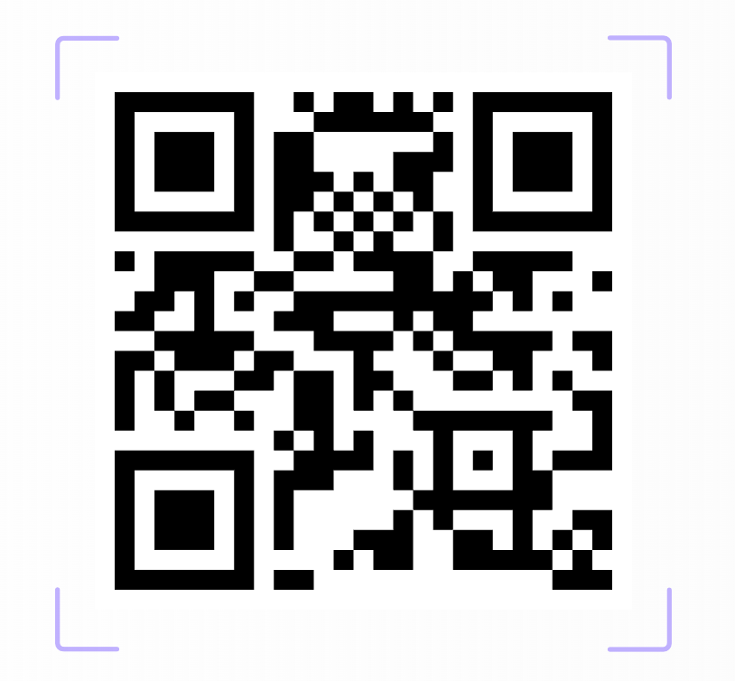

Testing Plan
Functional Testing
Unit Testing
Manual UI testing
Based on user stories & acceptance criteria
Validates complete user workflows
JUnit-based backend testing
Tests individual services & methods

Slide 15









Ethics & Impact on Society
Ethics
Impact on Society
Authorized Access
Academic Efficiency
Users can only access system features allowed by their assigned role.
Reduces manual effort in course work management.
Data Privacy & Confidentiality
Consistent Academic Artifacts
Academic data such as grades and reviews is visible only to authorized users.
Ensures consistent structure and format across system-generated academic content.
Security-Aware Design
Improved Administration
LDAP authentication is used, with security encryption planned for deployment.
Centralizes and streamlines administrative tracking and management tasks.
Responsible Use of Data
Automated Academic Workflows
Only necessary academic data is collected.
Automates core academic workflows such as submissions and evaluations.

Slide 16
Challenges & Conclusions
Challenges
Conclusions
Time constraints during design and development
Creating realistic and representative test data
Code & technical integration challenges
A functional prototype was successfully developed.
Iterative development helped adapt to changing requirements
The current implementation provides a solid baseline for future work

Slide 17
Spring 2026

Slide 18
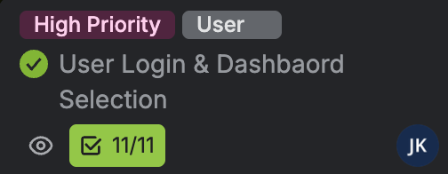
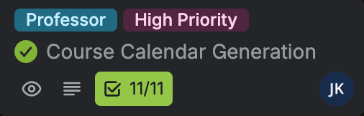
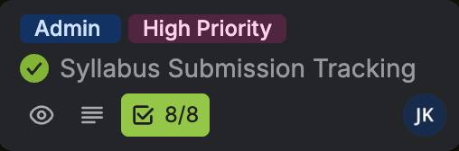
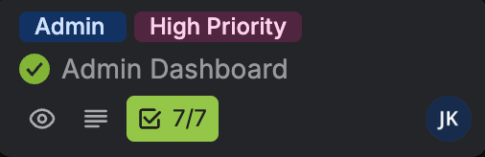
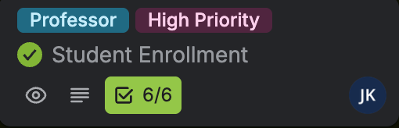
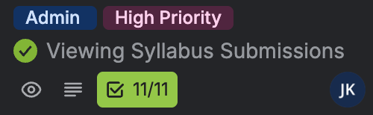
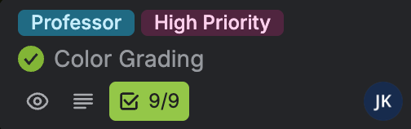
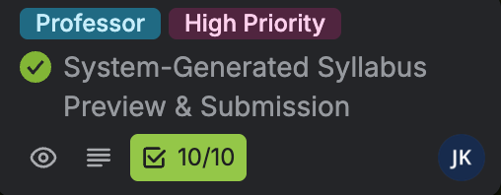
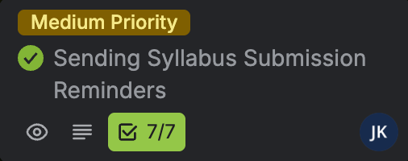
Product Increment

Slide 19
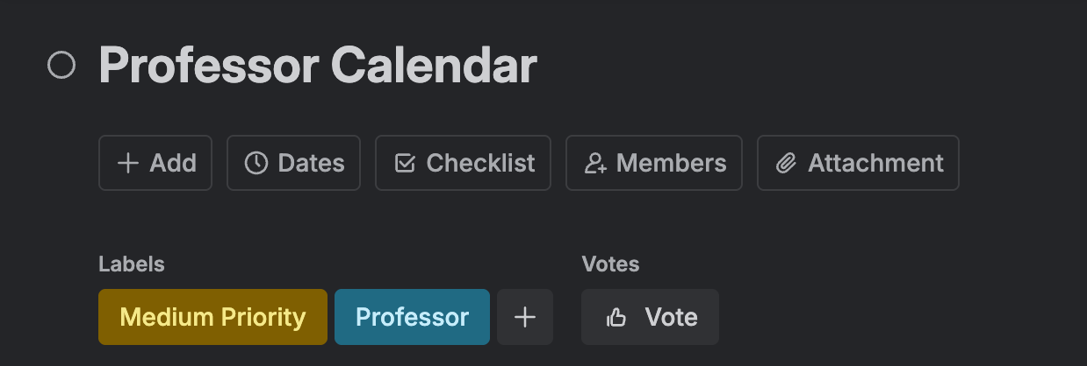
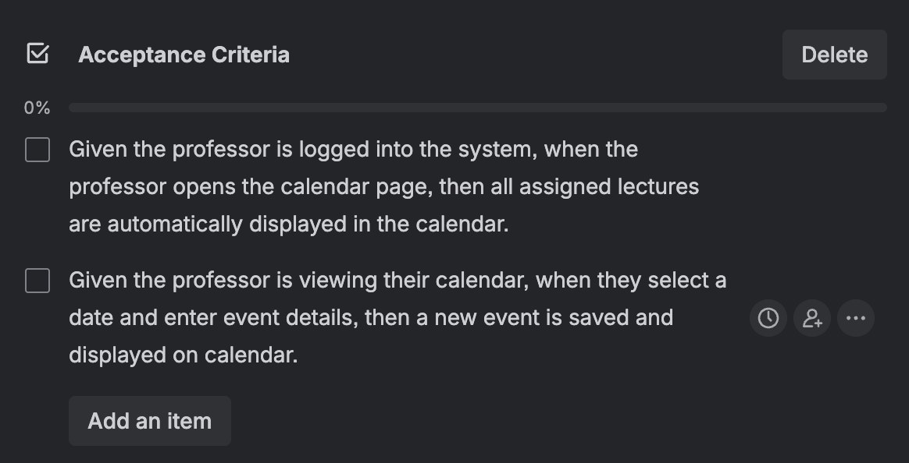
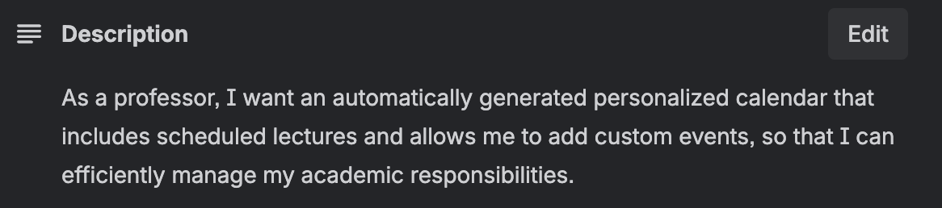
Backlog Refinement

Slide 20


Project Challenges
Database Schema Refactoring
System Deployment Limitations
Designing Effective User Workflows

Slide 21
Demo

Slide 22

Thank you!

