Slide 1
BASED ON THE PAPER “INTERACTIVE COLOR SEGMENTATION WITH LINEAR PROGRAMMING”
IMAGE SEGMENTATION
+
LINEAR PROGRAMMING
+
USER INTERACTION
PRESENTED BY JEEHEON KIM

Slide 2
CONTENTS
001/ Let’s Narrow it Down
002/ Mathematical formula
003/ Programming Algorithm
004/ Demo
005/ Wrap-up

Slide 3
IMAGE SEGMENTATION + LINEAR PROGRAMMING + USER INTERACTION
001/ Let’s Narrow it Down
This paper is heavily based on another paper that uses semi-definite programming
I am going to skip specificity…

Slide 4
IMAGE SEGMENTATION + LINEAR PROGRAMMING + USER INTERACTION
001/ Let’s Narrow it Down
But grasp the basic idea!
… useful for image segmentation using linear programming

Slide 5
IMAGE SEGMENTATION + LINEAR PROGRAMMING + USER INTERACTION
001/ Let’s Narrow it Down – but grasp the basics
What are the key concepts?
Segmentation, features, clustering

Slide 6
IMAGE SEGMENTATION + LINEAR PROGRAMMING + USER INTERACTION
001/ Let’s Narrow it Down – but grasp the basics
What are the key concepts?
Segmentation, features, clustering
Partitioning an image into meaningful regions
=> cluster pixels into coherent blobs
e.g., detecting a moving object in a surveillance camera

Slide 7
IMAGE SEGMENTATION + LINEAR PROGRAMMING + USER INTERACTION
001/ Let’s Narrow it Down – but grasp the basics
What are the key concepts?
Segmentation, features, clustering
Feature vector is just a vector that contains information describing an object’s important characteristics
Intuitive decision on feature vector
- Smallest unit of an image is a pixel
- Representative feature of a pixel is color
What else can be used as a feature?
- texture, intensity, chromaticity
Notes:
But you might wonder, how do we cluster pixels?
Looking at what?
This has to do with features and clustering.
But first, I am gonna tell you what can be features
---

Slide 8
IMAGE SEGMENTATION + LINEAR PROGRAMMING + USER INTERACTION
001/ Let’s Narrow it Down – but grasp the basics
What are the key concepts?
Segmentation, features, clustering
Remember, segmentation is “clustering pixels into coherent blobs”
We have feature vectors that are not pre-labeled
Technique of ‘discovering’ a label
Simplest way to define blob coherence of image
is to use similarity in color or brightness
Person
Car
Dog

Slide 9
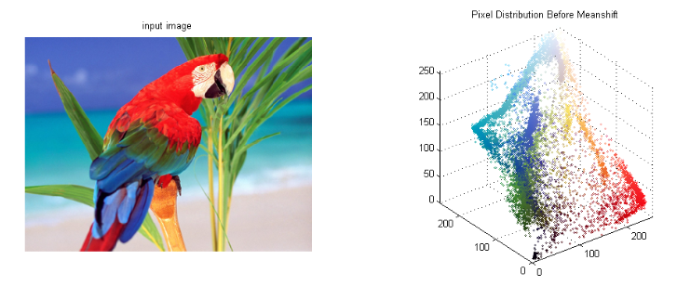
IMAGE SEGMENTATION + LINEAR PROGRAMMING + USER INTERACTION
001/ Let’s Narrow it Down – but grasp the basics
What are the key concepts?
Segmentation, features, clustering
Relation to Image Segmentation?
We try to divide feature vectors into k regions, and use regions to label them
Features has the same label means they represent the same object (segment)

Slide 10
IMAGE SEGMENTATION + LINEAR PROGRAMMING + USER INTERACTION
001/ Let’s Narrow it Down – but grasp the basics
What are the key concepts?
Segmentation, features, clustering
K-means Algorithm: Expectation-Maximization
Expectation step:
updating expectation of which cluster each point belongs to
Maximization step:
maximizing some fitness function that defines the location of the cluster centers
Procedure
Guess some cluster centers
Repeat until converged
E-Step: assign points to the nearest cluster center
M-Step: set the cluster centers to the mean
Notes:
EM: comes up in a variety of contexts within data science

Slide 11
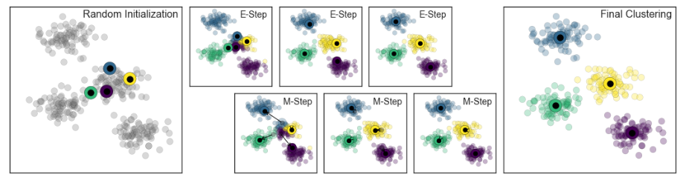
IMAGE SEGMENTATION + LINEAR PROGRAMMING + USER INTERACTION
001/ Let’s Narrow it Down – but grasp the basics
What are the key concepts?
Segmentation, features, clustering
K-means Algorithm: Expectation-Maximization
Guess some cluster centers
Repeat until converged
E-Step: assign points to the nearest cluster center
M-Step: set the cluster centers to the mean
Notes:
EM: comes up in a variety of contexts within data science

Slide 12
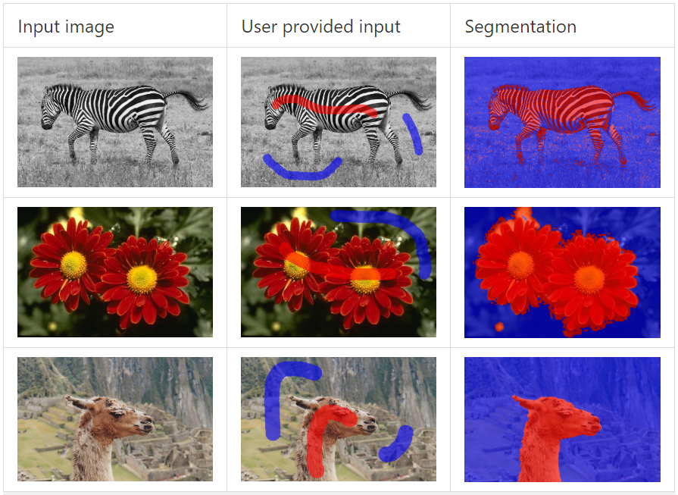
IMAGE SEGMENTATION + LINEAR PROGRAMMING + USER INTERACTION
002/ Mathematical Formula?
I want to dive into two-class segmentation problem (k=2)
Segmenting a background image and a foreground image
Notes:
--- How can we understand mathematical formula using the basic terms mentioned?

Slide 13
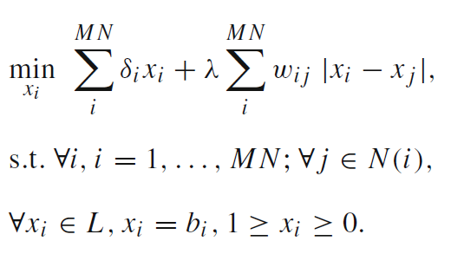
IMAGE SEGMENTATION + LINEAR PROGRAMMING + USER INTERACTION
002/ Mathematical Formula?
Notes:
Formulate segmentation quality function (objective function / energy)

Slide 14
IMAGE SEGMENTATION + LINEAR PROGRAMMING + USER INTERACTION
002/ Mathematical Formula?
How do we start segmentation of the image?
Unsupervised: no training data
features lie together because
they are locally coherent
Supervised: medical image analysis
features belong together because
they lie on the same object
We use semi-supervised technique
input from user interaction
User will draw scribbles which are used to
label data points (i.e., feature vector)
Notes:
There are too many notation to be explained, but since we already know basic idea of segmentation, it would be fairly easy to explain now.

Slide 15
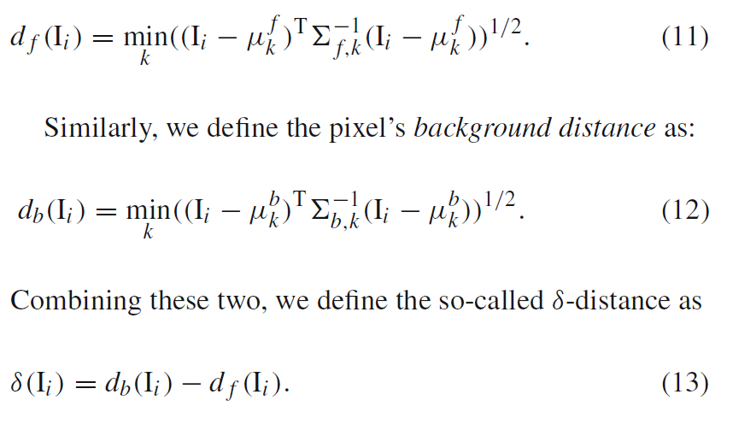
IMAGE SEGMENTATION + LINEAR PROGRAMMING + USER INTERACTION
002/ Mathematical Formula?
So where are features of the image?
We use a pixel and 4-neighbouring pixels’
CIELab as a feature vector
Dimension of a feature vector = 15
Notes:
There are too many notation to be explained, but since we already know basic idea of segmentation, it would be fairly easy to explain now.

Slide 16
IMAGE SEGMENTATION + LINEAR PROGRAMMING + USER INTERACTION
002/ Mathematical Formula?
Clustering technique?
Decision boundaries in feature space is estimated by
Automatic clustering method: GMM (parametric)
Notes:
There are too many notation to be explained, but since we already know basic idea of segmentation, it would be fairly easy to explain now.

Slide 17
IMAGE SEGMENTATION + LINEAR PROGRAMMING + USER INTERACTION
002/ Mathematical Formula?
Clustering technique? Gaussian Mixture Model
Why? Disadvantages of k-means
Lack of flexibility in cluster shape
Lack of probabilistic cluster assignment
What is GMM?
- Attempts to find a mixture of multi-dimensional Gaussian probability distributions that best model any input dataset
Notes:
There are too many notation to be explained, but since we already know basic idea of segmentation, it would be fairly easy to explain now.

Slide 18
IMAGE SEGMENTATION + LINEAR PROGRAMMING + USER INTERACTION
002/ Mathematical Formula?
Clustering technique? Gaussian Mixture Model
Procedure
Guess some starting points for location and shape
Repeat until converged
E-Step: for each point, find weights encoding the probability of membership in each cluster
M-Step: for each cluster, update its location, normalization, and shape based on all data points, making use of the weights
Notes:
There are too many notation to be explained, but since we already know basic idea of segmentation, it would be fairly easy to explain now.

Slide 19
IMAGE SEGMENTATION + LINEAR PROGRAMMING + USER INTERACTION
002/ Mathematical Formula?
Separation term:
Describing neighborhood
dependency
Data term: sums over pixels
Captures color consistency
Notes:
Formulate segmentation quality function (objective function / energy)

Slide 20

IMAGE SEGMENTATION + LINEAR PROGRAMMING + USER INTERACTION
002/ Mathematical Formula?
Delta-distance ($_{i}$)
Difference of background and foreground distance
Notes:
There are too many notation to be explained, but since we already know basic idea of segmentation, it would be fairly easy to explain now.

Slide 21

IMAGE SEGMENTATION + LINEAR PROGRAMMING + USER INTERACTION
002/ Mathematical Formula?
Delta-distance ($_{i}$)
Foreground distance
Eq. (11)
(Mahalanobis) Distance of foreground in respect to i-th feature vector
- Visual Occlusions and illumination changes are taken into account
k-th Guass mode (components) of the foreground object region’s mean
reciprocal of k-th Guass mode (components) of the foreground object region’s covariance
We estimate these by using Gaussian Mixture Model
Notes:
GMM models may not faithfully represent the true color distribution of the whole image because it only gets few strokes.

Slide 22

IMAGE SEGMENTATION + LINEAR PROGRAMMING + USER INTERACTION
002/ Mathematical Formula?
Delta-distance ($_{i}$)
Foreground distance
Notes:
There are too many notation to be explained, but since we already know basic idea of segmentation, it would be fairly easy to explain now.

Slide 23
IMAGE SEGMENTATION + LINEAR PROGRAMMING + USER INTERACTION
002/ Mathematical Formula?
Set of labeled pixels
Scribbles by user interaction
Already labeled
- 1 for foreground,
- 0 for background
Notes:
There are too many notation to be explained, but since we already know basic idea of segmentation, it would be fairly easy to explain now.

Slide 24
IMAGE SEGMENTATION + LINEAR PROGRAMMING + USER INTERACTION
002/ Mathematical Formula?
User-specified regularization parameter
Discourages overfitting
Shrinks the coefficient estimates towards zero
In the paper, it is set to 0.2 (for experiment)
Notes:
There are too many notation to be explained, but since we already know basic idea of segmentation, it would be fairly easy to explain now.

Slide 25

IMAGE SEGMENTATION + LINEAR PROGRAMMING + USER INTERACTION
002/ Mathematical Formula?
Coefficient
Weight depending on the colors of
pixel i and j
Belief: neighboring pixels should have
consistent labels unless their difference
(in color/feature) is too large
Possible choice of w is:
$${\text{||} I_{i}−I_{j}\text{ || }}^{−1}$$
Notes:
There are too many notation to be explained, but since we already know basic idea of segmentation, it would be fairly easy to explain now.

Slide 26

IMAGE SEGMENTATION + LINEAR PROGRAMMING + USER INTERACTION
003/ Programming algorithm
1. Convert the image to CIE-Lab space. Construct feature vector $I_{i}$ at each pixel
2. Use user-specified scribbles to estimate the foreground GMM and background GMM
3. Compute the delta-distance $_{i}$ at every pixel $i$, and the weight $w_{ij}$ for each of its 4-neighbor pixels
4. Establish the LP formulation based on Eq.14.
5. Solve this LP problem using any LP solver, and round the results to 0-1 variables
6. Output the rounded labels as the segmentation result

Slide 27

IMAGE SEGMENTATION + LINEAR PROGRAMMING + USER INTERACTION
004/ Demo.
Let’s use this algorithm to find this little Nemo!

Slide 28

IMAGE SEGMENTATION + LINEAR PROGRAMMING + USER INTERACTION
004/ Demo.
How was the quality of the result?
How long did it take?
- Less than 5 minutes
How big was the image?
- 275 x 184
Compare it with semi-definite programming and it is much faster
- $O{((MNk)}^{m})$ vs $O{((MNk)}^{2n})$ where $m≪n$

Slide 29
IMAGE SEGMENTATION + LINEAR PROGRAMMING + USER INTERACTION
005/ Wrap-up
Is it even useful?
- Linear solvers are more established than quadratic solvers
- Linear problems are faster and easier to solve
- Compared to graph-cut, it is more flexible (you can add more linear constraints)
Things that can be done…
- Video segmentation
- Try with better linear solver
- Use unsupervised-learning instead of user-interaction
This paper is published in 2008 and it is likely that there are better solutions already out there

Slide 30
PRESENTED BY JEEHEON KIM
Thank you

