Slide 1
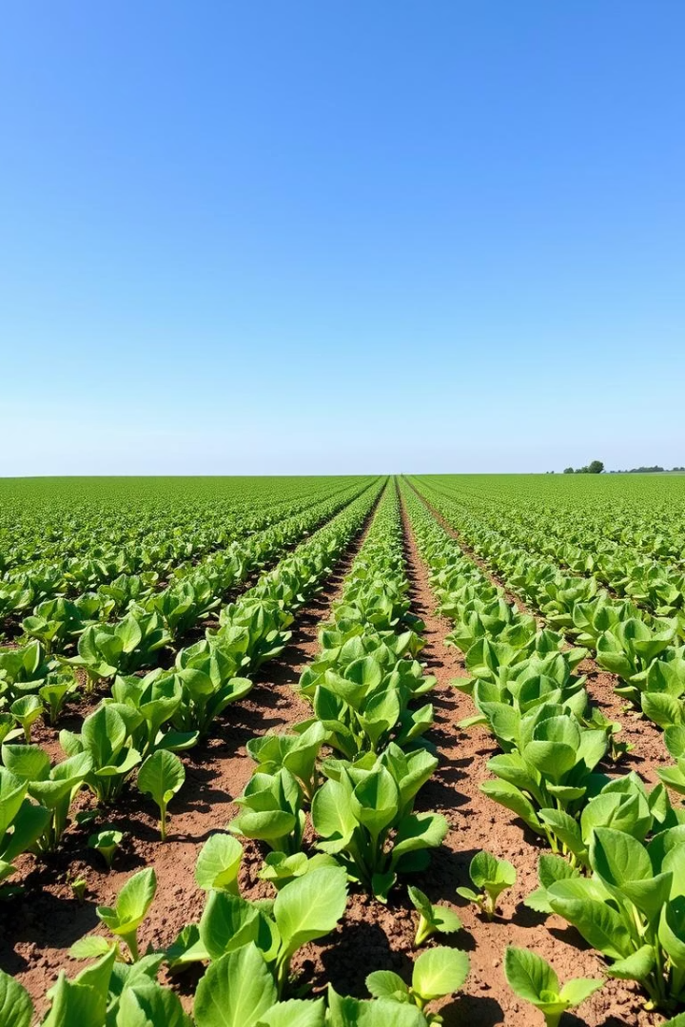
Crop Yield Prediction Using Machine Learning
An end-to-end machine learning pipeline to predict crop yield.
Utilizes soil nutrients and environmental factors for accurate estimates.
Presented by Jil gadhiya

Slide 2

Project Introduction
Objective
Features
Importance
Predict crop yield using soil nutrients and environment data.
Nitrogen, Phosphorus, Potassium
Helps optimize farming practices and improve food production.
Temperature, Humidity, pH, Rainfall

Slide 3
Dataset Overview
Soil Nutrients
Environmental Factors
Nitrogen (N)
Temperature (°C)
Phosphorus (P)
Humidity (%)
Potassium (K)
pH level
Rainfall (mm)

Slide 4
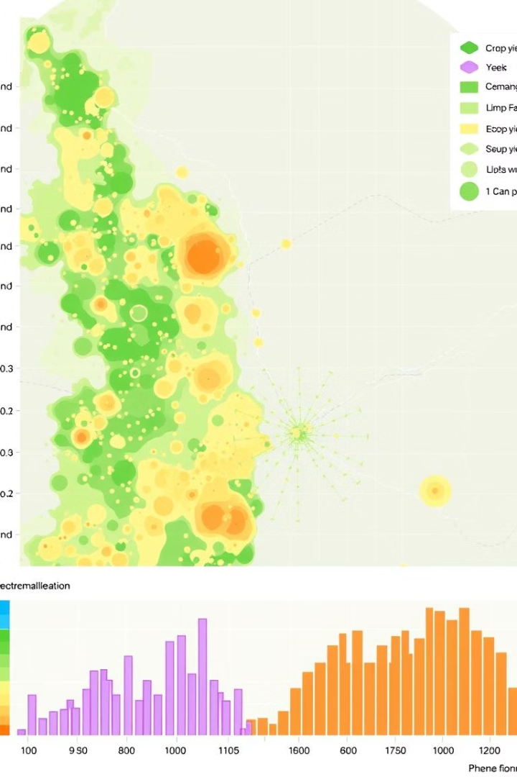
Exploratory Data Analysis
Feature Distributions
Correlations
Identified strong relationships among features and yield.
Analyzed nutrient and environmental variable ranges.
Visual Insights
Heatmaps and histograms helped detect patterns and outliers.

Slide 5




Data Preprocessing Steps
Missing Values
Detected and imputed missing nutrient and environmental entries.
Encoding
Converted categorical variables to numeric format.
Scaling
Standardized features for model consistency and improved training.

Slide 6
Modeling and Performance
Models Used
Performance Metrics
Random Forest Regressor
RMSE: 0.0155
Linear Regression
R² Score: 0.9942

Slide 7

Interactive Yield Prediction Example
Feature
Value
Nitrogen
33
Phosphorus
21
Potassium
25
Temperature
29°C
Predicted Yield
0.38 tons/hectare

Slide 8
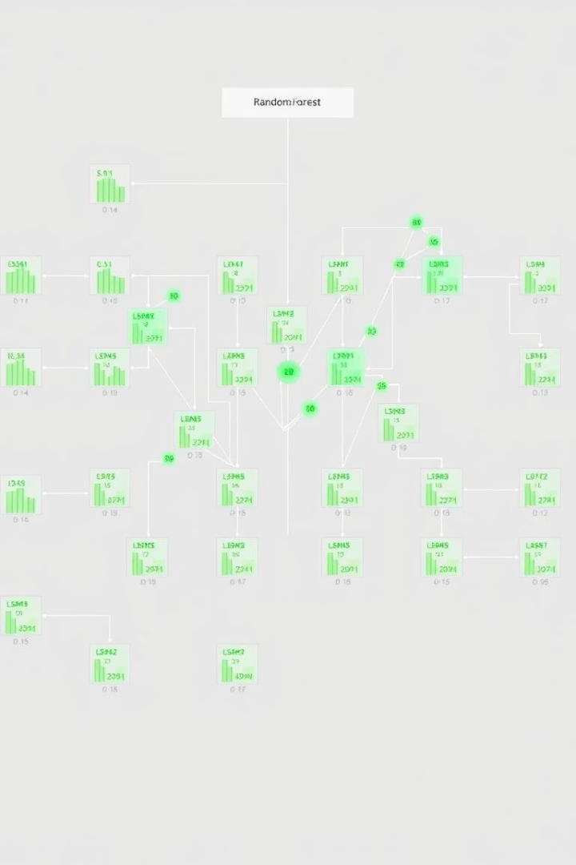
Key Findings
Model Effectiveness
Random Forest outperformed Linear Regression significantly.
Important Features
Nitrogen and Rainfall drive yield most strongly.

Slide 9

Conclusion and Recommendations
Summary
Random Forest achieved high accuracy (R² = 0.9942).
Future Work
Integrate real-world yield measurements for validation.
Explore advanced models like XGBoost for improvements.

