Slide 1

Prof.V.B.Shah Institute of Management & R.V.Patel College of Commerce (Eng.Med.) & V.L.Shah College of Commerce (Guj.Med.) & Sutex Bank College of Computer Applications & Science, Amroli
VEER NARMAD SOUTH GUJARAT UNIVERSITY, SURAT
Minor PROJECT REPORT FOR THE DEGREE OF
Bachelor of computer application (B.C.A 5TH SEMESTER) YEAR: 2026-27
PROJECT PRESENTATION ON
Cash-Book: Smart Finance & Digital Ledger
A Comprehensive Web Application for Personal & Small Business Cashflows, Ledgers & Expense Analytics
SUBMITTED BY:
GUIDED BY:
• Bhuva Jeel M. (Roll No: 520) – Seat No. : 5564
• Savsaviya Kushal B. (Roll No: 526) – Seat No. : 5908
• Narola Jash M. (Roll No: 558) – Seat No. : 5812
Prof. Sanskruti Ramani
Assistant Professor, BCA Dept.
Academic Year: 2026–2027

Slide 2
Project Profile & Specifications
Attribute | Specification Details
Project Title | Cash-Book: Smart Finance & Digital Ledger
Application Domain | Personal Finance, Digital Bookkeeping, Small Business Accounts Management
Front-End Technologies | React 18 (Vite Bundler), Tailwind CSS, Framer Motion, Lucide React Icons
Back-End Technologies | Node.js, Express.js (RESTful API Server)
Database Management | MongoDB (NoSQL Document Store) with Mongoose ODM
Security & Auth | JSON Web Tokens (JWT), Bcrypt Password Hashing, Role-Based Access Control
Development Tools & IDE | Visual Studio Code, Git, GitHub, Postman API Client, MongoDB Compass
Target Platforms | Cross-Platform Modern Web Browsers (Chrome, Edge, Firefox, Safari)

Slide 3
Presentation Overview (Table of Contents)
01
02
03
04
Introduction & Objectives
Technology Architecture
System Modeling & Diagrams
Database Schema Design
Background, problem statement & system scope
MERN stack, design patterns & development tools
System Flow, Context DFD & ER Diagrams
MongoDB collections, constraints & relations
05
06
07
08
Admin Governance Modules
User Digital Ledger Modules
Security & Best Practices
Future Enhancements & Conclusion
Dashboard, user controls & platform analytics
Cashbooks, Party Ledger, EMI tracker & vault
JWT sessions, hashing & data validation
AI OCR scanning, roadmap & project references

Slide 4
Introduction & Problem Statement
Traditional Paper Ledgers (Challenges)
The Cash-Book Digital Solution
• High Risk of Data Loss: Physical books get damaged by water, fire, or accidental misplacement.
• Calculation Errors: Manual arithmetic calculations lead to discrepancies and accounting mistakes.
• Lack of Portability: Physical books cannot be accessed remotely or shared across multiple partners.
• No Real-Time Insights: Impossible to see automated monthly spending charts, trends, or debt forecasts.
• 100% Cloud Persistence: Secure MongoDB database ensures transactions are never lost or corrupted.
• Automated Calculations: Real-time running balances, income/expense aggregation, and debt summaries.
• Multi-Cashbook Sharing: Invite business partners or family members via email invitations to collaborate.
• Built-in Receipts Vault: Upload digital bill images and attach them directly to monetary transaction logs.

Slide 5
Project Objectives & Key Goals
01
Simplify Financial Tracking
02
Credit Tracking (Party Ledger)
03
Manage Fixed Financial Commitments
Enable users to log daily income and expenses in seconds with categorized tags and payment modes.
Track credit, borrowing, and lending with automated Net Balance calculators and WhatsApp credit reminder triggers.
Centralized tracking of EMIs and recurring subscriptions with due-date calendar views to prevent late fees.
04
Digital Proof Storage (Vault)
05
Analytical Decision Making
06
Platform Security & Privacy
Eliminate physical paper receipts by offering a digital image vault linked to individual transaction records.
Equip users and admins with graphical category charts, cash flow breakdowns, and PDF/Excel export reports.
Deliver military-grade hashed authentication, active session oversight, and multi-user invitation controls.

Slide 6
Comprehensive Technology Stack
Frontend Tier
Backend Tier
Database Tier
DevOps & Tooling
• React.js (v18) Single Page Application
• Vite Ultra-Fast Build Engine
• Tailwind CSS Utility Styling
• Framer Motion Micro-Animations
• Lucide React Vector Icons Suite
• Node.js Asynchronous Runtime
• Express.js REST API Server
• Modular Controller-Route Pattern
• JSON Request / Response Format
• CORS & Security Middleware
• MongoDB Cloud Document Database
• Mongoose Schema
• Embedded Documents & Arrays
• Indexing for High Query Velocity
• Aggregation Pipelines for Balance
• Visual Studio Code Editor
• Git Version Control & GitHub
• Postman API Testing Suite
• MongoDB Compass Database GUI

Slide 7
Platform Architecture: Admin vs User Roles
ADMINISTRATOR MODULE
END-USER (CLIENT) MODULE
• System Analytics: Real-time overview of active users, total cashbooks, platform transaction volume.
• User Account Management: List, inspect, activate, deactivate, or delete user accounts across the system.
• Transaction Oversight: Audit platform transactions, monitor flags, and ensure database compliance.
• Cashbook Governance: Oversee shared cashbooks and invitation links for anti-abuse regulation.
• Multi-Cashbook Ledgers: Create distinct personal, household, and business financial books.
• Party Ledger (Credit Book): Record credit and debit amounts against specific party names with reminder dispatch.
• Receipts Vault: Upload and organize bill photos, PDF receipts, and transaction proofs.
• Reports & History: Filter records by date range, payment mode, or category with instant CSV/PDF export.

Slide 8
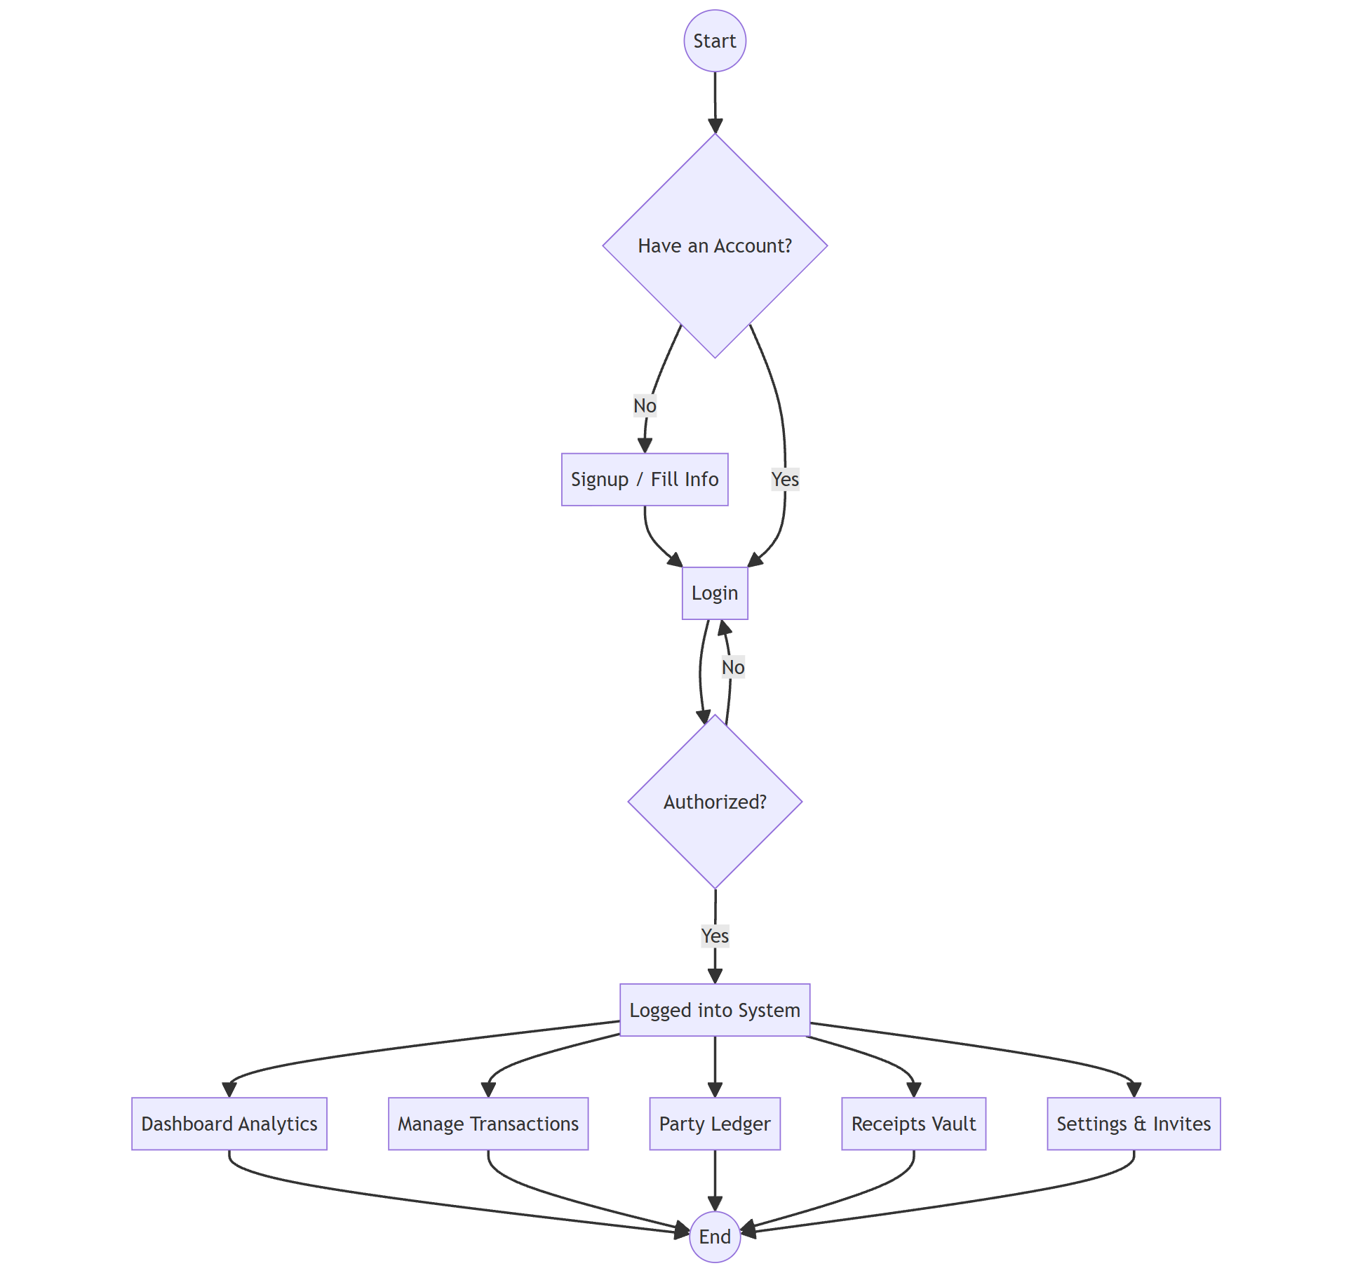
5. System Flow Diagram (Process Flow)
PROCESS FLOW
• Start: User accesses the Cash-Book portal.
• Auth Check: Checks existing account session; redirects to Sign Up or Login.
• Authorization: Validates hashed credentials via JWT token.
• Main Menu: Unlocks Dashboard, Transactions, Party Ledger, Receipts, Settings.
• Action Execution: Real-time CRUD operations update MongoDB state.
• End: Session termination or logout.

Slide 9
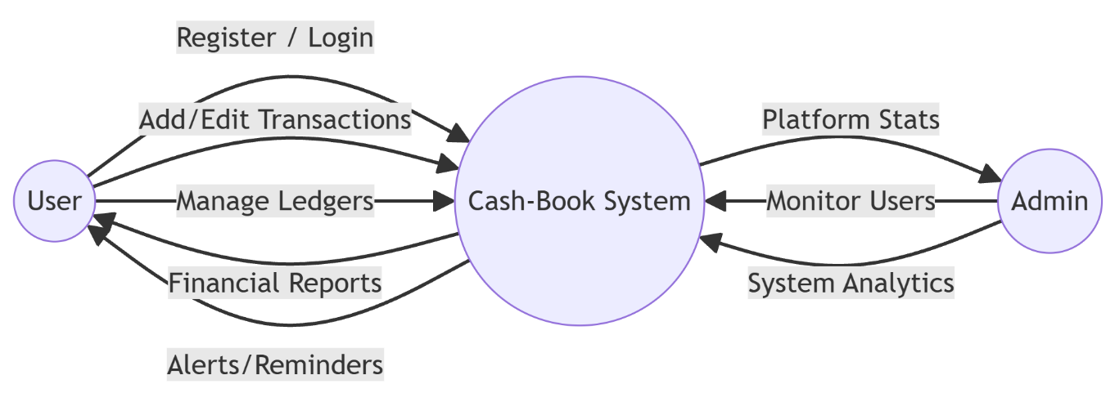
6. Data Flow Diagram (Context Level 0 DFD)
CONTEXT DFD
• External Entity (User): Registers, manages transactions, logs debts, views reports.
• External Entity (Admin): Monitors platform metrics, inspects accounts, oversees system health.
• Core Process (Cash-Book System): Central routing engine processing authenticated payloads.
• Bi-directional Flows: Alerts, reminders, and generated financial reports flow back to user.

Slide 10
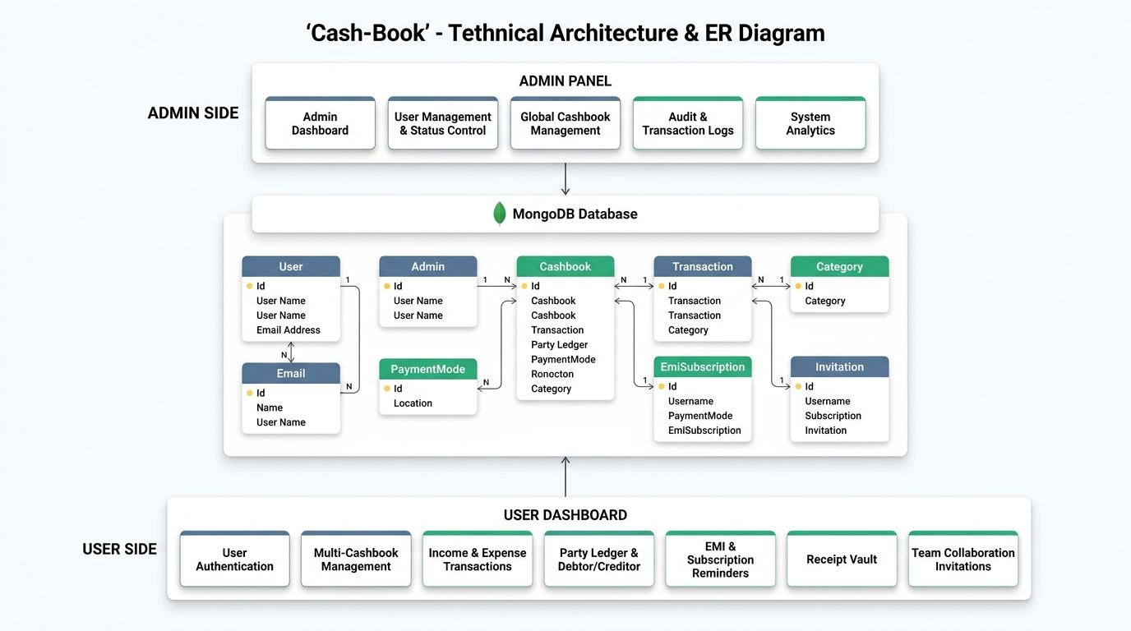
7. Entity-Relationship (ER) Diagram
ER DIAGRAM
• User Entity: PK email, credentials, admin role flag. Sends invitations, owns cashbooks.
• Cashbook Entity: Multi-cashbook support containing transactions.
• Transaction Entity: Linked to Cashbook; attributes: amount, type, party, date, time.
• Category & Receipt: Categorization mapping & cloud image URL attachment.

Slide 11
SECTION 02
DATABASE DESIGN & SCHEMAS
Data dictionary, field data types, constraints & Mongoose schemas
Cash-Book: Smart Finance & Digital Ledger

Slide 12
Database Schema: User Collection
Field Name | Data Type | Constraints | Description
username | String | Required, Trim | User display / business name
email_id | String | Required, Unique, Lowercase | Primary account identifier & login email
password | String | Required, Min: 6 chars | Bcrypt-hashed encrypted password string
phone_number | String | Optional | Phone number for SMS/WhatsApp debt reminders
is_admin | Boolean | Default: false | Flag distinguishing Admin vs Standard User
status | String | Enum: [active, suspended] | Account moderation state
created_at | Date | Default: Date.now | Timestamp when account was registered

Slide 13
Database Schema: Transaction Collection
Field Name | Data Type | Constraints | Description
cashbook_id | ObjectId | Ref: Cashbook, Required | Parent cashbook partition
title | String | Required, Trim | Brief transaction description / item
amount | Number | Required, Min: 0 | Monetary numeric value of transaction
type | String | Enum: [income, expense] | Flow indicator affecting net balance
party_type | String | Enum: [creditor, debtor] | Credit / Debit tracking classification
party_name | String | Optional, Trim | Name of the party/person owed to/from
payment_mode | String | Enum: [Cash, Bank, UPI] | Payment method utilized
date / time | String / Date | Default: Current | Audit timestamp of the record

Slide 14
Database Schemas: Cashbook & Invitation
Collection: Cashbook
Field Name | Data Type | Constraints | Description
cashbook_name | String | Required | Display title of the ledger
owner_email | String | Required | Creator user identifier
members | Array of String | Default: [] | List of accepted member emails
Collection: Invitation
Field Name | Data Type | Constraints | Description
inviter_email | String | Required | Email of user sending the invite
invitee_email | String | Required | Target collaborator email
status | String | Enum: [pending, accepted, rejected] | Invitation status workflow

Slide 15
SECTION 03
ADMINISTRATOR MODULES
Complete walk-through of admin security, analytics & platform moderation
Cash-Book: Smart Finance & Digital Ledger

Slide 16
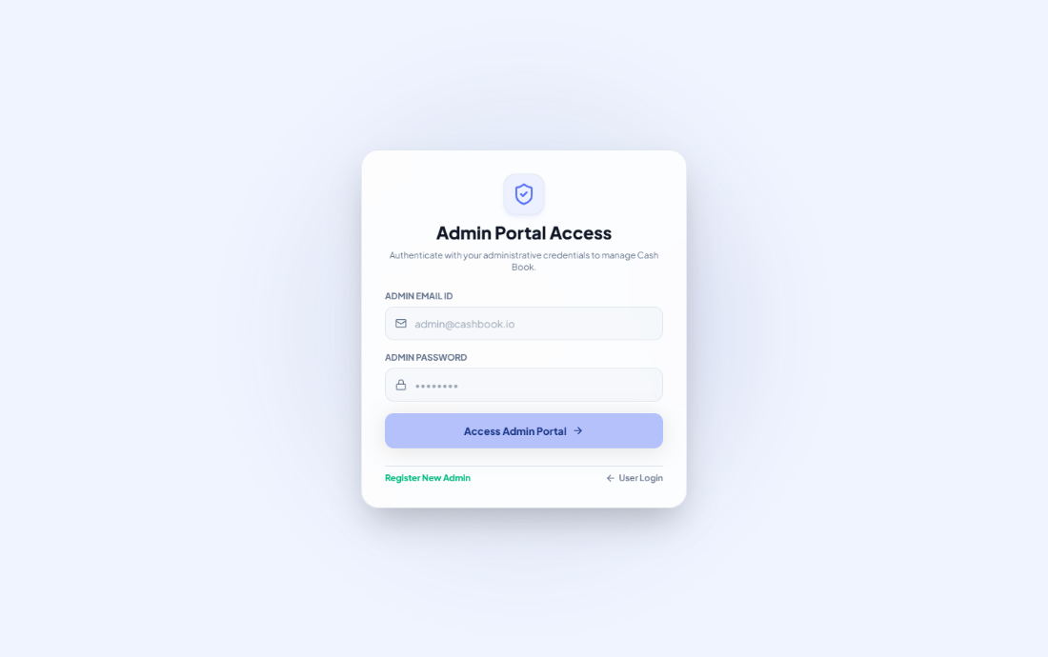
Admin Portal: Secure Authentication
ADMIN LOGIN
Dedicated administrator login route (/admin/login).
Enforces role-based checks (is_admin === true).
Protection against unauthorized privilege escalation.
Session storage caching for rapid administrative workflow.

Slide 17
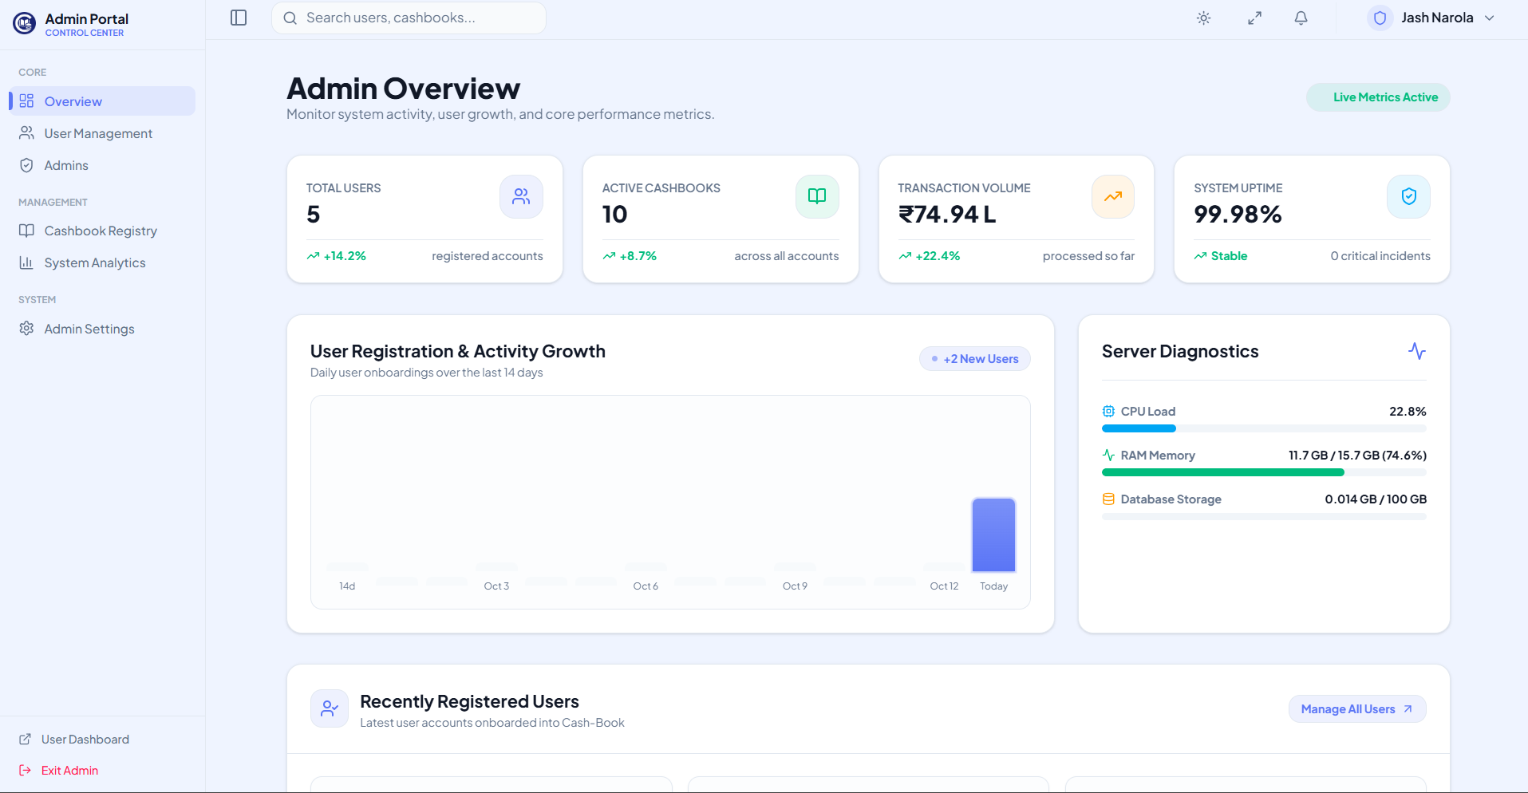
Admin Overview: Real-Time Analytics
OVERVIEW
Dynamic summary widgets: Total platform users, active ledgers, total cash volume.
Interactive visual charts breaking down growth velocity.
Quick action links to review user reports and system alerts.
Health status monitoring for database and server load.

Slide 18
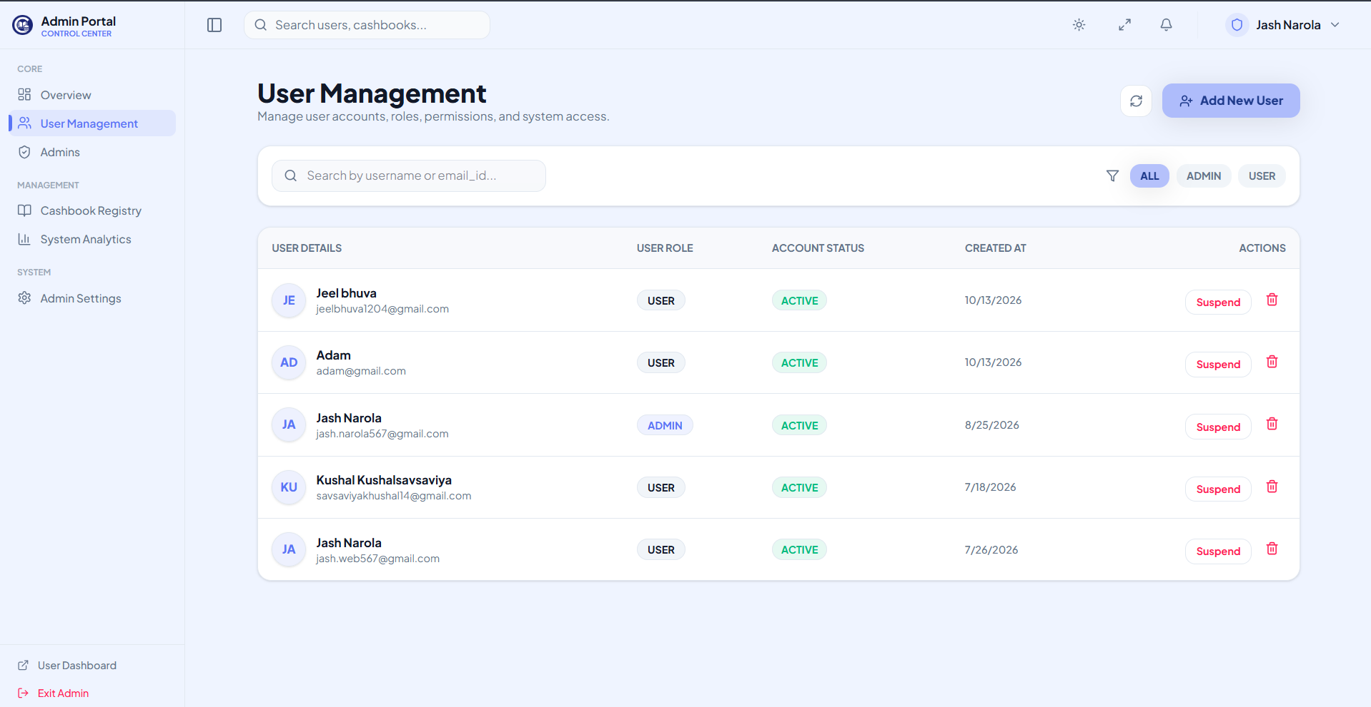
Admin User Management: Account Moderation
USER MANAGEMENT
Tabular view of all registered users across the platform.
Search and filter accounts by email, username, or role.
One-click suspend, reactivate, or delete user controls.
Inspection of user created cashbooks and activity timestamps.

Slide 19
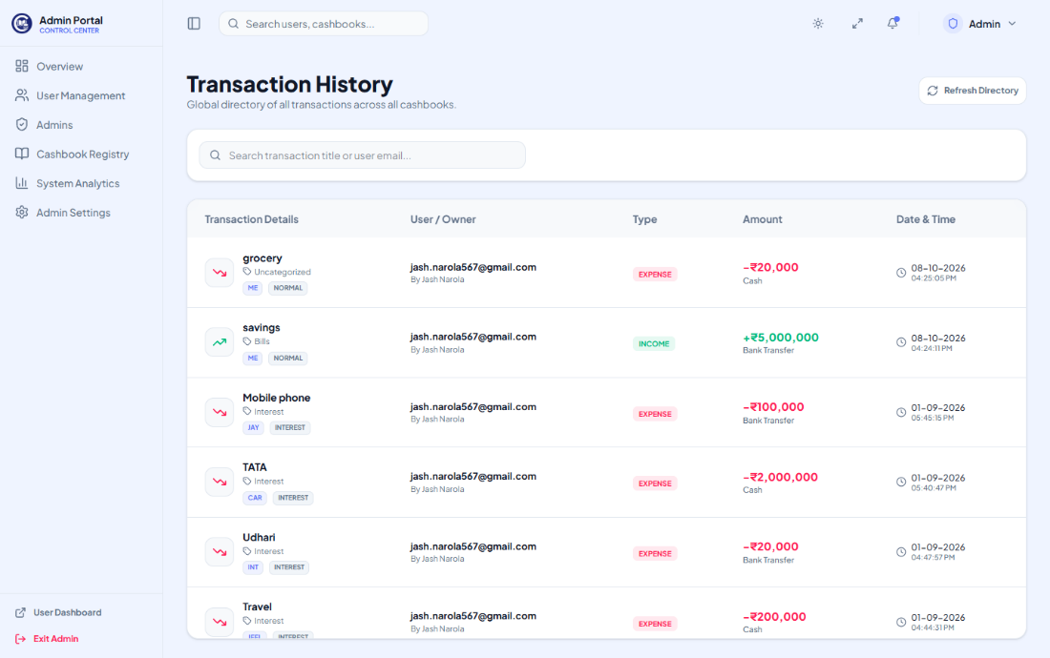
Cashbook Registry & Global Oversight
CASHBOOK REGISTRY
Global transaction audit ledger spanning all users.
Filter by monetary range, payment type, or suspicious flags.
Audit log records ensuring database transaction integrity.
Direct access to manage orphaned or shared cashbooks.

Slide 20
SECTION 04
USER CLIENT MODULES
Personal finances, digital cashbooks, credit ledger, receipts vault & reports
Cash-Book: Smart Finance & Digital Ledger

Slide 21
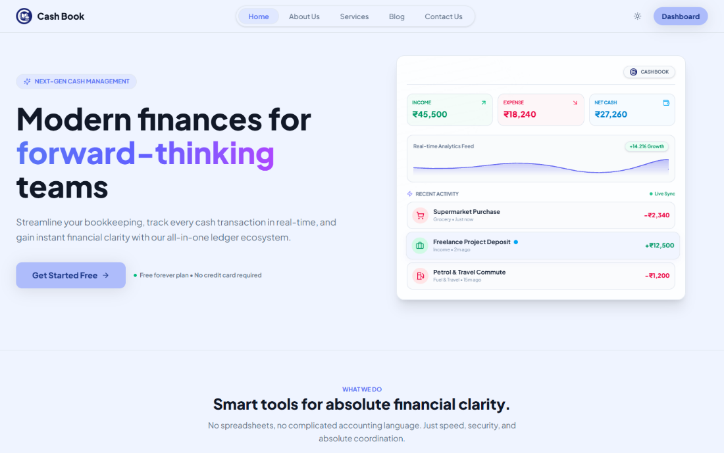
Landing Page: Modern Responsive Portal
LANDING PAGE
Clean landing page with clear call-to-actions (Get Started, Sign In).
Feature highlight cards illustrating the advantages of digital bookkeeping.
Customer testimonials and responsive mobile/desktop layout.
Direct onboarding path for new users.

Slide 22
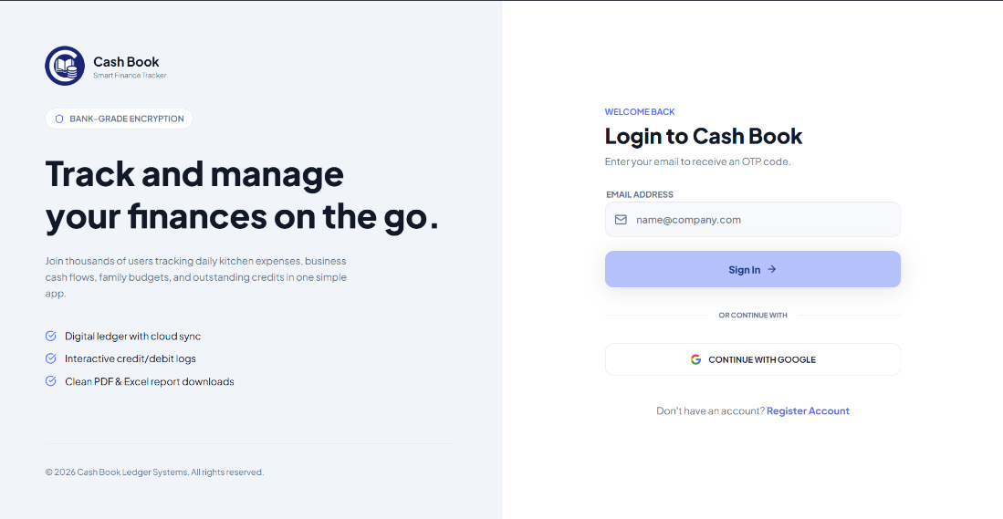
User Authentication: Login & Sign Up
USER LOGIN
Secure Sign In and Sign Up with validation.
Bcrypt password encryption and JWT token exchange.
Persistent light/dark UI theme preference storage.
Session restoration to keep logged-in users productive.

Slide 23
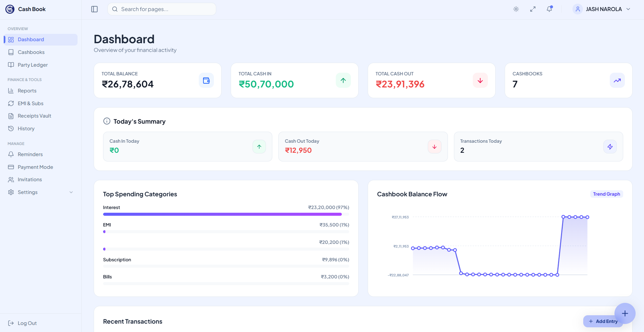
User Home Dashboard: Financial Overview
DASHBOARD
Real-time Net Balance card (Total In vs Total Out).
Color-coded cash inflow (Green) and outflow (Red) metrics.
Recent transaction feed with instant search and pagination.
Quick access buttons to add entries or view ledger statements.

Slide 24
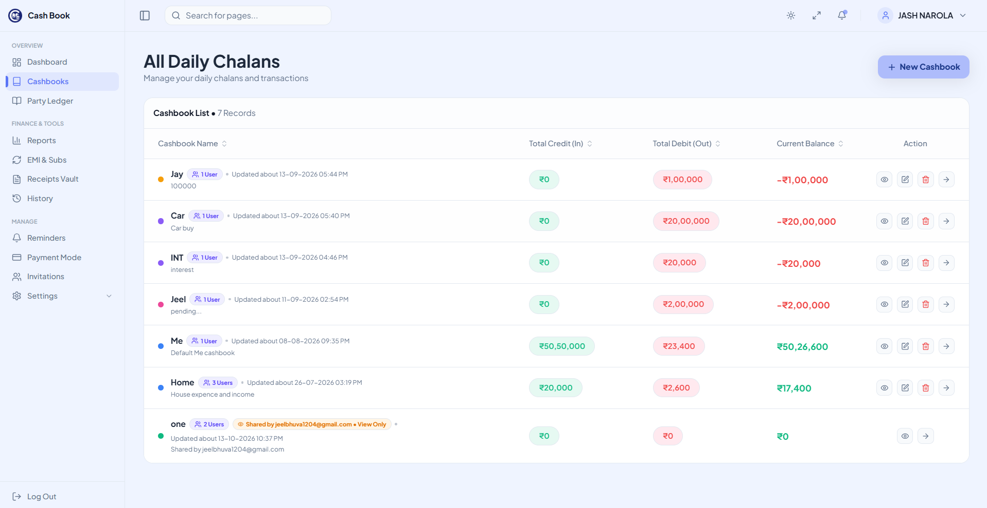
Cashbooks: Multi-Ledger Management
CASHBOOKS
Create unlimited segregated cashbooks (e.g. Home, Shop, Freelance).
Independent balances calculated per cashbook.
Seamless one-click switching between active cashbooks.
Shared cashbook indicators showing collaborator count.

Slide 25
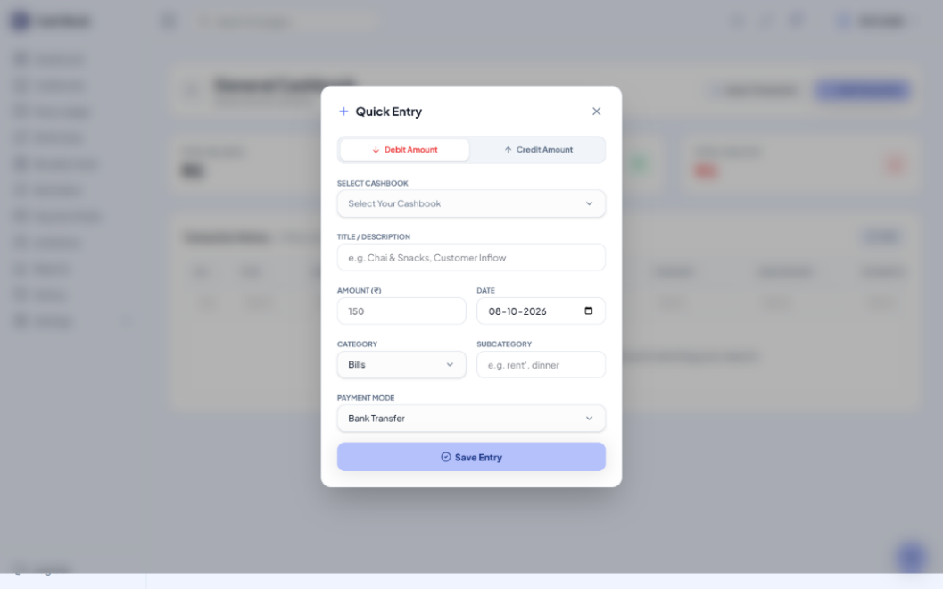
Transactions: Fast Logging & Popup
TRANSACTIONS
Fast modal popup for friction-free transaction entry.
Select transaction type (Income vs Expense).
Payment mode selection (Cash, Bank Transfer, UPI).
Optional party tagging for credit and debit ledger syncing.

Slide 26
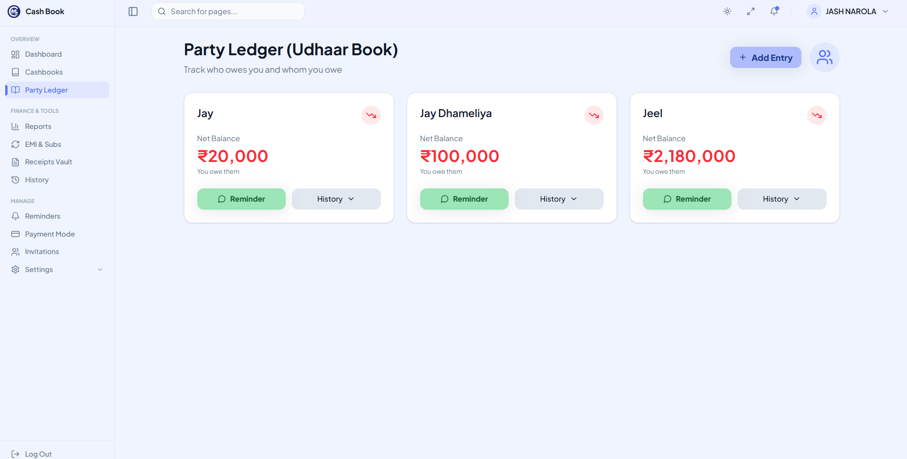
Party Ledger: Credit / Debit Tracking
PARTY LEDGER
Dedicated digitized ledger for tracking credit given and credit received.
Visual cards for each party with Net Balance and credit/debt status indicator.
Single-click WhatsApp reminder generator with pre-filled credit balance message.
Historical ledger timeline per person showing credits, debits, and settlements.

Slide 27
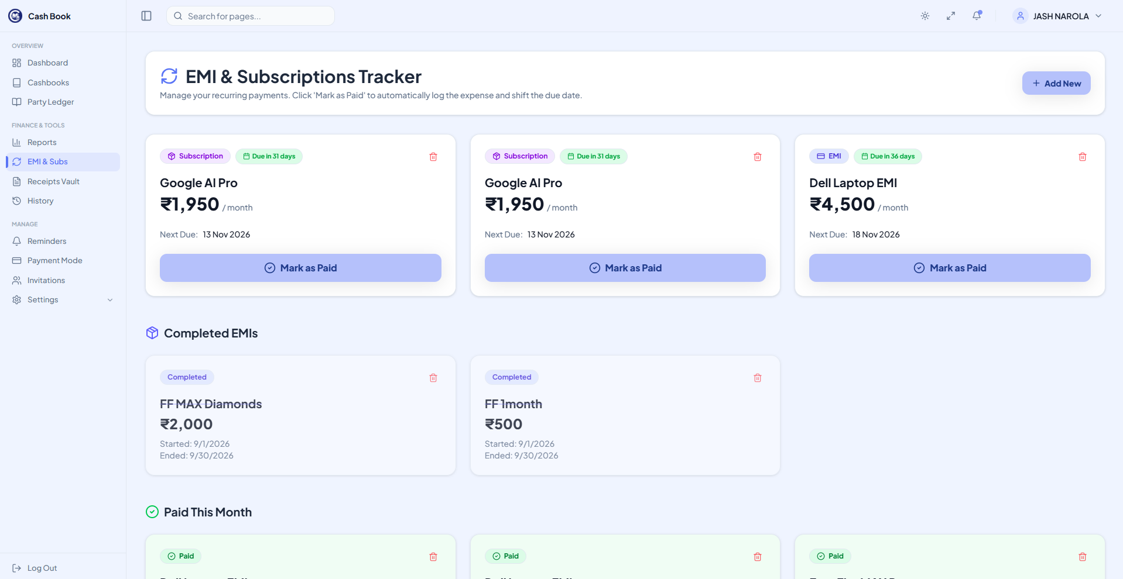
EMI & Subscription Tracker
EMI & SUBS
Centralized tracker for fixed monthly installments and subscriptions.
Due-date calendar views and countdown days remaining badges.
Auto-calculation of monthly recurring expenditure liability.
Mark paid / active toggles to prevent missed deadline penalties.

Slide 28
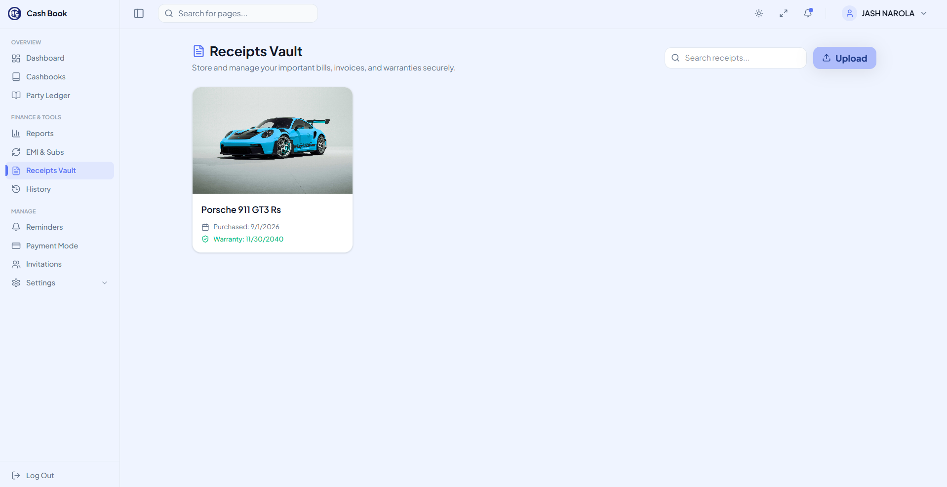
Receipts Vault: Document Storage
RECEIPTS VAULT
Secure digital storage for paper bill proofs, invoices, and warranties.
Upload image files directly attached to monetary transactions.
Full-screen modal image preview and download options.
Search receipts by merchant name, date, or amount.

Slide 29
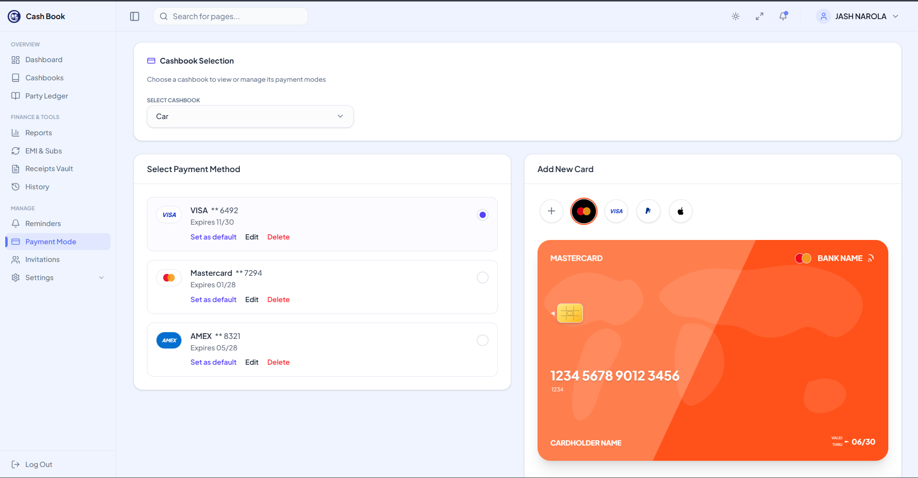
Reminders & Custom Payment Modes
PAYMENT MODE
Manage and add customized payment channels (Cash, Google Pay, PhonePe, Cards).
Set scheduled reminder alerts for recurring supplier payments.
Visual icons indicating transaction payment mode on statement feeds.
Real-time filter by payment channel in reports.

Slide 30
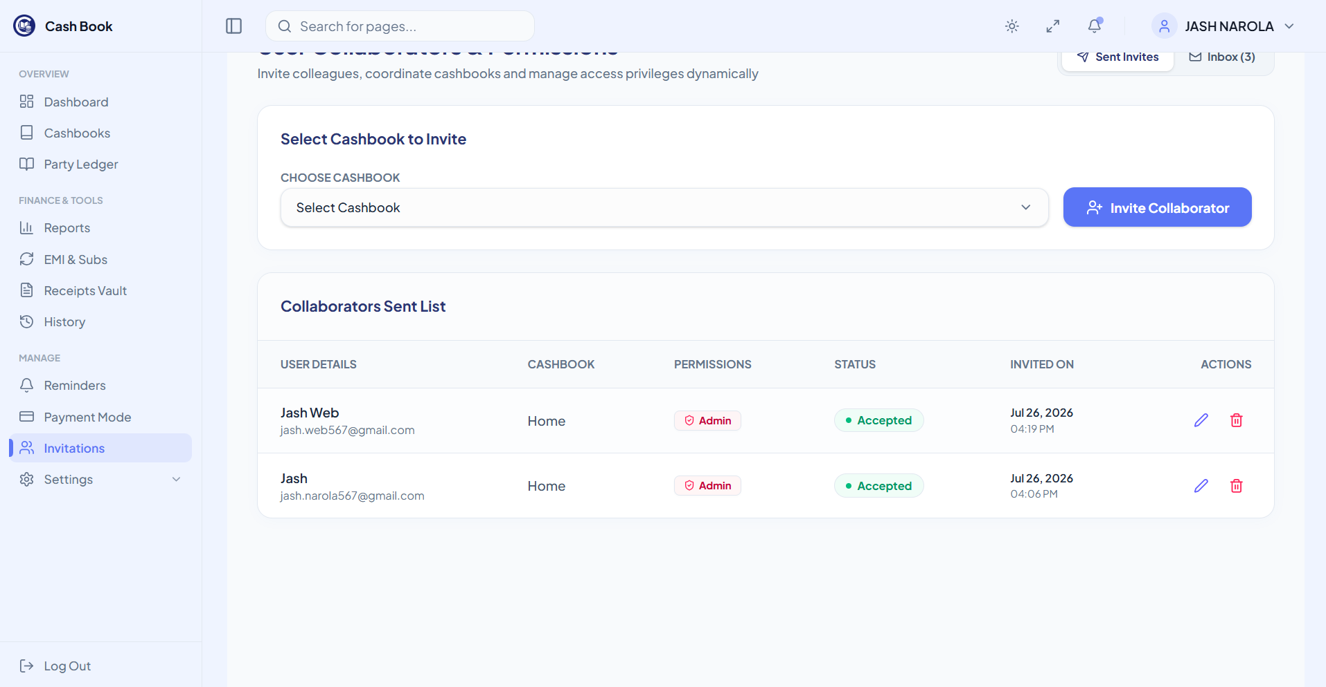
Shared Cashbooks & Member Invitations
INVITATIONS
Invite business partners, accountants, or family via email address.
Real-time invitation approval workflow (Pending, Accepted, Rejected).
Role permissions preventing unauthorized modifications.
Collaborative live updates across invited members.

Slide 31
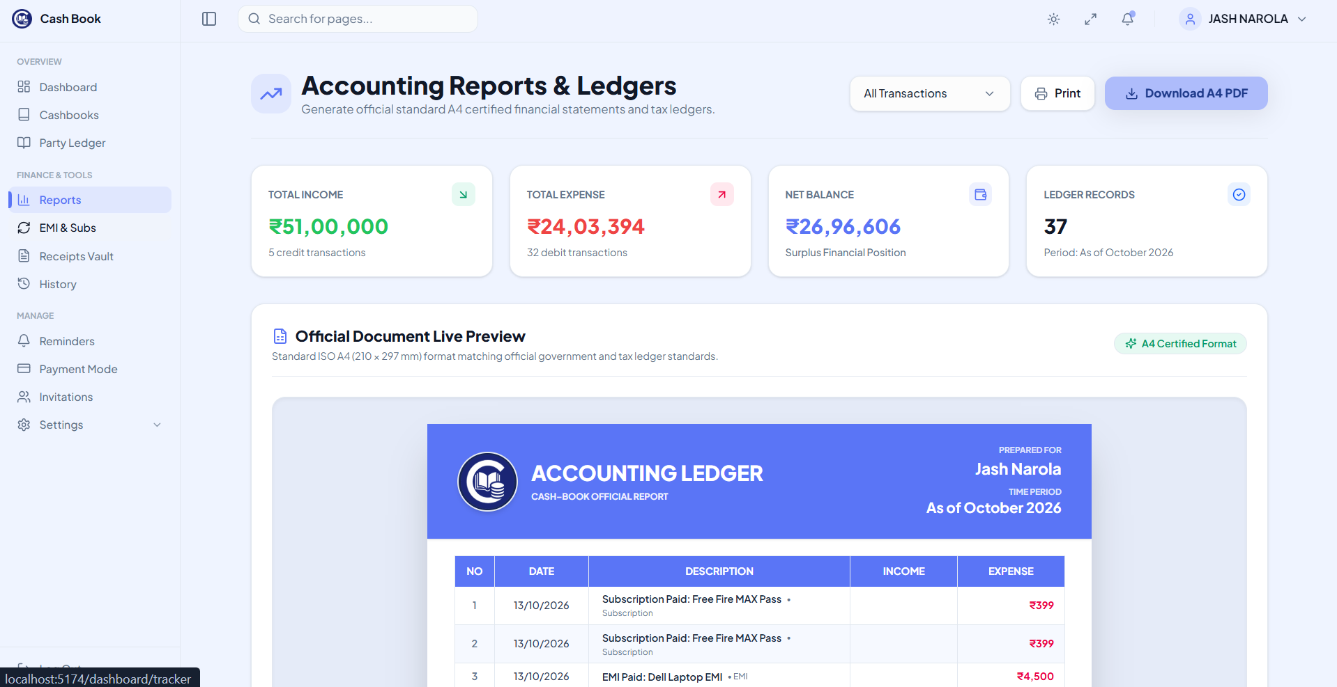
Financial Analytics & Exportable Reports
REPORTS
Interactive graphical analytics breaking down spending by category.
Date range filtering (Today, This Month, This Year, Custom).
One-click export of financial statements to PDF and Excel/CSV.
Print-ready professional statement formatting for tax/accounting.

Slide 32
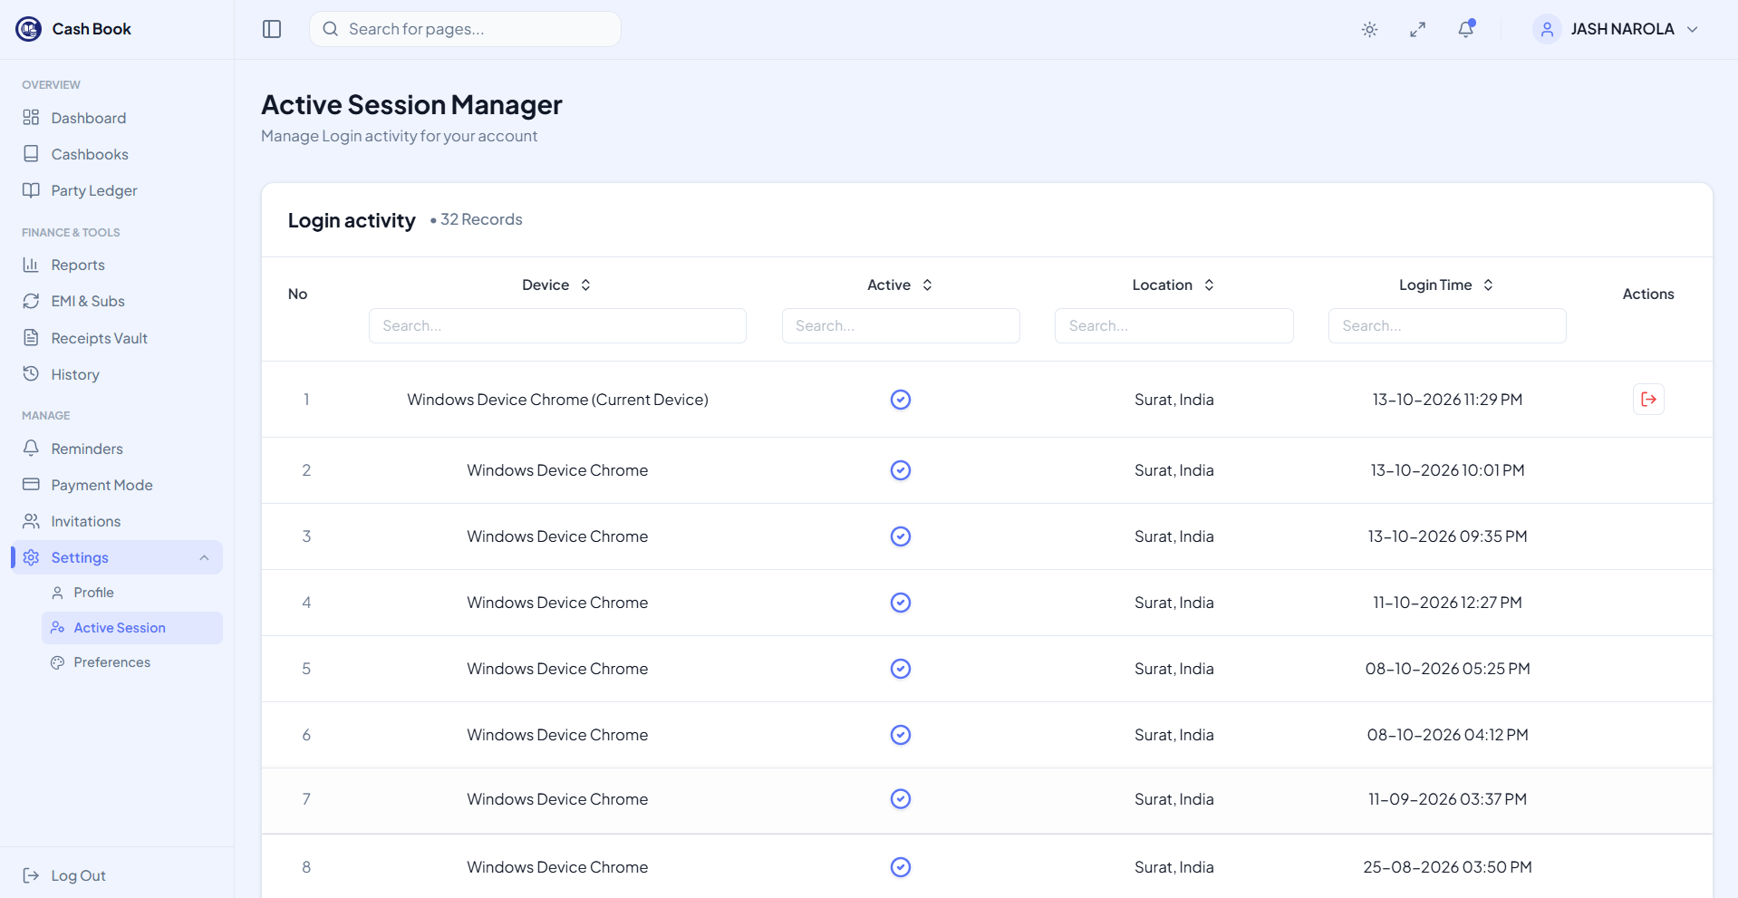
User Settings: Security & Active Sessions
SETTINGS
View all active devices and browser login sessions.
Remote session revocation to terminate unauthorized logins.
Profile information editing (Name, Phone Number, Password update).
UI Theme preferences with instant dark/light mode toggle.

Slide 33
Security Architecture & Performance Engineering
JWT Authentication
Bcrypt Password Hashing
Payload Sanitization
Stateless JSON Web Tokens with encrypted HMAC signing for API request authorization.
Salt rounds of 10 applied to all passwords before database storage; zero plain-text storage.
Mongoose schema validators and input scrubbing preventing NoSQL injection and XSS.
CORS & Protection
Database Indexing
Client Cache Optimization
Whitelisted origin access ensuring backend endpoints only accept valid requests.
Compound index on user_email, cashbook_id, and date for sub-millisecond query returns.
React state caching and optimistic UI updates minimizing redundant backend network roundtrips.

Slide 34


Future Scope & Technological Enhancements
🤖
AI Receipt OCR Scanner
📱
Cross-Platform Mobile App
Integrate Tesseract.js / OpenAI Vision to automatically extract merchant name, date, and total amount from photographed bills.
Develop React Native iOS and Android companion apps with offline-first synchronization and biometric fingerprint login.
🔔
Automated SMS & WhatsApp Bots
🏦
Open Banking API Sync
Automated scheduling bot dispatching friendly payment reminders and one-tap payment link receipts via Twilio/Meta API.
Direct integration with UPI and bank account feeds for automatic transaction logging without manual user input.

Slide 35

References & Bibliography
Documentation & Technical Resources:
• React Official Documentation: https://reactjs.org/docs/getting-started.html
• Node.js & Express API Reference: https://nodejs.org/en/docs/ | https://expressjs.com
• MongoDB : https://docs.mongodb.com/manual/
• Tailwind CSS Design https://tailwindcss.com/docs
• Gemini for Diagrams : https://gemini.google.com
Institutional Guidance & Support:
• Prof. V. B. Shah Institute of Management & Sutex Bank College of Computer Applications & Science, Amroli
• Guidance and Mentorship by (Assistant Professor)
• Veer Narmad South Gujarat University (VNSGU), Surat

Slide 36
THANK YOU
Cash-Book: Smart Finance & Digital Ledger
Any Questions or Feedback?
Bhuva Jeel M. • Savsaviya Kushal B. • Narola Jash M.

