Slide 1
Dan’s Jeep Rental
Web App
Chase Cheney - title that reflect strongest talent (knowledge domain)
Stephen Engst - title that reflect strongest talent (knowledge domain)
Clark Farnsworth - title that reflect strongest talent (knowledge domain)
Eric Wu - title that reflect strongest talent (knowledge domain)

Slide 2
Overview
We decided to create a web application with React for the frontend, Express for the backend, and Prisma for the database as three of our members had experience with these libraries while Chase has professional experience.
Our weekly agile meetings were beneficial in helping us stay on track and maintain consistent communication between members.
The product is ready for deployment as we have committed rigorous testing using both Postman and user testing. We have fixed all issues that were identified.

Slide 3
Requirement: Jeep Reservations
Functionality: Users can reserve unrented jeeps in the database
Usability: Users can access the reservation system on the web page
Reliability: Reservations should maintain consistency in the database when offline
Performance: The application should respond with the success of a reservation within 5 seconds
Supportability: The reservation system will be maintained through weekly updates to the github repo

Slide 4
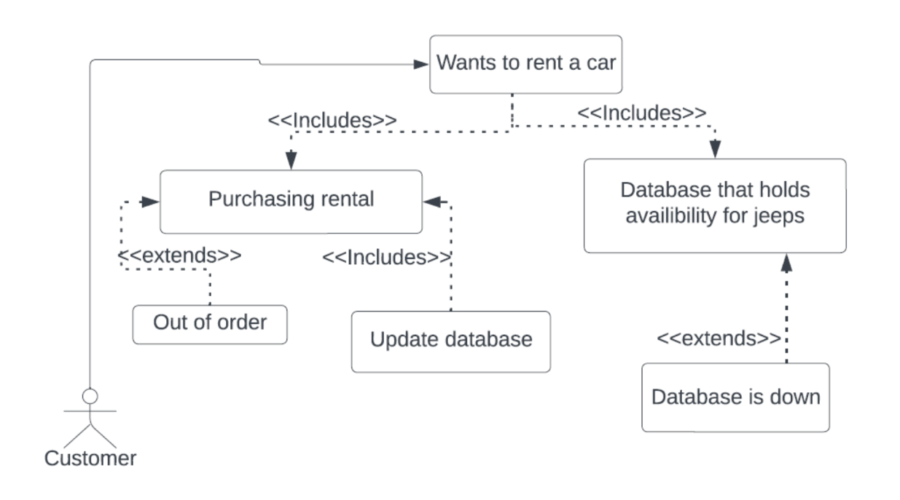
Requirement: Jeep Reservations
Use Case Diagram

Slide 5
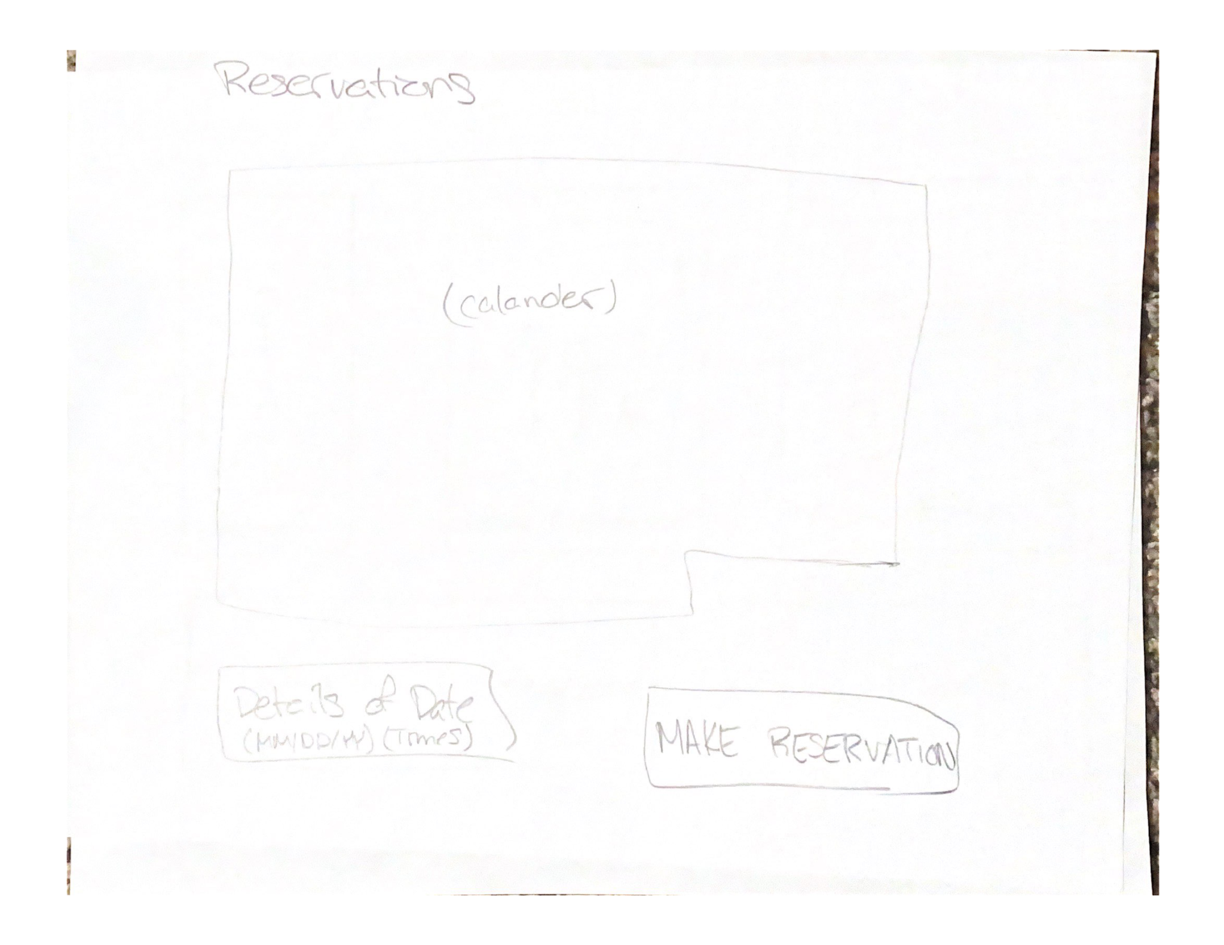
Requirement: Jeep Reservations - Wireframe

Slide 6
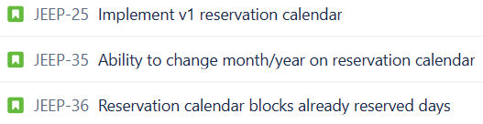
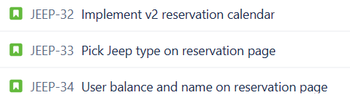

Requirement: Jeep Reservations - Scrum Tasks
Eric
Eric
Clark
Chase
Clark
Stephen
Stephen
Chase

Slide 7
Requirement: Jeep Reservations - Unit Testing
We used Postman to create reservations for testing
We also used the application through the browser to find potential bugs

Slide 8
Requirement: User Authentication/Roles
Functionality: Users can choose what type of account to create.
Usability: Users authentication is stored in the database
Reliability: Users should maintain consistency in the database when offline
Performance: The application should respond with the success of a user creation within 5 seconds
Supportability: The user system will be maintained through weekly updates to the github repo

Slide 9
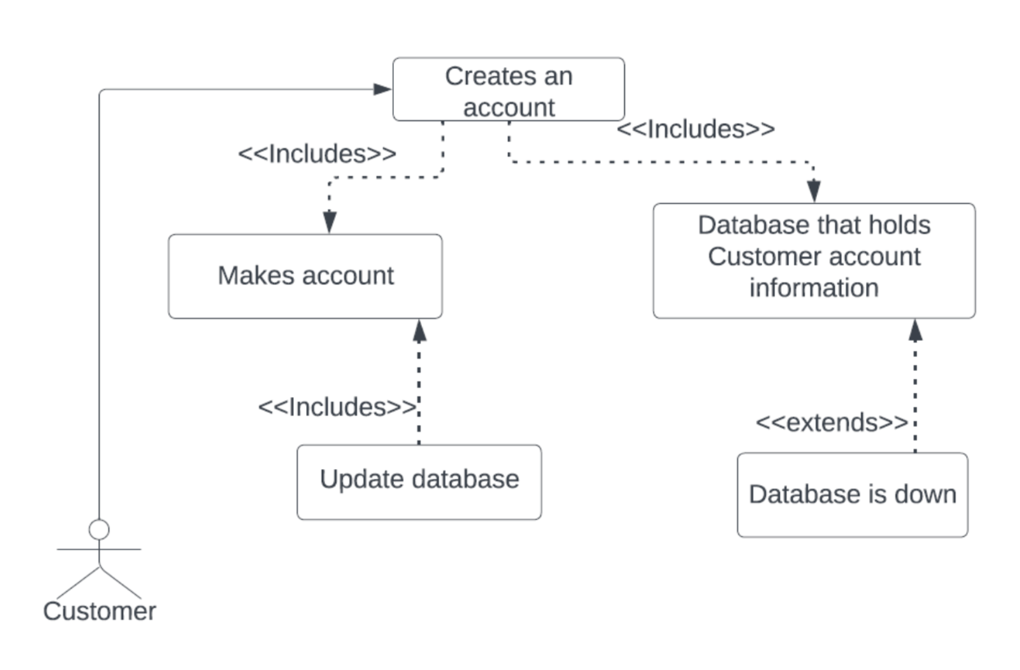
Requirement: User Authentication/Roles
Use Case Diagram

Slide 10
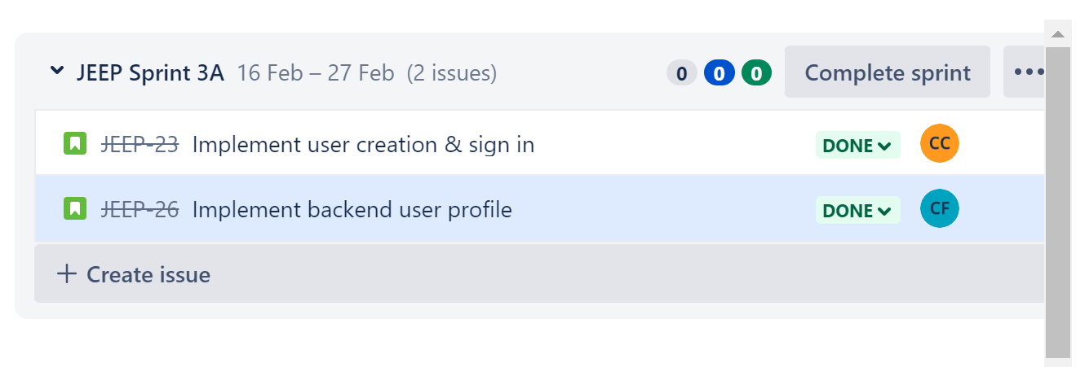
Requirement: User Authentication/Roles

Slide 11
Requirement: User Authentication/Roles - Unit Testing
Made sure the different roles had access to the data that is needed.
Users only have access to the data that should be available to that user role.
All of the relevant features are working.

Slide 12
Requirement: Payroll Management
Functionality: Managers are able to pay clerks (employees).
Usability: Manager Users are able to add money (pay) Clerks on their Manager screen.
Reliability: Account amounts should maintain consistency in the database when offline
Performance: The application should respond with the success of a employee payment within 5 seconds
Supportability: The payment system is dynamic and based on the local database. Any required changes will be done through the github repo

Slide 13
Requirement: Adding Money
Functionality: All users should be able to add money to their account.
Usability: Users can add money to their account on the web page
Reliability: Account amounts should maintain consistency in the database when offline
Performance: The application should respond with the new user account balance within 5 seconds
Supportability: User balances are based on the local database. Any required changes to the system will be done through the github repo

Slide 14
Resources

Slide 15

Screen Capture Reservation

Slide 16
Screen Capture User

Slide 17
Screen Capture Manager

Slide 18
Screen Capture Clerk

Slide 19
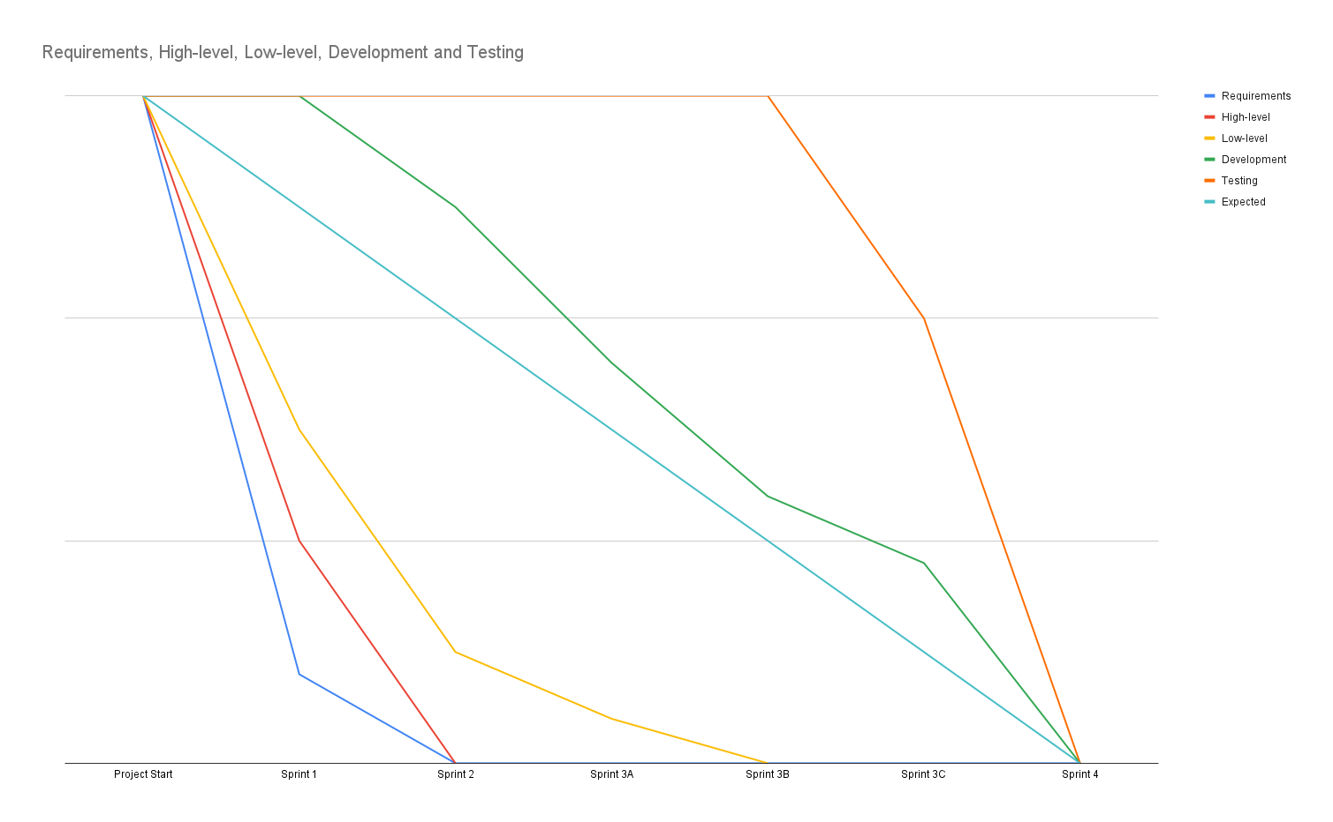
Burndown Chart
Team Velocity (completed stories / time estimate @ 4 hrs per story):
Sprint 1 - 3 / 12 hours
Sprint 2 - 12 / 48 hours
Sprint 3 - 7 / 28 hours
Sprint 4 - 10 / 40 hours
Overall - 8 / 32 hours
Total - 32 / 128 hours

Slide 20
Questions?

