Slide 1
HTML & CSS
Present by New Nuttachai

Slide 2
HTML : Language of the Web
WHAT IS HTML ?
- HTML : Hyper Text Markup Language.
- HTML describes the structure of Web pages .
- HTML elements are the building blocks of HTML pages
- HTML elements are represented by tags
- Browsers do not display the HTML tags, but use them to render the content of the page

Slide 3
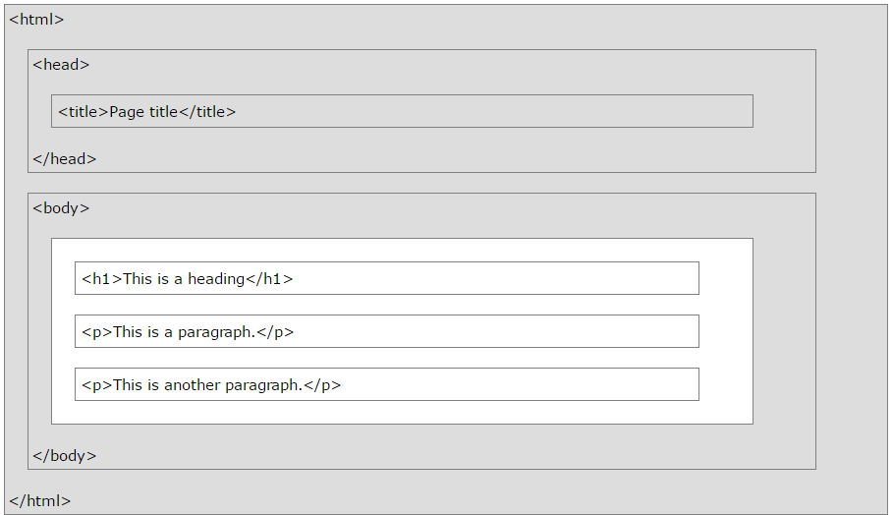
HTML look like this
<html>
<head>
<title>Welcome to my first site</title>
</head>
<body>
<h1>My name is HTML !</h1>
<p> I’m describe your self by tags </p>
</body>
</html>

Slide 4
HTML: Syntax
An HTML element starts with a start tag. <body>
An HTML element ends with an end tag </body>
The element content is everything between the start and the end tag
Empty elements are closed in the start tag < br />
Most HTML elements can have attributes

Slide 5
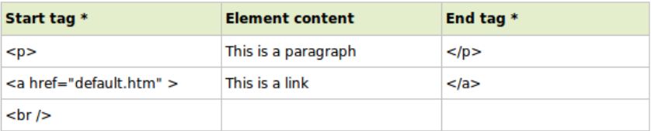
HTML: Syntax (Count.)

Slide 6
HTML: Attribute
HTML elements can have attributes.
Attributes provide additional information about the element .
Attributes are always specified in the start tag.
Attributes come in name/value pairs like: name="value"

Slide 7
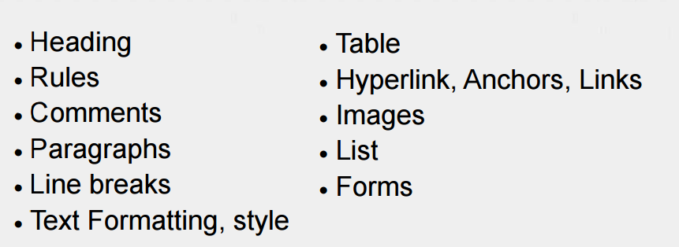
HTML: Basic elements

Slide 8
W3C & Web Standard
-The World Wide Web Consortium (W3C) is an international industry consortium dedicated to “leading the Web to its full potential”.
What are W3C Standard? HTML, XML, XHTML, CSS, DOM
Adventages
- Accessibility
- Stability

Slide 9
XHTML : eXtensible Hypertext Markup Language
- XHTML is a version of HTML modified to conform to the XML standard.
- Presentation controlled by Cascading Style Sheets (CSS)
- Specific syntax to use
- Validators help you get it right

Slide 10
XHTML : Differences
- All elements must have begin tags and end tags
<p> Hello </p>
Empty elements contain their own end tag . < br/ >
More specfics available at
http://www.w3.org/TR/xhtml1/#diffs

Slide 11
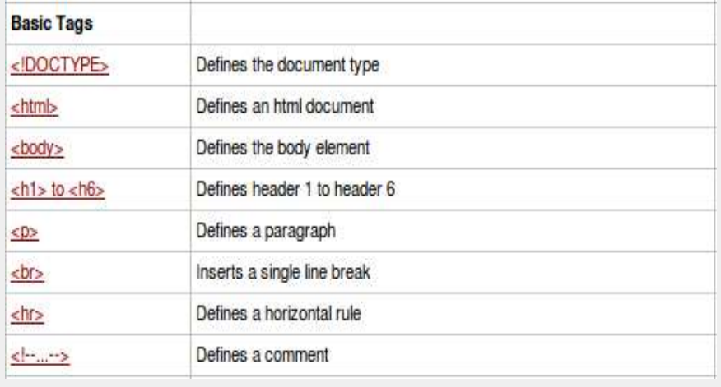
Basic TAGS

Slide 12
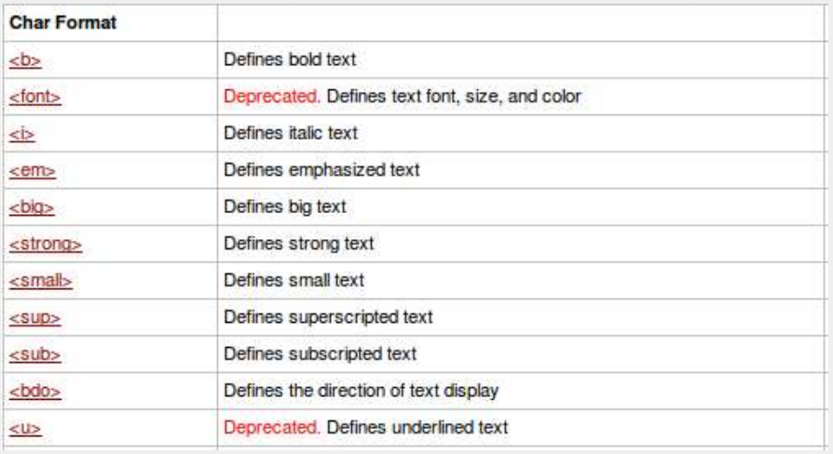
Char Format Tag

Slide 13
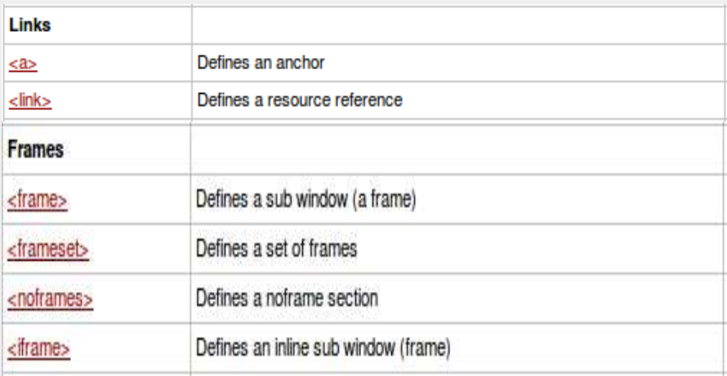
Link Tags & Frame Tags

Slide 14
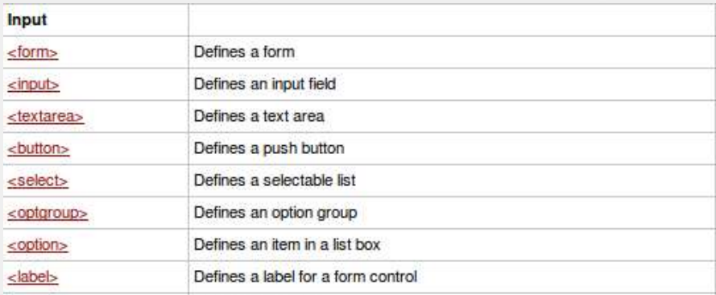
Input Tags

Slide 15
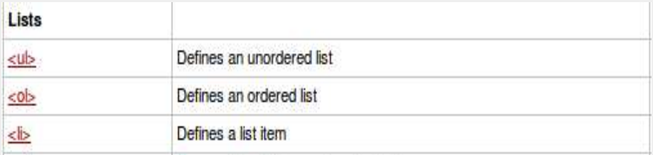
List Tags

Slide 16
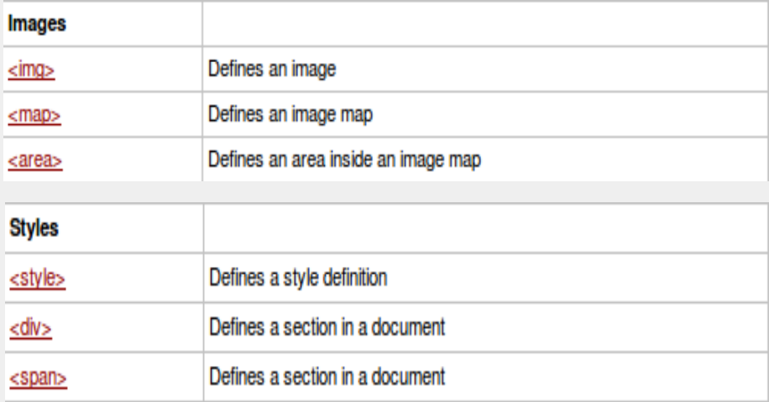
Image Tags & Style Tags

Slide 17
CSS : Cascading Style Sheets
Are used to control how elements are presented in the Web page
Use a different syntax that HTML/XHTML
Used properly, can great simplify visual design,
CSS is a language that describes the style of an HTML document.

Slide 18
CSS: Applying CSS
1 Apply Inline
<p style=“ color:red; ”> TEXT </p>
2 Apply in page
<style type=“text/css”>
p{
color :red;
}
</style>

Slide 19
CSS: Applying CSS(cont.)
3. External Style sheet
<head><link rel=“stylesheet” type=“text/css” href=“./basic.css” /></head>

Slide 20
CSS priority
1. Browser default
2. External style sheet
3. Internal style sheet (in the head section)
4. Inline style (inside an HTML element)

Slide 21
CSS : A Style
Selector Property Value
p{ font-family : times;
font-size : 20px; }
- The property is followed by a colon (:)
- the value is followed by a semicolon (;)

Slide 22
CSS : CSS Selector
Type selector, select for element
p, input {background-color: red;}
Class selectors use ( . )
.privacy {background-color : green; }
ID selectors, use ( # )
#username{background-color :blue }

Slide 23
CSS : Advance CSS Selector
1. Descendant selectors, selector for inner element.
h1 em { color: red }
<h1> this headline is <em> very </em> important </h1>
2. Child selectors, selector for child element .
body > P { background-color: #FFFFFF;}
3. Adjacent sibling selectors
h1 + h2 { margin-top: 5%; }

Slide 24
CSS : Advance CSS Selector (cont.)
4. Pseudo-class Selector
a:link {color : RED;}
a:visited{color:GREEN;}
a:hover{color:#00CCFF;}
a:active{color:BLUE;}
5. Pseudo-element Selector
p:first-line { text-transform: uppercase }

Slide 25
CSS : Comment
/* This is a CSS comment */

Slide 26
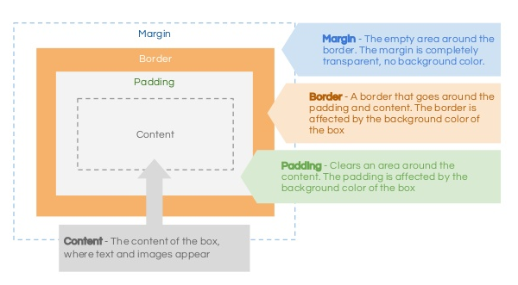
CSS : Box Model

Slide 27
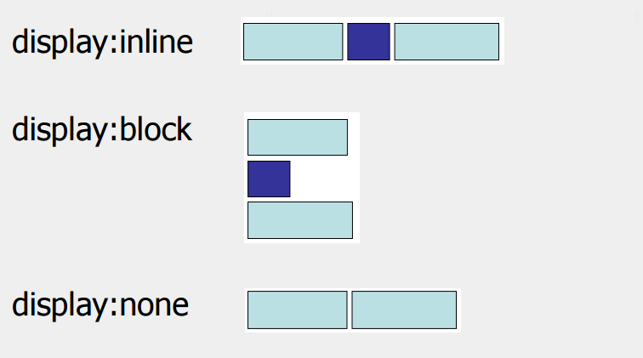
CSS : Display

Slide 28
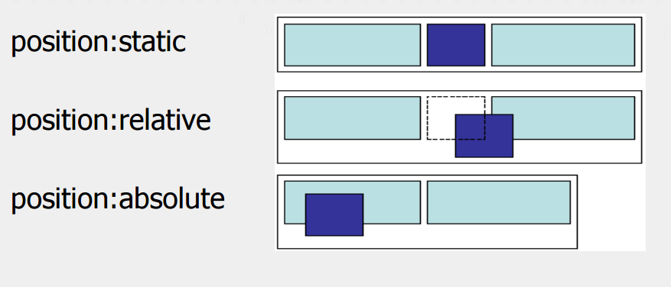
CSS : Position

Slide 29
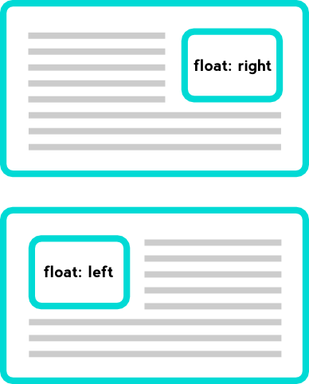
CSS : Floating
float : right/left/none
Shift a box to the right/left of the container box. If
there is no space, boxes will wrap around.

Slide 30
Exercise : Soft Square Coffee
On the Web page we just need something simple that includes the beverage names, prices, and descriptions.
House Blend, $1.49 A smooth, mild blend of coffees from Mexico, Bolivia and Guatemala.
Mocha Cafe Latte, $2.35 Espresso, steamed milk and chocolate syrup.
Cappuccino, 35 baht A mixture of espresso, steamed milk and foam.
Thai Tea, 25 baht A drink made with black tea, condensed milk.

Slide 31
Exercise : Soft Square Coffee (count.)
<style type="text/css">
body {
background-color: #d2b48c;
margin-left: 20%;
margin-right: 20%;
border: 1px dotted gray;
padding: 10px 10px 10px 10px;
font-family: sans-serif;
}
</style>

Slide 32
Exercise : Soft Square Coffee (count.)
ปรับหน้า coffee (coffee.html)
ให้แสดงหัว/คำโปรยว่า Soft Square Coffee ใช้font Comic Sans MS
มีรูปแก้วกาแฟอยู่ข้างๆ คำโปรยด้วย - font อื่นๆ ให้ใช้ font ประเภท Sans Serif - แสดงชนิดกาแฟที่มีอยู่ 4 ชนิด ใน ตาราง (table)
column แรกเป็น product , description, price ตามลำดับ
ให้ตารางแสดงเส้นด้วย เส้นเดี่ยวสีน้ำตาล- column ราคา align center
ให้สีของแต่ละ row ต่างกัน
ตอนท้ายใส่link ให้ไปยังหน้าสั่งซื้อกาแฟ (order.html)

Slide 33
Exercise : Soft Square Coffee (count.)
ใช้ตัวอักษรของหน้านี้เป็น family Sans
มีช่องให้ใส่ชื่อ member และ password
ช่อง member name ระบายสีเหลืองอ่อน
Choose your cup ให้แสดงเป็น list item เป็นจุดกลมๆ
ชื่อกาแฟจะต้อง clickแล้ว radioข้างหน้าถูกเลือก
Special requestให้มีกรอบสีน้ำตาลเข้ม

Slide 34
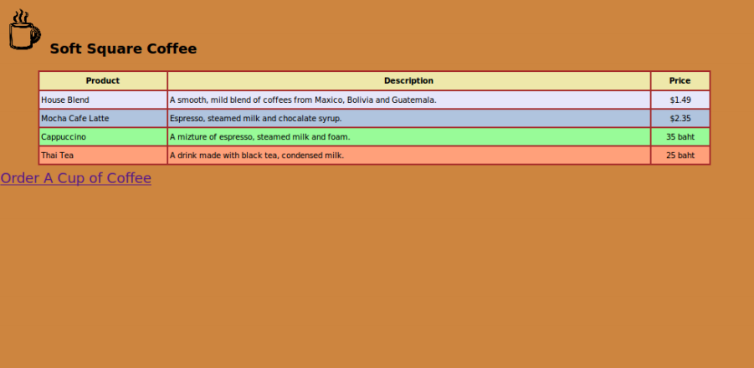
Coffee.html

Slide 35
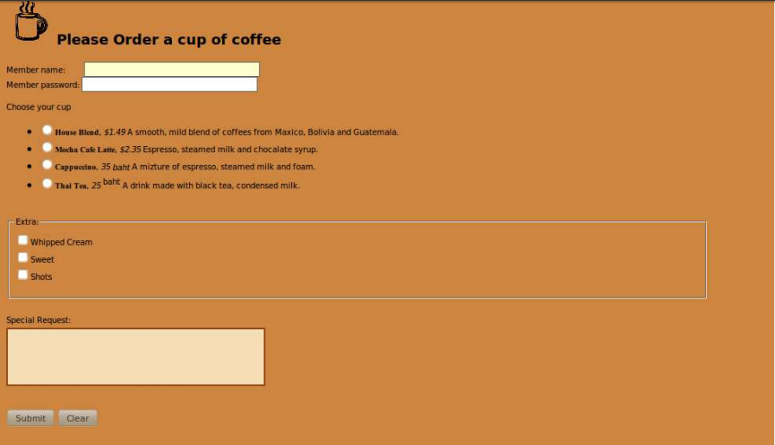
Order.html

