Slide 1
FDTEM · QUALITY ESTIMATION · LENGTH BIAS
Does COMET still work on longer text?
Results — block-level xSIM++, and the retraining plan
EXPERIMENT A · retrain COMET
EXPERIMENT B · block xSIM++
Better encoder + paragraph-level data. Does quality prediction hold up as text grows?
Training on the cluster — figures pending.
Bury one perturbed sentence in a k-sentence block: can the encoder still find the clean block?
Complete — 5 encoders, k = 2…5.
Data & models in ~/scratch · logged to Weights & Biases · FLORES+ (openlanguagedata/flores_plus)
FDTEM · COMET on long text
01 / 14

Slide 2
MOTIVATION
An aligner pulls together; a quality metric must also push apart
Aligners (LaBSE, LASER, E5) are trained to place a sentence and its translation near each other.
COMET has a harder job: it must also separate a correct translation from one that is nearly identical but contains an error.
The concern: COMET only saw short segments in training. On a paragraph, is a single localised error simply diluted away?
PULL TOGETHER ✓
src ↔ correct translation → close
PUSH APART ✗
src ↔ translation-with-one-error → must stay farther than the correct one
Experiment B measures the push-apart force directly, as text gets longer.
FDTEM · COMET on long text
02 / 14

Slide 3
EXPERIMENT B · OVERVIEW
xSIM++ on concatenated blocks
Standard xSIM++ perturbs one sentence. We move it to blocks of k sentences: perturb one sentence, keep the other k−1 intact, and ask whether the encoder can still retrieve the clean block.
THE QUESTION
As k grows, one error is a smaller fraction of the block. How fast does the encoder's sensitivity dilute?
THE METHOD IN ONE LINE
Cross-lingual retrieval: query = source block; find its true translation block in a pool seeded with hard negatives.
Encoder zoo (no training): COMET · Bio-COMET · raw XLM-R · LaBSE · E5.
Data: FLORES+ dev+devtest, cased languages de · es · fr · ru (zh/ja/th excluded — entity edits need letter case).
FDTEM · COMET on long text
03 / 14

Slide 4
EXPERIMENT B · AGGREGATING FLORES+
From FLORES+ sentences to parallel blocks
FLORES+ rows are in document order with a url column marking articles. We take non-overlapping windows of k consecutive sentences within one article (stride = k), and apply the same window to every language — blocks stay parallel.
• Pool dev + devtest → 2,009 sentences / language, 562 articles (2–6 sentences).
• Partial tail windows discarded — only full k-blocks kept.
• Larger k ⇒ fewer blocks; k = 5 is the practical ceiling.
ONE ARTICLE · k = 3 · parallel
EN
s1
s2
s3
s4
s5
s6
DE
t1
t2
t3
t4
t5
t6
→ aligned source block & target block
block size
blocks / language
k = 2
846
k = 3
468
k = 4
276
k = 5
141
FDTEM · COMET on long text
04 / 14

Slide 5
EXPERIMENT B · THE RETRIEVAL POOL — THE CORE OF THE RECIPE
What is the query, and what is it retrieved against?
QUERY — one source block (EN)
CANDIDATE POOL (target language)
s1
s2
s3
t1
t2
t3
✓ the answer — clean block
embed → nearest candidate by cosine similarity
t1
t2*
t3
hard negative — sentence 2 perturbed
t1*
t2
t3
hard negative — different sentence / edit
u1
u2
u3
every OTHER true block (distractors)
Crucial: hard negatives are built per block, from that block's own k translations — one sentence perturbed, the other k−1 byte-identical. They are not perturbations of other blocks. The whole-corpus pool = all clean target blocks (mutual distractors) + every block's own hard negatives.
FDTEM · COMET on long text
05 / 14

Slide 6
EXPERIMENT B · THE PERTURBATIONS
One sentence, three edit types, every block
CAUSALITY
ENTITY
NUMBER
antonym · negation · modal strengthening
swap a named-entity span from a corpus bank
change a digit / ordinal value
…ne s'amélioreraient pas → …s'amélioreraient
M. Pittman → M. Phéniciens
88 → 98 · first → sixth
For each k-block, hard negatives sweep:
• each position p = 1…k (perturb p, keep the rest)
• each category — causality, entity, number
• a few variants each (default 2, deduplicated)
The other k−1 sentences are byte-identical to the clean block — that is what makes the negative hard, and harder as k grows.
DE · pool sizes (variants/pos = 2)
k
true
hard neg
pool
2
846
6,379
7,225
3
468
5,287
5,755
4
276
4,172
4,448
5
141
2,611
2,752
FDTEM · COMET on long text
06 / 14

Slide 7
EXPERIMENT B · HOW WE SCORE IT
Retrieval rule & the metrics we read
Embed the query block and every candidate; retrieval picks the candidate of maximum cosine similarity (absolute-margin rule). A block is correct only if that argmax is its own clean target block.
xsim error
xsim++ error
over the clean-blocks-only pool (classic)
over the full pool incl. hard negatives
detection rate
error typology
P[ cos(q, clean) > cos(q, perturbed) ]
misaligned vs which category won
by position
margin
detection vs where the error sits
gold − best-negative similarity
FDTEM · COMET on long text
07 / 14

Slide 8
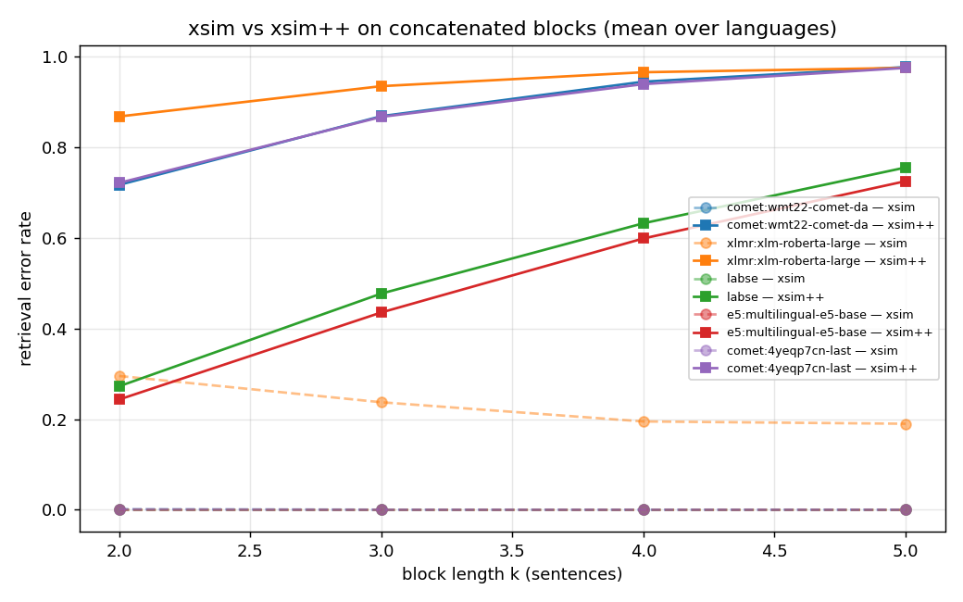
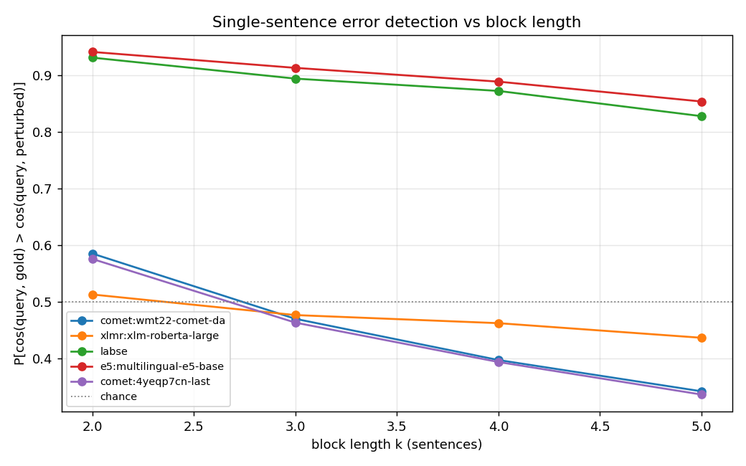
EXPERIMENT B · RESULT · H100, 13 MIN · MEAN OVER DE·ES·FR·RU
COMET aligns blocks perfectly — yet can't feel a buried error
Dashed = xsim (clean pool) ≈ 0 for COMET/LaBSE/E5. Solid = xsim++ (with hard negatives): COMET climbs 0.72 → 0.98.
P[clean closer than perturbed]. COMET & Bio-COMET fall below chance from k = 3; LaBSE/E5 hold ~0.85 at k = 5.
Finding: COMET's encoder is fooled by a single perturbed sentence 72% of the time at k=2, 98% at k=5 — and from k=3 ranks the corrupted block closer to the source than the clean one. Aligners resist this.
FDTEM · COMET on long text
08 / 14

Slide 9
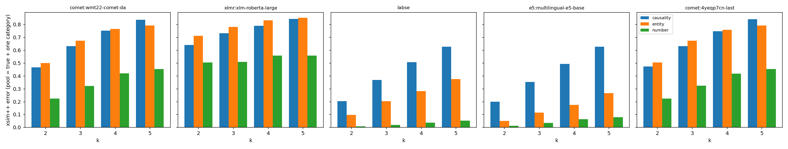
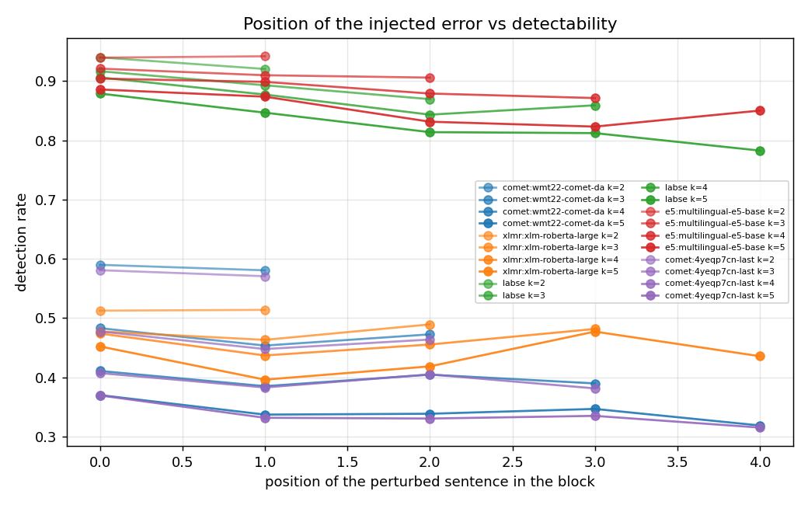
EXPERIMENT B · RESULT · WHICH EDITS, WHICH POSITIONS
What fools each encoder, and where in the block
xsim++ error with the pool restricted to one category. COMET & XLM-R: entity ≥ causality ≫ number. Aligners (LaBSE/E5): the reverse — entity/number are easy, causality is hardest.
Detection vs the position of the perturbed sentence in the block.
Two clean bands — aligners ~0.85–0.94 (top), COMET / XLM-R ~0.33–0.50 (bottom) — with a slight dip for errors in the middle and later sentences of the block.
FDTEM · COMET on long text
09 / 14

Slide 10
EXPERIMENT B · RESULT · THE NUMBERS
xsim++ error and detection rate, mean over languages
xsim++ error (↑ = worse)
detection rate (↓ = worse; .50 = chance)
encoder
k=2
k=3
k=4
k=5
k=2
k=3
k=4
k=5
COMET
0.72
0.87
0.94
0.98
0.59
0.47
0.40
0.34
Bio-COMET
0.72
0.87
0.94
0.98
0.58
0.46
0.39
0.34
LaBSE
0.27
0.48
0.63
0.76
0.93
0.89
0.87
0.83
E5
0.24
0.44
0.60
0.73
0.94
0.91
0.89
0.85
XLM-R (raw)
0.87
0.93
0.97
0.98
0.51
0.48
0.46
0.44
Detection below .50 (bold rust) = the encoder ranks the corrupted block closer than the clean one, on average. COMET/Bio-COMET cross that line at k = 3.
FDTEM · COMET on long text
10 / 14

Slide 11
EXPERIMENT A · RETRAINING
Retrain COMET — isolate the encoder from the data
ARM 1 · DATA EFFECT
Continue wmt22-comet-da on paragraph-level data. Same encoder, same head — only the training text gets longer.
Is short-segment data the limitation?
ARM 2 · ENCODER EFFECT
Retrain COMET's head on a better-aligned encoder (microsoft/infoxlm-large), from raw weights, on the same data.
Is the ageing XLM-R backbone the limitation?
Controlled comparison. Arm 2 is run twice on identical data — infoXLM vs a plain xlm-roberta-large baseline — so any difference is attributable to the encoder, not the recipe.
Task throughout: reference-based scalar regression (RegressionMetric), MSE loss. Trained: regression head + layer-attention pool + encoder (low LR, 30% frozen). Data: length-balanced Bio-MQM windows, k ∈ {1,2,3,4,6}, equal count per length — 15,410 train / 46,882 val.
FDTEM · COMET on long text
11 / 14

Slide 12
EXPERIMENT A · DATA
Length-balanced paragraph mix from Bio-MQM
Consecutive same-document Bio-MQM segments form real paragraphs. Slide a window of k segments, concatenate src/mt/ref, score by the mean per-segment MQM penalty. At k=1 this equals the sentence-level score — all lengths share one scale.
• Balanced: every k contributes the same number of train windows.
• Train windows overlap (augmentation); val is non-overlapping.
• Windows over 480 tokens dropped (512 encoder limit).
ONE DOCUMENT → WINDOWS
s1
s2
s3
s4
s5
s6
k=2
s1
s2
s3
s4
s5
s6
k=3
s1
s2
s3
s4
s5
s6
Each window → one example: score = mean penalty. Length grows ~40 → ~226 tokens (k=1 → k=6).
15,410
46,882
k∈{1,2,3,4,6}
train windows
val windows
equal share
FDTEM · COMET on long text
12 / 14

Slide 13
EXPERIMENT A · STATUS
Retraining runs in flight
Three COMET runs training on RTX 8000 (≤ 3 days), logging to W&B project comet-retrain:
• paragraph-continue — wmt22-comet-da on the length-balanced mix
• infoXLM-large — encoder swap
• XLM-R baseline — same recipe, controlled comparison
On completion, eval_length_correlation.py produces the Kendall-τ-vs-k figure — one line per model. A model that generalises to long text degrades less as k grows.
Kendall τ vs k, per model
— pending training —
FDTEM · COMET on long text
13 / 14

Slide 14
RECAP
Two experiments, one question
A · RETRAINING
data: Bio-MQM windows k∈{1,2,3,4,6}
task: reference-based regression (MSE)
trained: head + pool + encoder (low LR)
varies: encoder (infoXLM) · or data
eval: Kendall τ vs k
status: training
B · BLOCK xSIM++
data: FLORES+, non-overlapping k-blocks
task: cross-lingual block retrieval
negatives: 1 sentence perturbed, k−1 intact
varies: block length k = 2…5 · encoder zoo
eval: xsim vs xsim++, detection, dilution
result: COMET blind to buried errors ✓
Does COMET's quality signal — and its encoder's error-sensitivity — survive the move from sentences to paragraphs?
FDTEM · COMET on long text
14 / 14

