Slide 1
Does training on longer text
make MT metrics better?
Finetuning COMET and COMET-QE on WMT paragraph-level data
36 training runs · 262,080 training examples · held-out WMT + MetaDocEval
FDTEM · August 2026

Slide 2
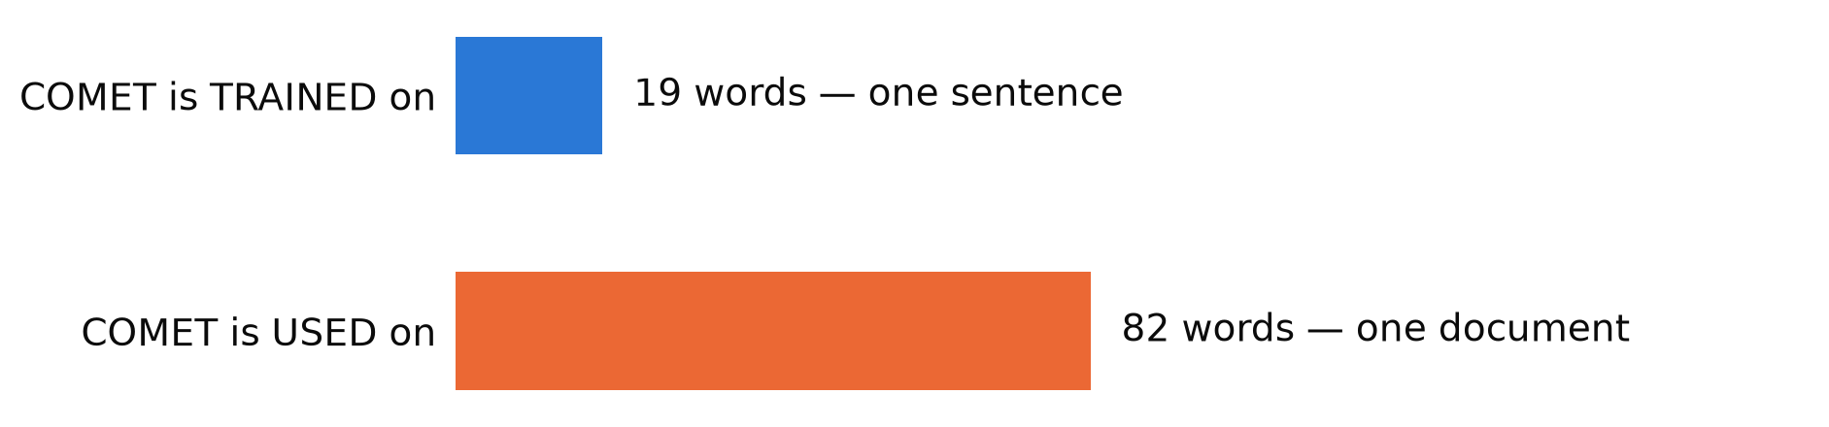
The mismatch
COMET learns on sentences. It is applied to documents.
Nobody knows what this costs. Nor what fixes it.
We measure both.

Slide 3
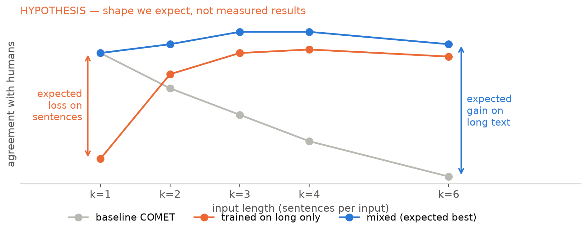
What we expect to find
Stated before the results. The experiment can refute it.
1. Long-only training helps on long text — and hurts on sentences.
2. A small share of sentences (~20%) restores the sentence-level skill.
3. Real documents teach more than concatenated sentences.
4. Better correlation ≠ understanding discourse errors.

Slide 4
Source A — real long text
WMT25 General MT: humans scored whole documents.
2,625
documents with reference
47,924
document × system human scores
13
language pairs
82
words per document (average)
Protocol: ESA, one score 0–100 per document, plus error spans.
Languages we never had before: cs→de, cs→uk, en→ar, en→ja, en→is …
After the validation split and the 512-token limit: 42,558 training rows.

Slide 5
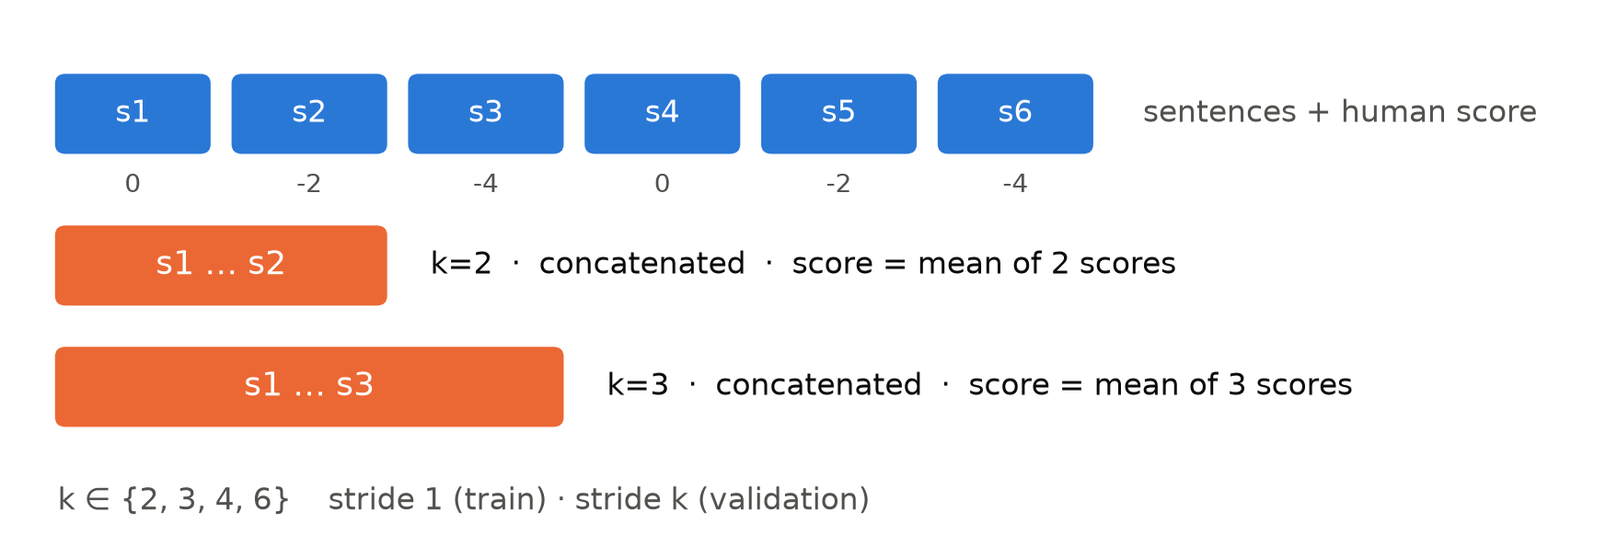
Source B — sentences, aggregated
WMT22 MQM sentences glued into windows. The score is averaged.
67,574 scored segments · en-de, en-ru, zh-en · 15 MT systems
→ 160,377 windows. A window keeps the same score scale as a sentence.

Slide 6
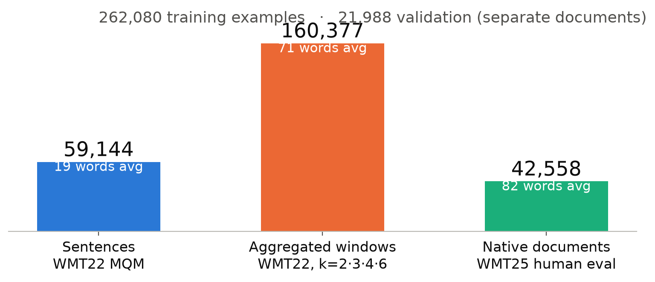
The training pool
Three kinds of examples. One common format: src · mt · ref · score.
Splits are document-disjoint. Scores are normalised per language pair.
Rank-based evaluation, so the normalisation changes nothing downstream.

Slide 7
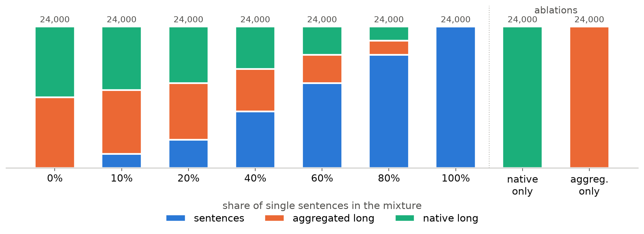
The experimental lever — data mixtures
Same size every time. Only the composition changes.
9 mixtures × 24,000 examples. Sampled from one shuffle, seed 42, md5 recorded.
Two extra mixtures isolate the long data: real documents only vs aggregated only.

Slide 8
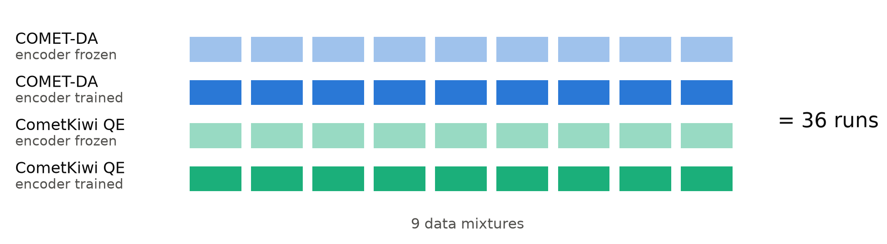
What we finetune
Two public metrics. Two encoder regimes. Nine mixtures.
COMET-DA uses the reference. CometKiwi QE does not — source and translation only.
Frozen = only the scoring head learns. Trained = the whole encoder adapts.
Everything else is identical: same schedule, same seed, early stopping on validation.

Slide 9
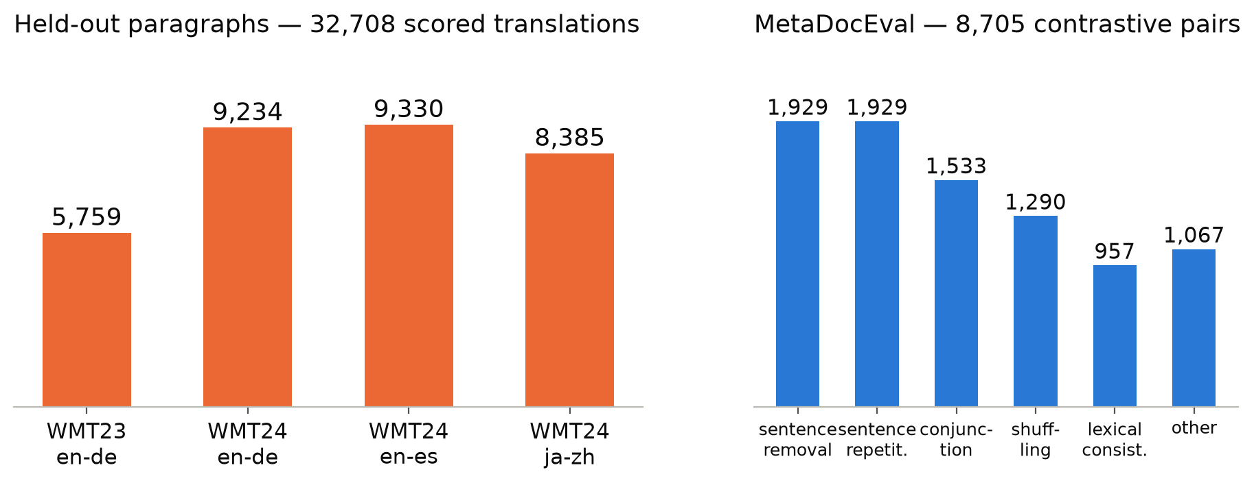
How we evaluate
Two questions. Two test sets. Neither is used in training.
Does the score still track human judgement? → WMT23 + WMT24 paragraphs, per length.
Does the metric see discourse errors? → MetaDocEval: original vs perturbed document.

Slide 10
No contamination
Training years and evaluation years do not overlap.
2022 + 2025
TRAIN sentences · documents
2023 + 2024
TEST paragraph correlation
WMT24++
TEST MetaDocEval discourse
MetaDocEval is built on WMT24 documents. WMT24 is therefore excluded from training.
The held-out sets also add unseen language pairs: en-es and ja-zh.
Uncertainty is measured by bootstrap over documents, not over examples.

Slide 11
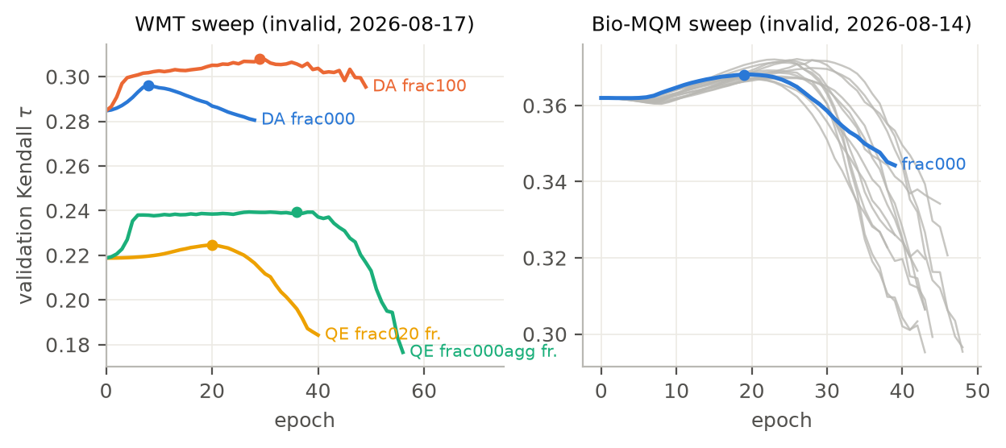
A silent failure, then a correction
The first 36-run sweep did not measure composition.
COMET reads ONE training file per epoch — every run trained on 205–6,940 rows
instead of its 24,000-row mixture, on a single language pair. Budgets differed ~34×.
Fixed: one concatenated file per mixture, 6 epochs everywhere, best-checkpoint selection.

Slide 12
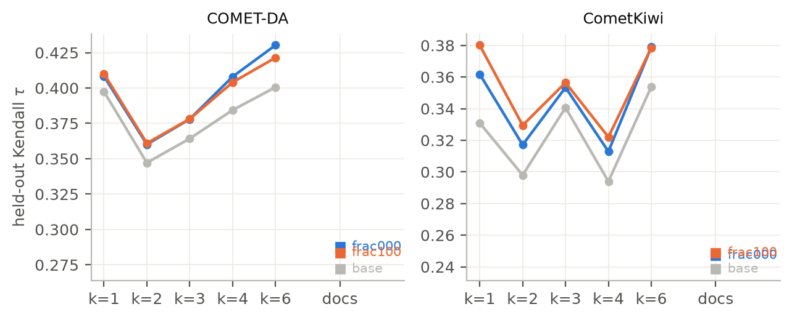
First corrected wave — correlation
8 arms: frac000 / frac100 × DA / QE × frozen / trained. Held-out test sets.
Every arm beats its base metric at every length — no catastrophic forgetting.
Long-only training is best on documents; sentence-only on sentences. The gap is small.

Slide 13
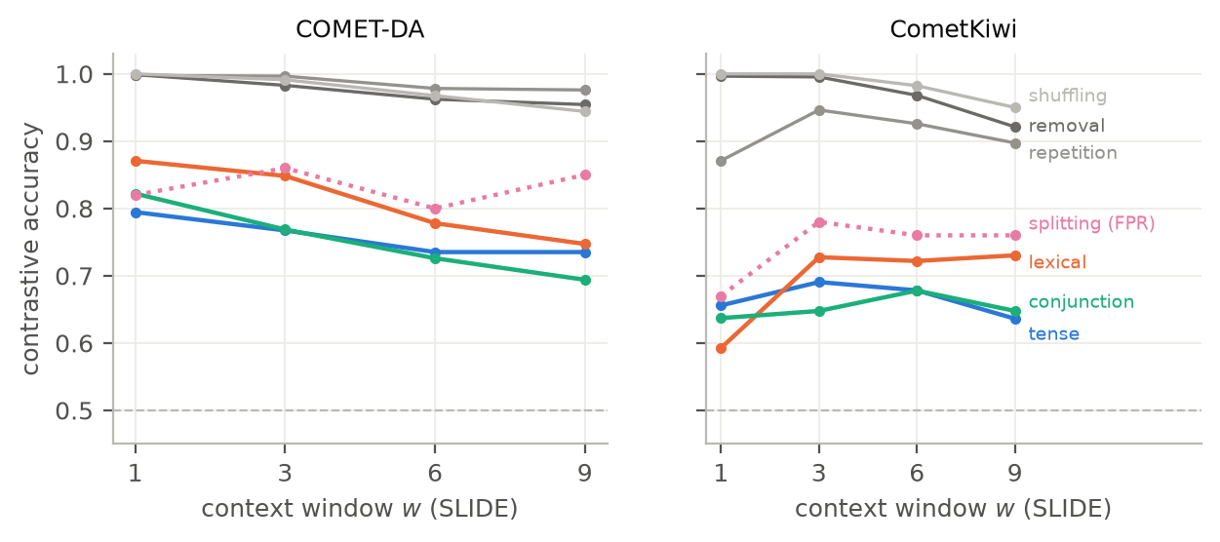
Discourse errors — no progress
MetaDocEval: original vs perturbed document, accuracy per context window.
No retrained arm improves with context — the gains above are score-level.
Training on longer text does not teach the metric to SEE document-level errors.

Slide 14
Audit finding — QE trained on truncated inputs
CometKiwi concatenates mt + src into one 512-token sequence. Our filter capped each side.
7.8%
native training rows overflowing
10.7%
k=6 training rows overflowing
~52%
of the source lost on overflowing eval docs
0%
DA arms affected (sides encoded separately)
Fix: rows must now also satisfy src + mt ≤ 508 tokens — applied to the shared pools,
so DA and QE keep training on identical rows. Redeploy:
RUN=1 SUBMIT=1 experiments/length_training/slurm/deploy_concat_fix.sh

Slide 15
Next
1. Re-run the first wave on the fixed pools (v2) — QE arms without truncation.
2. The remaining 28 arms: map the restoration point between f=0 and f=100.
3. Discourse competence needs more than data composition — longer training,
document-level supervision, or architectural change.

