Slide 1
ENCODER EVALUATION · LENGTH SENSITIVITY
Do encoders still feel a single error in longer text?
Block-level xSIM++: one planted error, diluted across k concatenated FLORES+ sentences
The one-line idea. Concatenate k parallel sentences into a block, corrupt exactly one of them with a minimal semantic edit, and test whether an encoder can still retrieve the clean translation over the corrupted one. Sweep k = 2…5 so that length is the only thing that changes.
FLORES+ dev+devtest · de · es · fr · ru · pivot en | encoders: COMET · Bio-COMET · XLM-R · LaBSE · E5 | no training, retrieval only
Encoder length-sensitivity · block-level xSIM++ on FLORES+
01 / 12

Slide 2
WHY THIS EXPERIMENT
Aligning is easy; noticing one buried error is the hard part
A cross-lingual encoder must do two things:
1. pull a sentence and its translation together;
2. push a wrong translation — one that is nearly identical but carries an error — farther away than the correct one.
Aligners (LaBSE, E5) are trained only for (1). A quality-aware encoder like COMET must also do (2).
The worry: COMET only ever saw short segments in training. In a long paragraph, is a single localised error simply averaged away?
PULL TOGETHER ✓
source ↔ correct translation → close
PUSH APART ✗ (the test)
source ↔ translation-with-one-error
→ must stay farther than the clean one
This deck measures the push-apart force, and how it decays as the block grows.
Encoder length-sensitivity · block-level xSIM++ on FLORES+
02 / 12

Slide 3
THE RECIPE AT A GLANCE
A cross-lingual retrieval task, made harder one length at a time
1
2
3
4
CONCATENATE
CORRUPT
RETRIEVE
SWEEP k
k consecutive FLORES+ sentences → one block. Same window in every language, so source and target blocks stay parallel.
Copy each target block, change exactly one sentence with a minimal semantic edit → a hard negative. Repeat per position & edit type.
Query = source block. Pool = every clean target block + all hard negatives. Correct only if the clean gold block is nearest.
Run k = 2,3,4,5. The edit is unchanged; only the amount of surrounding context grows. Watch sensitivity dilute.
Read the whole deck as: hold the error fixed, vary the length, and see when the encoder stops reacting. Everything that follows exists to make length the single independent variable.
Encoder length-sensitivity · block-level xSIM++ on FLORES+
03 / 12

Slide 4
STEP 1 · CONCATENATION — PRECISELY
How sentences become parallel blocks
Non-overlapping windows. Within one FLORES+ article (rows share a url), take k consecutive sentences with stride = k. Windows never overlap, so no two blocks are near-duplicates.
Same window, every language. The identical row range is applied to en, de, es, fr, ru — the source block and each target block are exact translations of one another.
Join rule. Sentences are joined with a single space (with no separator for space-less scripts zh/ja/th). Nothing else is inserted.
Only full blocks. A leftover tail shorter than k, or a window that would cross an article boundary, is discarded.
ONE ARTICLE · k = 3 · parallel
EN
s1
s2
s3
s4
s5
s6
DE
t1
t2
t3
t4
t5
t6
→ query = «s1 s2 s3» gold = «t1 t2 t3»
blocks per language (de, dev+devtest)
k = 2
846
k = 3
468
k = 4
276
k = 5
141
Encoder length-sensitivity · block-level xSIM++ on FLORES+
04 / 12

Slide 5
STEP 2 · THE ERRORS — PRECISELY
Three edit types, each a minimal meaning change
The three perturbation families of xSIM++ (§2.2). Each edit changes one sentence's meaning with the smallest possible surface change, so the block stays fluent and near-identical.
CAUSALITY
ENTITY
NUMBER
antonym swap · add/remove a negation · strengthen a modal (may→will)
replace a detected named-entity span with another of the same width, sampled from a corpus-wide bank
replace a digit with a random different value of the same length, or swap an ordinal
«…ne s'amélioreraient pas» → «…s'amélioreraient»
«chercheurs de Stanford» → «chercheurs de Pittman»
«88 personnes» → «89 personnes»
«augmenter de 12 %» → «diminuer de 12 %»
«première réunion» → «dixième réunion»
Which sentence, which side? Edits are applied to the pool side — the translations (direction en2xx) — to exactly one sentence at one position; the other k−1 sentences are left byte-identical. All edits are deterministic: the RNG is seeded from (seed, language, category, sentence, variant index), so the whole pool is reproducible.
Encoder length-sensitivity · block-level xSIM++ on FLORES+
05 / 12

Slide 6
STEP 3 · THE POOL — HOW MANY ERRORS PER BLOCK?
One error per candidate — many single-error candidates per block
CANDIDATE POOL for one block (k = 3)
Each candidate carries exactly one error.
A hard negative is a copy of the gold block with a single sentence edited — never two.
A block contributes many such negatives.
One per (position × edit type × variant), so longer blocks yield more negatives, not more errors per negative.
The gold block has zero errors and appears once.
Whole pool = all clean target blocks (they distract each other) + every block's own single-error negatives.
t1
t2
t3
✓ gold — 0 errors
t1*
t2
t3
1 error — pos 1 perturbed
t1
t2*
t3
1 error — pos 2 perturbed
t1
t2
t3*
1 error — pos 3 perturbed
× 3 edit types × up to 2 variants each → several single-error negatives per block.
Encoder length-sensitivity · block-level xSIM++ on FLORES+
06 / 12

Slide 7
THE CONTROLS — WHY LENGTH IS THE ONLY VARIABLE
Holding difficulty constant across block lengths
PARALLEL BLOCKS
ONE FIXED EDIT
The same sentence window is used in every language, so a source block and its gold target are exact translations — retrieval difficulty is not shifted by content, only by length.
Every negative differs from its gold by exactly one localised edit; the other k−1 sentences are byte-identical. The error's type and size are the same at k = 2 and k = 5 — only its share of the block shrinks.
SAME EDIT BUDGET
PAIRWISE READOUT
The same three categories and the same variants-per-position are applied at every k. What grows with k is the surrounding clean context, i.e. the dilution — nothing about the error itself.
The headline metric — detection rate — compares the gold block against each of its own single-error negatives one-to-one. Because it is pairwise, a larger pool cannot confound it: it isolates dilution.
Encoder length-sensitivity · block-level xSIM++ on FLORES+
07 / 12

Slide 8
EDGE CASES — TWO GUARDS THAT KEEP THE POOL CLEAN
When an edit can't be made, and never a duplicate of the answer
GUARD 1 · edit not applicable
GUARD 2 · never the gold in disguise
If a sentence has no number, no detectable entity, or no lexicon match, the perturbation function returns nothing.
That (position, category) simply produces no negative. The error is never forced onto a sentence that cannot host it.
So blocks do not all have the same negative count; per-category coverage is recorded in variant_stats so any gap is explicit.
A candidate is kept only if the edited sentence actually differs from the original (cand ≠ source), and duplicates are removed.
A no-op edit therefore never enters the pool. The unperturbed block is never added as a negative — it would be identical to the gold and corrupt the labels.
Generation over-samples (up to 6× draws) to reach the target variant count while discarding no-ops and repeats.
Net effect: every negative in the pool is a genuine, single-sentence corruption of its own block — no forced edits, no accidental copies of the correct answer.
Encoder length-sensitivity · block-level xSIM++ on FLORES+
08 / 12

Slide 9
STEP 3 · SCORING
Retrieval rule and the metrics we read
Embed the query block and every candidate; retrieval picks the candidate of maximum cosine similarity (absolute-margin rule). A block is scored correct only if that nearest candidate is its own clean gold block.
xsim error
xsim++ error
clean-blocks-only pool — pure alignment (should be ≈ 0)
full pool incl. hard negatives — the aggregate task
detection rate ★
by position
P[ cos(q, clean) > cos(q, perturbed) ] — length-controlled
detection vs where in the block the error sits
by category
margin
which edit type the encoder is blind to
gold − best-negative cosine (how decisive)
★ detection rate is the strictly length-controlled number: a pairwise gold-vs-own-negative vote, immune to pool size. 0.50 = chance.
Encoder length-sensitivity · block-level xSIM++ on FLORES+
09 / 12

Slide 10
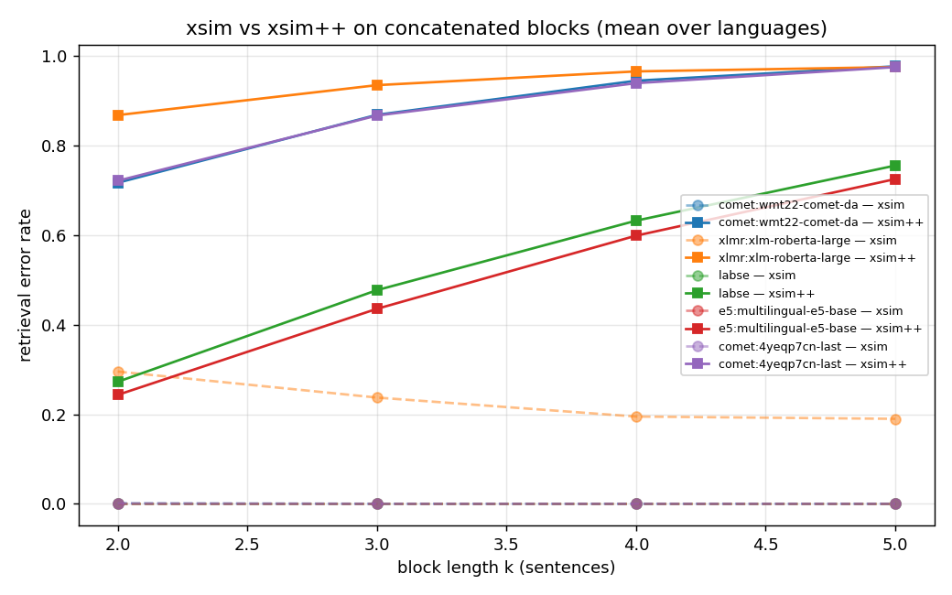
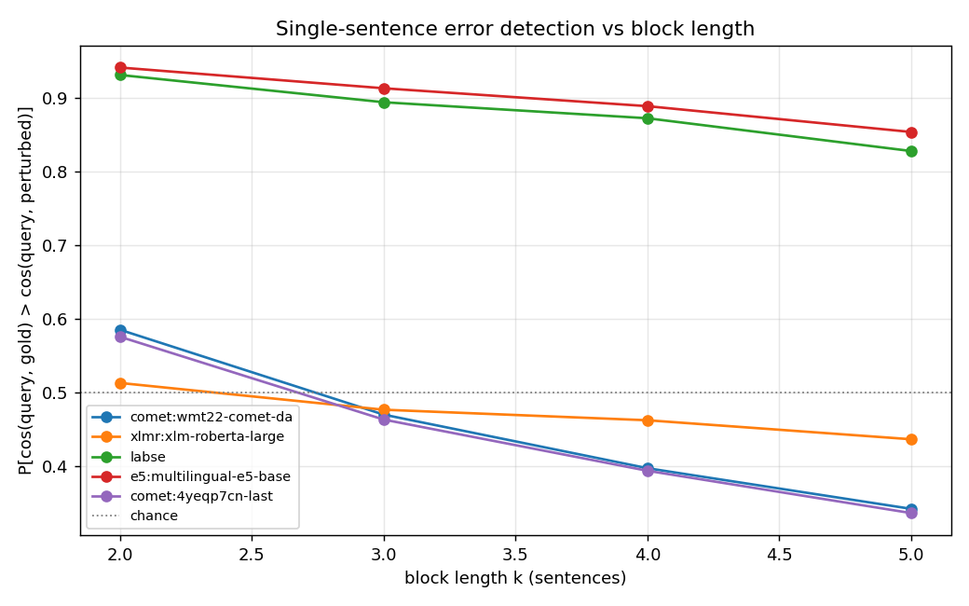
RESULT · MEAN OVER DE · ES · FR · RU
COMET aligns blocks perfectly — yet can't feel a buried error
Dashed xsim (clean pool) ≈ 0 for COMET/LaBSE/E5. Solid xsim++ (with hard negatives): COMET climbs 0.72 → 0.98 as k grows.
Detection = P[clean closer than perturbed]. COMET & Bio-COMET fall below chance from k = 3; aligners hold ~0.85 at k = 5.
Finding: COMET's encoder aligns the block flawlessly but is fooled by one perturbed sentence 72 % of the time at k = 2 and 98 % at k = 5 — from k = 3 it ranks the corrupted block closer than the clean one. The pure aligners resist.
Encoder length-sensitivity · block-level xSIM++ on FLORES+
10 / 12

Slide 11
RESULT · THE NUMBERS
xsim++ error and detection rate vs block length
xsim++ error (↑ = worse)
detection rate (↓ = worse; .50 = chance)
encoder
k=2
k=3
k=4
k=5
k=2
k=3
k=4
k=5
COMET
0.72
0.87
0.94
0.98
0.59
0.47
0.40
0.34
Bio-COMET
0.72
0.87
0.94
0.98
0.58
0.46
0.39
0.34
LaBSE
0.27
0.48
0.63
0.76
0.93
0.89
0.87
0.83
E5
0.24
0.44
0.60
0.73
0.94
0.91
0.89
0.85
XLM-R (raw)
0.87
0.93
0.97
0.98
0.51
0.48
0.46
0.44
Bold rust = detection below .50: the encoder ranks the corrupted block closer than the clean one, on average. COMET and Bio-COMET cross that line at k = 3; LaBSE and E5 never do.
Encoder length-sensitivity · block-level xSIM++ on FLORES+
11 / 12

Slide 12
RECAP
One planted error, four lengths, one conclusion
concatenate
non-overlapping k-sentence windows, same window in every language → parallel source & target blocks (k = 2…5).
corrupt
one sentence per candidate, edited by one of three minimal semantic edits — causality, entity, number; the other k−1 untouched.
control
the edit is fixed across k; only the surrounding context grows. Detection rate is a pairwise, pool-size-immune readout of dilution.
safeguards
no edit is forced on a sentence that can't host it; a no-op is never added — the gold is never duplicated as a negative.
result
COMET aligns blocks perfectly (xsim ≈ 0) but its error sensitivity dilutes fast: below chance from k = 3, 0.98 xsim++ at k = 5. Pure aligners resist.
Encoders can match a long block to its translation while staying blind to a single error inside it — and the blindness grows with length.
Encoder length-sensitivity · block-level xSIM++ on FLORES+
12 / 12

