Slide 1
controlling the mouse cursor with the WiiMote
WiiCursor
Jesper Niedermann 21/12-2008

Slide 2
WiiCursor
WiiCursor is a program for controlling the mouse cursor on a PC and sending mouse and key events using a WiiMote
Programmed using .NET and WiiMoteLib by Brian Peek
The Buttons on the WiiMote can be configured in XML files

Slide 3
The Wii explained

Slide 4
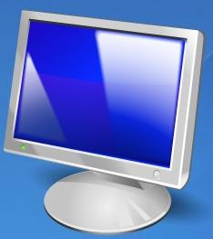
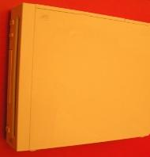

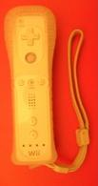
Wii
Scart
Wii Sensor Bar
Accelerometer
Infrared Camera
Loudspeakers
Memory
Vibrator
Standard Controls
Bluetooth
Wiimote
Infrared LEDs
Bluetooth

Slide 5
Infrared LED
Infrared LED
This means you can make your own sensor bar
Examples:
http://doctabu.livejournal.com/64758.html
http://www.youtube.com/watch?v=JTGSkYRDpWY&eurl=
http://www.youtube.com/watch?v=WoniC26LFPs&NR=1
Camera

Slide 6
.NET ?

Slide 7
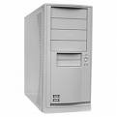
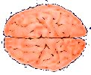
Wii
PC
.NET
Wii Sensor Bar
Wiimote

Slide 8
WiiMoteLib by Brian Peek
Managed API for the Wiimote
http://www.codeplex.com/WiiMoteLib/
http://www.brianpeek.com/blog/pages/wiimotelib.aspx
WiiMoteLib
.NET Framework
Bluetooth

Slide 9
WiiMoteLib by Brian Peek
Simple Event Based Model
Basicly one event – WiiMoteChanged
WiimoteChangedEventArgs contains entire state of Wiimote

Slide 10
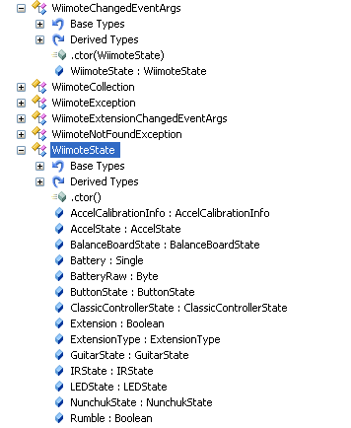
WiiMoteLib by Brian Peek
From Reflector:

Slide 11
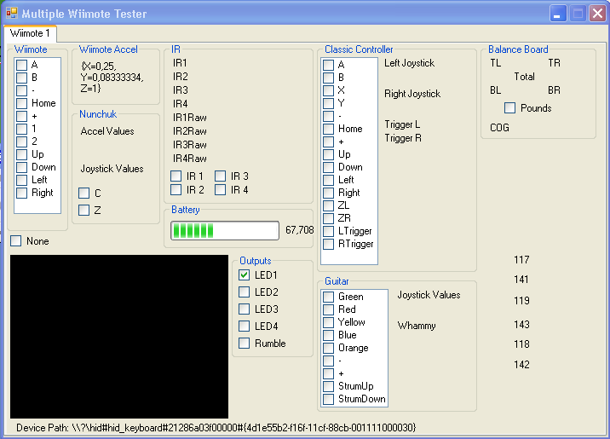
WiiMoteLib by Brian Peek
Brian Peek’s test Application:

Slide 12


WiiCursor + DrawCursor
DrawCursor can draw with mouse cursor on screen
Involves – WPF, WinForms, Interop to Win32, Keyboard Hooks and LinqToXml for configuration
WiiCursor can use Wiimote to move cursor on screen and buttons to send Mouse and Keyboard events
Involves – WinForms, Interop to Win32, Simulating Keyboard and Mouse events, LinqToXml for configuration

Slide 13
DrawCursor Architecture
Mouse
Keyboard
Keyboard
Listener
InkCanvas + Interop

Slide 14
WiiCursor Architecture
WiiMote
Simulated
Mouse
Configuration
WiiMoteLib
Input Simulator
Simulated
Keyboard

