Slide 1
SHOOTING
CRAFT
TEAM DOUBLE CHECK

Slide 2
Table of Contents
01
Introduction
02
Game Features
03
Game Play
04
Q&A

Slide 3
Introduction

Slide 4
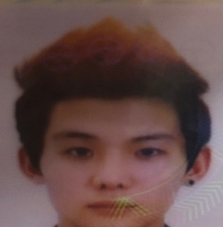
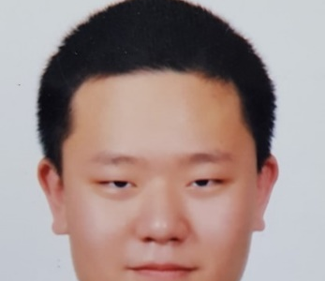
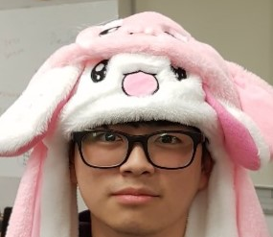
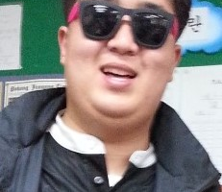
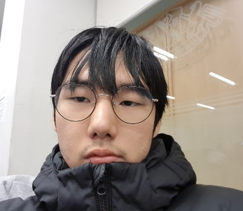
Team Members
DOUBLE CHECK!
Producer
Tech-Manager
Designer
Sound Director
Test Manager
JeeSoo Kim
SangMin Kim
Hyun Kang
ChulSeung Lee
JunSeo Bae

Slide 5

GAME CONCEPT
Top-Down shooting game in space
Build ships the way player wants

Slide 6
Game Features

Slide 7

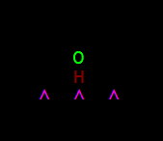

Customize
1
2
3

Slide 8



Enemy AI
1
2
3
?

Slide 9
Game Play

Slide 10

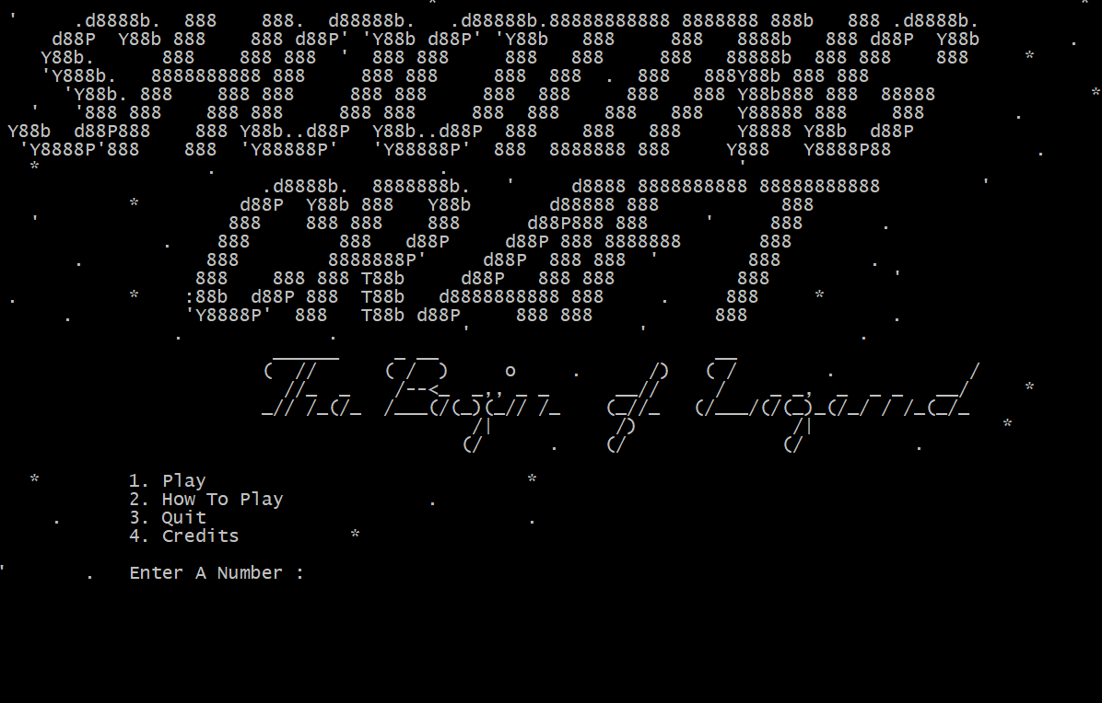


Game Play

Slide 11
Thank you
Any Questions?

