Slide 1
Gam 100
Team double check

Slide 2


Slide 3
index
Team Introduction
Game Concept
Game Features
4. Scope

Slide 4
Team member
Producer - JeeSoo Kim
Designer – Hyun Gang
Tech manager - SangMin Kim
Test manager – JunSeo Bae
Time manager - ChulSeung Lee

Slide 5
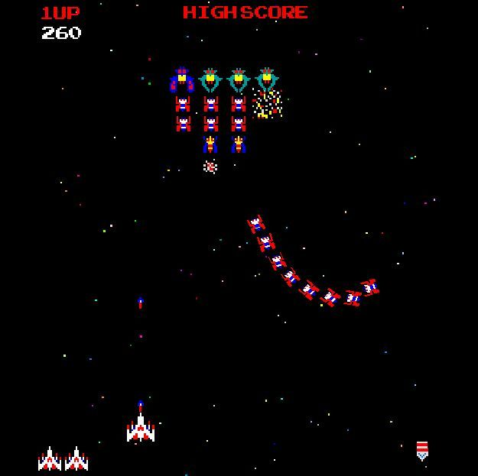
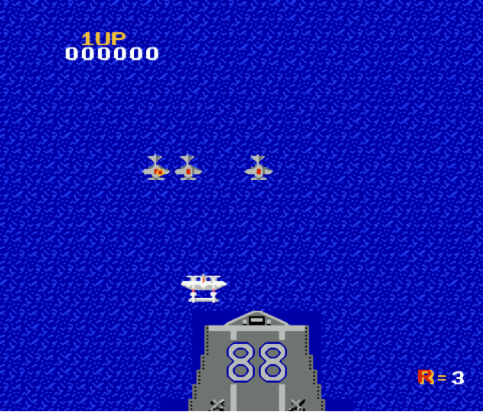
There are many top-down shooting games in the industry.
BUT, what if we can design our own ship?

Slide 6


Slide 7

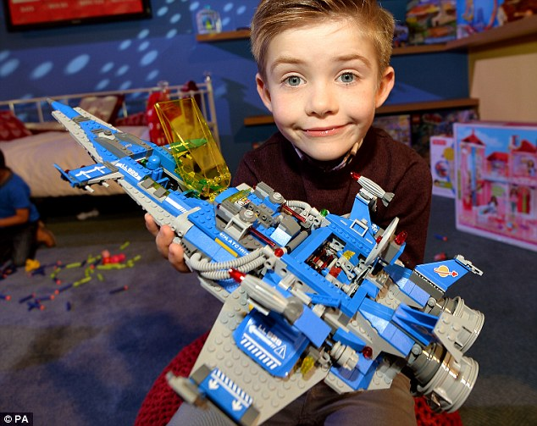
Game concept

Slide 8
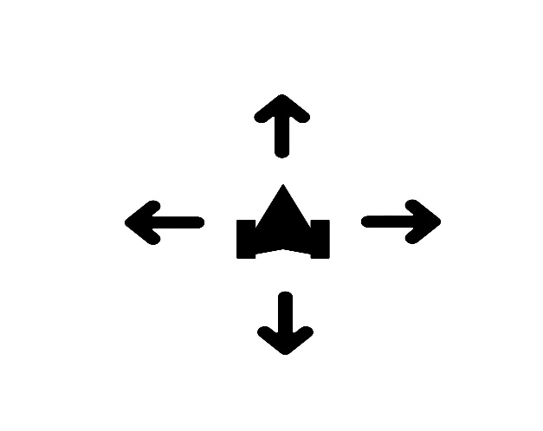



Game features
(1) Combat

Slide 9
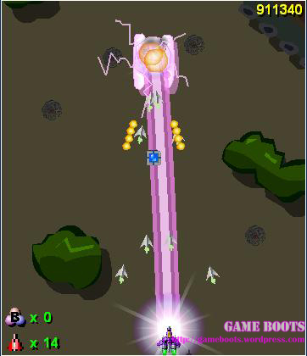
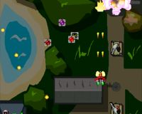
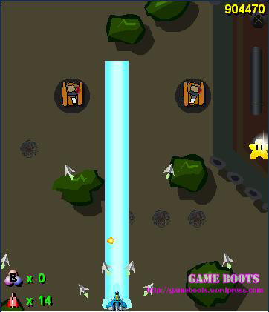
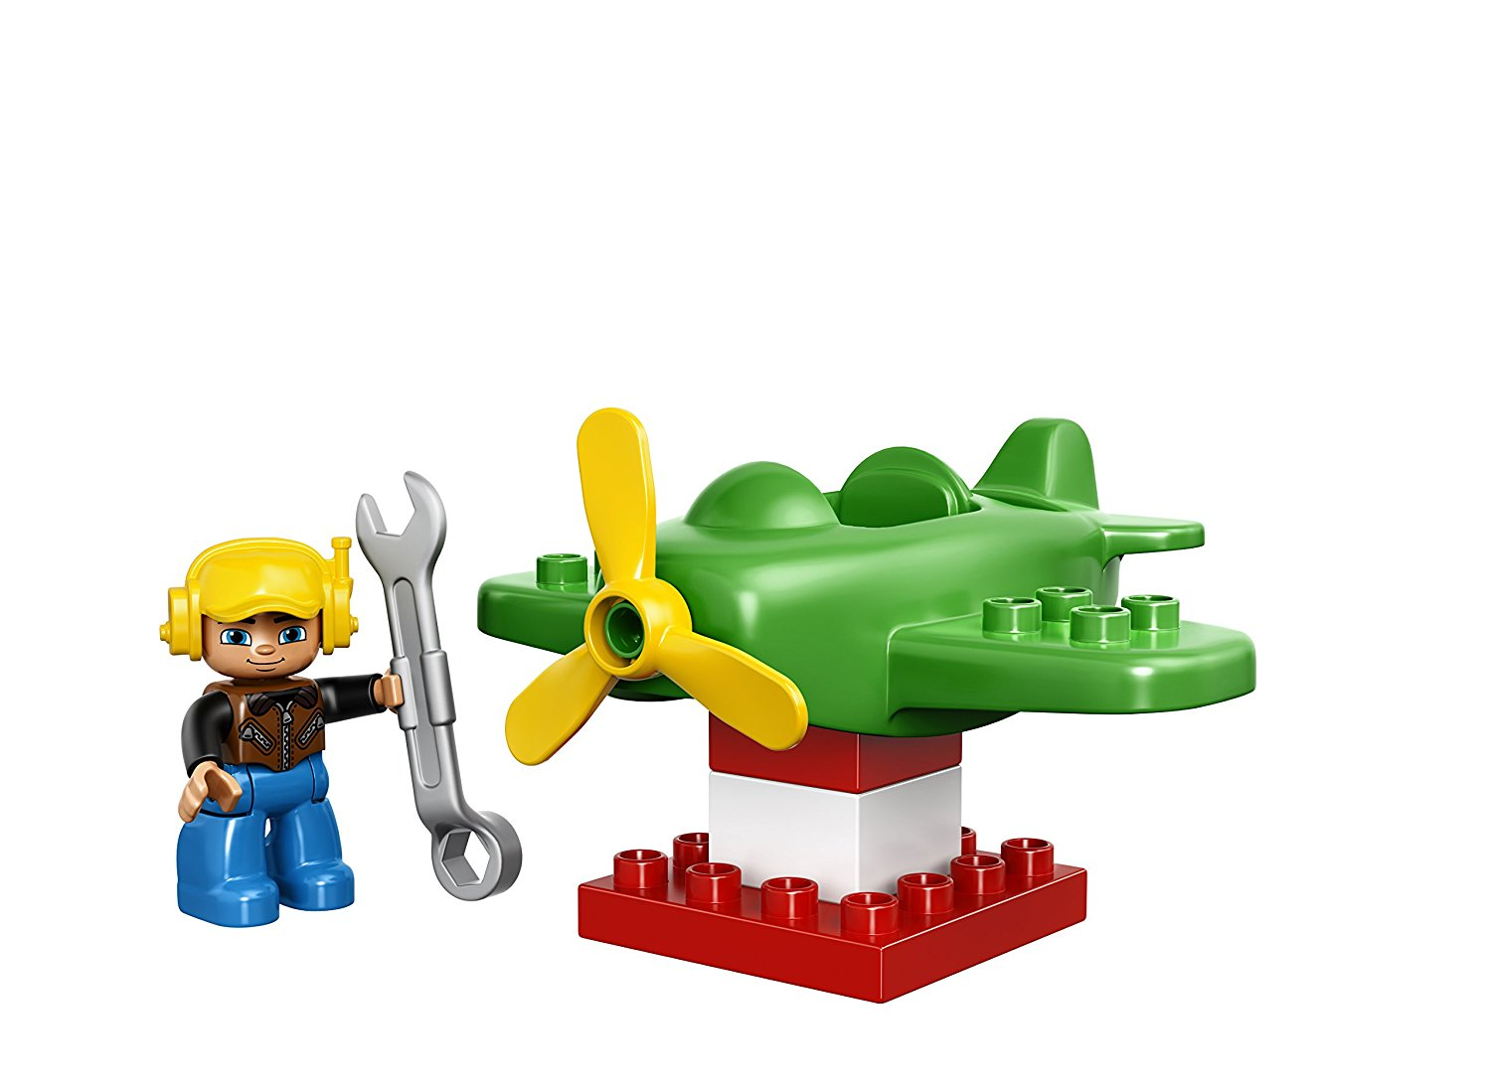
Game features
(2) Customize

Slide 10

Game features
(3) Enemy AI

Slide 11
scope
 | Week 10 | Week 11 ~ 13 | Week 14 | Week 15
Urgent | HP System | Various skills Level Stage System Fixing Severe Bugs | Ranking System (save score) | Submission
Important | Various Enemies | Visuals(Hit effect, enemy looks, etc) | Improving Code Quality Fixing Trivial Bugs | Play Test

Slide 12
Risk & mitigation
RISK | MITIGATION
Difficulties in Coding | Meet occasionally and code together. Double check each others’ code.
Sickness or Absence of team member | Assign substitution member for each role. Put emphasis on leaving comments in coding (So that other members can understand the code)

Slide 13

Thank you for listening

