Slide 1


Project Based Learning-1
2010003391
Kheti Connect
Group ID | 5
Enrollment No | 2502031830005, 2502031830037, 2502031830040, 2502031830048, 2502031830017
Name | Kushwaha Ankitkumar, Jeet Ranpariya, Het Nakrani, Yash Makwana, Rajdipsinh Chauhan
Branch | Computer Science & Engineering (CSE)
Guide Name | Ms. Vaishnavi Gupta

Slide 2
Index
Introduction
Background and Motivation
Relevance and Importance
Literature Survey
Objectives
UML Diagram
Work carried out till date (Table format)
Timeline Chart
References

Slide 3

Introduction
Kheti Connect is a digital platform that connects farmers directly with buyers, helping improve market access and provide fairer pricing.
It also provides farmer education, market information, and transport tracking in one platform.

Slide 4
Background and Motivation
Farmers often face challenges such as limited direct market access, dependence on intermediaries, and lack of proper information.
Kheti Connect is motivated by the need to provide farmers with a single digital platform for selling, learning, and tracking their deliveries.

Slide 5

Relevance and Importance
Kheti Connect is relevant because it addresses multiple challenges faced by farmers, including limited market access, lack of information, and transportation difficulties. It provides a single digital platform that connects farmers, buyers, educational resources, and logistics services.

Slide 6
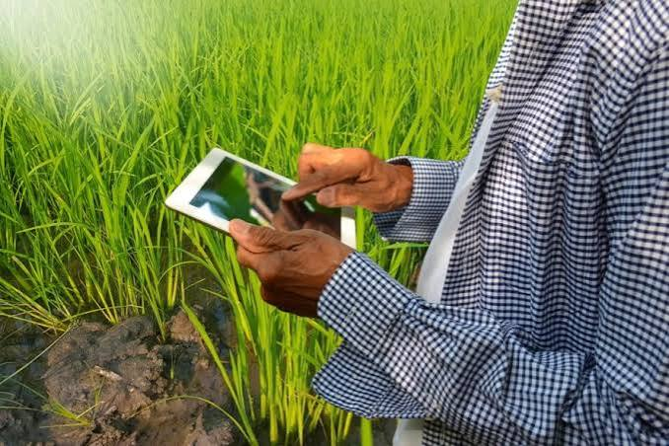
Literature Survey
Existing digital agriculture platforms mainly focus on online trading and market information. However, most solutions do not combine direct selling, farmer education, and logistics tracking in one platform.

Slide 7
Objectives
Develop a direct marketplace for farmers and buyers
Provide better market access and fair pricing for farmers
Offer educational and advisory resources
Enable transport and order tracking
Provide free platform access for farmers
Generate platform revenue from buyers/consumers and related services, not from farmers

Slide 8
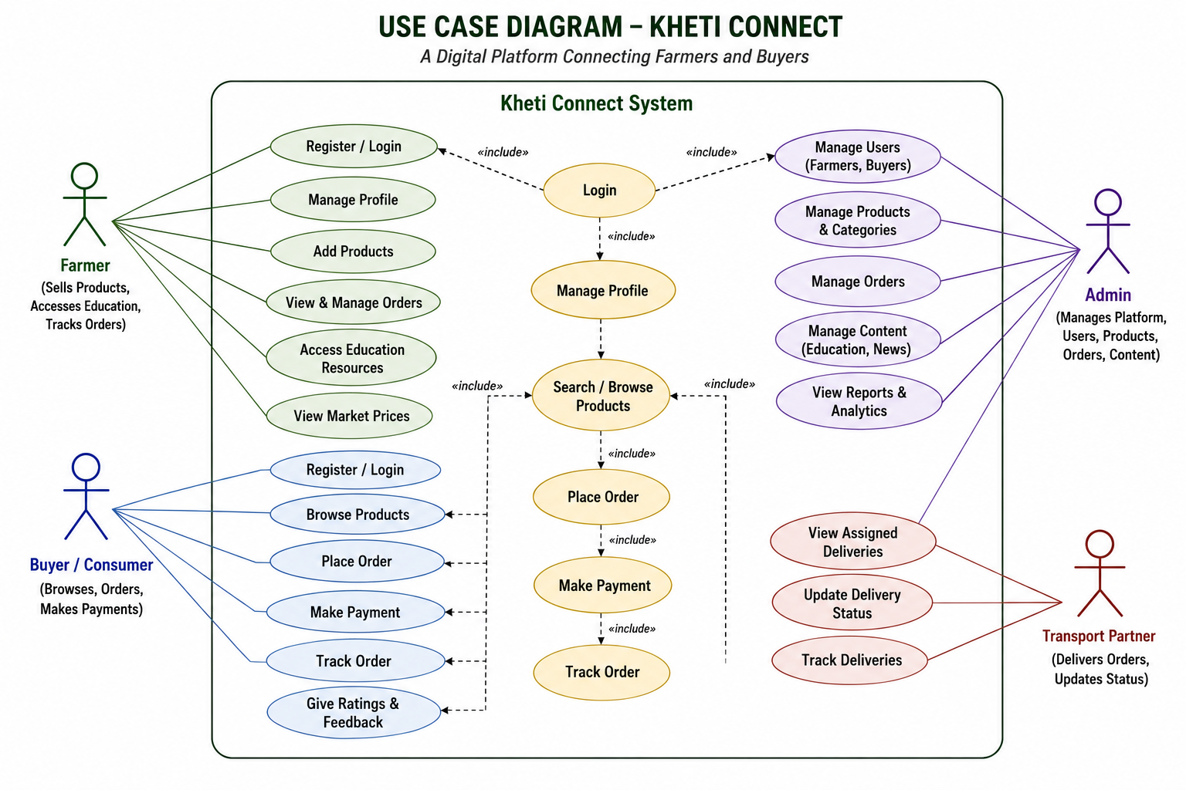

Slide 9
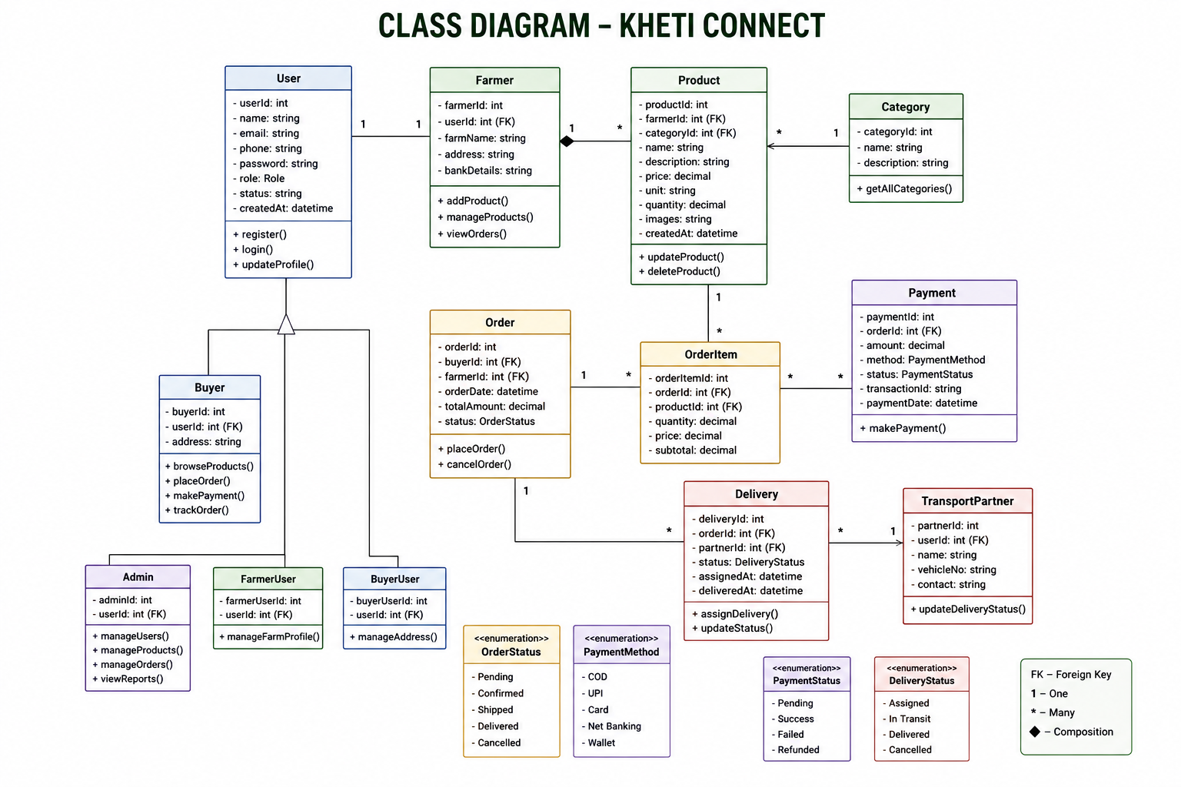

Slide 10
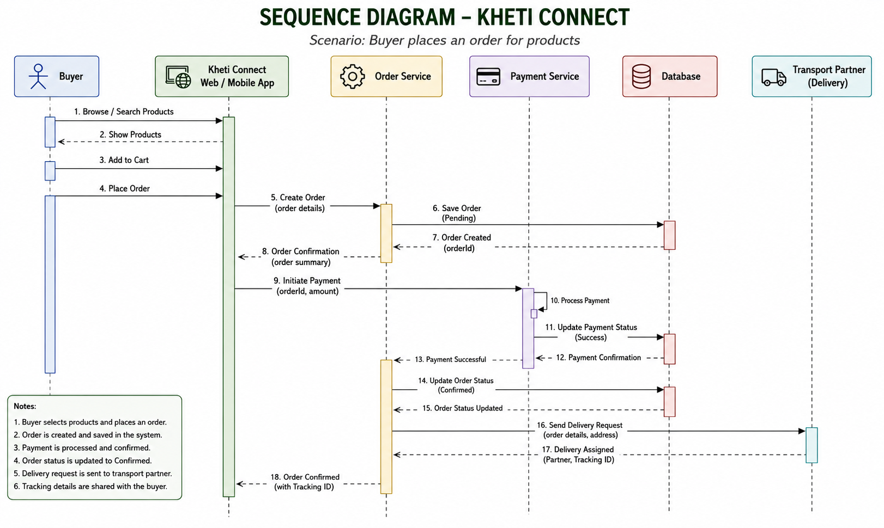

Slide 11
Work carried out till date
Area | Work Carried Out
Conceptual | Problem and solution identified
Analytical | Requirements and features analyzed
Theoretical | Existing platforms studied
Computational | UI and website modules developed
Methodological | Farmer and buyer workflow planned
Boundary | Prototype-based implementation

Slide 12
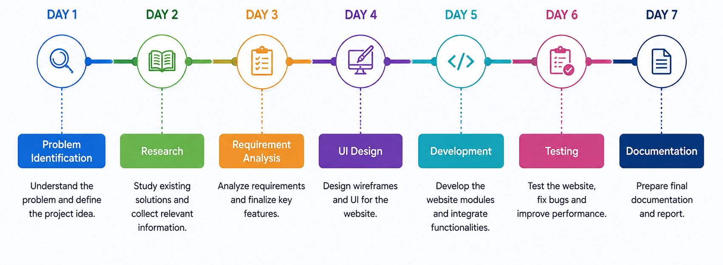
Timeline Chart

Slide 13
References
[1] Miraitu, The Future of Smart Farming, Available: www.miraitu.in
[2] Kisan Mandi, Connecting Fields to Families, Available: kisanmandi.in
[3] National Agriculture Market (e-NAM), Government of India. Available: e-NAM Official Website
[4] Department of Agriculture and Farmers Welfare, Farmers' Portal, Government of India. Available: Farmers' Portal

