Slide 1

CT216 - Introduction to Communication System Polar Codes
Lab Group - 6
Project Group - 3
Prof. Yash Vasavada
Mentor:- Bibin BABY JOHN

Slide 2
Overview
Introduction to Polar Codes
Transformation Matrix, Bit-Channels, Reliability Sequence
Channel Polarization
Reliability Sequence
Bit Channels
Encoding
Successive Cancellation Decoding [Hard Decision]
Successive Cancellation Decoding Process [Soft Decision]
BER Plots
Plot of Success Probability for SC
Soft-decision or SCL Decoding Process
Cyclic Redundancy Check(CRC) and Improvements
Plot of Success Probability for SCL with CRC

Slide 3
Honor Code
• We declare that
→ The work that we are presenting is our own work.
→ We have not copied the work (the code, the results, etc.) that someone else has done.
→ Concepts, understanding and insights we will be describing are our own.
→ We make this pledge truthfully. We know that violation of this solemn pledge can carry grave consequences.
• Signed by: all the members of the project group.

Slide 4
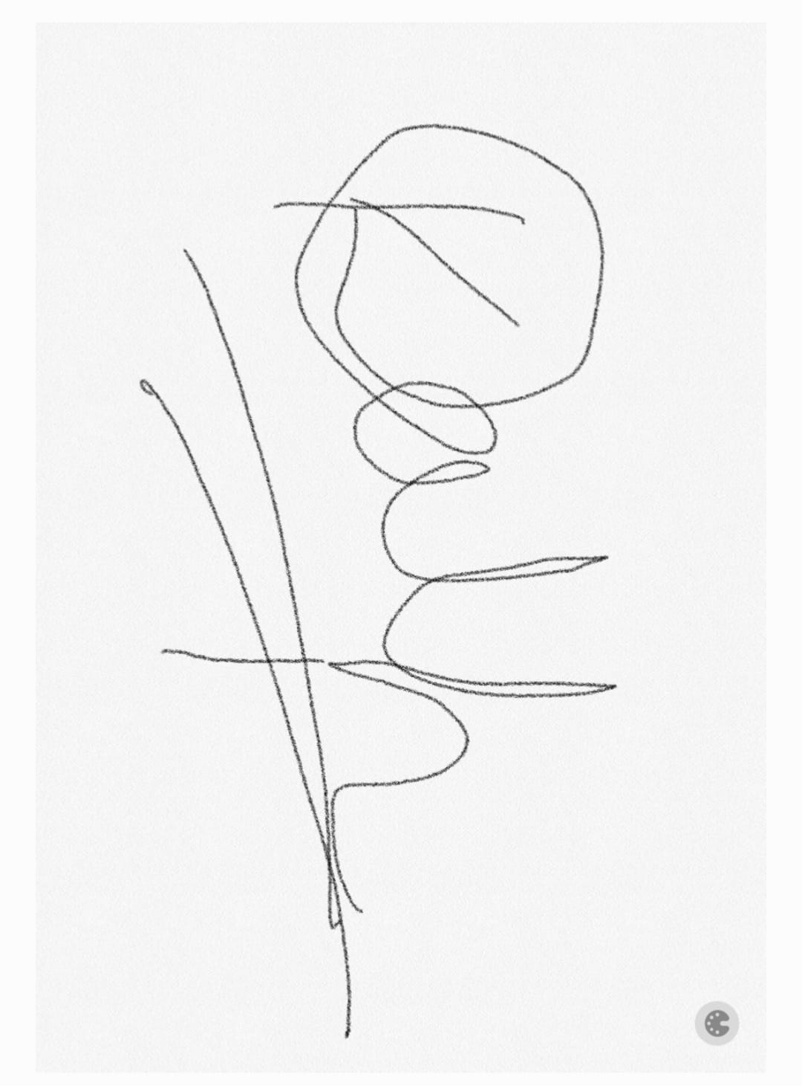
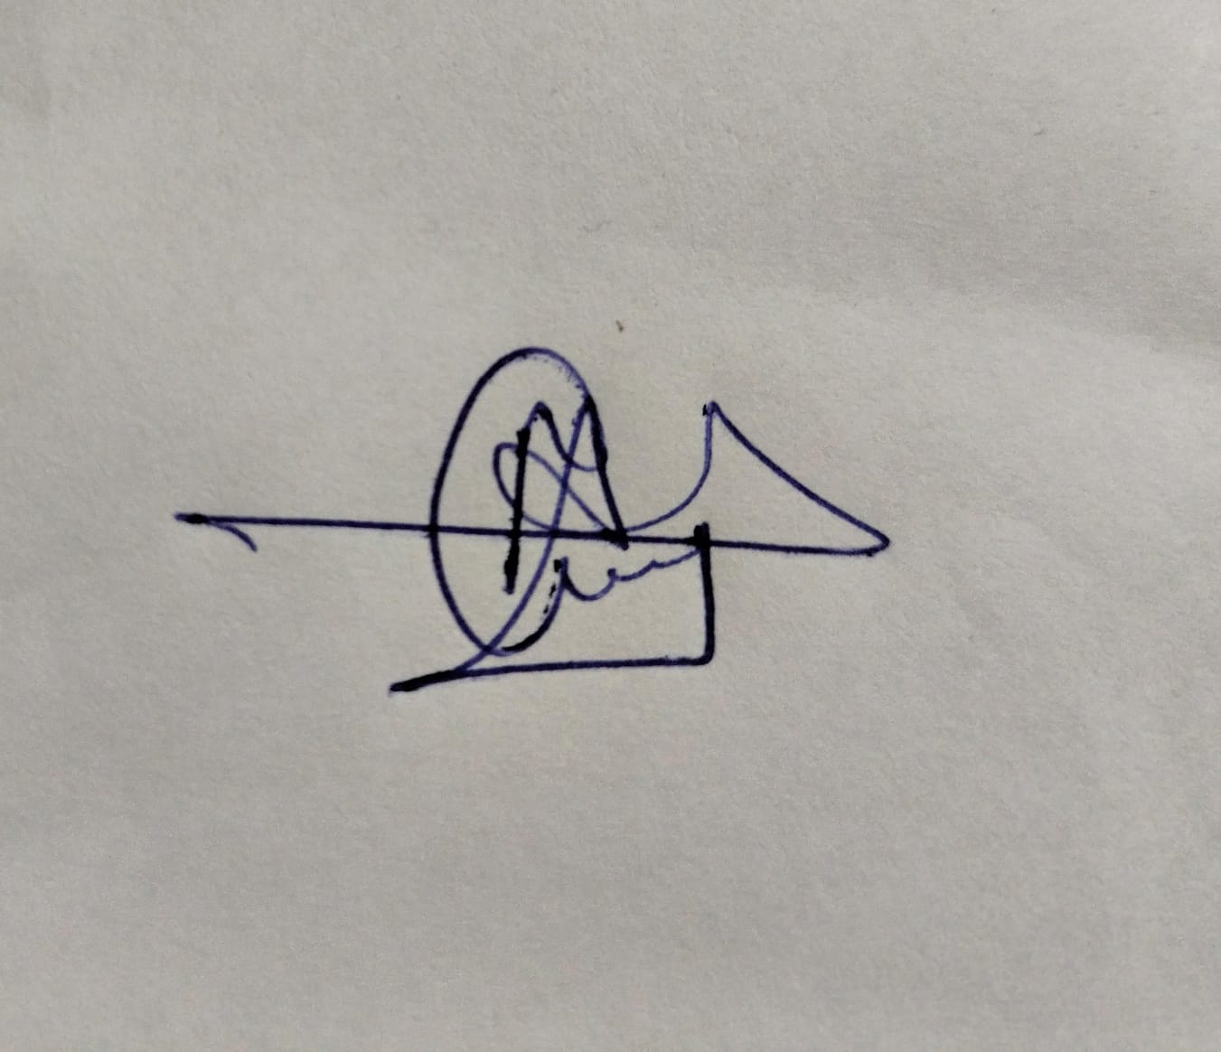
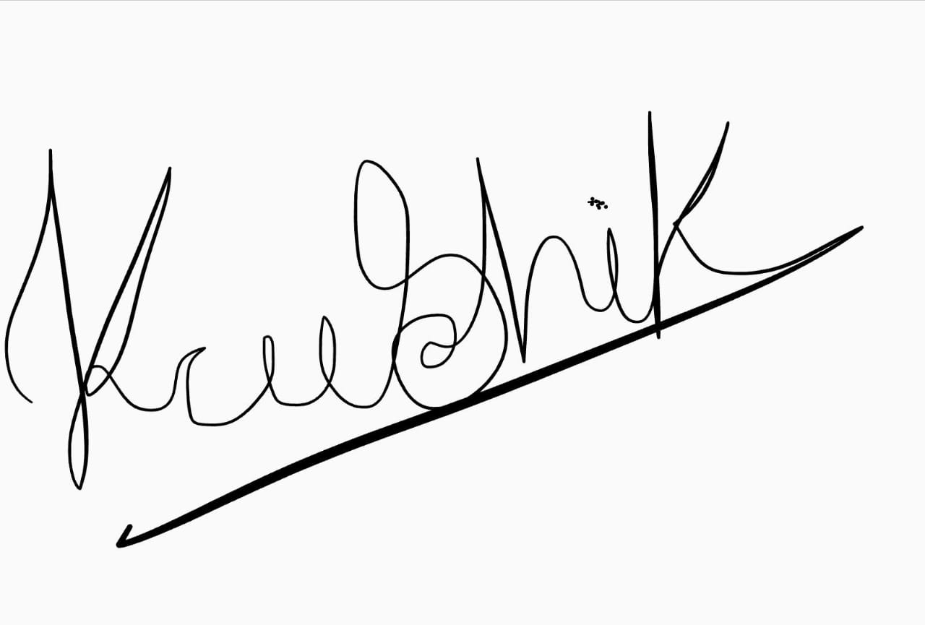
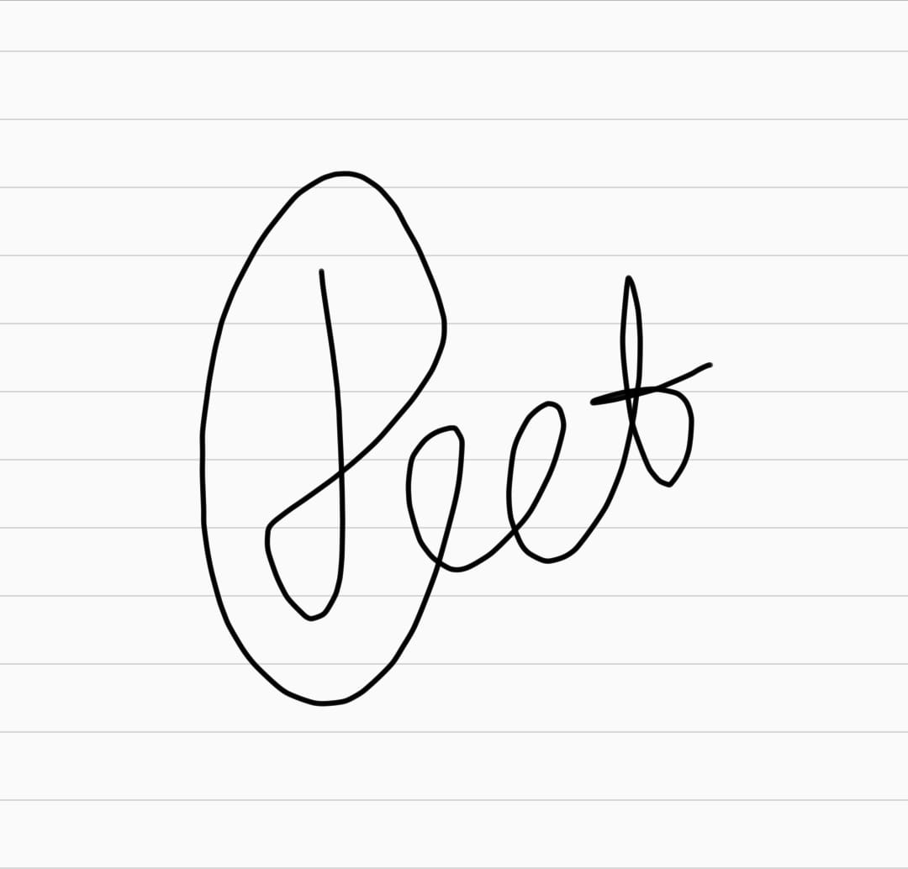
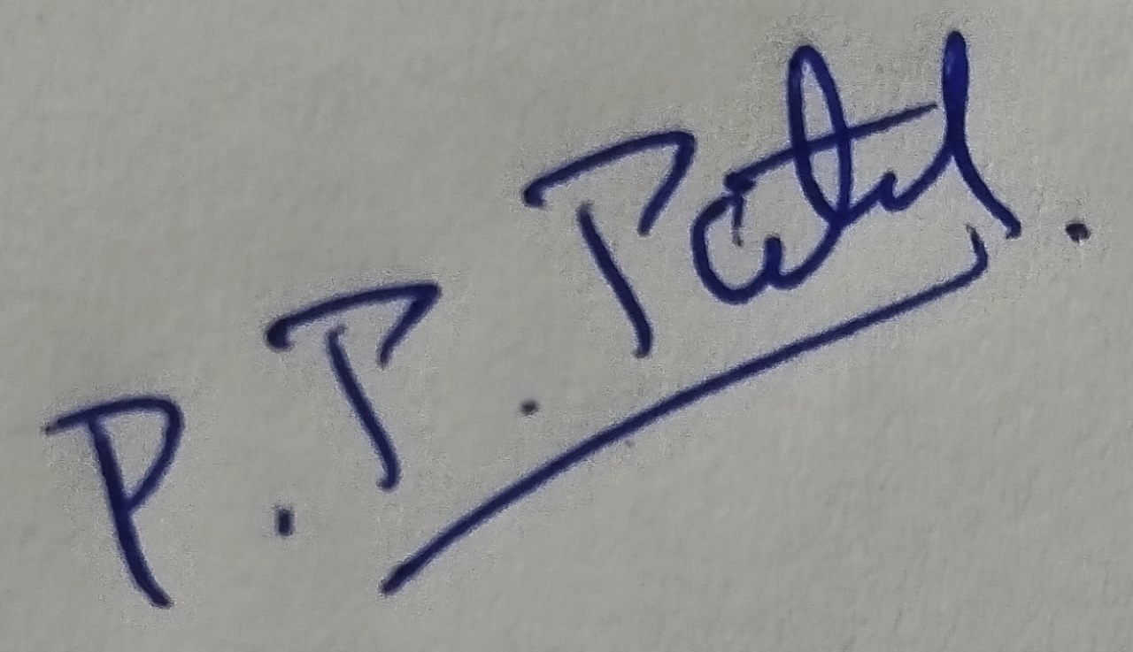
GROUP MEMBERS
KALP HARDIK SHAH: 202201457
ASODARIYA PRIYANK HITESHBHAI:202201470
PRAJAPATI KAUSHIK RAMESHBHAI: 202201472
DESAI JEET MEHULKUMAR: 202201474
PRATHAM PATEL : 202201485

Slide 5
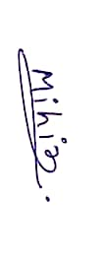
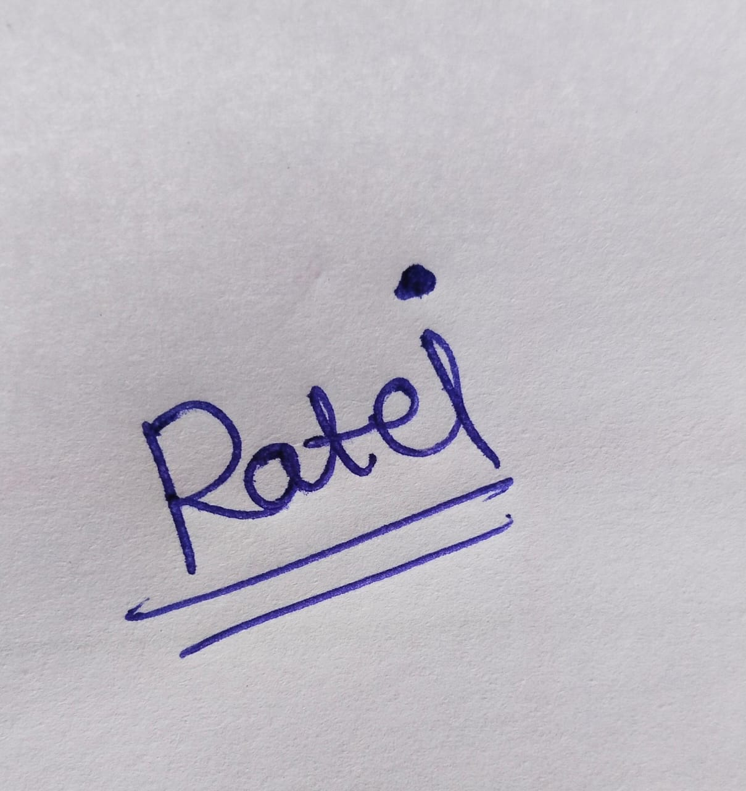

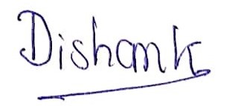
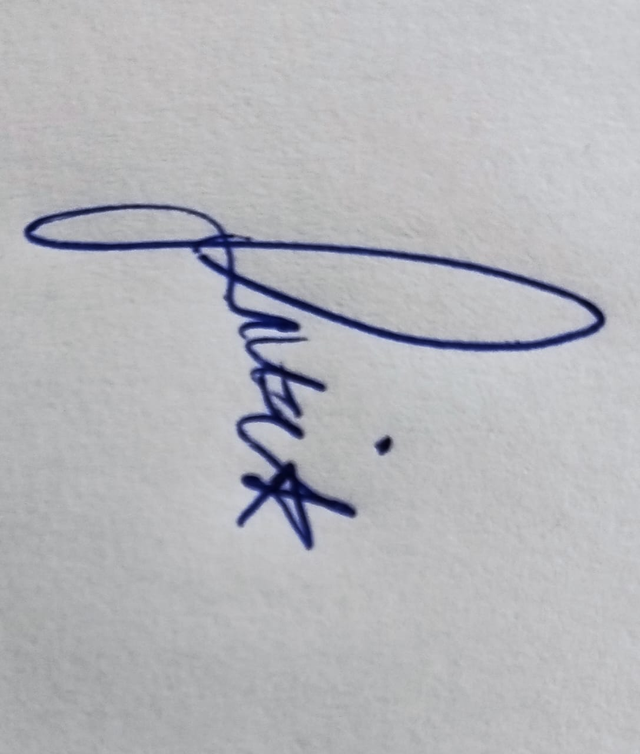
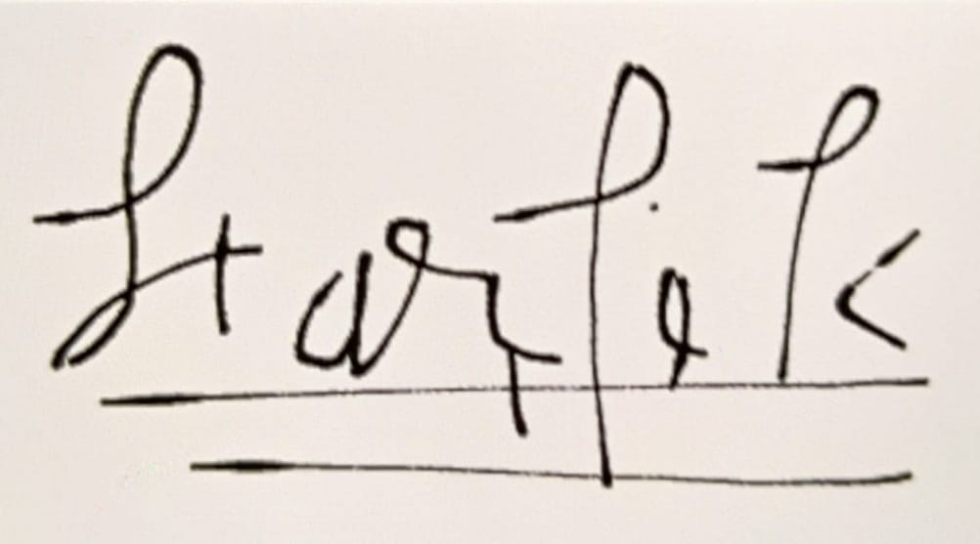
GROUP MEMBERS
PATEL MIHIRKUMAR SURESHBHAI: 202201506
RAMKUMAR PATEL: 202201509
TIRTH MODI : 202201513
THAKKAR DISHANK RAJESH:202201518
RITIK TIWARY : 202201519
HARDIK MAKAWANA : 202101246

Slide 6

Introduction
Polar Codes were Invented by Erdal Arikan in 2008.
Owing to their good performance and low complexity,
polar codes have been adopted as a coding scheme
for the control channel in the fifth-generation (5G)
wireless standards.

Slide 7
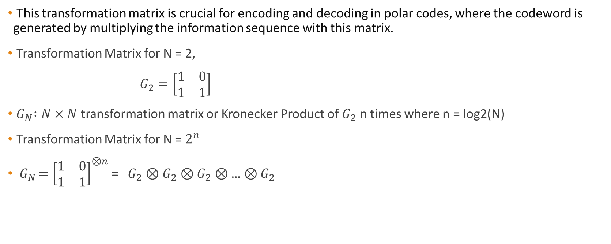
Transformation Matrix
This transformation matrix is crucial for encoding and decoding in polar codes, where the codeword is generated by multiplying the information sequence with this matrix.
Transformation Matrix for N = 2,
$G_{2}=\left[\begin{matrix}1 & 0 \\ 1 & 1\end{matrix}\right]$
${ G}_{N} :N×N$ transformation matrix or Kronecker Product of $G_{2}$ n times where n = log2(N)
Transformation Matrix for N = $2^{n}$
${ G}_{N }={\left[\begin{matrix}1 & 0 \\ 1 & 1\end{matrix}\right]}^{⊗n}$ = $G_{2}$ ⊗ $G_{2}$ ⊗ $G_{2}$ ⊗ … ⊗ $G_{2}$
n times

Slide 8

Kronecker Product
Let’s understand Kronecker product using G₄,
G₄ = G₂ ⊗ G₂
= $\left[\begin{matrix}1 & 0 \\ 1 & 1\end{matrix}\right]$ ⊗ G₂
= $\left[\begin{matrix}G2 & 0 \\ G2 & G2\end{matrix}\right]$
= $\left[\begin{matrix}\begin{matrix}1 & 0 \\ 1 & 1\end{matrix} & \begin{matrix}0 & 0 \\ 0 & 0\end{matrix} \\ \begin{matrix}1 & 0 \\ 1 & 1\end{matrix} & \begin{matrix}1 & 0 \\ 1 & 1\end{matrix}\end{matrix}\right]$

Slide 9



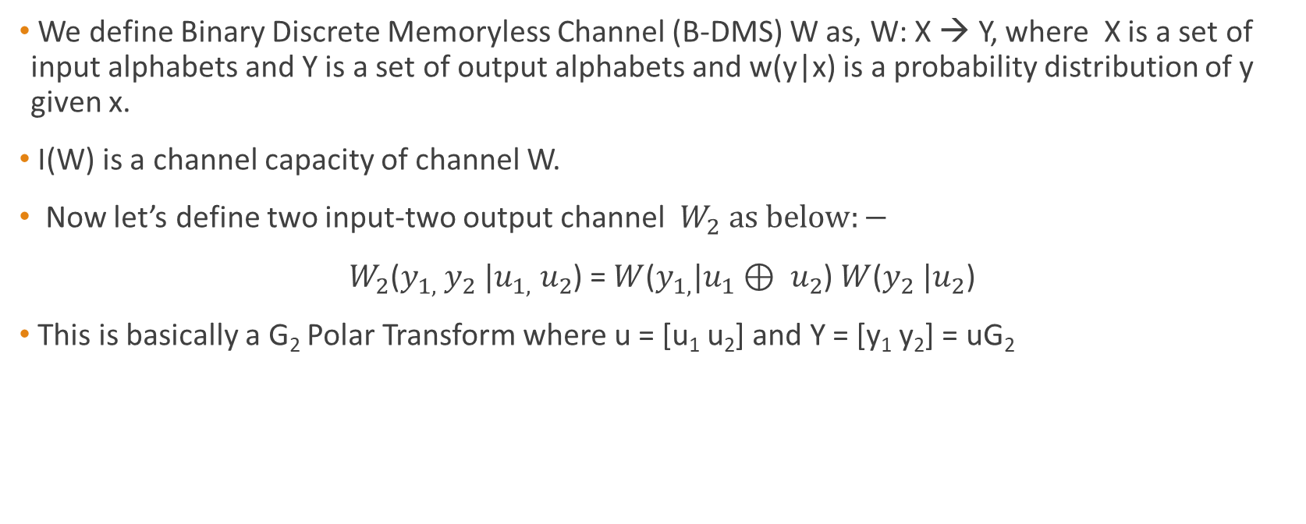




Channel Polarization
We define Binary Discrete Memoryless Channel (B-DMS) W as, W: X → Y, where X is a set of input alphabets and Y is a set of output alphabets and w(y|x) is a probability distribution of y given x.
I(W) is a channel capacity of channel W.
Now let’s define two input-two output channel $W_{2} as below:−$
$W_{2}$($y_{1,}$ $y_{2} |u_{1,} u_{2}$) = $W_{ }$($y_{1,}|u_{1}⊕ u_{2}$) $W_{ }$($y_{2} |u_{2}$)
This is basically a G₂ Polar Transform where u = [u₁ u₂] and Y = [y₁ y₂] = uG₂
$$u_{1}$$
$$x_{1}$$
$$y_{1}$$
W
$$u_{2}$$
$$x_{2}$$
$$y_{2}$$
W
$$W_{2}$$

Slide 10
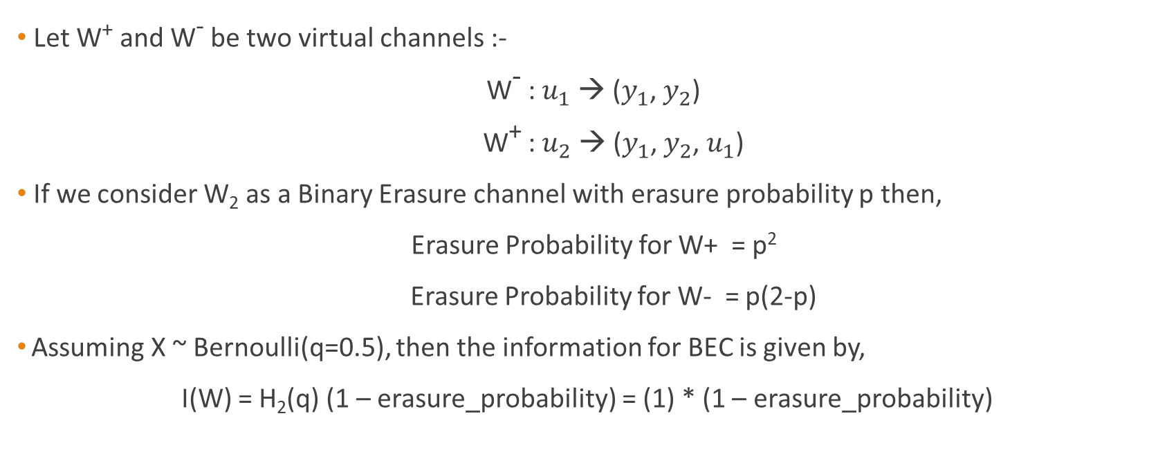
Channel Polarization
Let W⁺ and W⁻ be two virtual channels :-
W⁻ : $u_{1}$ → ($y_{1}$, $y_{2}$)
W⁺ : $u_{2}$ → ($y_{1}$, $y_{2}$, $u_{1}$)
If we consider W₂ as a Binary Erasure channel with erasure probability p then,
Erasure Probability for W+ = p²
Erasure Probability for W- = p(2-p)
Assuming X ~ Bernoulli(q=0.5), then the information for BEC is given by,
I(W) = H₂(q) (1 – erasure_probability) = (1) * (1 – erasure_probability)

Slide 11
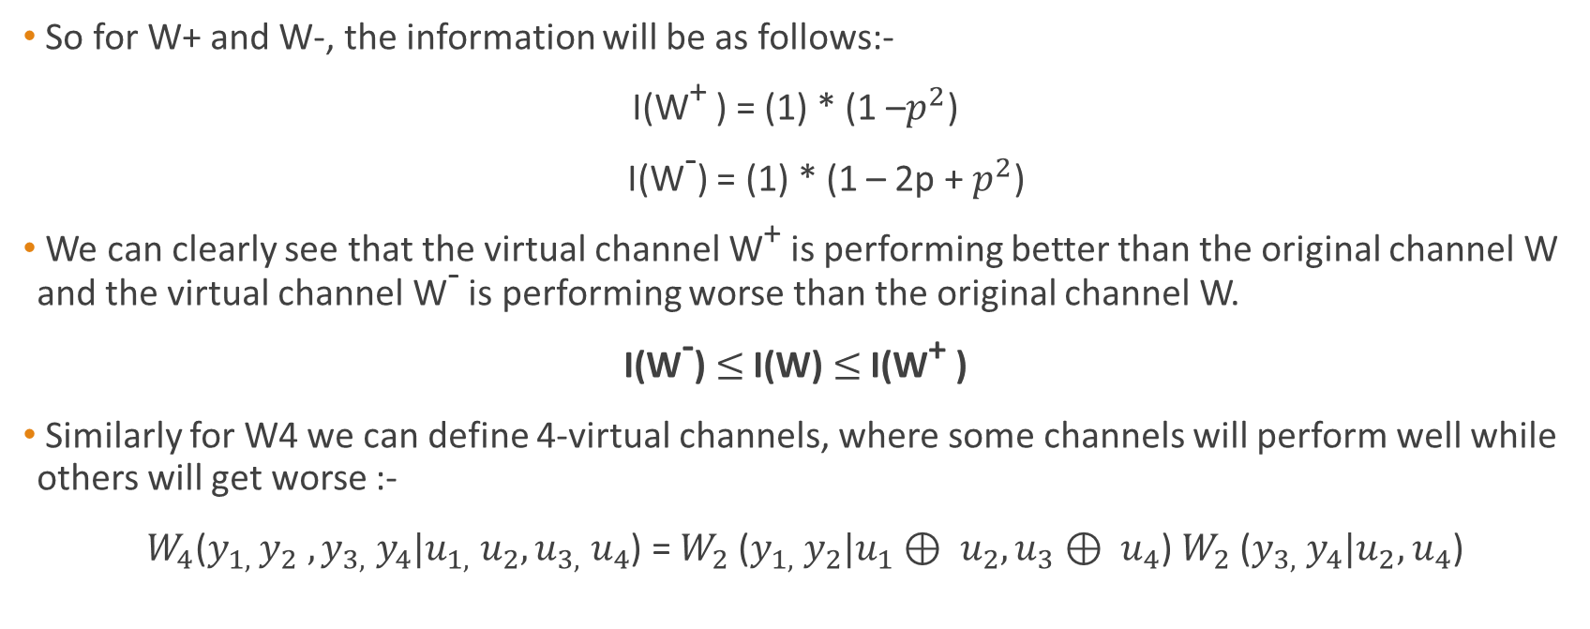
Channel Polarization
So for W+ and W-, the information will be as follows:-
I(W⁺ ) = (1) * (1 –$p^{2}$)
I(W⁻) = (1) * (1 – 2p + $p^{2}$)
We can clearly see that the virtual channel W⁺ is performing better than the original channel W and the virtual channel W⁻ is performing worse than the original channel W.
I(W⁻) $≤$ I(W) $≤$ I(W⁺ )
Similarly for W4 we can define 4-virtual channels, where some channels will perform well while others will get worse :-
$W_{4}$($y_{1,}$ $y_{2} ,y_{3,} y_{4}|u_{1,} u_{2},u_{3,} u_{4}$) = ${W_{2}}_{ }$($y_{1,} y_{2}|u_{1}⊕ u_{2},u_{3}⊕ u_{4}$) ${W_{2}}_{ }$($y_{3,} y_{4}|u_{2},$ $u_{4}$)

Slide 12
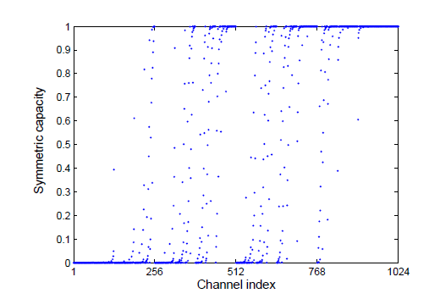
Channel Polarization
For larger N, Recursively doing this Half of the channel becomes highly informative and half of the channel becomes information-less ( Matthew Effect )
Erdal Arikan showed this in his paper on Polar Codes by simulations,
Source :- Research Paper by Erdal Arikan on Polar Codes [1]

Slide 13
Reliability Sequence
Reliability Sequence is defined as a sequence of these virtual channels, ordered in less informative to highly informative channels.
Thus, the reliability sequence in polar codes determines the position of highly reliable “information" bits and less reliable “frozen" bits.
In Polar Codes, generally we set these less reliable bit positions as ‘0’ called frozen bits and message bits at highly reliable positions.
Reliability sequence for N=32 is as follows,
0, 1, 2, 4, 8, 16, 3, 5, 9, 6, 17, 10, 18, 12, 20, 31, 24, 7, 11, 19,
13, 14, 21, 26, 25, 22, 28, 15, 23, 27, 30

Slide 14









Bit-Channels
These virtual will be consider as bit-channels with input $u_{i}$ and output as $r^{(N)}$, $u_{1}$, $u_{2},…,u_{i−1}$
We will see how these bit-channels plays a crucial role for successive cancellation decoding
Bit-Channels:-
$$u_{1}$$
Bit-Channel 1
$$r^{(N)}$$
$$u_{2}$$
Bit-Channel 2
$r^{(N)}$, $u_{1}$
$$u_{i}$$
Bit-Channel i
$r^{(N)}$, $u_{1}$, $u_{2},…,u_{i−1}$
$$u_{n}$$
Bit-Channel N
$r^{(N)}$ , $u_{1}$, $u_{2},…,u_{N−1}$

Slide 15

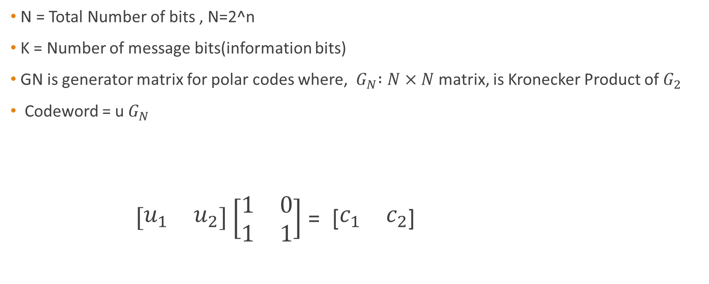


Polar Code Encoding
N = Total Number of bits , N=2^n
K = Number of message bits(information bits)
GN is generator matrix for polar codes where, ${ G}_{N} :N×N$ matrix, is Kronecker Product of $G_{2}$
Codeword = u${ G}_{N}$
$\left[\begin{matrix}u_{1} & u_{2}\end{matrix}\right]\left[\begin{matrix}1 & 0 \\ 1 & 1\end{matrix}\right]$ = [$\begin{matrix}c_{1} & c_{2}\end{matrix}$]
c $=[u_{1}+u_{2}{ u}_{2}]$
$$u_{1}$$
$$u_{2}$$

Slide 16
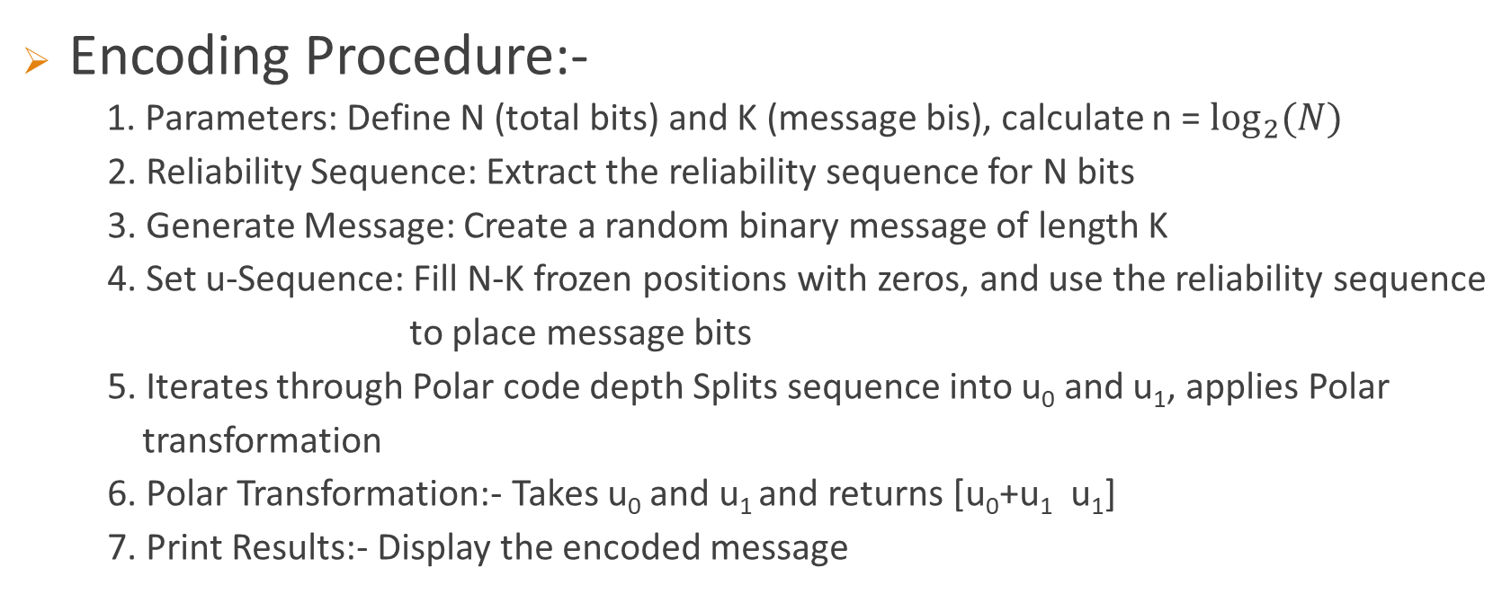
Encoding Procedure and Pseudocode
Encoding Procedure:-
1. Parameters: Define N (total bits) and K (message bis), calculate n = $\log_{2}{(N)}$
2. Reliability Sequence: Extract the reliability sequence for N bits
3. Generate Message: Create a random binary message of length K
4. Set u-Sequence: Fill N-K frozen positions with zeros, and use the reliability sequence
to place message bits
5. Iterates through Polar code depth Splits sequence into u₀ and u₁, applies Polar
transformation
6. Polar Transformation:- Takes u₀ and u₁ and returns [u₀+u₁ u₁]
7. Print Results:- Display the encoded message

Slide 17















Encoding Process – Tree Diagram
$$u_{ }^{(8)}=[u_{1}^{\left(4\right)}+u_{2 }^{\left(4\right)} u_{2}^{(4)}]$$
depth = 0
$$u_{1}^{(4)}=[u_{1}^{\left(2\right)}+u_{2 }^{\left(2\right)} u_{2}^{(2)}]$$
$$u_{2}^{(4)}=[u_{3}^{\left(2\right)}+u_{4 }^{\left(2\right)} u_{4}^{(2)}]$$
depth = 1
$$u_{1}^{(2)}=[u_{1}+u_{2}{ u}_{2}]$$
$$u_{2}^{(2)}=[u_{3}+u_{4}{ u}_{4}]$$
$$u_{3}^{(2)}=[u_{5}+u_{6}{ u}_{6}]$$
$$u_{4}^{(2)}=[u_{7}+u_{8}{ u}_{8}]$$
depth = 2
f
f
f
m
f
m
m
m
depth = 3
$$u_{1}$$
$$u_{2}$$
$$u_{3}$$
$$u_{4}$$
$$u_{5}$$
$$u_{6}$$
$$u_{7}$$
$$u_{8}$$

Slide 18


Encoding Procedure and Pseudocode
Pseudocode :-
Encode(message):
n := size of message bits
if n = 1 then,
return message
U0 = message[1 to n/2]
U1 = message[n/2 + 1 to n ]
encoded_U0 = Encode(U0)
encoded_U1 = Encode(U1)
C = [encoded_U0 encoded_U1] * G2
return C
T($\frac{n}{2}$)
T($\frac{n}{2}$)
O(n)

Slide 19
Encoding Procedure and Pseudocode
Recurrence Relation:- T(n) = 2 T(n/2) + n
T(n)
n
n
T(n/2)
T(n/2)
n/2
n/2
2*(n/2)
Log2(n) terms

Slide 20
Encoding Procedure and Pseudocode
Recurrence Relation:- T(n) = 2 T(n/2) + n
T(n) = n + 2 * (n/2) + 4 * (n/4) + ……. Log2(n) terms
T(n) = n + n + n + ……. Log2(n) terms
T(n) = n * Log2(n)
Thus, the time complexity for polar code encoding is NLog(N), where N is the total number of bits.

Slide 21
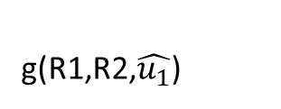

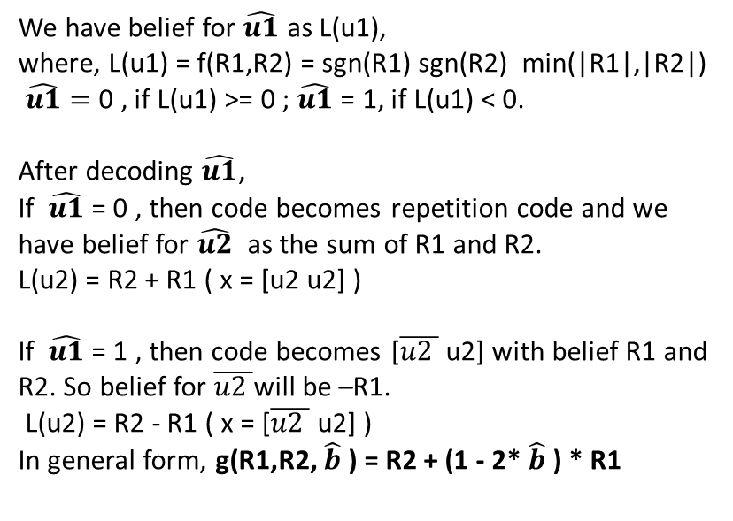




Successive Cancellation Decoding for N=2
[u1 u2]
[x1 x2]
BPSK
+
AWGN
G2
Receiver
[R1 R2]
We have belief for $\hat{u1}$ as L(u1),
where, L(u1) = f(R1,R2) = sgn(R1) sgn(R2) min(|R1|,|R2|)
$\hat{u1}=$ 0 , if L(u1) >= 0 ; $\hat{u1}$ = 1, if L(u1) < 0.
After decoding $\hat{u1}$,
If $\hat{u1}$ = 0 , then code becomes repetition code and we have belief for $\hat{u2}$ as the sum of R1 and R2.
L(u2) = R2 + R1 ( x = [u2 u2] )
If $\hat{u1}$ = 1 , then code becomes [$\overline{u2 }$ u2] with belief R1 and R2. So belief for $\overline{u2 }$will be –R1.
L(u2) = R2 - R1 ( x = [$\overline{u2 }$ u2] )
In general form, g(R1,R2, $\hat{b}$ ) = R2 + (1 - 2* $\hat{b}$ ) * R1
$\hat{x}=[\hat{u_{1}}+\hat{u_{2}} \hat{u_{2}}]$
b = [R1 R2]
x = [x1 x2]
g(R1,R2,$\hat{u_{1}}$)
f(R1,R2)
$$\hat{u_{1}}$$
$$\hat{u_{2}}$$
f
f
$$u_{1}$$
$$u_{2}$$

Slide 22
Pseudocode for Decoding Process [Hard Decision]
Decoding Procedure:-
1. Set the likelihood vector L as the received sequence
2. Initialize node as 0 and depth as the log base 2 of N
3. Call the decoding procedure with (L, node, and depth)
4. Decode the received message recursively by traversing the binary tree
structure.
5. We calculate the belief for the left sub-tree using the min-sum algorithm and call the decoding
procedure for the left sub-tree.
6. After receiving a decision from the left sub-tree, we calculate the belief for the right sub-tree using the g function.
7. When we have a decision from the left sub-tree and the right sub-tree, we perform the G2 transform and give
the decision back to the parent node.
8. Continue this process recursively and at the end we get the decoded message.

Slide 23

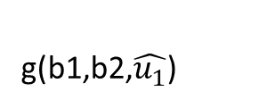


Decoding Process [Hard Decision] – Tree Diagram
Root Node
f(a,b) = sgn(a)*sgn(b)*min(|a|,|b|)
depth = 0
g(a,b,c) = b + (1 - 2*c) * a
depth = 1
$\hat{x}=[\hat{u_{1}}+\hat{u_{2}} \hat{u_{2}}]$
b = [b1 b2]
x = [x1 x2]
depth = 2
g(b1,b2,$\hat{u_{1}}$)
f(b1,b2)
$$\hat{u_{1}}$$
$$\hat{u_{2}}$$
f
f
f
m
f
m
m
m
depth = 3
$$u_{1}$$
$$u_{2}$$
$$u_{3}$$
$$u_{4}$$
$$u_{5}$$
$$u_{6}$$
$$u_{7}$$
$$u_{8}$$

Slide 24


Decoding Procedure and Pseudocode
Pseudocode :-
Decode(belief, node, depth):
if we are at the leaf node then
make a decision based on the belief
return decision
r1 = belief[1 to n/2]
r2 = belief[n/2 + 1 to n ]
belief_for_left_sub_tree = f(r1, r2)
left_sub_tree_decision = Decode(belief_for_left_sub_tree, 2*node, depth-1)
belief_for_right_sub_tree = g(r1, r2, left_sub_tree_decision)
right_sub_tree_decision = Decode(belief_for_right_sub_tree, 2*node+1, depth-1)
decision = [left_sub_tree_decision right_sub_tree_decision ] * G2
return decision
O(n)
T($\frac{n}{2}$)
O(n)
T($\frac{n}{2}$)
O(n)

Slide 25
Decoding Procedure and Pseudocode
Recurrence Relation:- T(n) = 2 T(n/2) + 3n
T(n) = 3n + 2 * (3n/2) + 4 * (3n/4) + ……. Log2(n) terms
T(n) = 3n + 3n + 3n + ……. Log2(n) terms
T(n) = 3n * Log2(n)
Thus, the time complexity for polar code decoding is Nlog(N), where N is the total number of bits.

Slide 26
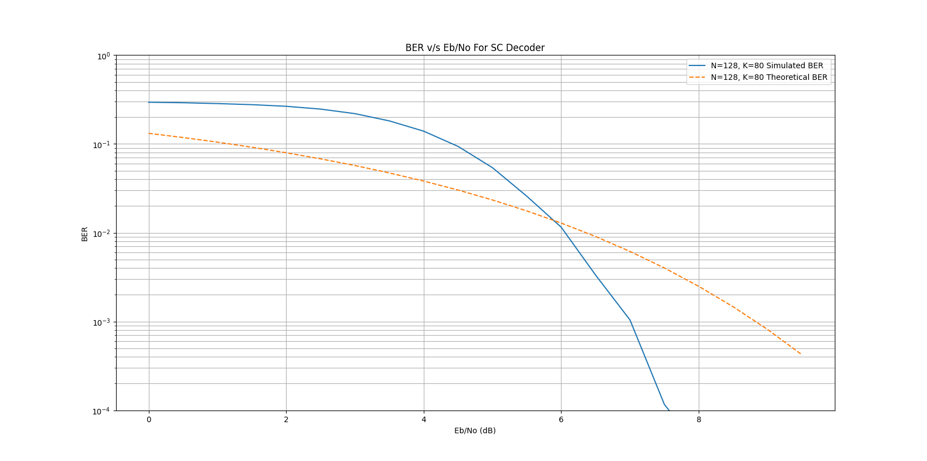
BER Plot SC Decoding

Slide 27
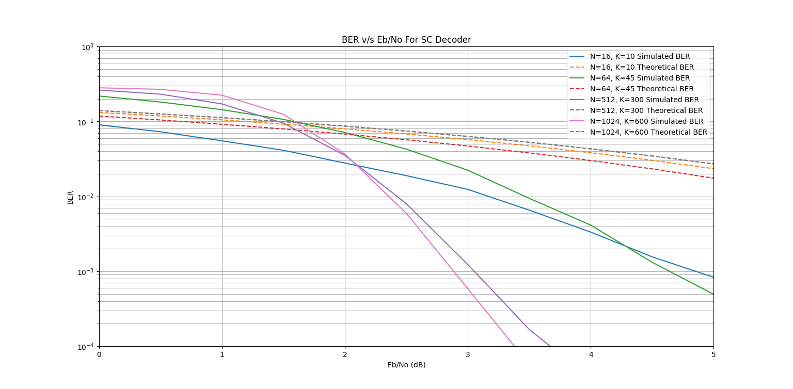
BER Plot SC Decoding

Slide 28
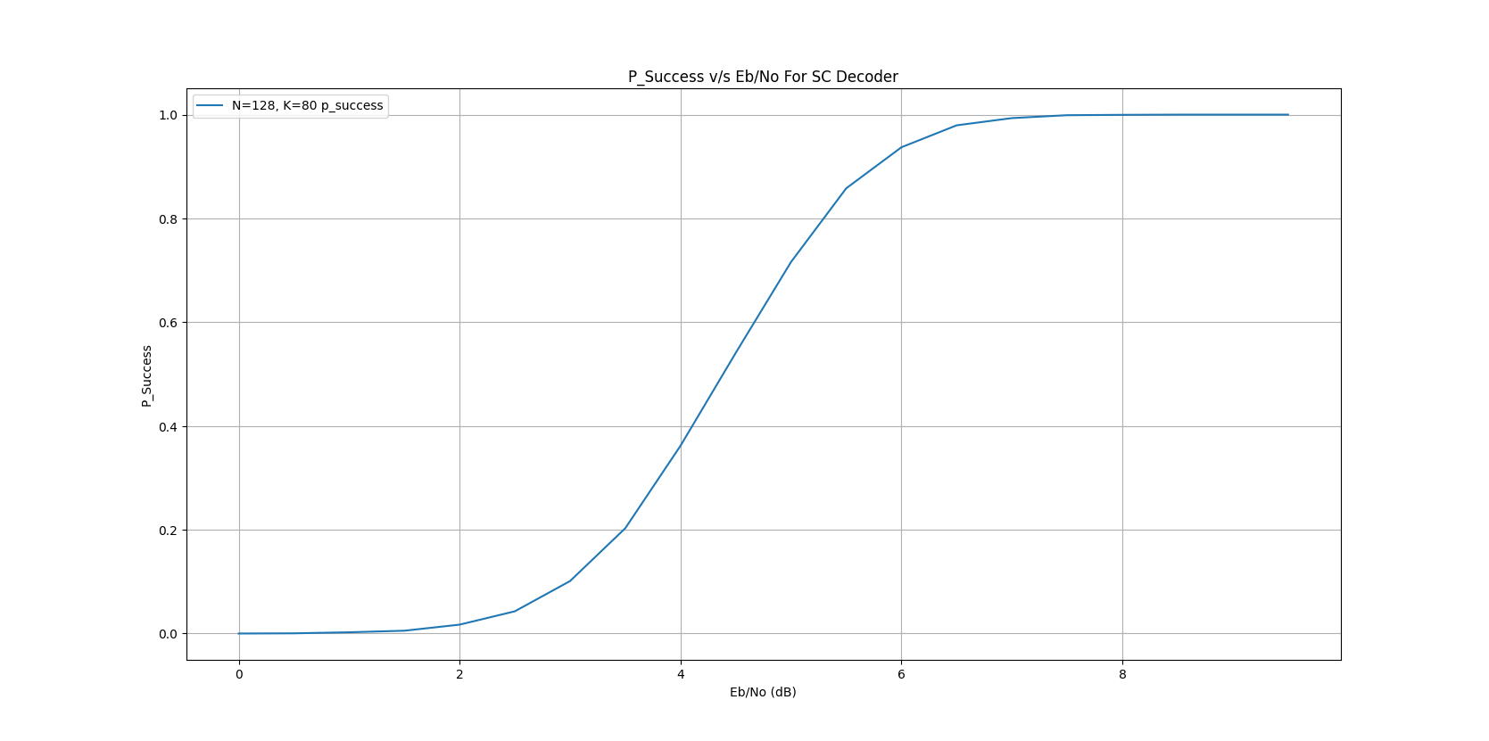
Plot of Success Probability for SC

Slide 29
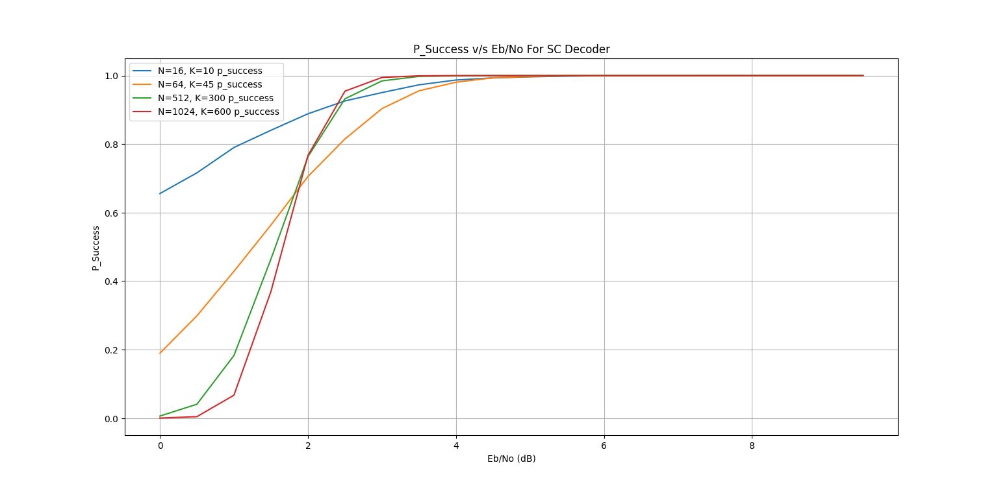
Plot of Success Probability for SC

Slide 30
Soft-Decision or SCL Decoding Process
Successive cancellation List decoding is the same as SC decoding. The extra thing is that instead of making a single decision we make multiple decisions and maintain a list of candidate codewords.
We do not make a single decision. We make both the possible decision and give a penalty for that decision. This penalty is called Decision Metric(DM). For a given decoding path, we define Path Metric(PM) as the sum of the decision metrics up to the current node.
If the belief is in favor of the decision then we give zero penalty for that decision and if the belief is not in favor of the decision then we give a penalty equal to |L|.
If the current bit is the frozen bit then still we give a penalty to it If the belief is not in favor.
For SCL decoding we keep the list size fixed say M. If at any given node position the list size increases than the fixed size, we keep only M decisions with the lowest path metric.
In simple words we can say that instead of running a single decoder procedure, we run M decoder simultaneously and choose those with the lowest path metric.
Thus, we can say that the time complexity for Successive Cancellation List decoding is M*NLogN

Slide 31









Decision Diagram
1
1
0
$$Pruned$$
1
0
1
$$Pruned$$
PM+0
0
0
PM
0
1
$$Pruned$$
1
PM+|L|
0
0
0
1
$$Pruned$$
0
0
$$u_{1}(Frozen)$$
$$u_{2}(Info.)$$
$$u_{3}(Frozen)$$
$$u_{4}(Info.)$$
$$u_{5}(Info.)$$

Slide 32
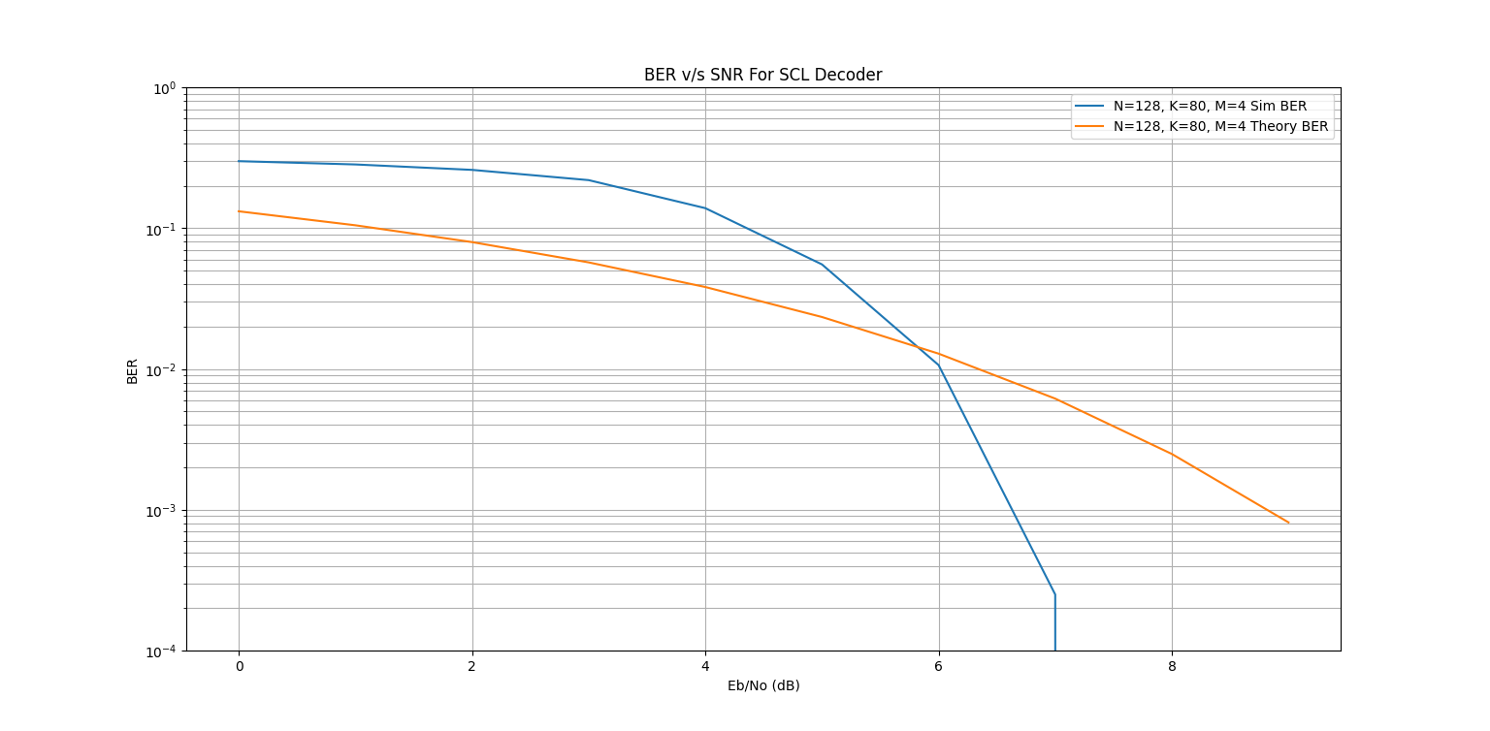
BER Plot for Soft Decision Decoding

Slide 33
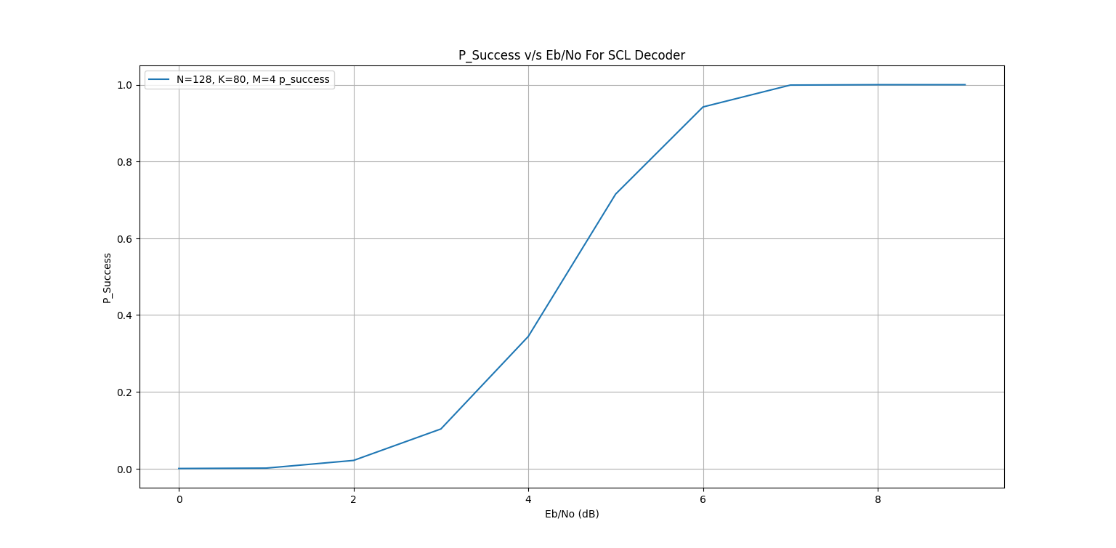
Plot of Success Probability for SCL

Slide 34
Cyclic Redundancy Check
CRC is a type of parity check bits that helps in checking error in the bits that occurred during the transfer of the message.
CRC offers a widely adopted method for checking the error in the code from digital communication to storage.
CRC uses a generator polynomial that maps to a key which is present at both receiver and the send side.
The remainder is calculated on the receiver side to check if there is error in the code .
If remainders turn out to be non zero than there is error in the code.

Slide 35
Cyclic Redundancy Check Algorithm
SENDER SIDE
RECEIVER SIDE
Code word we are sending– 100100(N) + 000(K-1)
Key – 1101(K) [ With generator polynomial x⁴ + x³ + 1]
When We divide our codeword by key we get remainder=001(K-1)
We will append the remainder at the end, so our codeword becomes : 100100(N) + 001(K-1)
This message is send through channel
Let there be an error in transmission media, Code word received at the receiver side – 100000001
When this message is divide by the Key(1101) , this will not yield remainder =0
Hence this will lead to error detection

Slide 36
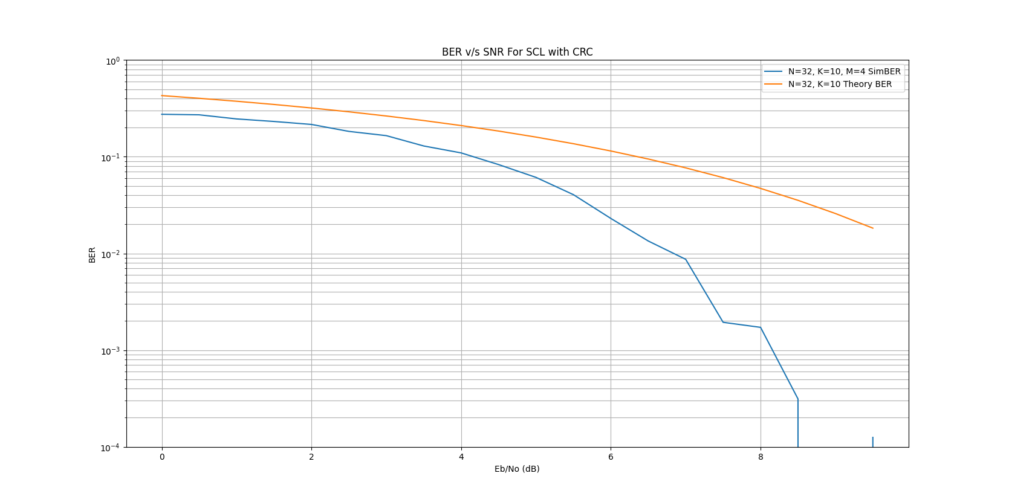
BER Plot for Soft Decision Decoding with CRC

Slide 37
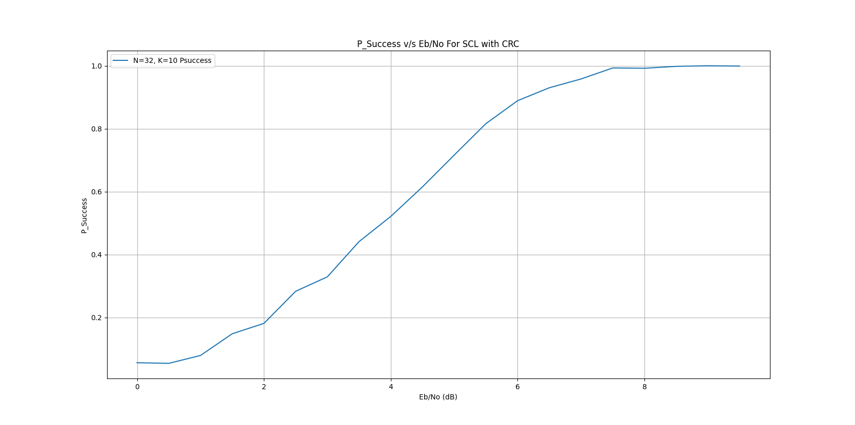
Plot of Success Probability for SCL with CRC

