Slide 1



Information and Network Security
Ms. Hansa Vaghela , Assistant Professor
Computer Science & Engineering

Slide 2

CHAPTER-1
Introduction

Slide 3
Outline
Computer Security Concept
OSI Security Architecture
Security Attacks
Security Services
Security Mechanism
A Model for Network Security

Slide 4
Computer Security Concepts
Computer Security:-
Computer Security, Cyber Security or IT Security Software is the protection of computer systems from theft of or damage to their hardware, software or electronic data, as well as from disruption or misdirection of the services they provide collection of program.
Computer Security means securing a standalone machine by keeping it updated and patched
Network Security is by securing both the software and hardware technologies
Cybersecurity is defined as protecting computer systems, which communicate over the computer networks

Slide 5
Information Security
Information Security:-
The internet is not a single network, but a worldwide collection of loosely connected networks
Accessible by individual computer hosts, in a variety of ways, to anyone with a computer and a network connection.
Along with the convenience and easy access to information come risks.

Slide 6
Information Security
Risks :- valuable information will be lost, stolen, changed, or misused.
If information is recorded electronically and is available on networked computers, it is more vulnerable than if the same information is printed on paper.

Slide 7
OSI Security Architecture
The OSI (Open Systems Interconnection) security architecture focuses on Security Attacks, Mechanisms, and Services.
Security Attack: Any action that compromises the security of information owned by an organization.
Security Mechanism: A process that is designed to detect, prevent, or recover from a security attack.
Security Service: A communication service that enhances the security of the data processing systems and the information transfers of an organization.

Slide 8
Security Attacks
There are mainly two types:
A passive attack attempts to learn or make use of information from the system but does not affect system resources.
Release of message contents
Traffic analysis
An active attack attempts to alter system resources or affect their operation.
Masquerade
Replay
Modification of messages
Denial of service.

Slide 9
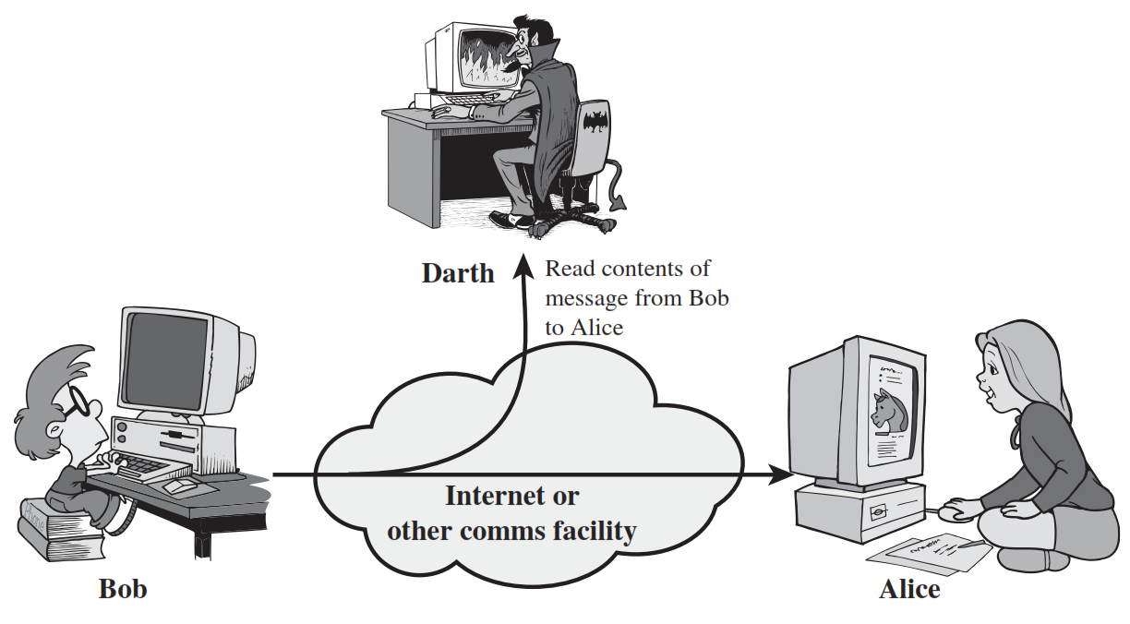
1) Release of message contents (Passive Attack)
Release of message contents^{[2}}

Slide 10
1) Release of message contents (Passive Attack)
A telephone conversation, an electronic mail message, and a transferred file may contain sensitive or confidential information.
We would like to prevent an opponent from learning the contents of these transmissions.

Slide 11
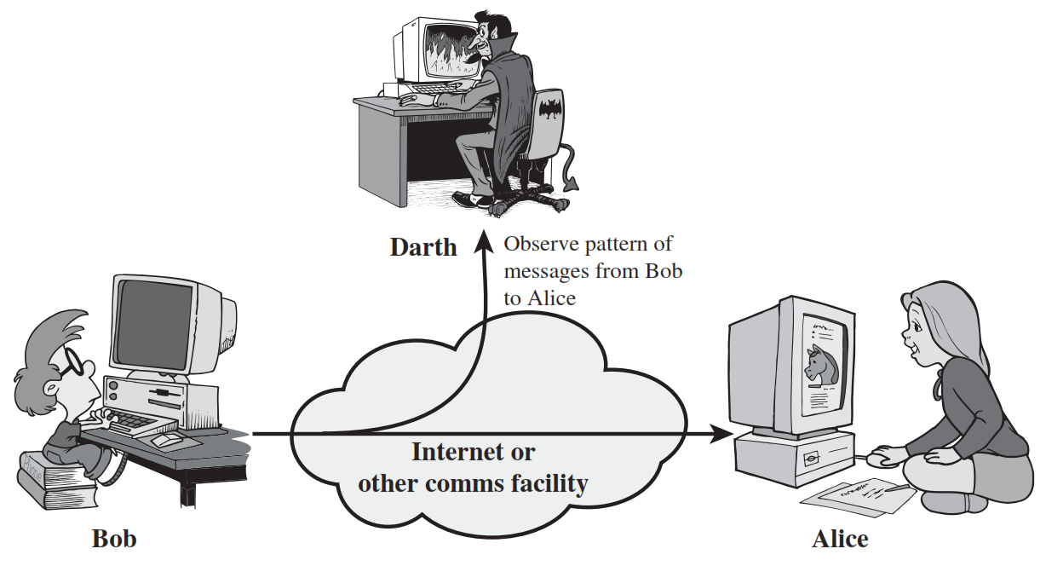
2) Traffic Analysis (Passive Attack)
2) Traffic Analysis (Passive Attack)
Traffic Analysis^{[3}}

Slide 12
2) Traffic Analysis (Passive Attack)
In such attacks, an adversary, capable of observing network traffic statistics in several different networks, correlates the traffic patterns in these networks.

Slide 13
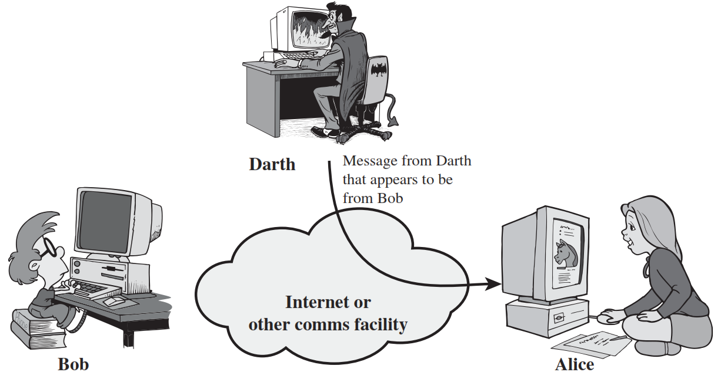
1) Masquerade Attack (Active Attack)
Masquerade Attack^{[1}}

Slide 14
1) Masquerade Attack (Active Attack)
A masquerade takes place when one entity pretends to be a different entity.

Slide 15

2) Replay Attack (Active Attack)
Replay Attack^{[4}}

Slide 16
2) Replay Attack (Active Attack)
Replay attack involves the passive capture of a data unit and its subsequent retransmission to produce an unauthorized effect.

Slide 17
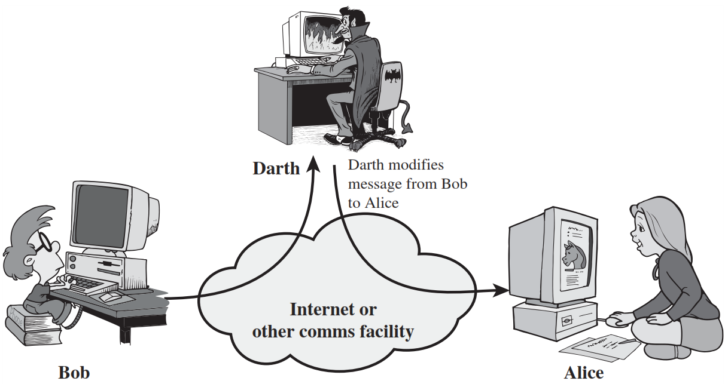
3) Modification of messages Attack (Active Attack)
Modification of messages Attack^{[5}}

Slide 18
3) Modification of messages Attack (Active Attack)
Modification of messages simply means that some portion of a legitimate message is altered, or that messages are delayed or reordered, to produce an unauthorized effect.

Slide 19
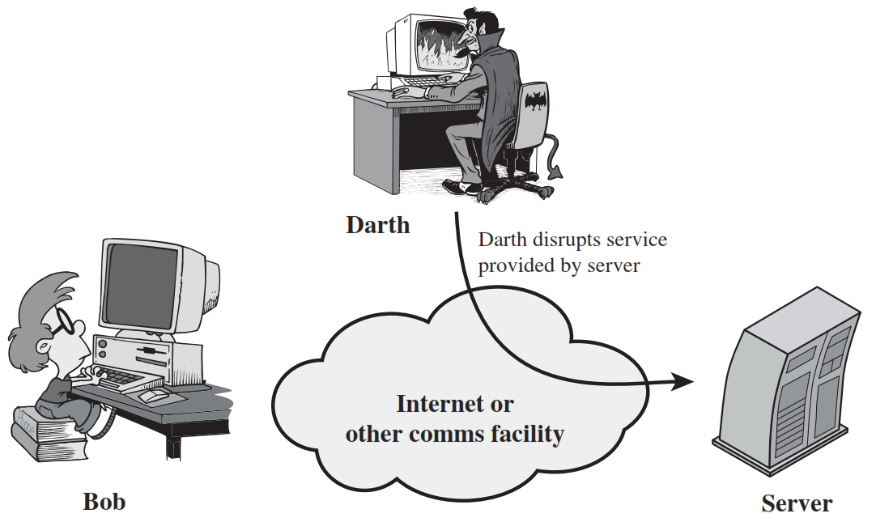
4) Denial of Service Attack (Active Attack)
Denial of service attack^{[3}}

Slide 20
4) Denial of Service Attack (Active Attack)
The denial of service attack prevents the normal use or management of communications facilities.

Slide 21
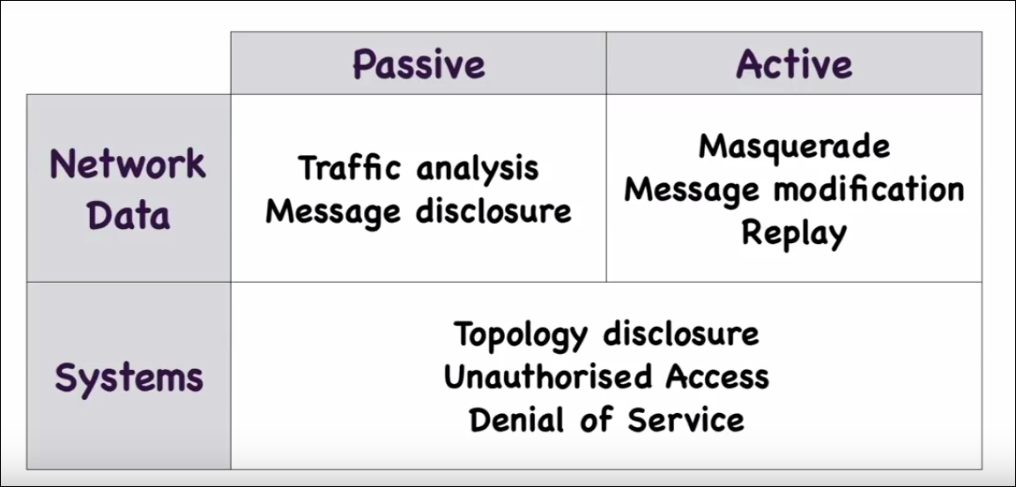
Security Attacks
Security Attacks^{[4}}

Slide 22
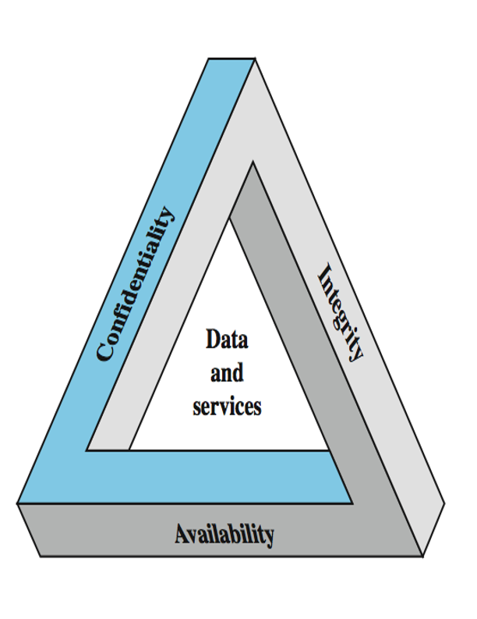
Security Services (X.800)
X.800 standard defines a security service as a service that is provided by a protocol layer of communicating open systems and that ensures security of the systems or of data transfers.
Security Services^{[3}}

Slide 23
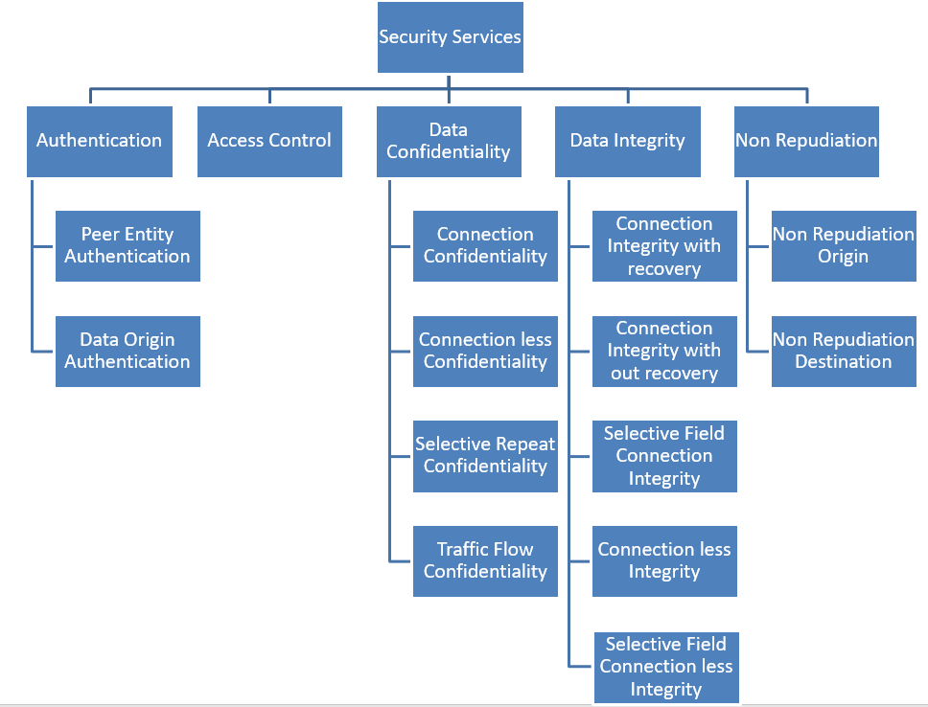
Security Services (X.800)
Security Services^{[3}}

Slide 24


Authentication
Authentication is the assurance that the communicating entity is the one that it claims to be.
Who you are ? (biometrics)
Peer Entity Authentication: Used in association with a logical connection to provide confidence in the identity of the entities connected.
Data-Origin Authentication: In a connectionless transfer, provides assurance that the source of received data is as claimed.
Physical authentication
where you are ?
Authentication^{[3}}
What you know ?
Password
One-time Passwords
Network address
Authentication^{[3}}

Slide 25
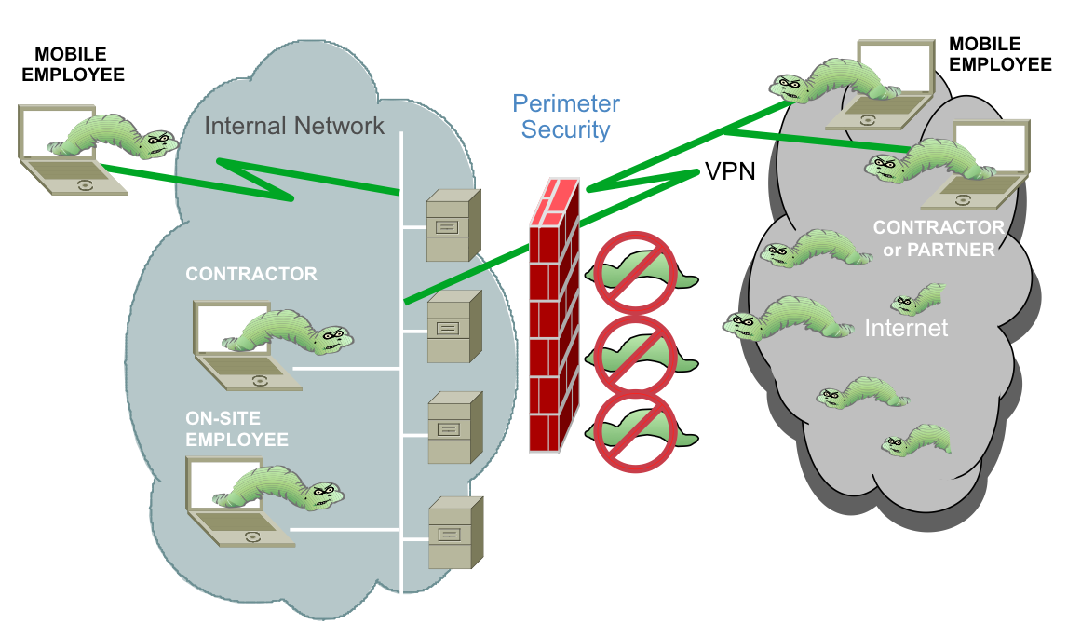
Access Control
Access control is the prevention of unauthorized use of a resource.
Access Control^{[2}}

Slide 26
Access Control
This service controls who can have access to a resource, under what conditions access can occur, and what those accessing the resource are allowed to do.

Slide 27
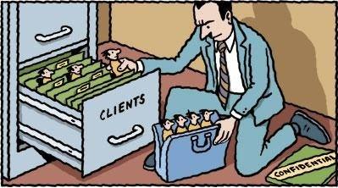
Data Confidentiality
Data confidentiality is the protection of data from unauthorized disclosure.
Data Confidentiality^{[4}}

Slide 28
Data Confidentiality
Connection Confidentiality: The protection of all user data on a connection.
Connectionless Confidentiality: The protection of all user data in a single data block.
Selective-Field Confidentiality: The confidentiality of selected fields within the user data on a connection or in a single data block.
Traffic-Flow Confidentiality: The protection of the information that might be derived from observation of traffic flows.

Slide 29
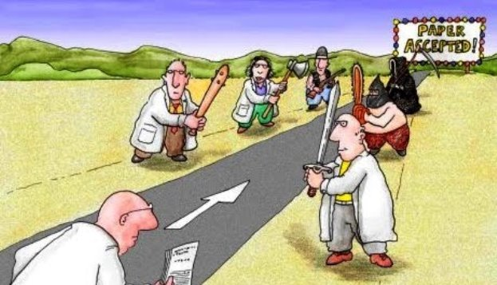
Data Integrity
Data integrity is the assurance that data received are exactly as sent by an authorized entity (i.e., contain no modification, insertion, deletion, or replay).
Data Integrity^{[3}}

Slide 30
Data Integrity
Connection Integrity with Recovery: Provides integrity of all user data on a connection and detects any modification, insertion, deletion, or replay of any data with recovery attempted.
Connection Integrity without Recovery: As above, but provides only detection without recovery.
Selective-Field Connection Integrity: Provides integrity of selected fields within the user data and takes the form of determination of whether the selected fields have been modified, inserted, deleted, or replayed.

Slide 31
Data Integrity
Connectionless Integrity: Provides integrity of a single connectionless data block and may take the form of detection of data modification. Additionally, a limited form of replay detection may be provided.
Selective-Field Connectionless Integrity: Provides integrity of selected fields within a single connectionless data block; takes the form of determination of whether the selected fields have been modified.

Slide 32
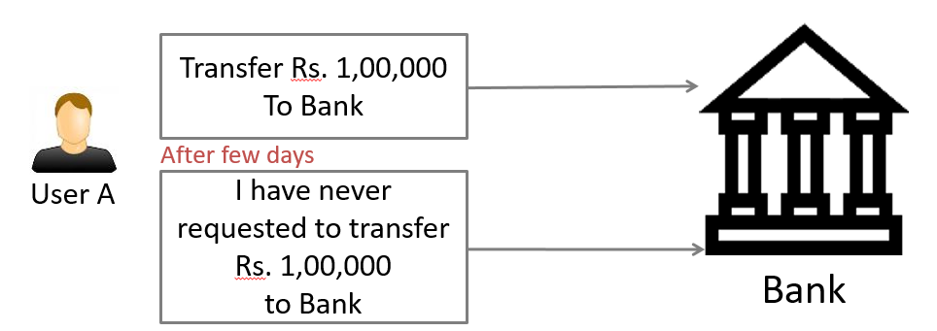
Non Repudiation
Nonrepudiation is the assurance that someone cannot deny something.
Non Repudiation^{[1}}

Slide 33
Non Repudiation
Typically, nonrepudiation refers to the ability to ensure that a communication cannot deny the authenticity of their signature on a document or the sending of a message that they originated.
Nonrepudiation-Origin: Proof that the message was sent by the specified party.
Nonrepudiation-Destination: Proof that the message was received by the specified party.

Slide 34
Security Mechanisms (X.800)
Specific security mechanisms: Integrated into the appropriate protocol layer in order to provide some of the OSI security services.
Pervasive security mechanisms: Not integrated to any particular OSI security service or protocol layer

Slide 35
Security Mechanism (Specific Security)
Encipherment: Hiding or covering data using mathematical algorithms.
Digital Signature: The sender can electronically sign the data and the receiver can electronically verify the signature.
Access Control: A variety of mechanisms that enforce access rights to resources.
Data Integrity: A variety of mechanisms used to assure the integrity of a data unit or stream of data units.
Authentication Exchange: Two entities exchange some messages to prove their identity to each other.

Slide 36
Security Mechanism (Specific Security)
Traffic Padding: The insertion of bits into gaps in a data stream to frustrate traffic analysis attempts.
Routing Control: Selecting and continuously changing routes between sender and receiver to prevent opponent from eavesdropping.
Notarization: The use of a trusted third party to assure and control the communication.

Slide 37
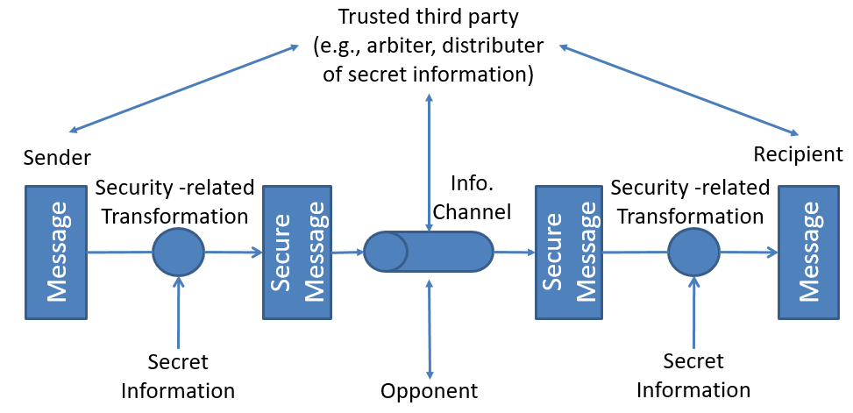
Model for Network Security
Network Security Model^{[3]}

Slide 38
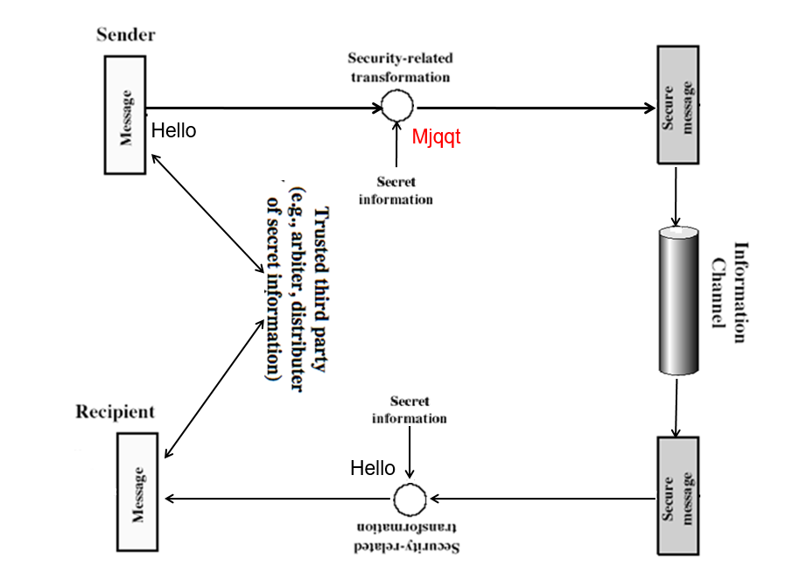
Model for Network Security
Network Security Model^{[3]}

Slide 39
Model for Network Security
The general model shows that there four basic tasks in designing a particular security service:
Design an algorithm for performing the security-related transformations. The algorithm should be such that an opponent cannot defeat its purpose.
Generate the secret information to be used with the algorithm.
Develop methods for the distribution and sharing of the secret information
Specify a protocol to be used by two principals that makes use of the security algorithm and the secret information to achieve a particular security service.

Slide 40
References
[1] Information Security Articles, References, & Blogs, UC SANTA BARBARA
https://www.it.ucsb.edu/general-security-resources/information-security-articles-references-blogs
[2] What is Information Security? cisco
https://www.cisco.com/c/en_in/products/security/what-is-information-security-infosec.html
[3] CRYPTOGRAPHY AND NETWORK SECURITY. Harlow: Tata McGraw-Hill.
[4] Nutt, G. J. (2004). Operating systems: A modern perspective. Boston: Pearson/Addison Wesley.
[5] Cyber Security Strategies. Tutorials point.
https://www.tutorialspoint.com/information_security_cyber_law/cyber_security_strategies.htm

Slide 41

www.paruluniversity.ac.in

