Slide 1



SOFTWARE TESTING & QUALITY ASSURANCE (SUBJECT CODE: 203105395)
Prof. Nileshkumar Kakade, Assistant Professor
Computer Science & Engineering Engineering

Slide 2

TEXT BOOKS
Roger Pressman, Software engineering- A practitioner’s Approach, McGraw-Hill International Editions
Reference Books:
Yogesh Singh, Software Testing, Cambridge University Press.
William E. Perry, Effective Methods for Software Testing, Second Edition, John Wiley & Sons
Notes:
Notes:
Follow as a text book : Software Engineering: A Practitioner's Approach, by R.S.Pressman published by TMH.
For better understanding of concepts : Software Engineering, 8th Edition by Sommerville, Pearson.

Slide 3

CHAPTER-2
Testing Techniques

Slide 4
Software Testing Fundamentals
The program is executed with desired input(s) and the output(s) is/are observed accordingly.
The observed output(s) is/are compared with expected output(s). If both are same, then the program is said to be correct as per specifications
“Testing is the process of executing a program with the intent of finding faults”
Who should test the software?
Role of developer, tester, customer etc in testing process
Verification and Validation
Test, Test Case and Test Suite
Acceptance Testing: customer is involved during acceptance testing
Alpha Testing: conducted at the developer’s site by the customer.
Beta Testing: conducted by potential customers at their sites
Image source : Google

Slide 5
Software Testing Fundamentals
Analyzing the requirement from the client
Participating in preparing the test plan
Preparing test scenario, test cases.
Defect tracking
Preparing suggestions to improve the quality
Communication with test lead/Test manager
Conducting review meeting with the team
Image source : Google

Slide 6
Software Tester Roles
A Software tester (software test engineer) should be capable of designing test suites and should have the ability to understand usability issues.
Such a tester is expected to have sound knowledge of software test design and test execution methodologies.
It is very important for a software tester to have great communication skills so that he can interact with the development team efficiently.
A Software Tester is responsible for designing testing scenarios for usability testing.
He is responsible for conducting the testing, thereafter analyze the results and then submit his observations to the development team.
Image source : Google

Slide 7
Software Tester Roles
He may have to interact with the clients to better understand the product requirements or in case the design requires any kind of modifications.
Software Testers are often responsible for creating test-product documentation and also has to participate in testing related walk through.
Creation of test designs, test processes, test cases and test data.
Carry out testing as per the defined procedures.
Participate in walkthroughs of testing procedures.
Prepare all reports related to software testing carried out.
Ensure that all tested related work is carried out as per the defined standards and procedures
Image source : Google

Slide 8
White Box Testing and Black Box
White-box testing, sometimes called glass-box testing, is a test case design method that uses the control structure of the procedural design to derive test cases
Guarantee that all independent paths within a module have been exercised at least once
exercise all logical decisions on their true and false sides
execute all loops at their boundaries and within their operational bounds
exercise internal data structures to ensure their validity.
Basis path testing is a white-box testing technique , in which Test cases derived to exercise the basis set are guaranteed to execute every statement in the program at least one time during testing.
Image source : Google

Slide 9
White Box Testing - BASIS PATH TESTING
The basis path method enables the test case designer to derive a logical complexity measure of a procedural design and use this measure as a guide for defining a basis set of execution paths.
This method is used to select values for test cases
Whatever methods & techniques we are going to see will help us to select data/test cases for testing software
The quality of test cases selected helps testers to ensure that the software is working according to specifications given
Image source : Google

Slide 10
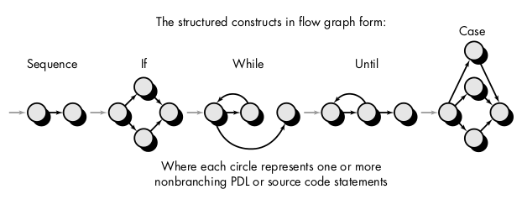
White Box Testing - flow graph notation
Image source : Roger Pressman, Software engineering- A practitioner’s Approach, McGraw-Hill International Editions

Slide 11
White Box Testing - Cyclomatic Complexity
Cyclomatic complexity is a software metric that provides a quantitative measure of the logical complexity of a program.
When used in the basis path testing method, the value computed for cyclomatic complexity defines the number of independent paths in the basis set of a program
Cyclomatic complexity provides us with an upper bound for the number of tests that must be conducted to ensure that all statements have been executed at least once.
An independent path is any path through the program that introduces at least one new set of processing statements or a new condition.
Image source : Google

Slide 12
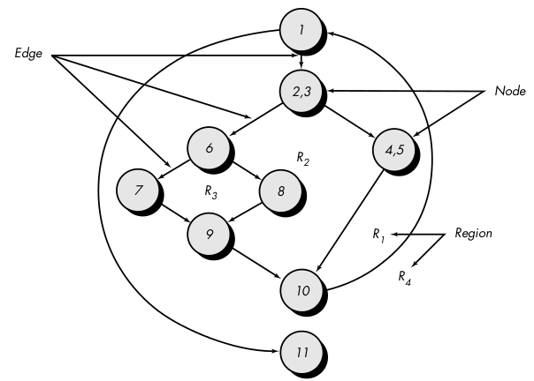
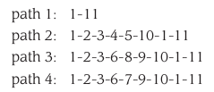
White Box Testing - Cyclomatic Complexity
So on…….
Image source : Roger Pressman, Software engineering- A practitioner’s Approach, McGraw-Hill International Editions

Slide 13
White Box Testing
Cyclomatic complexity, V(G), for a flow graph, G, is defined as V(G) = E - N + 2 , where E is the number of flow graph edges, N is the number of flow graph nodes.
Cyclomatic complexity, V(G), for a flow graph, G, is also defined as
V(G) = P + 1 , where P is the number of predicate nodes contained in the flow graph G
The flow graph has four regions.
V(G) = 11 edges - 9 nodes + 2 = 4.
V(G) = 3 predicate nodes + 1 = 4.
Image source : Google

Slide 14
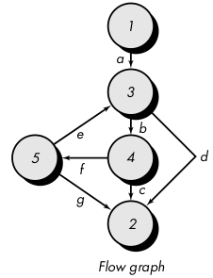
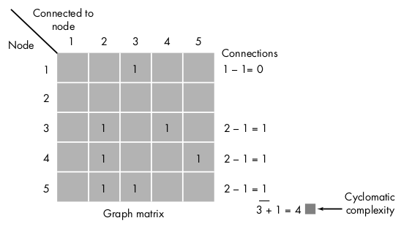
White Box Testing - Cyclomatic Complexity
Image source : Roger Pressman, Software engineering- A practitioner’s Approach, McGraw-Hill International Editions

Slide 15
White Box Testing - CONTROL STRUCTURE TESTING
Condition Testing: Condition testing is a test case design method that exercises the logical conditions contained in a program module.
Branch testing: compound condition C, the true and false branches of C and every simple condition in C need to be executed at least once
Boolean expression with n variables, all of 2^n possible tests are required (where n>0)
Condition
True
False
Image source : Google

Slide 16
White Box Testing - CONTROL STRUCTURE TESTING
Data Flow Testing: The data flow testing method selects test paths of a program according to the locations of definitions and uses of variables in the program.
Data Flow Testing is a type of structural testing.
It has nothing to do with data flow diagrams.
It is concerned with:
Statements where variables receive values
Statements where these values are used or referenced
It can be to find out :
- A variable is defined but not used or referenced
- A variable is used but never defined
- A variable is defined twice before it is used
Image source : Google

Slide 17
White Box Testing - CONTROL STRUCTURE TESTING
Loop Testing: Loop testing is a white-box testing technique that focuses exclusively on the validity of loop constructs.
Simple loops:
1. Skip the loop entirely.
2. Only one pass through the loop.
3. Two passes through the loop.
4. m passes through the loop where m < n.
5. n - 1, n, n + 1 passes through the loop
Nested loops
Concatenated loops
Unstructured loops
Image source : Google

Slide 18
Black Box
Black-box testing/behavioral testing/Functional testing, focuses on the functional requirements of the software.
Black-box testing is not an alternative to white-box techniques. Rather, it is a complementary approach that is likely to uncover a different class of errors than white-box methods.
Black-box testing attempts to find errors in the following categories:
Incorrect or missing functions
interface errors
errors in data structures or external database access
behavior or performance errors
initialization and termination errors.
Image source : Google

Slide 19
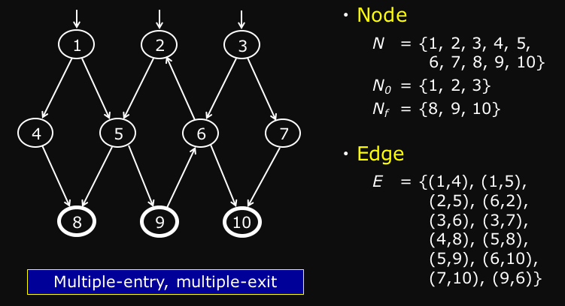
Graph: Nodes and Edges
Node represents : statement, State, Method,, Basic block
Edge represents: –Branch, Transition, Method call
Image source : Google

Slide 20
Graph: Nodes and Edges
A test path represents the execution test cases:
Some test paths can be executed by many test cases
Some test paths cannot be executed by any test cases
Some test paths cannot be executed because they are infeasible
Minimal set of test paths = the fewest test paths that will satisfy test requirements
Image source : Google

Slide 21
Equivalence Partitioning
Equivalence partitioning is a black-box testing method that divides the input domain of a program into classes of data from which test cases can be derived.
An equivalence class represents a set of valid or invalid states for input conditions.
Typically, an input condition is either a specific numeric value, a range of values, a set of related values, or a Boolean condition.
For example , if a system accepts names with character ength between 6 to 12 characters then input data will be divided into 3 classes
1. strings having length less than 6 i.e. invalid range
2. strings having length between 6 to 12 i.e. valid range
3. string having length greater than 12 i.e. invalid range
Image source : Google

Slide 22
Boundary Value Analysis
Boundary value analysis leads to a selection of test cases that exercise bounding values.
Boundary value analysis is a test case design technique that complements equivalence partitioning.
Rather than selecting any element of an equivalence class, BVA leads to the selection of test cases at the "edges" of the class.
If an input condition specifies a range bounded by values a and b, test cases should be designed with values a and b and just above and just below a and b.
For example, if a system expected to works fine for 5000 users then it will be tested for 4999 users and performance will be checked.
Image source : Google

Slide 23


www.paruluniversity.ac.in

