Slide 1


Slide 2

CHAPTER-5
Number Theory and Advance Encryption Standard

Slide 3
Contents
Modular arithmetic
Inverse
Euclidean algorithm
Extended Euclidean algorithm
Algebraic Structures
Advanced Encryption Standard
AES Key expansion

Slide 4
Modular Arithmetic
In Modular Arithmetic, we are interested in only one of the output(q i.e. quotient and r i.e. remainder)i.e. remainder r.
Modulo operator is represented as mod or %. It takes two input let say a and n, where n is called modulus. The output r is called the residue
Let a ,n and r are three numbers then the mod operation can be represented as
Where,
n is called modulus and r is called residue
a mod n = r

Slide 5
How mod operator works
Let a,n and r are three numbers and Z is a set of integers then
Z={……,-2,-1,0,1,2,3,4,………….}
a
n
(Positive)
mod
r(Non Negative)

Slide 6
Modular Arithmetic
Example :
27 mod 5=2
-18 mod 14=10
25 mod 3=1

Slide 7
Set of Residue
Set of Residue : Represented by Z_{n} and is defined as follow
Z_{n} = {0,1,2,…..n-1}
Example :
Z₂ = {0,1}
Z₆ = {0,1,2,3,4,5}
In Cryptography we used concept of Congruence instead of equality. It is represented by symbol (≅)
b≅ a(modn)

Slide 8
Diff b/w Equality and Congruence Operator
Equality Operator: Maps an integer to itself.
One-to-one: 𝑎=𝑏a=b if and only if 𝑎a and 𝑏b are the same.
Congruence Operator: Maps an integer to a residue class in 𝑍𝑛Zn​.
Many-to-one: 𝑎≡𝑏(mod𝑛)a≡b(modn) if 𝑎a and 𝑏b have the same remainder when divided by 𝑛n.
Residue Classes
A residue class [a] or [a]_{n} is the set of integers congruent modulo_{n} i.e. it is the se of all integers such that
x=a(mod n)
Example :
If n=5, we have five sets [0],[1],[2],[3],[4]

Slide 9
Operations in Z_{n}
Operations in Z_{n}
The three binary operations(addition, Subtraction and Multiplication) can be defined for the set of Z_{n.}
The result may need to be mapped to Z_{n} using the mod operator.
Z_{n}
a
b
Operations :
+ , - ,*
(a+b)mod n=c
(a-b)mod n=c
(a*b)mod n=c
n
mod
c
Z_{n} ={0,1,2,…(n-1)}

Slide 10
Operations in Z_{n}
Example:
Add 7 to 14 in Z₁₅
Subtract 11 from 7 in Z₁₃
Multiply 11 by 7 in Z₂₀
Multiply 123 by -10 in Z₁₉
Solution :
(14+7) mod 15 = 21 mod 15 = 6 Ans.
(7-11) mod 13 = (-4) mod 13=9 Ans.
(7*11) mod 20 = (77) mod 20=17 Ans.
(123*(-10)) mod 19 = (-1230) mod 19 = 5 Ans.

Slide 11
Operations in Z_{n}
Properties:
First Property : (a+b) mod n=[(a mod n)+(b mod n)] mod n
Second Property: (a-b) mod n = [(a mod n) – (b mod n)] mod n
Third Property: (a*b) mod n =[(a mod n)*(b mod n)] mod n
NOTE :
10^{n} mod x = (10 mod x)^{n} // Applying the third property n times
a mod 3 =(a_{n} +……..+ a₁ + a₀) mod 3

Slide 12
Inverse

Slide 13
Inverse
Inverse
Inverse
Additive Inverse
Multiplicative Inverse

Slide 14
Additive Inverse
Additive Inverse
In Z_{n} two number’s a and b are additive inverse to each other if
a+b ≅0(mod n)
In Z_{n} , additive inverse of a can be calculated as b=n-a
In modular arithmetic, each integer has an additive inverse
The sum of an integer and its additive inverse is congruent to 0 modulus n
Additive inverse are reciprocal i.e. if a is additive inverse of b then b is additive inverse of a
Example :
Additive Inverse of 4 in Z₁₀ is 10-4=6
All additive Inverse pair in Z₁₀ are (0,0),(1,9),(2,8)(3,7)(4,6) and (5,5)

Slide 15
Multiplicative Inverse
Multiplicative Inverse
In Z_{n} two number’s a and b are multiplicative inverse to each other if
a*b ≅1(mod n)
In modular arithmetic, an integer may or may not have a multiplicative inverse
A number a has multiplicative inverse in Z_{n} if and only if gcd(n,a)=1 i.e. a and n are relatively prime.
Example :
All additive Inverse pair in Z₁₁ are (1,1),(2,6),(3,4)(5,9)(7,8),(9,9) and (10,10)

Slide 16
Euclidean algorithm
What is the Euclidean Algorithm?A method to compute the greatest common divisor (GCD) of two integers.
Greatest Common Divisor (GCD): The largest positive integer that divides two numbers without leaving a remainder.
Mathematical Formulation:𝑎=𝑏𝑞+𝑟a=bq+r
gcd(𝑎,𝑏)=gcd(𝑏,𝑟)gcd(a,b)=gcd(b,r)
Stopping Condition:When 𝑟=0r=0, gcd(𝑎,𝑏)=𝑏gcd(a,b)=b.

Slide 17
Extended Euclidean Algo for Multiplicative Inverse
Extended Euclidean algorithm for Multiplicative Inverse
Extended Euclidean algorithm can find multiplicative inverse of b in Z_{n} when n and b is given and the inverse of b exist in Z_{n.}
By extended Euclidean algorithm to calculate GCD(n,b)
S*n+b*t=GCD(n,b)
Multiplicative inverse will exist only if GCD(n,b)=1 so,
S*n+b*t=1
Taking (mod n) both side
(S*n+b*t)mod n=1 mod n
[(S*n)mod n]+[(b*t)mod n]=1 mod n
0+[(b*t)mod n] = 1 mod n
(b*t) mod n = 1

Slide 18
Extended Euclidean Algo for Multiplicative Inverse
That means t is multiplicative inverse of b
NOTE :
Extended Euclidean Algorithm finds multiplicative inverse of b in Z_{n} when n and b are given and GCD(n,b)=1
Algorithm :
r₁ = a; r₂ = b;
t₁ = 0; t₂ = 1;
While(r₂ > 0){
q=r₁ / r_{2;}
r= r₁ - q* r₂
r₁ = r₂; r₂ =r;
t= t₁ - q* t₂
8. t₁ = t₂; t₂ =t;
9. }
10. if(r₁ = 1) the b⁻¹ = t₁

Slide 19
Extended Euclidean Algo for Multiplicative Inverse
Example :
Calculate Multiplicative Inverse of 11 in Z₂₆
r₁ = 26 r₂ = 11
So multiplicative inverse of 11 = -7+26=19
q | r₁ | r₂ | r | t₁ | t₂ | t
2 | 26 | 11 | 4 | 0 | 1 | -2
2 | 11 | 4 | 3 | 1 | -2 | 5
1 | 4 | 3 | 1 | -2 | 5 | -7
3 | 3 | 1 | 0 | 5 | -7 | 26
 | 1 | 0 |  | -7 | 26

Slide 20
Extended Euclidean Algo for Multiplicative Inverse
Example :
Calculate Multiplicative Inverse of 23 in Z₁₀₀
r₁ = 100 r₂ = 23
So multiplicative inverse of 23 = -13+100=87
q | r₁ | r₂ | r | t₁ | t₂ | t
4 | 100 | 23 | 8 | 0 | 1 | -4
2 | 23 | 8 | 7 | 1 | -4 | 19
1 | 8 | 7 | 1 | -4 | 9 | -13
7 | 7 | 1 | 0 | 9 | -13 | 100
 | 1 | 7 |  | -13 | 100

Slide 21
Extended Euclidean Algo for Multiplicative Inverse
Example :
Calculate Multiplicative Inverse of 12 in Z₂₆
r₁ = 26 r₂ = 12
So multiplicative inverse of 12 in Z₂₆ does not exist since GCD(12,26) is not 1.
Example :
Calculate Multiplicative Inverse of 12 in Z₂₆
r₁ = 26 r₂ = 12
So multiplicative inverse of 12 in Z₂₆ does not exist since GCD(12,26) is not 1.
q | r₁ | r₂ | r | t₁ | t₂ | t
2 | 26 | 12 | 2 | 0 | 1 | -2
6 | 12 | 2 | 0 | 1 | -2 | 13
 | 2 | 0 |  | -2 | 13

Slide 22
Contents
Algebraic structures
rings
commutative ring
groups
semi groups
monoid
abelian or commutative group
cyclic group
finite group
sub group
field
finite field

Slide 23
Algebraic Structures
A non empty set S is called an algebraic structure with respect to an binary operation * if
(a*b) Є S ∀ a,b Є S
That is * is closed operation on “S” and it is denoted by (S,*)
OR
The combination of the set and the operations that are applied to the element of the set is called an algebraic structure.

Slide 24
Some Examples on Algebraic Structures
N = Set of all natural no’s={1,2,3,4,……..}
Z=Set of all integers
Q= Set of all rational no’s
R=Set of all real no’s
C=Set of all complex no’s
Example :
(N,+) is an algebraic structure
Since (a+b) Є N ∀ a,b Є N i.e + is closed operation on N
(N, .) is an algebraic structure
(N,-) is not an algebraic structure

Slide 25
Common Algebraic Structure
Common Algebraic Structure
Groups
Ring
Field

Slide 26
Groups
Group : A group (G) is a set of elements with a binary operation “*” that satisfy the following Properties
Closure Property : if a and b are elements of G , then c=a*b is also an element of G. This means that the result of applying the operation on any two elements in the set is another element in the set.
Associativity : if a , b, and c are any three element of G then
(a*b)*c = a*(b*c)
Existence of identity : ∀a in the G there exist an element e , called the identity element such that e*a=a*e=a
Existence of inverse : ∀a in the G there exist an element a⁻¹ , called the inverse of a , such that a* a⁻¹ = a⁻¹ * a =e

Slide 27
Some Examples on Groups
Examples :
G = <Z_{n} , + > is a group
Closure is satisfied since a,b Є Z_{n} then a+b = c Є Z_{n}
Associativity is satisfied since for any a,b,c Є Z_{n} then (a+b)+c = a+(b+c)
Identity element exist i.e. 0, for any element a, a+0 = 0+a = a
Existence of Inverse since a+b = 0 then b = -a so inverse exist
G = <Z_{n} , * > is a group
Closure is satisfied since a,b Є Z_{n} then a*b = c Є Z_{n}
Associativity is satisfied since for any a,b,c Є Z_{n} then (a*b)*c = a*(b*c)
Identity element exist i.e. e = 1, for any element a, a*1 = 1*a = a
Existence of Inverse (Extended Euclidean Algorithm)

Slide 28
Some Examples on Groups
Examples :
3. G = <Z_{n} , - > is not a group
4. G = <{a,b,c,d}, *> is group
* | a | b | c | d
a | a | b | c | d
b | b | c | d | a
c | c | d | a | b
d | d | a | b | c
Operation table

Slide 29
Some Examples on Groups
Examples :
Closure is satisfied
Associativity is satisfied
Identity element e=a
Existence of inverse (a,a),(b,d),(c,c)

Slide 30
Semi Groups
Semi Group : A semi group is a set of element with a binary operation “*” that satisfy the following properties
Closure Property
Associative Property

Slide 31
Some Example on Semi Groups
Example :
(N,+) is a semi group because Closure and Associative property is satisfied
(N,.) is a semi group because Closure and Associative property is satisfied
(Z,-) is not a semi group because Closure property is satisfied but Associative property is not satisfied

Slide 32
Monoid
Monoid : A semi group G = <S , *> is called a monoid if there exist an element e belongs to S i.e. e Є S such that
a*e = e*a = a ∀ a Є S
element e is called identity element

Slide 33
Some Example on Monoid
Example :
(N,.) is a monoid with identity element 1 Є N
(N,+) is not a monoid because identity element 0 is not an element of N
(Z,+) is a monoid with identity element 0Є N

Slide 34
Abelian Group or Commutative Group
Abelian Group : A group (G,*) is said to be abelian group if
a*b = b*a ∀ a,b
Example :
<Z,+> is an abelian group

Slide 35
Finite Group
Finite Group : A group is called a finite group if the set has a finite number of elements, otherwise it is an infinite group
Order of a finite Group(G,*) :is defined as no of element in G and is represented by O(G) or |G|.
Order of an element of a group : Let (G,*) be a group and a ЄG then the order of an element a is defined as the smallest +ve integer n such that a^{n} is an identity element if a^{n} = e then O(a) = n
NOTE :
If a group has only one element then it is the identity element of the group.
In a group order of identity element is always 1 i.e. O(e) = 1

Slide 36
Some Example on Finite Group
Examples :
S= {0} is a group of order 1 w.r.t addition operator.
S={1} is a group of order 1 w.r.t. multiplication.
G={1,-1} is a group w.r.t. multiplication
O(1) = 1 as 1¹ = 1
O(-1)= 2 as (-1)² =1
G={1,w,w² } is a group w.r.t. multiplication
O(1) = 1 as 1¹ = 1
O(w)= 3 as (w)³ =1
O(w²)= 3 as (w²)³ =1

Slide 37
Some Points on Finite Group
NOTE :
In a finite group (G,*) for any element a of G , O(a) is a divisor of O(G)
O(a)=O(a⁻¹ ) for all a element of G

Slide 38
Subgroup
Let (G,*) be a group. A subset H of G is called a subgroup of G if (H,*) is a group.
NOTE :
Let (G,*) is a group with identity element e then {e} and G are called trivial subgroup of G. Another subgroup of G is called proper subgroup.
Example :
G = {1,-1,i,-i} is group w.r.t. multiplication and H={1,-1} is proper subgroup of G.

Slide 39
Some Theorems on Subgroup
Theorems :
Let H be an non empty subset of a group (G,*) then (H,*) is a subgroup of G iff (a* b⁻¹ ) Є H ∀ a , b Є H then H is a subgroup.
Let H be a non empty finite subset of a group (G,*) then H is a subgroup of G iff (a*b) Є H ∀ a , b Є H [Valid only for infinite group]
Langrange’s Theorem :
If H is a subgroup of a finite group (G,*) then O(H) is a divisor of O(G)
NOTE :
The converse of above theorem need not be true.

Slide 40
Cyclic Group
Cyclic Group : A group (G,*) is said to be cyclic if there exist an element a Є G such that every element of G can be written as a^{n} for some integer n then a is called generating element of a cyclic group G or generator of group G.
Example :
G = {1,-1} is a cyclic group of order 2 w.r.t. multiplication. The generator of G = -1
The set G ={1,w,w²} is a cyclic group of O(3) w.r.t. multiplication. The generator of G are w and w² .

Slide 41
Some Points on Cyclic Group
NOTE :
(G,*) is a cyclic group with generating element ‘a’ then
a⁻¹ is also a generator of G
O(a) = O(G)
Let (G,*) be a cyclic group of order n with generator ‘a’
Number of generator in G = Ф(n)=Euler function of n
a^{m} is also a generator of a if gcd(m,n) = 1

Slide 42
Some Examples on Cyclic Group
Example :
Let (G,*) be a cyclic group of order 8 with generator ‘a’ then the no of generator in G ?
Solution : No. of generator in G = Ф(8)=Ф(2³)= 2³ - 2² = 8 – 4 = 4
and the generators are {1,3,5,7} where gcd(8,1)= gcd(8,3)= gcd(8,5)= gcd(8,7)=1 so generators are a,a³ , a⁵ , a⁷ .
2. Let (G,*) be a cyclic group of order 84 with generator ‘a’ then the no of generator in G ?
Solution : No of generator = Ф(84)=Ф(2³ * 3 * 7)=(2² - 2¹) * (3¹ - 3⁰ ) * (7¹ - 7⁰ )
= 2* 2 * 6 = 24

Slide 43
Ring
Ring : A Ring {R_{g} , + , * } is a set with two binary operation + and * such that it satisfy the following axioms
The set R_{g} should be a abelian group over first operation + i.e. (R_{g} , +) should be an abelian group i.e. set R_{g} should satisfy the following property
Closure Property
Associative Property
Existence of Identity
Existence of inverse
Commutative Property

Slide 44
Ring
Ring : A Ring {R_{g} , + , * } is a set with two binary operation + and * such that it satisfy the following axioms
2. The set R_{g} should be a semi group over second operation * i.e. (R_{g} , *) should be a semi group i.e. set R_{g} should satisfy the following property
Closure Property
Associative Property
3. Distributive Property : a*(b+c)=(a*b)+(a*c) for all a,b,c Є R_{g}
Example :
<I,+,*> is a ring, Where I is the set of integers
(I,+) is an abelian group.
(I,*) is an semi group
a, b,c Є I , a*(b+c) = (a*b)+(b*c)

Slide 45
Commutative Ring
Commutative Ring : A Ring {R_{g} , + , * } is a set with two binary operation + and * is called a commutative Ring if it satisfy the following properties
{R_{g} , + , * } is a Ring
{R_{g} , * } should be commutative i.e. ∀ a,b Є R_{g} , a*b = b*a i.e. ‘*’ is commutative.
Example :
(I,+ *) is a commutative Ring

Slide 46
Field
Field : A Field {F , + , * } is a set with two binary operation + and * such that it satisfy the following axioms
(F,+) is an abelian group
(F-{0},*) is an abelian group [since 0 has no multiplicative inverse over multiplication]
Distributive Property i.e. a*(b+c) = (a*b)+(a*c)
Example :
(R,+,.) is a field
(R,+) is an abelian group
(R-{0},.) is an abelian group
Distributive Property satisfied

Slide 47
Finite Field
Finite Field : A finite field is a field with finite number if elements. Finite field only exist if they have P^{m} elements where P is any prime number and m is any integer.
The finite field is also called Galois field and is denoted as GF(P^{m}).
Example :
There is a finite field with 11 elements : GF(11)
There is a finite field with 81 elements : GF(81)=GF(3⁴ )
There is a finite field with 256 elements : GF(256)=GF(2⁸ )
There is not a finite field with 12 elements : 12=2⁴ * 3

Slide 48
Types of Finite Field
Types of Finite Field :
GF(P^{m} )
GF(P)
GF(P^{m} )
Prime field
Extension field

Slide 49
Prime Field Arithmetic
Prime Filed Arithmetic :
The elements of a prime field GF(P) are the integers {0,1,2,….,P-1}.
Addition , Subtraction , Multiplication :
Let a , b Є GF(P)={0,1,……,P-1} then
a+b ≅ c mod P
a-b ≅ c mod P
a*b ≅ c mod P
NOTE :
All conditions of field are satisfied with these computation
2. Inversion :
The inverse a⁻¹ must satisfy a. a⁻¹ ≅ 1 mod P[Extended Euclidean Algorithm]

Slide 50
Extension Field Arithmetic
extension Filed Arithmetic :
Element representation :
The element of GF(2^{m}) are polynomials
a_{m-1} X^{m-1} +……..+a₁ X+a₀ = A(X) Є GF(2^{m}) where a_{i} Є GF(2)={0,1}
Example :
Find the element of GF(2³)=GF(8)
Solution : A(X)= a₂ X² + a₁ X¹ + a₀ =(a₂ , a₁ , a₀ )
GF(2³)={0,1,X,X+1,X² , X² +1, X² +X, X² +X+1 }
={000,001,010,011,100,101,110,111}

Slide 51
Extension Field Arithmetic
extension Filed Arithmetic :
Addition , Subtraction in GF(2^{m}) :
Use the regular Polynomial add or subtraction , where the coefficients are computed in GF(2)
Example :
Add A(x)= X² + X+1 and B(x) = X² +1 in GF(2³)
Solution : A(x)= X² + X+1
B(x) = X² +1
A(X)+B(X)=(1+1) X² + X +(1+1)
=0 X² + X +0
= X

Slide 52
Extension Field Arithmetic
extension Filed Arithmetic :
NOTE :
Add and Sub in GF(2^{m}) are the same operation since the additive inverse of a polynomial with coefficient in GF(2) is the polynomial itself.
Additive identity in a polynomial is a zero polynomial (a polynomial with all coefficient set to zero)
2. Multiplication in GF(2^{m}) :
Intuition : Just do regular Polynomial multiplication
Example :
Multiply A(x)= X² + X+1 and B(x) = X² +1 in GF(2³)

Slide 53
Extension Field Arithmetic
Solution :
A(X)*B(X)=(X² + X+1)*(X² +1)
= X⁴ + X³ + X² + X² + X+1
= X⁴ + X³ + (1+1)X² + X+1
= X⁴ + X³ +X+1
NOTE :
If we apply regular polynomial multiplication as shown in above example, lead to an error since (X⁴ + X³ +X+1) is not an element of an GF(2³) so we need to reduce the above polynomial. Hence we nee a polynomial that behaves like a prime, these are called irreducible polynomial.

Slide 54
Extension Field Arithmetic
2. Multiplication in GF(2^{m}) :
Intuition : Just do regular Polynomial multiplication
Example :
Multiply A(x)= X² + X+1 and B(x) = X² +1 in GF(2³) with irreducible polynomial as P(X)=(X³ + X+1)
Solution : A(X)*B(X)= X⁴ + X³ +X+1
So now we have to reduce it so,
A(X)*B(X)= (X⁴ + X³ +X+1) mod P(X)
= (X⁴ + X³ +X+1) mod (X³ + X+1)
=(X² + X) Ans.

Slide 55
Extension Field Arithmetic
3. Inversion in GF(2^{m}) :
The inverse A⁻¹ (X) of an element A(X) in GF(2^{m}) must satisfy
A(X). A⁻¹ (X) ≅ 1 mod P(X)
It can be calculate using extended Euclidean algorithm for Polynomials.

Slide 56
Extension Field Arithmetic
Example :
Calculate inverse of (X²+1) modulo (X⁴+X+1) in GF(2⁴)
Solution: Hence the inverse of (X²+1) is (X³+X+1)
q | r₁ | r₂ | r | t₁ | t₂ | t
(X²+1) | (X⁴+X+1) | (X²+1) | X | 0 | 1 | (X²+1)
X | (X²+1) | X | 1 | 1 | (X²+1) | (X³+X+1)
X | X | 1 | 0 | (X²+1) | (X³+X+1) | (X⁴+X+1)
 | 1 | 0 |  | (X³+X+1) | (X⁴+X+1)

Slide 57
Advanced Encryption Standard

Slide 58
Advance Encryption standard
The Rijndael proposal for AES defined a cipher in which the block length and the key length can be independently specified to be 128, 192, or 256 bits.
Key size (words/ bytes/ bits) | 4/16/128 | 6/24/192 | 8/32/256
Block size (words/ bytes/ bits) | 4/16/128 | 4/16/128 | 4/16/128
Round key size (words/ bytes/ bits) | 4/16/128 | 4/16/128 | 4/16/128
Number of Rounds | 10 | 12 | 14
AES designed to have characteristics
Resistance against all known attacks
Speed and code compactness on a wide range of platforms
Design simplicity

Slide 59
AES Block Diagram
Plaintext (128 bits)
AES
Key (128-256 bits)
Ciphertext (128 bits)

Slide 60
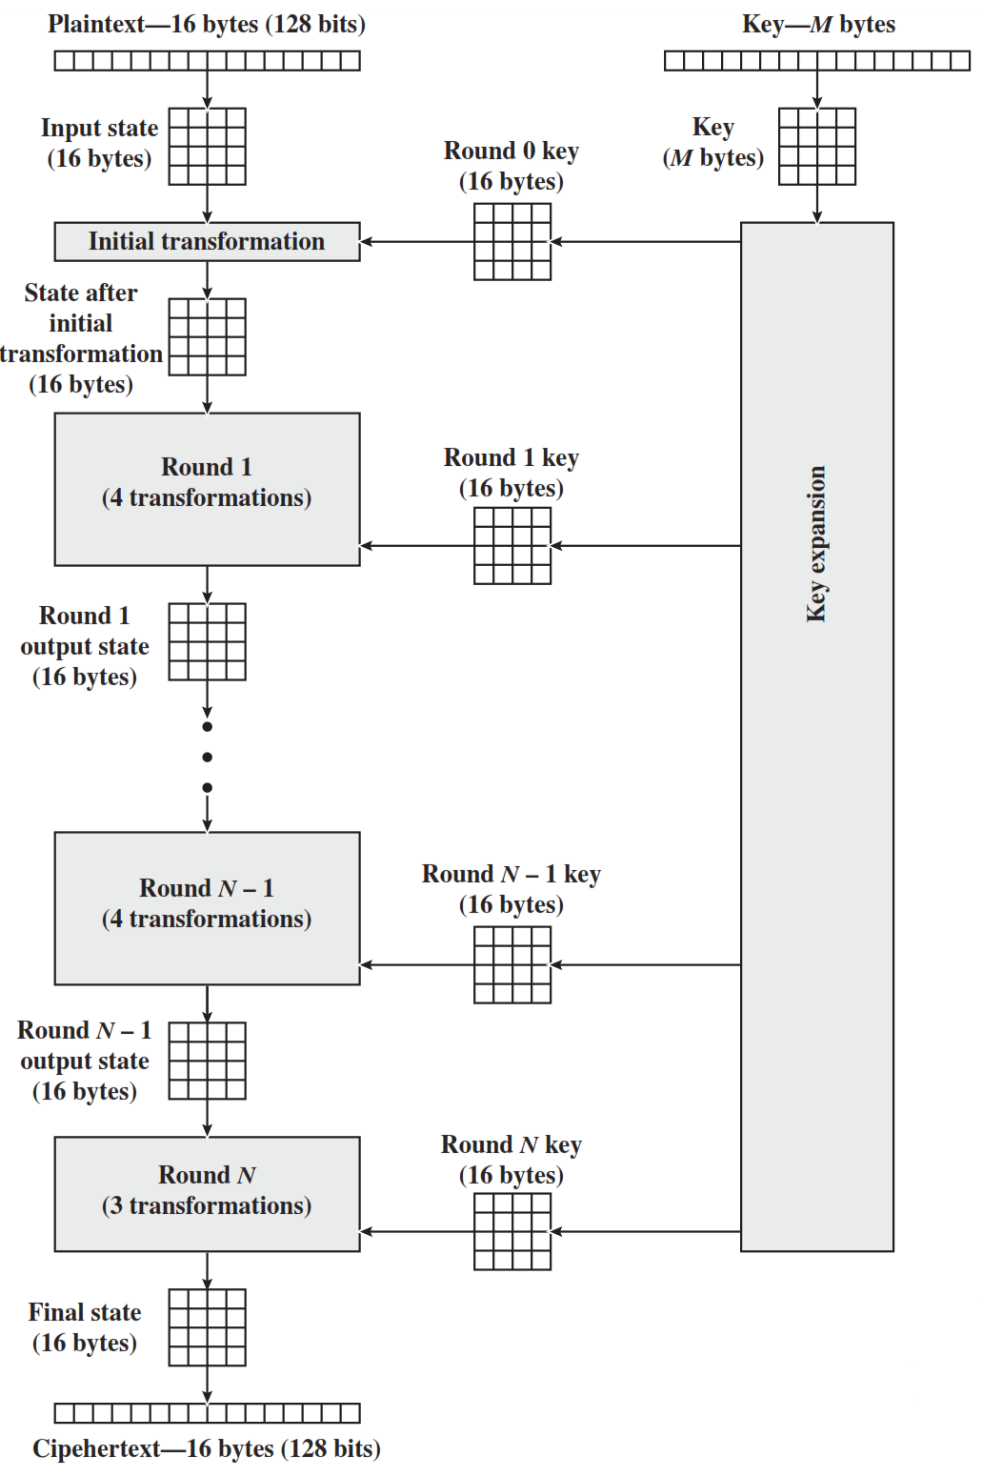
AES Structure
Initialization
Expand 16-byte key to get the actual key block to be used.
Initialize 16-byte plaintext block called as state.
XOR the state with the key block.
For each round
Apply S-box
Rotate rows of state
Mix columns
Add Round key: XOR the state with key block.
www.google.co

Slide 61
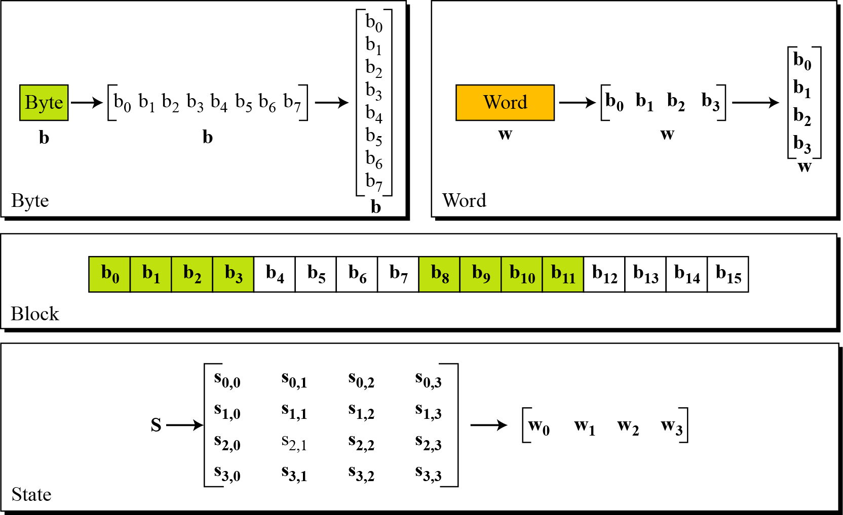
Data Units in AES
www.google.co

Slide 62
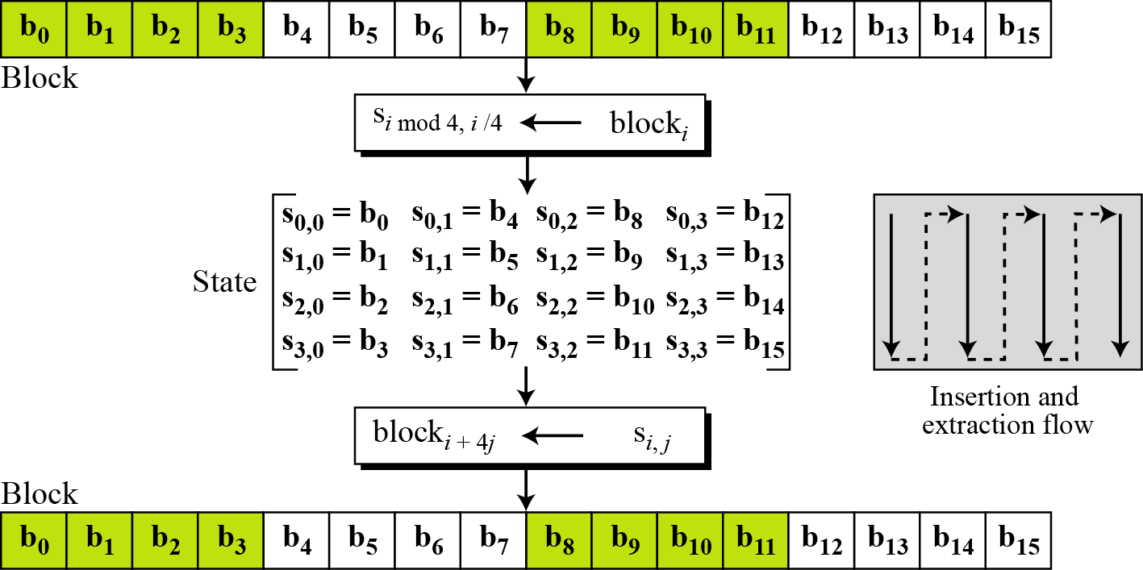
Data Units in AES
www.google.co

Slide 63
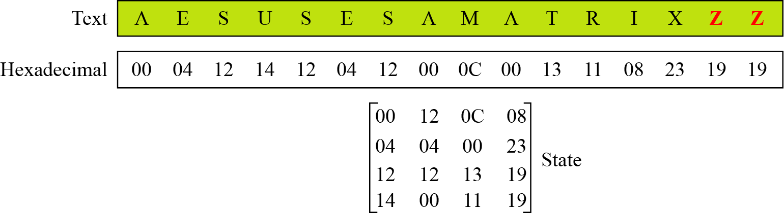
Data Units in AES
www.google.co

Slide 64
AES Structure
The First N-1 rounds consist of four distinct transformation
SubBytes
The 16 input bytes are substituted using S-box
ShiftRows
Each of the four rows of the matrix is shifted to the left
Mixcolumn
Each column of four bytes is now transformed using a special mathematical function.
AddRoundKey
The 16 bytes of the matrix are now considered as 128 bits and are XORed to the 128 bits of the round key.

Slide 65
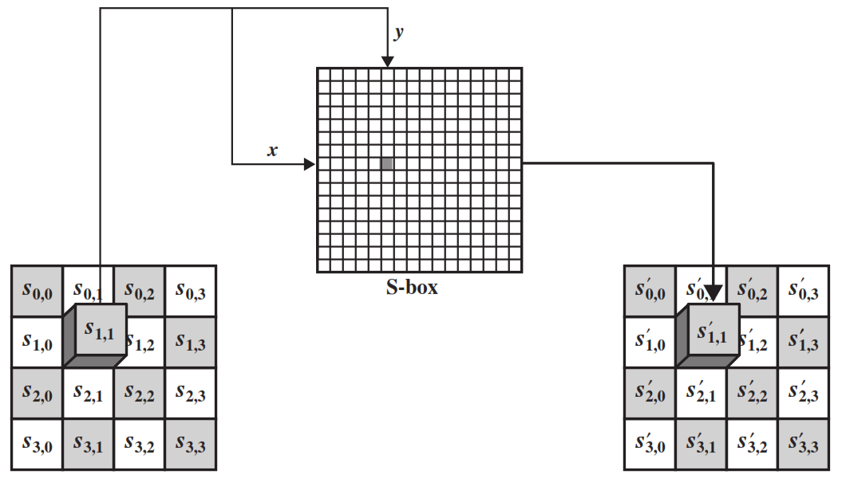
SubByte Transformation
The forward substitute byte transformation, called SubBytes, is a simple table lookup
www.google.co

Slide 66
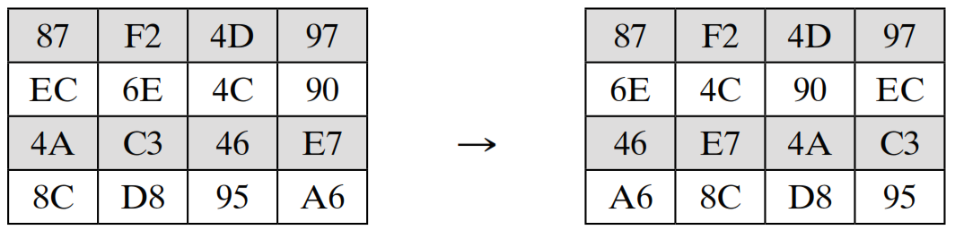
ShiftRows
The first row of State is not altered.
For the second row, a 1-byte circular left shift is performed.
For the third row, a 2-byte circular left shift is performed.
For the fourth row, a 3-byte circular left shift is performed.

Slide 67
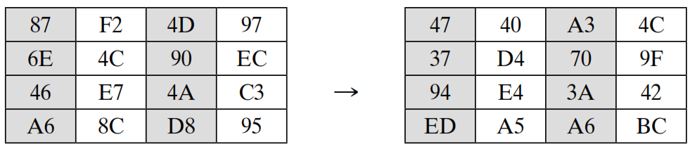
MixColumns
Each byte of a column is mapped into a new value that is a function of all four bytes in that column.
www.google.co

Slide 68
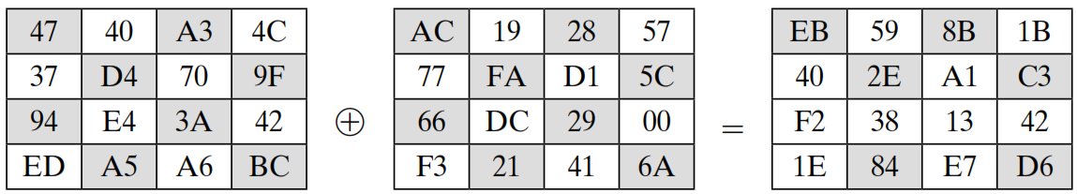
AddRoundKey
In the forward add round key transformation, the 128 bits of State are bitwise XORed with the 128 bits of the round key.
State
Round
Key
www.google.co

Slide 69
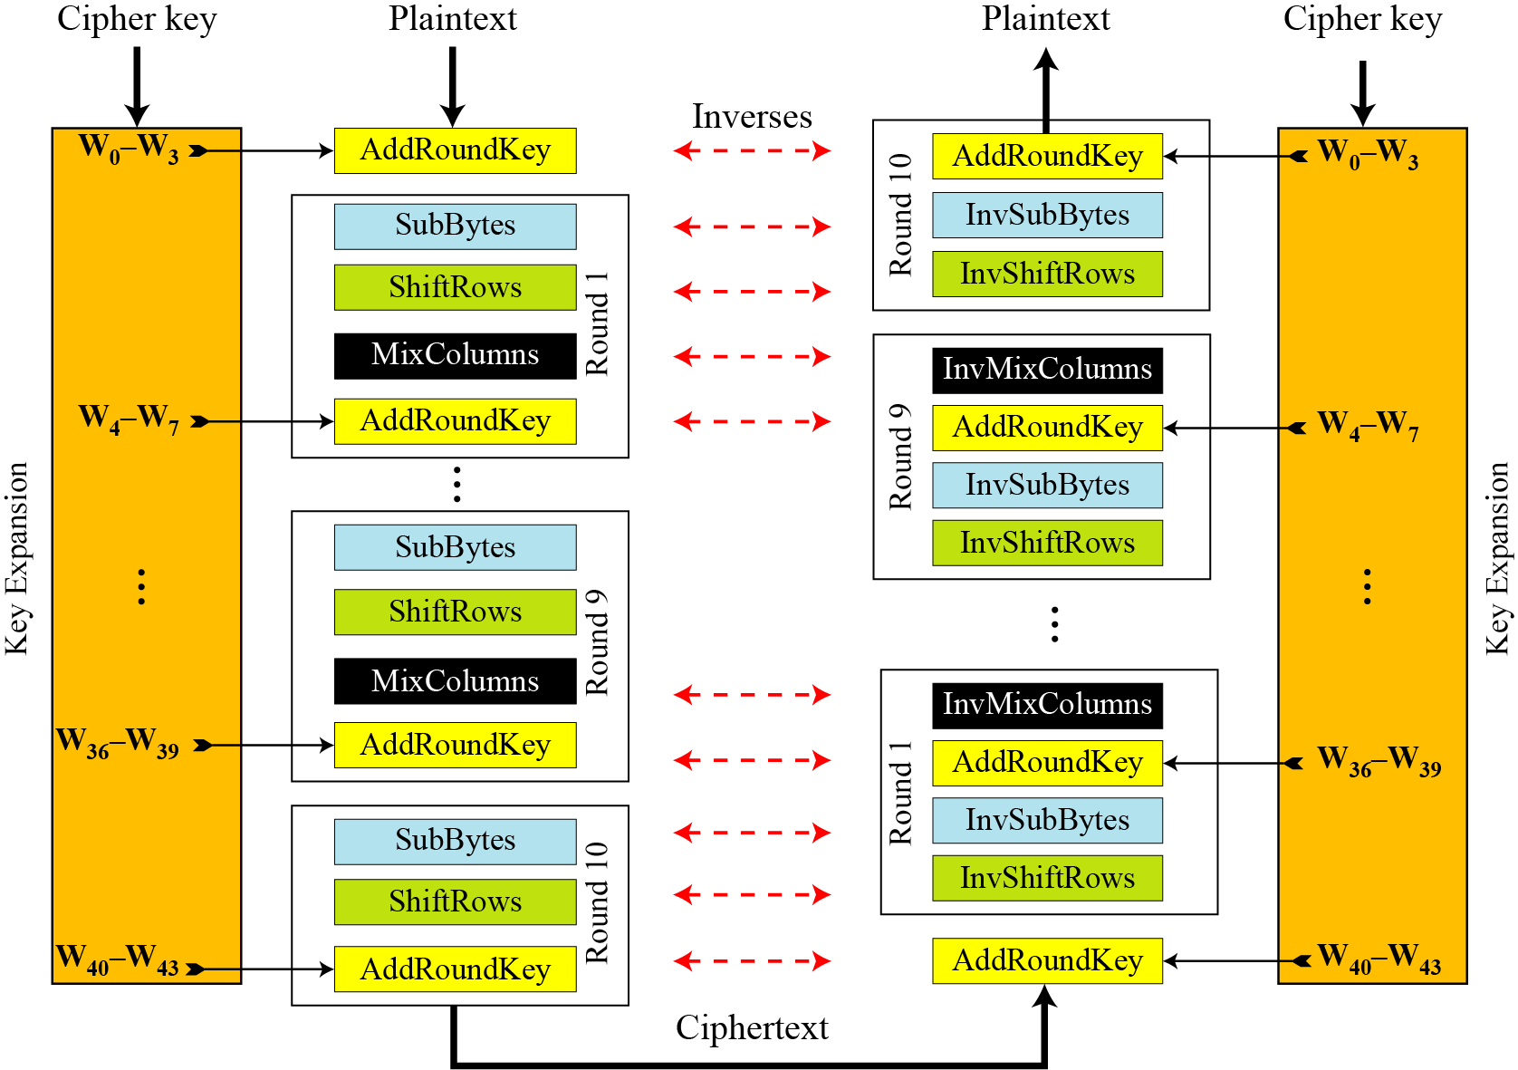
AES Overall Structure
www.google.co

Slide 70
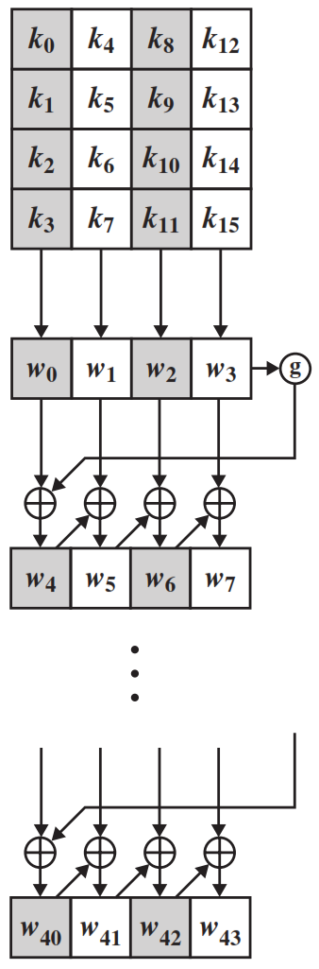
AES Key Expension
The AES key expansion algorithm takes as input a four-word (16-byte) key and produces a linear array of 44 words (176 bytes).
Each added word w[i] depends on the immediately preceding word, w[i - 1].
In three out of four cases, a simple XOR is used.
www.google.co

Slide 71
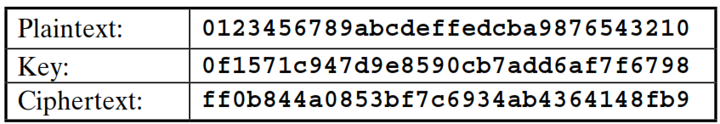
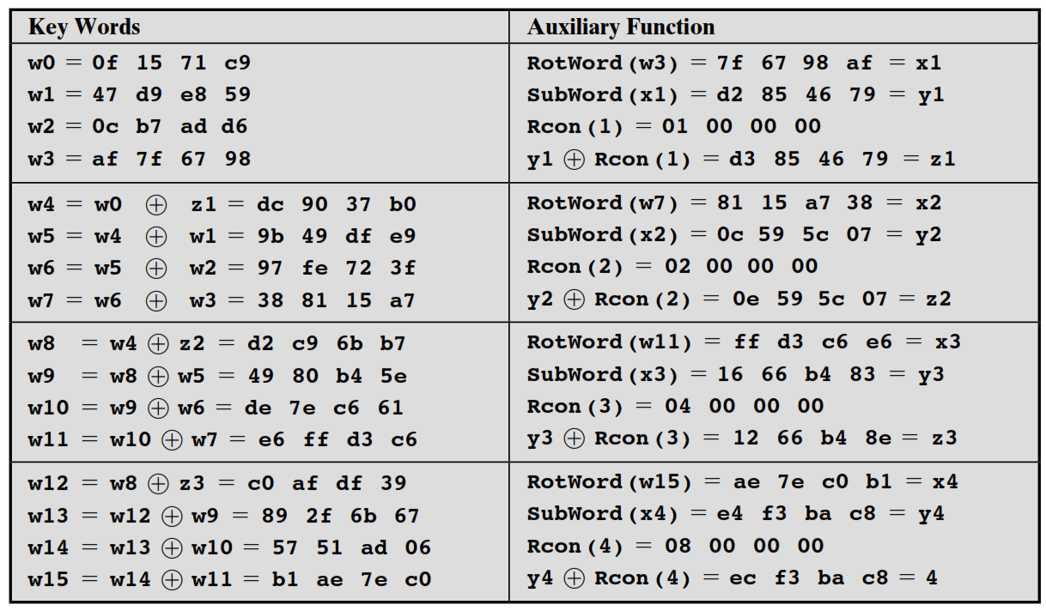
Key Expansion Example
www.google.co

Slide 72

www.paruluniversity.ac.in

