Slide 1


Slide 2

CHAPTER-6
Asymmetric Ciphers
2

Slide 3
Contents
Prime numbers
Euler Totient function
Euler’s theorem
Fermat’s Theorem
Testing for primality
Principles of public key Cryptosystems
RSA algorithm
Diffie – Hellman Key exchange algorithm

Slide 4
Prime Numbers
• An integer p > 1 is a prime number if and only if its only divisors are 1 and itself
Ex. 2,3,5,7 are prime, 4,6,8,9,10 are not
List of prime number less than 200 is:
2 3 5 7 11 13 17 19 23 29 31 37 41 43 47 53 59 61 67 71 73 79 83 89 97 101 103 107 109 113 127 131 137 139 149 151 157 163 167 173 179 181 191 193 197 199
Prime Factorisation
The prime factorisation of a number n is when its written as a product of primes
eg. 91=7x13 ; 3600=24x32x52
4

Slide 5
Relative Prime Number
• Two numbers a, b are relatively prime if have no common divisors apart from 1
Ex. 8 & 15 are relatively prime
since factors of 8 are 1,2,4,8 and of 15 are 1,3,5,15 and 1 is the only common factor
5

Slide 6
EULER’S TOTIENT FUNCTION

Slide 7
Euler Totient Function ø(n)
The Euler’s totient function ø(n), defined as the number of positive integers less than n & relatively prime to n.
Ex. for n=10 ø(n) = {1,3,7,9}
Term “residue” refers to numbers less than some modulus, and the “reduced set of residues” to those numbers (residues) which are relatively prime to the modulus (n).
Ex for n=10,
complete set of residues is {0,1,2,3,4,5,6,7,8,9}
Reduced set of residues is {1,3,7,9}
7

Slide 8
Euler Totient Function ø(n)
To compute ø(n) need to count number of residues to be excluded
In general need prime factorization, but
for p (p prime) ø(p) = p-1
for p.q (p,q prime) ø(pq) =(p-1)x(q-1)
eg.
ø(37) = 36
ø(21) = (3–1)x(7–1) = 2x6 = 12
8

Slide 9
Euler’s Theorem
For every a and n that are relatively prime
a^{ø(n)} ≡ 1 (mod n) for any a,n where gcd(a,n)=1
Ex.
a=3; n=10; ø(10)=4;
hence 3⁴ = 81 = 1 mod 10
a=2; n=11; ø(11)=10;
hence 2¹⁰ = 1024 = 1 mod 11
9

Slide 10
FERMAT’S THEOREM

Slide 11
Fermats theorem
if 'p' is a prime number and 'a' is a positive integer not divisible by 'p' then a(p-1) = 1 (mod p)
Example: Does Fermat's theorem hold true tor P= 5 and a=2?
Solution: Given P=5&a=2
a(P-1) = 1 (modp)
2(5-1)= 1 Imod 5)
2(4) = 1 (mod5)
16 = 1 (mods)
Therefore, fermats theorem hold true for above.

Slide 12
Fermat’s Theorem
a^{p-1}=1(mod p)
P is prime and a is a positive integer not divisible by p
3²⁰¹mod 11
3 is not divisible by 11
Hence a^{p-1}mod p
3⁽¹¹⁻¹⁾ = 3¹⁰=1mod11
(3¹⁰)²⁰*(3) mod 11
=1*3 mod 11
=3
12

Slide 13
Fermat’s Theorem
Solve following:
2³⁴⁵ mod 11
3⁵⁰ by 7
5¹⁰¹mod31
13

Slide 14
TESTING FOR PRIMALITY
For many cryptographic algorithms, it is necessary to select one or more very large prime numbers at random.
Thus, we are faced with the task of determining whether a given large number is prime.
There is no simple yet efficient means of accomplishing this task.
Miller-Rabin Algorithm
Probabilistic primality test
checks whether a specific property, which is known to hold for prime values, holds for the number under testing
14

Slide 15
Miller-Rabin Algorithm
The algorithm due to Miller and Rabin [MILL75, RABI80] is typically used to test a large number for primality
TEST (n)
1. Find integers k, q, with k > 0, q odd, so that (n-1 = 2^{k}q);
2. Select a random integer a, 1 < q < n-1;
3. if a^{q} mod n = 1 then return (“inconclusive”);
4. for j = 0 to k – 1 do
5. if a^{2jq} mod n = n – 1 then return (“inconclusive”);
6. return (“composite”);
15

Slide 16
Example
Suppose n =29
Find ( n- 1) = 28 = 2²(7)= 2^{k}q
Let us try a = 10
10⁷ mod 29 = 17 (its neither 1 nor 28, so continue test)
(10⁷)² mod 29 = 28 hence test return “in clonclusive”
16

Slide 17
Example
Now let us apply the test to the composite number
N = 13*17 = 221
Then
(n-1) = 220 = 2²(55)= 2^{k}q
Let us try a=5
5⁵⁵mod 221 = 112 (neither 1 nor 220)
(5⁵⁵)² mod 221 = 168 test return “Composite”
17

Slide 18
PRINCIPLES OF PUBLIC KEY CRYPTO SYSTEMS

Slide 19
Principles Of Public-Key Cryptosystems
Public-Key Cryptosystems
Applications for Public-Key Cryptosystems
Requirements for Public-Key Cryptography
Public-Key Cryptanalysis
19

Slide 20
Introduction
Asymmetric encryption is a form of cryptosystem in which encryption and decryption are performed using the different keys- one is a public key and one a private key. It is also known as public-key encryption.
Asymmetric encryption transform plaintext into ciphertext using one of two keys and an encryption algorithm. Using the paired key and decryption algorithm, plaintext is recovered from the ciphertext.
Asymmetric encryption can be used for confidentiality, authentication, or both.
The most widely used public-key cryptosystem is RSA. The difficulty of attacking RSA is based on the difficulty of finding the prime factors of a composite number.
20

Slide 21
Principles of Public-key Cryptosystems
Public-key algorithms are based on mathematical functions rather than on substitution and permutation.
Public-key encryption is more secure from cryptanalysis than is symmetric encryption.
The concept of public-key cryptography evolved from an attempt to attack two of the most difficult problems associated with symmetric encryption.
(1) two communications already share a key, which somehow has been distributed to them.
(2) the use of key distribution center.
The idea of public-key cryptography was invented by Diffie and Hellman.
21

Slide 22
Public-key Cryptosystems
Asymmetric algorithm rely on one key for encryption and a different but related key for decryption.
Characteristic of PKC: it is computationally infeasible to determine the decryption key given only knowledge of the cryptographic algorithm and encryption key.
Public key is known to every one even, it is infeasible to derived a private key related to that public key.
22

Slide 23
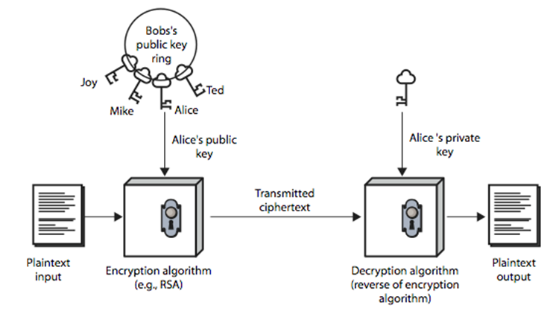
Public-key Cryptosystems (Conti…)
Fig 5.1: Encryption
23

Slide 24
Public-key Cryptosystems (Conti…)
A public-key encryption scheme has six ingredients.
Plaintext
Encryption algorithm
Public and private key
Ciphertext
Decryption algorithm
24

Slide 25
Public-key Cryptosystems (Conti…)
The essential steps for the communication in PKC are as follows:
Each user generate a pair of keys to be used for the encryption and decryption of messages.
Each user places one of the two keys in a public register or other accessible file. This is public key. The companion key is kept private.
If bob wishes to send a confidential message to alice, bob encrypts the message using alice’s public key.
When alice receives the message, she decrypt it using her private key. No other recipient can decrypt the message because only alice knows her private key.
25

Slide 26
Public-key Cryptosystems (Conti…)
With this approach, all participants have access to public keys, and private keys are generated locally by each participant and therefore need never be distributed .
As long as a user’s private key remains protected and secrete, incoming communication is secure.
At any time, a system can change its private key and publish the companion public key to replace its old key.
26

Slide 27
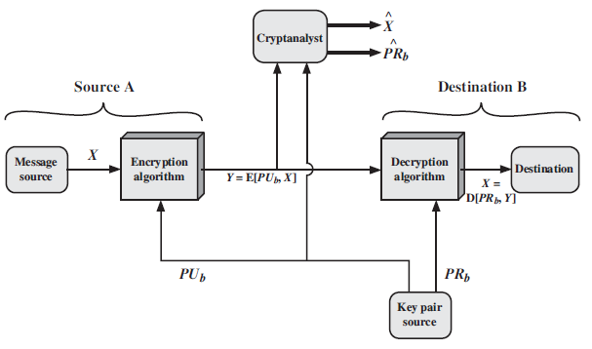
Public-key Cryptosystems (Conti…)
Fig 5.2: Public-Key Cryptosystem: Secrecy
27

Slide 28
Public-key Cryptosystems (Conti…)
User A want to send some message to B.
B generates a related pair of keys: a public key PUb, and private key PRb. PRb is known to only B, whereas PUb is publicly available and so accessible by A.
With the message X and the encryption key PUb as input, A forms ciphertext y = [y1, y2, y3,….yn]
Y = E(PUb, X)
The intended receiver, in possession of the matching private key, is able to invert the transformation:
X = D(PRb, Y)
28

Slide 29
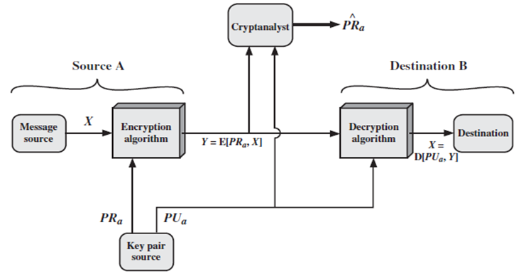
Public-key Cryptosystems (Conti…)
Fig 6.3: Public-Key Cryptosystem: Authentication [1]
29

Slide 30
Public-key Cryptosystems (Conti…)
Figurer 6.3 show the use of public-key encryption to provide authentication.
Y = E(PRa, X)
X = D(PUa, Y)
In this case, A prepare a message to B and encrypts it using A’s private key before transmitting it.
B can decrypt it using A’s public key .
Because the message was encrypted using A’s private key, only A could have prepare the message.
So, the entire encrypted message serves as a digital signature.
In addition, it is impossible to alter the message without access to A’s private key, so the message is authenticated both the terms of source and in terms of data integrity.
30

Slide 31
Public-key Cryptosystems (Conti…)
In the preceding scheme, the entire message is encrypted, which, although validating both author and contents, requires a great deal of storage.
Each document must be kept in plaintext to be used for pratical purpose.
A copy also stored in ciphertext so that the original and contents can be verified in case of dispute.
A more efficient way of achieving the same results is to encrypt a small block of bits that is a function of the document.
Such a block, called an authenticator, must have the property that it is infeasible to change the document without without changing the authenticator.
If the authenticator is encrypted with the sender’s private key, it serve as signature that verifies origin, content, and sequencing
31

Slide 32
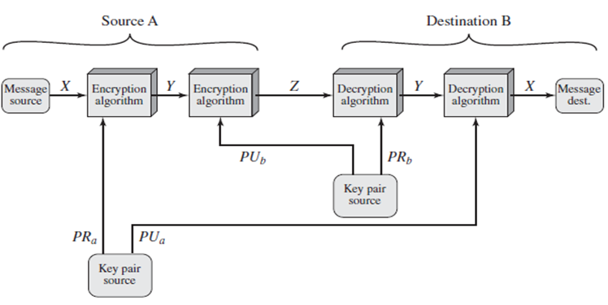
Public-key Cryptosystems (Conti…)
Fig 5.4: Public-Key Cryptosystem: Authentication & Secrecy[1]
32

Slide 33
Applications for Public-key Cryptosystem
In broad terms, we can classify the use of public-key cryptosystem into three categories:
Encryption/decryption
Digital signature
Key exchange
33

Slide 34
Requirements for Public-key Cryptography
The PKC algorithm must fulfill the following conditions
It is computationally easy for party B to generate the key pair.
It is computationally easy for a sender A, knowing the public key and the message to be encrypted, M, to generate the corresponding cipher text.
It is computationally easy for the receiver B to decrypt the resulting cipher text using private key to recover the original message.
It is computationally infeasible for an adversary, knowing the public key to determine the private key.
It is computationally infeasible for an adversary, knowing the public key and cipher text to recover the original message
34

Slide 35
THE RSA ALGORITHM

Slide 36
The RSA Algorithm
RSA - Ron Rivest, Adi Shamir and Len Adleman at MIT, in 1977.
RSA is a block cipher
The most widely implemented
Provides confidentiality (encryption/decryption) and digital signatures for authentication and integrity checking.
Encryption: Data is encrypted using the recipient's public key. This scrambled data, called ciphertext, can only be decrypted with the corresponding private key.
Decryption: The recipient uses their private key to decrypt the ciphertext, transforming it back to the original data (plaintext).
The security of RSA relies on the difficulty of factoring large numbers. Because the public key is based on the product of two large prime numbers, cracking it would involve factoring this large number, which is computationally infeasible with current technology.
36

Slide 37
RSA Algorithm
Here's why RSA is important for network security:
Confidentiality: It ensures only authorized parties with the private key can access encrypted information.
Digital Signatures: RSA can be used for digital signatures, allowing verification of the sender's identity and message integrity.
However, it's important to note that RSA isn't perfect. The key size is crucial, and with increasing computing power, larger key sizes are needed to maintain security.

Slide 38
The RSA Algorithm (Conti…)
Key Generation Alice
Select p,q p and q both are prime, p≠q
Calculate n= p*q
Calculate ø (n)= (p-1)*(q-1)
Select integer e gcd(ø(n),e)=1; 1<e< ø(n)
Calculate d d=e⁻¹ (mod(ø(n)))
Public Key PU= {e,n}
Private Key PR={d,n}
38

Slide 39
The RSA Algorithm (Conti…)
To encrypt a message
c = m^{e} mod n
To decrypt a message
m = c^{d} mod n
= (m^{e} mod n)^{d} mod n
= m^{ed} mod n
= m^{1+kø(n)}mod n
= m . m^{kø(n)}mod n
= m
39

Slide 40
RSA Example- Key setup
Select two prime numbers
P=17 and q=11
Compute n
n= p*q = 17*11= 187
Compute ø Value
Ø (n) = (p-1)*(q-1)= (17-1)*(11-1)= 16*10 = 160
Select Encryption Parameter
e : gcd(e,160)=1; choose e =7
40

Slide 41
RSA Example- Key setup
Determine Decryption Parameter
d: de=1 mod 160 and d < 160
Value of d = 23 since 23*7 = 161
Public Key PU= {7, 187}
Private Key PR= {23, 187}
41

Slide 42
RSA Example- En/Decryption
Encrypt message M =88
C = 88⁷ mod 187
= 88 ⁽³⁺³⁺¹⁾ mod 187
= ((88³ mod 187) (88³mod 187)(88 mod 187)) mod 187
= (44 * 44 * 88 ) mod 187
= 11
Decryption is:
M = 11²³ mod 187 = 88
42

Slide 43
RSA Example- Key setup
Select two prime numbers
P=11 and q=3
Compute n
n= p*q = 11*3= 33
Compute ø Value
Ø (n) = (p-1)*(q-1)= (11-1)*(3-1)= 10*2 = 20
Select Encryption Parameter
e : gcd(e,20)=1; choose e =3
Determine decryption parameter
d: de=1 mod 20 and d<20 ; d=7 since
43

Slide 44
RSA Example- En/Decryption
The sample RSA private/public operations are:
Given message M = 7
Encryption is:
C= 7³ mod 33
= 343 mod 33
= 13
Decryption is:
M = 13⁷ mod 33
= 13⁽³⁺³⁺¹⁾ mod 33
=((13³ mod 3)*(13³ mod 33)*(13 mod 33)) mod 33
=19*19*13 mod 33= 4693 mod 33 = 7
44

Slide 45
RSA Example- Key setup
Consider the text grouping in the groups of three i.e
ATTACKXATXSEVEN = ATT ACK XAT XSE VEN
Represent the blocks in base 26 using A=0, B=1, C=2 …
ATT = 0*26² + 19*26¹ + 19 = 513
ACK =0*26²+ 2*26¹ + 10 = 62
XAT= 23*26² + 0*26¹ + 19 = 15567
XSE= 23 *26² + 18 * 26¹ + 4 = 16020
VEN= 21*26² + 4*26¹ + 13 = 14313
What should be the value of n?
The value of n should be greater than 17575. How & Why?
Let p = 137 and q = 131; so that n= pq = 17947
45

Slide 46
RSA Example- Key setup
Compute phi value:
Ø(n) = (p-1)(q-1) = 136*130 = 17680
Select encryption parameter
e: gcd(e,17680)=1; choose e=3
Determine decryption parameter
d: de=1 mod 17680 and d< 17680
Value is d=11787 since 11787*3 = 35361= 11787*2+1
Publish public key PU= {3, 17947}
Keep secret private key PR={7, 17947}
46

Slide 47
RSA Example- En/Decryption
The sample RSA private/public operations are:
Given message M = ATT = 513
Encryption is
C = 513³ mod 17947 = 8363
Decryption is
M= 8363¹¹⁷⁸⁷ mod 17947 = 513
Plaintext is represented as the set of integer’s m
{513, 62, 15567, 16020, 14313}
Cipher text is represented as the set of integers m
{ 8363, 5017, 11884, 9546, 13366}
47

Slide 48
The RSA Algorithm (Conti…)
Encryption by Bob with Alice’s Public Key
Plaintext: M<n
Cipher Text C= Me mod n
Decryption by Alice with Alice’s Private Key
Cipher text: C
Plain Text: M= C^{d} mod n
48

Slide 49
The Security of RSA
Four possible approaches to attacking the RSA algorithm are as follows:
Brute force: this involves trying all possible private keys.
The defense against the brute-force approach is same for RSA as for other cryptosystem, namely, use a large key space.
So the large number of bit in d is better.
However, because the calculations involve, both in key generation and in encryption/decryption, are complex, the large the size of key, the slower the system will run.
Timing attacks: these depend on the running time of the decryption algorithm.
Chosen ciphertext attacks: this type of attack exploits properties of the RSA algorithm.
49

Slide 50
The Security of RSA (Conti…)
The Factoring Problem: we can identify three approaches to attacking RSA mathematically.
Factor n into its two prime factors. This enables calculation of ø(n)=(p-1)(q-1), which, in turn, enables determination of d = e⁻¹ mod ø(n)
Determine ø(n) directly, without first determining p and q. Again, this enables determination of d = e⁻¹ mod ø(n).
Determine d directly, without determining ø(n)
50

Slide 51
The Security of RSA (Conti…)
Timing Attacks:
Paul kocher, a cryptographic consultant, demonstrated that a snooper can determine a private key by keeping track of how long a computer takes to decipher message.
Timing attacks are applicable not just for RSA, but to other public-key cryptography systems.
This attack is alarming for two reasons: it comes from a completely unexpected direction and it is a ciphertext-only attack.
51

Slide 52
The Security of RSA (Conti…)
There are simple countermeasures that can be used for timing attack:
Constant exponentiation time.
Ensure that all exponentiations take the same amount of time before returning a result. This is a simple but does degrade performance.
Random delay
Better performance could be achieved by adding a random delay to the exponentiation algorithm to confuse the timing attack.
Blinding: multiply the ciphertext by a random number before performing exponentiation .
This process prevents the attacker from knowing what ciphertext bits are being processed inside the computer and so prevents the bit-by-bit analysis essential to the timing attack
52

Slide 53
Issue:
How to exchange same secret key so that no one else can obtain a copy.
Diffie Hellman Key Exchange algorithm
53

Slide 54
DIFFIE-HELLMAN KEY EXCHANGE ALGORITHM

Slide 55
Diffie Hellman Algorithm
The Diffie-Hellman (DH) key exchange algorithm is a clever method for two parties (like Alice and Bob) to securely establish a shared secret key over an insecure public channel, without ever actually exchanging the key itself. Here's a simplified explanation:
Imagine Alice and Bob want to chat secretly over a walkie-talkie:
Public Agreement: They agree on two publicly known numbers: a large prime number (p) and a base number (g). Think of these like ingredients for a secret recipe.

Slide 56
Diffie Hellman Algorithm
Secret Ingredients: Each keeps a secret number to themselves (a for Alice and b for Bob). These are their private keys.
Key Exchange:
Alice uses her secret (a) and the public ingredients (g and p) to create a message (A) and sends it over the walkie-talkie (insecure channel).
Bob does the same with his secret (b), creating a message (B) and sending it back.
Secret Handshake:
Alice now uses Bob's message (B) along with her own secret (a) and the public numbers (p and g) to create a shared secret key (K).
Bob uses Alice's message (A) along with his own secret (b) and the public numbers to arrive at the same shared secret key (K).

Slide 57
Diffie Hellman Algorithm
Crucially, no one listening on the walkie-talkie can figure out the secret key (K) from the messages exchanged (A and B). The math behind DH makes it very difficult to derive the secret key without the private information (a and b).

Slide 58




Alice wants to send a message to Bob
Eve
Alice
Bob
58

Slide 59

Can use cryptography
Eve
Bob
Alice
Need to have Key for Encryption – Decryption
59

Slide 60
Objective
Describe key Exchange
Discuss Diffie Hellman Key Exchange Algorithm
Solve Numerical based on Diffie Hellman Key Exchange Algorithm
60

Slide 61
Introduction
Discovered by Whitfield Diffie and Martin Hellman
“New Directions in Cryptography”
Diffie-Hellman key agreement protocol
Exponential key agreement
Allows two users to exchange a secret key
Requires no prior secrets
Real-time over an untrusted network
61

Slide 62
Introduction Cont..
Security of transmission is critical for many network and Internet applications
Requires users to share information in a way that others can’t decipher the flow of information
62

Slide 63
Key exchange
=
=
63
Notes:
63

Slide 64
Key Exchange Cont…
=
=
64
Notes:
64

Slide 65
Basic Concept
easy
+
hard
+
Based on the difficulty of computing discrete logarithms of large numbers.
65

Slide 66



Key exchange
Y_{A}
Y_{A}
Y_{B}
Y_{B}
q
q
α
=
α
Y_{A}
=
Y_{B}
X_{B}
X_{A}
66
Notes:
66

Slide 67

Key Exchange Cont…
Y_{A}
Y_{B}
X_{A}
=
K
=
X_{B}
K
Y_{B}
Y_{A}
67
Notes:
67

Slide 68
Algorithm
Global Public Elements
q prime number
α α < q and α a primitive root of q
User A Key Generation
Select private X_{A} X_{A} < q
Calculate public Y_{A} Y_{A}= α^{XA} mod q
User B Key Generation
Select private X_{B} X_{B} < q
Calculate public Y_{B} Y_{B} = α^{XB} mod q
68

Slide 69
Algorithm Cont…
Calculation of Secret Key by User A
K = (Y_{B})^{XA} mod q
Calculation of Secret Key by User B
K = (Y_{A})^{XB} mod q
69

Slide 70
Example
Alice and Bob get public numbers
q = 23, α = 9
Alice and Bob choose Private Number
X_{A} = 4
X_{B} = 3
Alice and Bob compute public values
Y_{A} = 9⁴ mod 23 = 6561 mod 23 = 6
Y_{B} = 9³ mod 23 = 729 mod 23 = 16
Alice and Bob exchange public numbers
70

Slide 71
Example cont..
Alice and Bob compute symmetric keys
K = (Y_{A} ) ^{XB} mod q = 16⁴ mod 23 = 9
K = (Y_{B} ) ^{XA} mod q = 6³ mod 23 = 9
Alice and Bob now can talk securely!
71

Slide 72
Applications
Diffie-Hellman is currently used in many protocols, namely:
Secure Sockets Layer (SSL)/Transport Layer Security (TLS)
Secure Shell (SSH)
Internet Protocol Security (IPSec)
Public Key Infrastructure (PKI)
72

Slide 73
Conclusion
Authenticated Diffie-Hellman Key Agreement (1992)
Defeats middleperson attack
Diffie-Hellman POP Algorithm
Enhances IPSec layer
Diffie-Hellman continues to play large role in secure protocol creation
73

Slide 74
Man in the middle attack
Suppose Alice and Bob wish to exchange keys, and Darth is the adversary.
Darth prepares for the attack by generating two random private keys X_{D1} and X_{D2} and then computes corresponding public keys Y_{D1} and Y_{D2}.
Alice transmits Y_{A} to Bob.
Darth intercepts Y_{A} and transmits Y_{D1} to Bob. Darth also calculates K₂=(Y_{A})^{XD2} mod q.
Bob receives Y_{D1} and calculates K₁ = (Y_{D1})^{XB} mod q.
Bob transmits Y_{B} to Alice.
Darth intercepts Y_{B} and transmits Y_{D2} to Alice. Darth calculates K₁=(Y_{B})^{XD1} mod q.
Alice receives Y_{D2} and calculates K₂ = (Y_{D2})^{XA} mod q.

Slide 75
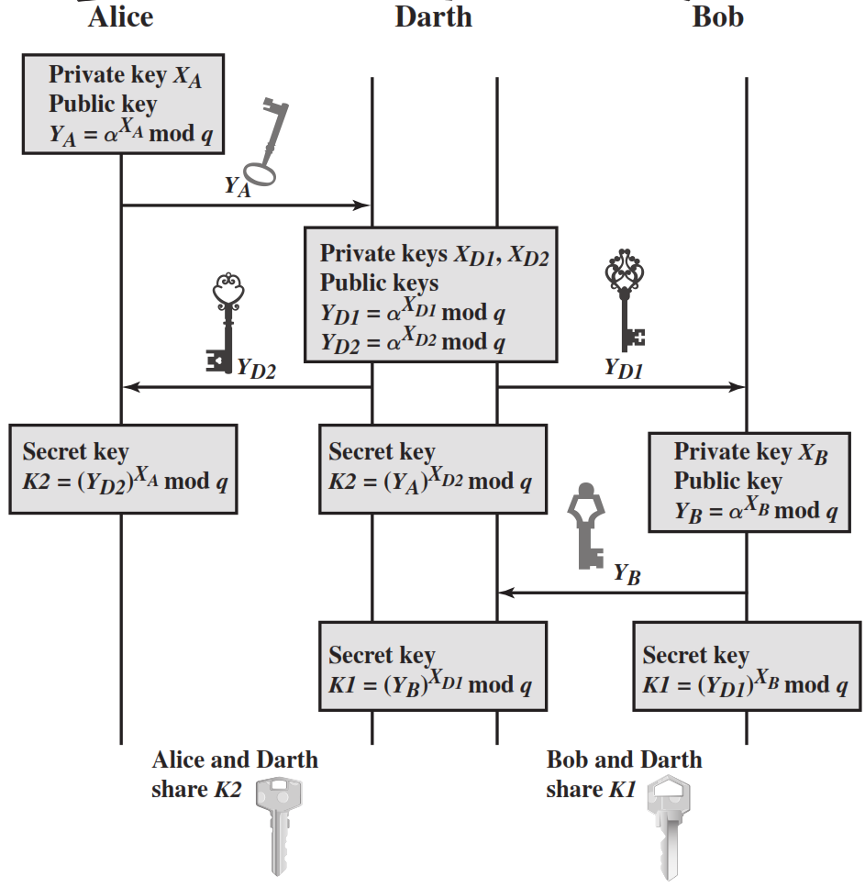

Slide 76
Thank You
76

Slide 77


www.paruluniversity.ac.in
77

