Slide 4
Contents
Symmetric key Distribution using Symmetric Encryption
Symmetric key Distribution using Asymmetric Encryption
Diffie hellman key exchange
Distribution of public key
X.509 Certificates

Slide 5
Contents
key Distribution
For symmetric encryption to work, the two parties to an exchange must share the same key, and that key must be protected from access by others.
The strength of any cryptographic system rests with the key distribution technique, a term that refers to the means of delivering a key to two parties who wish to exchange data, without allowing others to see the key.

Slide 6
Key distribution
For two parties A and B wish to communicate, key distribution can be achieved in a number of ways, as follows:
A can select the key and physically deliver it to B.
A third party can select the key and physically deliver it to A and B.
If A and B have previously and recently used a key, one party can transmit the new key to the other, encrypted using the old key.
If A and B has an encrypted connection to a third party C, C can deliver a key on the encrypted links to A and B.

Slide 7
Key distribution
In symmetric encryption is number of user is N then total [n(n-1)]/2 number of keys are required.
If we use 4th option of key distribution the N number of keys only are required.
Session key
Master key

Slide 8
Key Distribution Scenario
Let us assume that user A wishes to establish a logical connection with B and requires a one-time session key to protect the data transmitted over the connection.
A has a master key, Ka, known only to itself and the KDC; similarly, B shares the master key, Kb with the KDC.

Slide 9
Key Distribution Scenario (Conti…)
A issues a request to KDC for a session key to protect a logical connection to B.
The message includes the identity of A and B and unique identifier, N1, for this transaction, which is refer to as nonce.
The nonce may be a timestamp, counter, or a random number; the minimum requirement is that it differs with each request.
It prevent masquerade, it should be difficult for an opponent to guess the nonce.
Thus, a random number is a good choice for a nonce.

Slide 10
Hierarchical Key Control
It is not necessary to limit the key distribution function to a single KDC.
For very large network, it may not be practical to do so.
As an alternative, a hierarchy of KDCs can be established.
For an example, there can be local KDCs, each responsible for a small domain of the overall internetworking, such as single LAN or a single building.
For communication among entities within the same local domain, the local KDC responsible for key distribution.
If two entities in different domains desire a shared key, then the corresponding local KDC s can communicate through a global KDC.
Such a scheme limit the damage of a faulty KDC to its local area only

Slide 11
Session Key Lifetime
The more frequently session keys are exchanged, the more secure they are.
On the other hand, the distribution of session keys delays the start of exchange and place a burden on network capacity.
A security manager must try to balance these competing consideration in determining the lifetime of a particular session key.
For connection-oriented protocols, one obvious choice is to use the same session key for the length of time that the connection is open, using new session key for each new session.

Slide 12
Session Key Lifetime (Conti…)
For connectionless protocols, such as a transaction-oriented protocols, the most secure approach is to use a new session key for each exchange.
However, this negates one of the principal benefits of connectionless protocols, which is minimum overhead and delay for each transaction.
A better strategy is to use a given session key for a certain fixed period only or for a certain number of transactions.

Slide 13
A Transparent Key Control Scheme
The scheme is useful is useful for providing end-to-end encryption at a network or transport level in a way that is transparent to the end user.

Slide 15
A Transparent Key Control Scheme (Conti…)
The approach assumes that communication makes use of a connection-oriented end-to-end protocol, such as TCP.
When one host wishes to set up a connection to another host, it transmits a connection request packet.
The session security module (SSM) saves that packet and applies to the KDC for permission to establish the connection.
The communication between the SSM and the KDC is encrypted using the master key shared only by SSM and the KDC.

Slide 16
A Transparent Key Control Scheme (Conti…)
If the KDC Approves the connection request, it generate the session key and delivers it to the two appropriate SSMs, using a unique permanent key for each SSM.
The requesting SSM can now release the connection request packet, and a connection is set up between the two end systems.

Slide 17
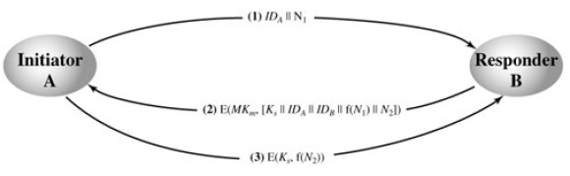
Decentralized Key Control

Slide 18
Decentralized Key Control
A session key may be established with the following sequences of the steps.
A issues a request to B for a session key and includes a nonce, N1.
B response with a message that is encrypted using the shared master key. The response includes the session key selected by B, the value f(N1), and another nonce N2.
Using the new session key, A returns f(N2) to B.
Because the message transferred using the master key are short, cryptanalysis is difficult.

Slide 20
Simple Secret Key Distribution
If A wishes to communicate with B, the following procedure is employed:
A generates a public/private key pair {PUa, PRa} and transmits a message to B consisting of PUa and an identifier of A, IDA.
B generates a secret key, Ks, and transmits it to A, encrypted with A's public key.
A computes D(PRa, E(PUa, Ks)) to recover the secret key. Because only A can decrypt the message, only A and B will know the identity of Ks.
A discards PUa and PRa and B discards PUa.
A and B can now securely communicate using conventional encryption and the session key Ks. At the completion of the exchange, both A and B discard Ks. Despite its simplicity, this is an attractive protocol. No keys exist before the start of the communication and none exist after the completion of communication. Thus, the risk of compromise of the keys is minimal. At the same time, the communication is secure from eavesdropping.

Slide 21


Slide 22
Secret Key Distribution with Confidentiality and Authentication
This approach suggested in [NEED78], provides protection against both active and passive attacks.
Assuming A and B have exchanged public keys
1 A uses B's public key to encrypt a message to B containing an identifier of A (IA) and a nonce (N1), which is used to identify this transaction uniquely.
2 B sends a message to A encrypted with PUa and containing A's nonce (N1) as well as a new nonce generated by B (N2). Because only B could have decrypted message (1), the presence of N1 in message (2) assures A that the correspondent is B.
3 A returns N2, encrypted using B's public key, to assure B that its correspondent is A.

Slide 23
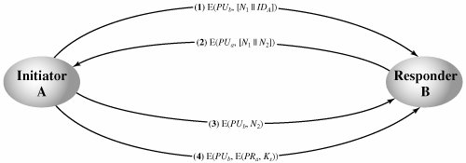

Slide 24
Secret Key Distribution with Confidentiality and Authentication
4 A selects a secret key Ks and sends M = E(PUb, E(PRa, Ks)) to B. Encryption with B's public key ensures that only B can read it; encryption with A's private key ensures that only A could have sent it.
5 B computes D(PUa, D(PRb, M)) to recover the secret key.
The result is that this scheme ensures both confidentiality and authentication in the exchange of a secret key.

Slide 26
Diffie Hellman key exchange

Slide 27
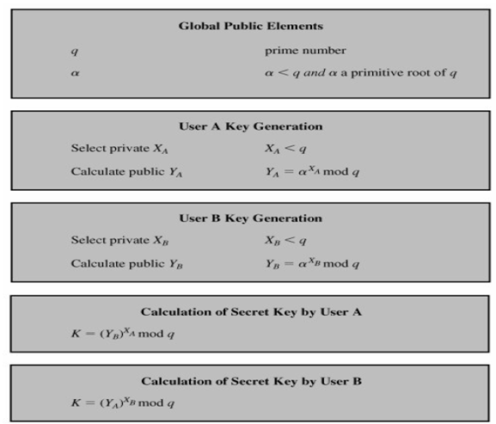

Slide 28
Distribution of public key
Public announcement
Publicly available directory
Public-key authority
Public-key certificates

Slide 29
Public announcement
The point of public-key encryption is that the public key is public, hence any participant can send his or her public key to any other participant, or broadcast the key to the community at large.
Its major weakness is forgery, anyone can create a key claiming to be someone else and broadcast it, and until the forgery is discovered they can masquerade as the claimed user.

Slide 30
Publicly available directory
can obtain greater security by registering keys with a public directory
directory must be trusted with properties:
contains {name,public-key} entries
participants register securely with directory
participants can replace key at any time
directory is periodically published
directory can be accessed electronically
still vulnerable to tampering or forgery

Slide 31
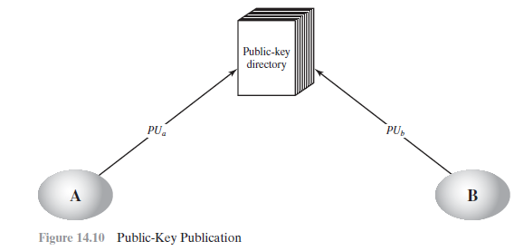

Slide 32
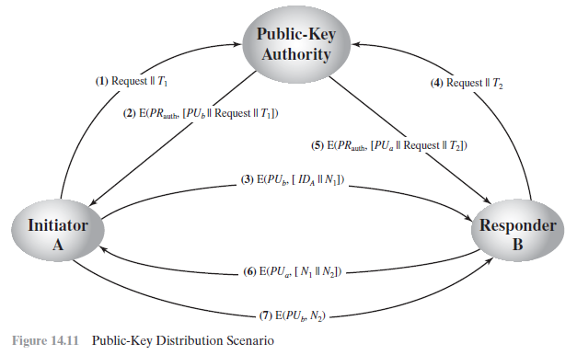
Public-key authority

Slide 33
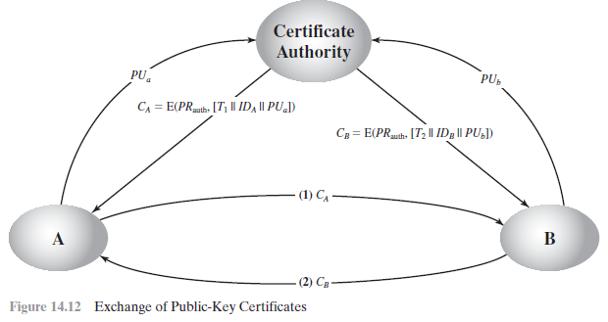
Public-key certificates

Slide 34
X.509 certificates
The ITU-T recommendation X.509 Directory Authentication Service is part of the X.500 series of recommendations that define a directory service.
X.509 defines a framework for the provision of authentication services by the X.500 directory to its users.
The directory may serve as a repository of Public Certificates.
Each certificate contains the public key of a user and is signed with the private key of a Trusted Certificate Authority (CA).

Slide 35
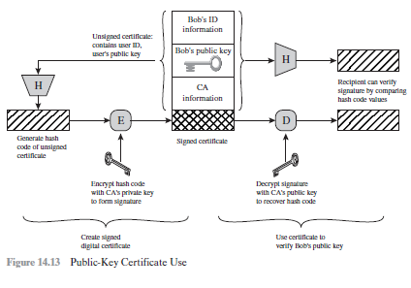
X.509 certificates cont…..

Slide 36
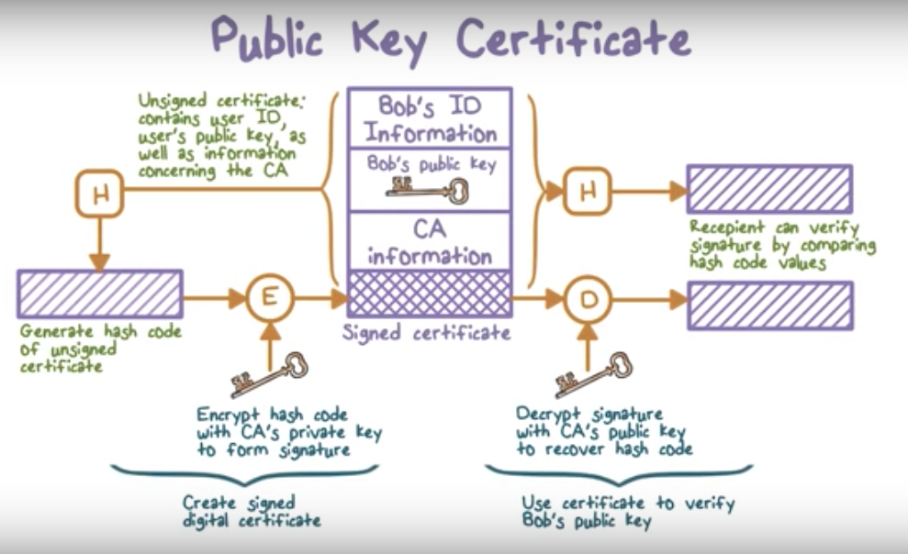
Public key certificate

Slide 37
User certificates generated by CA have following characteristics:
Any user with access to the public key of the CA can recover the user public key that was certified
No party other than the CA can modify the directory
An outline of the X.509 is shown in figure and includes the following elements:

Slide 38
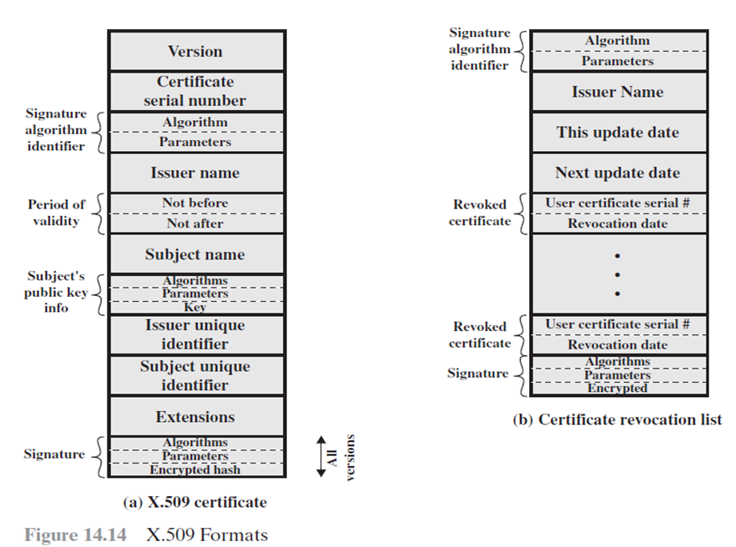
Differentiates among successive versions of the certificate format
An integer value, unique within the
issuing CA, that is unambiguously associated with this certificate
The algorithm used to sign the certificate, together with any associated parameters; this has little utility due to a repeat of this information in the
X.500 name of the CA that created
and signed this certificate
Version 1
Two dates, the first and last on which the certificate is valid
Version 2
Version 3
The name of the user to whom the certificate refers
The public key of the subject plus an identifier of the algorithm for which the key is to be used together with any associated parameters
An optional bit string field used to identify uniquely the issuing CA in the event the X.500 name has been reused for different entities
An optional bit string field used to identify uniquely the subject in the event the X.500 name has been reused for different entities
A set of one or more extension fields these were added in version 3
Covers all of the other fields of the certificate. It contains the hash code of the other fields, encrypted with the CA’s private key. This field includes the signature algorithm identifier

Slide 39
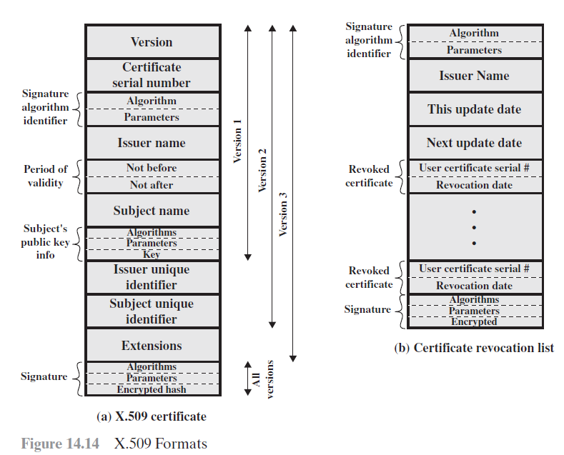

Slide 40
Notation to define a certificate:
version of the certificate
Name of certificate authority
Period of validity of
the certificate
serial number of the certificate

Slide 41
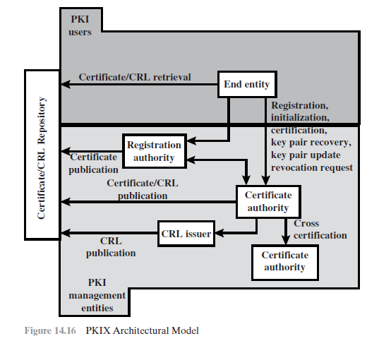
PUBLIC-KEY INFRASTRUCTURE

Slide 42
FIREWALL
A firewall is a network security device or software that monitors and controls incoming and outgoing network traffic based on predetermined security rules, establishing a barrier between a trusted internal network and untrusted external networks to prevent unauthorized access and protect against cyber threats through techniques like packet filtering, stateful inspection, proxy service, and advanced features in next-generation firewalls.

Slide 43
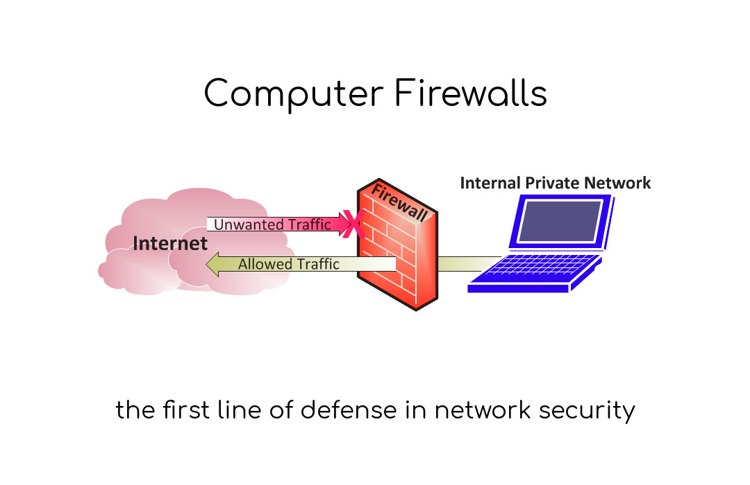

Slide 44
INTRUDERS
Intruders are unauthorized individuals or entities that attempt to gain access to a computer system, network, or data, often with malicious intent. Their activities can range from stealing sensitive information and disrupting services to installing malware and exploiting system vulnerabilities. Intruders can be external hackers, malicious insiders, or automated software designed to breach security defenses.

Slide 45
VIRUS
A virus is a type of malicious software (malware) designed to replicate itself and spread from one computer to another. It attaches itself to legitimate programs or files and can perform harmful activities, such as corrupting or destroying data, slowing down system performance, and compromising the security of the infected system. Viruses often require user interaction to spread, such as opening an infected file or running an infected program.

Slide 46
TROJANS
A Trojan, or Trojan horse, is a type of malicious software (malware) that disguises itself as a legitimate or harmless program to deceive users into installing it. Once activated, Trojans can perform a variety of malicious activities, such as stealing sensitive information, creating backdoors for unauthorized access, or downloading and executing additional malware. Unlike viruses, Trojans do not replicate themselves but rely on deception and social engineering to spread.

Slide 47


Slide 48
MALWARE
Malware is a broad term encompassing any software intentionally designed to cause damage or perform unwanted actions on a computer, server, client, or network. This malicious software can take various forms, including viruses, worms, Trojans, spyware, adware, and ransomware. The primary goal of malware is to compromise the integrity, confidentiality, or availability of information systems. Malware can be used to steal sensitive data, such as personal information or financial details, disrupt operations by corrupting or deleting files, or gain unauthorized access to systems, allowing attackers to control the affected machines remotely. The methods of infection can vary, including email attachments, malicious websites, software downloads, and network vulnerabilities. The impact of malware can range from minor annoyances to severe disruptions and substantial financial losses for individuals and organizations.

Slide 49
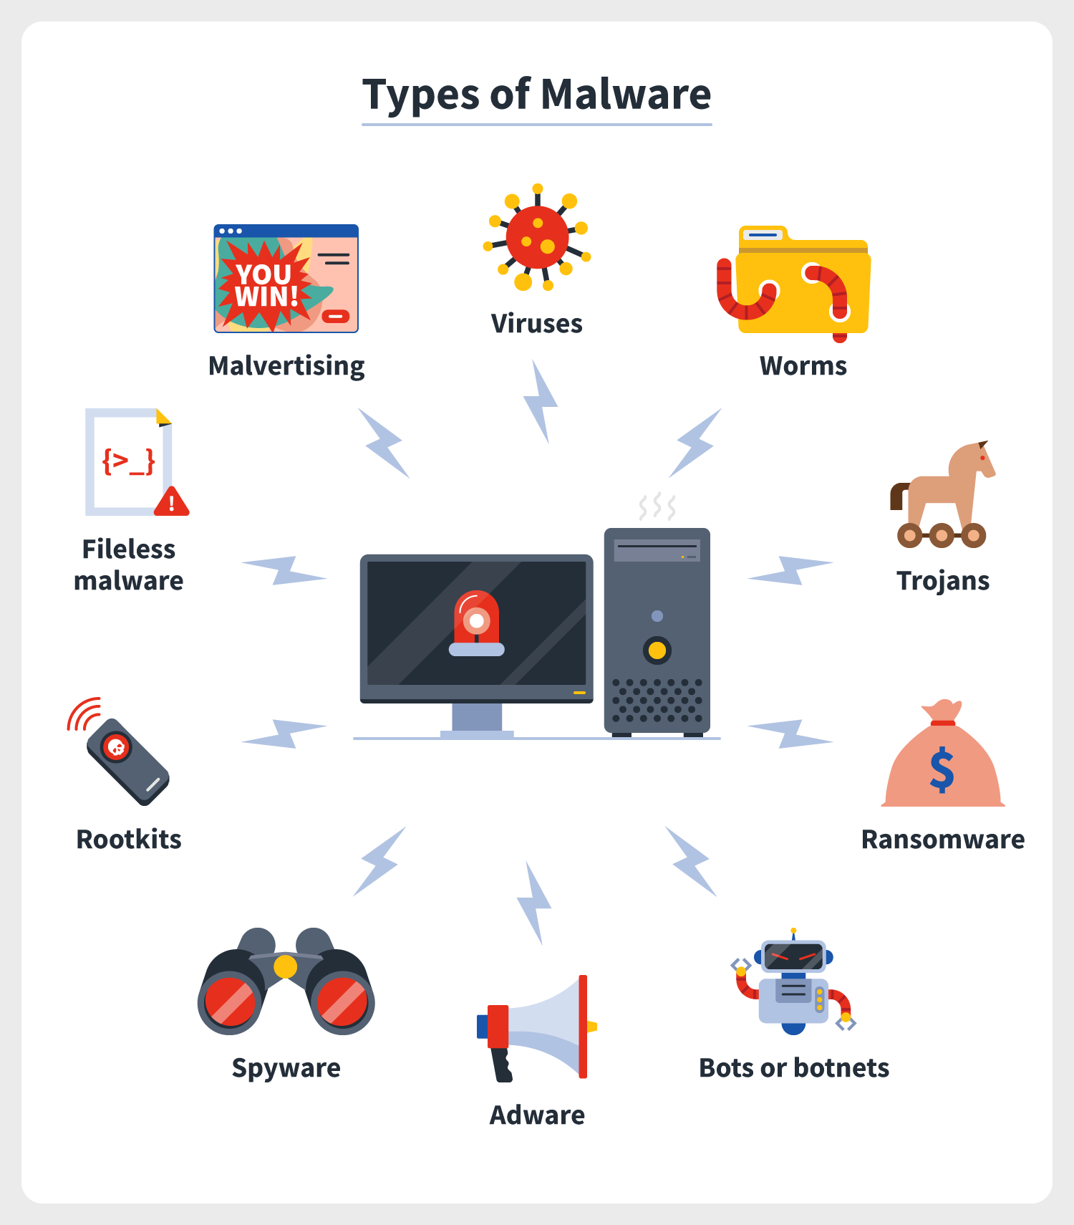

Slide 50
RANSOMEWARE
Ransomware is a specific type of malware that represents a significant and growing threat to both individuals and organizations. Once it infects a system, ransomware encrypts the victim's files, rendering them inaccessible, or locks the user out of their system entirely. The attacker then demands a ransom payment, typically in cryptocurrency, in exchange for the decryption key or to unlock the system. Ransomware can spread through phishing emails, malicious downloads, or exploiting vulnerabilities in software or networks. The consequences of a ransomware attack can be devastating, including the loss of critical data, disruption of business operations, and significant financial costs related to the ransom payment, recovery efforts, and potential legal liabilities. Even if the ransom is paid, there is no guarantee that the attackers will provide the decryption key or that the decrypted data will be intact and usable. Preventing ransomware involves a combination of robust cybersecurity practices, such as regular data backups, user education on phishing, maintaining updated software, and employing security measures like firewalls and antivirus programs.

Slide 51


Slide 53


www.paruluniversity.ac.in

