Slide 1



SOFTWARE TESTING & QUALITY ASSURANCE (SUBJECT CODE: 203105395)
Prof. Pathan Bilalkhan R.
Assistant Professor
Computer Science Engineering

Slide 2
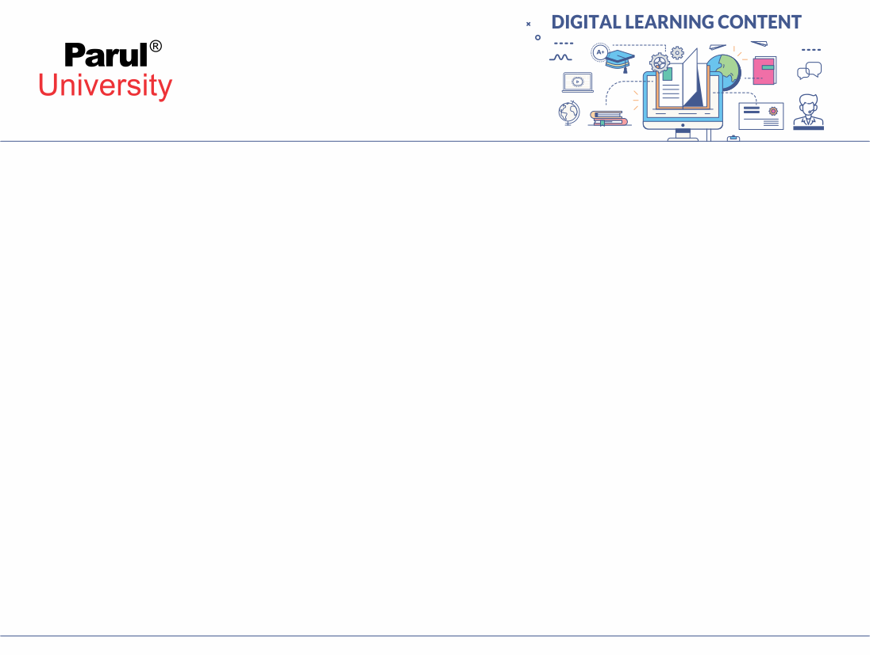

CHAPTER-4
Testing Process and Specialized System

Slide 3
Test plan development
As per ISTQB definition: “Test Plan is A document describing the scope, approach, resources, and schedule of intended test activities.”
Making Test Plan document has multiple benefits
- Help people outside the test team such as developers, business managers, customers understand the details of testing.
Test Plan guides our thinking. It is like a rule book, which needs to be followed.
Test estimation, test scope, Test strategy are documented in Test Plan, so it can be reviewed by Management Team and re-used for other projects.
Image source : Google

Slide 4
Test plan Identifier
Sr | Parameter | Description
1 | Test plan identifier | Unique identifying reference.
2 | Introduction | A brief introduction about the project and to the document
3 | Test items | A test item is a software item that is the application under test.
4 | Features to be tested | A feature that needs to tested on the test ware.
5 | Features not to be tested | Identify the features and the reasons for not including as part of testing.
6 | Approach | Details about the overall approach to testing.
7 | Item pass/fail criteria | Documented whether a software item has passed or failed its test.

Slide 5
Test plan Identifier
Sr | Parameter | Description
8 | Test deliverables | The deliverables that are delivered as part of the testing process, such as test plans, test specifications and test summary reports.
9 | Testing tasks | All tasks for planning and executing the testing.
10 | Environmental needs | Defining the environmental requirements such as H/W,S/W, OS, N/W configurations, tools required.
11 | Responsibilities | Lists roles & responsibilities of the team members.
12 | Staffing and training needs | Captures the actual staffing requirements and any specific skills and training requirements.
13 | Schedule | States the important project delivery dates and key milestones.
14 | Risks and Mitigation | High-level project risks and assumptions and a mitigating plan for each identified risk.

Slide 6
Test plan development
You already know that making a Test Plan is the most important task of Test Management Process. Follow the seven steps below to create a test plan as
per IEEE 829 :-
Analyze the product
Design the Test Strategy
Define the Test Objectives
Define Test Criteria
Resource Planning
Plan Test Environment
Schedule & Estimation
Determine Test Deliverables
Image source : Google

Slide 7
Test plan development
Analyze the product
How can you test a product without any information about it? The answer is Impossible. You must learn a product thoroughly before testing it.
Design the Test Strategy
Test Strategy is a critical step in making a Test Plan in Software Testing.
A Test Strategy document, is a high-level document, which is usually developed by Test Manager.
This document defines:
The project’s testing objectives and the means to achieve them.
Determines testing effort and costs.
Following steps need to be followed
-Define the scope of testing
-Identify testing type
-Documents risk and issues
Image source : Google

Slide 8
Test plan development
Define the Test Objectives
Test Objective is the overall goal and achievement of the test execution. The objective of the testing is finding as many software defects as possible; ensure that the software under test is bug free before release.
To define the test objectives, you should do 2 following steps
List all the software features (functionality, performance, GUI…) which may need to test.
Define the target or the goal of the test based on above features.
Test Criteria is a standard or rule on which a test procedure or test judgment can be based. There’re 2 types of test criteria as following
Suspension criteria:Specify the critical suspension criteria for a test. If the suspension criteria are met during testing, the active test cycle will be suspended until the criteria are resolved.
Image source : Google

Slide 9
Test plan development
Exit Criteria
It specifies the criteria that denote a successful completion of a test phase. The exit criteria are the targeted results of the test and are necessary before proceeding to the next phase of development. Example: 95% of all critical test cases must pass.
Resource Planning
Resource plan is a detailed summary of all types of resources required to complete project task. Resource could be human, equipment and materials needed to complete a project
The resource planning is important factor of the test planning because helps in determining the number of resources (employee, equipment…) to be used for the project. Therefore, the Test Manager can make the correct schedule & estimation for the project.
Image source : Google

Slide 10
Test plan development
Plan Test Environment
A testing environment is a setup of software and hardware on which the testing team is going to execute test cases. The test environment consists of real business and user environment, as well as physical environments, such as server, front end running environment.
Schedule & Estimation
Making schedule is a common term in project management. By creating a solid schedule in the Test Planning, the Test Manager can use it as tool for monitoring the project progress, control the cost overruns.
Determine Test Deliverables
Test Deliverables is a list of all the documents, tools and other components that has to be developed and maintained in support of the testing effort.
Image source : Google

Slide 11
Requirements Phase
This is the initial phase of the development process wherein the development team works closely with the customer to determine the customer's requirements for the product.
The requirements phase identifies the functionality, performance levels, and other characteristics which the product must satisfy in order for it to be acceptable to the customer.
The requirements developed in this phase serve as a foundation for the remaining phases of the development process, and as the customer acceptance criteria.
Image source : Google

Slide 12
Activities in Requirement Phase Testing
Identify types of tests to be performed.
Gather details about testing priorities and focus.
Prepare Requirement Traceability Matrix (RTM).
Identify test environment details where testing is supposed to be carried out.
Automation feasibility analysis (if required).
Image source : Google

Slide 13
Design Phase
In the design phase the architecture is established.
This phase starts with the requirement document delivered by the requirement phase and maps the requirements into an architecture. The architecture defines the components, their interfaces and behaviors.
The deliverable design document is the architecture. The design document describes a plan to implement the requirements. This phase represents the ``how'' phase.
Details on computer programming languages and environments, machines, packages, application architecture, distributed architecture layering, memory size, platform, algorithms, data structures, global type definitions, flow charts, state transition diagram interfaces, and many other engineering details are established.
Image source : Google

Slide 14
Program Phase Testing
Check the code for consistency with design
Start testing with organized and systematic manner
Use available tools
Apply Stress to the Program set.
Measure testing coverage/When should testing stop?
Unit Test
API Testing
Integration Test
Image source : Google

Slide 15
Testing Client/Server Systems
Client-server software requires specific forms of testing to prevent or predict catastrophic errors.
Servers go down, records lock, I/O (Input/Output) errors and lost messages can really cut into the benefits of adopting this network technology.
Testing addresses system performance and scalability by understanding how systems respond to increased workloads and what causes them to fail.
It involves the dynamic analysis of the software being tested.
It instructs the software to perform tasks and functions in a virtual environment. This examines compatibility, capability, efficiency, reliability, maintainability, and portability.
Image source : Google

Slide 16
Testing Client/Server Systems
Component Testing
Integration testing: After successful testing of server, client and network, they are brought together to form system testing.
Performance testing: System performance is tested when number of clients is communicating with server at a time. Volume testing and stress testing is used
Concurrency Testing
Disaster Recovery Business continuity testing
Testing for extended periods: In case of client server applications generally server is never shutdown unless there is some agreed Service Level Agreement (SLA) where server may be shut down for maintenance. It may be expected that server is running 24X7 for extended period.
Compatibility Testing: Client server may be put in different environments when the users are using them in production. Servers may be in different hardware, software, or operating system environment than the recommended.
Image source : Google
Notes:
Component Testing: One need to define the approach and test plan for testing client and server individually. When server is tested there is need of a client simulator, whereas testing client a server simulator, and to test network both simulators are used at a time.
Integration testing: After successful testing of server, client and network, they are brought together to form system testing.
Performance testing: System performance is tested when number of clients is communicating with server at a time. Volume testing and stress testing may be used for testing, to test under maximum load as well as normal load expected. Various interactions may be used for stress testing.
Concurrency Testing: It is very important testing for client-server architecture. It may be possible that multiple users may be accessing same record at a time, and concurrency testing is required to understand the behavior of a system in this situation.
Disaster Recovery Business continuity testing: When the client server are communicating with each other , there exit a possibility of breaking of the communication due to various reasons or failure of either client or server or link connecting them. The requirement specifications must describe the possible expectations in case of any failure.
Testing for extended periods: In case of client server applications generally server is never shutdown unless there is some agreed Service Level Agreement (SLA) where server may be shut down for maintenance. It may be expected that server is running 24X7 for extended period. One needs to conduct testing over an extended period to understand if service level of network and server deteriorates over time due to some reasons like memory leakage.
Compatibility Testing: Client server may be put in different environments when the users are using them in production. Servers may be in different hardware, software, or operating system environment than the recommended. Other testing such as security testing and compliance testing may be involved if needed, as per testing and type of system.

Slide 17
Testing Web based Systems
Functionality Testing: Verify there is no dead page or invalid redirects, validations on each field, Wrong inputs to perform negative testing , Verify the workflow of the system, Verify the data integrity.
Usability testing: Test the navigation and controls, Content checking, Check for user intuition
Interface testing
Compatibility testing: Browser compatibility, Operating system compatibility, Compatible to various devices like notebook, mobile, etc.
Performance testing: Load testing, Stress testing
Security testing
Image source : Google

Slide 18
Testing Off the-Shelf Software
What is off the shelf component or software
Why it is used
Compatibility testing
Interoperability and Integration testing
Image source : Google

Slide 19
Testing in Multiplatform Environment
Multi-platform testing is a type of software testing focused on verifying whether the system operates properly on the required platforms.
A platform means a combination of the device, operating system and some other software.
Multi-platform testing process consists of testing:
- functionality of the software;
- graphical user interface of the software;
- performance issues of the software;
- security aspects of the software;
- usability aspects of the software;
Image source : Google

Slide 20
Testing for Real Time Systems
Testing a real time system is often difficult because of the very nature of real time systems.
Unit Testing
Software Integration Testing
Software Validation and Verification Testing
Software / Hardware Integration Testing
System Testing
Recovery Testing
Security Testing
Stress testing
Performance testing
https://dzone.com/articles/selenium-java-tutorial-how-to-test-login-process
Image source : Google

Slide 21
Testing Security
SECURITY TESTING is a type of Software Testing that uncovers vulnerabilities, threats, risks in a software application and prevents malicious attacks from intruders.
The purpose of Security Tests is to identify all possible loopholes and weaknesses of the software system which might result in a loss of information, revenue, repute at the hands of the employees or outsiders of the Organization.
Vulnerability Scanning
Penetration testing: This testing simulates an attack from a malicious hacker. It involves analysis of for potential vulnerabilities to external hacking attempt.
Risk Assessment:
Ethical hacking
Security Auditing
Ethical hacking
Image source : Google

Slide 22


www.paruluniversity.ac.in

