Slide 1



SOFTWARE TESTING & QUALITY ASSURANCE
Prof. Yassir Farooqui, Assistant Professor
Computer Science Engineering

Slide 2
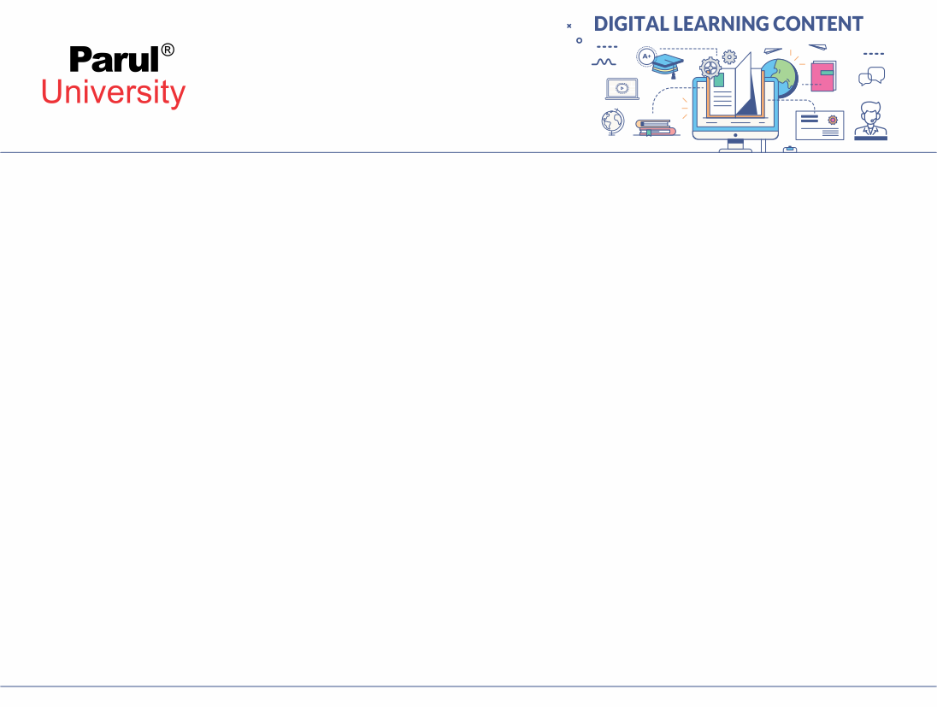

CHAPTER:5
Software Quality Assurance Concepts and Standards

Slide 3
Topics to be Covered
Quality Concepts
Test Strategies for Conventional and OO types
Unit Testing
Integration Testing
Validation Testing
SystemTesting
Security Testing, Stress Testing, Performance Testing
Metrics for Source Code, Metrics for Testing
Debugging Process, Debugging Strategies

Slide 4
Quality Concepts
The concept of software quality is more complex than what common people tend to believe.
set of characteristics that allows us to rank things as better or worse than other similar ones.
Different attempts to define software quality as a complex concept that can be decomposed
In more detailed characteristics have been presented since 1970s.
Metrics proposed by Mc call were clearly obsolete

Slide 5
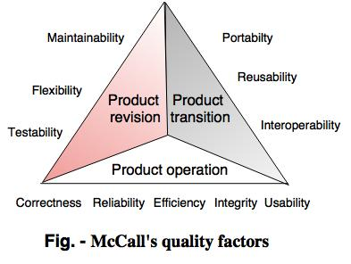
Mc Call’s Quality Factors

Slide 6
Quality Control
Quality management is a collection of strategies for achieving quality parameters used by organisations.
Quality targets and constantly enhance the capacity of the company to ensure that quality goals are met by a software product.
Quality management includes inspection of units and deciding if they are beyond the final product requirements.
The aim of the testing is to assess any need in the production process for corrective measures.
The quality control used in a organisation is extremely high.

Slide 7
Quality Control
It is a method of software engineering used in a product or a service to ensure consistency.
The methods used to make a commodity are not dealt with.
It investigates the consistency and the final outcome of the "end goods"
Quality control 's main goal is to verify if the goods follow the customer's expectations and requirements.
It has to be resolved before distribution to the customer if a malfunction or problem is found.
.

Slide 8
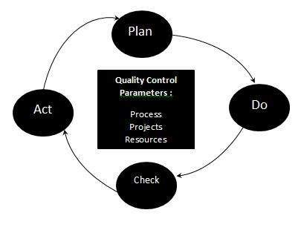
Example
The three class parameters that control software quality are:
Products
Processes
Resources
.
The method of complete quality control :
Plan-It is the stage where the processes of quality management are designed.
Do-Use specified parameters for quality production
Check-A stage to check if the consistency of the parameters is met.
Act-If necessary , take corrective steps and repeat the work.

Slide 9
Quality Assurance
Assurance is nothing but an optimistic statement that gives trust in a product or service.
It's a result or a service 's trust that it will perform well.
It offers an assurance that, according to expectations or requirements, the product will operate without any problems.
Quality assurance focuses on enhancing and making the software development process successful.
Effective for products according to the quality standards established
Quality Assurance is commonly referred to as QA Checking.

Slide 10
Quality Assurance
Software quality assurance (SQA) is a mechanism that ensures that approaches are used for all software engineering processes.
Activities and work items shall be tracked and shall comply with the standards specified.
These specified standards could be one or a combination of all such standards, such as ISO 9000, CMMI, ISO15504, etc.
SQA combines all phases of software development from the description of specifications to coding until publication.
Its primary purpose is to guarantee consistency.

Slide 11
SQA Activities
1) Creating an SQA Management Plan
2) Setting the Checkpoints:
3) Apply software Engineering Techniques:
4) Executing Formal Technical Reviews:
5) Having a Multi- Testing Strategy:
6) Enforcing Process Adherence:
7) Controlling Change:
8) Measure Change Impact:
9) Performing SQA Audits:
10) Maintaining Records and Reports:

Slide 12
SQA Activities
1)Creating a Plan for SQA Management
The primary task involves setting up a proper plan for how the SQA will be carried out in your project.
Along with what SQA plan you will follow.
What engineering tasks will be done, and it also means ensuring that in your team you have a proper talent mix.
2) Configuring the checkpoints:
The SQA community defines numerous checkpoints according to which it evaluates.
At each checkpoint, the quality of the project activities
This ensures that regular quality inspection and working as per the schedule.

Slide 13
SQA Activities
3) Apply Engineering Techniques software
The implementation of such software engineering methods allows a software designer to achieve high-quality requirements.
A designer can use methods such as interviews and Quick (Functional Analysis System Technique) for gathering information.
Techniques such as WBS (structure of work breakdown), SLOC (code source line), and estimation of FP(functional point).
4) Conducting professional systematic evaluations.
This activity helps in detecting errors in the early phase of SDLC and reduces rework effort in the later phases.

Slide 14
SQA Activities
5) Having a plan for multi-testing:
Instead, various forms of testing can be carried out based on some particular testing technique.
To ensure higher consistency, so that the software product can be checked well from all angles.
6) Regulation of Conformity to Process:
This practise insists on the need for adherence to processes throughout the phase of software creation.
The process of development should also stick to the procedures specified.

Slide 15
SQA Activities
7) Shift Monitoring
A blend of manual processes and automated methods with a system for monitoring changes.
Evaluating the essence of change and monitoring the impact of change by validating the change requests.
During the production and maintenance periods, it is assured that the software quality is maintained.
8) Effect of Calculating Change
The QA team can assess the effect of the shift caused by this correction of the defect.
Not only do they need to verify whether the modification has corrected the flaw,, but also if the change is compatible with the whole project.
.

Slide 16
SQA Activities
9) Carrying out SQA Audits
The entire actual SDLC process is inspected by the SQA audit, followed by comparison with the process defined.
It also tests what was actually done or not reported by the team in the status reports.
Any non-compliance concerns are also highlighted by this operation.
10) Management of archives and reports
It is important to preserve the required SQA-related documentation
To share with the stakeholders the required SQA information.
The outcomes of the exam, audit results, analysis rep, change requests documentation, etc. should be kept for future reference.

Slide 17
SQAC Activities
Quality Control Activities | Quality Assurance Activities
Walkthrough | Quality Audit
Testing | Defining Process
Inspection | Tool Identification and selection
Checkpoint review | Training of Quality Standards and Processes

Slide 18
Software Review
A software review is a phase or meeting at which a project team reviews a software product.
For comment or approval, users , devices, user members, or other interested parties.
As it offers a clearer view of the software created, a software review has its own significance.
It needs a team that can provide insight into the software being developed.
It also gives an expectation that this initiative is also worth launching.
The trained team tests the programme in compliance with the guidelines provided.

Slide 19
Software Review
It is one such approach that provides the development team & the client with an opportunity to get clarity on the project and its specifications.
The team will check whether or not the software is built according to the specifications requested.
Make the requisite changes prior to its arrival on the market.
It needs a team that can provide insight into the software being developed.
It also gives an expectation that this initiative is also worth launching.

Slide 20
Important reasons for Software Review
It increases the performance of the production team.
It makes the time and cost-efficient testing process effective as more time is spent on testing the software during the product's initial development.
In the final software, less bugs are found, which helps reduce the expense of the entire project.
As they are established at the earlier stage, the reviews given at this stage are found to be cost-effective.
It is only at this point that the shortcomings are removed.This process results in dramatic reduction of time taken in producing a technically sound document.

Slide 21
Types of Software Review
There are various forms of Software Peer Reviews that are listed below:
Code Review:The source code of the programme is reviewed here. The programme is tested for bugs and the code eliminates the bugs.
Pair programming: It is also a form of analysis of the code involving two individuals. At the same workstation, the two individuals create a code together
Inspection: In order to find defects / defects, it is a structured type of review where a person has to go through a given set of instructions.
Walkthrough:This is a process where the authors of the software as well as other associates are gathered at one place and they discuss about the software defects

Slide 22
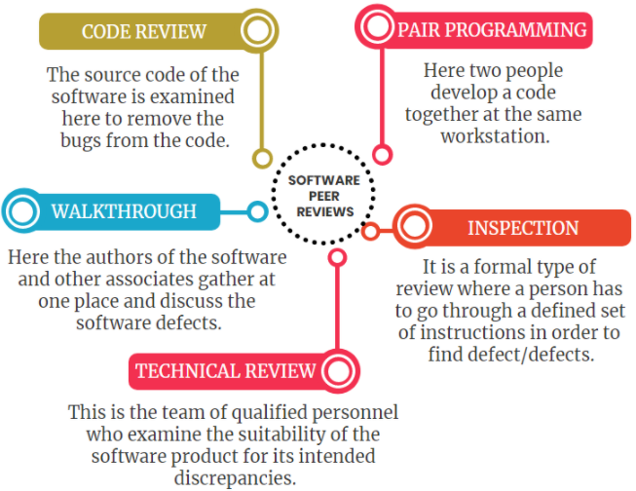
Types of Software Review

Slide 23
Formal Technical Reviews
Formal technical review (FTR) is a software quality control activity performed by software engineers.
The objectives of an FTR are:
To uncover errors in function, logic, or implementation for any representation of the software.
To ensure that the software has been represented according to predefined standards
To verify that the software under review meets its requirements
To achieve software that is developed in a uniform manner
To make projects more manageable.The FTR serves as a training ground to observe different approaches to software analysis, design.

Slide 24
Formal Technical Reviews
Phase
Procedures and Stages
Roles -Roles
Moderator, Author, Reader, Reviewer, Recorder
Objectives
Removing flaws, eliciting specifications, etc.
The Measurements
Types, coherent forms

Slide 25
Pre-Meeting Preparation
Materials that will be given to reviewers
Expectations for time prior to the meeting
Understanding participants' positions
Education for members of the team in their different positions
Expected end product

Slide 26
FTR Team roles
Author
Moderator
Reader
Reviewer
Recorder (optional?)

Slide 27
Review Guidelines
1. Reviews of an identity we can check must be submitted.
We must be able to verify your identity, even though you wish to display your review anonymously.
To help to facilitate this verification, we encourage you to log in via LinkedIn.
2. Reviewers do not have a conflict of interest with the reviewed product.
Vendors, their staff, or anyone with a financial interest in a product's success.
They are not eligible to check their own brand or a rival's.
3. The real reviewer must post reviews.
We do not allow reviews to be posted on behalf of others or under an assumed name, in compliance with our verification process.

Slide 28
Review Guidelines
Reviews must contain original content.
We do not allow reviews to be copied from another source, including our own website.
Reviews must not contain abusive, hateful, threatening, or harassing content.
We do not allow reviews to contain personal threats, obscenities, or hate speech.
Reviews must provide honest feedback about the product being reviewed and must not be used to deliberately promote or disparage another product.
Reviews must not violate any legal agreements.
A review must not violate any third party confidentiality, non-disclosure, or contractual obligations.

Slide 29
Software Reliability
A software's reliability can be described as a software that has no failure and works with a specific environment in a special time span.
It is possible to describe the probability of failure with the probability that the programme will fail at the next selected input.
The following points can describe the reliability of software.
The Software's Precision.
Presence of zero-percent device failure.
To meet the user's needs.
Error avoidance ability.
Capacity of recuperation.
Application sophistication.

Slide 30
Software Reliability
Different Reliability of hardware because it doesn't age, wear out, rust, deform or crack!
Usually, software remains in the same state as when it was developed, unless hardware-induced changes occur.
We might presume the software doesn't really "break," like changes in the storage content or data path.
In software systems , physical errors are still found.
Software reliability, along with functionality, is an integral attribute of software quality.
Usability, consistency, serviceability.

Slide 31
Software Reliability
Software characteristics vs hardware
Failure cause: Defects in software are primarily defects in design.
Wear-out: Software does not have a wear-out phase associated with electricity. Without alert, errors may occur.
Repairable machine idea: Frequent restarts will help repair issues with apps.
Time dependence and life cycle: operating time is not a function of software reliability.

Slide 32
Software Reliability
Environmental variables: Do not affect the efficiency of software, except that programme inputs can be affected.
Prediction of reliability: Reliability of software can not be predicted on any physical basis, as it totally depends on human design factors.
Redundancy: If similar software components are used, software reliability can not be changed.

Slide 33
Software Safety
Ensures the software runs within the framework of a system without creating an unreasonable risk
Functions of safety-critical apps
Allowing a risky machine state to occur directly or indirectly
Technology Vital to Protection
It contains security-critical functions.
Over time, inputs and outputs
Subsystem for Monitoring
Function overview to be done
Operational constraints specification (quality, power, operation, and protection) Safety constraints are hazards that are rewritten as limitations
Safety constraints written, maintained, and audited separately

Slide 34
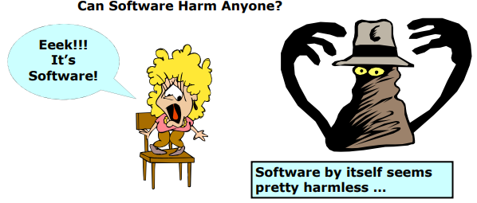
Software Safety

Slide 35
Software Safety
Software would be "secure" if ...
It has features and protocols to ensure that it operates predictably in regular and abnormal conditions.
It has features and processes to ensure that it performs.
Minimizing the risk of an unexpected event occurring in that programme
If an unexpected occurrence occurs, the results are regulated and contained.
RTCA DO-178CC Aerospace Systems-SAE AS9006A Aircraft-
Cars-BS ISO 26262; SAE JA 1002 BS ISO 26262; SAE JA 100262;Information Technology Equipment – IEC 60950-1
Nuclear Power – ANSI/IEEE 7-4.3.2
Railway Systems - BS EN 50128

Slide 36
Software Safety
Right deliberate machine functions?
Maintainable and understandable structure structure is
Verifying the design of algorithms and data structures against requirements
Verify code compatibility with the design of algorithms and data structures
Check the appropriateness of device testing

Slide 37
Quality Assurance Standards:ISO9000
ISO ( International Organization for Standards) is a coalition or alliance of 63 countries set up to plan and facilitate standardisation.
In 1987, ISO announced its 9000 series of standards,
It acts as a guide between the independent parties to the contract.
The requirements for maintaining a quality framework are determined by the ISO 9000 standard.
Operational techniques and operational approaches such as tasks, reporting, etc. are primarily discussed in the ISO standard.
ISO 9000 defines a set of guidelines for the production process and is not directly concerned about the product itself.

Slide 38
Quality Assurance Standards:ISO9000
The kinds of industries to which the different ISO norms relate are as:
ISO 9001: This requirement refers to companies involved in the design, production, manufacture and maintenance of products.
This is the standard applicable to most companies for software creation.
ISO 9002: This standard refers to companies that do not design products, but instead engage in manufacturing.
ISO 9003: This standard applies only to organisations which participate in the installation and testing of the products.
For example, Gas companies.

Slide 39
ISO9001:2000
The requirements replaced the ISO 9001, 9002 and 9003 standards of 1994 by unifying them.
It presents requirements to the implementation of quality management systems.
Its primary objective is to satisfy customers by meeting their needs.
In addition, by offering conforming services / products and continuous improvement development.
A management system is a collection of interrelated or interacting elements that enable an organisation to operate.
Establish policies and goals and achieve those goals.

Slide 40
ISO9001:2000
What we call a Quality Management System (QMS) is the coordinated activities to direct and control an organisation with regard to quality.
It's the way things are done to meet the demands of customer performance.
In a quality management system, ISO 9001 indicates "what to do" as a general standard, but not "how to do it".
In addition, by offering conforming services / products and continuous improvement growth.
A system of management is the collection of interrelated or interacting elements that enable an organization

Slide 41
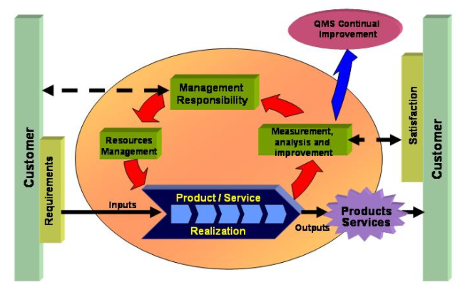
ISO9001:2000

Slide 42
ISO9001:2000
The ISO 9001:2000 standard is based on eight principles to achieve its goals:
Customer-focused organisation: organisations should understand and exceed their expectations of the current and future needs of customers.
Leadership: establishing a unity of purpose and direction to create an internal environment where individuals can contribute to the expected results of the organisation.
People's involvement: full employee participation allows their skills to be used for the organisation's activities.
Process approach: Systematic identification and management in order to obtain the desired outcome of the various processes employed within an organisation and the interactions between these processes.

Slide 43
ISO9001:2000
Systemic approach: managing a system of interrelated processes to a given objective contributes to efficiency. Integrating and aligning processes leads to better results.
Continual improvement: should be a permanent objective of the organization, leading to improvements in the overall performance.
Factual approach to decision making: effective decisions are based on the logical analysis of reliable data and information.
Mutually beneficial supplier relationships: establishing relationships with suppliers to enhance the ability of both organizations to create value.

Slide 44
ISO9126 Quality Factors
ISO 9126 is an international standard for software evaluation.
ISO9126-1 reflects the latest (and ongoing) research into software characterization for software quality control purposes.
Quality assurance of software and improvement of software processes (SPI)
6 key quality characteristics are identified by the ISO 9126-1 software quality model:
Functionality
Dependability
Usability, usability
Effectiveness
Mantenability
Portability – Portability

Slide 45
Functionality
The basic objective of any product or service is functionality.
This is relatively easy to define for certain items, such as the anchor of a ship having the function of holding a ship at a given location.
The more features a product has, such as an ATM machine, the more complex it is to define its functionality.
A list of functions can be defined for software, i.e. a sales order processing system
It should be capable of recording customer data so that it can be used for reference a sales order.

Slide 46
Reliability
Once, as defined, a software system is operating and the reliability feature is delivered.
It determines the system's ability to manage its service provision for specified periods of time under defined conditions.
Fault tolerance, which is the ability of a device to withstand component failure, is one aspect of this feature.
For example, if the network goes down for 20 seconds, the device should be able to recover and continue to run when it returns.

Slide 47
Usability
In terms of functionality, usability only exists and refers to the ease of use for a given function.
For example a function of an ATM machine is to dispense cash as requested.
Placing common amounts, i.e. $20.00, $40.00, $100.00 etc, on the screen for selection,
It does not affect the function of the ATM, but the function's usability is discussed.
Another important sub-characteristic of usability is the desire to learn how to use a device (learnability).

Slide 48
Efficiency
The device resources used when providing the necessary functionality are concerned with this feature.
A clear example of this trait is the amount of disc space , memory, network, etc.
As with a number of these functions, overlaps occur.
The usability of a scheme, for example, is affected by the performance of the system.
The system will not be easy to use if a system takes 3 hours to react, whereas the essential problem is output or quality or efficiency characteristic.

Slide 49
Maintainability
What the maintainability function discusses is the ability to detect and correct a fault within a software component.
This trait is referred to in other software quality models as supportability.
It is influenced, as well as modularization, by code readability or complexity.
The problem of maintainability is something that helps to determine the cause of a fault and then to repair the fault.
One of the sub-sub-systems is also the ability to check (or test) a scheme, i.e. testability.

Slide 50
Portability
This function refers to how well the programme can adapt to improvements in its environment or its specifications.
Adaptability is included in the sub features of this attribute.
To the degree to which this feature is present in a given framework, object-oriented design and implementation practises may contribute.

Slide 51
CMM
CMM was developed in 1987 at Carnegie Mellon University by the Software Engineering Institute ( SEI).
It is not a blueprint for software processes.
It is a tool used to examine the strategy and strategies that every company follows to produce software products.
It also offers recommendations for further enhancing the maturity of the method used to manufacture such software products.
It is focused on in-depth feedback and development strategies implemented globally by the most effective organisations.

Slide 52
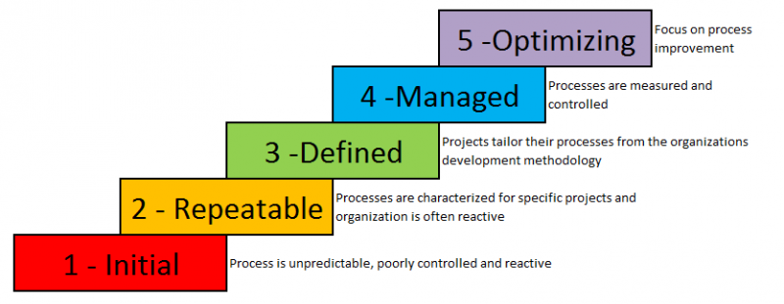
CMM

Slide 53
CMM
This model outlines a software process enhancement technique that should be implemented by going across 5 distinct stages.
Each maturity level displays a level of process capability.
Key Process Areas (KPA's) further define all of the levels except level-1.
The basic requirements that a software process should fulfil are specified by each of these KPA's.
To satisfy the KPA and reach the maturity level.
Key process areas form the basis of software project management control and define the context in which technical methods are implemented.
Work products such as models, papers, data, reports, etc. are produced, targets are set, quality is ensured

Slide 54
CMM
Level-1: Initial
No identified KPAs.
The following processes are adhoc and immature and are not well developed.
Unstable software development environment.
No basis for product quality estimation, time for completion, etc.
Level-2: Repeatable
It focuses on the development of fundamental policies for project management.
For the management of new projects of a similar type, experience with earlier projects is used.
It involves project planning, configuration management , management of specifications, management of subcontracts and quality assurance.

Slide 55
CMM
Level-3: Defined
Documentation of standard rules and procedures takes place at this stage.
It is a well defined, interconnected set of software engineering and management processes unique to projects.
It involves peer reviews, collaboration of intergroups, concentration of organisation procedures, training programmes.
Level-4: Managed
At this point, for software products as well as software processes, quantitative quality objectives are set for the organisation.
The measurements allow the company to predict the brand and process quality within some limits defined quantitatively.
It Includes Software Quality Management,Quantative Management.

Slide 56
CMM
5. Level-5: Optimizing
This is the highest degree of process sophistication in CMM and, using quantitative feedback, focuses on continuous process development in the enterprise.
New methods, strategies and software process validation are used to avoid the recurrence of identified defects.
Method Change Management, Management of Technological Change, Defect Prevention and Product

Slide 57
TQM
We will have a very good method and instrument for test management to ensure the effectiveness of your testing.
Management of evaluations alone can not guarantee consumer satisfaction.
Total Quality Control is a way to not only offer goods and services of high quality, but also to reach higher levels of customer satisfaction.
We need to track all the activities and tasks to maintain the required level of excellence in every project.
The act of achieving a benchmark standard of quality by formulating a quality policy is Quality Management.
Quality preparation, quality assurance management for enhancement of quality.

Slide 58
7 fundamental principles of TQM
1. Customer Focus
The method of quality control aims to satisfy consumer expectations and achieve beyond planned product or service levels.
2. Commitment from Leadership
The representatives at all hierarchical levels help to create a sense of purpose and direction.
The leadership is responsible for establishing a conducive atmosphere in order to achieve the organisation's quality goals.
3. People engagement
This theory states that all the individuals in the business must be qualified, motivated and active in providing value.
This also increases the value-creating ability.

Slide 59
7 fundamental principles of TQM
4. Process Approach
In order to produce consistent and predictable outcomes, all the operations should be handled as interrelated processes.
As a cohesive structure, these interrelated activities work.
5. Continuous Improvement
A essential concept for the performance of a company is an ongoing emphasis on change.
6. Evidence-based Decision making
Decisions are focused on knowledge obtained from data analysis and evaluation.
7. Relationship Management
Organizations should manage their relationships with interested parties such as suppliers very well.

Slide 60
Example & Tool of TQM
1. TQM Example: One of the most famous examples of total quality management is Toyota. Toyota implemented Kanban System to make its assembly line more efficient. The company decided to keep just enough inventories to fulfil customer orders as they were generated.
2. TOOL: ReQtest is a total quality management tool with Test Management, Requirements Management, and Bug Tracking modules. It helps to establish a process to monitor all the activities and tasks to ensure a high quality of the process is in place to release great software. Explore the capabilities of ReQtest as a quality management tool, signup for a free trial today.

Slide 61
Six Sigma
A vision and philosophical determination to deliver the best quality, lowest cost goods to our customers
A Metric that demonstrates quality standards at 99.9997 percent output for goods and processs
A Benchmark of our ability to equate our product and process to 'best in class'
Practical use of statistical tools and methods to help us calculate, assess, optimise and monitor the process

Slide 62
Six Sigma
A methodology for quality improvement of customer satisfaction and benefit is Six Sigma.
Management of evaluations alone can not guarantee satisfaction.
It is a theory of management aiming to enhance productivity and effectiveness.
Six Sigma is a highly focused mechanism that allows us to concentrate on designing and providing goods and services that are almost flawless.
The goal of Six Sigma is to eliminate waste and inefficiency, thereby increasing customer loyalty by providing what the customer is doing.
Six Sigma follows a formal approach, and the participants have specified positions.
Six Sigma is a technique guided by data , which includes reliable collection of data for the analysed processes.

Slide 63
Six Sigma
Six Sigma is a multi-dimensional, business-driven, organised strategy for:
Enhancing processes
Decreasing Defects
Reducing uncertainty of processes
Lowering costs
Growing satisfaction with customers
Increased gains
The word Sigma is a statistical term which measures how far from perfection a given process deviates.
The core concept behind Six Sigma: Whether you can calculate how many "defects" in a method you have.
You will find out how to remove them systematically to get as close to "zero defects" as possible.

Slide 64
Key Concepts of Six Sigma
Critical to Quality
Attributes most important to the customer.
Defect
Failing to deliver what the customer wants.
Process Capability
What your process can deliver.
Variation
What the customer sees and feels.
Stable Operations
Ensuring consistent, predictable processes to improve what the customer sees and feels.
Design for Six Sigma
Designing to meet customer needs and process capability.

Slide 65
Six Sigma as a Tool
Process Mapping
Structure Tree
Pareto Analysis
Gauge R & R
Baselining
Tolerance Analysis
Components Search
Hypothesis Testing
Regression
DOE
SPC

Slide 66
SPICE
SPICE IS Software Process Improvement & Capability determination.
An international partnership for the development of a software process evaluation standard
Carried out under the auspices of the ISO (International Standards Organization) Joint Technical Committee and the International Electro-Technical Committee
The 1998 timeline is supposed to culminate in a new universal standard.
The general objectives of the norm are to enable organisations to hire established, consistent organisations.
Reliable approaches for evaluating and using their review of the state of their processesas part of a coherent improvement program.
The scope is process assessment, process improvement and capability.

Slide 67
SPICE
The lowest level of the standard architecture forms a collection of activities. This architecture differentiates between:
Basic practises which are the fundamental activities of a particular process.
Generic practises (management), applicable to any process.
Representing the activities required to control a process and enhance its capacity to function.

Slide 68
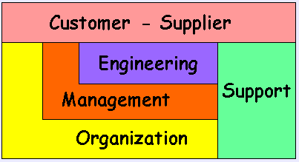
SPICE

Slide 69
SPICE
The SPICE architecture model contains five process categories:
Customer-Supplier - processes that directly impact the customer, support development and transition of the software to the customer,and provide for its correct operation and use.
Engineering - processes that directly specify, implement, or maintain a system and software product and its user documentation.
Management - processes which establish the project, and coordinate and manage its resources.
Support - processes which enable and support the performance of the other processes on a project.
Organization - processes which establishthe business goals of the organization and develop the process, product, and resource assets necessary to achieve its goals.

Slide 70
Software Quality Assurance Metric
The software features are calculated by recording the amount of bugs or safety loopholes present in the software.
However, other aspects of the attributes are also guarded, such as conservation, reliability, honesty, accessibility, customer satisfaction, etc.
To describe and categorise elements so that each and every mechanism and attribute can be better understood.
Evaluating and evaluating each of these processes and attributing them to the requirements and specifications provided.
Predicting and organising the software and business specifications of the next step w.r.t.
Improving the overall quality of the process and product, and of the project as a result.

Slide 71
Software Quality Assurance Metric
Software metrics that mainly emphasizes on quality assets of the software product, process and project.
Software metric is a broader concept that incorporates software quality metrics in it, and mainly consists of three types of metrics
Product Metrics:It includes size, design, complexity, performance and other parameters that are associated with the product's quality.
Process Metrics:It involves parameters like, time-duration in locating and removing defects, response time for resolving issues, etc.
Project Metrics:It may include number of teams, developers involved, cost and duration for the project, etc.

Slide 72
Refrences
[1]. Roger Pressman, Software engineering- A practitioner’s Approach, McGraw-Hill International Editions
[2]. Yogesh Singh, Software Testing, Cambridge University Press.
[3]. William E. Perry, Effective Methods for Software Testing, Second Edition, John Wiley & Sons
[4]. Ron Paton, Software Testing, second edition, Pearson education.
[5] Dohorthy Graham foundation of Software Testing,ISTQB Certification
[6] Softwaretesting. Tutorialspoint.
https://www.tutorialspoint.com/Software testing

Slide 73


www.paruluniversity.ac.in

