Slide 1

A Comparison of ED, SVM, ANN and CNN for Face Recognition using SIFT and HoG
 | Presented by: (Group – 5)
 | Jeet Jivrajani (201501039)
 | Priya Mehta (201501085)
 | Harshil Shah (201501097)
 | Vishwa Saparia (201501118)
 | Hiren Galiyawala (1849004)

Slide 2
Problem Statement
Face recognition using SIFT and HoG features
Performance comparision of different classifier
Check robustness against affine transformation (Rotation, Scaling, Translation).

Slide 3
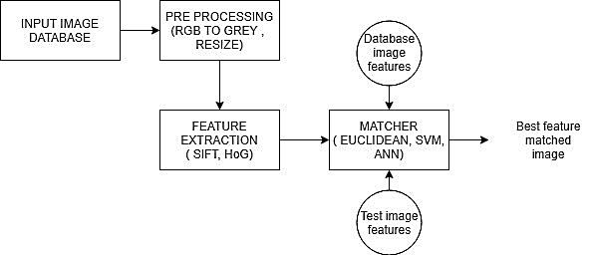
System block diagram

Slide 4
Dataset
Total face images: 36 x 16 = 576 (8 original + 8 sketch)
Joy, fear, disgust, surprise, sadness, anger, cap and goggles
No. of person | Training |  | Testing
 | No. of image per person | Total Images | No. of image per person | Total Image
36 | 12 | 36*12 = 432 | 4 | 36*4 = 144

Slide 5
Preprocessing and Feature exraction
Images are converted to gray scale
Resized to 200 x 200
Scale Invariant Feature Transform [1]
Histogram of Oriented Gradient [2]
[1] David G. Lowe, “Distinctive Image Features from ScaleInvariant Keypoints”, International Journal of Computer Vision, 2004
[2] N. Dalal and B. Triggs, "Histograms of oriented gradients for human detection," 2005 IEEE Computer Society Conference on Computer Vision and Pattern Recognition (CVPR'05), San Diego, CA, USA, 2005, pp. 886-893 vol. 1.

Slide 6
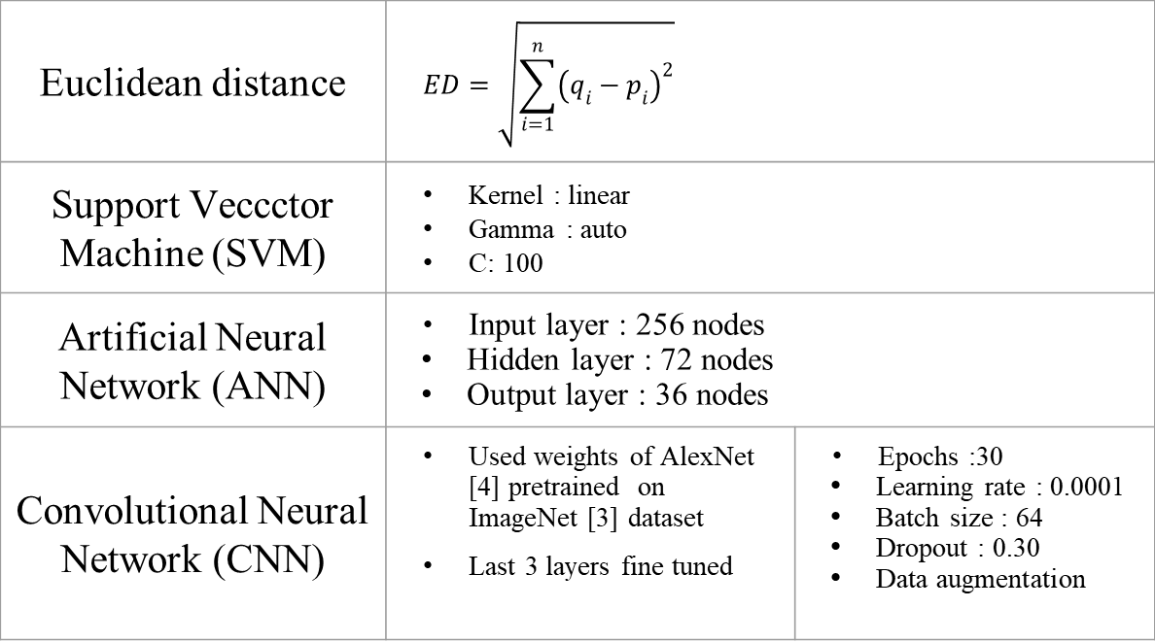
Classifiers
Euclidean distance | $$ED=\sqrt{\sum_{i=1}^{n}{{\left(q_{i}−p_{i}\right)}^{2}}}$$
Support Veccctor Machine (SVM) | Kernel : linear Gamma : auto C: 100
Artificial Neural Network (ANN) | Input layer : 256 nodes Hidden layer : 72 nodes Output layer : 36 nodes
Convolutional Neural Network (CNN) | Used weights of AlexNet [4] pretrained on ImageNet [3] dataset Last 3 layers fine tuned | Epochs :30 Learning rate : 0.0001 Batch size : 64 Dropout : 0.30 Data augmentation

Slide 7

Precision – Recall
$$Precision (P)=\frac{tp}{tp+fp}$$
$$Recall (R)=\frac{tp}{tp+fn}$$

Slide 8
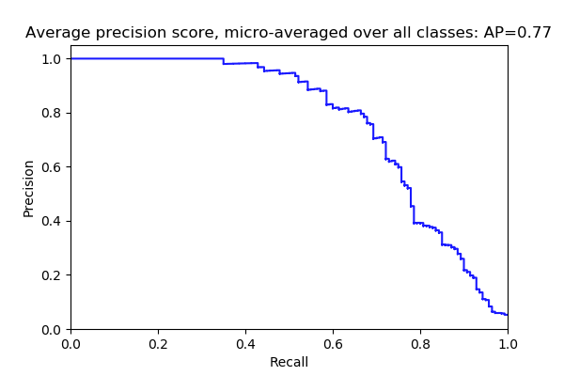
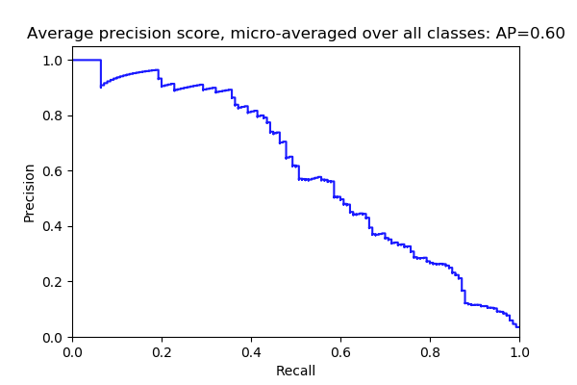
Results
HoG with ANN (AP = 0.77)
SIFT with ANN (AP = 0.60)

Slide 9
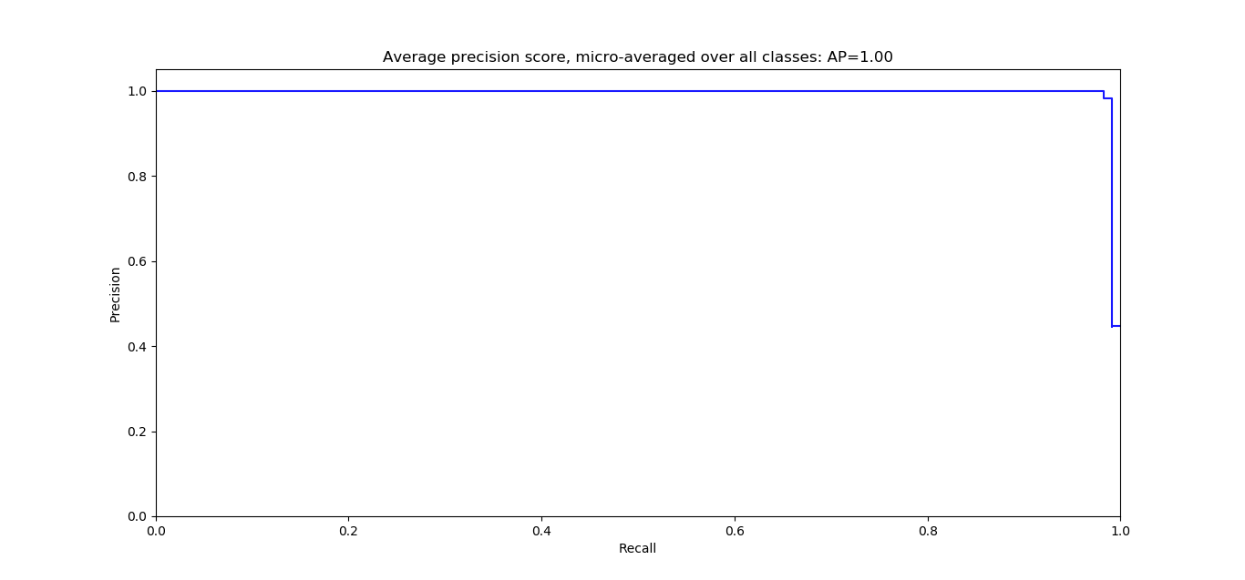
Results
CNN

Slide 10
Performance comparison – Accuracy (%)
Feature | Classifier | NORMAL | SCALING (Zoom by 2) | ROTATION |  | TRANSLATION X-dir (30) Y-dir (20)
 |  |  |  | 2 degree | 5 degree
SIFT | Euclidean | 60.71 | 50.71 | 37.10 | 37.80 | 40
 | ANN | 55 | 52.14 | 45.71 | 39.28 | 43.57
 | SVM | 65 | 61.42 | 49.28 | 41.42 | 49.28
HoG | Euclidean | 80 | 81.42 | 30 | 21.4 | 5
 | ANN | 70 | 69.28 | 10.71 | 12.14 | 2.8
 | SVM | 85 | 85.71 | 23.57 | 25 | 5.7
 | CNN | 98.28 | - | - | - | -

Slide 11
Conclusion
HoG performs well for normal images
SIFT performs better in case of affine transformation
Average Precision – 0.60 (SIFT), 0.77 (HoG)
CNN achieves highest accuracy of 98.28 %

Slide 12
REFERENCES
[1] David G. Lowe, “Distinctive Image Features from ScaleInvariant Keypoints”, International Journal of Computer Vision, 2004
[2] N. Dalal and B. Triggs, "Histograms of oriented gradients for human detection," 2005 IEEE Computer Society Conference on Computer Vision and Pattern Recognition (CVPR'05), San Diego, CA, USA, 2005, pp. 886-893 vol. 1.
[3] J. Deng, W. Dong, R. Socher, L. Li, Kai Li and Li FeiFei, "ImageNet: A large-scale hierarchical image database," 2009 IEEE Conference on Computer Vision and Pattern Recognition, Miami, FL, 2009, pp. 248-255.
[4] A. Krizhevsky, I. Sutskever, G. E. Hinton. “ImageNet Classification with Deep Convolutional Neural Networks”, in 25th International Conference on Neural Information Processing Systems 2012 (pp. 1097 – 1105)
[5] H. Gao, L. Dou, W. Chen and J. Sun, "Image classification with Bag-of-Words model based on improved SIFT algorithm," 2013 9th Asian Control Conference (ASCC), Istanbul, 2013, pp. 1 -6.
[6] Hongyan Zhang, Jiazhen Luo, Zihao Wang, Long Ma and Yifan Niu, "An accelerated matching algorithm for SIFT-like features," 2017 2nd International Conference on Image, Vision and Computing (ICIVC), Chengdu, 2017, pp. 103-107.
[7] K. T. Islam, R. G. Raj and A. Al-Murad, "Performance of SVM, CNN, and ANN with BoW, HOG, and Image Pixels in Face Recognition," 2017 2nd International Conference on Electrical & Electronic Engineering (ICEEE), Rajshahi, 2017, pp. 1 -4.
[8] S. G. Bhele and V. H. Mankar, "Recognition of Faces Using Discriminative Features of LBP and HOG Descriptor in Varying Environment," 2015 International Conference on Computational Intelligence and Communication Networks (CICN), Jabalpur, 2015, pp. 426-432.
[9] J. Yu and C. Li, "Face Recognition Based on Euclidean Distance and Texture Features," 2013 International Conference on Computational and Information Sciences, Shiyang, 2013, pp. 211 -213.

Slide 13
THANK YOU

