Slide 1
Pose Estimation in Surveillance Video
 | Presented by:
 | Jeet Jivrajani (201501039)
 | Priya Mehta (201501085)
 | Harshil Shah (201501097)
 | Vishwa Saparia (201501118)
 | Hiren Galiyawala (1849004)

Slide 2
Motivation
Person identification in surveillance
Activity detection of a person
Suspicious activity detection of person in surveillance

Slide 3
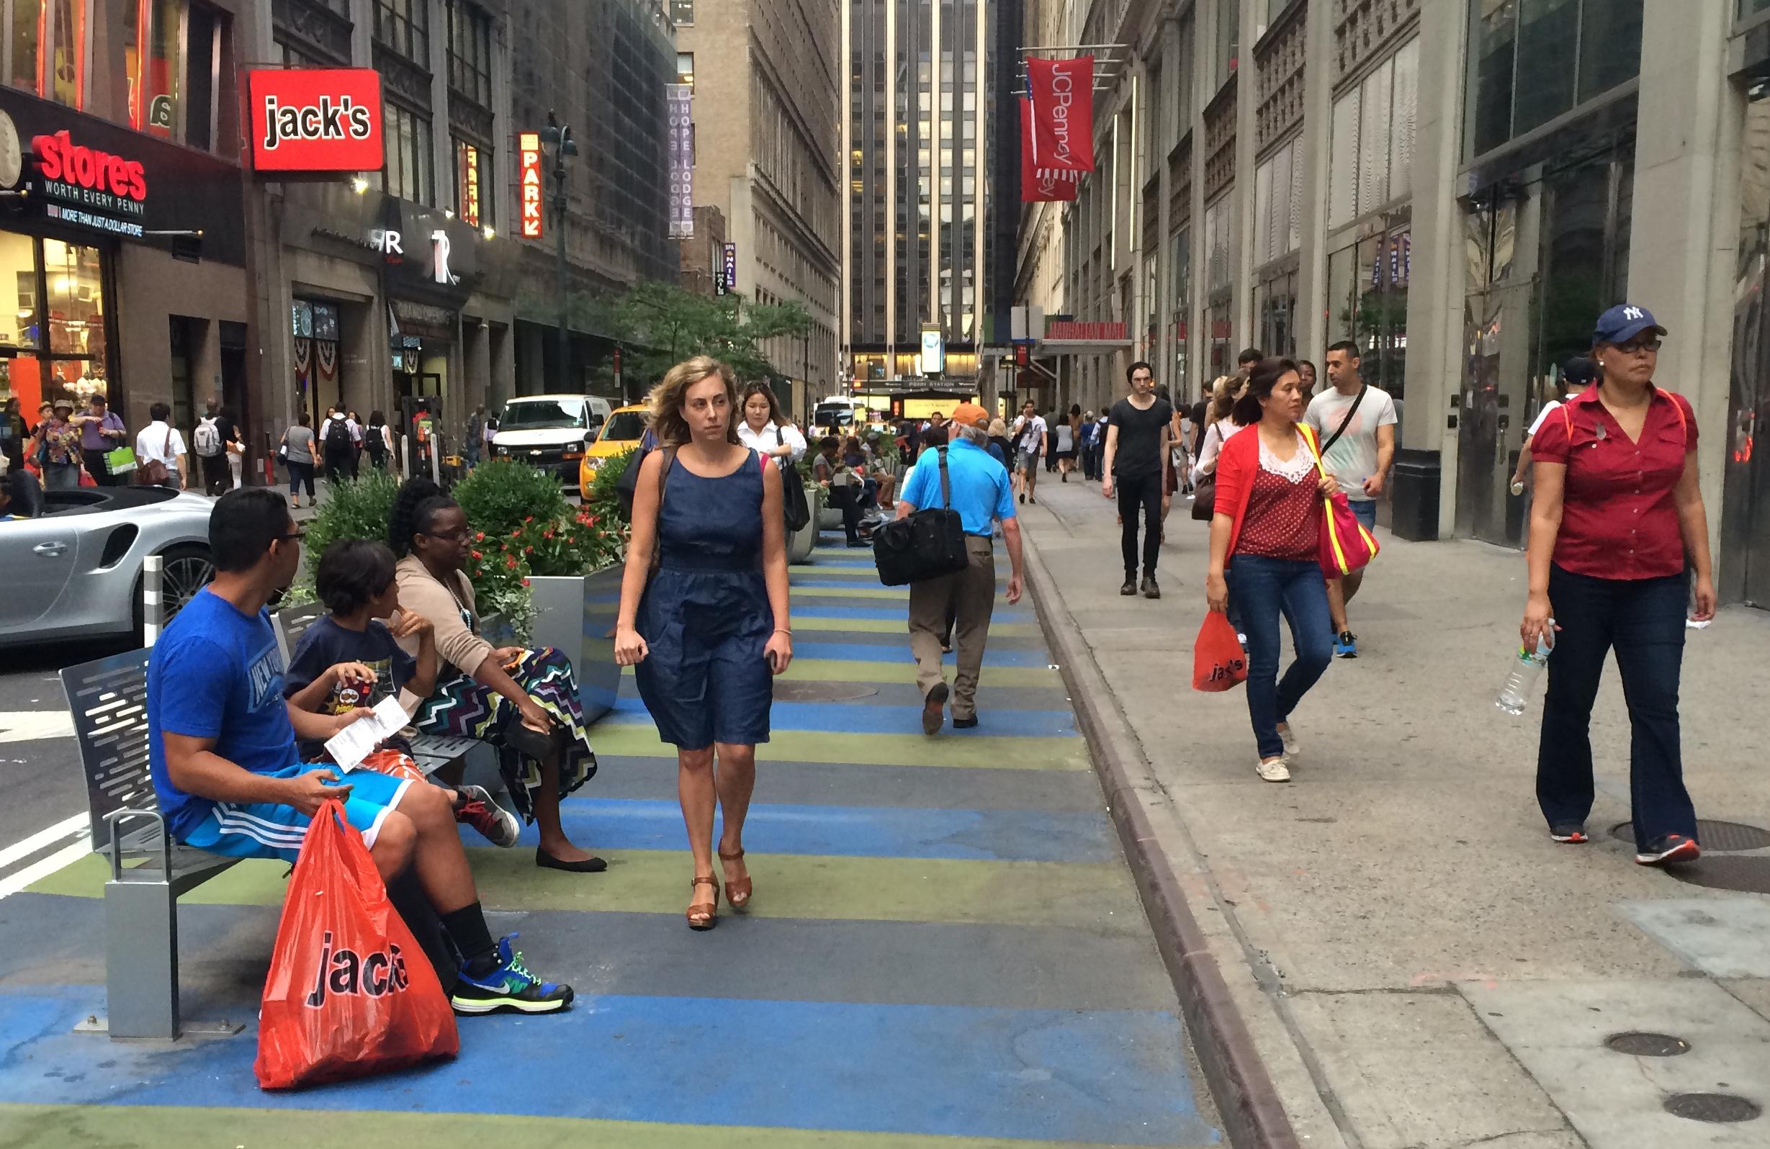
Problem statement
Human pose estimation from surveillance video.
Up-right,
front pose
Up-right,
back pose
Sitting,
side pose
https://nyc.streetsblog.org/2015/09/01/wider-32nd-street-sidewalk-could-be-erased-to-bring-back-loading-zones/

Slide 4
Deliverables
Literature review
Implementation
Pose Classification
Analysis
Report

Slide 5
Work distribution
Literature review | Jeet, Priya, Hiren
Coding | Jeet, Priya, Harshil, Vishwa, Hiren
Analysis | Harshil, Vishwa
Documentation (Report + Presentation) | Priya, Hiren

Slide 6
Thank You

